Slide 1
Immutable Secure Data Exchange and Storage for Urban Air Mobility Environments
Kenneth Freeman , Norbert Gillem , Aidan R. Jones
NASA Ames Research Center
AIAA Science and Technology Forum and Exposition 2022
January 3-7, 2022
Copyright © This material is declared a work of the U.S. Government and is not subject to copyright protection in the United States.
Published by the American Institute of Aeronautics and Astronautics, Inc., with permission.
Banavar Sridhar
Universities Space Research Association
Nishant Sharma
Intrinsyx Technologies Corporation

Slide 2
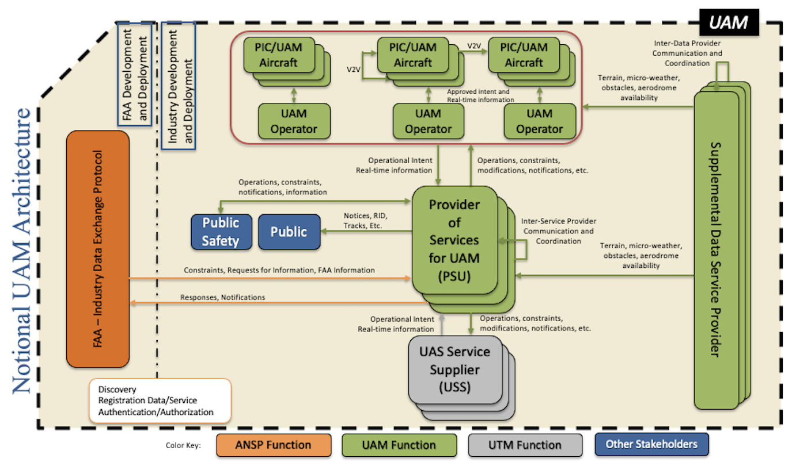
Overview / Motivation
Urban Air Mobility (UAM), leveraging a service-based architecture for Secure Airspace solutions
UAM Environment :
Independent UAM operators leveraging diverse communications
Data exchange between multiple PSUs and operators
Decentralized local computing and cloud environments requiring security
Motivation: Research a methodology for providing secure data exchange and storage

Slide 3
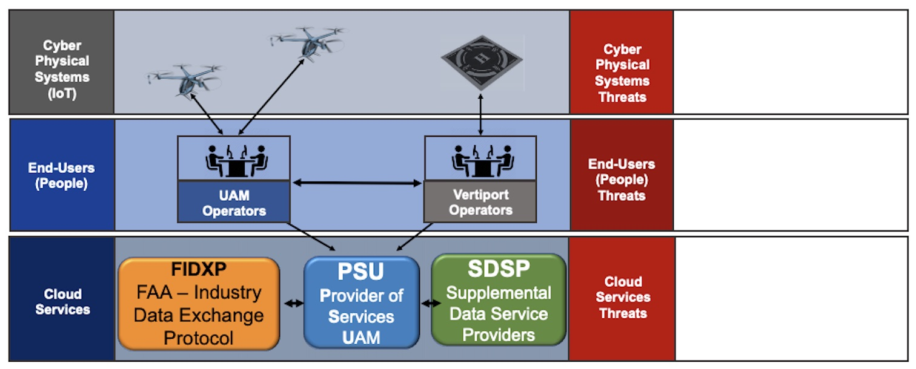
Threat Landscape
Man-in-the-middle attack, leading to unauthorized access or data manipulation
Jamming, leading to the limitation of available data
Victim of spear phishing, leading to the interaction with malicious content
Exploitation of valid accounts, leading to the loss of credentials
Exploitation of valid accounts, leading to the loss of credentials and system access
Exploitation of public facing application, leading to corruption of data

Slide 4
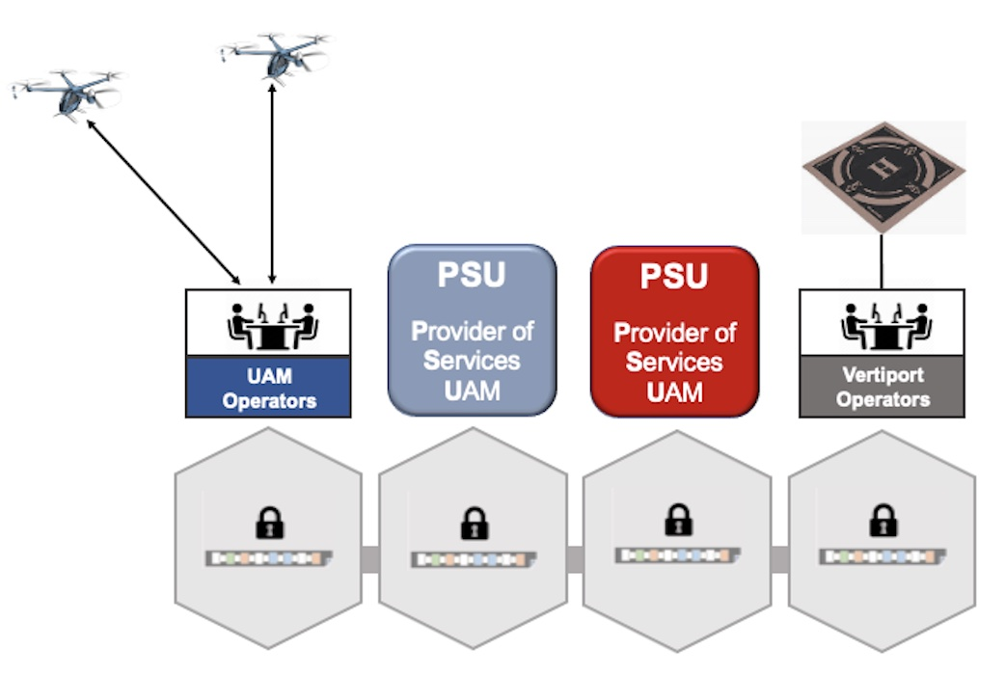
Why Use Blockchain?
A definition for immutability: the state of not changing, or being unable to be changed
Immutability ensures that
the no one can alter the
state of the blockchain data
The information recorded to a
blockchain is append-only
A blockchain is a distributed ledger
that records all the transactions
that take place on the network
Immutability also ensures
that no one can intrude
on the system

Slide 5
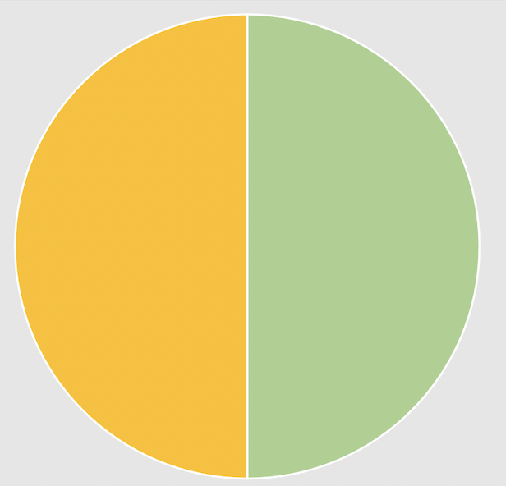
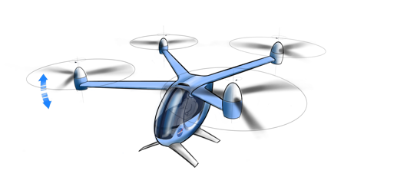

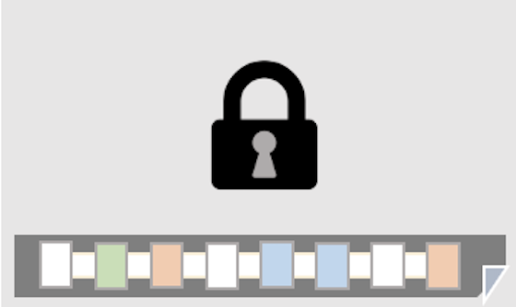
Use Cases
Scenario: Telemetry
  Each vehicle broadcasts its ID and Location to the network
Key Threat Mitigated: Man-in-the-middle attack
Objectives of research:
  What data / security trade-offs are needed to ensure confidential information exchange between the PSU, Vertiport operators and the UAM operators in a federated UAM environment?
Simulate transmission
of vehicle telemetry
based on ADS-B
Translate telemetry
simulation data to
smart contract readable
information
Leverage DFW
Low Demand Traffic Routes
Write data to
blockchain

Slide 6
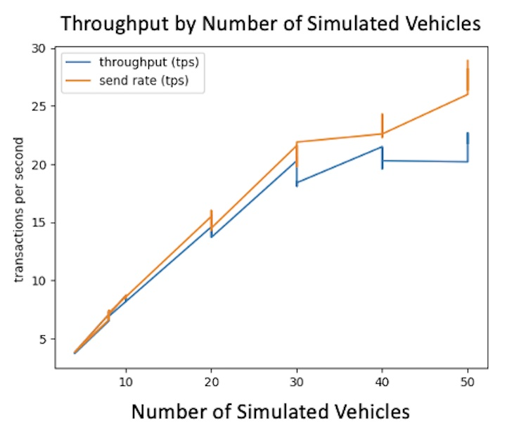
Concluding Remarks
The immutability properties of blockchain can be leveraged to mitigate some cybersecurity attacks
However, it can also yield results that are
inadequate for some UAM applications
A combination of underlying blockchain
parameter tuning and an increase in
computational capabilities will be required
to meet the telemetry use case requirements
for initial UAM operations (10 – 50 simultaneous
vehicles)
Blockchain can be leveraged to support data exchange UAM applications that support regulatory or operational issues

