Slide 1
Performance of Li-SeS₂ Solid State Cathodes: Composition and Process Dependence
Brandon Walker
Mentors: Dr. Yi Lin, Dr. John Connell
2021 Fall NIFS Research Symposium
Advanced Materials and Processing Branch

Slide 2
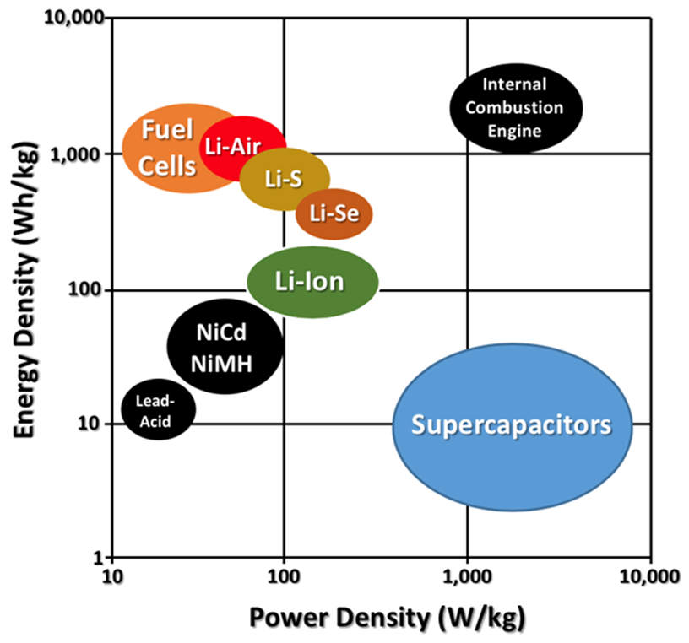
Challenge
To develop high energy density batteries capable of powering electric aircraft (Minimum ~400 Wh kg⁻¹)
High energy density chemistries such as Li-S/Se are being considered
Se has an additional advantage of electrical conductivity, which improves the power density of the battery
Combining S and Se could yield high performance batteries in terms of energy and power density
 | Specific Capacity (mAh g⁻¹)
Li-ion | 100-200
Li-S | 1675
Li-Se | 678

Slide 3
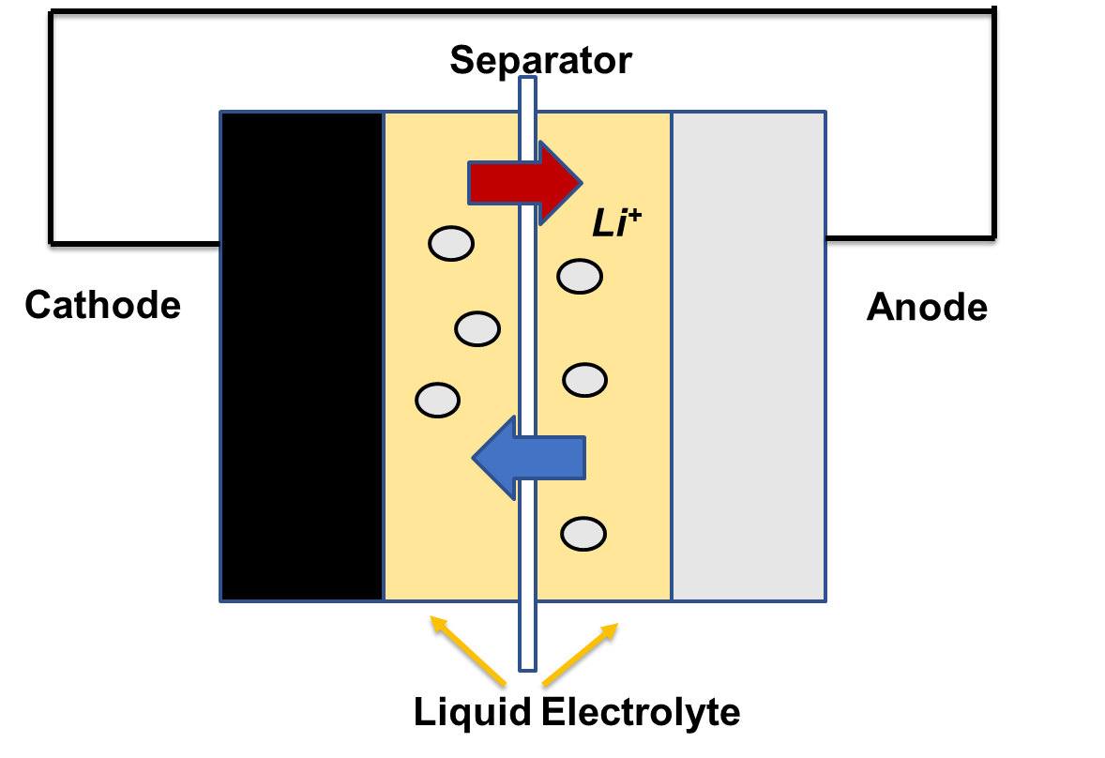
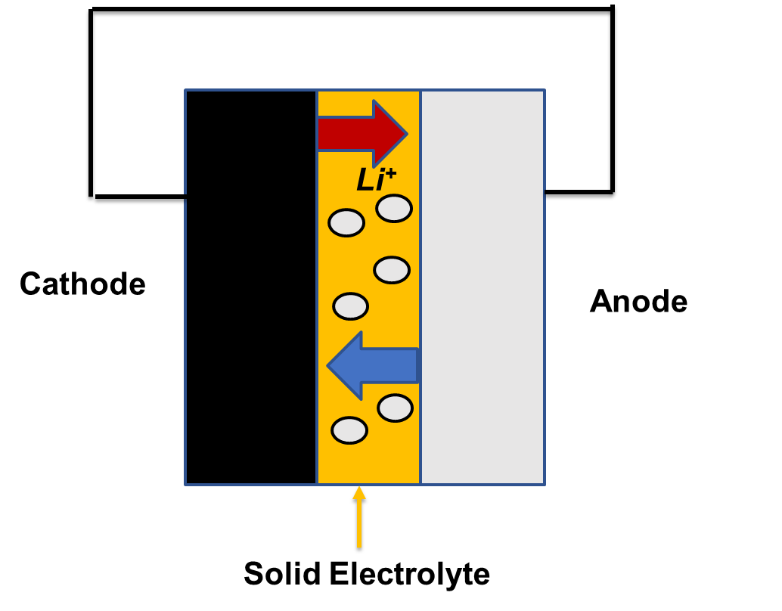
Challenge
Due to safety issues with flammability, solid state batteries (SSB) are being considered over batteries with liquid electrolytes
Other potential benefits from SSBs include: volume reduction, increased energy density, and longer life
A major challenge to the implementation of SSBs are their lower ionic conductivity of solid electrolytes than commercial batteries with liquid electrolytes
The optimization of the materials and cathode composition of SSBs remain a key research topic
Notes:
Optimizating elect/ ion conduct and maint high energy density

Slide 4
Objective
Develop high energy density solid state Li-S/Se batteries capable of powering electric aircraft (minimum ~400 Wh kg⁻¹)
  Develop optimized cathode compositions that result in high energy, power density, and rechargeability for high performance solid state batteries
  Approach
    Investigate and develop processes for high energy density Li – SeS₂ solid state cathodes with high utilization, ionic, and electrical conductivity

Slide 5
Cathode Composite
(1) Premix SeS₂ and LPSC
Scaffolding mixing process creates long range and short range electrical and ionically conductive paths
(2:3:1) composition was chosen for the higher percentage of electrolyte
SeS₂
LPSC
(2) PBM 5mm 1hr or Hand ground
SeS₂ / LPSC
LPSC
hG
(3) Ball mill 20s
_{Cathode Composite}
hG
Final composition SeS₂:LPSC:hG, (2:3:1)
*PBM: Planetary ball mill
Notes:
Importance of cathode and composition? Why not one pot? Why step wise mixing? Graphics for mixing PBM hand ground (images)

Slide 6
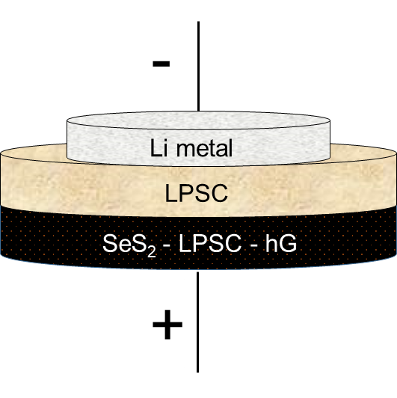

Battery Fabrication Process
500 MPa compression
10 min
LPSC
SeS₂ - LPSC - hG
Anode: Li Metal or Li – In alloy
Notes:
Cell Parameters polish make arrows nicer
Separator: 200 mg
Cathode: 50 mg
Active material: 10.8 mg
Loading: 9.55 mg/cm2
Fabrication Pressure: 500 MPa
Li diameter: 0.6 cm (~1 cm)
Torque: ~1.4 N.m (50 – 60 MPa)
Voltage: 1-3 V
Current: 0.05 mA

Slide 7
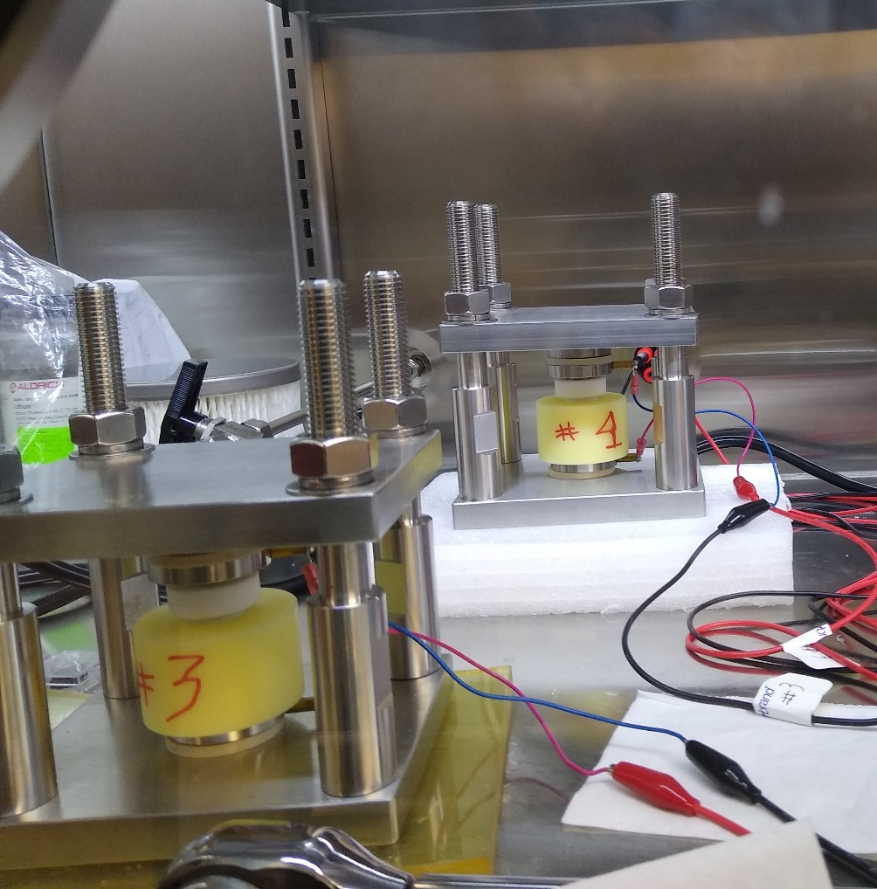
Pressurized Split Cell Testing
Stack Pressure: 50-60 MPa
Split Cell vs. Coin cell
Split cells allow for quick testing assembly and disassembly without the need for crimping
Additionally split cells can be loaded with a pressure jig to increase the stack pressure on the cell
Increased stack pressure improve the electrochemical performance of the cell by improving contact between the constituents of the cell; electrolyte, active material, carbon additive.
Notes:
Discuss coin cell and split cell performance
Why is it needed?
Coin cells

Slide 8
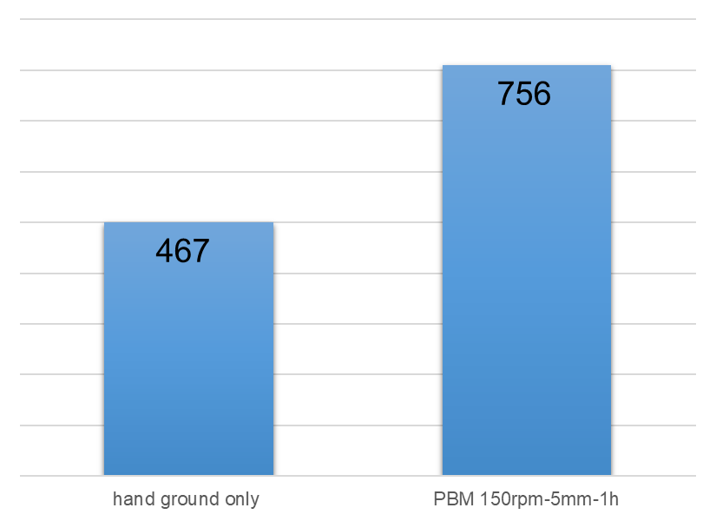
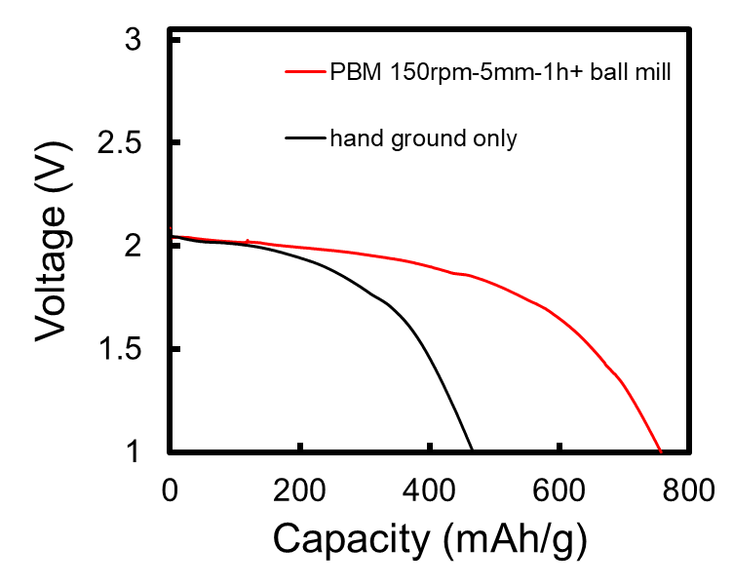
Pressurized Split Cell Experiments
Loading: 9.6 mg/cm²
(231) SeS₂-LPSC- hG (Li as anode) Mixture Comparison
Current: 0.05 mA
Capacity (mAh/g)
Step 1 (SeS₂ + ½ LPSC) PBM or Hand Ground
Step 2 ((SeS₂ LPSC composite)+ ½ LPSC + hG) Ball Mill 20s
1st discharge
Notes:
Just compare two high and low capacitance

Slide 9
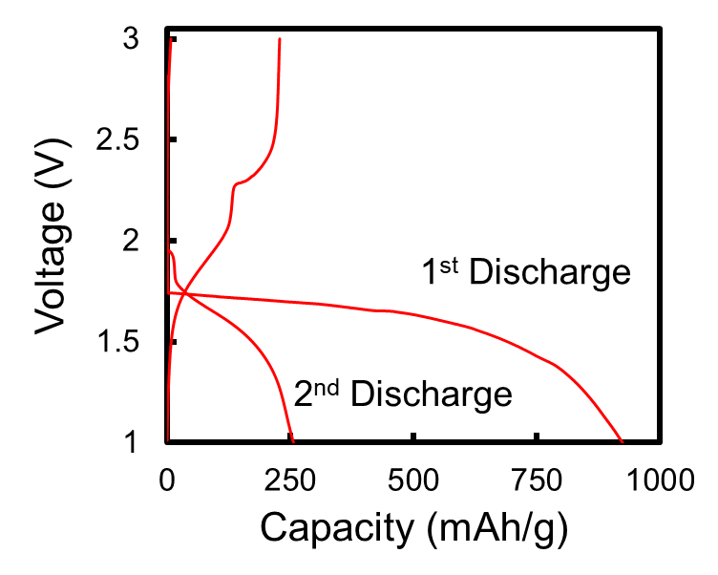
Pressurized Split Cell Experiments
(231) SeS₂-LPSC- hG (Li-In as anode)
Loading: 9.6 mg/cm²
Challenges
Volume expansion(S: 80%)
Lower electronic ionic conductivity
Potential solution
AM particle size reduction
Improve contact between SeS₂, hG, and LPSC
Optimize loading
Large decrease in capacitance after first discharge
Notes:
Bullet points reasons
solutions

Slide 10
Cathode Composite Melt Infiltration
(1) Premix SeS₂ and hG
Process Advantages:
Smaller AM particle size
Improved AM to carbon additive connection
Two-step mixing process creates long range and short range electrical and ionically conductive paths
SeS₂
hG
(2) Melt infiltrated SeS₂ 115 C, 12h
SeS₂ / hG
LPSC
(3) PBM 5mm 1hr
SeS₂ / hG / LPSC
LPSC
hG
(4) Ball mill 20s
_{Cathode Composite}
Final composition SeS₂:LPSC:hG, 2:3:1
Notes:
Center figure text /balance slides

Slide 11
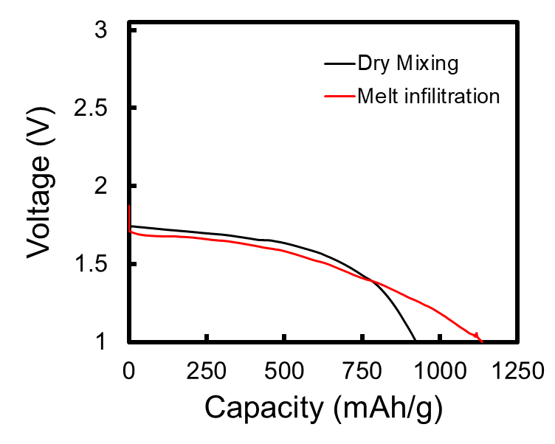
Melt Infiltration vs. Dry Mixing
(231) SeS₂-LPSC- hG (Li-In as anode)
Loading: 9.6 mg/cm²
At similar mass loading the melt infiltration process provides a high initial discharge capacitance
Melt infiltration can be optimized to further reduce the size of the active material

Slide 12
Summary
Li-SeS₂ solid state cathodes with good utilization with high mass loading were created using a two-step scaffolding mixing process.
Varying the process conditions of the cathode significantly changed the performance of the cell.
Optimal compositions with both high ionic and electric conductivities were achieved while maintaining high mass loading.
Notes:
Tense past

Slide 13
Next Steps/Outlook/Future Work
What would you do if you had 4 more weeks?
  Perform additional characterizations
What would you do if you had 4 more months?
  Investigate more solid electrolytes with high ionic conductivity
  Further optimize cathode compositions and processes
  Match the experimental work with our SESAM models
I can see this work broadening due to the opportunity to investigate several solid electrolytes, conductive additives, and S and Se based active materials

Slide 14
Acknowledgements
SABERS Team: Dr. Vesselin Yamakov, Dr. Ji Su, Dr. Rodolfo Ledesma, April Rains, Zachary Lewis
LaRC AMPB: Dr. Catharine Fay for permission to work onsite
NIFS program coordinators: Christine M. Dillard, Patricia Sanchez, and Jalisa Thomas
Funding: CAS-SABERS (Convergent Aeronautics Solutions: Solid-State Architecture Batteries with Enhanced Rechargeability and Safety)

