Slide 1
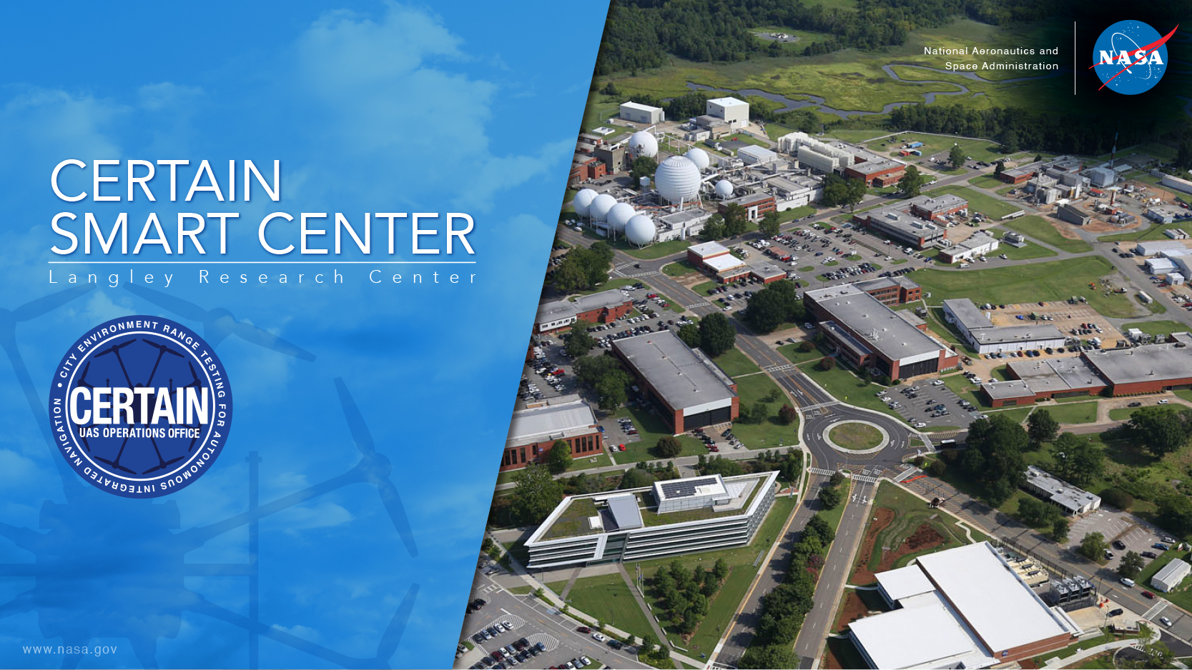
Embracing Transformation:
The Pursuit of Initial
“Smart Center” Solutions at
NASA Langley Research Center

Slide 2
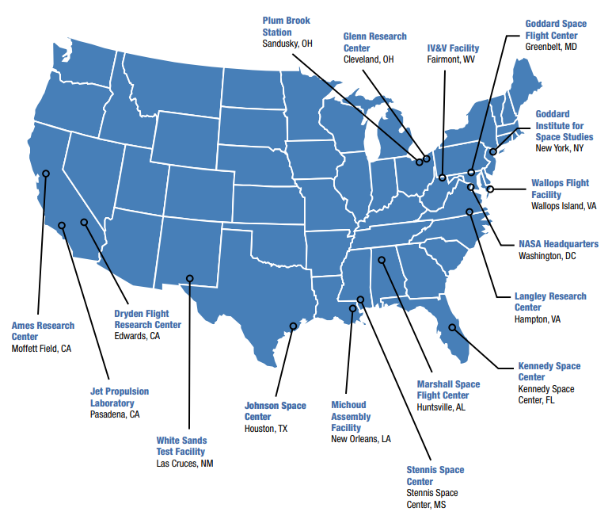
NASA Facilities and Centers
Source: https://www.nasa.gov/sites/default/files/files/NASAFacilitiesAndCenters.pdf

Slide 3
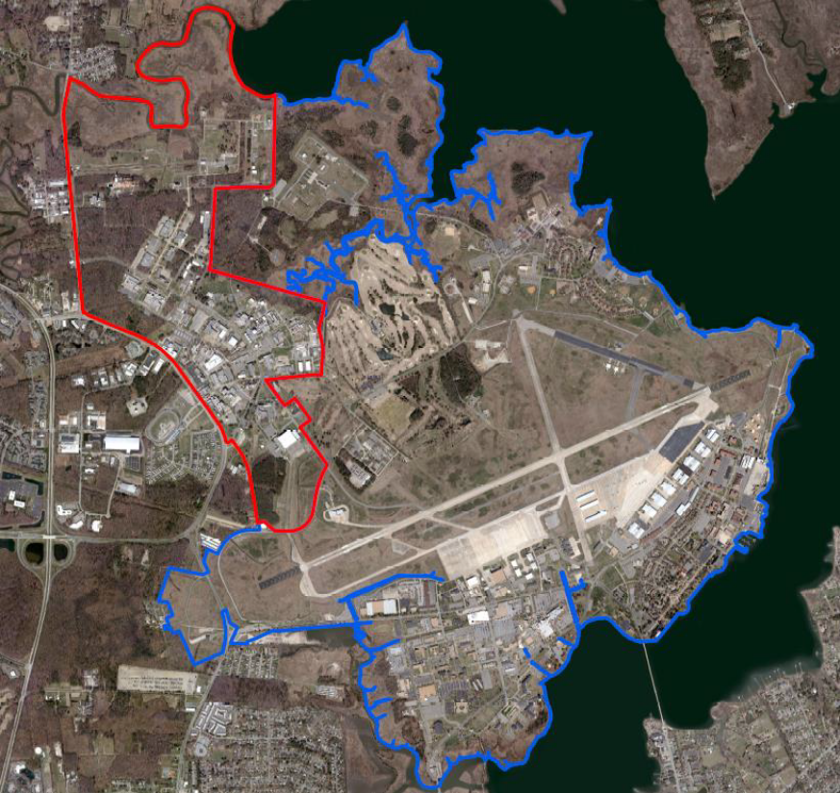
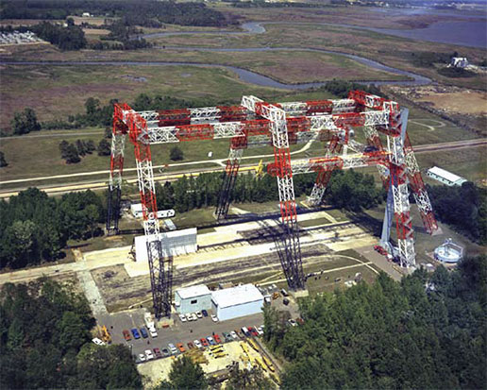
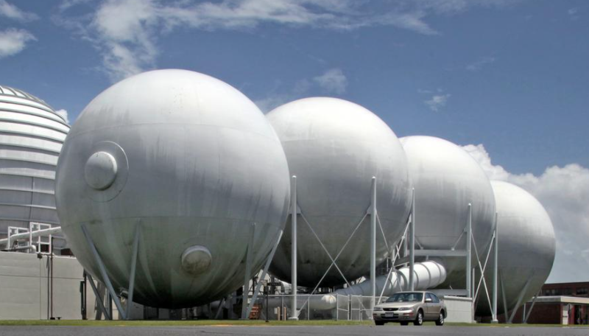
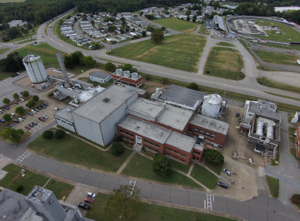
NASA Langley Research Center
NASA Langley Services
Clinic
Fire Station
Child Development Center
Cafeteria and Exchange Shop
NASA Langley Gantry
NASA Langley Vacuum Spheres
Source: https://www.nasa.gov/centers/langley/news/factsheets/fs-2007-08-138-larc.html
NASA Langley National Transonic Facility
Credit: NASA Langley’s Geographic Information Systems (GIS) Team
Source: https://images.nasa.gov/details-LRC-2013-00371
NASA Langley Research Center
Langley
Air Force Base
Credit: NASA Langley’s Gary Banziger

Slide 4
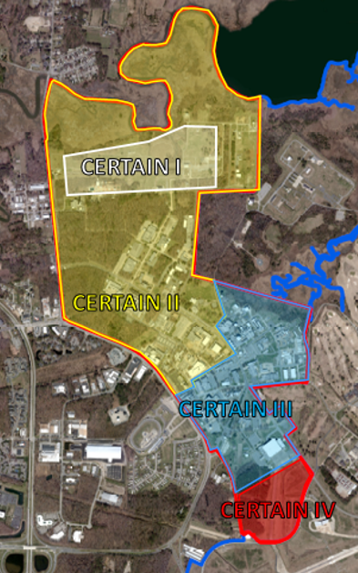
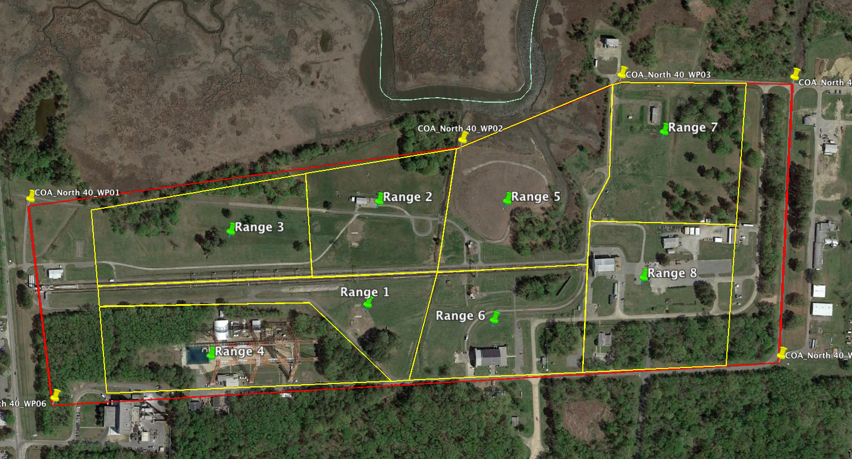
CERTAIN – City Environment Range Testing for Autonomous Integrated Navigation
Expansion of CERTAIN to Areas I, II, III, and IV
CERTAIN I
Credit: NASA Langley’s Geographic Information Systems (GIS) Team
Credit: NASA Langley’s Geographic Information Systems (GIS) Team
Credit: NASA Langley’s Geographic Information Systems (GIS) Team
Letter of Procedure with Langley Air Force Base
Class D airspace when tower is open (UAS operations up to 400’)
Class G airspace when tower is closed
NASA Langley Research Center
Langley
Air Force Base

Slide 5
CERTAIN → CERTAIN 2.0 → CERTAIN SC
CERTAIN 2.0 Vision Team and Strategy Team efforts were led by NASA Langley Executive Sponsors Shane Dover and George Finelli in 2020/early 2021
The following NASA Langley organizations – plus the Offices of the Center Director (OD) and Chief Information Officer (OCIO) – contributed to efforts that gave rise to the CERTAIN Smart Center project:
  Systems Analysis and Concepts Directorate (SACD), Research Directorate (RD), Center Operations Directorate (COD), Engineering Directorate (ED), Aeronautics Research Directorate (ARD), and Research Services Directorate (RSD)
Vision Team Members
Strategy Team Members
Ersin Ancel (SACD)
Tony Arviola (OCIO)
Andy Carnell (OD)
Evan Dill (RD)
Ben Galke (COD)
Lou Glaab (ED)
Dave Hinton (ARD)
Frank Jones (RSD)
Ron Maddox (RD)*
Garry Qualls (RD)
Tony Arviola (OCIO)
Andy Carnell (OD)
Matt Coldsnow (RSD)*
Evan Dill (RD)
Ben Galke (COD)
Ron Maddox (RD)*
Ray Rhew (ED)
* Members of the CERTAIN Smart Center Project Management Team
Transformation in a team sport!!

Slide 6


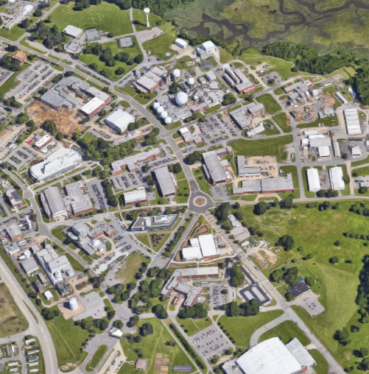
Steps Toward an Integrated CERTAIN Smart Center (SC)
Goal 1 – Conduct regular UAS flights that primarily support Center operations
2 Year Goals
Goal 4 – Mature aviation safety technologies
CERTAIN SC
Goal 3 – Complete a NASA airworthiness and safety review for sUAS that enables operations over people
Goal 2 – Conduct autonomous Beyond Visual Line-of-Sight (BVLOS) ops in Class D airspace
Goal 5 – Demonstrate ubiquitous access to and analysis of flight-related data
10 years
CERTAIN
5 years
2 years
CERTAIN Smart Center Vision
Provide a nationally recognized research, development, and test environment with advanced capabilities that serves as a strategic enabler defining the future of autonomous flight for emerging operations (e.g., UAS, Urban Air Mobility (UAM), Advanced Air Mobility (AAM))
Today

Slide 7
Purpose of the CERTAIN Smart Center Project
CERTAIN Smart Center Project
Leading the strategic migration of CERTAIN to an enhanced capability
that transforms Center operations, safety, and research

Slide 8
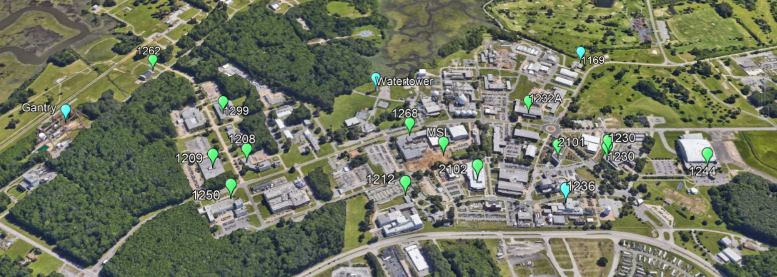

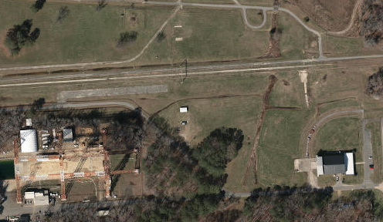
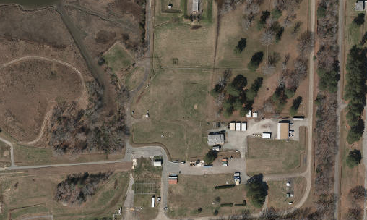
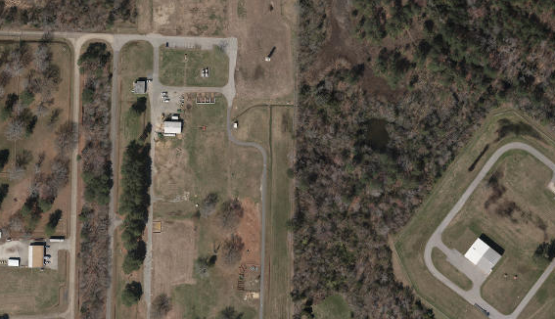
Sample of CERTAIN Smart Center Capabilities and In-Progress Enhancements
Monitoring Node Installations
Real-time, network-accessible GPS and meteorological measurements
GPS:
Ephemeris
Almanac
Pseudo-range
Code phase
Carrier phase
Meteorological:
Wind Speed
Wind Direction
Rainfall
Humidity
Local Air Pressure
Blue – Location and Timing Beacons
Green – Weather Stations
Credit: NASA Langley’s Geographic Information Systems (GIS) Team
Vertiport Locations
Power (110 and 220V)
24 port Ethernet Switches
Video Cameras
Weather Stations
1
1a
2
3
Credit: NASA Langley’s Geographic Information Systems (GIS) Team
Credit: NASA Langley’s Geographic Information Systems (GIS) Team
Credit: NASA Langley’s Geographic Information Systems (GIS) Team

Slide 9
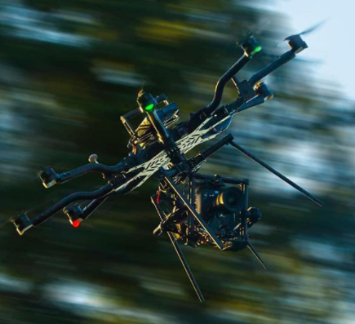
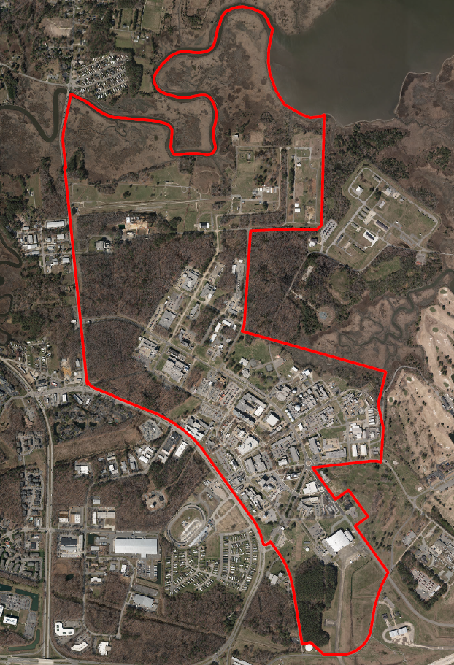
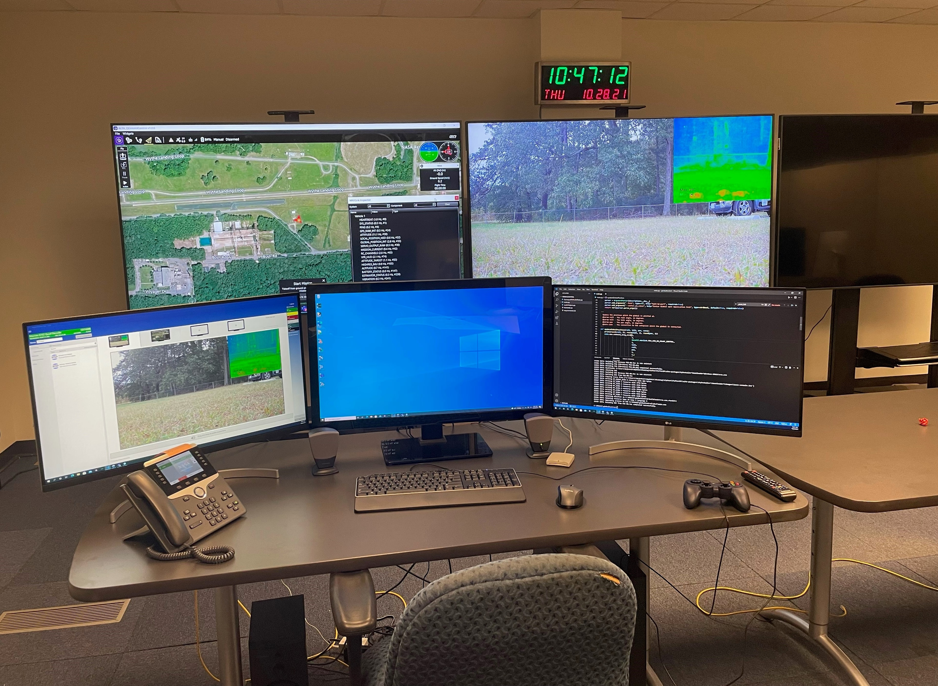
NASA Langley’s Perimeter Surveillance Use Case – CY21 Proof-of-Concept Demonstration
Alta 8
Mission Ops & Autonomous Integration Center
Located in NASA Langley B1268A/R2119E
Source: https://freeflysystems.com/alta-8/agile
Credit: NASA Langley’s Geographic Information Systems (GIS) Team
Credit: NASA Langley’s Matt Miser
NASA Langley Boundary (in red), with
Portion of Fence Line to be Surveilled by sUAS
highlighted (in yellow)

Slide 10
Summary
CERTAIN Smart Center Vision
Provide a nationally recognized research, development, and test environment with advanced capabilities that serves as a strategic enabler defining the future of autonomous flight for emerging operations (e.g., UAS, Urban Air Mobility (UAM), Advanced Air Mobility (AAM))
Two-Year Goals toward CERTAIN Smart Center
  Conduct regular UAS flights that primarily support Center operations
  Conduct autonomous Beyond Visual Line-of-Sight (BVLOS) operations in Class D airspace
  Complete a NASA airworthiness and safety review for sUAS that enables operations over people
  Mature aviation safety technologies
  Demonstrate ubiquitous access to and analysis of flight-related data
Purpose of the CERTAIN Smart Center Project
Lead the strategic migration of CERTAIN to an enhanced capability that supports NASA Langley’s transformation to an Airspace-Enabled Smart Center
Transform Center operations, safety, and research by enabling pervasive UAS ops, leveraging an evolving Data Backbone and Data Science Services

Slide 11
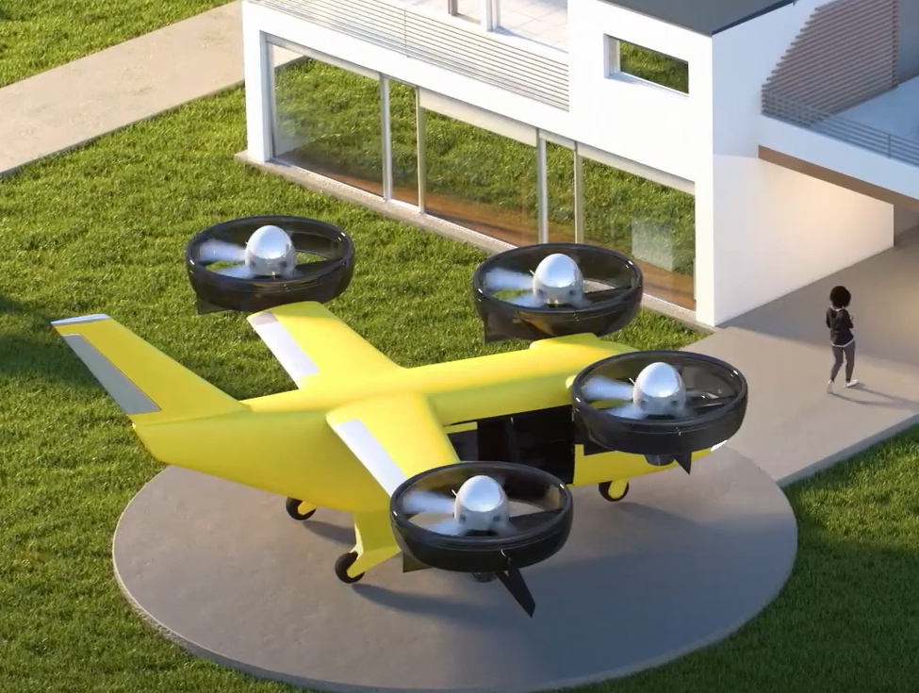
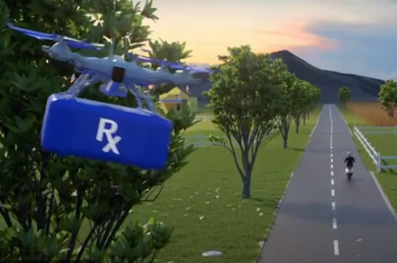
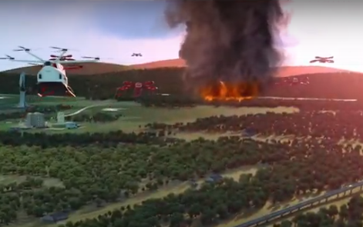
CERTAIN Smart Center Impacts
  Value to the external community will be delivered in the form of data, research results, and technology transfer as well as operational knowledge, lessons learned, and best practices
    Provide critical data to the FAA to help accelerate the safe integration of new vehicle types, technologies, and procedures into the National Airspace System
    Advance aviation’s role in a “Smart City” ecosystem
  An opportunity to change the world through aviation is presented
    Significant contributions to emerging methods of air travel can be achieved through research, development, test, and evaluation (RDT&E) conducted in a complex, comprehensive flight environment
    Autonomous aviation operations can support a variety of extremely important public good missions
Source: https://sky4all.marquilabs.com/
Source: https://sky4all.marquilabs.com/
Source: https://sky4all.marquilabs.com/

