Slide 1
H11F-07
The Application of Remote Sensing and Machine Learning to Improve Early Warning Systems for Harmful Algal Events in the Highland Lake Chain, TX
Shuyu Chang, Kaitlynn Hietpas, Mark Radwin, Addison Pletcher, Emma Waugh, Ryan Hammock, Erin Urquhart
Notes:
Welcome everyone, thank you for joining us today! My name is ____ and I am joined by my teammates____. We are the Highland Lakes Water Resources Team and over the past ten weeks we have been working to utilize NASA's earth observations to improve early warning systems for harmful algae events in the Highland Lakes near Austin, Texas.
For Guest Presenter: Hello All and thanks for coming! This was a project undertaken by NASA DEVELOP's Highland Lakes Water Resources Team who worked to improve early warning systems for harmful algae events in the Highland Lakes near Austin, Texas.

Slide 2
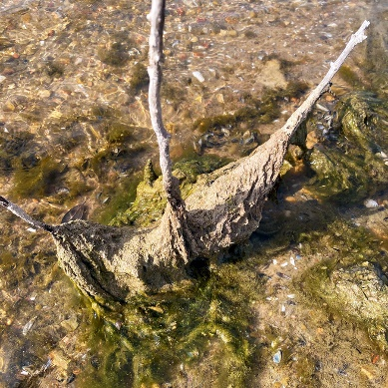
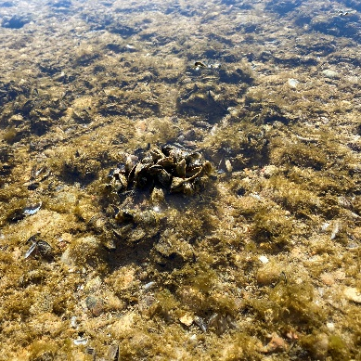
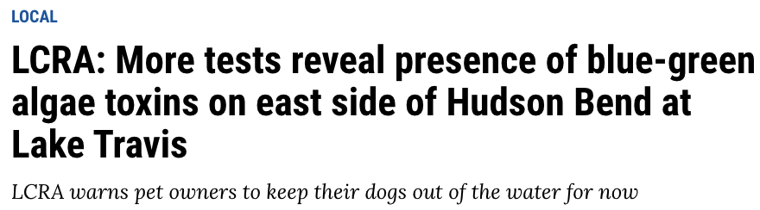
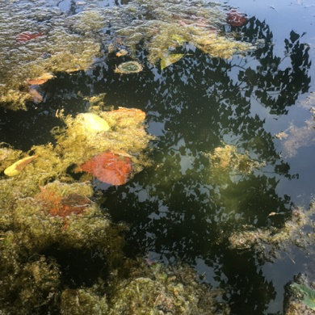
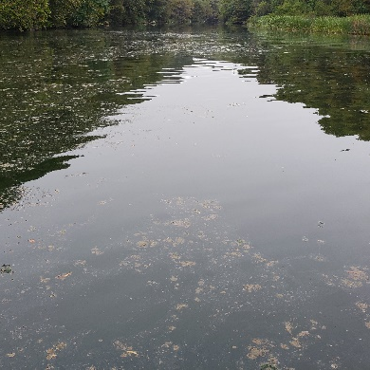
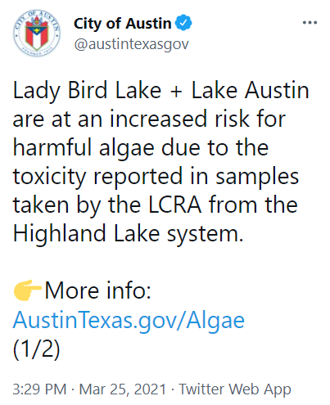
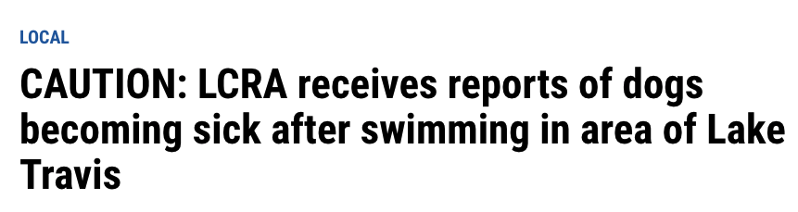
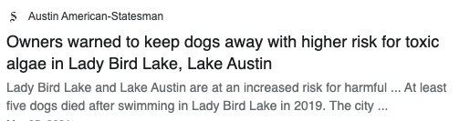
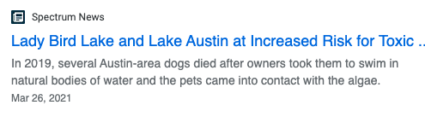
Algae in the News
Source: CoA DWP
Source: Lower Colorado River Authority & City of Austin Department of Watershed Protection
Notes:
Algae is a natural part of ecosystems and is not always harmful! But, algae events—or, periods of prolific algae growth—can be detrimental to public health, economies, and ecosystems—and results in many headlines like these. Algae events can deplete dissolved oxygen levels, harming other aquatic life and can force beaches and nearby businesses to close, reducing tourism income, and occasionally producing toxins that are dangerous to recreational users. The Highland Lakes region began experiencing events like these only recently, with the first reports of canine deaths from toxic algae in Lady Bird Lake in 2019 and subsequently Lake Travis in 2021.
----------Image Credits---------
Lower Colorado River Authority & City of Austin, Department of Watershed Protection (CoA DWP) Partner Images
---------- News Credits -------------
1. Gates, B., & Ramkissoon, J. (2021, February 26). LCRA: More tests reveal presence of blue-green algae toxins on east side of Hudson Bend at Lake Travis. KXAN Austin. https://www.kxan.com/news/local/lcra-initial-tests-show-lake-travis-water-not-toxic-despite-dogs-death/
2. Falcon, R., & Rahman, T. (2021, February 23). CAUTION: LCRA receives reports of dogs becoming sick after swimming in area of Lake Travis. KXAN Austin. https://www.kxan.com/news/local/caution-lcra-receives-reports-of-dogs-becoming-sick-after-swimming-in-area-of-lake-travis/
3. Vuaghn, M. (2021, March 6). Lady Bird Lake and Lake Austin at Increased Risk for Toxic Algae. Spectrum Local News. https://spectrumlocalnews.com/tx/austin/news/2021/03/26/lady-bird-lake-and-lake-austin-at-increased-risk-for-toxic-algae
4. Moreno-Lozano, L. (2021, March 25). Owners warned to keep dogs away with higher risk for toxic algae in Lady Bird Lake, Lake Austin. Austin American-Statesman. https://www.statesman.com/story/news/2021/03/25/lady-bird-lake-lake-austin-increased-risk-blue-green-algae-water-samples-tested/7002799002/
5. City of Austin Twitter (@austintexasgov). Lady Bird Lake + Lake Austin are at an increased risk for harmful algae due to the toxicity reported in samples taken by the LCRA from the Highland Lake System. https://twitter.com/austintexasgov/status/1375168019840839680

Slide 3
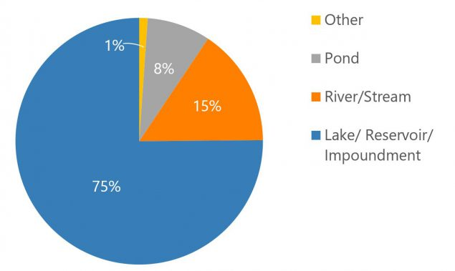
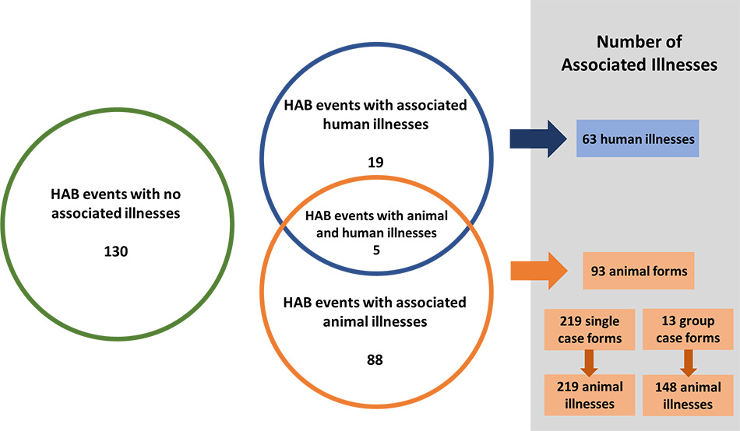
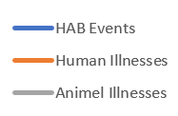
One Health Harmful Algal Bloom System (OHHABS), US, 2019
HAB events resulted in 63 human illnesses and 367 animal illnesses in 2019
Most freshwater HAB events from 2019 were in lakes, reservoirs, and impoundments
Most reported HAB events occurred during the summer and early fall in 2019
Source: CDC

Slide 4
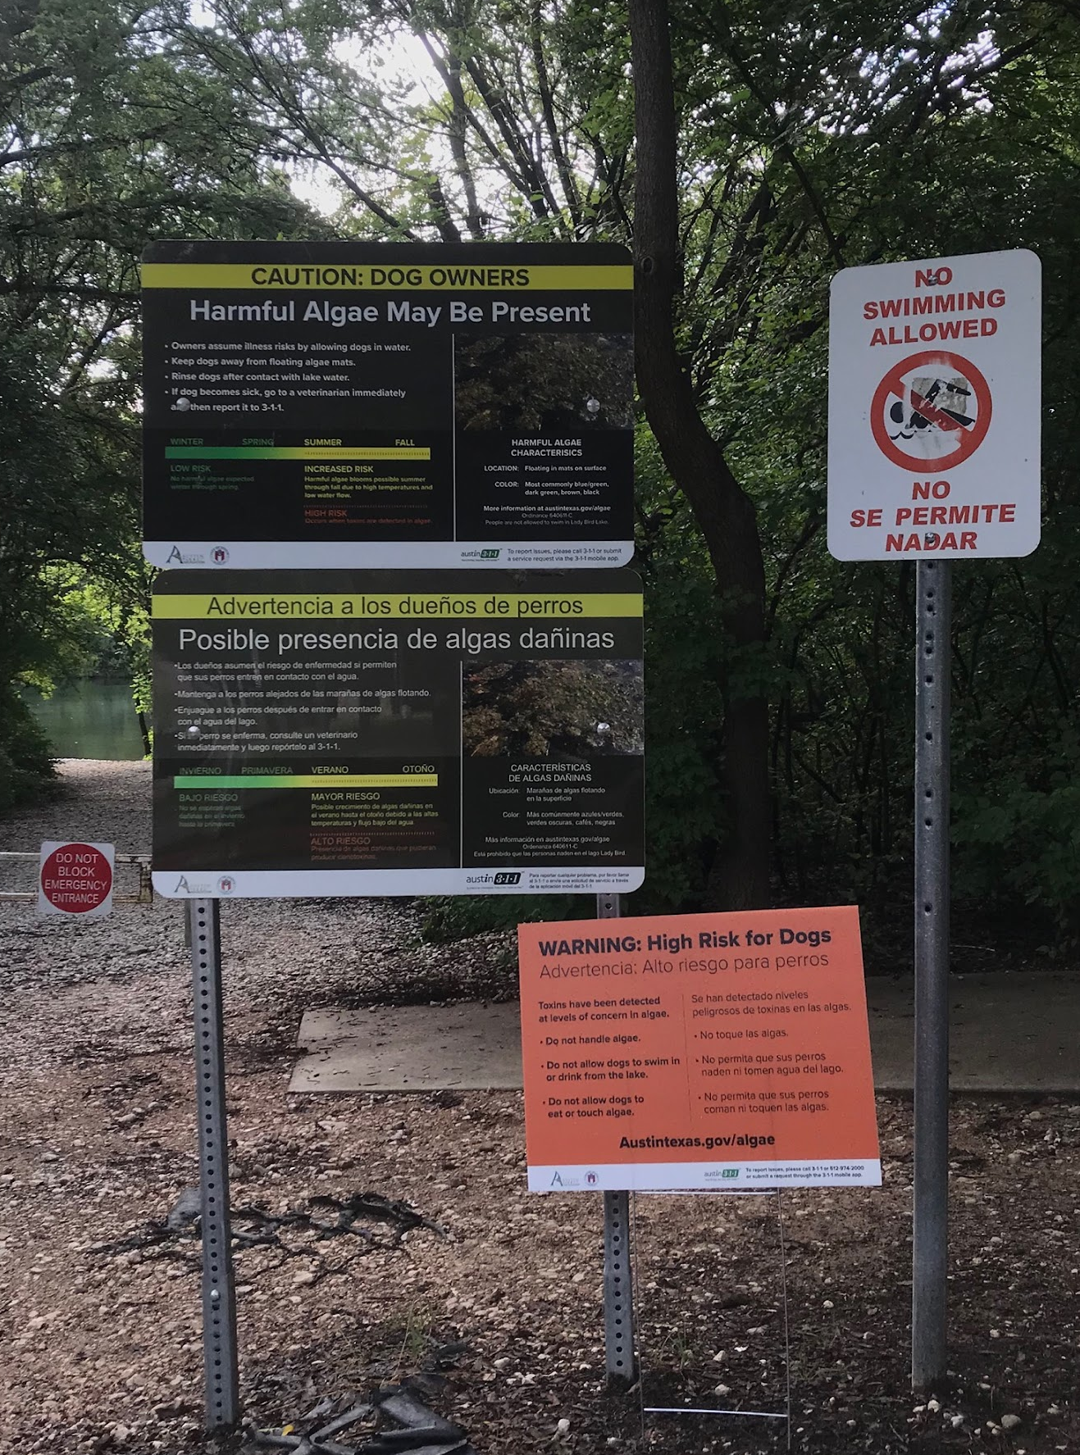




Partners
End users:
City of Austin, Department of Watershed Protection ​
Lower Colorado River Authority ​
Collaborators:
The University of Texas at Austin, Department of Molecular Sciences ​
Austin Water Utility​
Source: Addison Pletcher
Notes:
To aid in the effort of monitoring algae conditions, our Highland Lakes DEVELOP team patterned with the Lower Colorado River Authority and the City of Austin, Department of Watershed Protection as end users. These end users are responsible for managing water quality in the Highland Lakes region and worked with our team to incorporate NASA earth observations into their decision making toolkit. Historically, they have relied on in situ water quality sampling to monitor for algae events, but by utilizing more frequent satellite derived measurements they will be better prepared to recognize when to take mitigating actions against algae conditions.
The University of Texas at Austin, dep. Of Molecular Science, and the Austin Water Utility provided additional support and collaboration for the project.
---------- image credit ----------------
Photo taken by DEVELOP team member Addison Pletcher

Slide 5
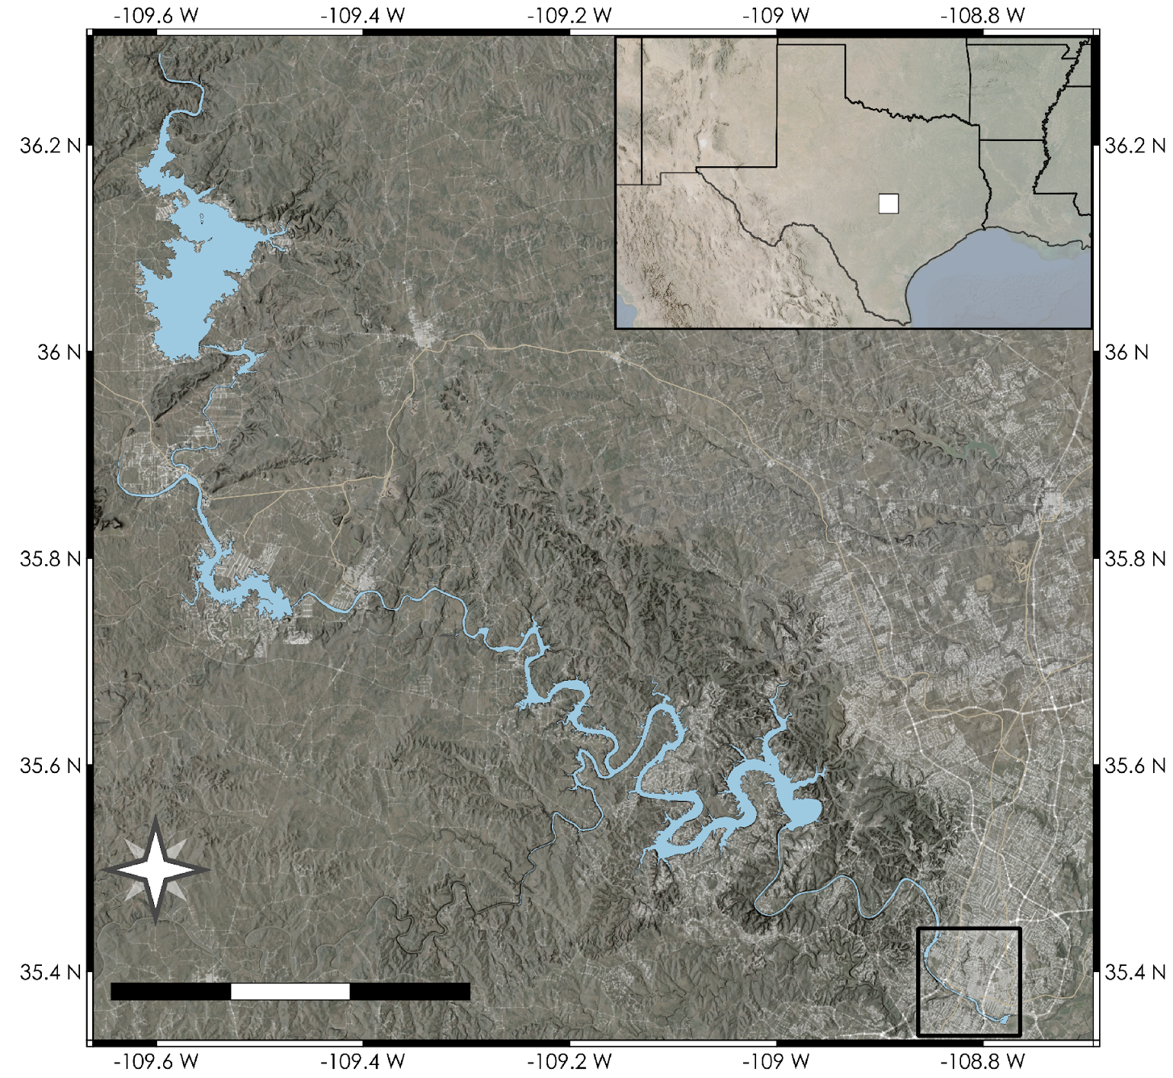

Study Area and Periods
OK
Toxins first detected, Lady Bird Lake
NM
AR
Landsat 8
Launch
Sentinel-2A
Launch
Sentinel-2B
Launch
Toxins first detected, Lake Travis
TX
LA
2013
2015
2017
2019
2021
Burnet
Austin
Lake Buchanan
Lake Austin
Austin
Lake Austin
Lady Bird
Lake
Lake Travis
Lake Lyndon B. Johnson
Austin
1
2
3 km
Lady Bird
Lake
N
Lakes of
interest
10
20
30 km
1
2
3 km
Notes:
The area of interest for this work is the highland lakes region in Texas, which runs through the city of Austin. On the left we see the spatial extent of the Highland Lakes with Austin as a reference. The lake chain is part of the Lower Colorado River and is dammed at many points, creating a chain of man made reservoirs. The placement of cities near the lake chain has led to a strong influence by human activities, which is believed to be a leading cause of the conditions favorable to algae events. Our focus observational period is between 2013 and the present, as the main satellites utilized started launching in 2013. The first harmful algal events were reported in 2019, thus more recent time periods are more important for this project. Most importantly is the focus on the present, such that more informed decisions can be made regarding current algal dangers.

Slide 6
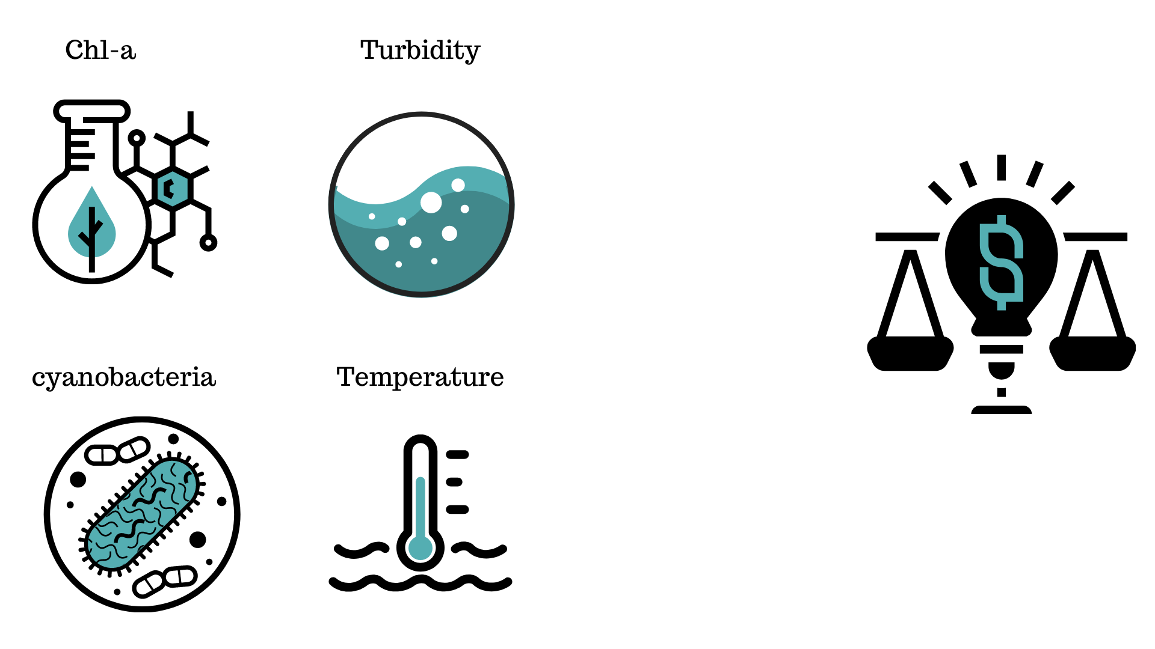

Objectives
Chlorophyll-a
Turbidity
Temperature
Cyanobacteria
Color Imagery
NASA
User-friendly Algae Monitor GUI
Support Decision
Making
Monitor near real-time satellite derived algae event indicators
Identify locations of high concentrations of algae
Improve early warning system of further algae events
Notes:
To provide a useful monitoring tool to our end users, our objectives were to utilize environmental proxies such as chlorophyll-a concentrations, turbidity, water surface temperature, and cyanobacteria detections which help us to understand algae conditions. In order to convey the information we designed a user-friendly graphical user interface to provide an interactive near real-time algae monitoring tool. Additionally, we ran statistical analyses on all of the images from 2013 to the present to provide the end users with maps and charts to better understand historical trends and potential hotspot locations.

Slide 7
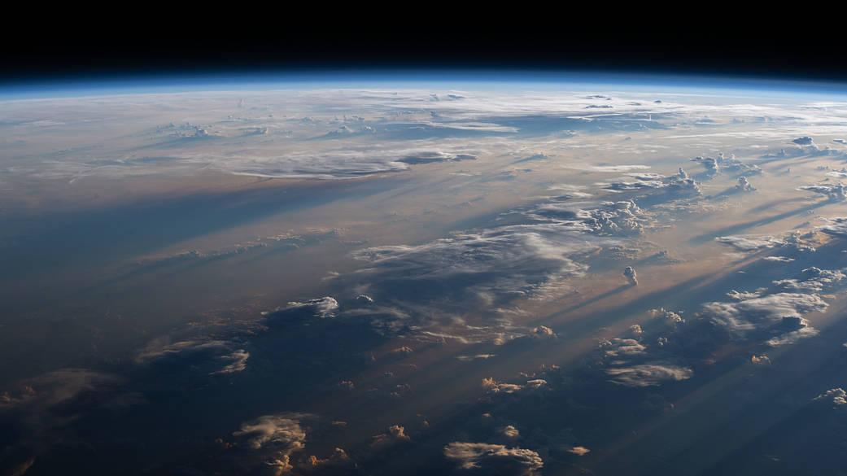
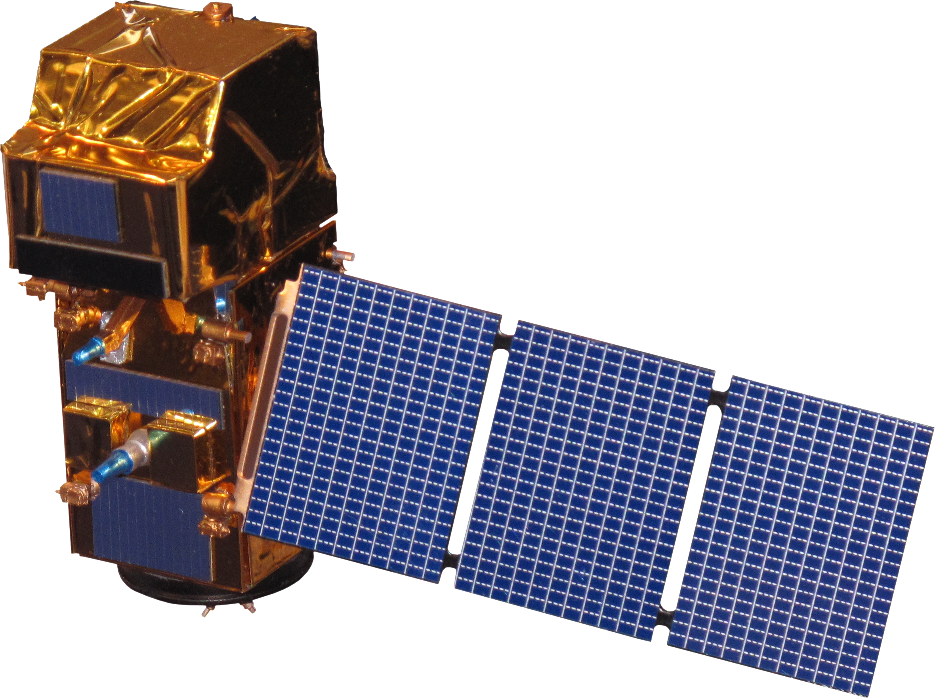
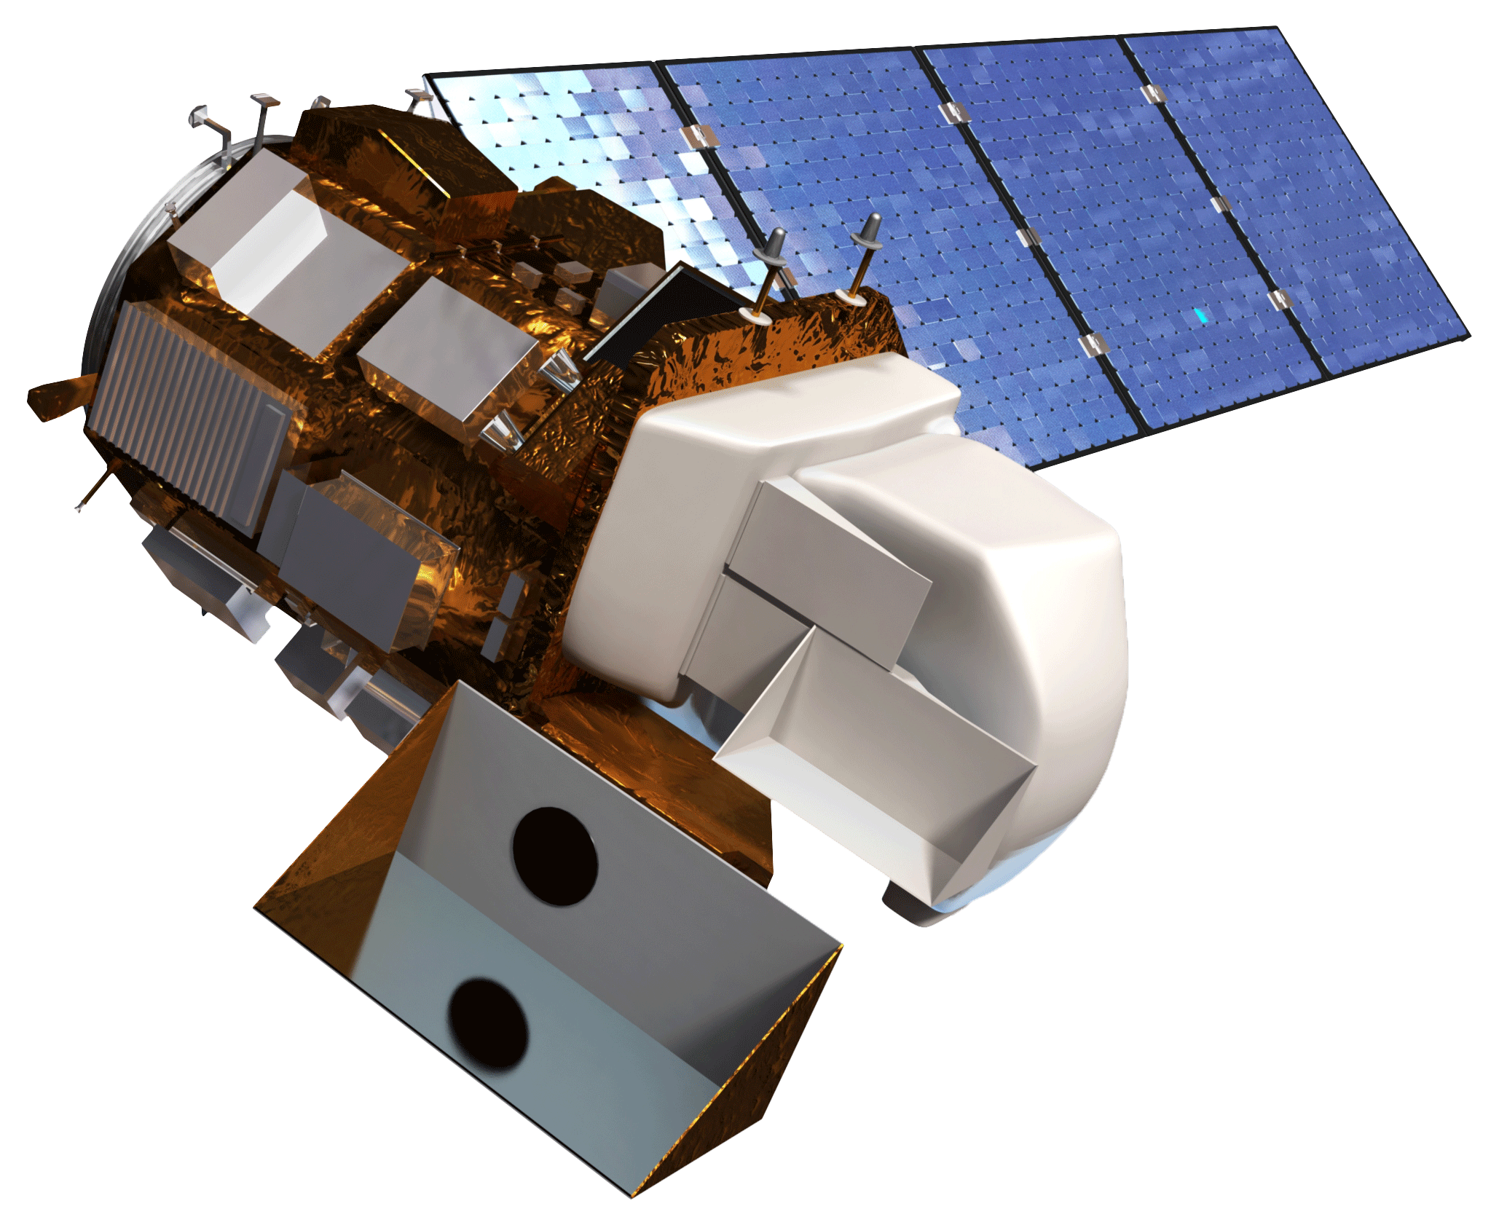
Satellites & Sensors
Sentinel-2 MSI (ESA)
Landsat 8 OLI
16-day revisit
5-day revisit (A + B)
Source: NASA, ESA
Notes:
To meet our objectives, we harnessed the jointly operated NASA & USGS Landsat-8 satellite with the Operational Land Imager (OLI) sensor, as well as the European Space Agency's (ESA) Sentinel-2 A & B satellites with the MultiSpectral Imager (MSI) sensor. Landsat-8 has a long revisit time of 16-days, has a moderately high resolution of 30 meters, and captures a large area with each pass. Meanwhile, each Sentinel-2 satellite has a revisit time of 10-days, a combined have a revisit time of 5-days. The Sentinel-2 MSI sensor provides bands with a notably high resolution of 10 meters as well as 20 and 60 meter bands. We utilized 10 and 20 meter sentinel bands for our products. Although Sentinel-2 has a great revisit time and sharp resolution, each image captured spans nearly a quarter of the area of each Landsat image. When both Landsat-8 and Sentinel-2 platforms are used in conjunction, the revisit time can be as short as 3 days.
Image from https://www.nasa.gov/sites/default/files/styles/full_width_feature/public/thumbnails/image/iss063e076166.jpg

Slide 8
Methodology Workflow
Chlorophyll-a concentrations
Earth Engine
Historical water quality statistics and maps
Widgets for alerting
Tool deployment
Landsat 8 OLI
Surface Reflectance
Cyanobacteria detection
Earth Engine
Combined visualization
Tiled maps
Sentinel-2 MSI
Surface Reflectance
Mask clouds and land
Turbidity index
Time series charts
In situ error validation
Uncertainty estimates
Water surface temperature
Notes:
This workflow chart illustrates the path taken to produce an informative and interactive tool hosting the desired end products. Surface reflectance products from Google Earth Engine were masked down to water pixels using NDWI land-water segmentation and cloud pixel detection. The masked imagery were then processed utilizing machine learning and spectral algorithms to produce chlorophyll-a concentration, cyanobacteria abundance, turbidity, and water surface temperature maps. In-situ data were then used to provide error estimates and validate the products. Utilizing the processed products, a statistical analysis was performed to retrieve historical trends as time series charts, animations, and maps. The products were also then combined into a cohesive visualization environment with interactive maps, optional time series charts, and informative widgets. Finally, the graphical environment displaying recent observations was deployed as a usable tool for the end users to access.

Slide 9
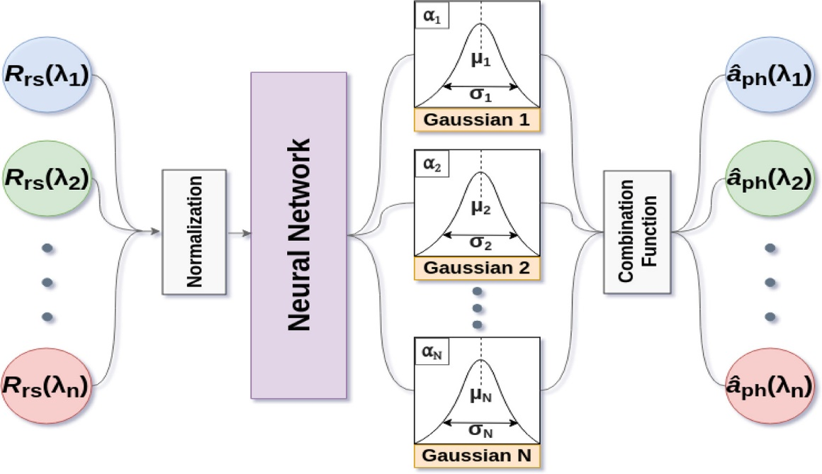
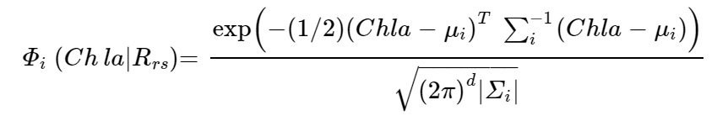
Spectral Processing
Products
Mixture Density Network Chlorophyll-a
Broad Wavelength Algae Index (BWAI)
Smith et al. (2021) and Pahlevan et al. (2020)
Zhao et al., 2020
Normalized Difference Turbidity Index (NDTI)
Lacaux et al., 2007
Water Surface Temperature
Sekertekin & Bonafoni, 2020
Notes:
To calculate the environmental proxies we used a variety of spectrally derived products. Chlorophyll-a concentrations were calculated using a pre-trained machine learning (mixture density network) model, as well as the best reported performing indices for Landsat and sentinel, the fluorescene line height violet and 2 band algorithm, respectively. For the detection of cyanobacteria we used a spectral algorithm called the Broad Wavelength Algae Index (BWAI), originally designed for Landsat but operational for Sentinel. The BWAI has two versions, one to detect cyanobacteria in the water column and one for floating cyanobacteria mats. To quantify turbidity, we use the Normalized Difference Turbidity Index (NDTI) which identifies suspended sediment in the water based on the observation that suspended sediment causes higher reflectance in the red wavelengths. Finally, the calculation of water surface temperature was achieved through inverting Planck's law and harnessing the thermal infrared bands of Landsat-8.
Processing for the Broad Wavelength Algae Index, Normalized Difference Turbidity Index, and water surface temperature were all done utilizing spectral features specific to cyanobacteria, suspended sediment, and infrared brightness temperature, respectively. The BWAI harnesses a Reflectance Peak Height index that isolates algal mats or blooms based on their different spectral features, where mats reflect more in the NIR. The BWAI uses two factors to depress noise and spectral contamination from the environment to more accurately differentiate cyanobacteria. The NDTI harnesses the increased reflectance of red wavelengths in water with increasing amounts of suspended sediment. It is normalized to prevent differences in values from environmental and lighting changes throughout the year. Water surface temperature was retrieved using a workflow which uses the infrared bands on Landsat and related the brightness temperature to surface temperature using Planck's law.
Lacaux, J. P., Tourre, Y. M., Vignolles, C., Ndione, J. A., & Lafaye, M. (2007). Classification of ponds from high-spatial resolution remote sensing: Application to Rift Valley Fever epidemics in Senegal. Remote Sensing of Environment, 9.
Nill, L., Ullmann, T., Kneisel, C., Sobiech-Wolf, J., & Baumhauer, R. (2019). Assessing Spatiotemporal Variations of Landsat Land Surface Temperature and Multispectral Indices in the Arctic Mackenzie Delta Region between 1985 and 2018. Remote Sensing, 11(19), 2329. https://doi.org/10.3390/rs11192329
Zhao, Y., Liu, D., & Wei, X. (2020). Monitoring cyanobacterial harmful algal blooms at high spatiotemporal resolution by fusing Landsat and MODIS imagery. Environmental Advances, 2, 100008. https://doi.org/10.1016/j.envadv.2020.100008

Slide 10
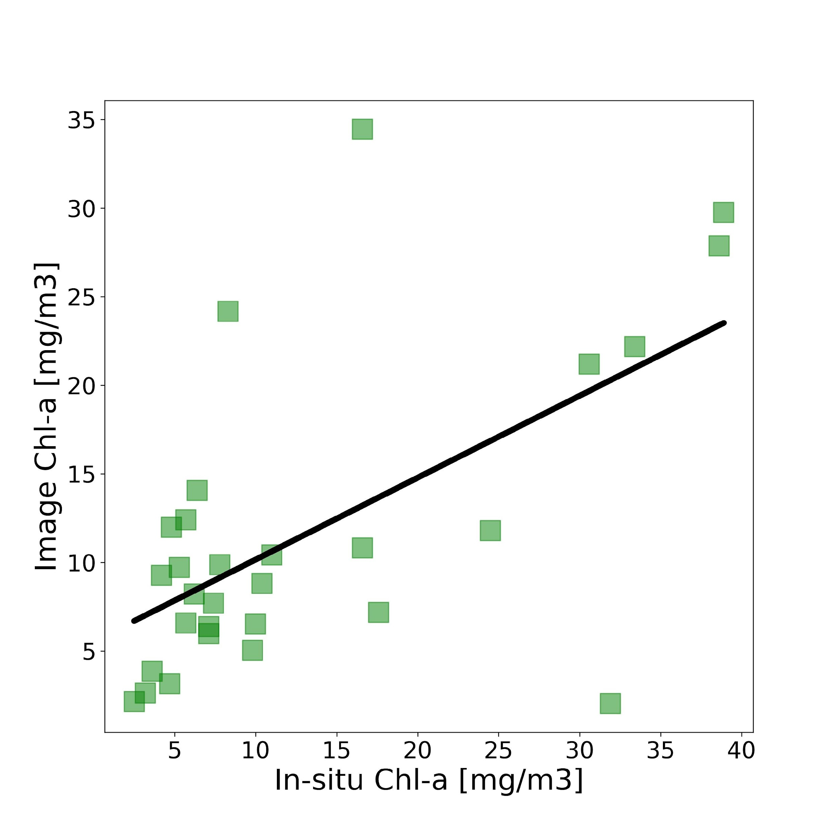
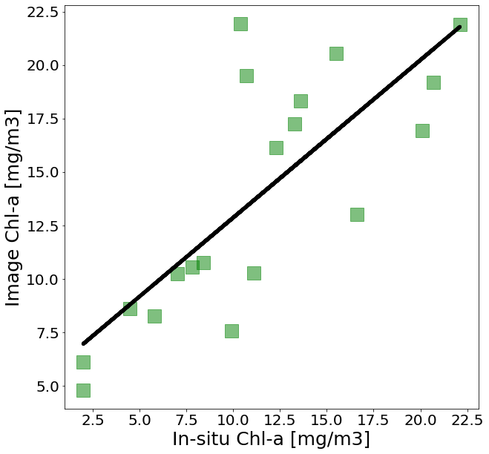
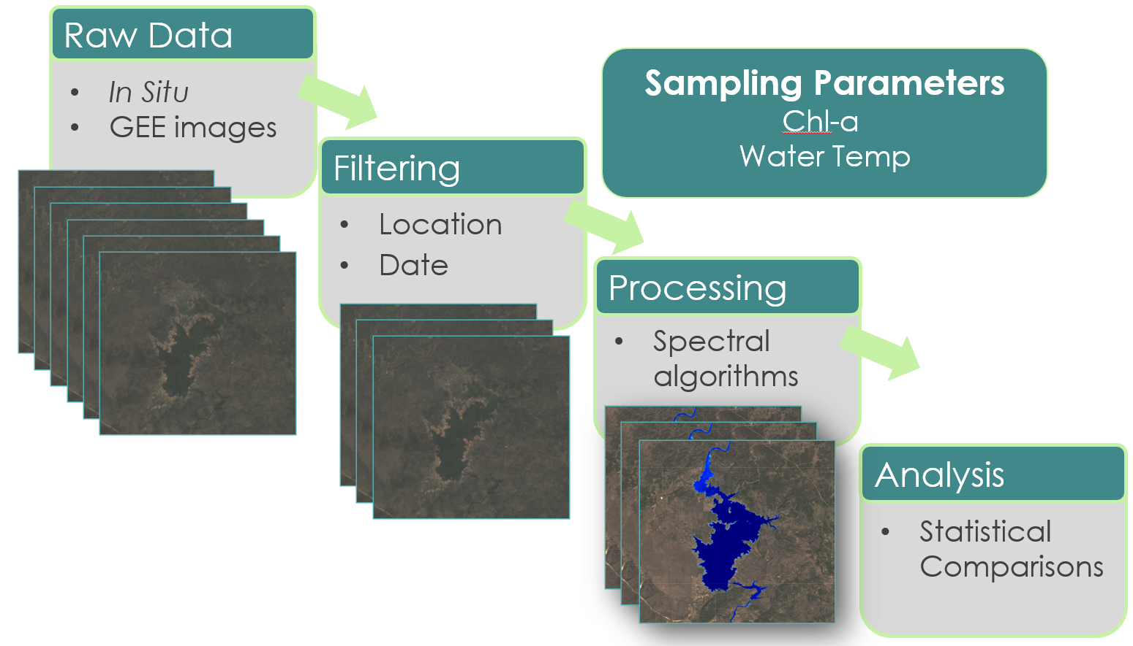
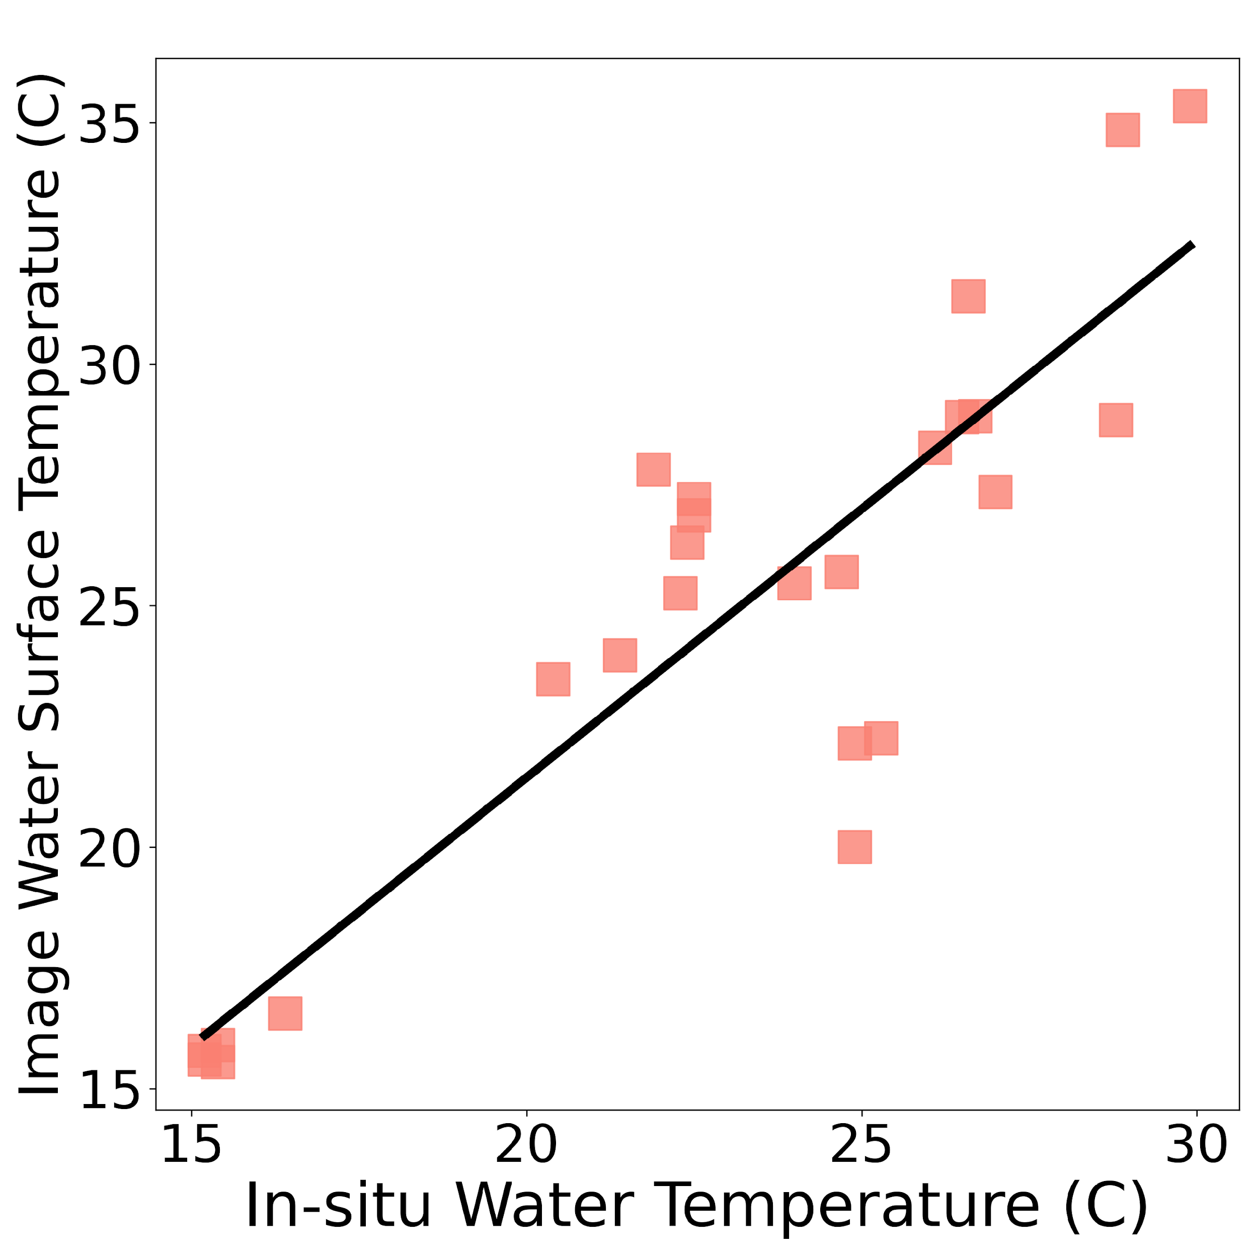
Validations
Chlorophyll-a
MDN - MSI
MDN - OLI
Validation Methods
Slope = 0.85
R² = 0.73
P = 8.0e-5
RMSE = 5.33
Slope =0.46
R² = 0.60
P = 5.0e-4
RMSE = 9.15
Water Surface Temp
LST - OLI
MSI = Sentinel-2
Slope = 0.88
R² = 0.77
P = 8.0e-9
RMSE = 3.3
OLI = Landsat 8
R2 = Coefficient of determination
P = P- value
RMSE = Root Mean Square Error
Notes:
Our goal is not only to provide products, but also provide verified, solid products. Therefore, we also performed validation analysis to validate remotely sensed measurements and quantify uncertainties. For the chla, you can see that the machine learning model performs the best for both Sentinel and Landsat, compared with other traditional Spectral chlorophyll-a indices. Turbidity regressions performed a little poorly, which can be explained by the inherent mismatches and differences between satellite derived indices and sampling data. Luckily, When we identified suspended sediment manually, the NDTI accurately identify turbid pixels most of the time. The water surface temperature product shows a good fit with in-situ data. Overall, validation efforts have suggested that these products are feasible to retrieve biogeochemical properties and identify important environmental trends.

Slide 11

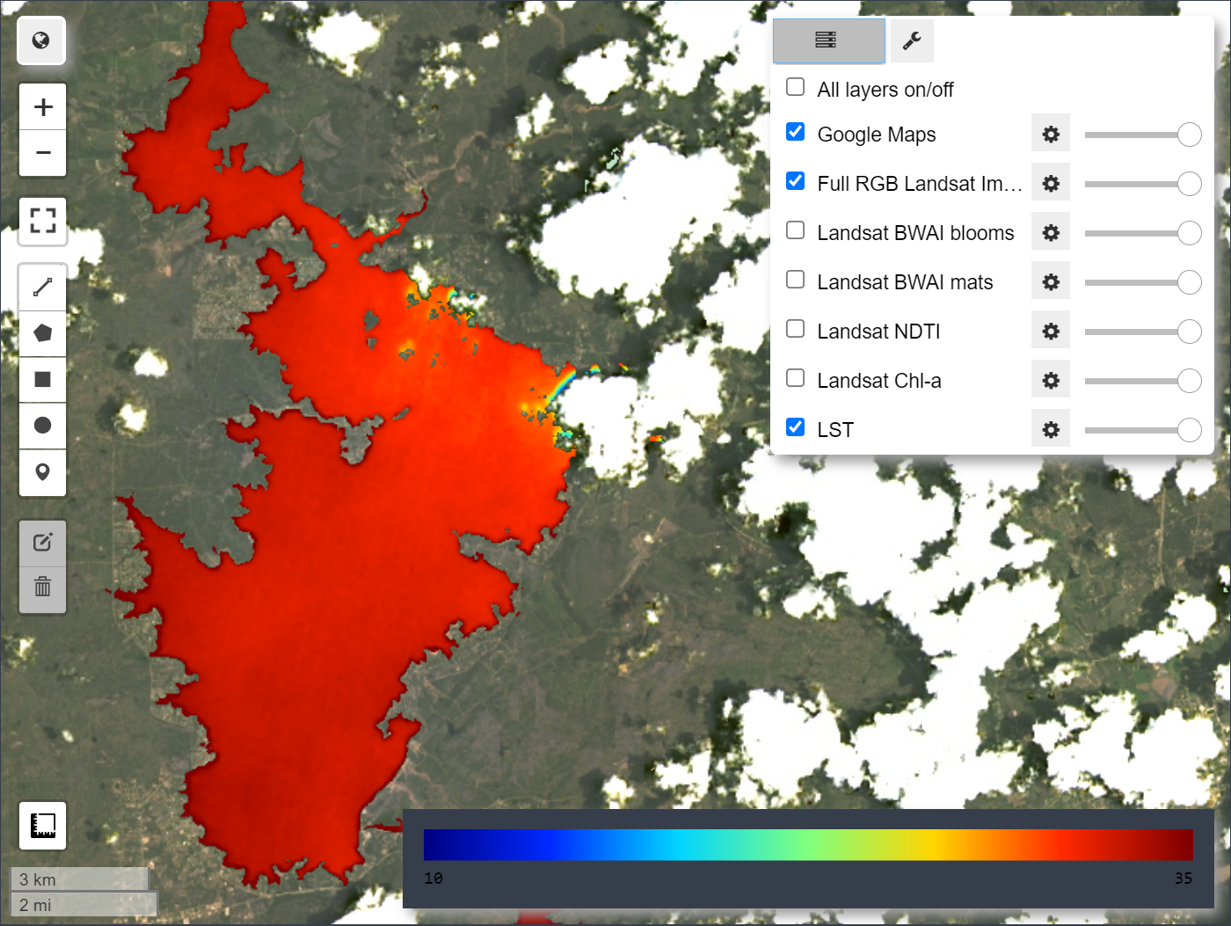
Tool/GUI Development
Workflow
Date Slider
Process informative products
Start
End
Info widget
Employ interactive components
Parameter Select
Time Series Chart
Deploy as easily usable tool
Notes:
Once we had our products working and validated, we organized our code and employed some interactive components to make a graphical user interface, or GUI, to serve as a tool for our end users. The Lake Algal Monitoring Dashboard, or LAMDA, is easy to use and interactive.
Shown on the left is an example wireframe showing how we planned out our tool and included the elements our end users wanted. The central feature is an interactive map that lets users toggle between layers and zoom in and out.
There is also an info widget, where the image date and some other useful statistics and metadata will be displayed. Additionally, there is a dropdown menu that allows users to select different parameters to create a time series chart that they can view and then even download. All these features will help our end users access and visualize the information they need.

Slide 12
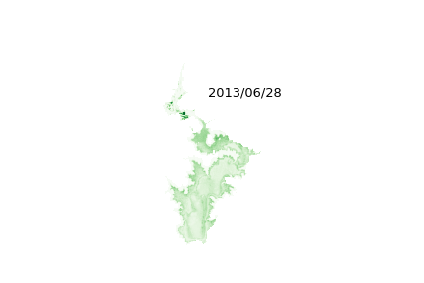
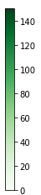
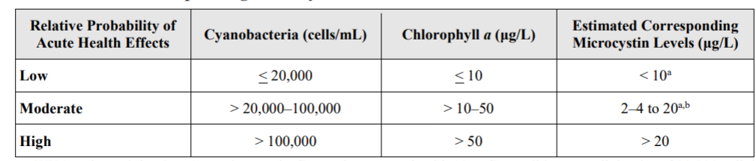

Chlorophyll-a
WHO (2003a) Recreational Guidance/Action Levels
Cyanobacteria >20ug/L can be viewed as concern and cyanobacteria >40 ug/L can be considered as bloom

Slide 13
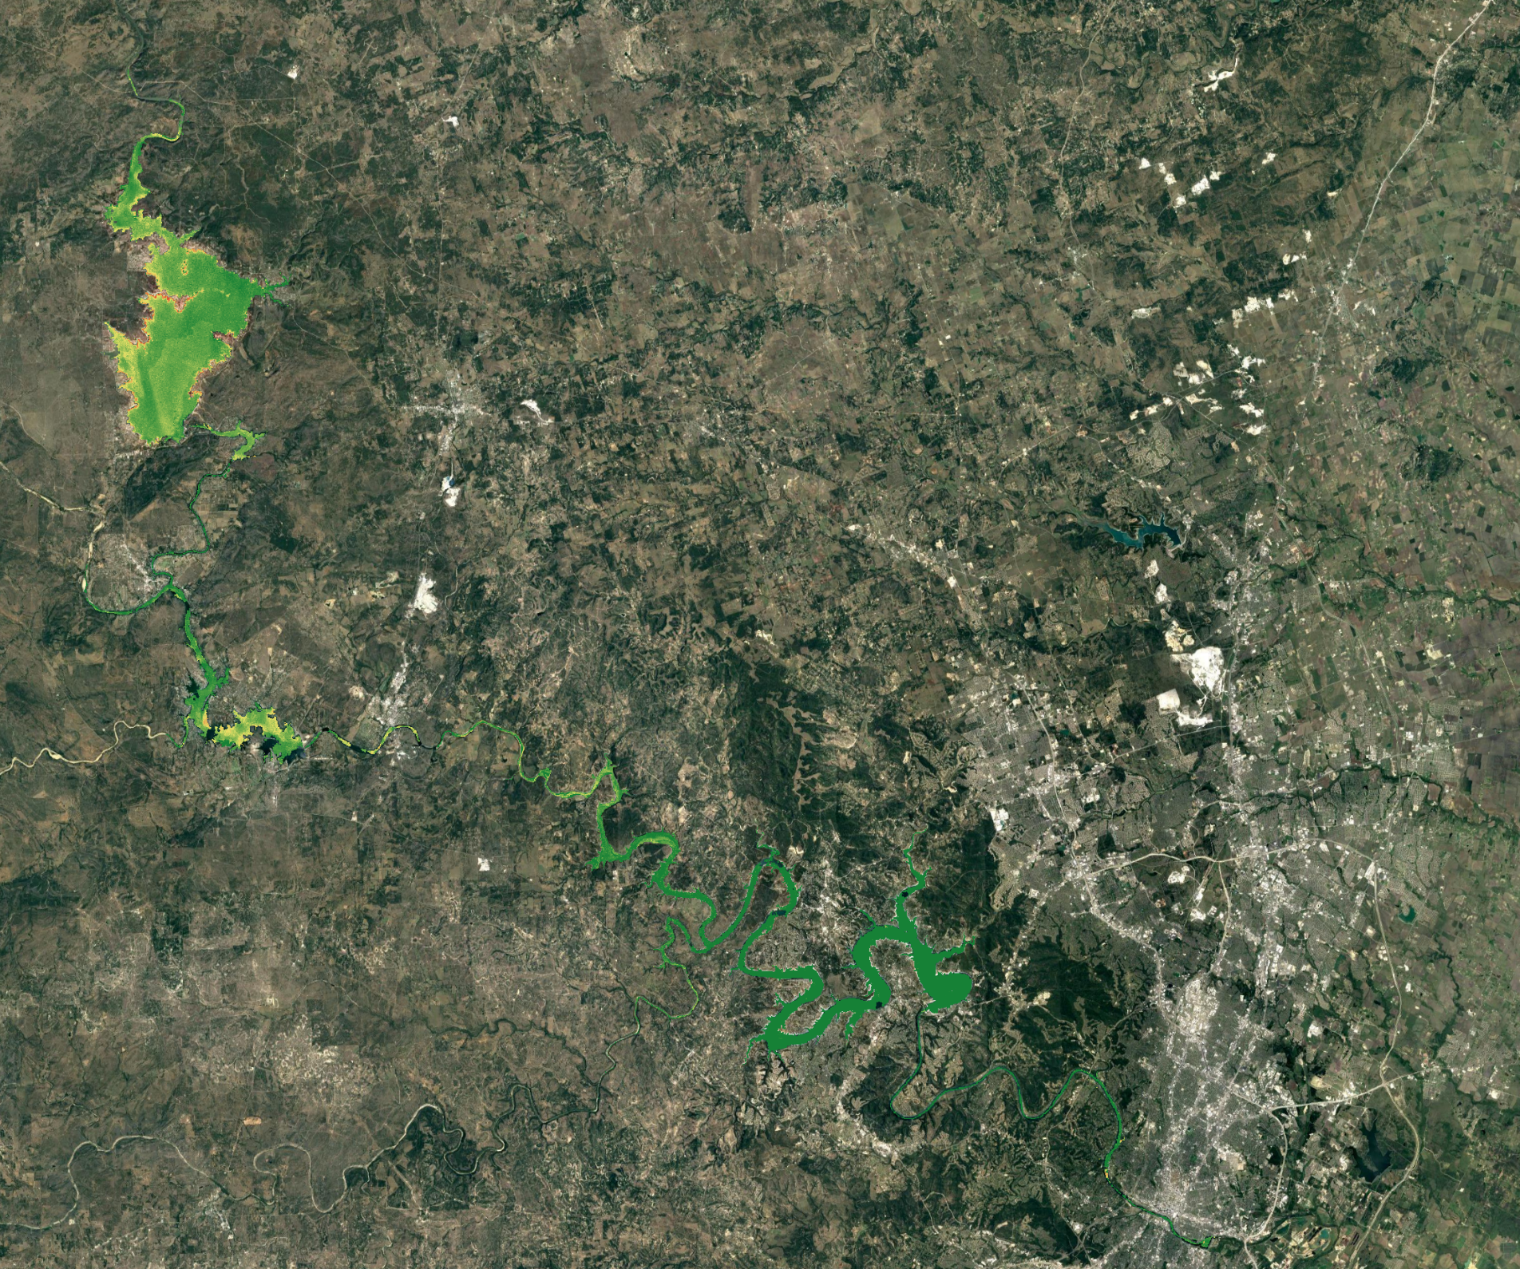
Historical Harmful Algal Hot Spot Detections
Landsat-8 retrieved averaged chlorophyll-a concentration in 2019- 2020 summer
Expand the end users’ observational toolkit
Better understand historical bloom hotspots
Support decision making
<10 ug/L, Risk low
10-50 ug/L, Risk moderate
>50 ug/L, Risk high

Slide 14
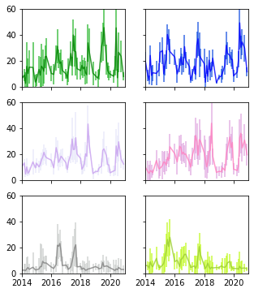
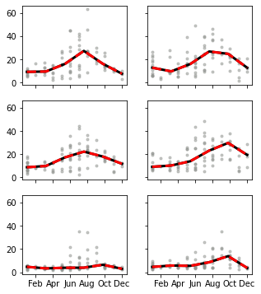
Better understand the historical trend of chl-a in annual and seasonal scales, using remote sensing products
Interannual Variability
Seasonality Trends
Lake Buchanan
Inks Lake
Lake Buchanan
Inks Lake
Chlorophyll-a [ug/L]
Chlorophyll-a [ug/L]
Lake Lyndon B Johnson
Lake Marble Falls
Lake Lyndon B Johnson
Lake Marble Falls
Lake Travis
Lake Austin
Lake Travis
Lake Austin
Notes:
Beyond monitoring of near real-time conditions we also performed historical analyses with the created products. Shown here are Landsat 8 retrieved chlorophyll-a concentrations for the six lakes in the highland lake chain from upstream to downstream. You can see these are time-series plot with error bars. Basically, the dot shows the median chl-a for each lake with one standard deviation of uncertainty. These plot include all available dates of Landsat 8 from 2013 to 2020 . This figure actually shows up a lot of interesting pattern. At first, the figure suggests a clear seasonality of chl-a in all lakes. In general, it peaks around July and August. Additionally, we can see lakes upstream have relatively higher chla compared to lakes downstream. We only have 7-year of data, it would be a little risky to talk about trends, but we did observe different lakes have different behaviors. You can see chla in the Lake Austin and the Lake Travis are pretty stable, compared to other lakes. But the data did capture some spikes in the summer of 2015 and 2016, which corresponds to the severe drought in the lake Travis. And the spike in the summer of 2019 corresponds to reported harmful algal events. Overall, It suggest that we should take different mitigation policies and measurements , according to the ecological conditions in these lakes.

Slide 15
Science Advisors
Dr. Erin Urquhart, Science Systems & Applications, Inc., NASA Goddard Space Flight Center
Dr. Christine Lee, California Institute of Technology, NASA Jet Propulsion Laboratory
Dr. David Hondula, Arizona State University
Partners
The City of Austin Department of Watershed Protection
  Brent Bellinger
The Lower Colorado River Authority
  Lisa Benton
Additional NASA Advisors
Dr. Nima Pahlevan, Science Systems & Applications, Inc., NASA Goddard Space Flight Center
Brandon Smith, Science Systems & Applications, Inc., NASA Goddard Space Flight Center
NASA DEVELOP Lead & Fellow
Ryan Hammock, NASA DEVELOP Arizona
This material contains modified Copernicus Sentinel data (2021), processed by ESA.
Notes:
We would like to thank Dr. Erin Urquhart, Dr. Christine Lee, Dr. David Hondula, Dr. Nima Pahlevan, Ryan Hammock, The City of Austin Department of Watershed Protection, and the Lower Colorado River Authority (LCRA) for their support and contributions.

