Slide 1
A42C-07
Assessing Urban Heat in the Cincinnati and Covington Area to Inform Local Decision-makers and Environmental Justice Initiatives
Celeste Gambino, Paxton LaJoie, Olivia Cronin-Golomb, Samuel Feibel, and Katrina Rokosz
Notes:
Hello everyone, my name is Celeste Gambino and I am the senior communications fellow for NASA‘s DEVELOP program. For those of you who don’t know, DEVELOP is a part of NASA’s applied sciences program and our mission is to address environmental and public policy issues through interdisciplinary research projects that apply NASA earth observations to real world community concerns and help inform environmental decision makers. We do that through 10 week rapid feasibility studies, one of which I’ll highlight for you today.
In the spring of this year, our team at the Boston Massachusetts location partnered with Groundwork USA and Groundwork Ohio River Valley to assess urban heat in the Cincinnati and Covington area to help inform their local and regional environmental decision-making and environmental justice initiatives. Our work helped to inform Groundworks climate safe neighborhoods program, which explores the relationship between historical race-based housing segregation and impacts of climate change such as increased urban heat.

Slide 2

Study Area and Period
N
Study Area:
Cincinnati, Ohio & Northern Kenton County, Kentucky
Study Period:
Summer (June, July, August) of 2010 – 2020
Ohio
Cincinnati
Northern Kenton County
Kentucky
Study Area
0
2.5
5
mi
Notes:
The study area was limited to the 2010 city limits of Cincinnati, Ohio, including the municipalities of Norwood, St. Bernard, and the village of Elmwood Place. The three areas were included due to their geographic location within the boundaries of Cincinnati and socioeconomic consistencies with outer Cincinnati. The 2010 city limits were used to match the year of the majority of the data used in this project. The Kentucky side of the study area was limited to the region of Kenton County between the Ohio River and Interstate 275 to reflect areas prioritized by our partners and due to time constraints of the time.
The study period focused on summer months because the impacts of urban heat on local communities is greater in the summer than winter. Data primarily came from 2010 because that was the most recent data our partner was able to provide.
------------------------------Image Information Below -----------------------------
Study area base layer: Esri, HERE, Garmin, SafeGraph, METI/NASA, USGS, EPA, NPS, USDA

Slide 3

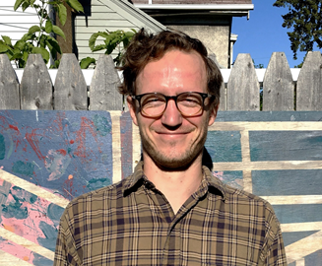


Project Partners
Groundwork USA
Groundwork Ohio River Valley
Cate Mingoya
Lawrence Hoffman
Tanner Yess
Sarah Morgan
Image Credit: Written Permission from Partners
Notes:
For this project we partnered with Groundwork USA and Groundwork Ohio River Valley. Groundwork USA is a network of local nonprofit organizations that focuses on the regeneration, improvement, and management of urban spaces to help mitigate environmental, economic, and social inequalities within marginalized communities. Groundwork Ohio River Valley, a subsidiary of Groundwork USA, is focused on expanding environmental awareness and environmental justice through the communication of spatial data. Both Groundwork USA and Ohio River Valley use NASA Earth observations and GIS mapping to educate the public about environmental issues within communities and help communities with city-specific resilience planning.
------------------------------Image Information Below ------------------------------
Image Credit: Cate Mingoya, Groundwork USA
Image Credit: Lawrence Hoffman, Groundwork USA
Image Credit: Tanner Yess, Groundwork Ohio River Valley
Image Credit: Sarah Morgan, Groundwork Ohio River Valley

Slide 4
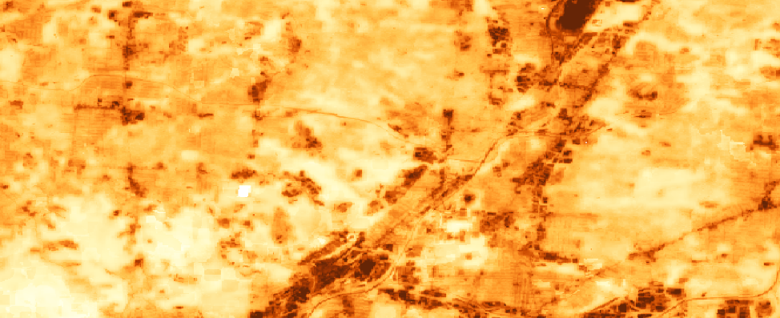
Objectives
1
2
Calculate the cooling capacity, heat mitigation index, and heat island extent of the study area
Map daytime and nighttime land surface temperature anomalies
Notes:
For the project, we had three primary objectives:
1. The team aimed to model the cooling capacity, heat mitigation index, and urban heat island extent of Cincinnati and northern Kenton County to understand factors contributing to the urban heat island issue in the region.
2. The team also identified and mapped urban heat anomalies from mean temperature, identified using daytime and nighttime land surface temperature data to highlight communities under greatest risk of urban heat island effects.

Slide 5

Urban Heat Island (UHI) Effect
Urban environments experience warmer temperatures and impaired cooling capacity compared to rural counterparts
Image Credit: Carol M. Highsmith
Notes:
The urban heat island effect is the difference in temperature between warm urban areas and the cooler natural surrounding environment. They form because of energy from solar radiation and waste energy from urban energy consumption. Albedo, or is the measure of the proportion of radiation reflected by a surface, also plays a part in the urban heat island effect. Many urban surfaces have low albedos, meaning they absorb radiation well. During the day, urban surfaces and buildings collect and store energy than is dissipated at night, elevating nighttime temperatures. Additionally, limited green spaces in urban areas limit cooling through evapotranspiration by vegetation.
Urban heat islands are a public health risk because they increase respiratory hospital admission rates and heat-related health issues and mortalities, and worsen air pollution.
------------------------------Image Information Below ------------------------------
Image Credit: Carol M. Highsmith
Image Source: https://www.flickr.com/photos/vintage_illustration/44436783010/
Image license: Attribution 2.0 Generic (CC BY 2.0)

Slide 6

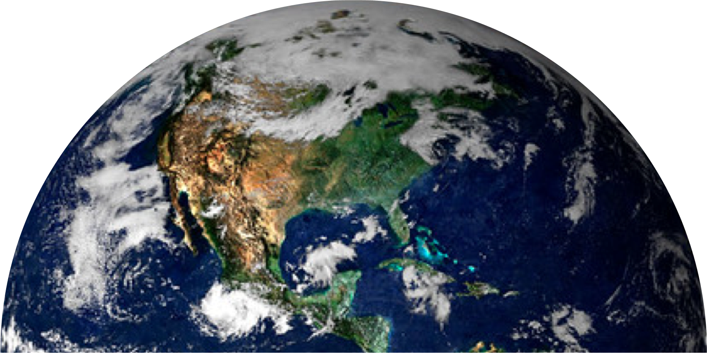
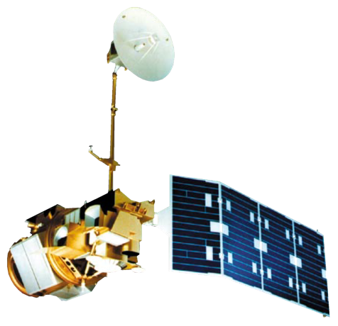
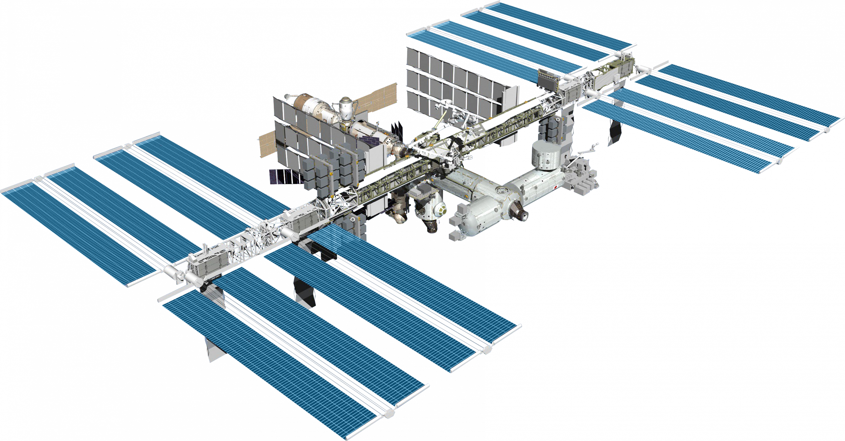
NASA Satellites and Sensors
ISS-ECOSTRESS
Landsat 5 TM
Image Credit: NASA; Kevin M. Gill
Notes:
Earth observation data were acquired for summer months, defined as June 1st – August 31st, of 2010 – 2020.
Landsat 5 satellite imagery was retrieved and processed to calculate albedo and daytime LST in Google Earth Engine for 2010-2012 by modifying a script written by the NASA DEVELOP Spring 2020 AZ Philadelphia Health and Air Quality team
ISS-ECOSTRESS LST Level 2 data were downloaded from NASA AppEEARS for 2018 – 2020 and filtered in RStudio to only include nighttime imagery
The ISS-ECOSTRESS daily-integrated evapotranspiration product was also downloaded from NASA AppEEARS for 2018 – 2020.
------------------------------Image Information Below ------------------------------
Image Credit: NASA
Image Source: https://www.devpedia.developexchange.com/dp/images/6/69/01_Landsat5.png (DEVELOPedia)
Image Credit: NASA
Image Source: https://science.nasa.gov/toolkits/spacecraft-icons (NASA)
Image Credit: Kevin M. Gill
Image Source: https://search.creativecommons.org/photos/36bed9ec-eee5-471c-8e19-0d2d9754b675 (licensed with CC BY 2.0)

Slide 7
Methodology: Reference Areas for Temperature Anomalies
N
Study Area
Reference Area
Reference Areas:
Big Oaks National Wildlife Refuge
Miami Whitewater Forest
Tranquility State Wildlife Area
Indiana
Ohio
Kentucky
0
25
50
mi
Notes:
Three reference polygons, shown in pink, were selected for temperature anomaly work. The purpose of these reference polygons was to provide land surface temperature measurements of natural areas to directly compare to our study area to understand the extent of the Urban Heat Island. These three reference polygons were selected due to a lack of urban corridors within them, their similar elevation and latitude to the study area, and the sum of the reference polygon areas being similar to the area of study. Additionally, water bodies were removed from the reference polygons.
------------------------------Image Information Below ------------------------------
Study area base layer: Esri, HERE, Garmin, SafeGraph, METI/NASA, USGS, EPA, NPS, USDA

Slide 8
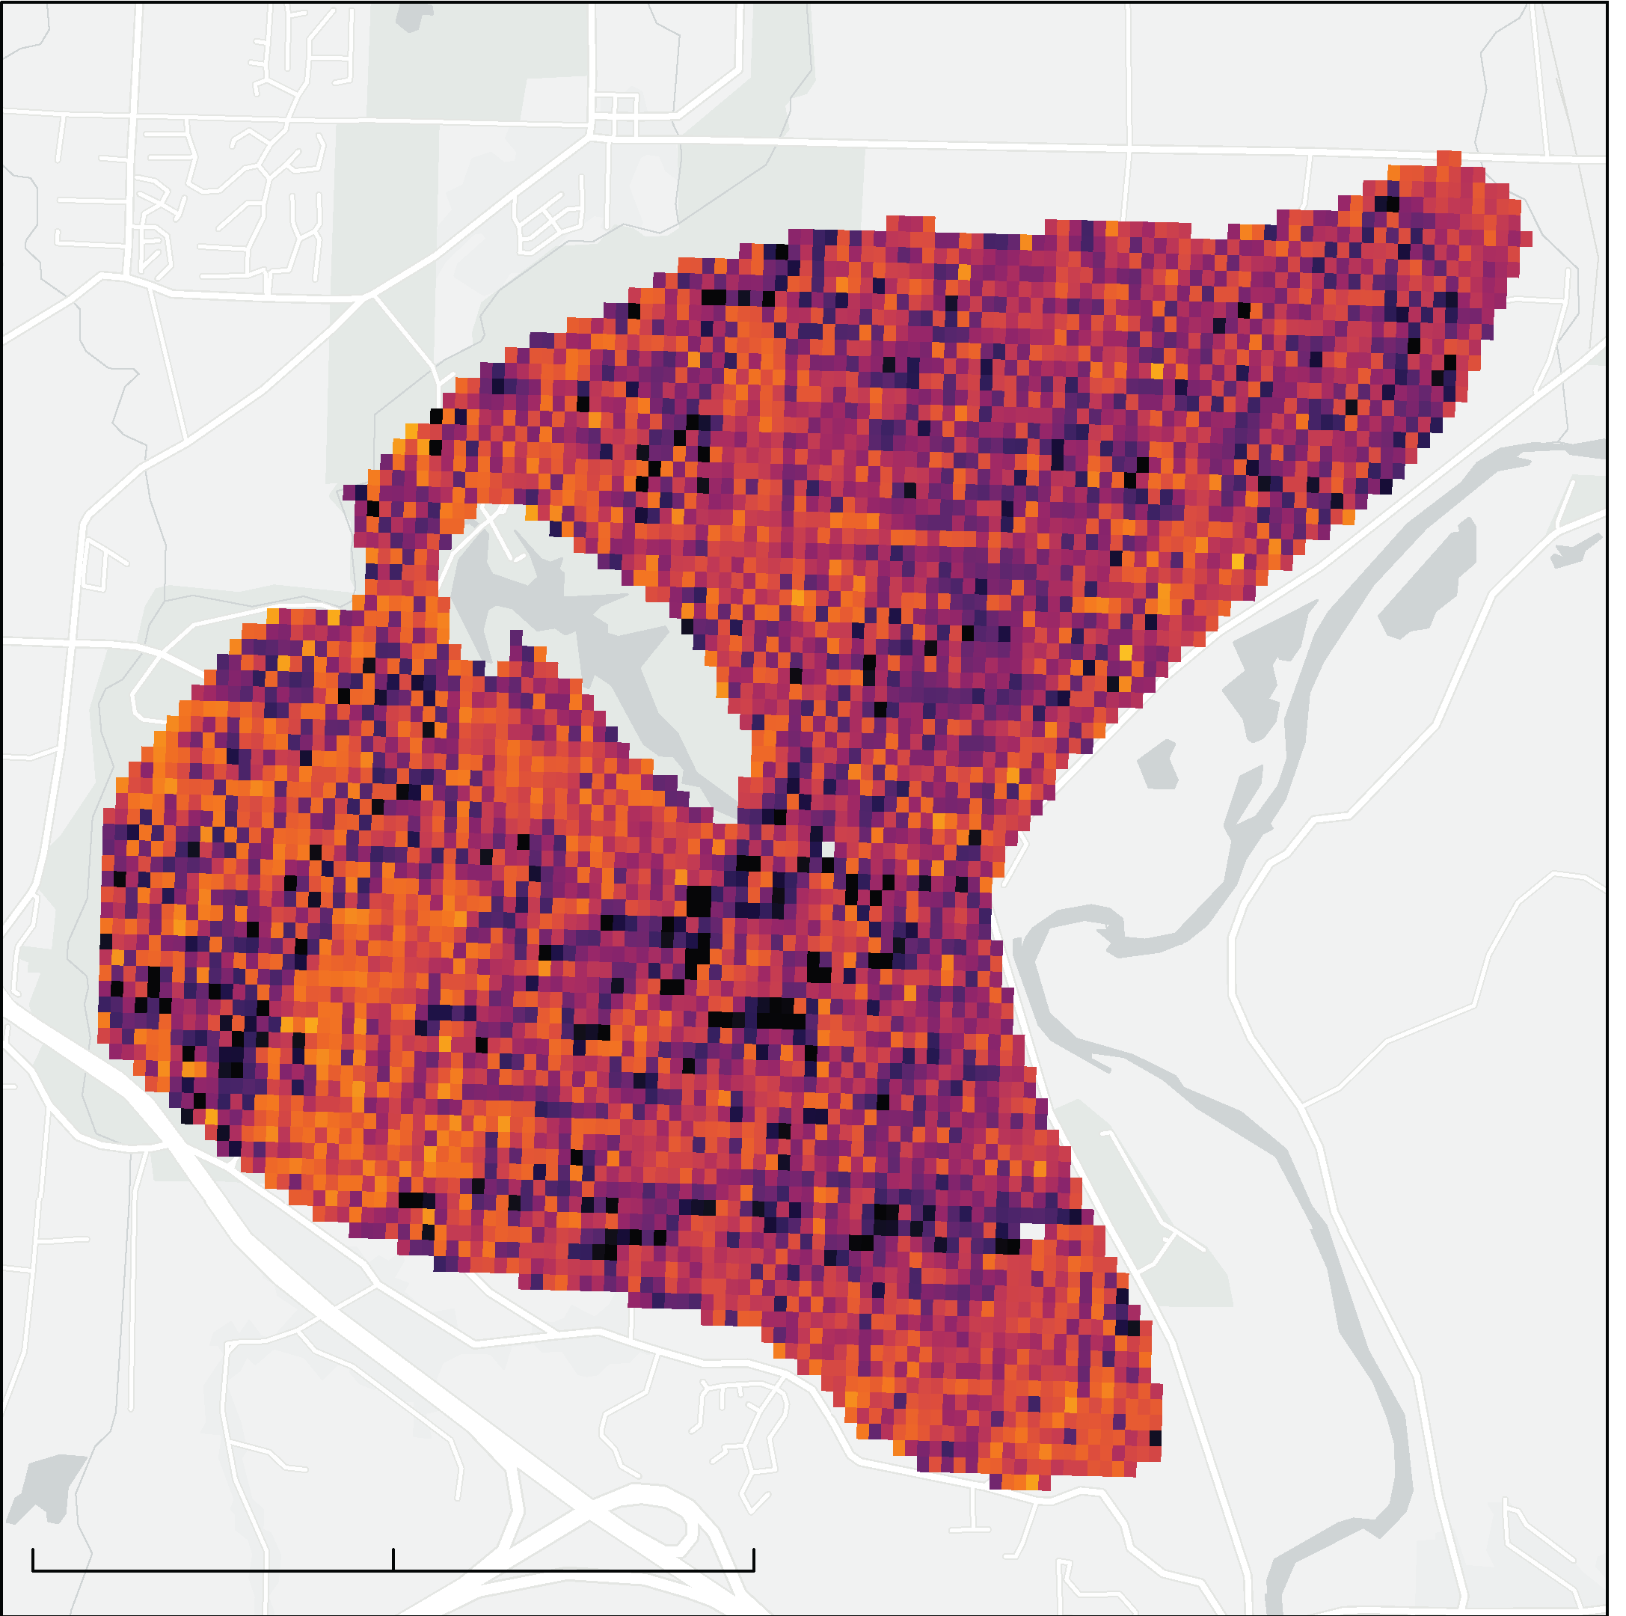
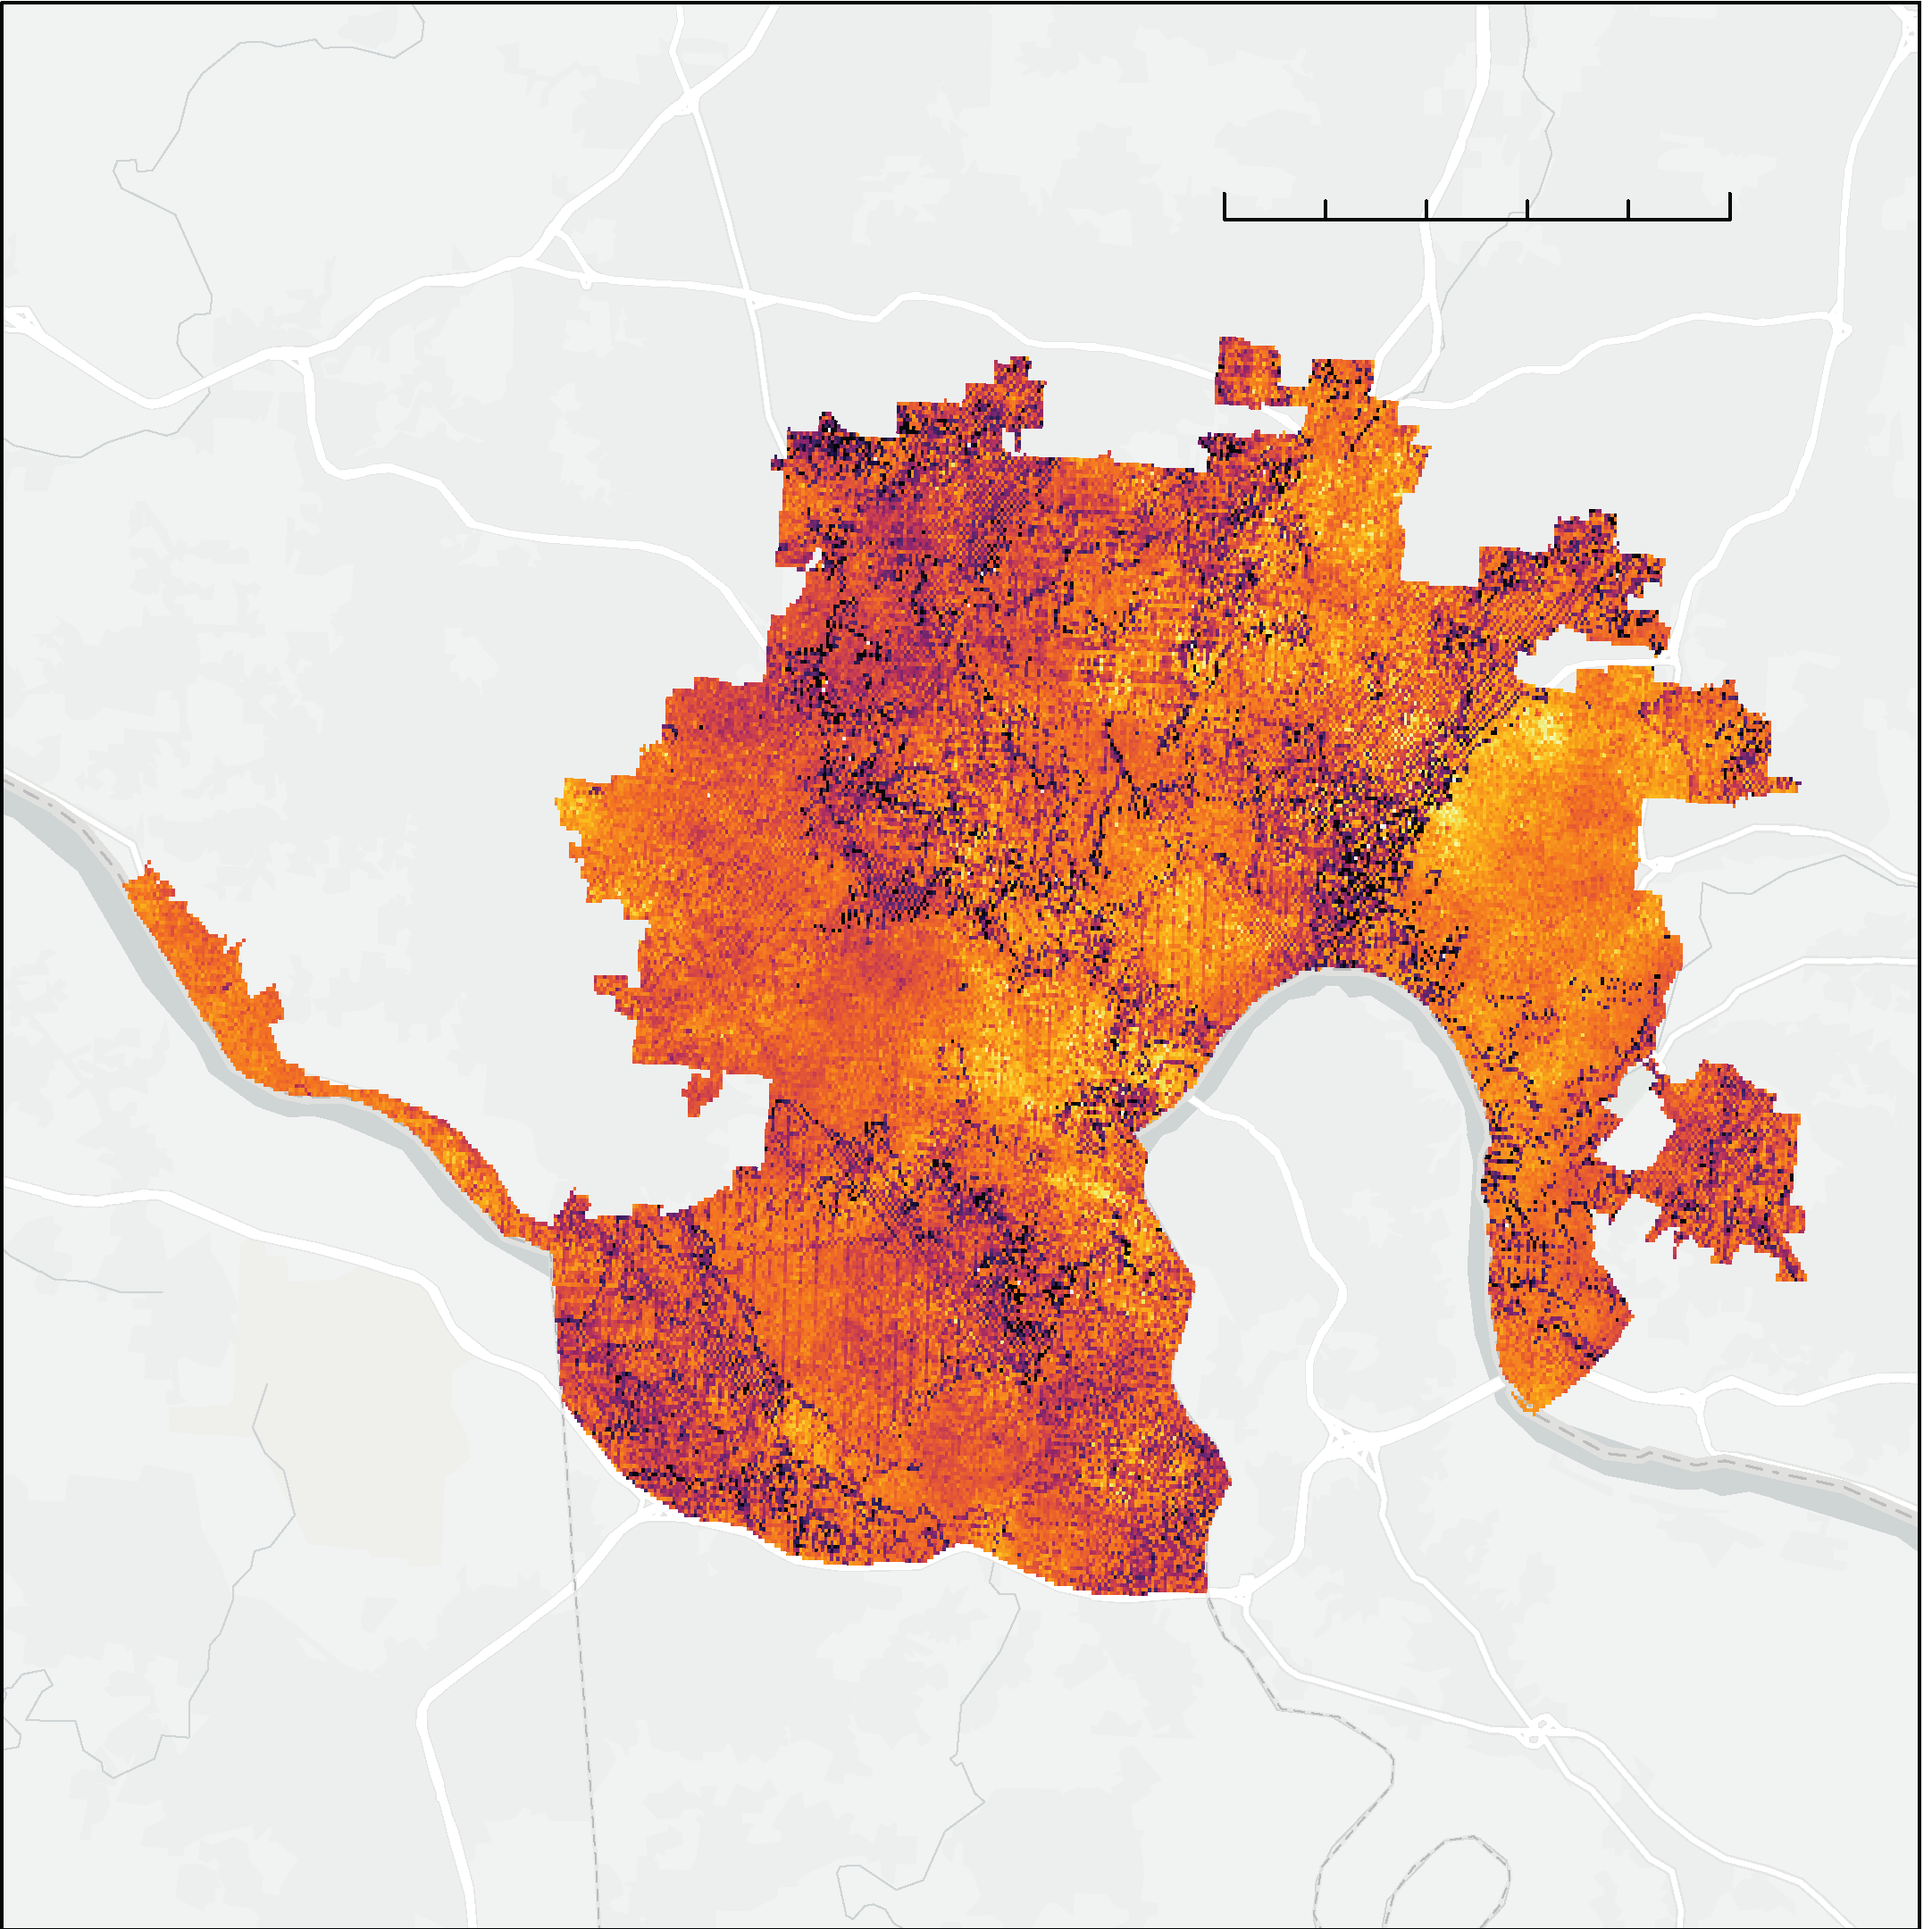
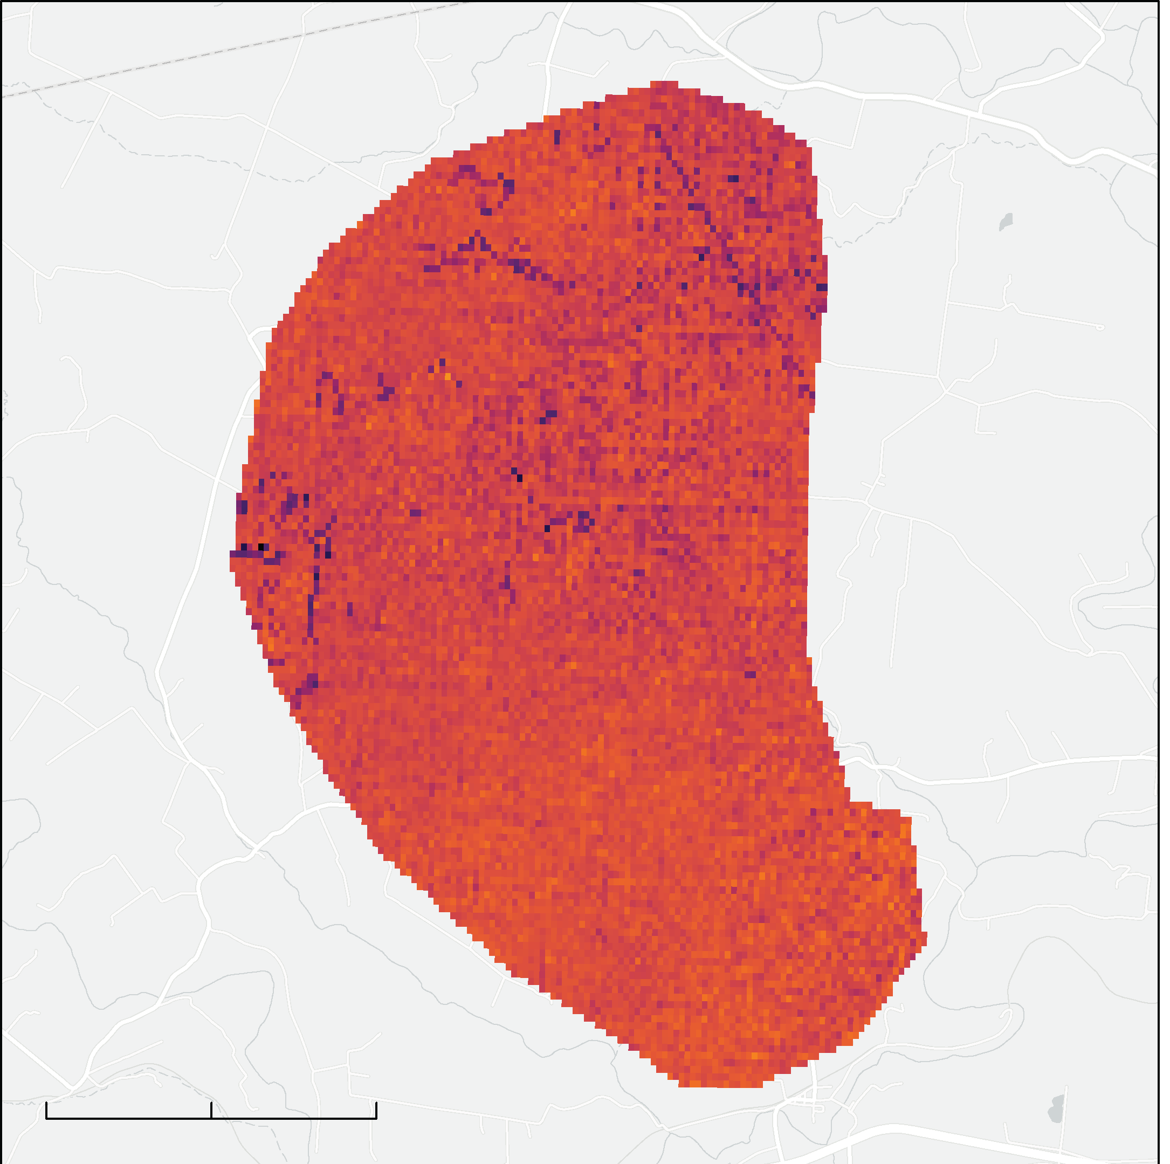
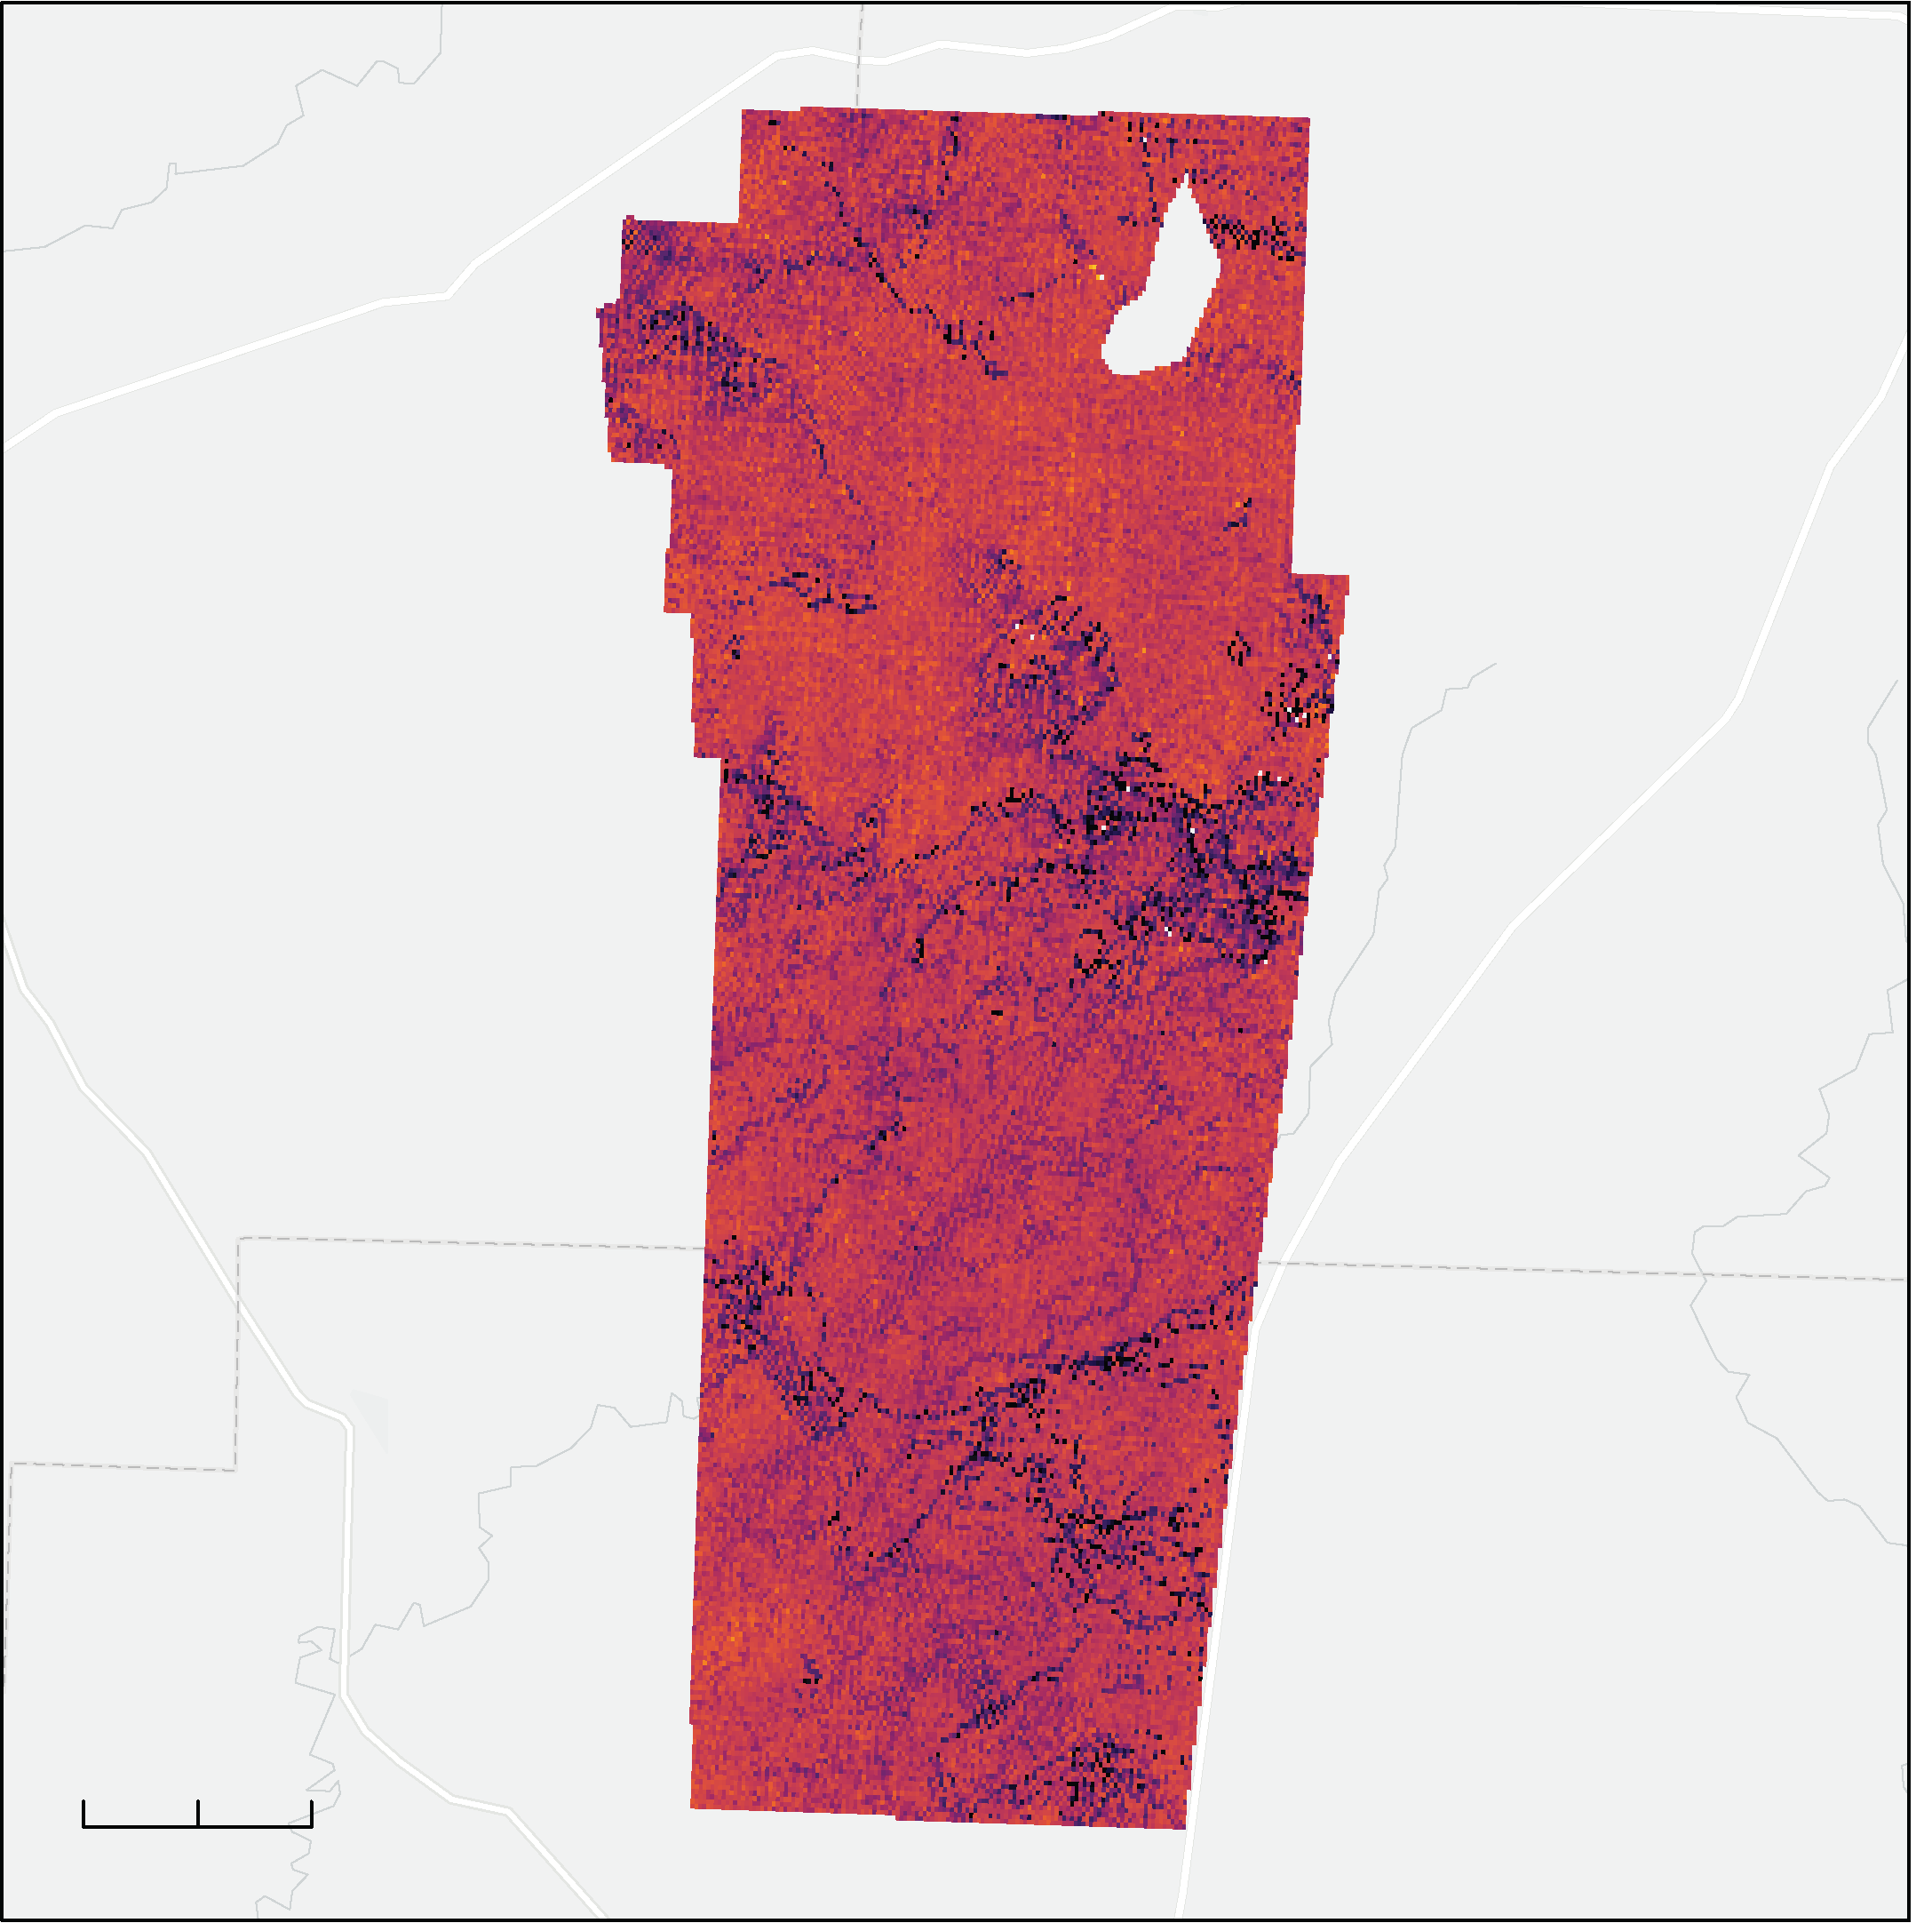

Methodology: Magnitude of the UHI
N
0
5 mi
0
2 mi
0
2 mi
0
2 mi
40
50
60
70
80
90
Temperature Anomaly (°F) = T _{nighttime LST raster} - T _{reference polygons}
km
Notes:
In order to calculate the extent and magnitude of the Urban Heat Island throughout our study area, we compared the both the daytime and nighttime temperatures of neighboring rural areas to our study area.
The downloaded ECOSTRESS LST collection was filtered in R to only include summer nighttime imagery. Nighttime was defined as 10:00pm to 4:00am, Eastern Standard Time. Pixels covered by clouds or cloud shadows were removed from the analysis using the corresponding ECOSTRESS cloud image collection. Mean nighttime LST was calculated for each pixel across the study period to create a single mean nighttime LST image.
To quantify and visualize the magnitude of nighttime temperature anomalies, the team compared the nighttime LST throughout the study area to reference polygons in neighboring rural areas. The size and location of these polygons were selected using the following criteria: outside city limits, overlaying largely vegetated areas with the similar latitude and elevation as the study area, and not including large bodies of water or urban corridors such as freeways. The team used local knowledge from project partners to find areas that would satisfy these criteria.
The average nighttime LST for the reference polygons were subtracted from the average nighttime LST raster to visualize and quantify the Urban Heat Island.

Slide 9
Methodology: InVEST Urban Cooling Model
Urban Cooling Model
Land use/ land cover map
Biophysical table
Land surface temperature
Area of interest
Evapotranspiration
Crop coefficient
Building intensity
Shade
Green area
Albedo
Notes:
To assess different environmental and urban factors influencing the urban heat island, the team used the Integrated Valuation of Ecosystem Services and Tradeoffs (InVEST) Urban Cooling Model. The InVEST urban cooling model calculates an index of heat mitigation based on shade, evapotranspiration, and albedo; as well as distance from cooling islands. Using the InVEST model afforded the team the opportunity to link data to the land use land cover classes within the study area and understand their relationship to urban heat. InVEST also allows inputs to be adjusted to run different scenarios to alter urban heat; such as inputting additional green spaces in urban areas or instituting white roof requirements.
Nighttime vs. Daytime models
-Cooling capacity (an important output of the model) can account for nighttime temperature by using building intensity, a value calculated by dividing the total (estimated) area of floors in buildings in a particular LULC class by the total land area of that LULC class. The model uses building intensity as a predictor of nighttime temperature, whereas evapotranspiration, shade, and albedo are used as temperature predictors in the daytime model.

Slide 10
Land Use Land Cover
N
Developed, Open Space, <20% impervious surfaces
Developed, Low, 20-49% impervious surfaces
Developed, Medium, 50-79% impervious surfaces
Developed, High, 80-100% impervious surfaces
Open Water
Wetlands
Forest
Shrub and Grassland
Agriculture Fields
Barren Land
0
2.5
5
mi
Notes:
This map shows the land cover data from the National Land Cover Database from 2011 we used as an input for the InVEST model. As you can see, varying shades of red indicate different levels of development, with the darkest red areas being the most developed areas, largely consisting of apartment buildings, and commercial and industrial complexes. They are also where the stadiums for the Cincinnati Reds and Bengals stadiums are.
This land use data was used in the InVEST model to accurately identify areas with large potential to mitigate heat, and areas that exacerbate the urban heat in Cincinnati and the Covington area. Highly developed urban areas with little green space exacerbate heat concerns, while open green spaces with little impervious surface offer cooling factors to the urban environment. Assessing land use land cover in our study area helped to validate our results in their temperature consistencies with land use trends.
https://www.mrlc.gov/data/legends/national-land-cover-database-2011-nlcd2011-legend
------------------------------Image Information Below ------------------------------
Study area base layer: Esri, HERE, Garmin, SafeGraph, METI/NASA, USGS, EPA, NPS, USDA

Slide 11
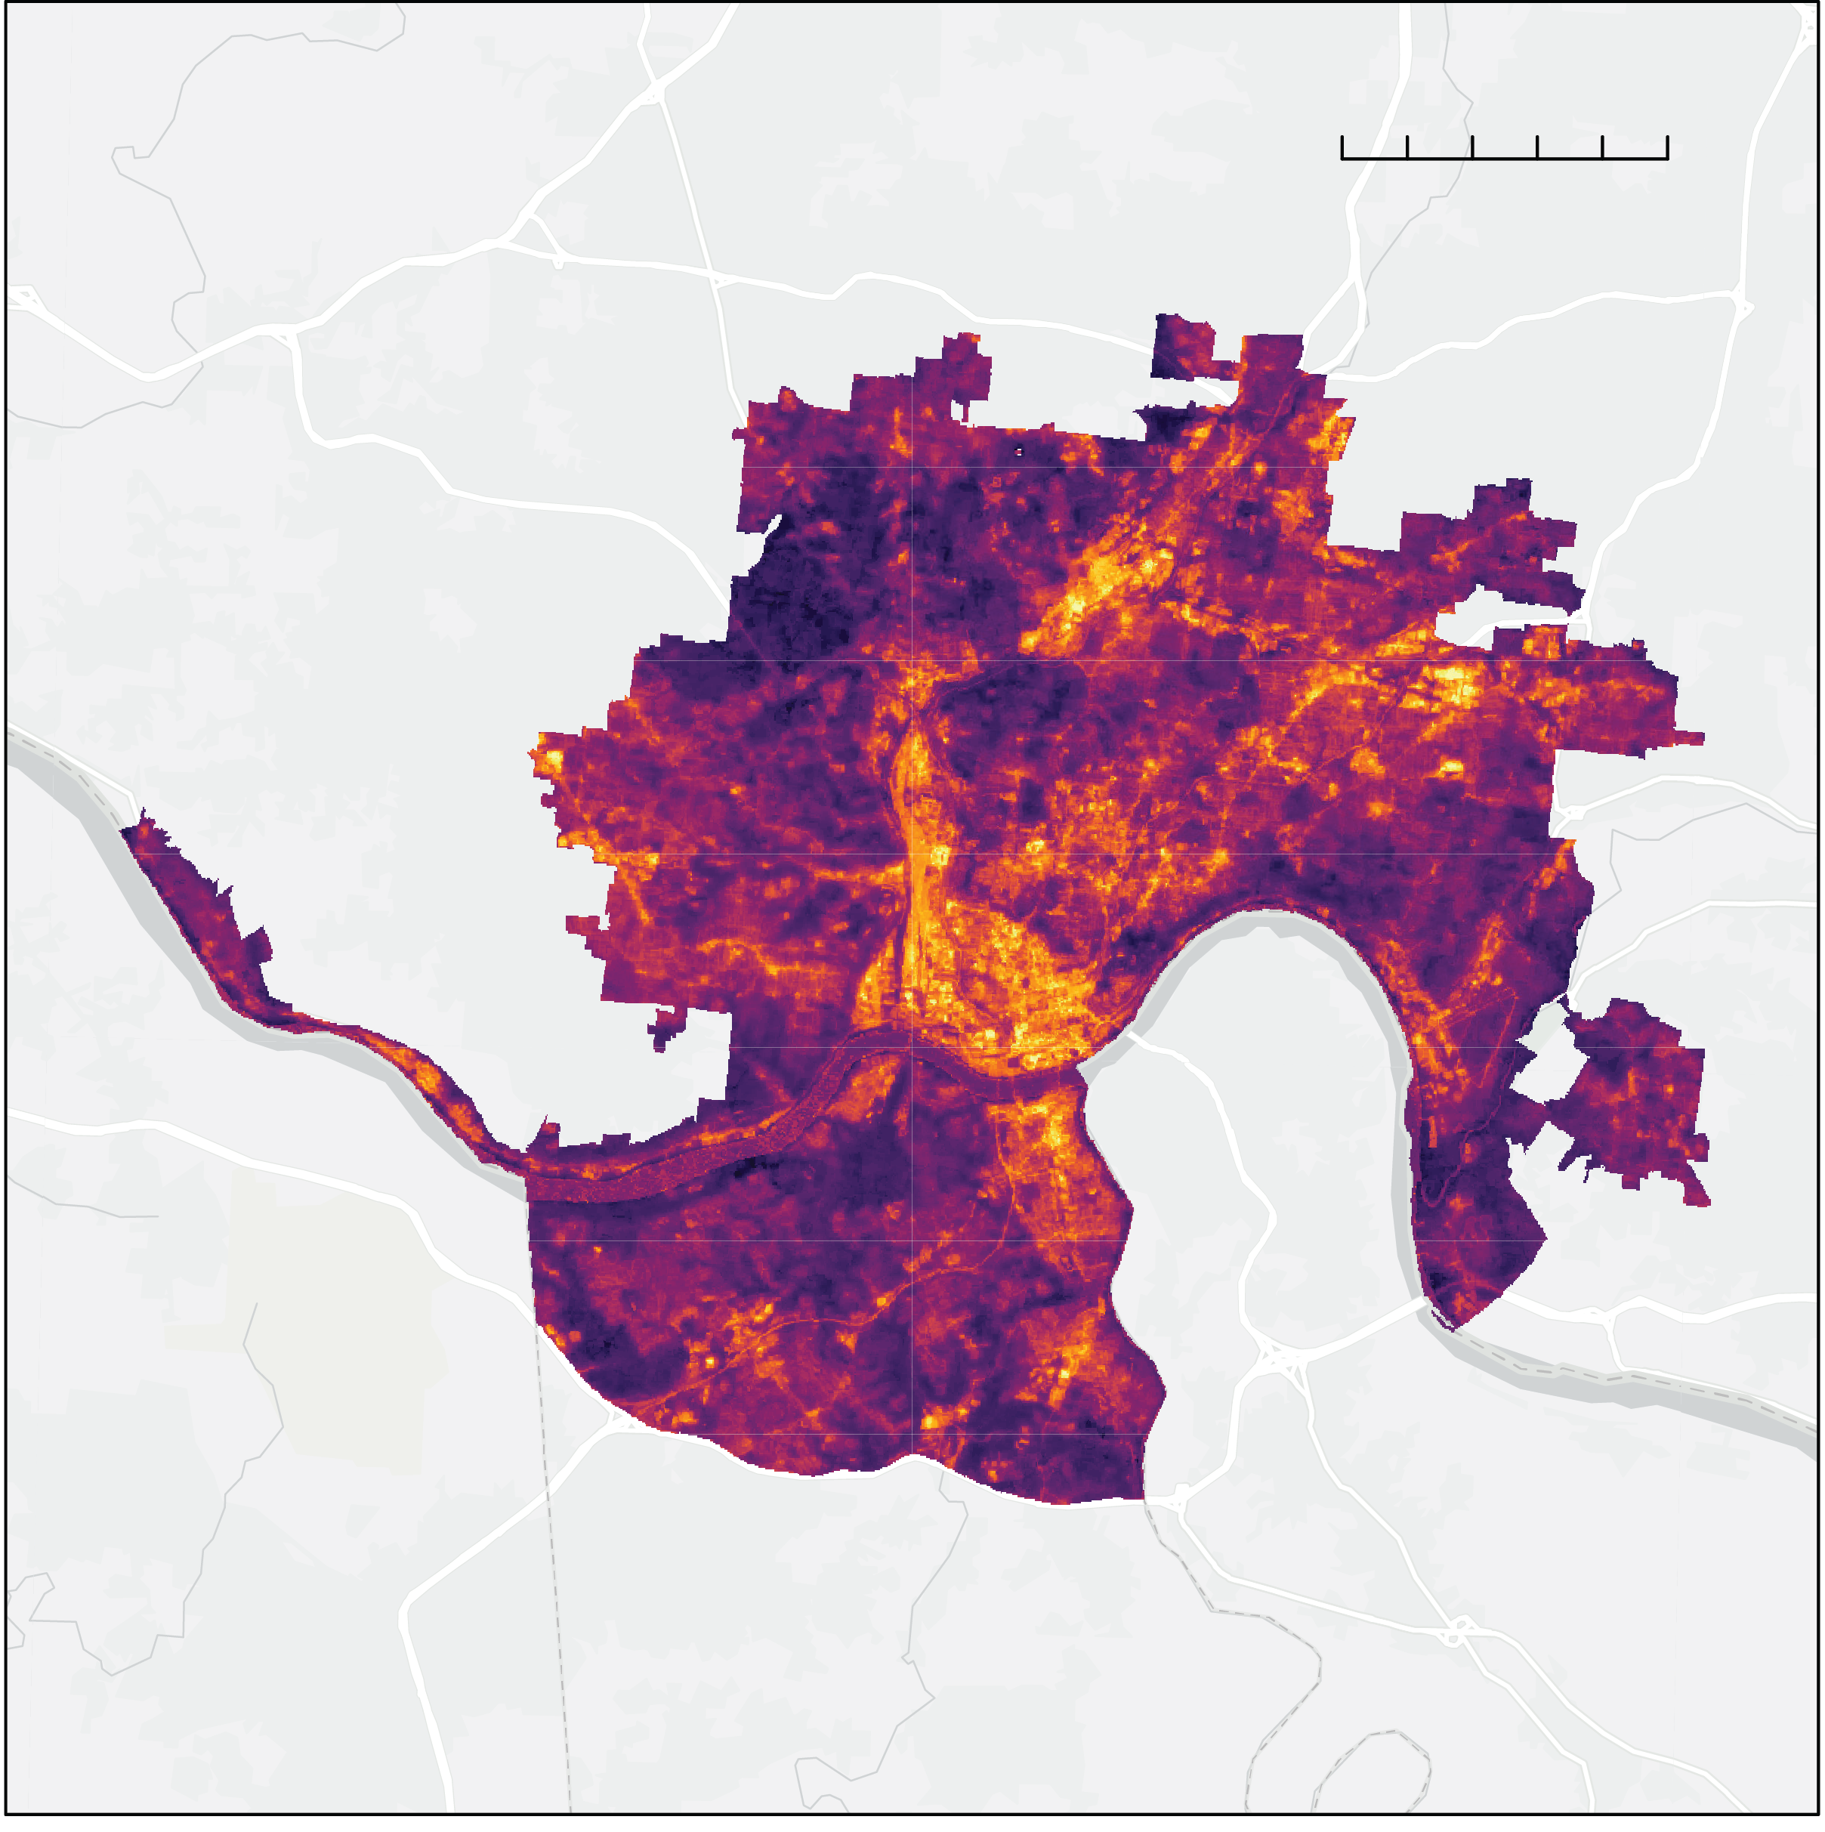
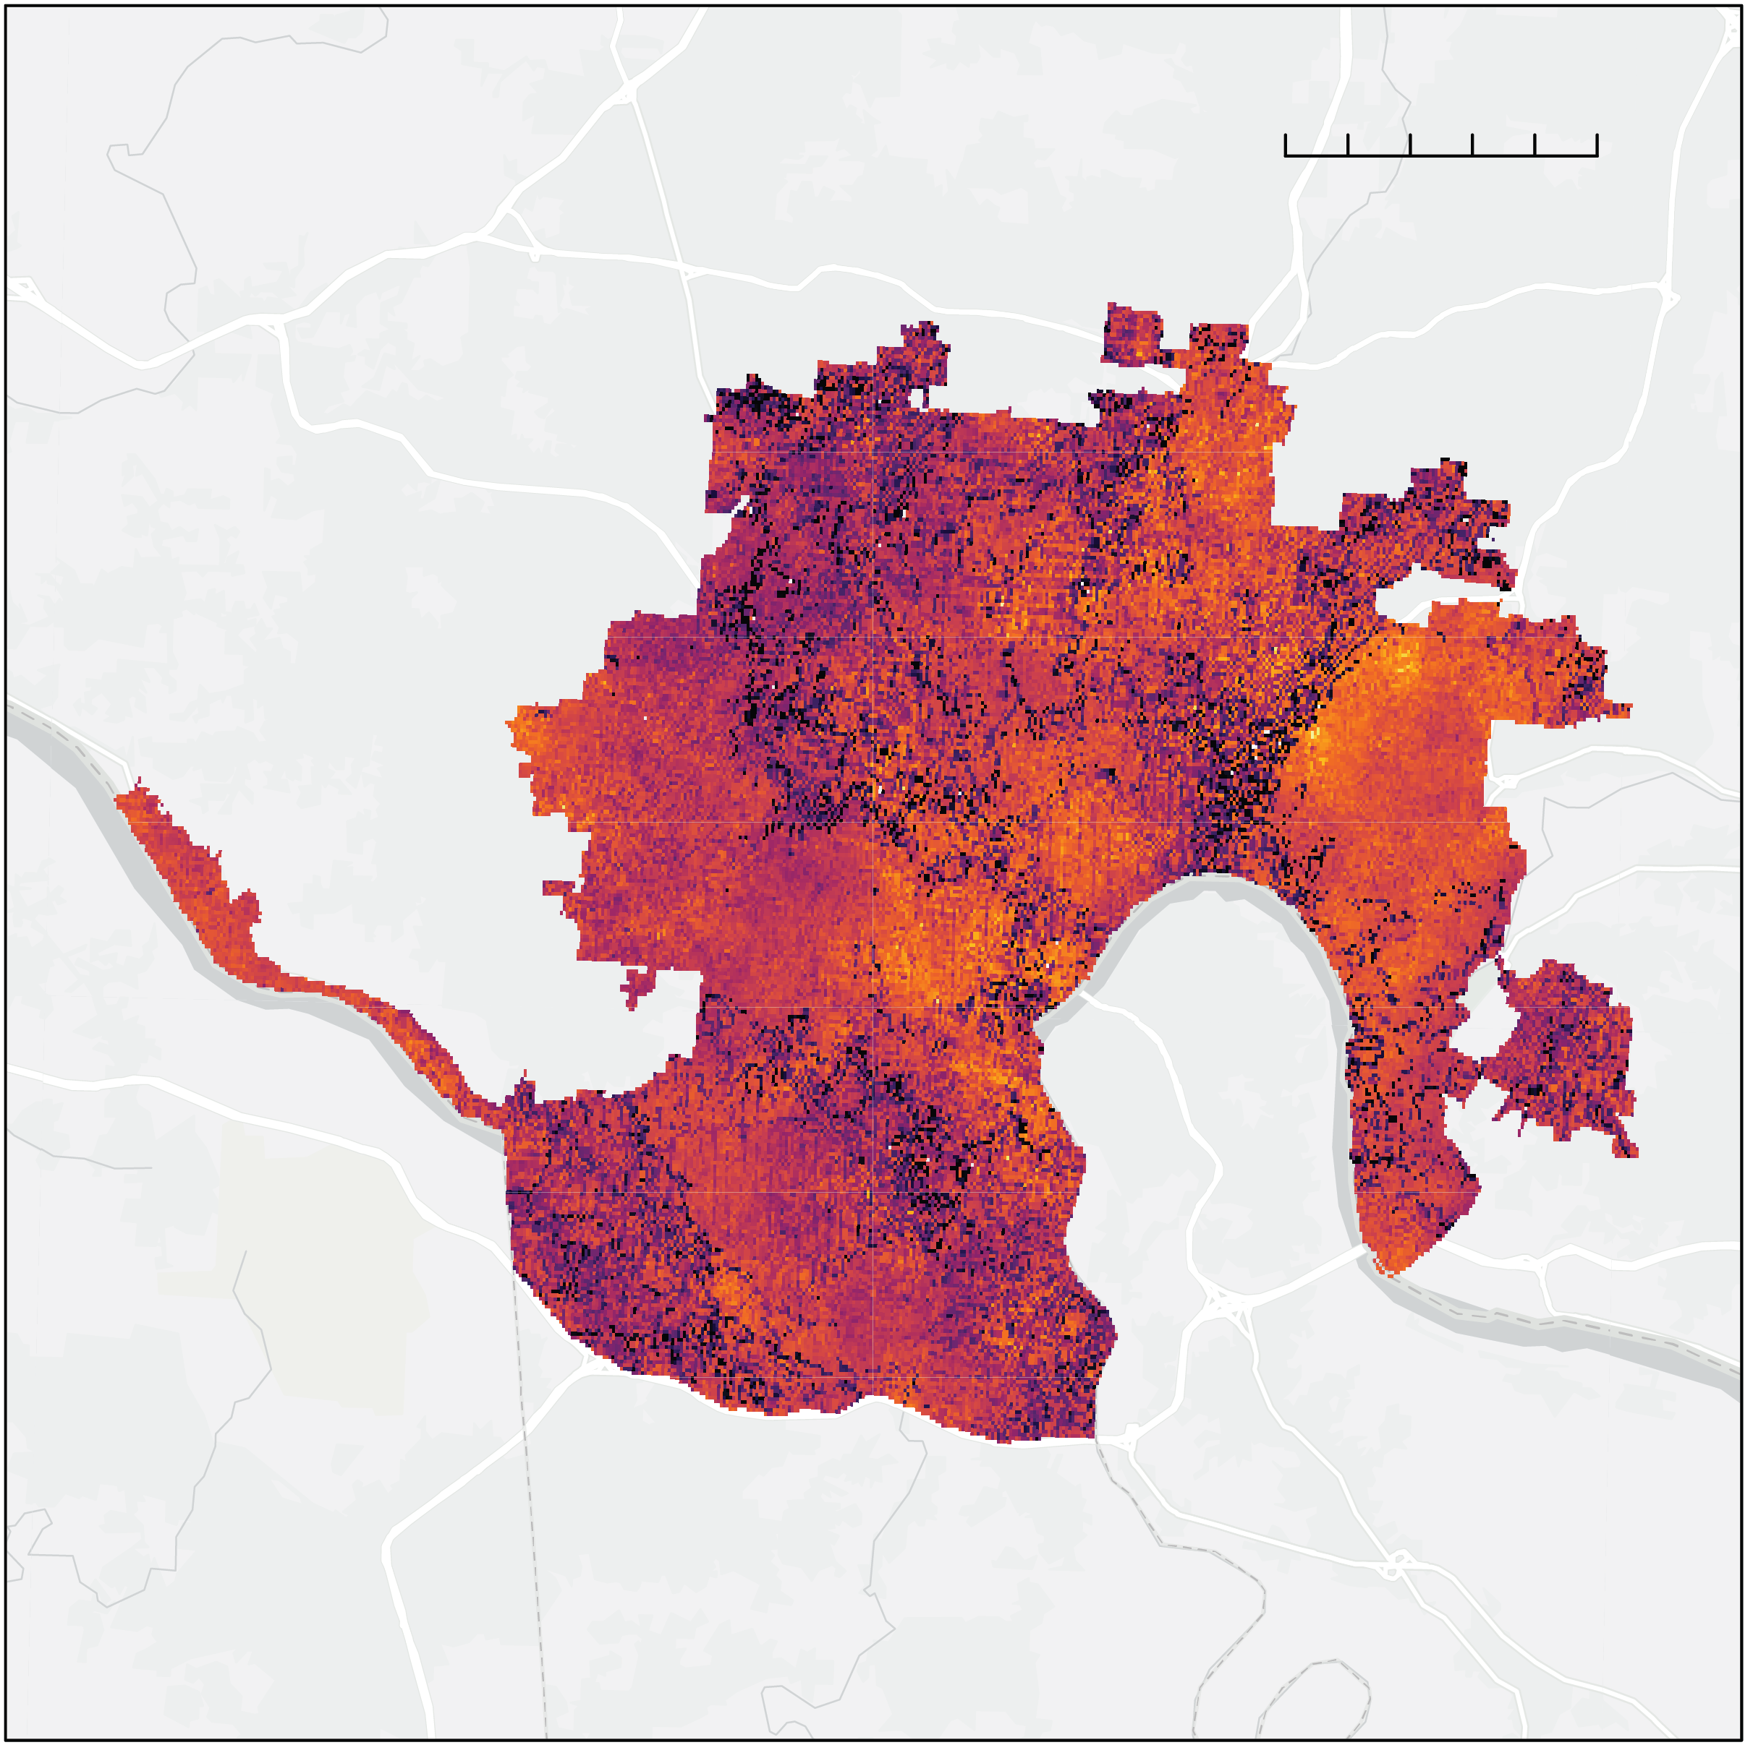

Results: UHI Magnitude
N
0
5 mi
N
0
5 mi
-20
-10
0
10
20
30
-20
-10
0
10
20
30
Average Summer Daytime UHI Magnitude (°F)
Average Summer Nighttime UHI Magnitude (°F)
Notes:
Urban Heat Island magnitude is the difference between the mean rural reference temperature and the mean temperature observed in the city. The rural reference temperatures were calculated using the reference polygons of green spaces outside of the study area boundaries. We can see that areas that are classified as developed land cover experience an average temperature much greater than the mean temperature of the surrounding areas.
The magnitude of the urban heat island within the area was calculated to consider both daytime and nighttime temperatures within the summer months (June, July, and August) of the study period. We can see that even during the nighttime, temperatures in the most developed areas of the Cincinnati and northern Kenton County study area are up to 30 degrees F hotter than their non-urban counterparts outside of the city limits.
------------------------------Image Information Below ------------------------------
Study area base layer: Esri, HERE, Garmin, SafeGraph, METI/NASA, USGS, EPA, NPS, USDA

Slide 12
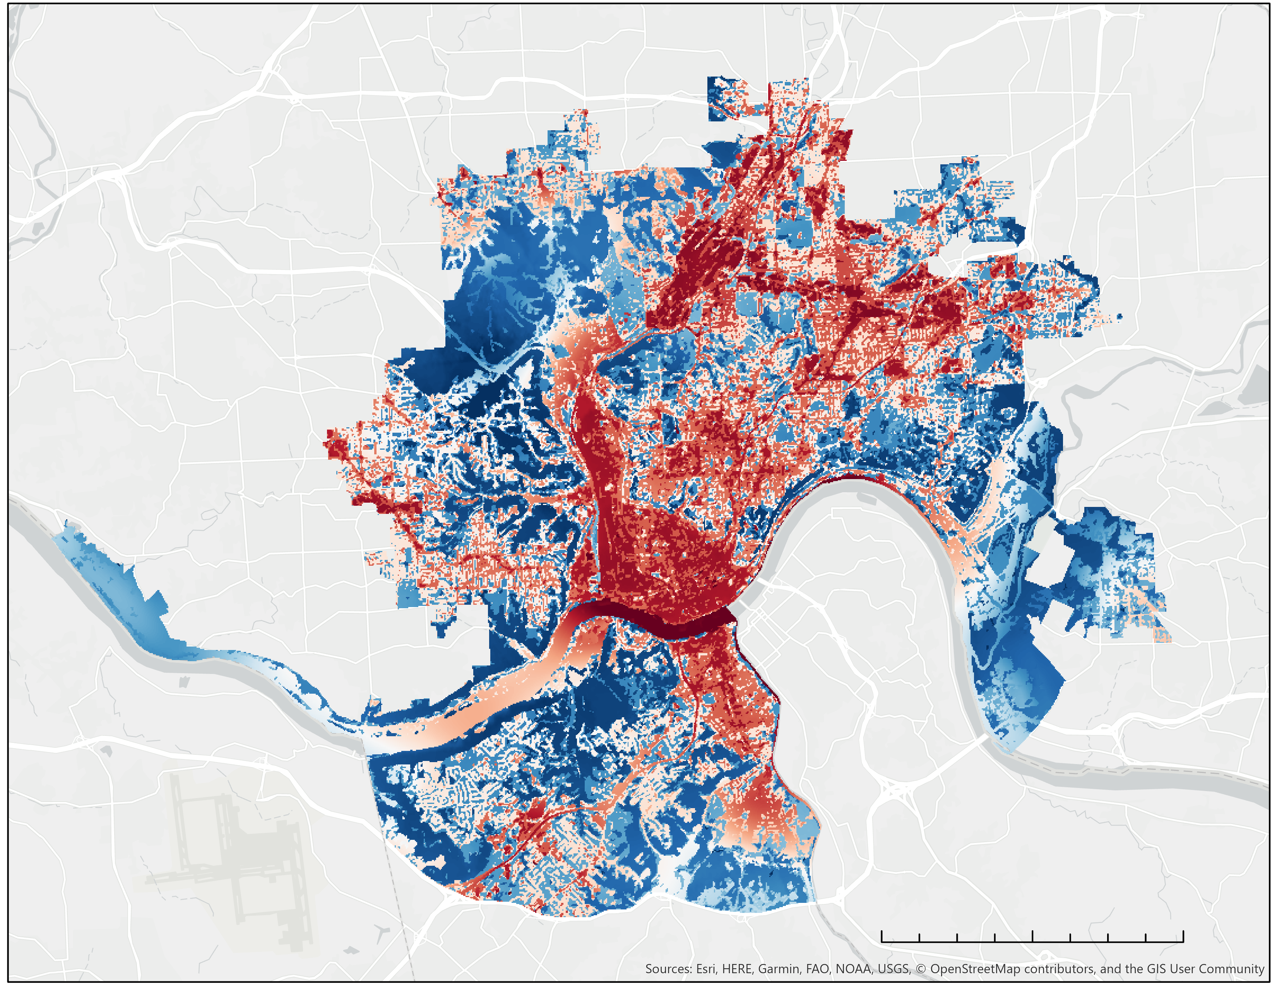

Results: Heat Mitigation Index
N
0.75
N
Open Space
0.5
Low
Medium
0.25
High
Open Water
Wetlands
Forest
Shrub/Grass
Agriculture
0
2.5
5
mi
Barren Land
Daytime Heat Mitigation Index
0
2.5
5
mi
Land Cover
Notes:
The heat mitigation index assesses the ability for an area to regulate temperature by vegetation and is the primary output of the InVEST Urban Cooling Model. Areas that have a high heat mitigation index will be more resilient to the higher temperatures associated with the Urban Heat Island. Heat mitigation is represented on a unitless scale, with 0 corresponding to areas with the lowest heat mitigation score and 1 corresponding to areas with the highest heat mitigation score.
Heat mitigation is calculated based on the presence of green space and its size and proximity to other land use categories. We can see the relationship between heat mitigation index and land cover. The daytime heat mitigation index map shows the areas in dark red with the lowest capacity to mitigate the effects of intense urban heat, which corresponds with the highly developed areas in the land cover map. However, the heat mitigation index map accounts for the cooling effect of green spaces on these developed areas.
------------------------------Image Information Below ------------------------------
Study area base layer: Esri, HERE, Garmin, SafeGraph, METI/NASA, USGS, EPA, NPS, USDA

Slide 13
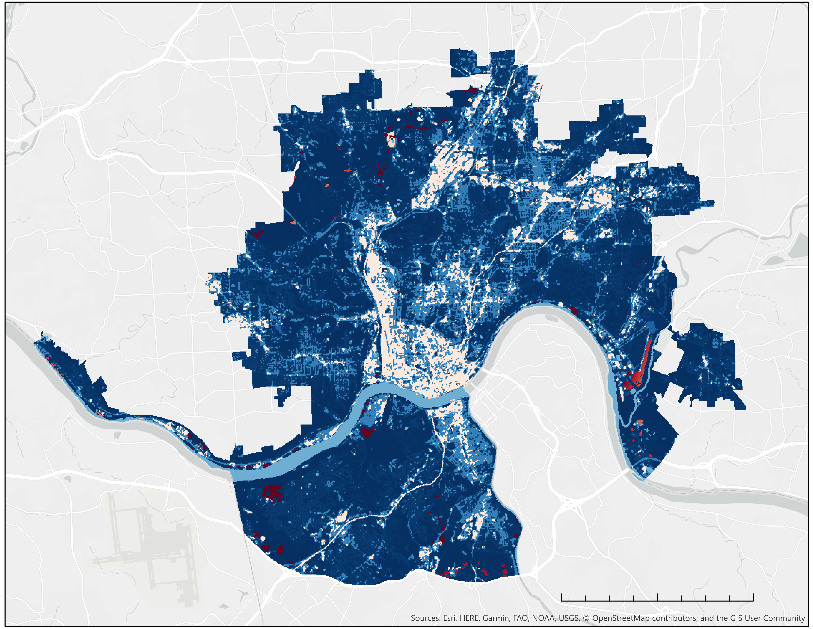
Results: Heat Mitigation Index
0.75
N
0.75
N
0.5
0.5
0.25
0.25
0
2.5
5
0
2.5
5
mi
mi
Daytime Heat Mitigation Index
Nighttime Heat Mitigation Index
Notes:
When compared to nighttime heat mitigation, we can see that the green spaces are significantly cooler, and urban areas far from significant green space are retaining heat. This can help give context to urban planners regarding the extent of the effect of current green spaces, and can help target areas best suited for improvements. These results demonstrate the importance of open green spaces for urban heat mitigation.
------------------------------Image Information Below ------------------------------
Study area base layer: Esri, HERE, Garmin, SafeGraph, METI/NASA, USGS, EPA, NPS, USDA

Slide 14
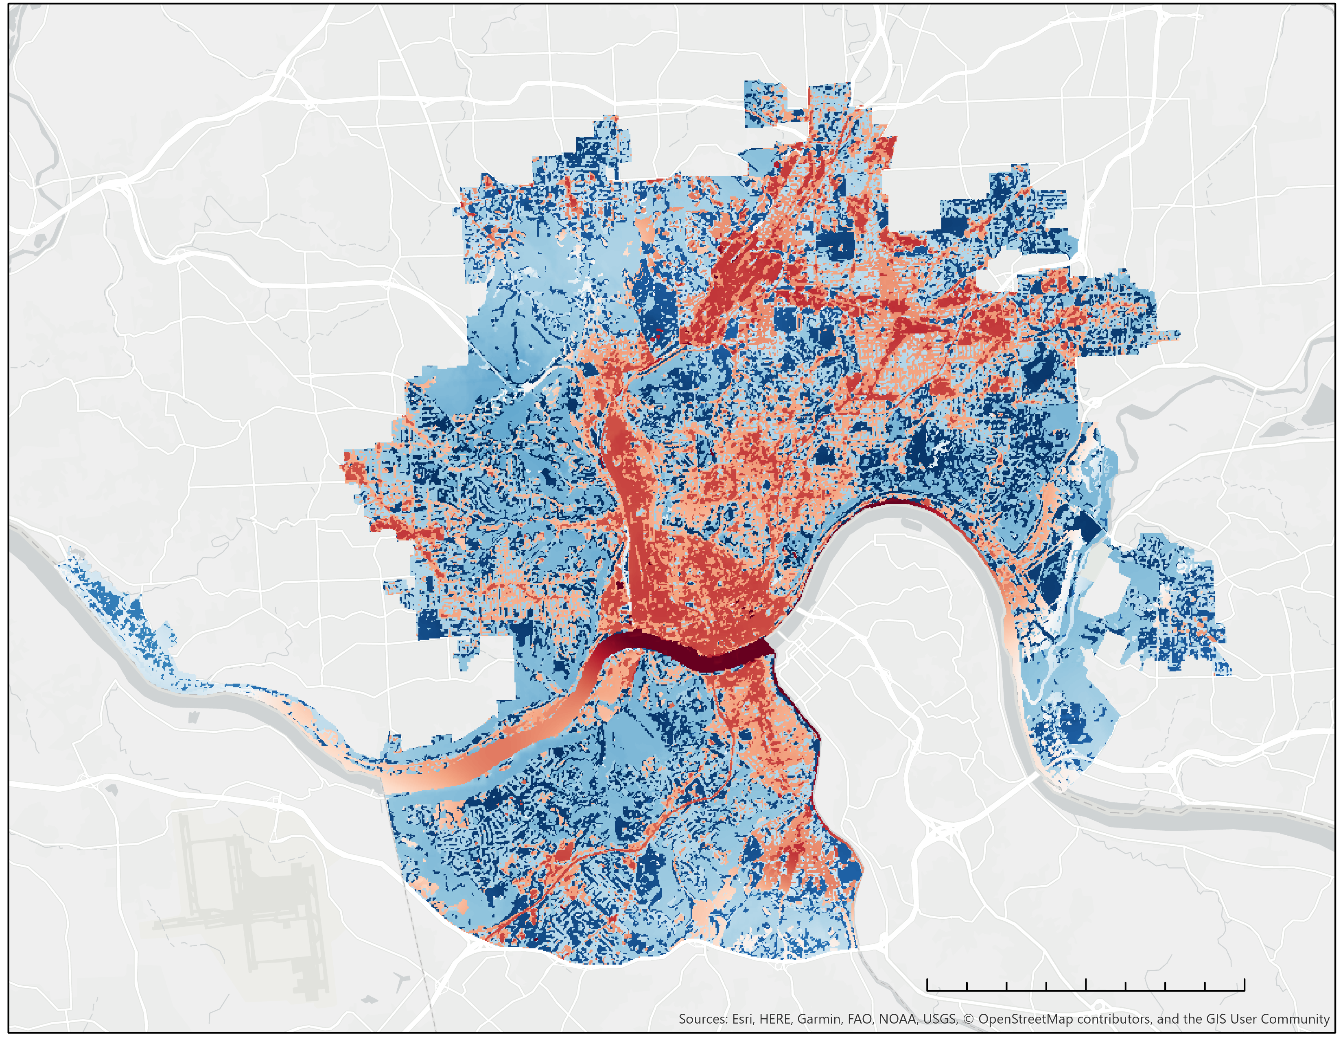
Results: InVEST Tree Canopy Scenario
0.75
N
0.75
N
0.5
0.5
0.25
0.25
0
2.5
5
0
2.5
5
mi
mi
Current Daytime Heat Mitigation Index
Daytime Heat Mitigation Index
Scenario: 25% Tree Canopy Cover Increase
Notes:
We ran an alternate scenario with our data to determine the effectiveness of the InVEST model for predicting outcomes of potential heat mitigation strategies. In this scenario, we decided to analyze the impacts of increasing tree canopy cover across only the developed area by a total of 25%. However, we made the tree canopy cover increase more realistic by increasing the tree canopy cover for each developed land use class by different amounts. We assumed that it would be easiest to increase tree canopy cover in open developed areas, and hardest to increase tree canopy cover in highly developed areas. Therefore, we increased the tree canopy cover in open developed areas by 35%, low developed tree canopy cover by 31%, medium developed tree canopy cover by 14%, and high developed tree canopy cover by 10%. These percent increases were determined by a model that weighted the proportion of developed tree canopy cover in each developed class.
------------------------------Image Information Below ------------------------------
Study area base layer: Esri, HERE, Garmin, SafeGraph, METI/NASA, USGS, EPA, NPS, USDA
InVEST shows us the impact increasing tree canopy cover in our specified areas has on heat mitigation. Specifically, current vulnerable areas such as Norwood and downtown areas are able to better mitigate heat with small canopy cover changes. Additionally, the InVEST model can be manipulated to model other mitigation strategy impacts, including adding green space, implementing white roof policies, and other changes to tree canopy cover.

Slide 15
Conclusions
1
Mapping UHI magnitude and the heat mitigation index allows urban planners to identify communities most at risk for impacts from urban heat
2
Increasing tree canopy cover by 25% across the Cincinnati and Covington area increased the average heat mitigation score from 0.49 to 0.56
3
On average, the Cincinnati and Covington area is 8.32°F warmer during the day and 4.97°F warmer during the night compared to non-urban areas
Notes:
Our results help our partners provide information to local communities, and allow our partners to make informed decisions to help mitigate the environmental, economic, and social inequalities cause by urban heat islands within marginalized communities. We were able to determine areas in Cincinnati and Northern Kenton County that have great potential for mitigation strategies, such as developing new green spaces or converting roofs to white roofs as shown through scenarios created in the InVEST model.
Our results also showed that when compared to the land use land cover data, we could identify clear trends of high intensity urban land use corresponding to high daytime and nighttime urban heat. Meanwhile, land use such as forested areas or parks maintained consistently cooler temperatures and offered cooling effects to surrounding urban area.
Finally, we found that our methodologies indicated continuously higher temperatures in the urbanized areas of our study region compared to the reference polygons, and we were able to visualize the areas most impacted by this constant heat. Partners will be able to use these methods to identify communities at greatest risk of UHI health impacts, and make recommendations based on scenarios.

