Slide 1
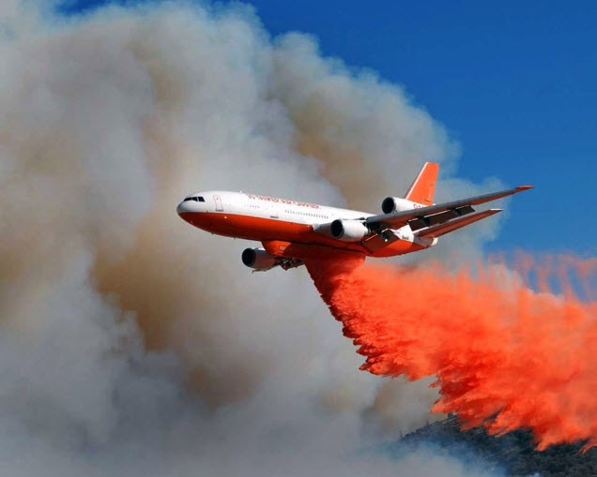

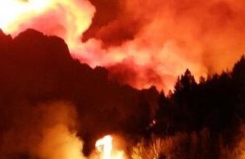
Wildfire Related Potential R&D Opportunities
Parimal Kopardekar and Laurie Grindle
TFRSAC, 2021
1

Slide 2
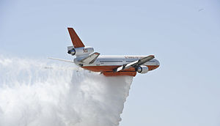
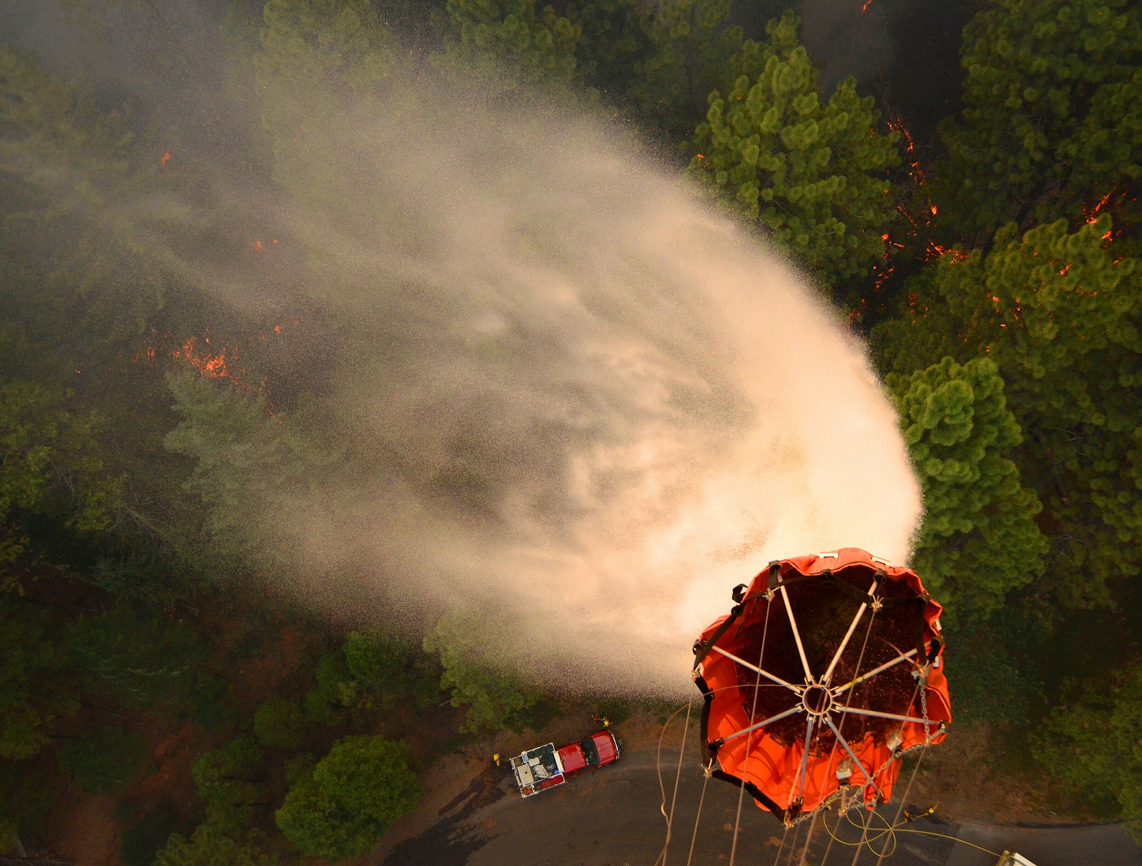
Outline
Part 1: Introduction
Part 2: Observations from Needs Assessment
Part 3: Potential Next Steps & Summary

Slide 3
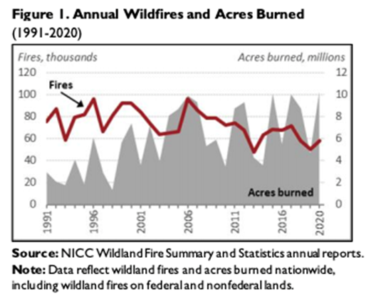
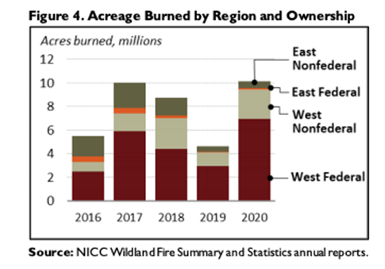
Wildfire Statistics
Total suppression costs
  5-year average $2.351B
  10-year average $1.910B
10-year average
  20,510 fires
  1,048,649 acres
2020 Statistics
  58,950 fires and 10,122,336 acres
https://fas.org/sgp/crs/misc/IF10244.pdf
https://www.nifc.gov/fire-information/statistics

Slide 4
Outline
Part 1: Introduction
Part 2: Observations from Needs Assessment
Part 3: Potential Next Steps & Summary

Slide 5

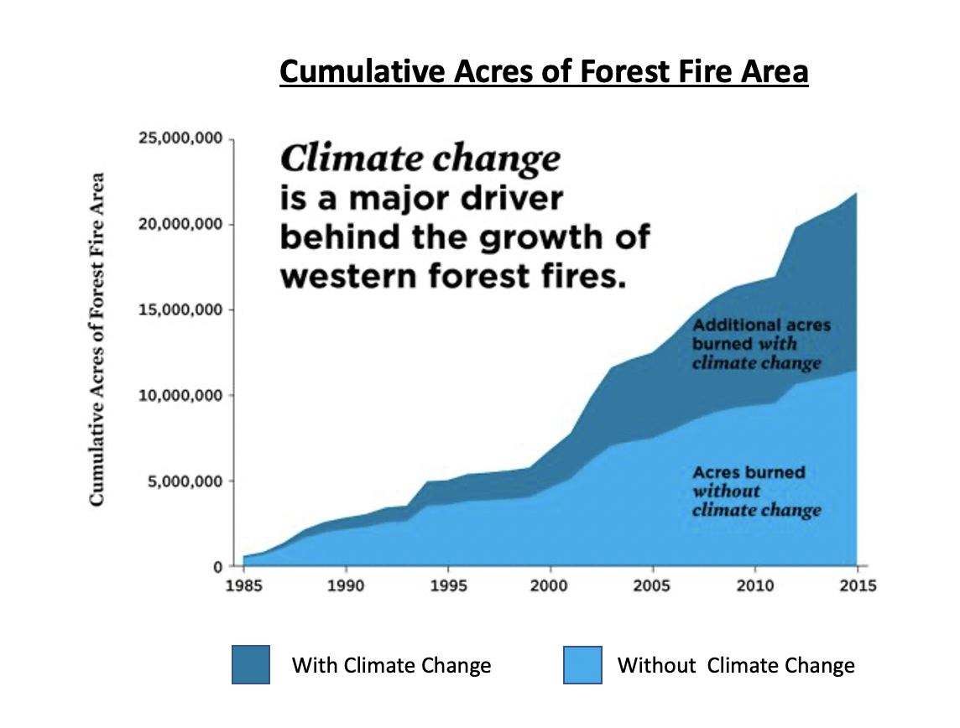
Subsequent observations are based on workshop, SME inputs, literature review, RFI and questionnaire inputs
22 M
11 M
https://www.ucsusa.org/resources/infographic-wildfires-and-climate-change
5

Slide 6
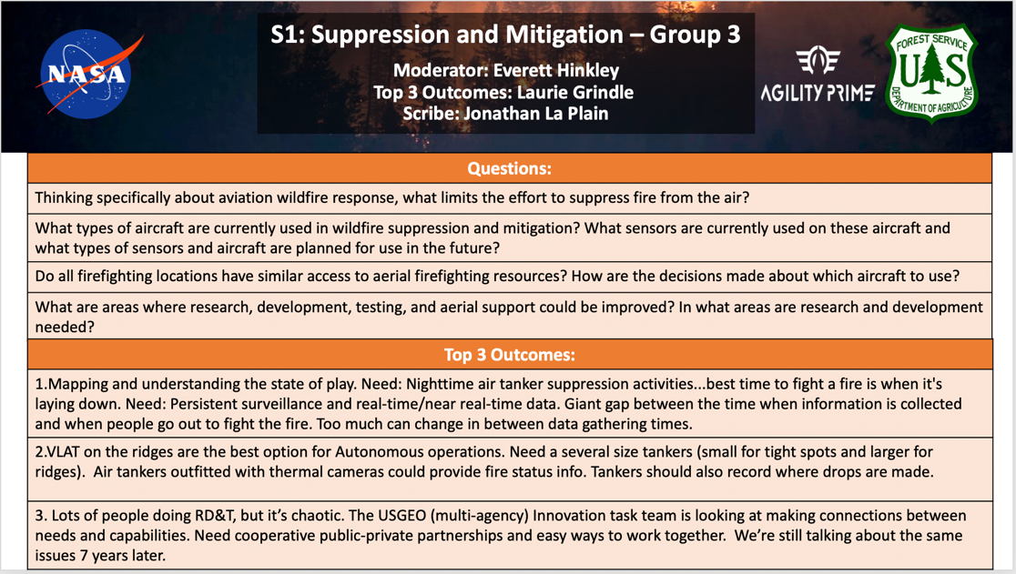
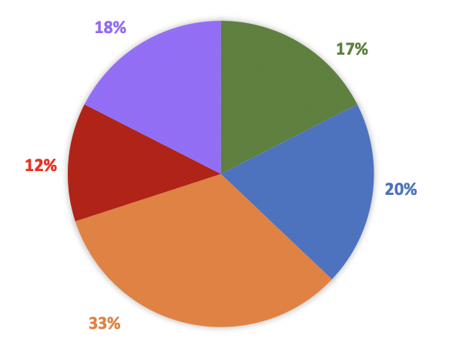
Workshop Goals, Objectives, and Approach
Understand the comprehensive needs of wildfire management
Identify the needs and challenges of stakeholders at various decision cycles from planning, prediction, detection, tracking, mitigation, suppression, and post-fire remedial efforts
  Spans near-term (< 3 years), mid-term (3 – 7 years), and long-term (10+ years) needs
  Needs will reflect the various agencies and roles that are involved in wildfire management
Breakout sessions are the means to gather needs and hear directly from the wildfire community
Topic Attendees (154)
Planning for Fire Season
Prediction Modeling and Challenges
Aerial Fire Surveillance
Suppression and Mitigation
Post-Fire Remedial Efforts

Slide 7
RFI & Questionnaire
Purpose: To aid NASA in gaining insights from the stakeholder community regarding potentially relevant technologies and capabilities
Key Challenges:
  Funding
  Data Management & Availability
  Collective Access to Higher Resolution and Improved Real-Time Wildfire Data
  Seamlessly Integrated Equipment to View and Understand Relevant Data
  Real-Time Communications for Collaborative Decision Making
  Vehicle Capabilities (e.g., VTOL for suppression) and Integrated Sensors
  Relevant and Consistent Standards and Regulations
  Security and Reliability of Internet Infrastructure
  Wildfire Management Community Buy-In

Slide 8
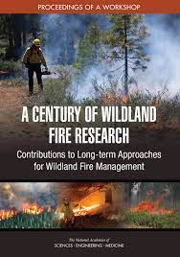
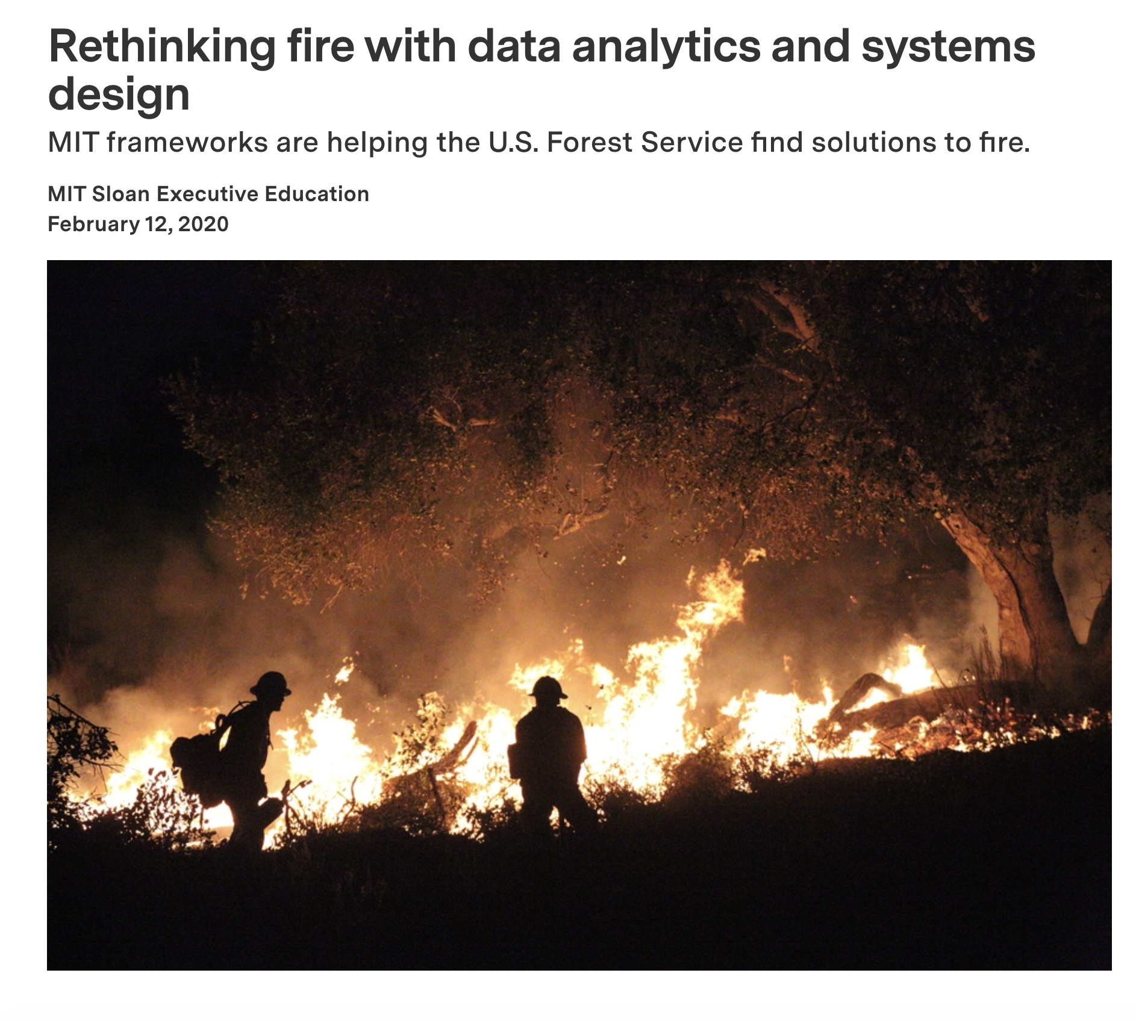
Observations: Crosscutting
Comprehensive Concept of Operations
  Multi-agency comprehensive concept of operations could help unify focus, create necessary agency partnerships, and leverage resources
  Metrics of effectiveness, roles/responsibilities, and an agreed-upon roadmap
Systems Thinking/Engineering Approach
  Many stakeholders, many requirements, and reliable system performance is critical
Partnership for Successful Research to Reality Transition
  Products need to have higher TRL to be useful in operational settings
  Partners among government, state, local, industry, philanthropic organizations, and private entities are critical for resources in the life cycle

Slide 9

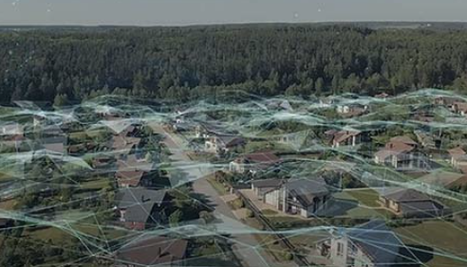
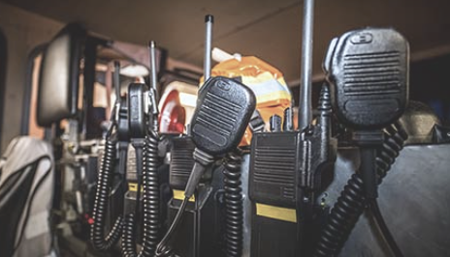
Observations: Technology
Wildfire R&D Related Opportunities
Persistent Surveillance
  Satellite based surveillance is infrequent and gets hindered if there is cloud cover
  Need additional small satellite constellation (being pursued with private funding)
  Need high altitude long endurance platforms for both surveillance and communications
Persistent Communications
  Continuous communications regardless of location
  Firefighters, incident commanders, airspace coordinators, etc.
9

Slide 10
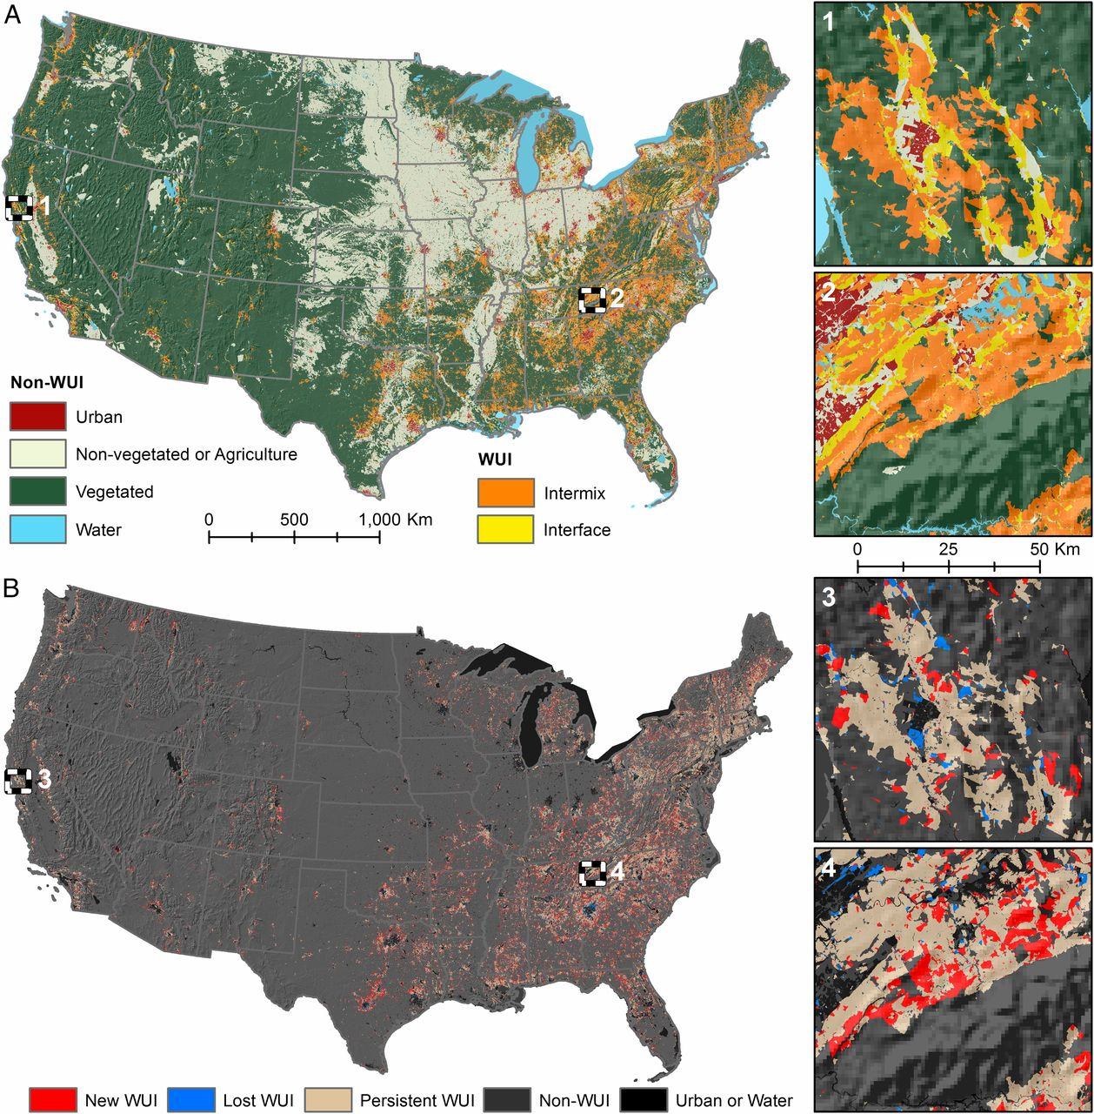
Observations: Technology
Wildfire R&D Related Opportunities
Cooperative Airspace Management for Manned and Unmanned Operations
  Ability to share airspace by heterogeneous aircraft types in a safe manner is key to real-time information about fire and tracking
Aerial Wildfire Fighting Duration
  Current aerial wildfire operations are confined to largely VMC and would benefit from expanding to 24X7
10

Slide 11
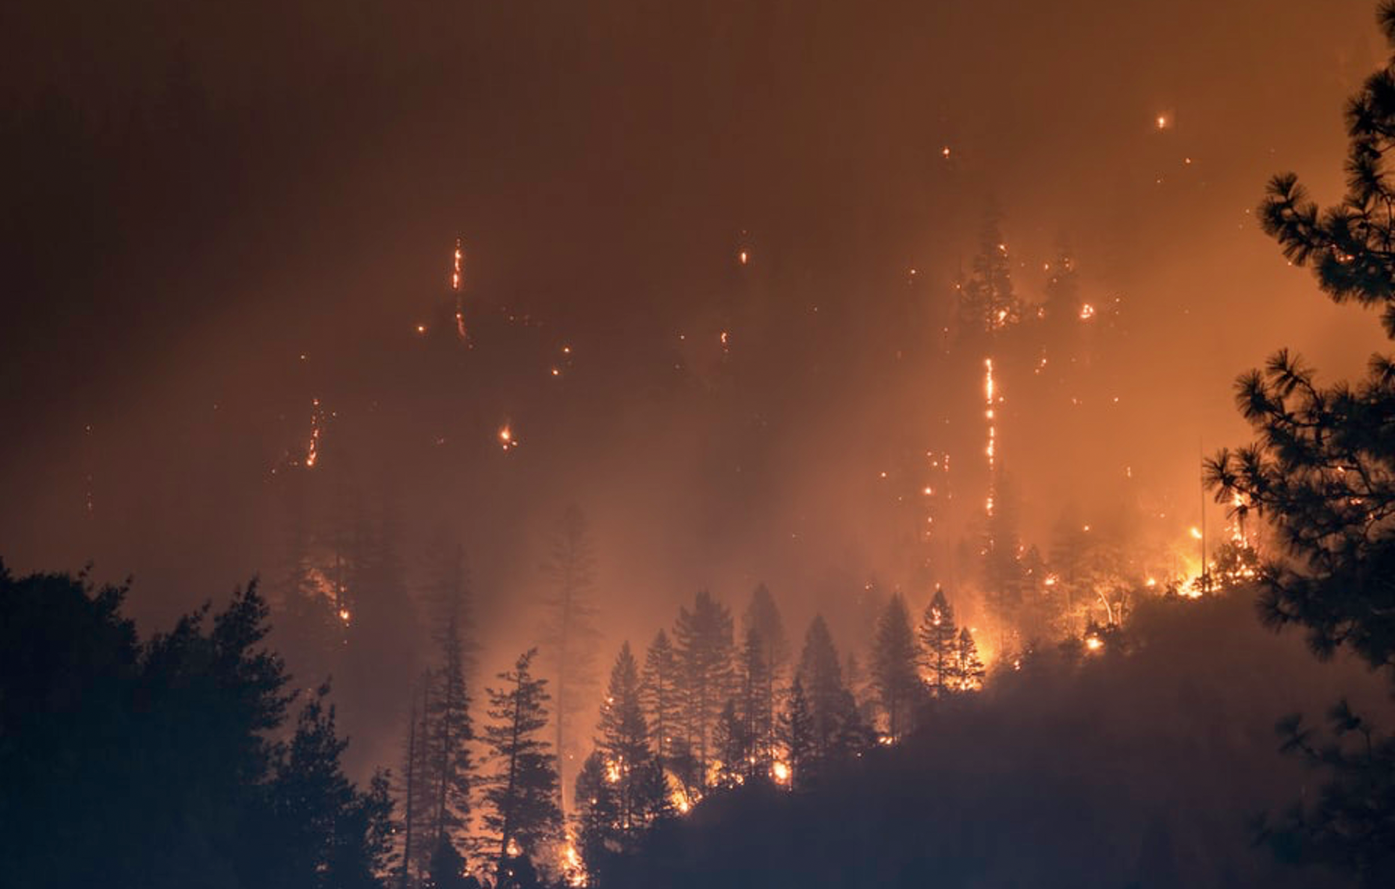
Observations: Technology
Wildfire R&D Related Opportunities
Future Aircraft and Fleet Suitability
  Nature of wildfire fighting is changing (e.g., ridges, valleys, near wildland urban interfaces (WUI), etc.)
  Analysis of aircraft and fleet requirements to support emerging needs (e.g., autonomous aircraft, eVTOL, etc.)
  Also related to persistent surveillance
  Ensure highest safety and efficiency of operations
  Aerial firefighting accidents (e.g., Arizona this week)
11

Slide 12
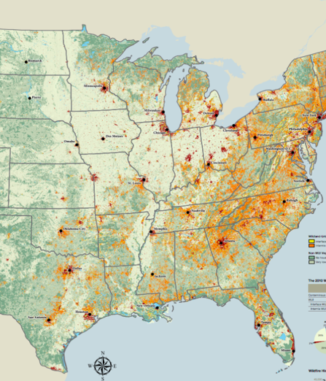
Observations: Technology
Wildfire R&D Related Opportunities
Data and Models Inventory Analysis
  Assess gaps and overlaps
  Many data sources and models, but not integrated, unified, or interoperable
  On site integrated information that is easy to use and accessible is key for firefighters and incident commanders
  Integration and interoperability is not easy without standards
  Machine Learning (ML) and predictions
12

Slide 13
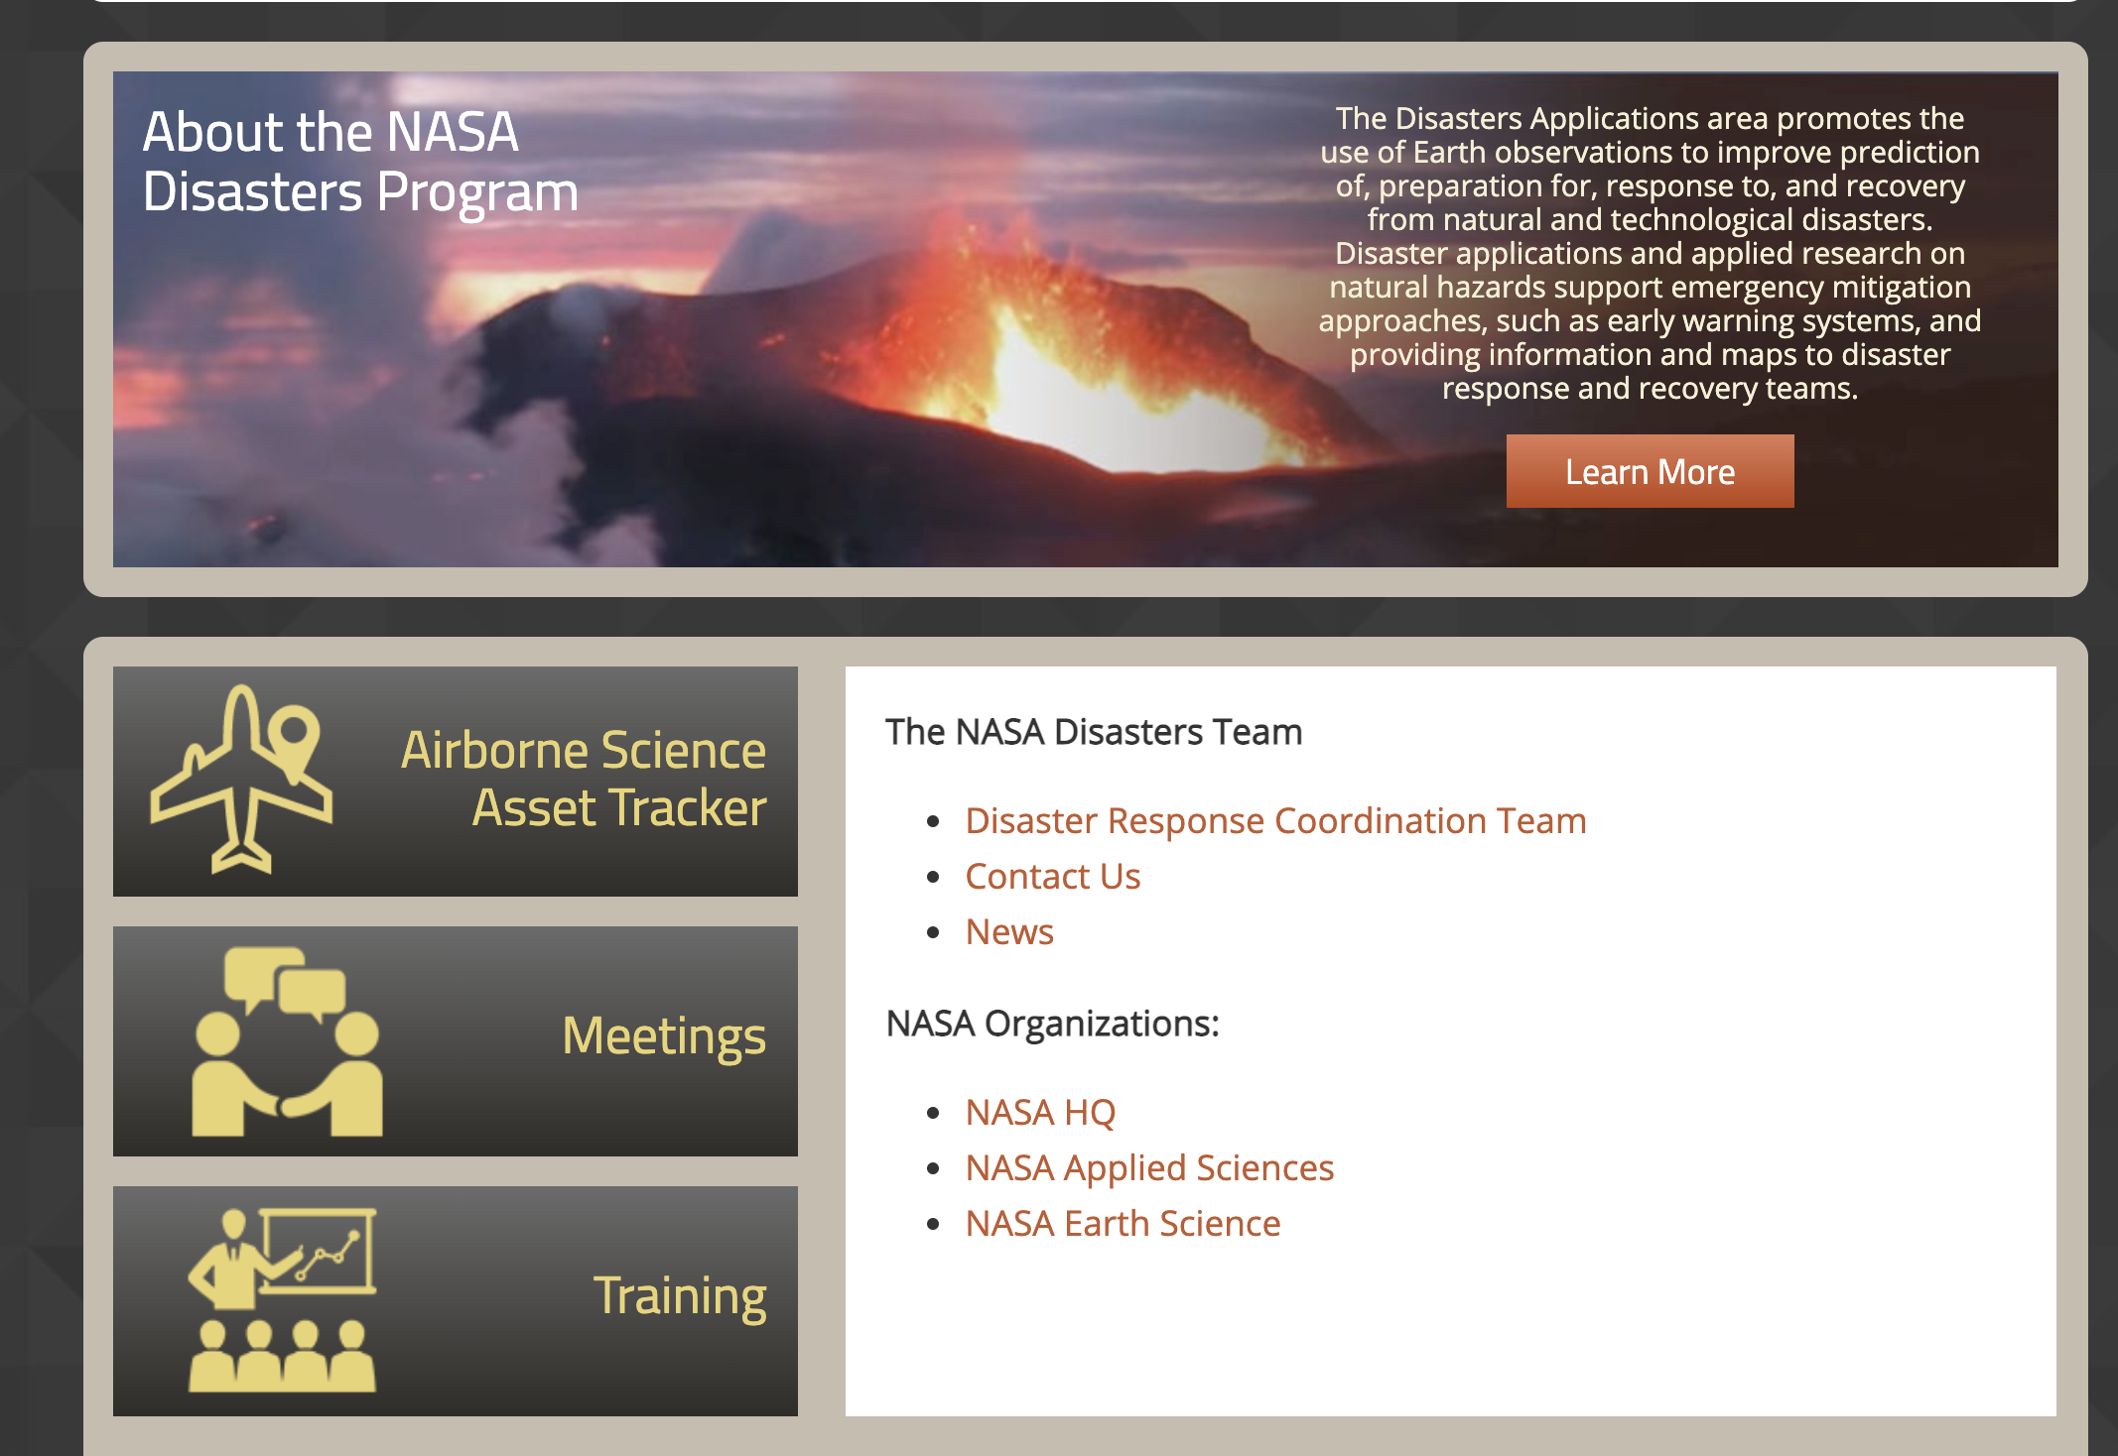
Observations: Internal Collaboration
Wildfire R&D Related Opportunities
SMD: Data sources and access to satellite data
  Rich collection of disaster data and models
  New initiatives, e.g., Earth System Observatory, present good opportunities for ARMD collaboration
  Sensor fusion
  Satellite and HALE use for surveillance
STMD: Prizes, competitions, SBIRs and STTRs
  ARMD could identify wildfire management subjects to pursue
13

Slide 14
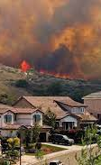
Observations: Partnership Opportunities
Wildfire R&D Related Opportunities
Public-Private-Philanthropy-Partnership (P4)
Government, industry, academia, state/regional, non-profits
Two key areas:
  Technology maturity from TRL 4/6 through TRL 9
  Operationalization of technology in the hands of users
14

Slide 15
Outline
Part 1: Introduction
Part 2: Observations from Needs Assessment
Part 3: Potential Next Steps & Summary

Slide 16
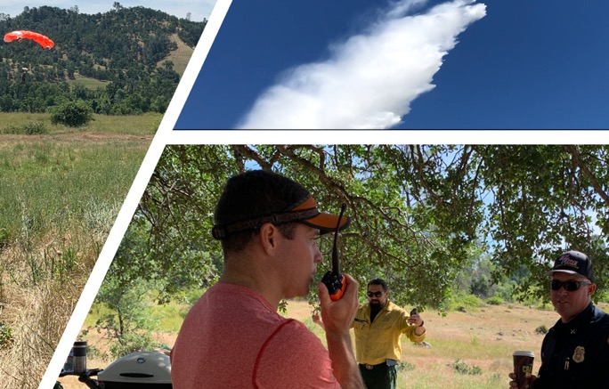
Potential Next Steps & Summary
Wildfire R&D Related Opportunities
Interagency working group focused on concept of operations
Based on approved budget, project will be formulated to focus on key areas: enhanced surveillance and communication, 24X7 suppression, and aircraft safety
Close coordination with NASA’s Science Mission Directorate and Space Technology Mission Directorate
Close coordination with other govt agencies
Partnership plan
16

Slide 17
BACK UP

Slide 18
Workshop Attendee Organizations

