Slide 1
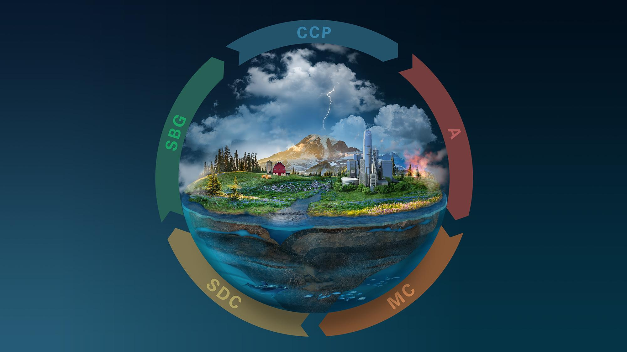

The Next Evolution
of the EOSDIS
Andrew Mitchell
Jeanne Behnke, Tracy Zeiler, Diane Hronek, Mark McInerney
Goddard Space Flight Center
December 17, 2021
AGU Fall Meeting 2021
IN51A-05: Cloud Computing’s Support for Earth and Space Informatics Has Become a Sophisticated Solution to Computing Needs

Slide 2
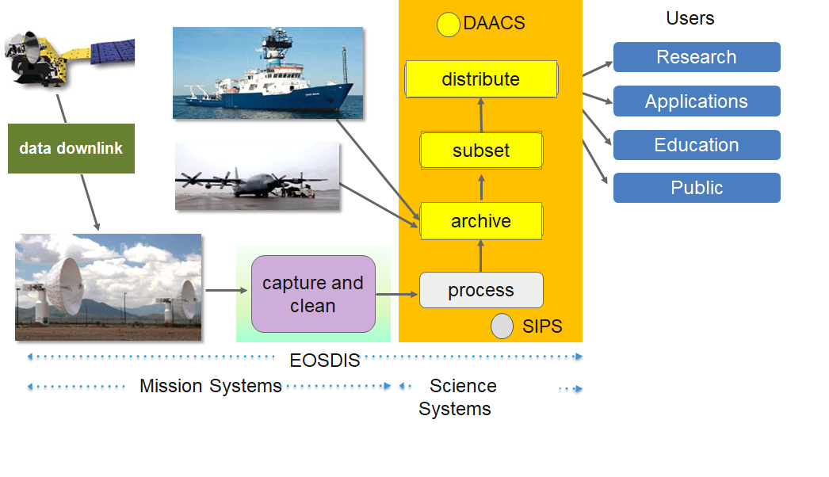
Earth Science Data and Information System (ESDIS)
The ESDIS Project manages the science systems of the Earth Observing System Data and Information System (EOSDIS).
EOSDIS is a comprehensive distributed Earth science data and information system designed to support NASA's Earth science missions.
EOSDIS is designed to ingest, archive, distribute, visualize, all types of Earth Science data which include:
  field campaign measurements, airborne data, in situ data, model data, ancillary products used for processing and other related datasets.
The ESDIS Project provides and controls all aspects of the effort including but not limited to requirements, design, acquisition, development, operations, maintenance and decommission.
International Partners ESA, JAXA
Operating since 1994, it has been evolving to keep pace with technology and users' requirements.

Slide 3
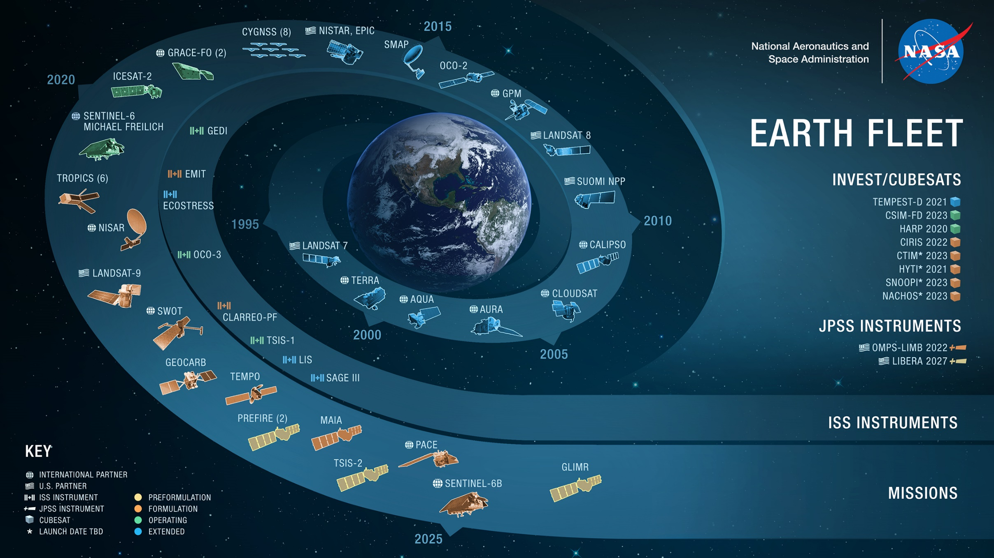
05.25.21

Slide 4
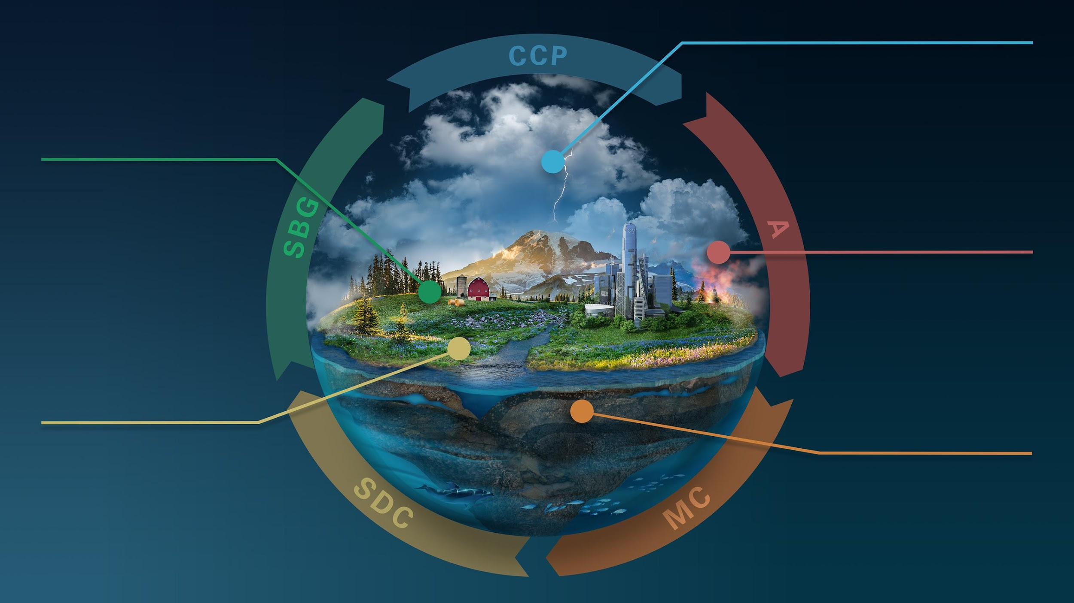
EARTH SYSTEM
OBSERVATORY
CLOUDS, CONVECTION
AND PRECIPITATION
Water and Energy in
the Atmosphere
SURFACE BIOLOGY
AND GEOLOGY
Earth Surface & Ecosystems
AEROSOLS
Particles in the
Atmosphere
SURFACE DEFORMATION
AND CHANGE
MASS CHANGE
Earth Surface Dynamics
Large-scale Mass
Redistribution
Notes:
Making things open earlier in the life cycle of the missions. Earlier stages are critical to scientific process
So when the mission launches there's more community
Slide with different phases of missions
Earth System Observatory – the core of which will be an array of five satellite missions providing key information to guide decisions related to climate change, severe weather and other natural hazards, wildfires, and global food production. We’ll augment the core with Earth Explorer missions, that will be competitively selected to bring innovation and additional key observations to the observatory.

Slide 5
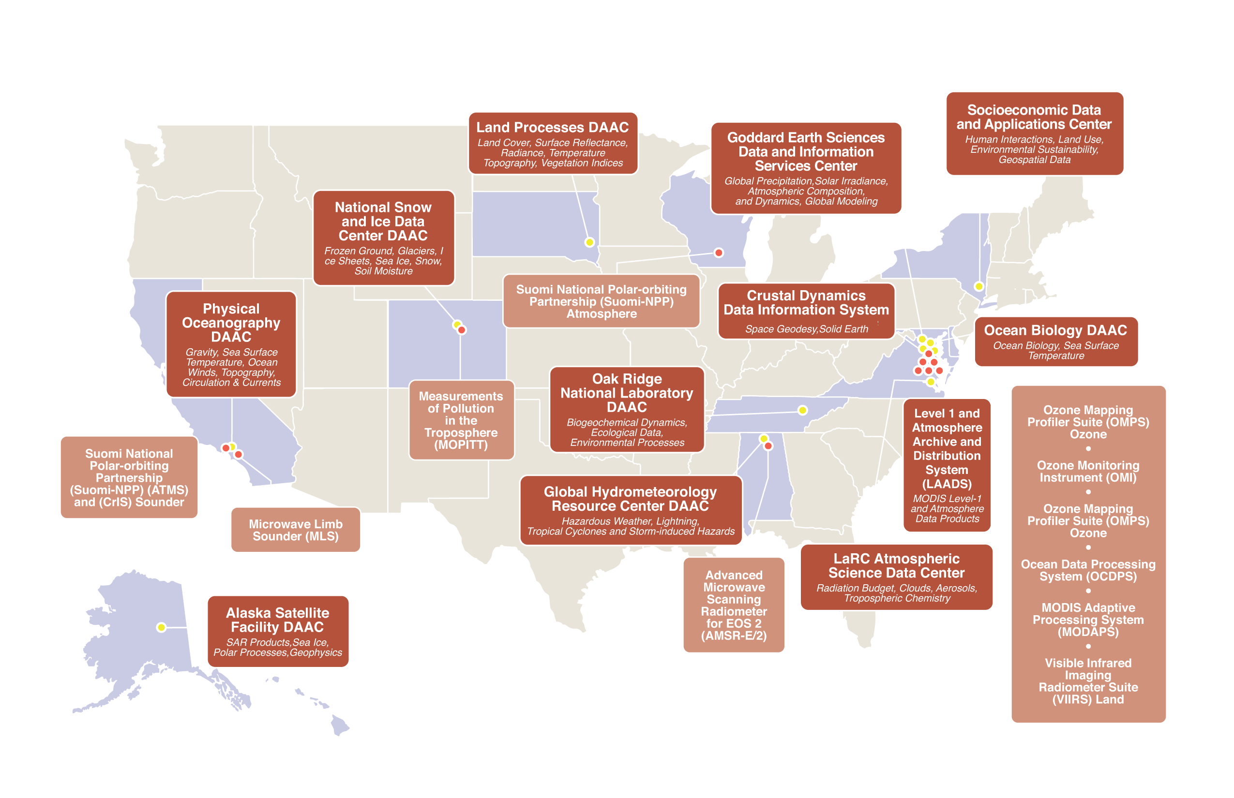
Discipline Specific, Distributed, Active Archive Centers (DAACs)
Science Investigator-led Processing Systems (SIPS)

Slide 6

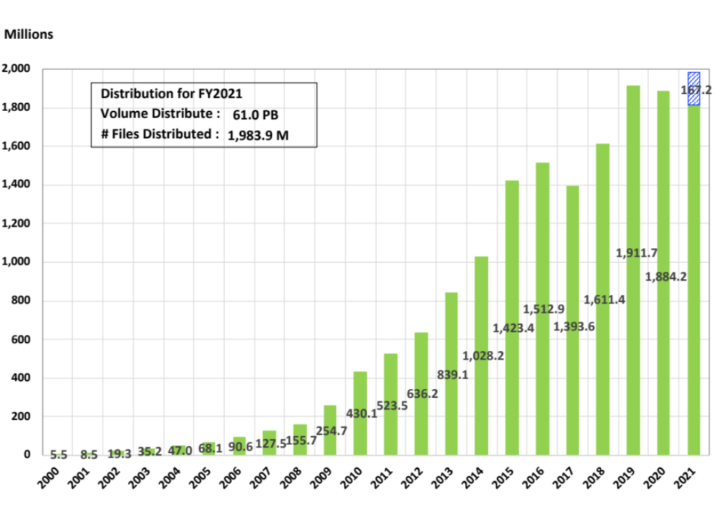
EOSDIS Products Delivered: FY00 thru September 2021
Added in Sep 2021
Fiscal Year
Notes:
As of Feb 2009, all historical data comes from EMS (no EDGRS annual report data for pre-2000) and OBPG data is added from the Ocean Color website statistics for FY04 through FY12.
Prior years (FY00-FY2008) products distribution data sources cover the following data centers:
ASF DAAC, LP DAAC, GES DISC, GHRC DAAC, PO.DAAC, ASDC, NSIDC DAAC, ORNL DAAC, SEDAC, including OBPG* since FY2004, LAADS DAAC since FY2006, CDDIS since FY2009 and LANCE since FY10. All data are on FY boundaries.
FY2011 data is cumulated per month for the following 11 data centers:
ASF DAAC, LP DAAC, GES DISC, GHRC DAAC, PO.DAAC, ASDC, NSIDC DAAC, ORNL DAAC, LAADS DAAC, SEDAC, CDDIS, and LANCE with OBPG* added at end of the fiscal year.
FY2012 data is cumulated per month for the following data centers:
ASF DAAC, LP DAAC, GES DISC, GHRC DAAC, PO.DAAC, ASDC, NSIDC DAAC, ORNL DAAC, LAADS DAAC, SEDAC, CDDIS and LANCE; OBPG* data included as of June 2012, the earlier months added at end of the fiscal year.
As of FY12 CALIPSO distribution is included in ASDC totals.
FY2013/14/15/16/17/18/19 data is cumulated per month for the following data centers:
ASF DAAC, LP DAAC, GES DISC, GHRC DAAC, PO.DAAC, ASDC, NSIDC DAAC, ORNL DAAC, LAADS DAAC, SEDAC, CDDIS, OB.DAAC*, LANCE
(* Beginning in October 1 2015, OBPG has been renamed to OB.DAAC)

Slide 7
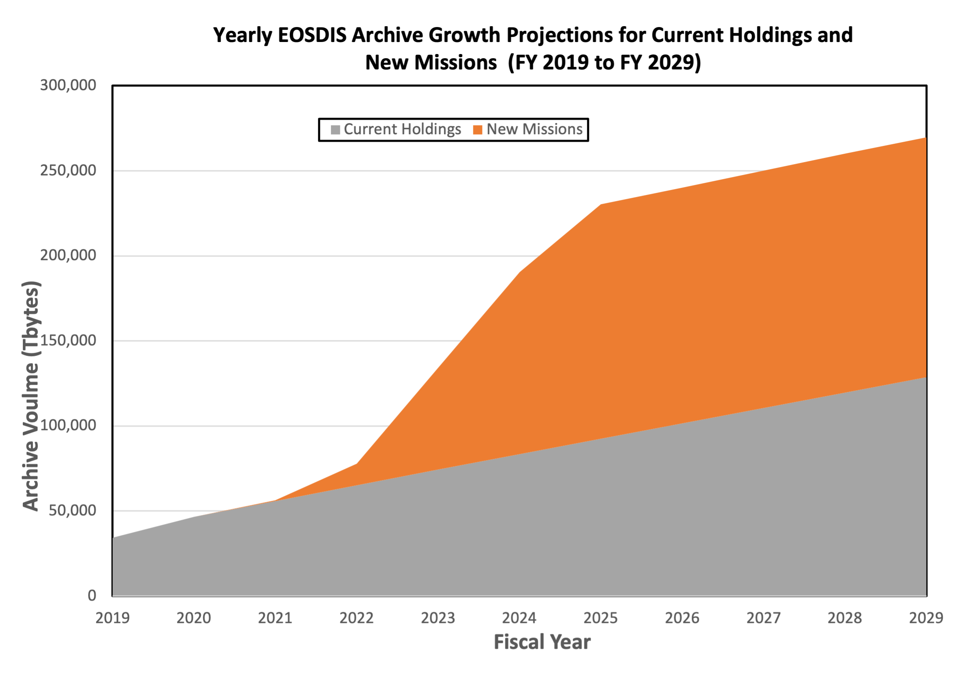

Motivation for Commercial Cloud
Motivation for Cloud
Projected Data Volumes
Growth of Mission Data & Processing: Projected rapid archive growth and the need to effectively process significantly larger volumes of new mission data requires rethinking existing architectures.
Data Systems: More cost-effective, flexible, and scalable data system ingest, archive, and distribution solutions are needed to keep pace with new mission advancement.
Science Users: Significantly larger data volumes requires additional ways to access and utilize this data, with “Data Close to Compute” or Data Lake”. Bring Algorithms to the cloud.

Slide 8

Our Elevator Pitch
By hosting EOS data in the cloud, EOSDIS is able to realize several end user benefits:
Power: Any user can access big processing power “next to” Big Data.
Performance: Data can be offered in a form enabling high-performance analysis.
Freedom from Data Transfers: Users need not move Big Data.
Freedom from Data Management: Users need not store and manage Big Data.
Data Co-location: Users can easily work with multiple EOSDIS datasets together.
Choice: Users can still download data if they prefer.
Free image from https://www.dreamstime.com/photos-images/elevator-pitch.html

Slide 9

Current User Interaction
User must download data from centers across the US
What’s Good: decentralization means that systems are independently available; minimize the decentralized view by common functions (Earthdata Search)
What’s Not So Good: user has to get data from each location; user must invest in processing capacity; having many interfaces is confusing and complicated
Notes:
In the current on-premise world, if a user wants to use datasets from multiple DAACs together, they pretty much have to download them to their own space.

Slide 10

Hey, we’re going to have an EOSDIS “Data Lake”!
User now goes to one location to get data
- still has ability to download data - but will be able to use even more services that will be available in a common environment
ASF
ASDC
CDDIS
GESDISC
GHRC
LAADS
LPDAAC
NSIDC
ORNL
OBDAAC
PODAAC
SEDAC
Evolution of EOSDIS in the 2020s
Move data into commercial cloud where all is accessible
Make data versions in the Cloud analysis ready
Provide common services on the data
Enable easily understood access/use in the Cloud
Notes:
But by putting the data in the cloud, we have created a data lake, where it should be easier for the users to use the data together, again without having to move or manage all these bits of data.

Slide 11
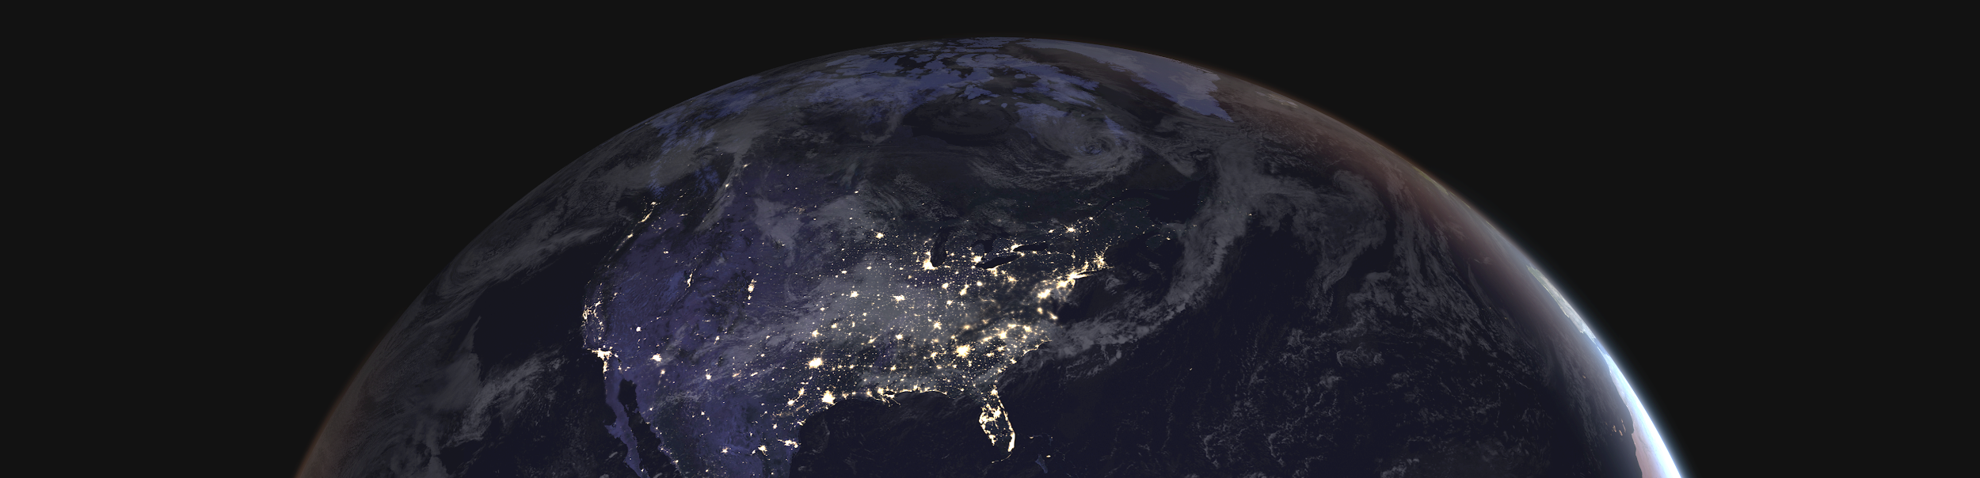
Earthdata Cloud (EDC)
“Managed” commercial cloud for EOSDIS
Improves the efficiency of NASA’s data systems operations – maintaining free/open data policy
Architected for EOSDIS applications and mission data ingest, archive, distribution
Operational July 2019, DAAC focused needs.
Routine systematic onboarding of mission data by DAACs.
NASA Earthdata Cloud (EDC) – http://earthdata.nasa.gov

Slide 12
Cloud Platform Infrastructure
Ingest, Archive, & Mission Data Management
Data Services & analytics
Organizational Governance
Budget Controls
Metrics Management
Community Development Model
01
02
03
04
05
06
07
Components of the Earthdata Cloud

Slide 13
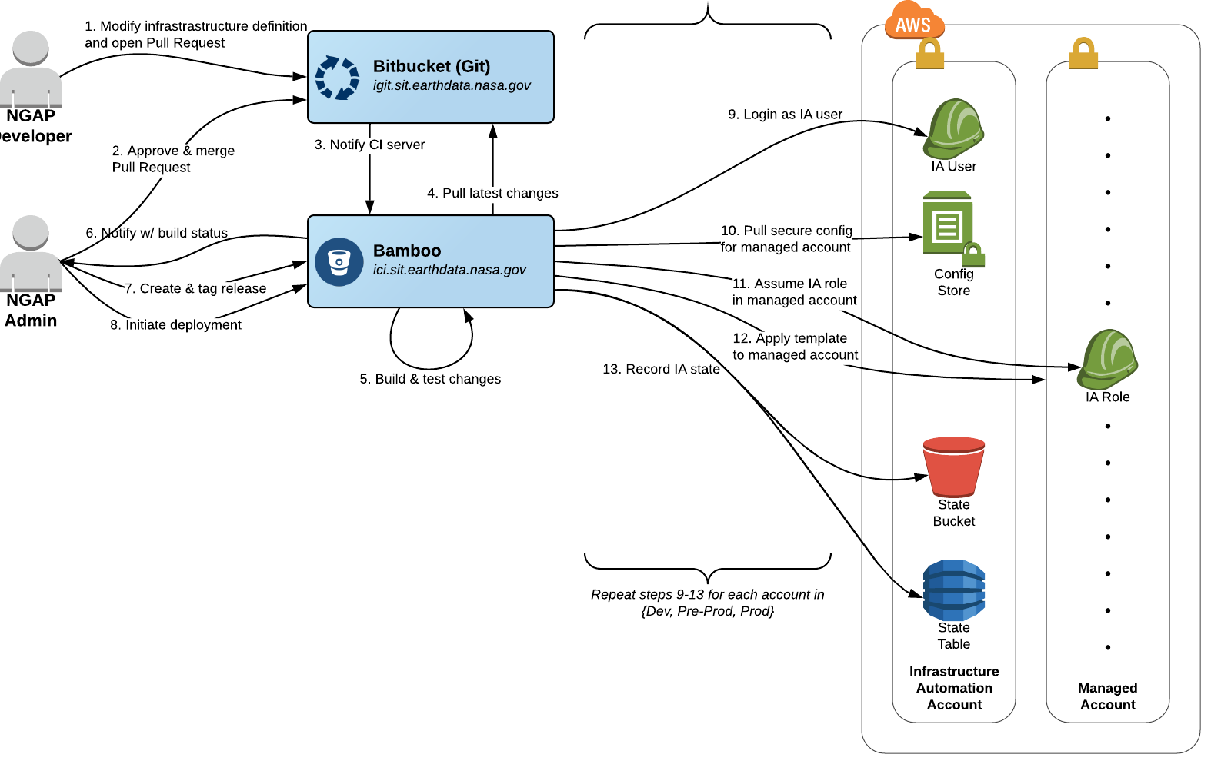
Common Services and Controls
Cloud Platform Infrastructure
Common Services & Controls
NASA-Approved Amazon Web Services (AWS): vetted AWS and third- party Software-As-A-Service (SAAS) services and process to add new. Focus is on using AWS cloud-native services
Code Deployment Services: DevOps Continuous Integration Continuous Delivery (CICD) Pipeline to security scan, build, and deploy code
Use of Infrastructure as Code: including re-useable template to define a multi-account ecosystem
Single System Security Plan (SSP) and Authority to Operate (ATO)
Single Identity and Access Management Solution (CloudTamer.io):
  Rotate AWS access keys
  Apply session limits
  Provide role-based access control
  two-factor authentication

Slide 14
IT Security and Networking Services
Cloud Platform Infrastructure
Security & Networking
“LOW” System Security Plan (SSP) / Certification and Accreditation
  Single ESDIS owned cloud SSP
  Operational Security Agreements (OSA) for EOSDIS organizations.
    Defining application account boundaries and local security operations
Platform Level Operational IT Security Services
  Implement NASA security policies & apply system security architecture principles
  Incident detection & contingency response management
  Continuous Diagnostics and Mitigation (CDM). NASA CDM tools not updated for cloud, so AWS services deployed:
    AWS Simple Systems Manager (asset management)
    AWS Inspector (vulnerabilities)
    AWS Guard Duty (threat detection)
    AWS Config (Configuration Management)
    AWS CloudTrails, CloudWatch, Elastic Search (event management)
Risk Management
System Security Principles
NASA (OCIO) Policy
Incident & Contingency Response
Security Configuration Management
Independent Assessment & Authorization
Security Metrics / Security Analytics

Slide 15
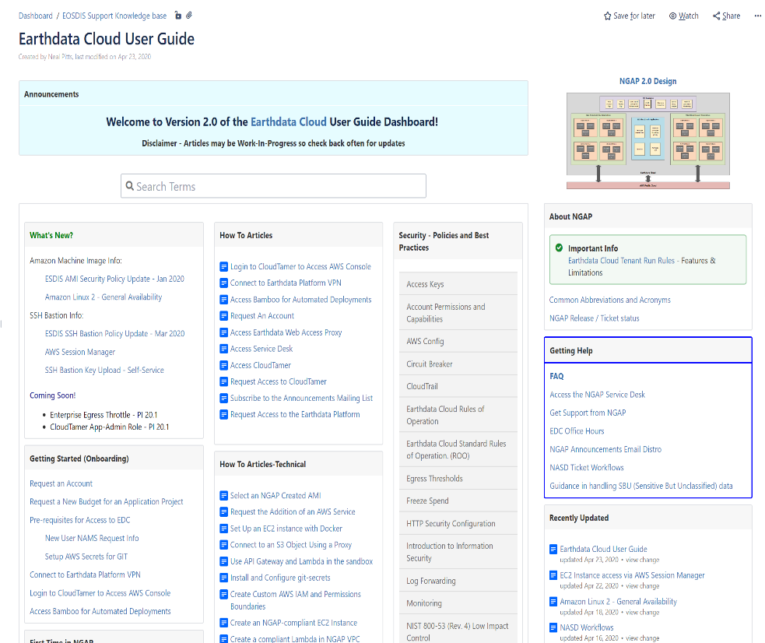
User Support Services: EDC Knowledge Base
Cloud Platform Infrastructure
User Support Services
EDC User Guide provides user level documentation on topics such as….
Requesting Accounts
  Requesting Access to the Earthdata Platform
  Request an Account
  Request a New Budget for an Application Project
  Requesting Access to CloudTamer
  …..
First Time Using NGAP
  Access CloudTamer
  Paring a Yubi Key with CloudTamer
  Connect to an AWS instance using Bastion host
  Generating AWS Access Keys
  …
Getting Help
  Access the Service Desk
  Get Support from NGAP
  Request the addition of an AWS Service or SAAS
  Request to Archive an Account
  Request to Freeze an Account
  Request to open Ports of IP Addresses
  Request to modify default auto scaling policy
  …..
Useful links
  AWS Snowball
  How to submit a cost model
  AWS Best Practices
  …

Slide 16
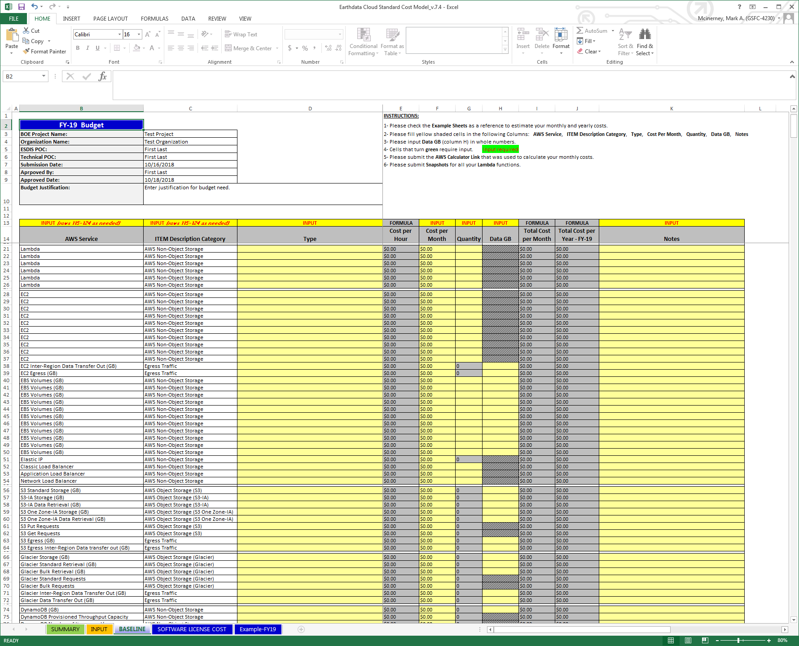
Cloud Resource & Cost Model
Budget Controls
Cost accounting begins with first capturing individual mission/application level required AWS resources and cost for execution year and out to year 5.
  Used to:
  Project level cloud resource and cost capture
  Feed NASA’s Planning, Programming, Budgeting and Execution (PPBE) 5 year budget request / cycle
  Input into execution year monthly “cost phasing plan” and account level budget caps
  Support performance and cost optimization processes, routine cloud account auditing
  Initial capture of AWS service needs, vetting for availability and metrics for reserved instance purchases
NASA Earthdata Cloud (EDC) – http://earthdata.nasa.gov

Slide 17









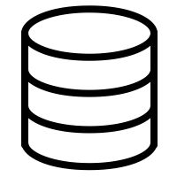


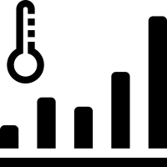


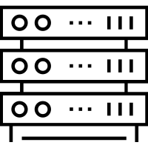

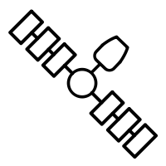


Ingest, Archive, & Mission Data Management
EOSDIS Conceptual Cloud Based Architecture
NASA Funded Research
Benefits
Collocated, pay-as you-go processing for anyone
Expert user support
Streamlined product addition
Reduced duplication of tools and services
Challenges
Development coordination
Cost Management
Shifting Labor Needs
Security/Export Compliance
Vendor Lock In
Cloud-Native
Ingest/Archive/Distribution System
DAAC’s Thematic Stewardship
SIPS
Varied Data Sources
NASA Earthdata Cloud (EDC)

Slide 18
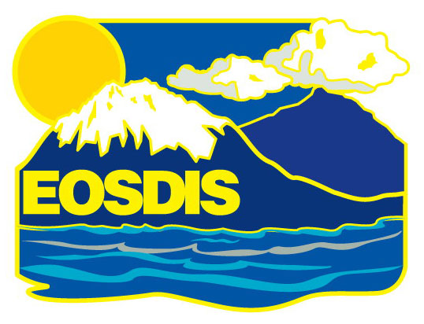
Additional information is available at:
  http://earthdata.nasa.gov/
  https://earthdata.nasa.gov/learn/articles/cloud-articles-announcement
  Thanks for the support from all of the scientists, engineers, accountants, developers and operators of the EOSDIS system

