Slide 1
Emerging Data Stewardship Practices to Enable Effective Data Discovery and Use in Transient, Optimized Analysis Platforms
Kaylin Bugbee, Aaron Kaulfus, Rahul Ramachandran
NASA Marshall Space Flight Center, Earth Science Branch (ST11)
Inter-Agency Implementation and Advanced Concepts Team (IMPACT)
Notes:
https://agu.confex.com/agu/fm21/meetingapp.cgi/Paper/981738

Slide 2
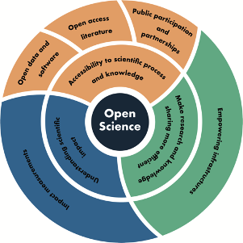
Analysis Platforms for Open Science
A key component of open science is making research & knowledge sharing more efficient through building empowering infrastructures, like transient optimized analysis platforms.
These platforms focus on
  Providing scalable, flexible storage and compute resources
  Can either be on the cloud or on HPCs (or both)
  Not meant to be a permanent archive of record, instead focuses on providing improved capabilities
  Flexible environment for exploring the effects of cloud computing and analysis at scale on open data access and cost.
Figure Source: Ramachandran, R., Bugbee, K., & Murphy, K. (2021). From open data to open science. Earth and Space Science, 8, e2020EA001562. https://doi.org/10.1029/2020EA001562

Slide 3
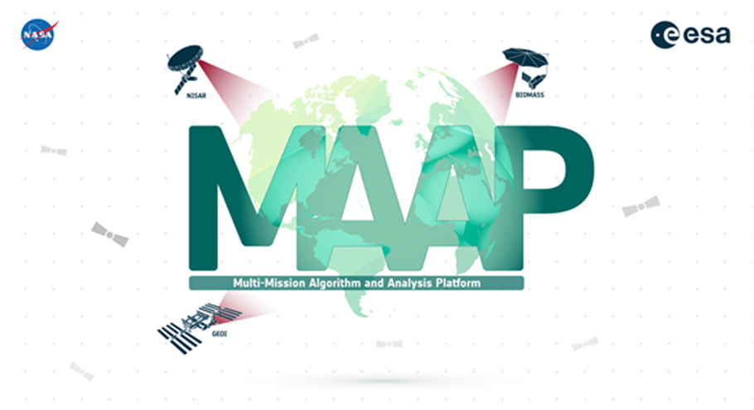
What is the Multi-Mission Algorithm and Analysis Platform?
An open-source science tool dedicated to the unique needs of sharing and processing data from relevant field, airborne and satellite missions.
  Jointly managed by ESA and NASA.
Adopts the following open science principles:
  Provides open access to data and code
  Enables efficient collaboration across large teams
  Accelerates research through a cloud-based infrastructure
  An exemplar of a transient and optimized analysis platform.

Slide 4
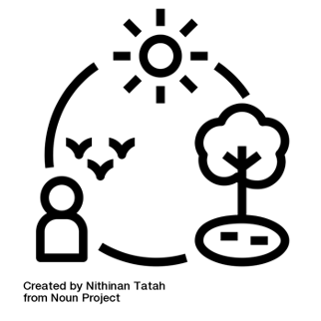
Current MAAP Stewardship Model
MAAP requires that data and information not be managed like a ‘time capsule or Egyptian tomb’ (Heidorn 2011) but as a dynamic system that is constantly changing and evolving.
  More like a data ecosystem with relationships between people, technologies, data and information (Parsons et al 2011)
  Stewardship model more aligned with data and information governance management which considers entire ecosystem of data lake(s), pipelines, tools and services within a platform.
Requires a different approach to a data governance team the includes
  Data stewards
  Data engineers
  Users themselves

Slide 5
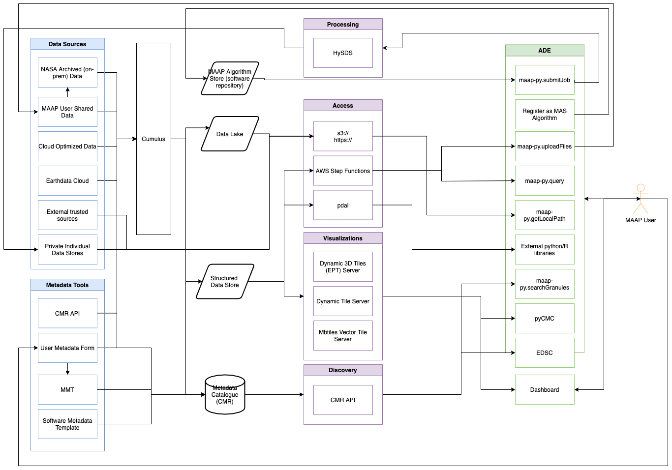
MAAP Data System Architecture
MAAP Data System Architecture and Workflows
Heterogeneous data sources along with a number of different paths for data access and use.
Complexity requires a scalable approach to stewardship while still maintaining curation.

Slide 6
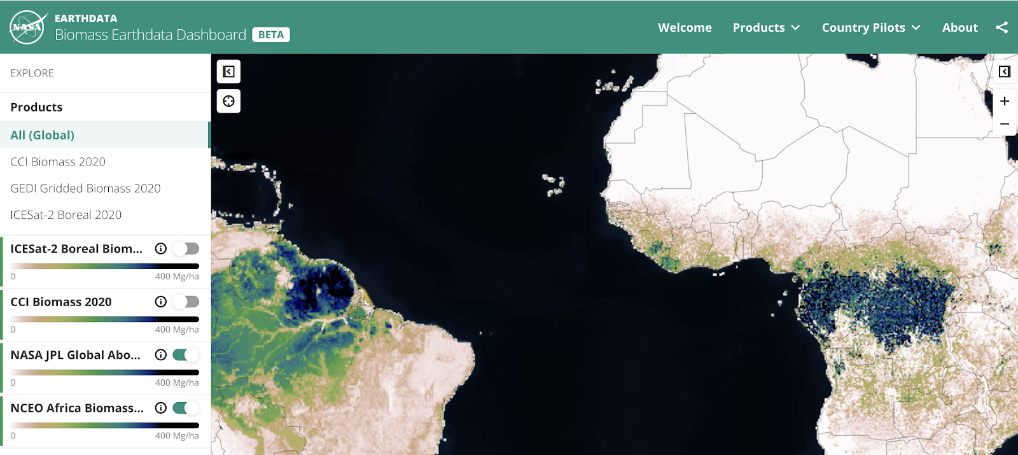
MAAP Data System Capabilities
Reuses core open-source EOSDIS data system components including Cumulus, CMR, Earthdata Search, Earthdata Dashboard and the Metadata Management Tool (MMT).
Over 55 relevant datasets available in the cloud from ESA, NASA and other data providers
Includes additional metadata needed for specialized biomass search needs with some datasets provided in cloud-optimized formats (COG, EPT)
Easily connects to other relevant data on the cloud
Enables users to share data to the MAAP
The MAAP biomass Earthdata dashboard.

Slide 7
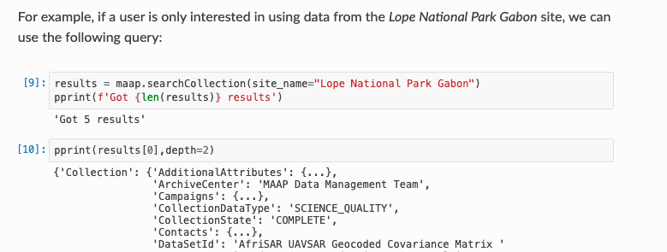
Specialized Search Needs
Additional Attribute Name | Description
Polarization | Transmit and receive polarization specification for the SAR file. Will vary by instrument & by granule. Examples include: HH, HV, VH, VV
Flight Number | Unique number to identify an individual aircraft flight.
Site Name | Geographic description of the location under observation.
Plot Area | Describes the area of each biomass field data collection plot.
Laser Footprint Diameter | The diameter of the laser beam that reaches the ground.
The MAAP use cases demonstrated a need for expanded metadata information to support the unique search criteria of the biomass community. These search needs vary from platform and instrument type.
The MAAP currently uses around 40 additional attributes, not currently available, to facilitate additional search needs.
Additional attributes are applied to both collection level and file level metadata to enable search.
Example of querying a MAAP additional attribute using the MAAP API and the MAAP CMR.

Slide 8
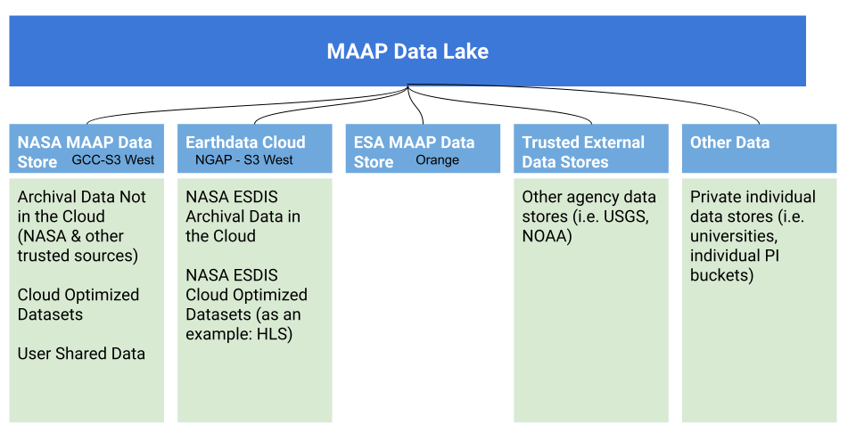
Federated Data Lake Approach
To be more efficient and to reduce redundancies, the MAAP connects users to the authoritative archival data products on the cloud including Earthdata Cloud.
To enable specialized search within the MAAP, the data team currently replicates the operational CMR metadata into the MAAP CMR and includes the additional MAAP attributes needed for search.

Slide 9

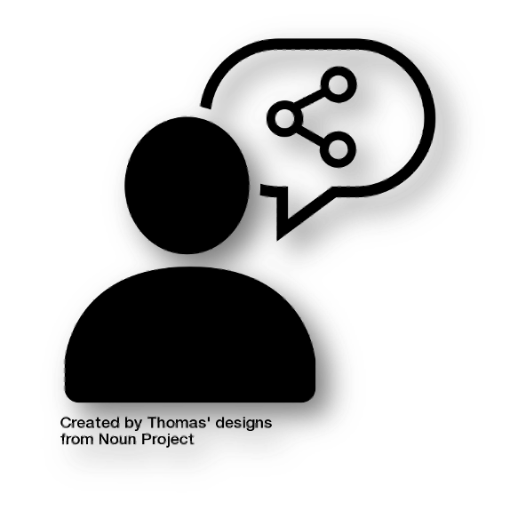

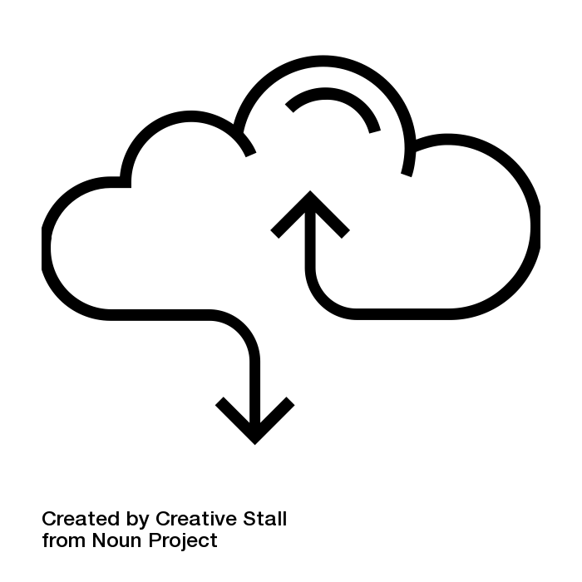
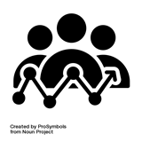
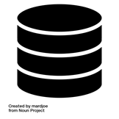
User Shared Data Workflow
User is Ready to Share Data
User Provides Information via a Streamlined Questionnaire
User Submits Information for
Wider Sharing
User Data Ingested into the Data Store and Metadata Created
User’s Data Available and Discoverable in MAAP
The user shared data workflow allows users to efficiently share data with the wider MAAP community yet still create metadata to enable discovery & use.
Similar in nature to a traditional data publication workflow but limited to the MAAP environment.

Slide 10
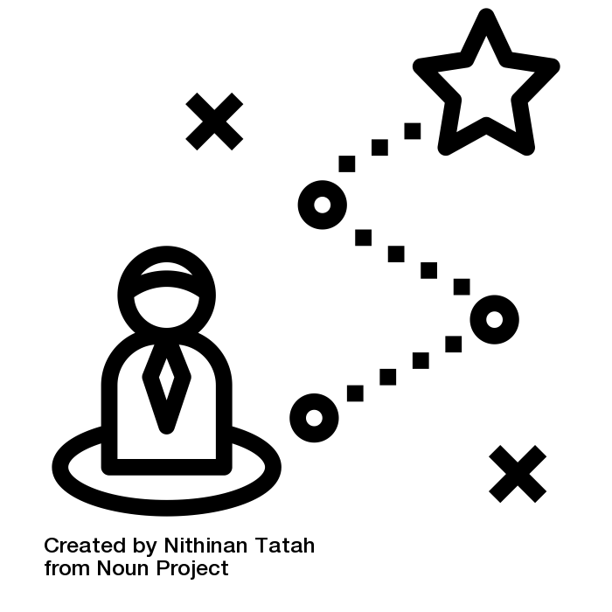
Vision for the Future: MAAP and Beyond
Our experiences managing data in the MAAP to date have shown us the need to give users more autonomy to bring in the data needed and to eliminate the blockers caused by having a traditional publication model in place.
We propose to reframe the data stewardship model to empower users to act either independently or collectively as groups to accelerate open science.
  Strive to both straightforwardly present the rules of the system to users
  Implement mechanisms that will make it easier for users to comply with those rules.
  Remove blockers that occur in current systems, such as the misalignment or misunderstanding of user needs
  Shifts the role of data stewards from a person who is separate and set apart from the community to a member of the network working to make science possible.
Notes:
This is not to say that the rules and best practices of data management are completely discarded

Slide 11
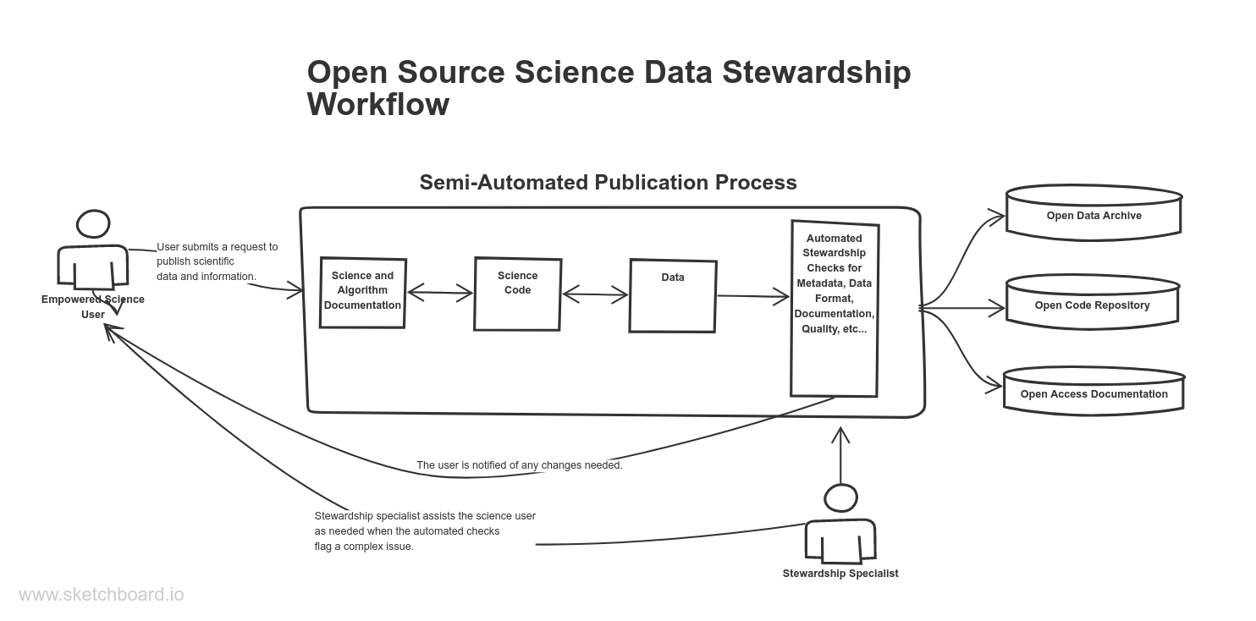

Slide 12
References
Heidorn, B. The Emerging Role of Libraries in Data Curation and E-science. Journal of Library Administration. 2011; 51:662–672.
Parsons MA, Godøy Ø, LeDrew E, et al. A conceptual framework for managing very diverse data for complex, interdisciplinary science. Journal of Information Science. 2011;37(6):555-569. doi:10.1177/0165551511412705

Slide 13
Thank you!
Kaylin Bugbee: kaylin.m.bugbee@nasa.gov

Slide 14
Slides for 5 minute presentation

Slide 15
What is the Multi-Mission Algorithm and Analysis Platform?
An open-source science tool dedicated to the unique needs of sharing and processing data from relevant field, airborne and satellite missions.
  Jointly managed by ESA and NASA
Adopts the following open science principles:
  Provides open access to data and code
  Enables efficient collaboration across large teams
  Accelerates research through a cloud-based infrastructure
  An exemplar of a transient and optimized analysis platform.

Slide 16
Current MAAP Data Stewardship Approach & Capabilities
MAAP manages data and information system as a dynamic one that is constantly changing and evolving. More like a data ecosystem with relationships between people, technologies, data and information (Parsons et al 2011).
Capabilities include:
Reuses core open-source EOSDIS data system components including Cumulus, CMR, Earthdata Search, Earthdata Dashboard and the Metadata Management Tool (MMT).
Over 55 relevant datasets available in the cloud from ESA, NASA and other data providers.
Includes additional metadata needed for specialized biomass search needs with some datasets provided in cloud-optimized formats (COG, EPT).
Easily connects to other relevant data on the cloud.
Enables users to share data to the MAAP.
The MAAP biomass Earthdata dashboard.

Slide 17
Vision for the Future: MAAP and Beyond
Our experiences managing data in the MAAP to date have shown us the need to give users more autonomy to bring in the data needed and to eliminate the blockers caused by having a traditional publication model in place.
We propose to reframe the data stewardship model to empower users to act either independently or collectively as groups to accelerate open science.
  Strive to both straightforwardly present the rules of the system to users
  Implement mechanisms that will make it easier for users to comply with those rules.
  Remove blockers that occur in current systems, such as the misalignment or misunderstanding of user needs
  Shifts the role of data stewards from a person who is separate and set apart from the community to a member of the network working to make science possible.
Notes:
This is not to say that the rules and best practices of data management are completely discarded

