Slide 1

NASA ASDC Distributed Active Archive Center (DAAC)
Earth Venture Sub-Orbital Support Team
Kasey Phillips; Kasey.E.Phillips@nasa.gov
DCOTSS Science Team Meeting

Slide 2
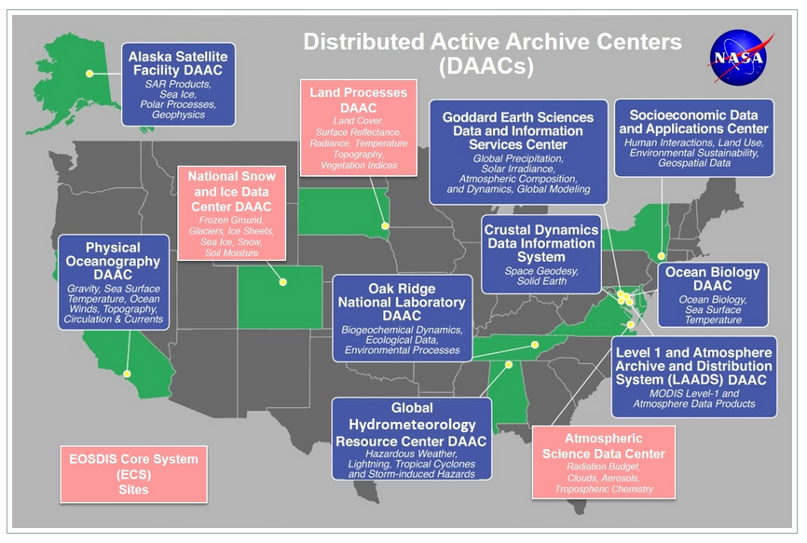
Distributed Active Archive Center​
(DAAC):​
• NASA’s Earth Observing System​
Data and Information System​
(EOSDIS)​
​
ASDC Role:​
Ingest, archive, distribution, metrics, outreach and user support​
Experienced in caring for data from ingest to preservation​
NASA’s EOSDIS DAAC for satellite missions and sub-orbital campaigns for:​
Aerosols​
Clouds​
Radiation Budget​
Tropospheric Composition

Slide 3
ASDC's Role in DCOTSS
Long term preservation and distribution of data products
  Active stewardship
  High public visibility to broad user communities
  User support
DCOTSS data holdings
  Archive the latest versions of publication quality data, including observational, derived, and value-added data products
  Contextual information to facilitate data use by research community at large
  Documentation to maintain reprocessing capability and openness
Assign DOIs to data products tailored to support manuscript and presentation development

Slide 4
Data Organization and DOIs
ASDC uses collections/data groupings (folders) to organize the DCOTSS data files
  Will work with the data manager to determine the best organization for the groupings (i.e., platform, deployment, etc.)
DOIs are assigned at the project-level and collection-level

Slide 5
Metadata/Ingest, Archive, and Distribution Process
Work with data manager to determine collections/data groupings
Create collections in metadata repository CAMP (Collaboratory for quAlity Metadata Preservation) and reserve DOIs
Obtain data from data repository (https://www-air.larc.nasa.gov/missions/dcotss/index.html)
Once data transfer is complete, publish and make data “world” visible
Register DOIs and verify visibility on ASDC Website, ASDC Direct Data Download, and Earthdata Search
Continually check data repository for updated, revised and new data products

Slide 6
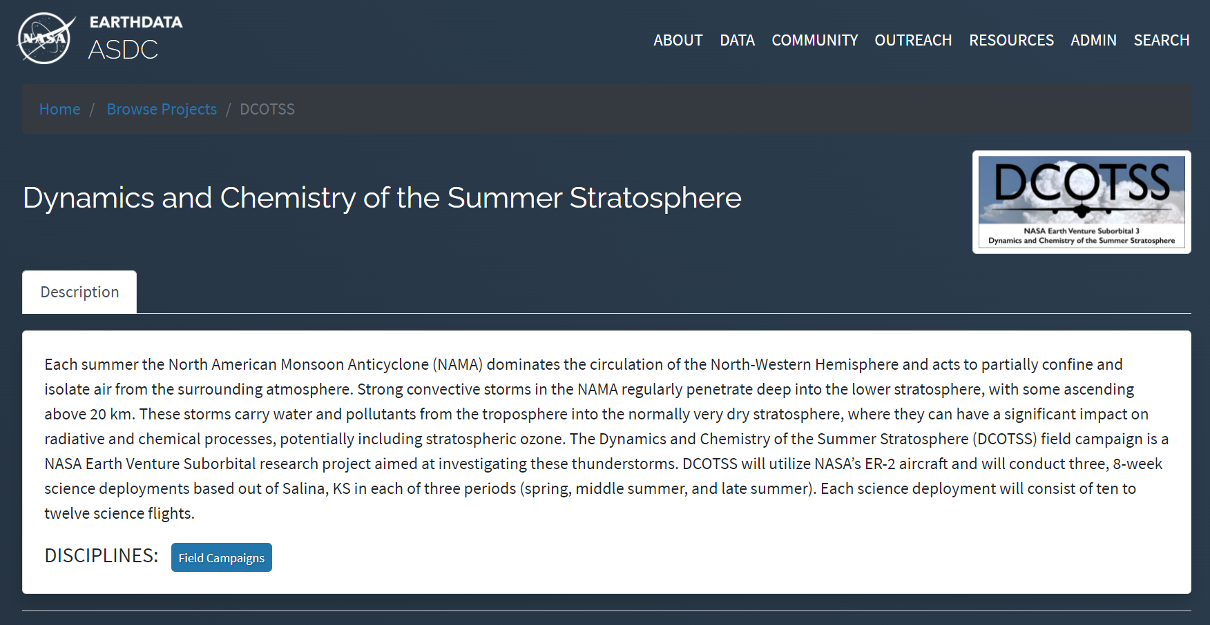
Data Distribution Options: ASDC Website/DDD
Direct Data Download (DDD) provides the ability to access and download all ASDC publicly available data collections via https

Slide 7
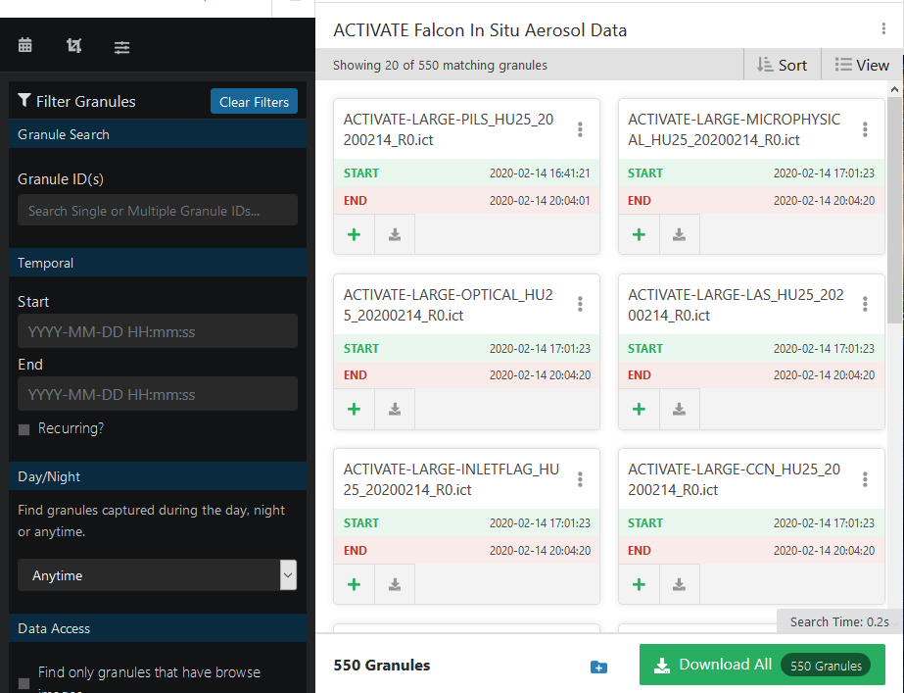
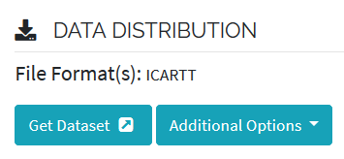
Data Distribution Options: Earthdata Search
Explore and retrieve information via collections

Slide 8
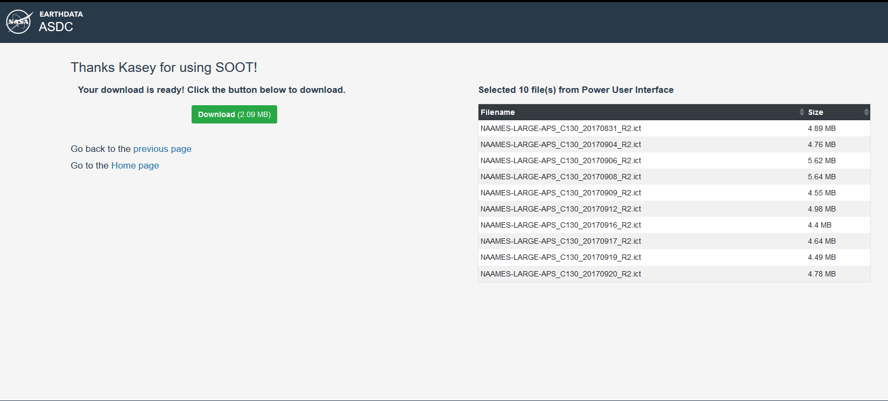
Data Distribution Options: Sub-Orbital Order Tool (SOOT) – future for DCOTSS
Support data access by flight: all variables from flight(s) or variables of interest for all flights

Slide 9
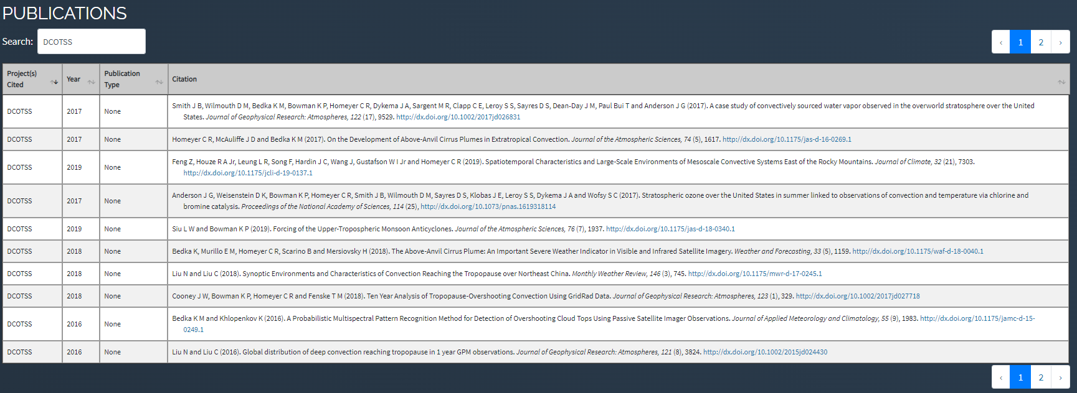
Publications
Notes:
Showing how we can add publications?

Slide 10
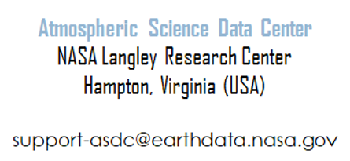
Contact Us/ Resources
ASDC DCOTSS Landing Page
Sub-Orbital Order Tool (SOOT)
Kasey Phillips: Kasey.e.Phillips@nasa.gov
Megan Buzanowicz: megan.e.buzanowicz@nasa.gov

