Slide 1

Lessons from the Frontline:
Preserving Earth Science Data
AGU FM 2021
IN14A-07: Accelerating Science: Moving from Simply Sharing Data to Reproducibility
Jeanne Behnke & Sara Lubkin
NASA Goddard Space Flight Center
December 13, 2021

Slide 2

Establishing a culture where data is easier to discover, understand, and reuse
The Earth Observing System Data and Information System (EOSDIS) has developed and operated its data systems since the 1990s, all with the purpose of preserving Earth Science data for NASA research. Our top 5 lessons come from the frontline support for EOSDIS.
Build a user-focused system framework
Advocate friendly user policies: Open Science/Open Source
Be Community Activists
Communicate
Stay on top of technology and be effective at 'change'

Slide 3
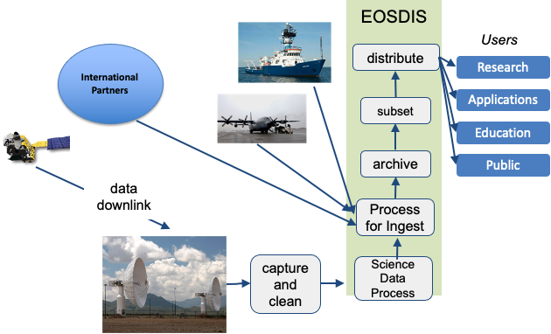
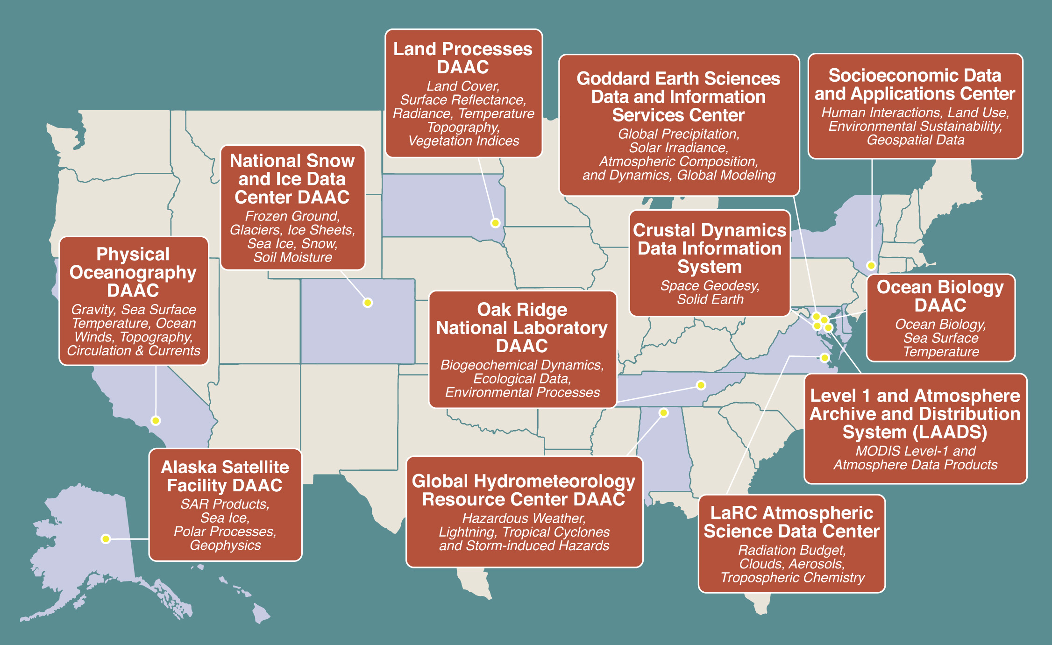
Build a user-focused system framework
Setting up Centers of Excellence by Science Discipline
    Specific expertise and understanding the science and the community enables us to provide special, personal support to users
EOSDIS actively develops and evolves its repositories based on TRUST principles
The basic logical structure has not changed in 30 years. We continue to preserve and steward Earth Science data.
What does change are underlying parts:
Software Components, methods, languages, lifecycles
Hardware and computing techniques
Interfaces and processes
Standards

Slide 4
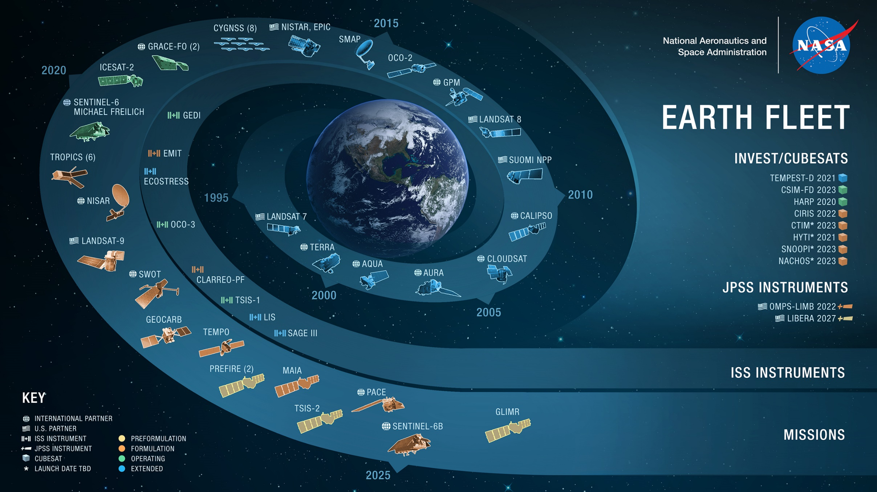
05.25.21

Slide 5
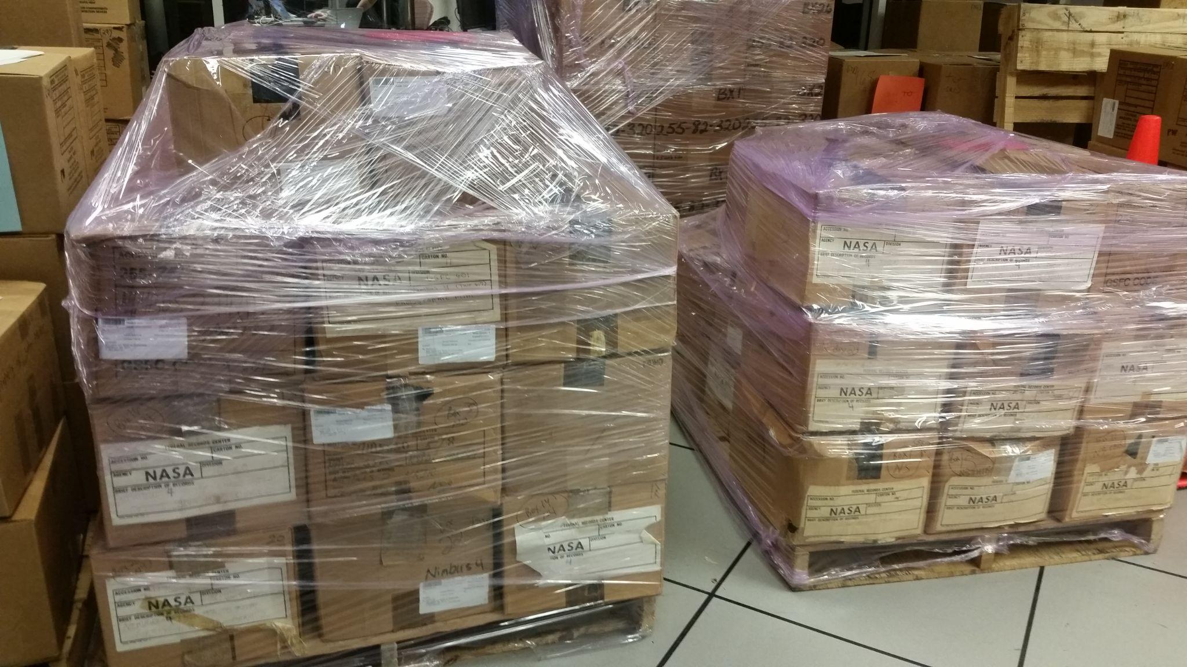
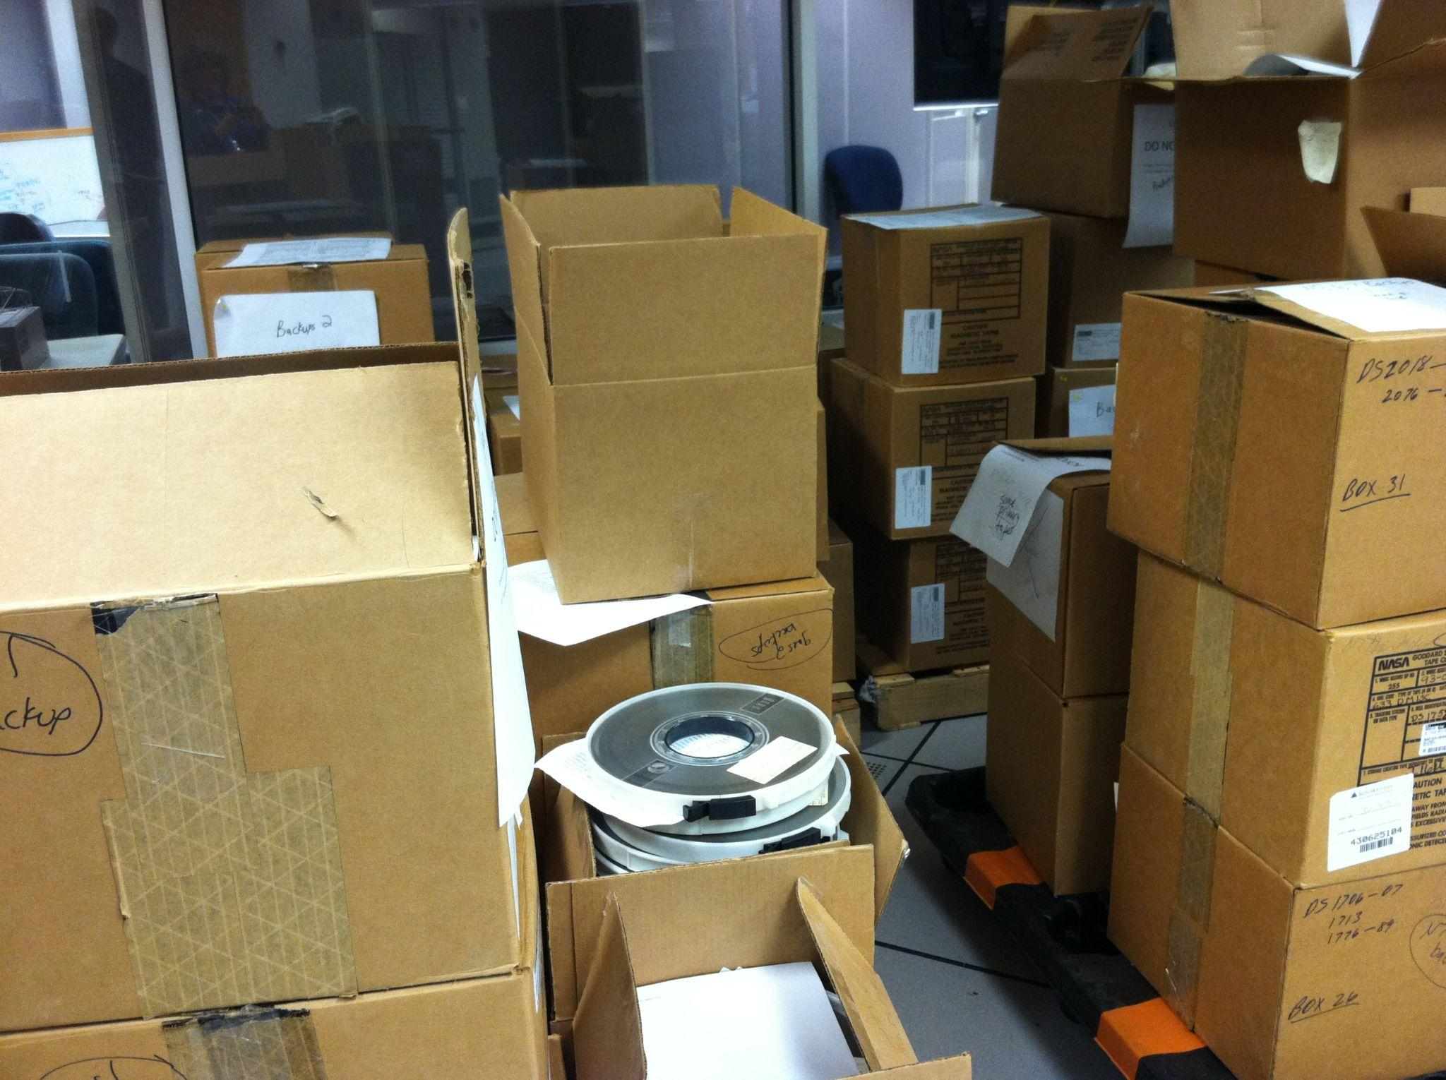

Stay on top of technology & be effective at change
In the 1990’s tapes filled our repositories; By 2005 we were moving everything to online disks; Today we are moving to the AWS commercial cloud, building the Earthdata Cloud
We keep our digital collections relevant in an environment of constant technological change:
Preservation of data is a continuous process
Work as a team, identify risks to the collections
Develop prototypes to mitigate risks
Team(s) are allowed time to make effective choices
Employ Scaled Agile Framework for software development
Constant communications because our teams are remote (e.g. use Slack)
Use Continuous Integration Continuous Delivery (CICD) pipelines. Build security processes into planning
Continuous development of staff skills
1980/1990s
Earthdata
Cloud
2021
Notes:
EOSDIS has weathered a number of technology challenges

Slide 6

Advocate friendly user policies
Since the 1990s, NASA has supported an open data policy
  Data was made freely available, user support services were provided to solely focus on getting data into the hands of users
Today it’s not enough that the data is available, with the large collections of data we are accumulating we need better ways to support users
New policy of open science defined as a collaborative culture enabled by technology
  Online User forums with many subject matter experts (e.g. Earthdata Forum)
  Enhanced tools that are free to users
  Encourage data providers to use Open Source to post all software used in processing datasets
  Encourage users to also use Open Source to post software
  Sharing data with the larger user community through efforts like OpenScapes, enhanced tools, Jupyter notebooks, articles, guides

Slide 7
Be Community Activists
All DAACs are recognized as World Data Centers. The Coretrust Seal is applied to all DAACs to provide user a reference for the quality of our data repositories
Staff across the program are encouraged to participate in conferences, working groups, review panels, etc…
  ESIP, CEOS, GEO, AGU and AMS, etc...
Participate by science discipline - enables us to be responsive to our entire user community which has differing perspectives, motives and cultures
  Science Team meetings
  Decadal Study type efforts
Earth Science Data Systems Working Group/
ACCESS Program
Science Researchers & Application users
Each DAAC meets with User Working Groups
ESDSWG - Opportunity for ESDS community to work together on emerging issues
            Use American Customer Satisfaction Index (ACSI Survey) to do an independent survey or our users for the past 12 years.
Data Needs
Opportunities
IT and Security Directives
NASA HQ Earth Science Division
Guidance,
Technology,
Re-use
National Needs
Foundational
EOSDIS System Architecture
Decadal Survey
Vision & Direction
New Missions
Existing knowledge
Improvements,
Technology,
Re-use
Shared
Data
Opportunities
ESA
NOAA
Mission Operations
USGS
Processing Centers
Collaborating Systems
Data Centers
EOSDIS Elements

Slide 8
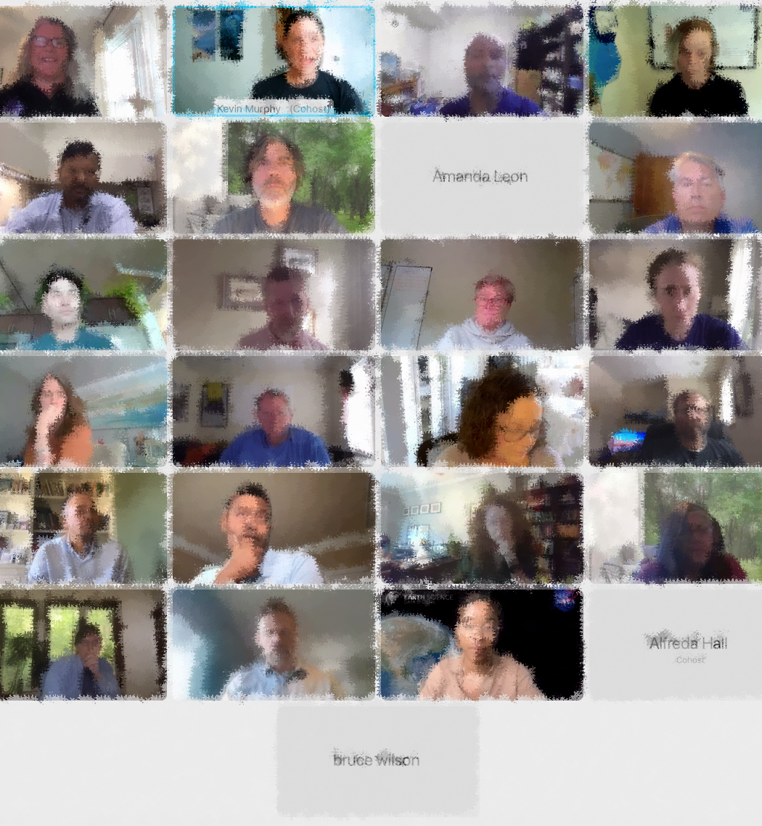
Communicate!
Internal communication processes and relationship development are critical to our success
Program Increment planning on a quarterly cycle (in person if possible)
System Engineering Technical Interchange meetings
Tech Spotlights to bring in fresh ideas
Reviewing key goals with all of the managers as part of Epic planning
Slack, TEAMS, Webex and other collaboration tools are enablers

Slide 9
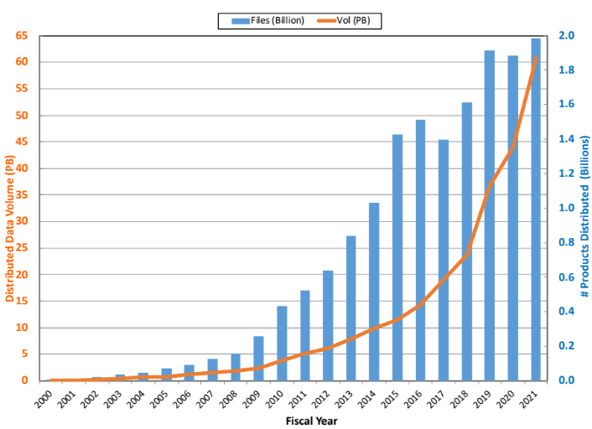
Summary
Accelerating Science can only be done when the internal system supports change
Many lessons, methodologies have been developed by EOSDIS to enable us to evolve
Customer confidence in EOSDIS has driven its success:
  at getting more data into the hands of our users
  next step is getting customized data into the hands of our users
By setting the example, we will encourage users to adopt new ways to share science….
The Moment When the Value of Sharing Data Surpasses the Activity Required for Preservation

Slide 10
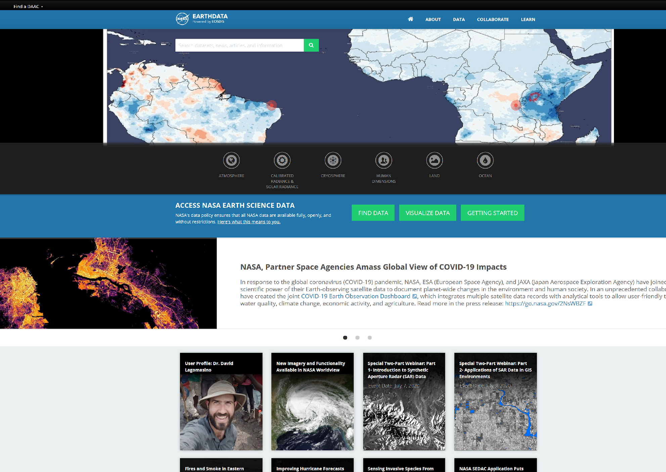
Additional information is available at:
  http://earthdata.nasa.gov/
Feel free to contact the authors:
Jeanne Behnke, Jeanne.Behnke@nasa.gov
Sara Lubkin sara.h.lubkin@nasa.gov
Thanks for listening!
Thanks to all the people who build and operate the EOSDIS!!

