Slide 1

Detecting Hail from Space:
Using a multi-frequency passive-microwave retrieval to analyze the global climatology and diurnal cycle of severe hail
Sarah D. Bang and Daniel J. Cecil
NASA Marshall Space Flight Center
Huntsville, AL

Slide 2
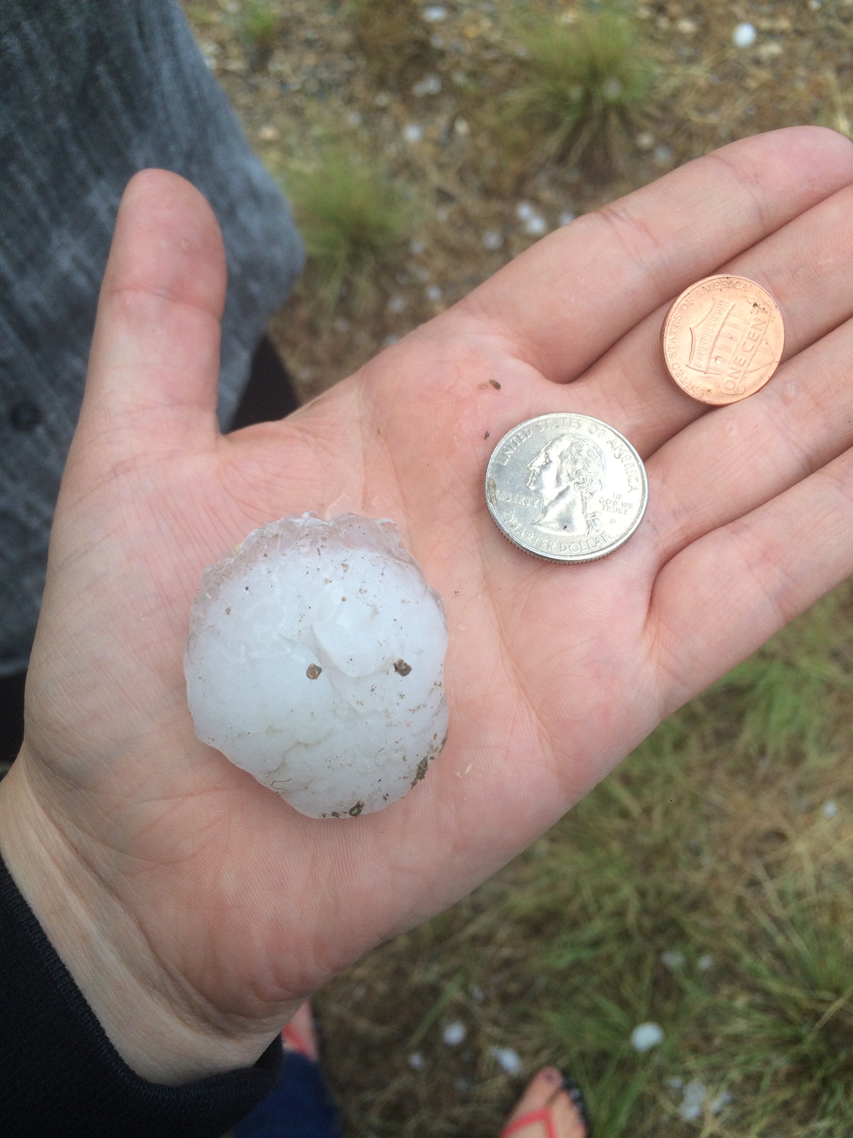
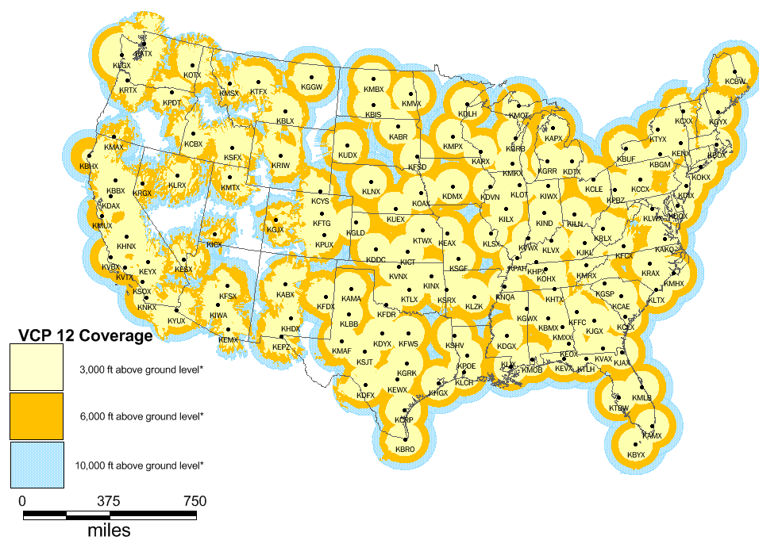
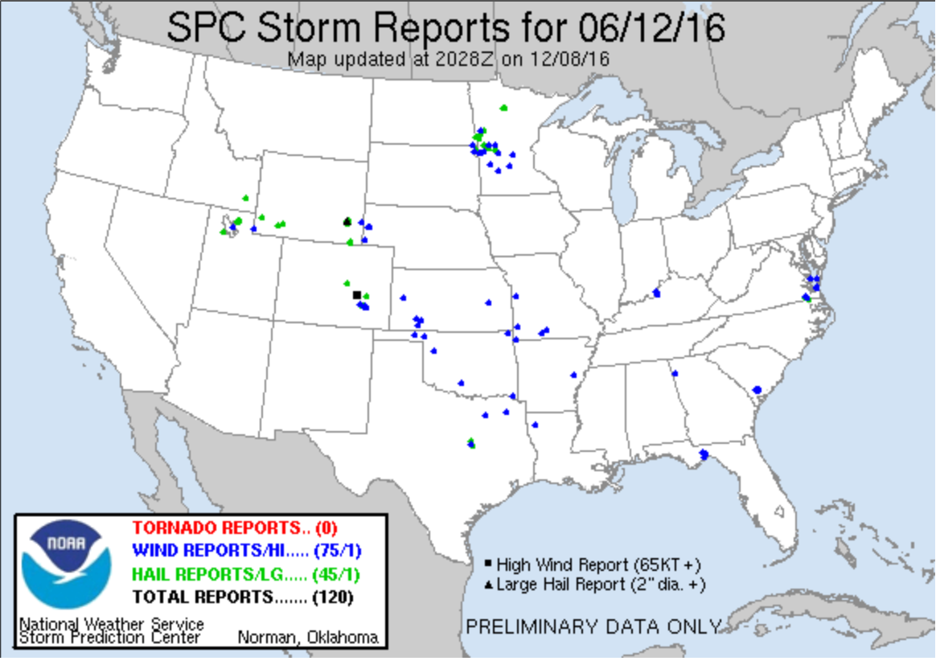
Observing Severe Hail
Severe Hail (> 25 mm) poses threats to life, property, infrastructure and agriculture
Hail climatologies can be made using ground radar, surface reports
Spotter reports suffer from nonmeteorological bias
Radar coverage is not available everywhere
For consistency, uniformity and to avoid bias, satellite datasets are the best option
Can observe remote, data-sparse,
and oceanic regions
Tens of billions of USD in insured loss each year from severe storms
Hail constitutes 70% of these losses
Hail can cause attenuation in observations, multiple scattering, and lead to errors in retrievals
Seldom retrieved in large-scale satellite precipitation algorithms
spc.noaa.gov
Aon Benfield, 2018; 2020; Bataglia et al., 2015

Slide 3
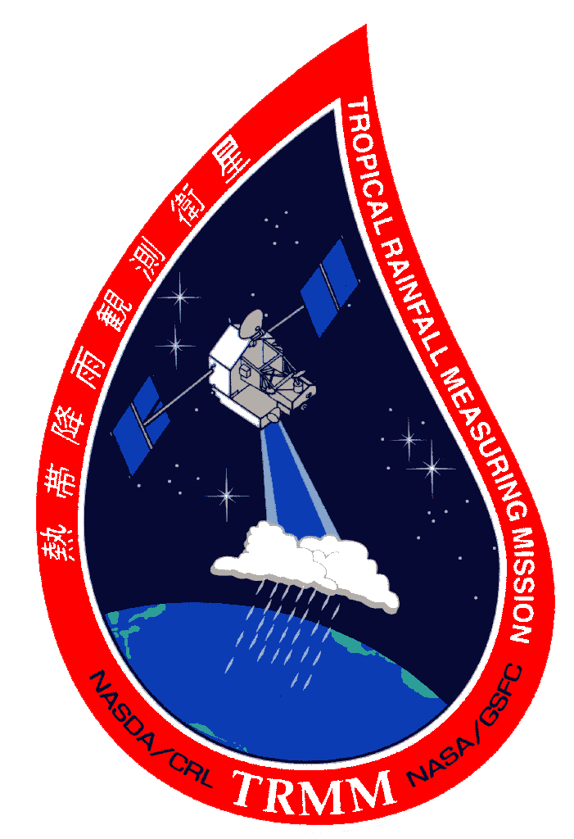
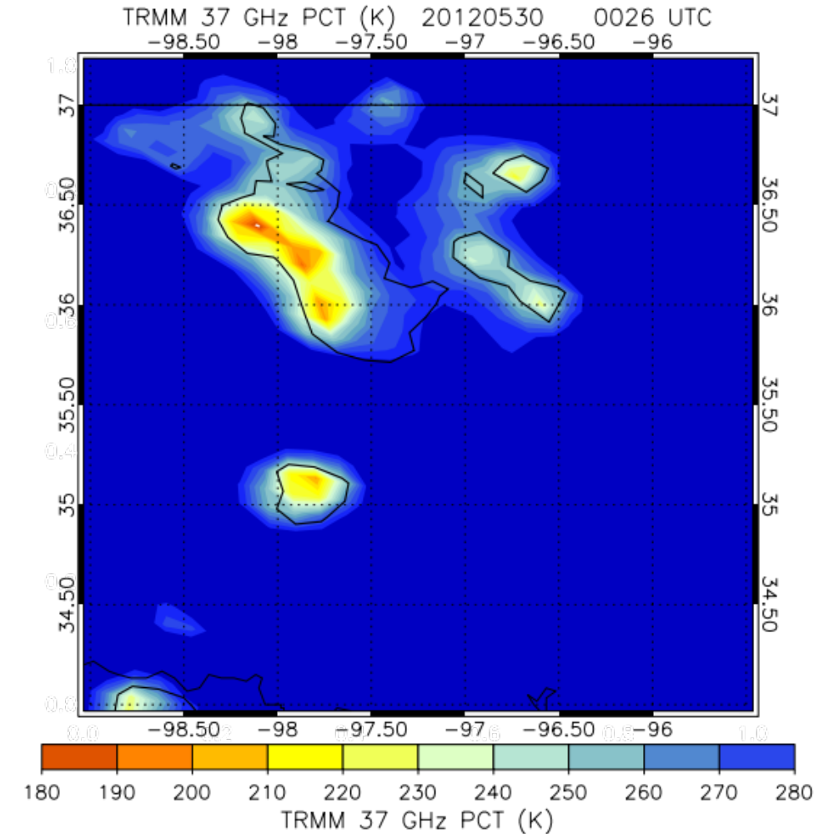



Passive-Microwave Hail Detection
Spaceborne Passive-Microwave Radiometers:
Excellent global coverage
Long legacy in space
Passive-Microwave Hail Detection:
Upwelling microwave radiation is scattered by hail, resulting in a T_{b} depression
The hail size and the frequency determine the magnitude of the depression
Tropical Rainfall Measuring Mission
TRMM Microwave Imager (TMI), 1997 - 2014
Global Precipitation Measurement
GPM Microwave Imager (GMI), 2014 – present
Aqua
Advanced Microwave Scanning Radiometer for EOS (AMSR-E), 2002 – 2011
GCOM-W1
Advanced Microwave Scanning Radiometer 2 (AMSR2), 2012 – present
T_{b} depression
TRMM 37 GHz PCT
30 May 2012

Slide 4
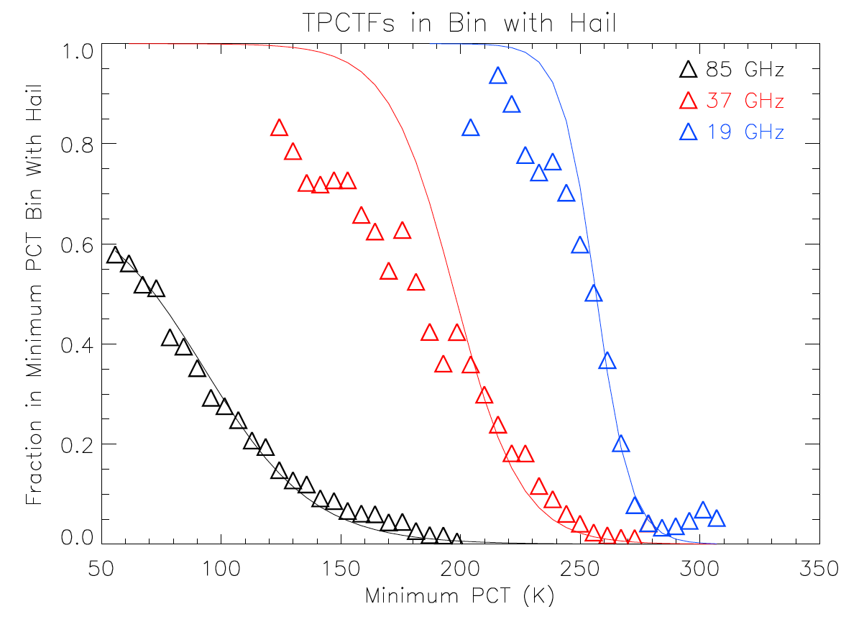
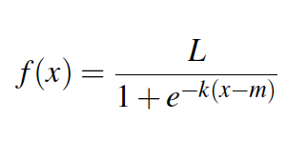
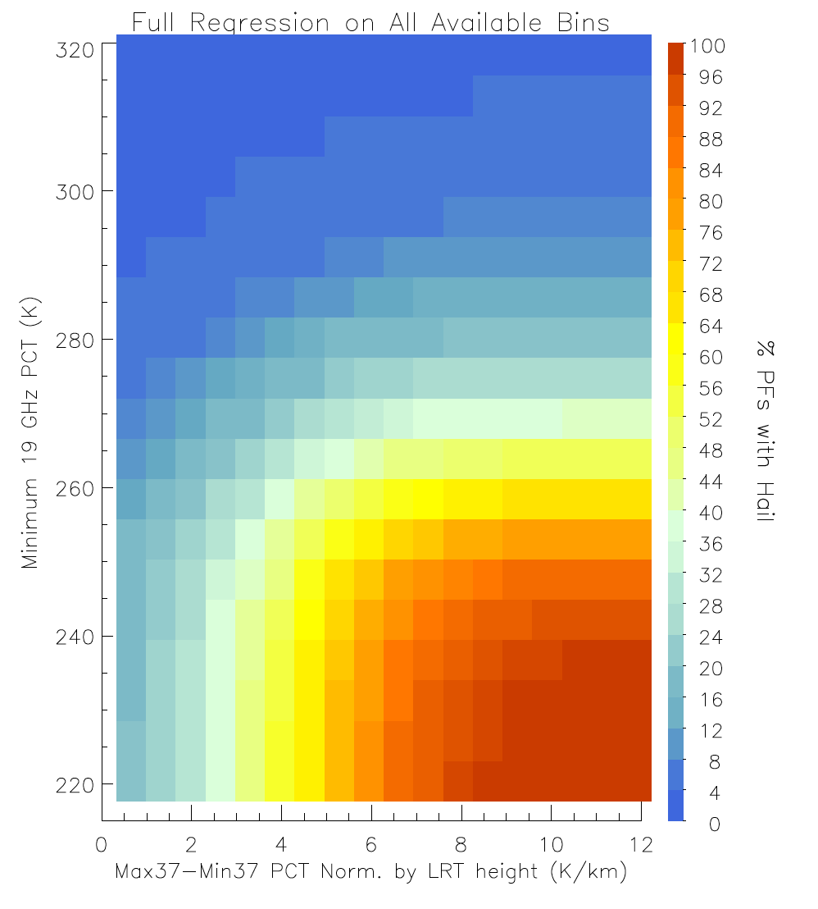
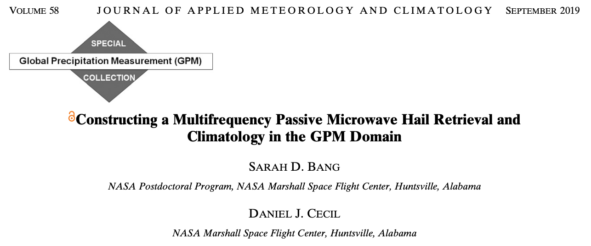
Passive-Microwave Hail Algorithm
Hail-detection algorithms leverage the relationship between decreasing T_{b} and increasing probability of hail.
The Bang and Cecil (2019) algorithm was constructed using 17 years of TRMM TMI data paired with surface spotter reports of severe hail.
It uses 19 and 37 GHz PCTs and is normalized by tropopause height using MERRA2 reanalysis to account for varying tropopause depth with latitude.
Increasing Prob. of Hail
Bang and Cecil, 2019

Slide 5
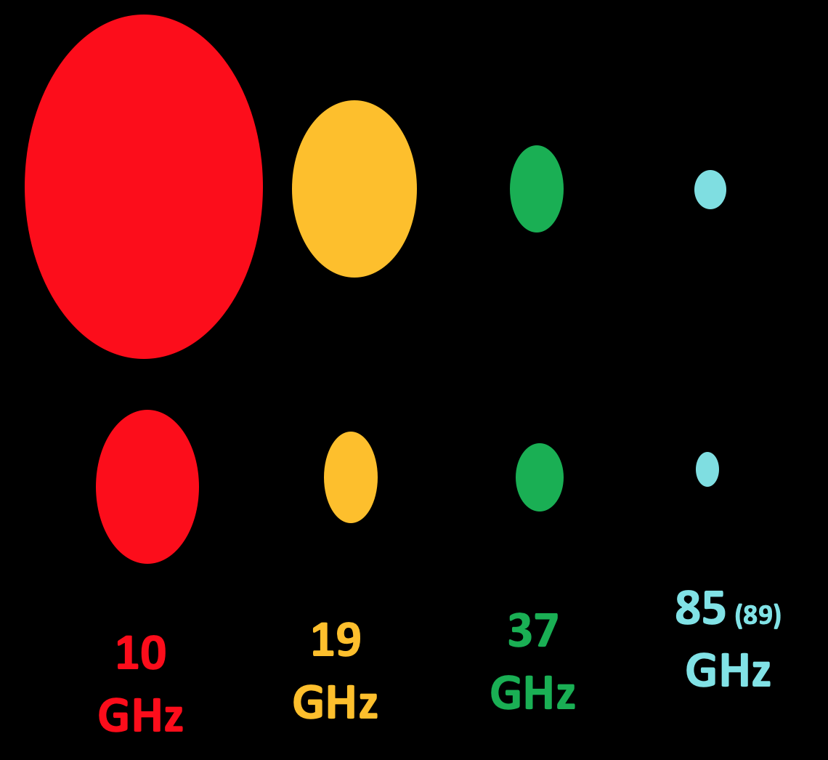
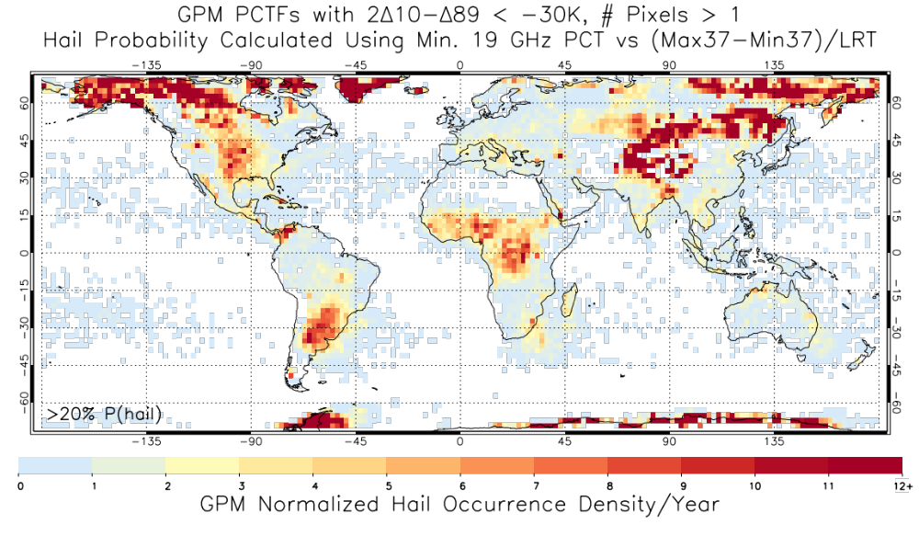
Caveats, Asterisks, Grains of Salt, etc.
Footprint Adjustment & Nonuniform Beam Filling (NUBF)
Surface Snow & Ice Artifacts
Ice and snow at the surface register low T_{b}s (but are not hailing) and must be removed.
TRMM
imagine a 10km hail core
GPM
Melting and Ice Particle Size Distribution
A deep layer of smaller ice particles (i.e., graupel) can significantly depress the T_{b}, but is not specifically hail.
Graupel and small hail aloft may register low T_{b} but may melt along its trajectory, leaving subsevere or no hail at the surface.
A hail core that is smaller than the footprint size will not uniformly fill the field of view, and the resulting T_{b} will incorporate hailing and not hailing regions.
For a horizontally small concentration of scatterers, a smaller footprint will yield a lower T_{b}

Slide 6
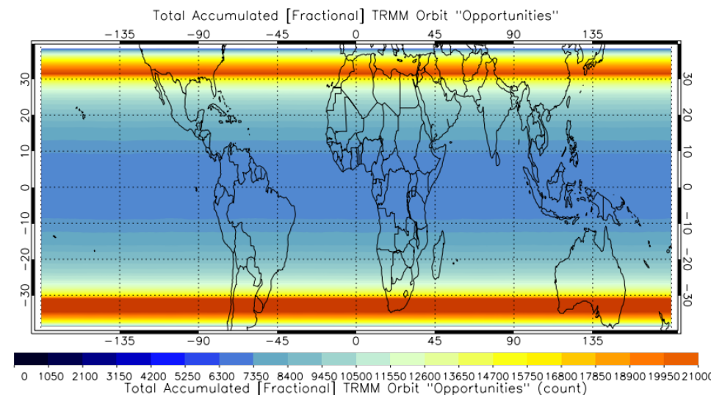
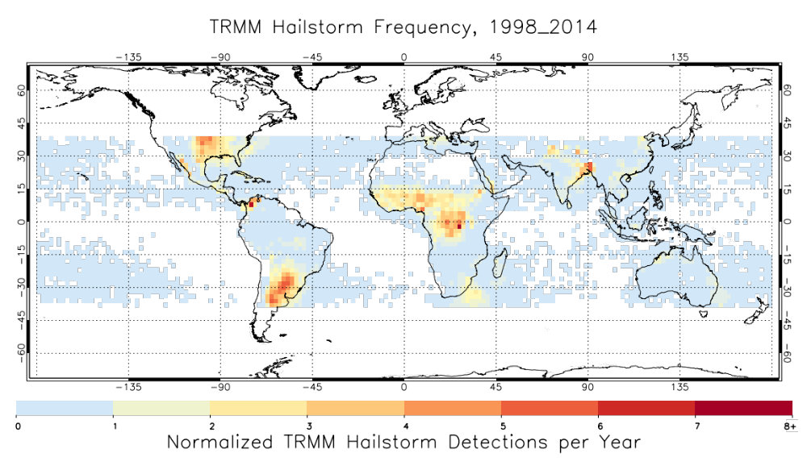
Building a Climatology
TRMM Sampling Counts
We can now estimate a probability of hail for any precipitating feature given a set of T_{b}s in the same frequencies and tally them to make a hail climatology.
16%
81%
81%
Bang & Cecil (2019)
Prob. of Hail
TRMM TMI Hail Climatology 1998-2014
35%
TRMM 37 GHz PCT
30 May 2012

Slide 7
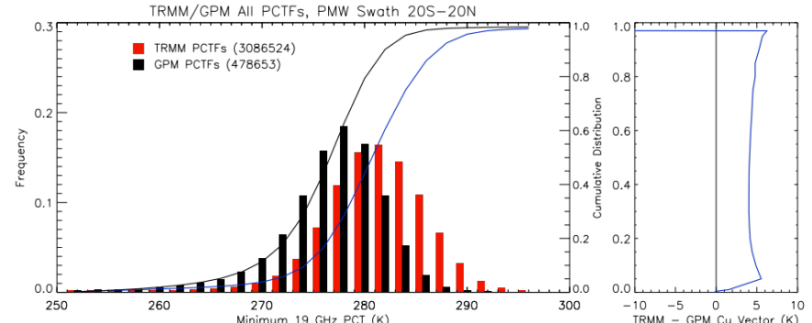
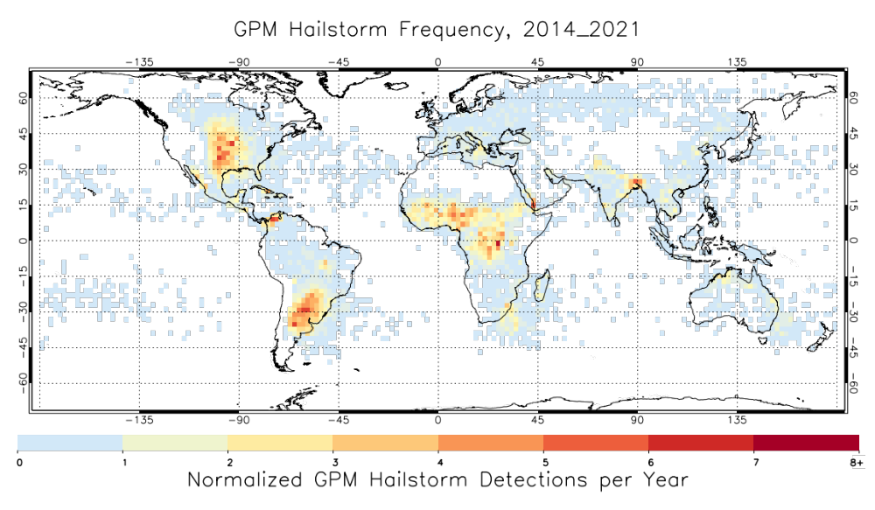
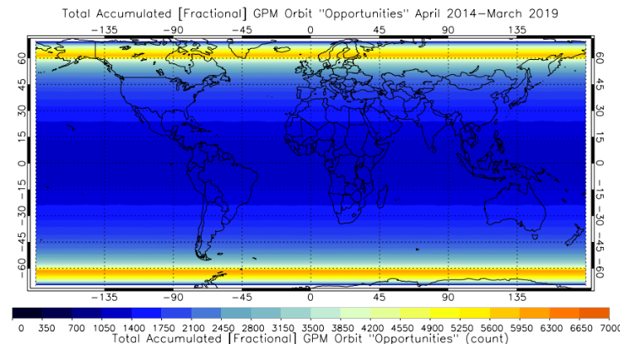
Applying this Method to Other Platforms
TRMM
GPM
For algorithm methodology, snow/ice artifact filtering, histogram footprint adjustment, and testing with GPM DPR radar, see Bang and Cecil, 2019 & 2021.
This climatology has been updated through March 2021 using the MERRA2 reanalysis for tropopause heights.

Slide 8
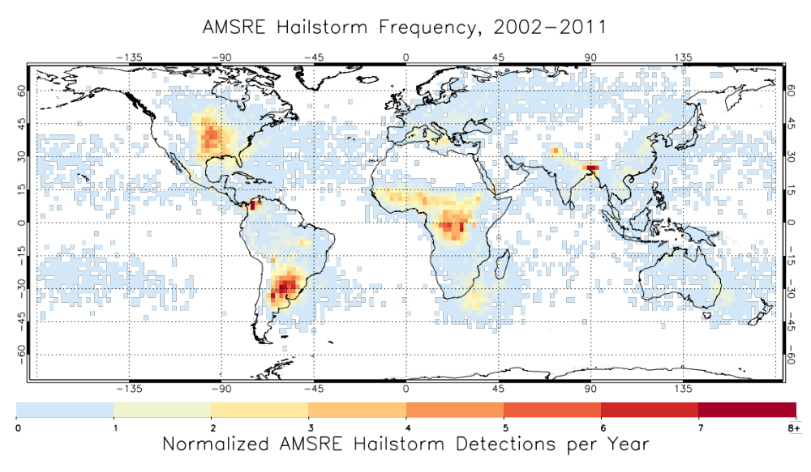
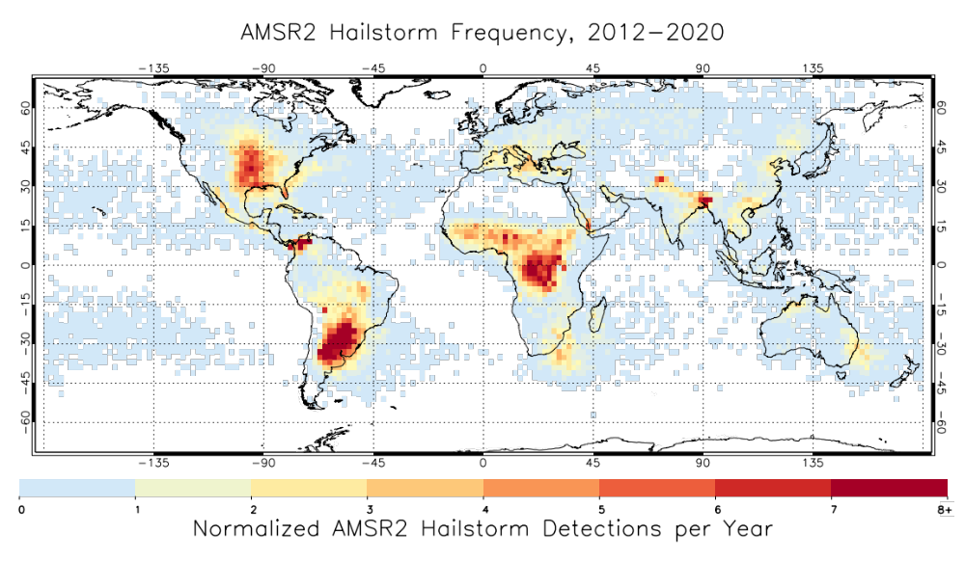
Climatologies from Sun-Synchronous Platforms
Aqua AMSR-E
GCOM-W1 AMSR2

Slide 9
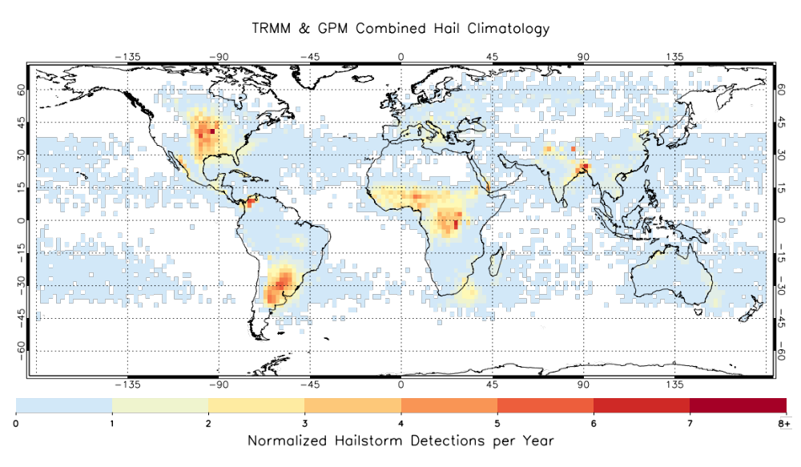
Combining Climatologies
TRMM & GPM Combined Climatology 1998 - 2021
TRMM, GPM,
and Combined (TRMM + GPM) gridded climatologies publicly available from the GHRC DAAC
http://dx.doi.org/10.5067/MODEL/DATA101

Slide 10
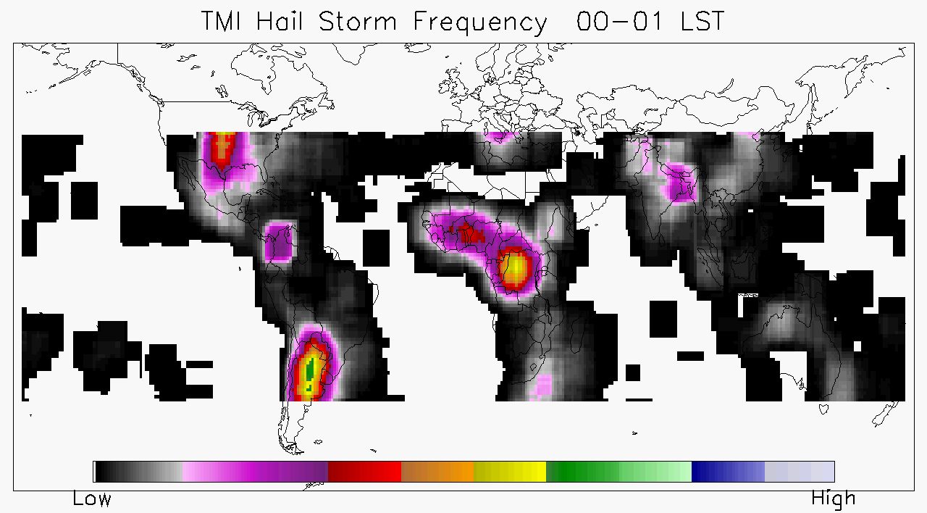
Using LEO Satellite Platforms to Assess Diurnal Cycle of Hail
This analysis aids in:
Establishing the [near] global diurnal cycle of severe hail
Normalizing the sampling by instruments in sun-synchronous orbit in order to combine climatologies for a multi-satellite product.

Slide 11
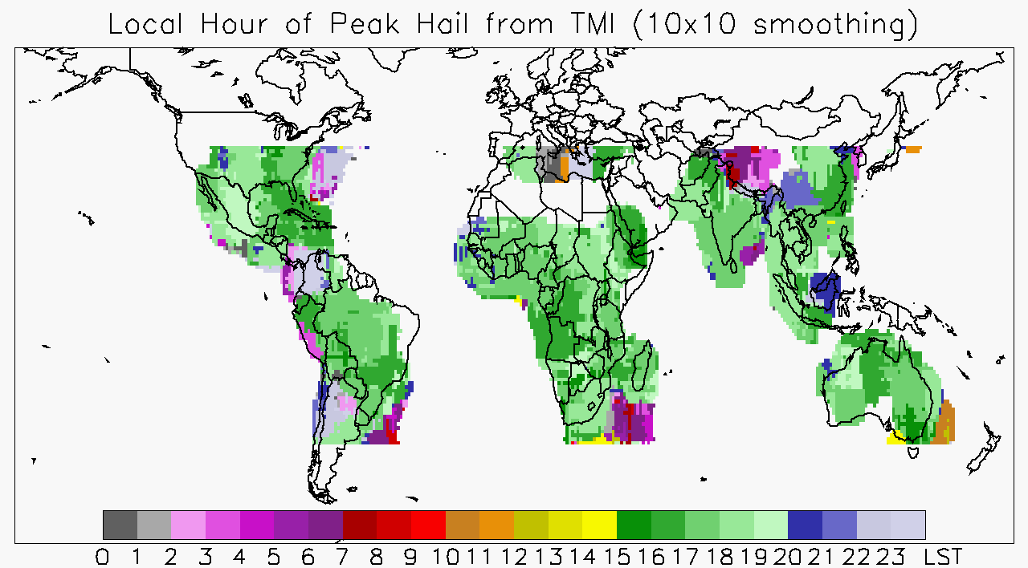
Using LEO Satellite Platforms to Assess Diurnal Cycle of Hail
This analysis aids in:
Establishing the [near] global diurnal cycle of severe hail
Normalizing the sampling by instruments in sun-synchronous orbit in order to combine climatologies for a multi-satellite product.

Slide 12
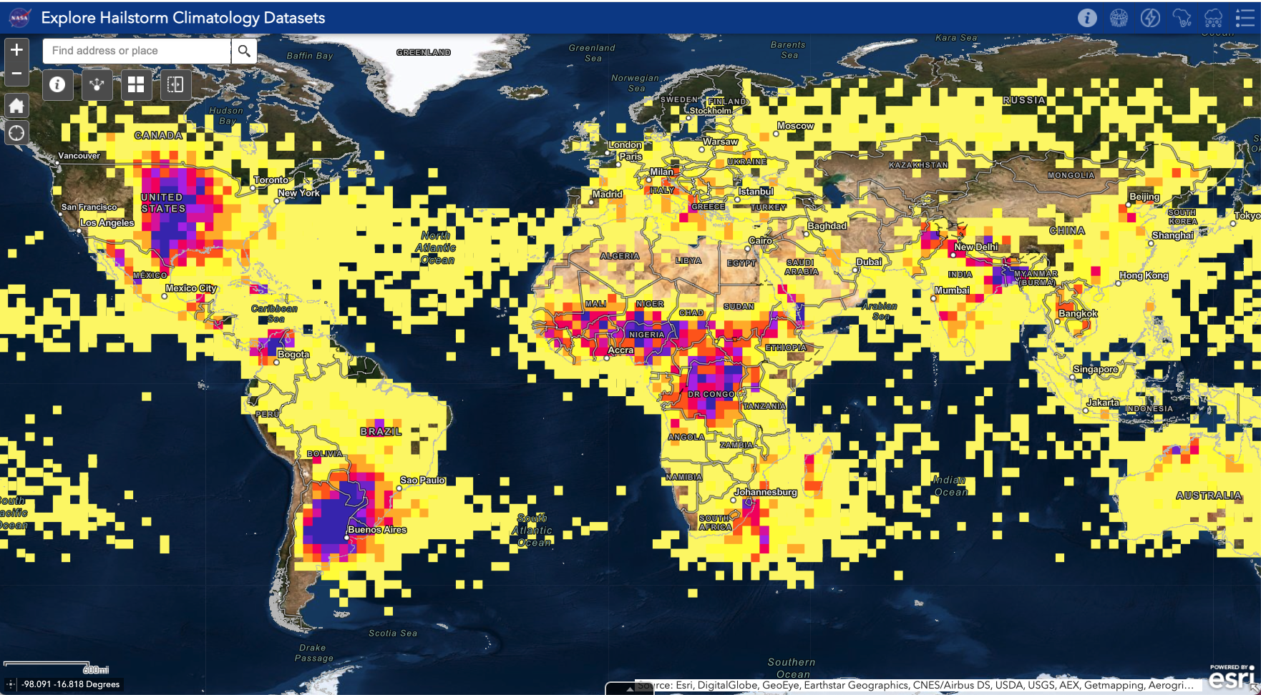
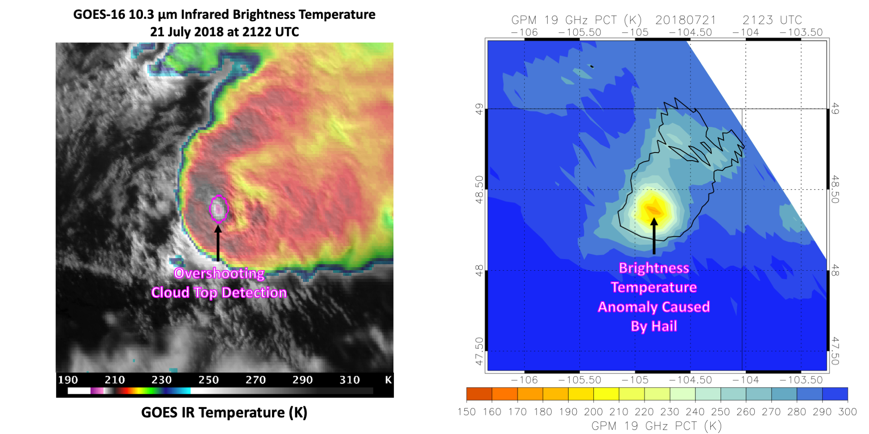
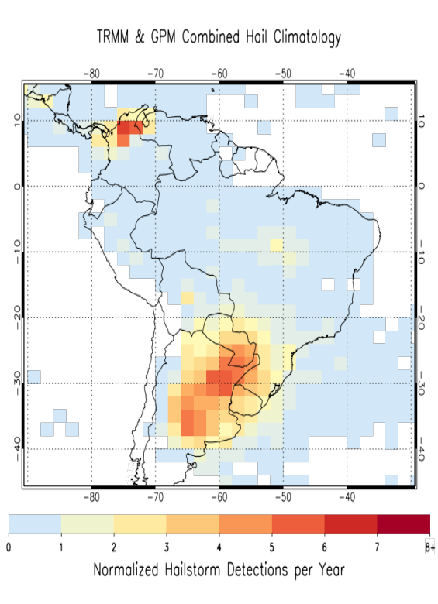
Future, Concurrent, and Parallel Work
Hailstorms Research in the Disasters Program
NASA Earth Science Applied Sciences
ArcGIS Hailstorm Climatology Visualization Portal
https://arcg.is/0C8eXC
Related AGU Presentations:
Bedka (NH45A-0594) “Use of Geostationary IR, Passive Microwave Imager, and Reanalysis Datasets to Assess Climatological Hailstorm Risk.” Thursday 12/16 @ 4-6p
Bell (GC451-0925) “Identifying and Mapping Agricultural Areas Using Synthetic Aperture Radar Time Series” Thursday 12/16 @ 4-6p
The passive-microwave climatologies are shared with international partners and end-users, as well as paired with other severe weather datasets (Visible/IR, Lightning, Surface Damage) to assess and improve hail detection, prediction, response.

Slide 13
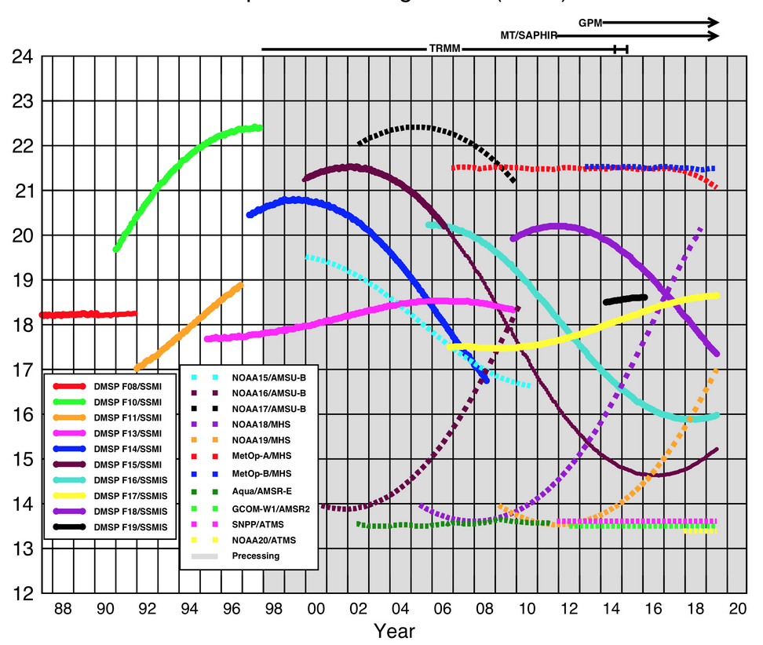
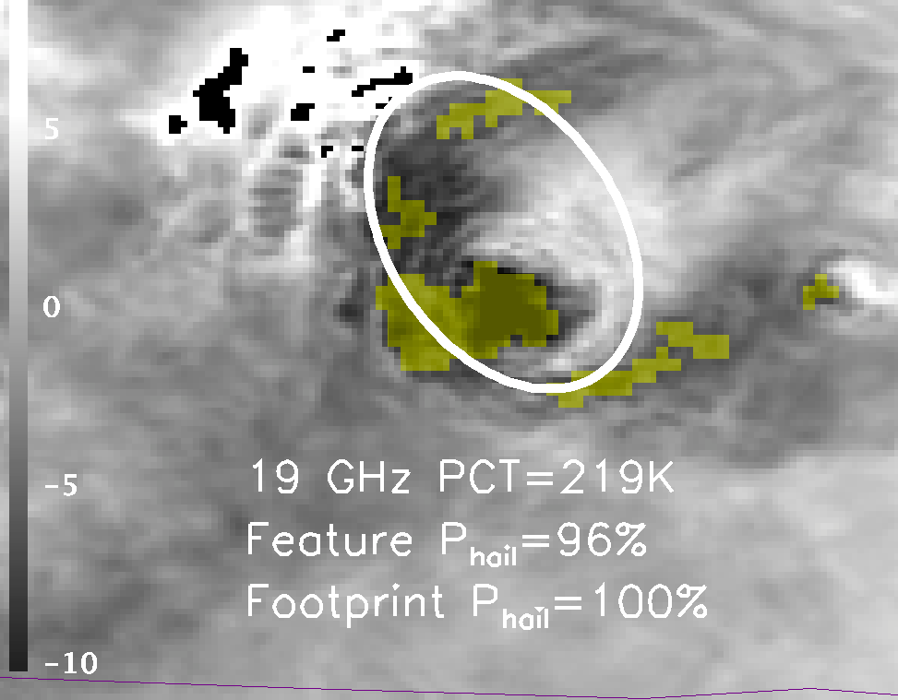
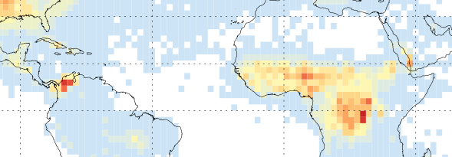
Future, Concurrent, and Parallel Work
NUBF in Hail and the Passive-Microwave
Recently funded work in the NASA Science of Terra, Aqua, and Suomi-NPP program includes using Aqua MODIS vis/IR observations to assess NUBF in AMSR-E passive- microwave observations.
Aqua AMSR-E 19 GHz footprint over MODIS IR T_{b}
With Overshooting Tops
Global coverage and long history of spaceborne passive microwave instruments from 10 – 91 GHz.
Aim to assess the hail climatologies from as many of these platforms as possible.
Going beyond the 4 sensors shown here poses challenges:
Melting and Ice Particle Size Distribution
Future work in the NASA Precipitation Measurement Mission includes a focus on assessing hail size distributions, melting, and how this is manifested in the passive-microwave T_{b}s.
Very large footprints Different scan patterns | Missing 10 GHz channel (used for snow/ice filter)
Notes:
Are the enhanced signatures in the tropics from small hail that melts along its trajectory?

Slide 14
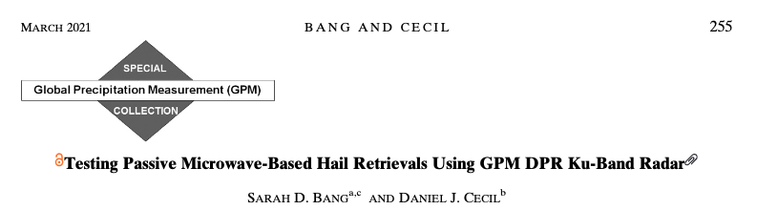
Thank You!
Contact Us:
Sarah.D.Bang@nasa.gov
Daniel.J.Cecil@nasa.gov
Bang and Cecil 2019 & 2021
(JAMC, open access)
TRMM, GPM, and TRMM & GPM Combined Gridded Climatologies
NASA Global Hydrometeorology Resource Center (GHRC) DAAC
http://dx.doi.org/10.5067/MODEL/DATA101
Publicly Available with [free] Earthdata Login

Slide 15
References
Aon Benfield, 2018: Global catastrophe recap: First half of 2018. Aon Benfield Analytics and Impact Forecasting, 1-12 pp.
Aon Benfield, 2020: Weather, Climate & Catastrophe Insight: 2019 Annual Report. Aon Benfield Analytics and Impact Forecasting, 1-81 pp.
Bang, S. D. and D. J. Cecil, 2021: Testing Passive Microwave-based Hail Retrievals using GPM DPR Ku-band Radar J. App. Met. Clim.
Bang, S.D. and D.J. Cecil, 2019: Constructing a Multifrequency Passive Microwave Hail Retrieval and Climatology in the GPM Domain. J. Appl. Meteor. Climatol., 58, 1889–1904.
Battaglia, A., Tanelli, S., Mroz, K., and Tridon, F. (2015), Multiple scattering in observations of the GPM dual-frequency precipitation radar: Evidence and impact on retrievals. J. Geophys. Res. Atmos., 120, 4090– 4101
Cecil, D. J., 2009: Passive microwave brightness temperatures as proxies for hailstorms J Appl Meteorol Climatol., 48 (6), 1281–1286.
Liu, N., Liu, C., Chen, B., & Zipser, E., 2020: What Are the Favorable Large-Scale Environments for the Highest-Flash-Rate Thunderstorms on Earth?, J. Atmos. Sci., 77(5), 1583-1612.
Spencer, R.W., M. R. Howland, and D. A. Santek, 1987: Severe storm identification with satellite microwave radiometry: An initial investigation with Nimbus-7 SMMR data. J Appl Meteorol Climatol., 26 (6), 749–754.

