Slide 1
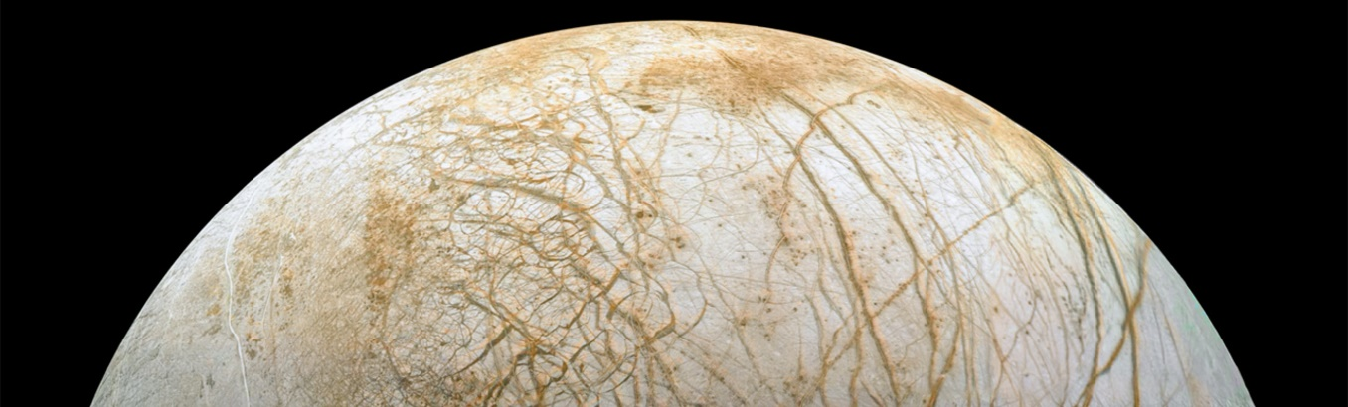
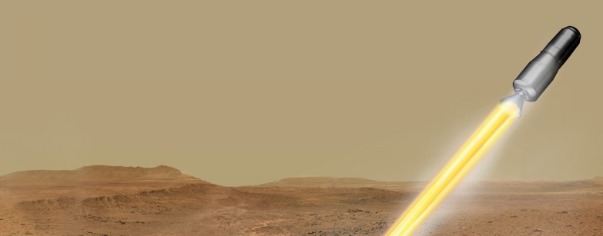

Planetary Protection at Marshall Space Flight Center
Chelsi D. Cassilly, Ph.D.
Jacobs Space Exploration Group/ESSCA
Space Environmental Effects Team
Nonmetallic Materials and Space Environmental Effects Branch
NASA/MSFC/EM41
Chelsi.D.Cassilly@nasa.gov
MindGirl Online Program– August 10
Notes:
Europa Image: NASA (Europa Stunning Surface | NASA Image and Video Library)
MAV Image: NASA (Mars Ascent Vehicle Launching with Samples (Artist's Concept) | NASA Image and Video Library)

Slide 2
Who am I?
Lipscomb University – B.S. in Molecular Biology
  ’08 – ’12
University of Tennessee, Knoxville – Ph.D. in Microbiology
  ’12 – ’17
Harvard Medical School – Postdoctoral Fellow in Chemical Biology
  ’18 – ’21
Jacobs Space Exploration Group – Planetary Protection
  ’21 – present

Slide 3
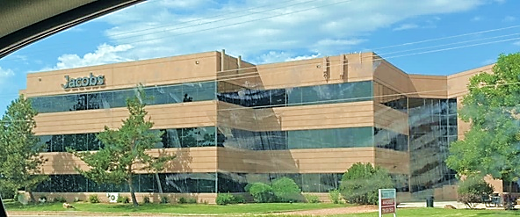
Jacobs Engineering Group Inc. is a technical professional services company
Jacobs Space Exploration Group – subset of Jacobs that supports human spaceflight
  ESSCA contract with NASA MSFC
Notes:
Image: Chelsi Cassilly

Slide 4
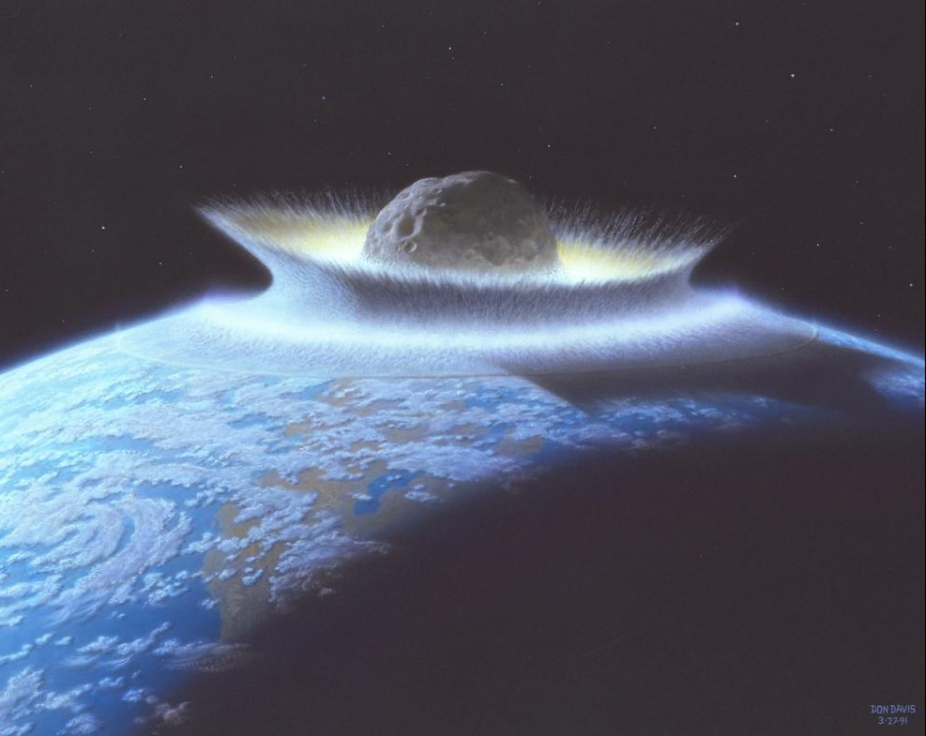
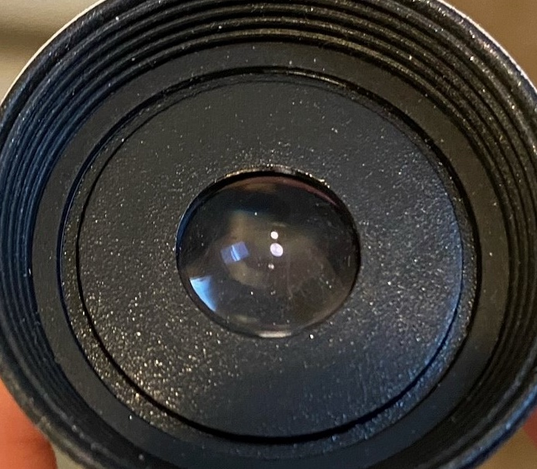
What is Planetary Protection?
It’s NOT:
NASA/ARC
Planetary Defense Contamination Control
Notes:
Asteroid Image: ARC-1991-AC91-0193 | NASA Image and Video Library
Lens: Chelsi Cassilly

Slide 5
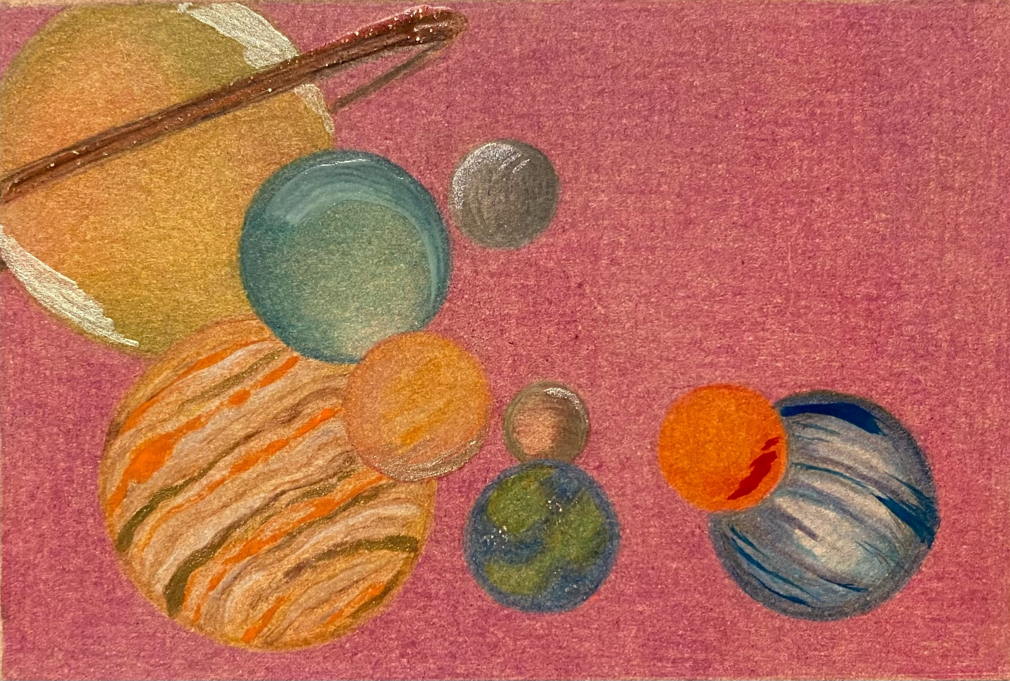
What is Planetary Protection?
Planetary Protection is the practice of protecting solar system bodies from contamination by Earth life and protecting Earth from possible life forms that may be returned from other solar system bodies.

Slide 6
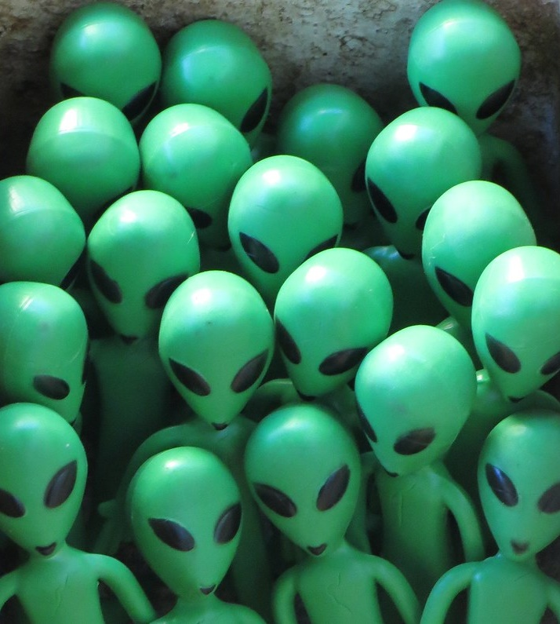
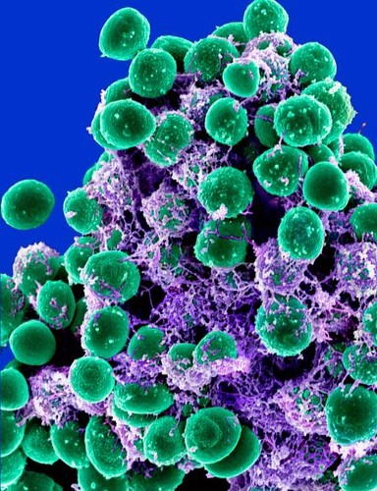
So, what are these “life forms” we care about?
"GroupET10 Aliens" by interdimensionalguardians is licensed under CC BY 2.0
"Staphylococcus epidermidis Bacteria" by NIAID is licensed under CC BY 2.0

Slide 7
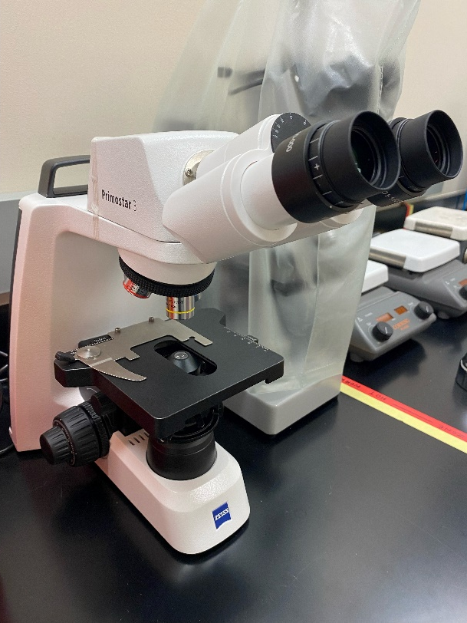
Microbes, Bacteria, and Spores
Microbes are living organisms that are too small to see without the aid of a microscope
Bacteria, viruses, archaea, protozoa, fungi are subsets of microorganisms
Spores are hardy, dormant cells that some bacteria produce in order to survive harsh conditions
Planetary protection is most concerned with endospores, although some bacteria are very resistant to sterilization, and all “bioburden” can be problematic.

Slide 8
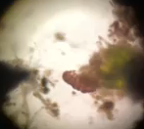
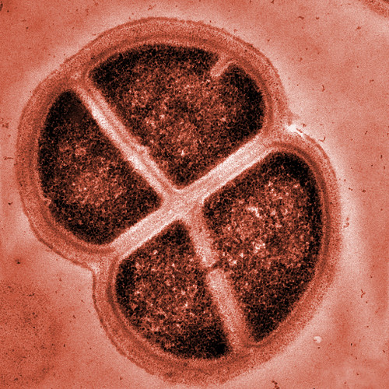
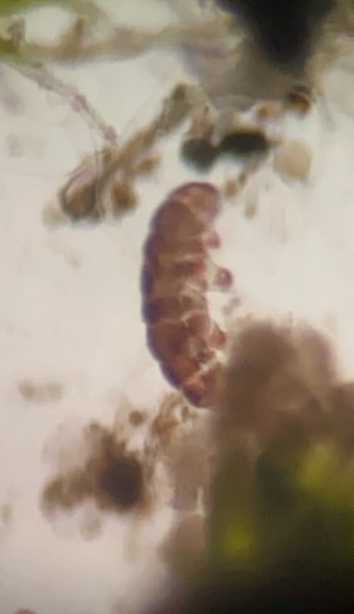
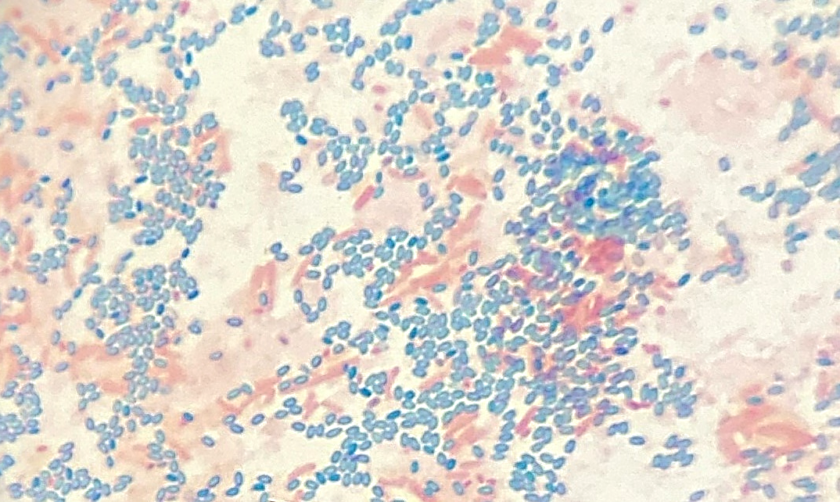
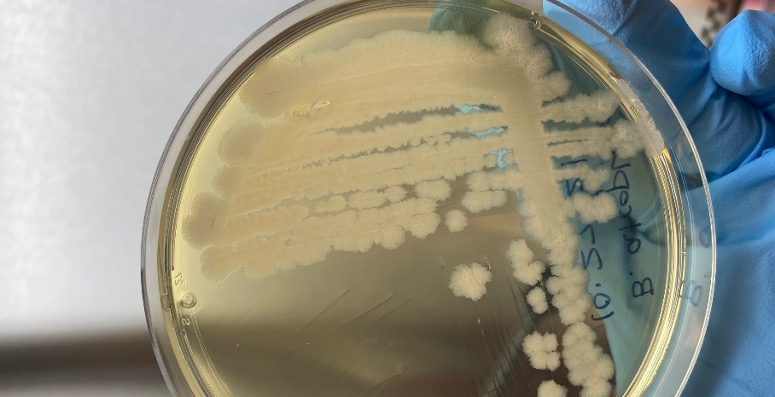
VIDEO
"Deinococcus Radiodurans" by EMSL is licensed under CC BY-NC-SA 2.0
Notes:
Tardigrade Image: jsc2021e019949 | NASA Image and Video Library
Bacillus spores: Chelsi Cassilly

Slide 9
Many microbes can survive one or more of the conditions below:
  Radiation
  Vacuum
  Heat
  Cold
  Dehydration
  Chemicals
  Acid
  Salt
  Impact
  Pressure
  O₂ deprivation
  Starvation
  Time

Slide 10
Why is planetary protection important?
Ethically, to preserve pristine environments and avoid contamination/seeding with Earth microbes

Slide 11
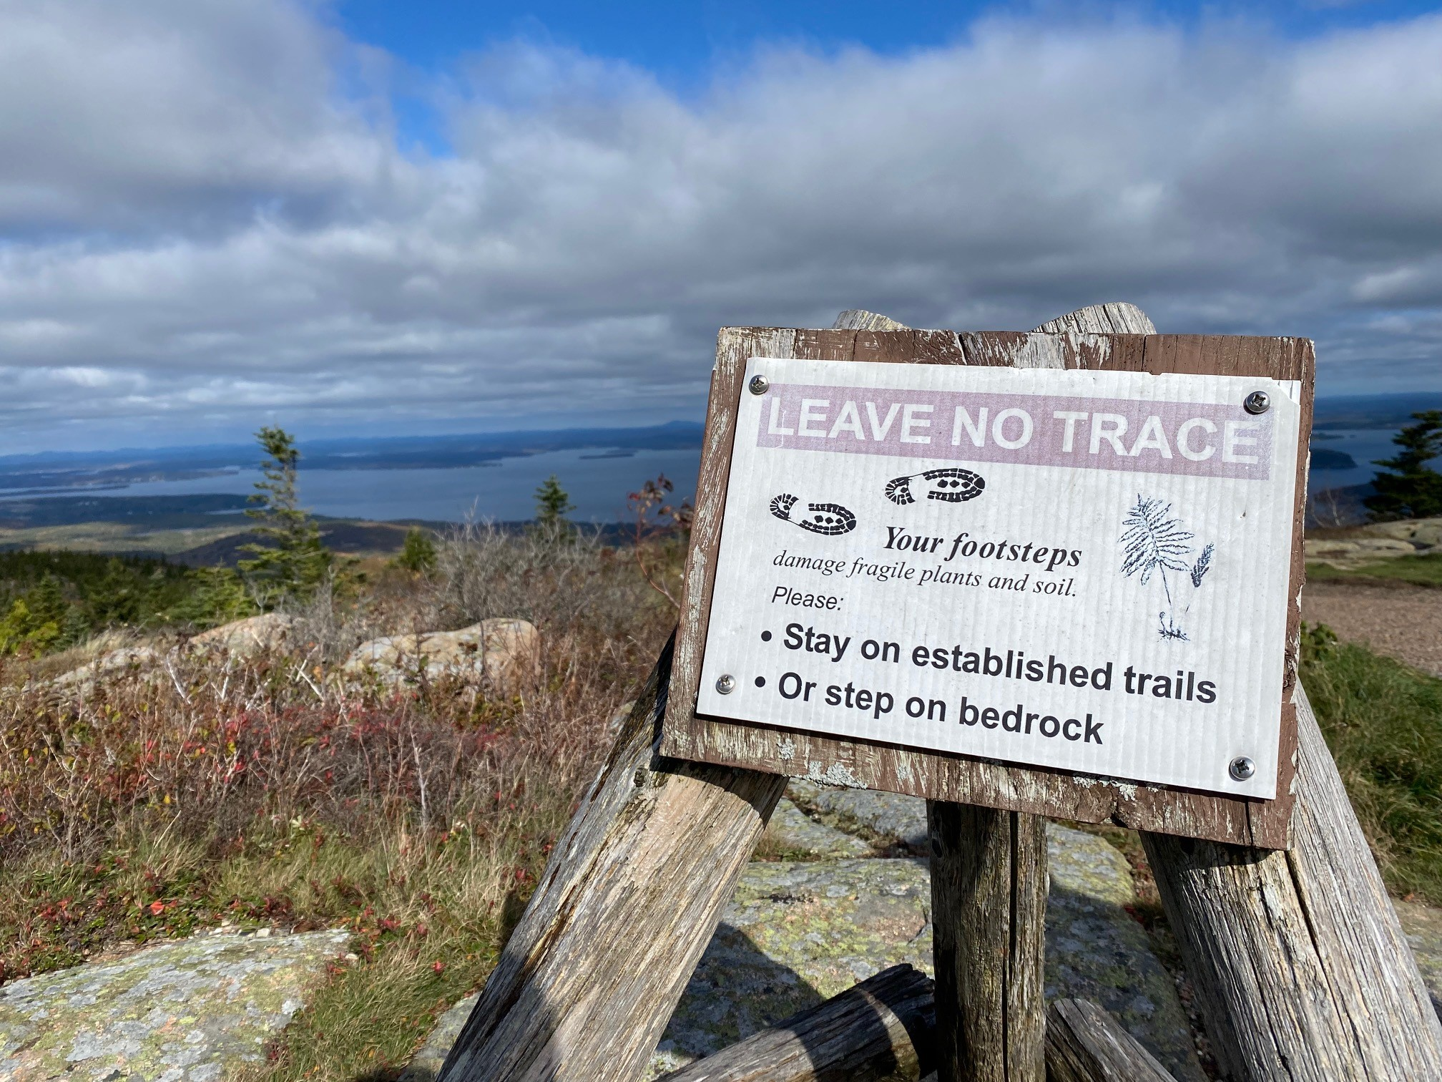
Just as we wish to preserve certain places on Earth...
Notes:
Image: Chelsi Cassilly

Slide 12
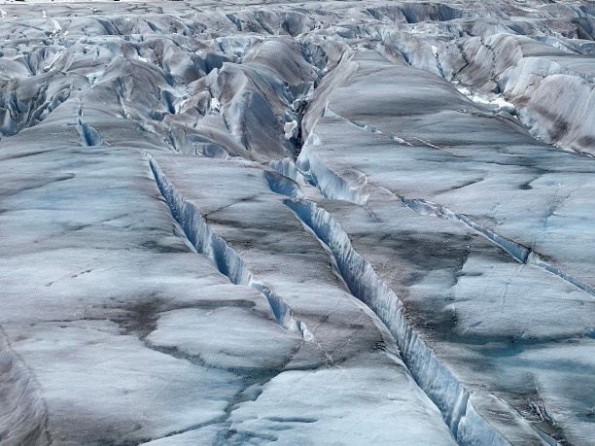
…we also wish to preserve other planetary bodies.
Notes:
Image: Artist Concept of Europa Water Vapor Plume | NASA Image and Video Library

Slide 13
Why is planetary protection important?
Ethically, to preserve pristine environments and avoid contamination/seeding with Earth microbes
To protect Earth from possible microbes or bioactive molecules returning in samples or on spacecraft

Slide 14
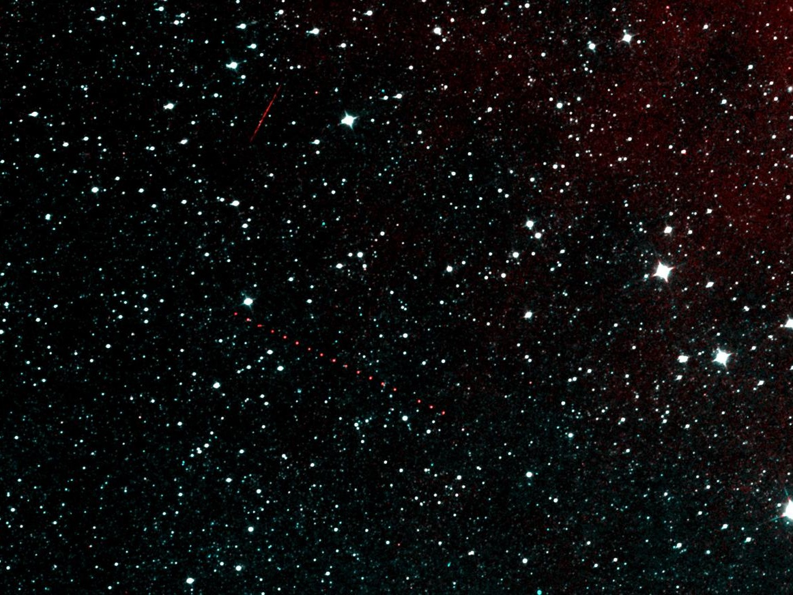

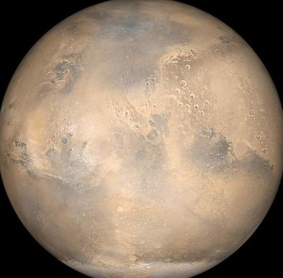
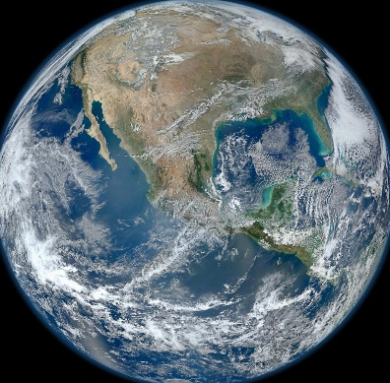
“Backward” Planetary Protection is concerned with protecting Earth
NASA/JPL/MSSS
Notes:
Sky: NEOWISE Next Light | NASA Image and Video Library
Mars: Mars Opposition and Equinox | NASA Image and Video Library
Earth: Earth | NASA Image and Video Library

Slide 15
Why is planetary protection important?
Ethically, to preserve pristine environments and avoid contamination/seeding with Earth microbes
To protect Earth from possible microbes or bioactive molecules returning in samples or on spacecraft
To maintain integrity of science conducted
  Hardware functionality
  Purity of samples collected

Slide 16
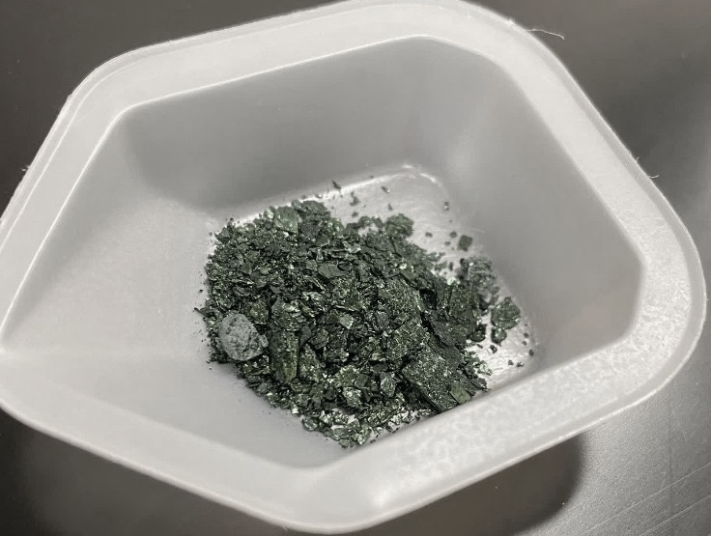
How can we search for life if we bring our own?
Notes:
Image: Chelsi Cassilly
Witness tubes will help scientists tell which materials in the Martian materials may actually be of Earth origin.
Sample tubes are made of titanium, white coating to protect from heating by the sun
Perseverance's sample tubes must isolate and preserve the scientific value of their contents for well over 10 years.

Slide 17
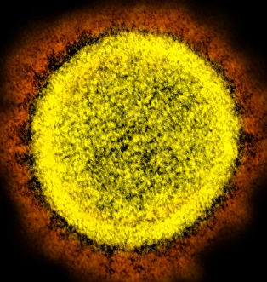
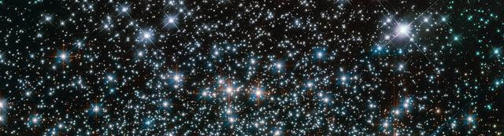
"Novel Coronavirus SARS-CoV-2" by NIAID is licensed under CC BY 2.0
1 × 10³¹ viruses on earth end to end would stretch for 100 million light years
100 million times as many bacteria in the oceans (13 × 10²⁸) as there are stars in the known universe
Microbiology by numbers. Nat Rev Microbiol 9, 628 (2011). https://doi.org/10.1038/nrmicro2644
NASA Goddard
Notes:
Image: Hubble Friday - Heavy Metal Stars | NASA Image and Video Library

Slide 18
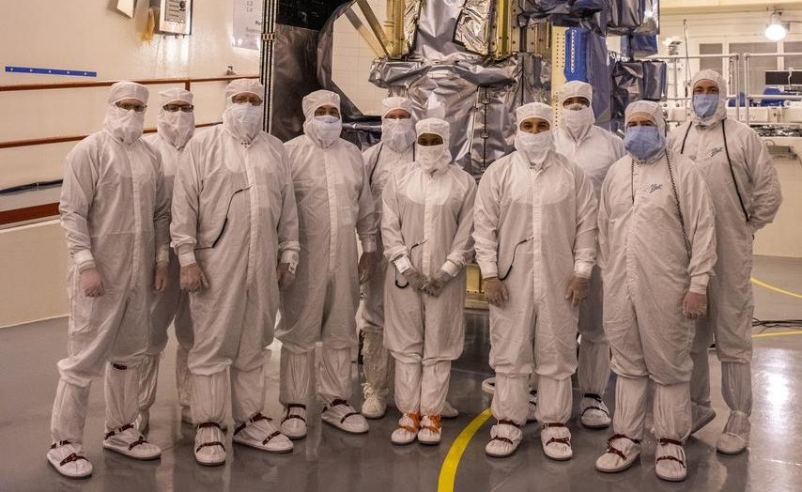
NASA/KSC
Notes:
Image: Landsat 9 Spacecraft (Observatory) Cover Removal | NASA Image and Video Library

Slide 19

We leave a trail of microbes on surfaces and in the air
Humans give off ~1 million biological particles every hour by exhaling, sloughing off skin cells, and radiating hot air from the top of the head
Our Bodies, Our Microbial Clouds. Bloomberg CityLab (2015)

Slide 20
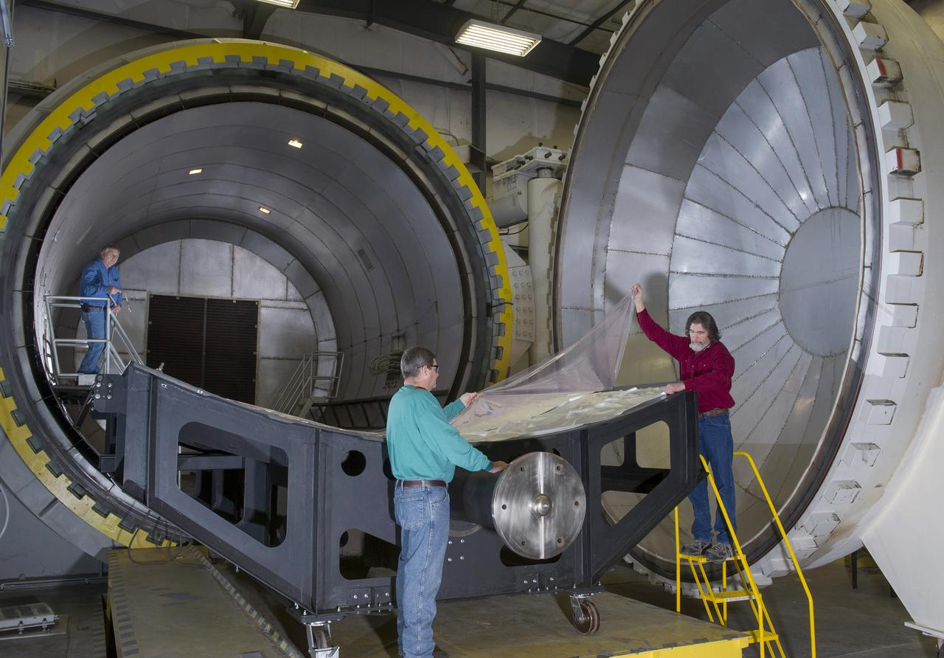
Acceptable Treatment and Cleaning
Heat Microbial Reduction (HMR)
Vapor Hydrogen Peroxide (VHP)
Credit: ESA
NASA/MSFC
Notes:
Image: 18' X 20' AUTOCLAVE | NASA Image and Video Library
NASA PPO has approved use of VHP as a low-temperature sterilization modality, for simple surfaces, with specifications for time, rate, and H₂O₂ concentration levels. Complex geometries (e.g., vented boxes and electronic chassis inside the warm electronics box of a rover), however, require further directions. Thus, an additional study aims to describe the effect of VHP on electronic materials, materials with different configurations, solder joints, etc. Work has also begun for developing a portable VHP system that can be used locally (e.g., at the site of hardware integration in a cleanroom or on the launch pad).

Slide 21
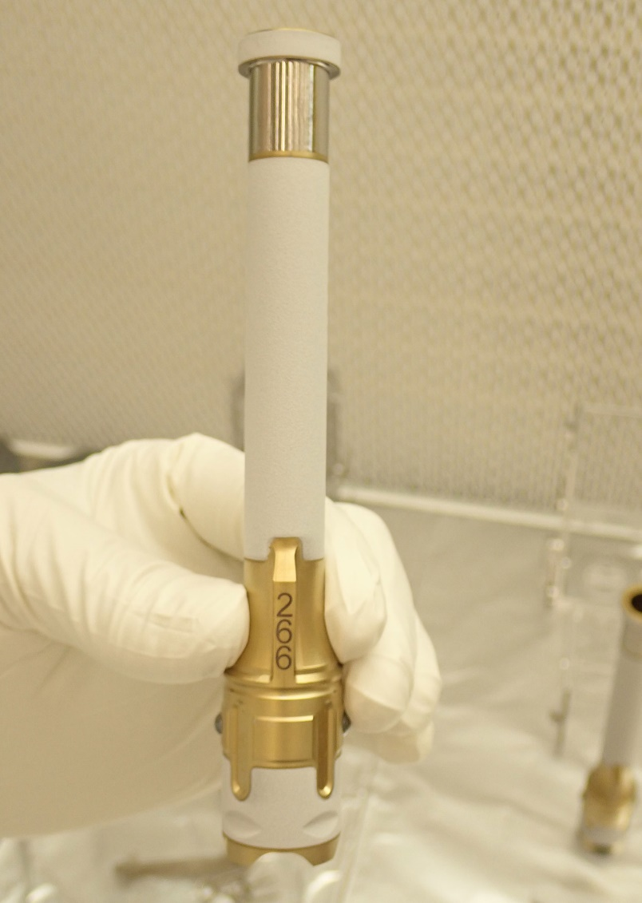
“Clean” is relative
Strict rules limit contaminants from Earth
Sample handling hardware must be very clean
  Sample tubes
  Sample scoops/drills
  Anything contacting samples
Mars 2020 tubes - novel cleaning process
Image Credit: NASA/JPL
Notes:
Tube Image: Perseverance Sample Tube 266 | NASA Image and Video Library

Slide 22
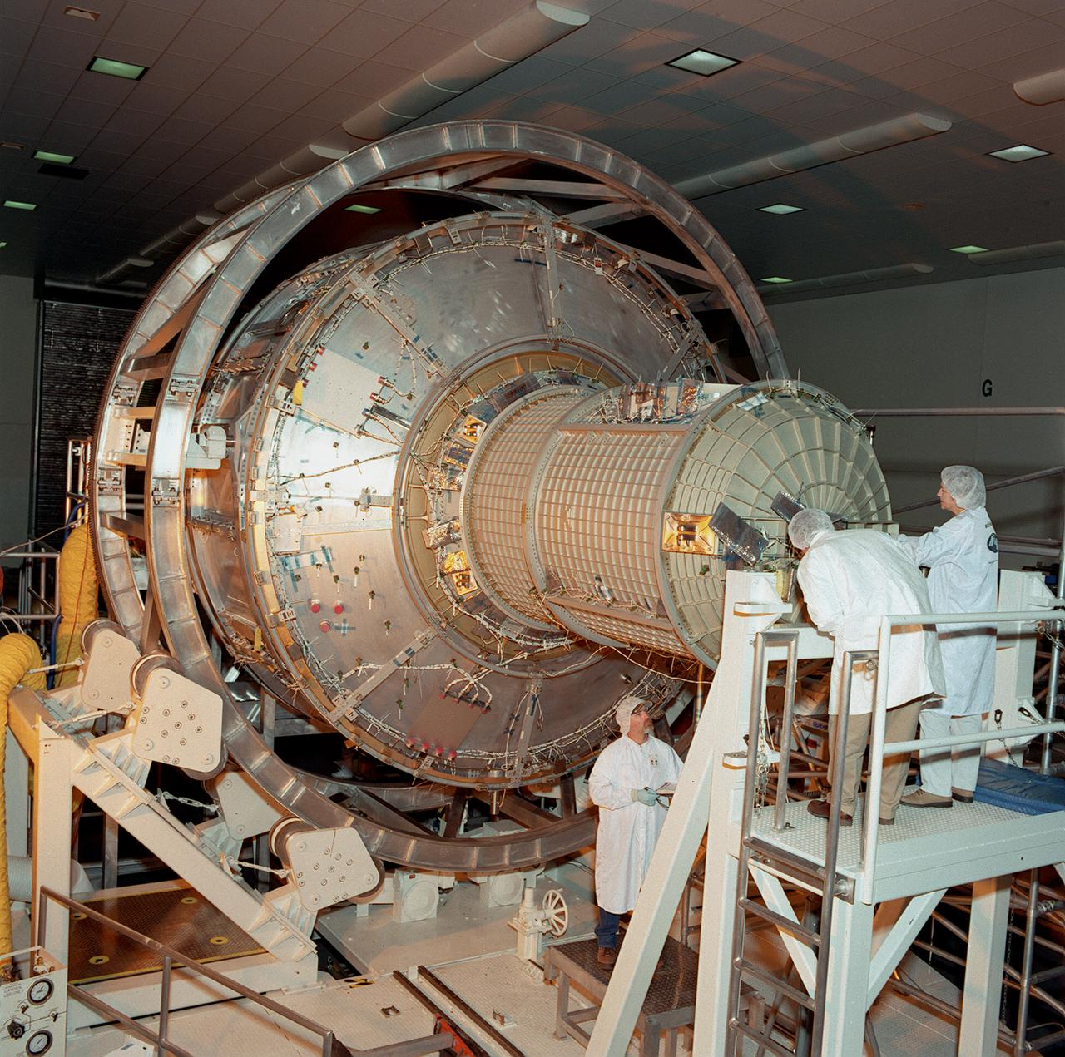
JPL and MSFC – Novel Cleaning Methods
Using new solvents to clean materials
  Vapor hydrogen peroxide
Manufacturing credit
  Can we take credit for reducing bioburden if the hardware goes through curing steps?
NASA/MSFC
Notes:
Image: International Space Station (ISS) | NASA Image and Video Library

Slide 23
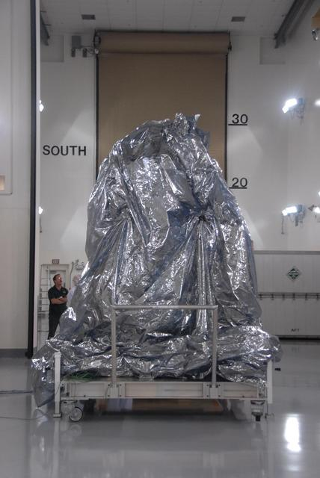
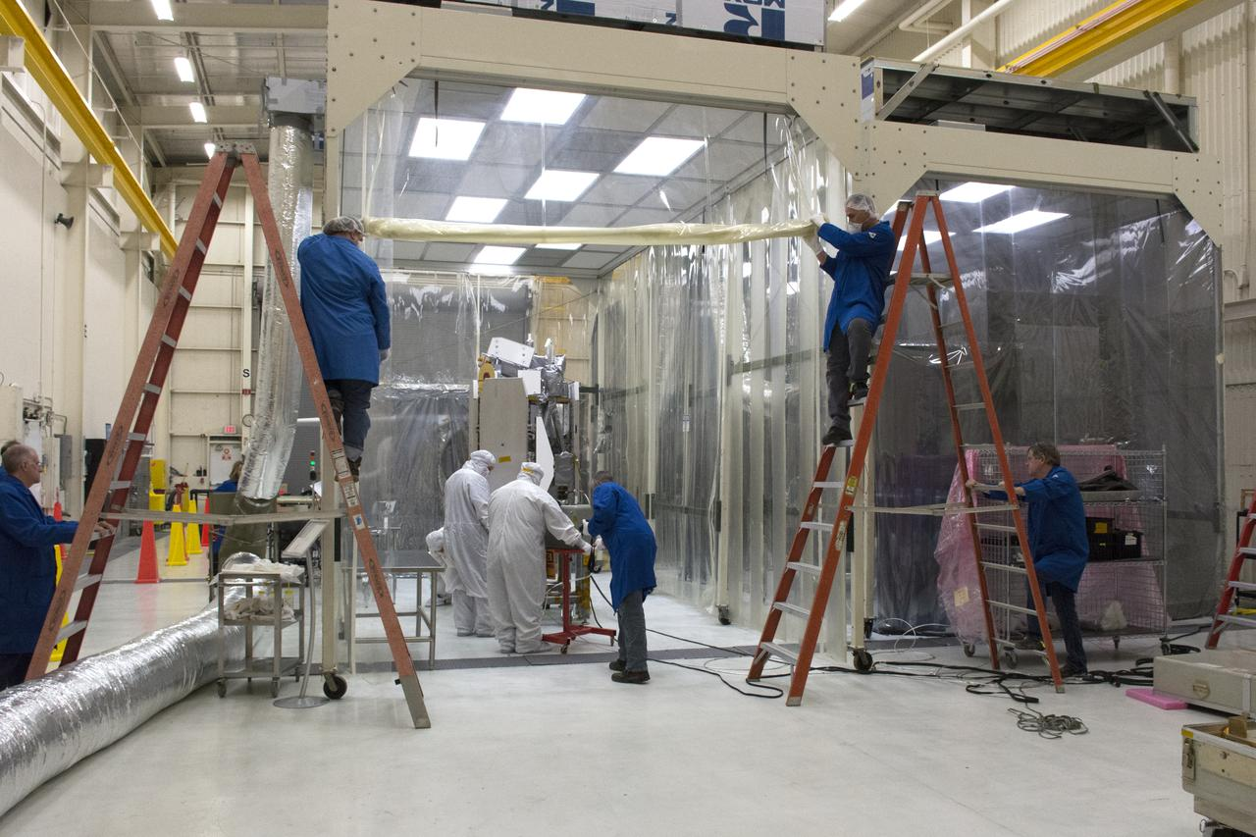
Keep it clean!
Bio-barriers/ bagging
Surface wiping with IPA
HEPA filters
NASA/KSC
NASA/JPL-Caltech
Notes:
Image: NASA WISE Spacecraft in Protective Covering | NASA Image and Video Library
Image: Pegasus ICON Spacecraft Move Into Cleanroom | NASA Image and Video Library

Slide 24
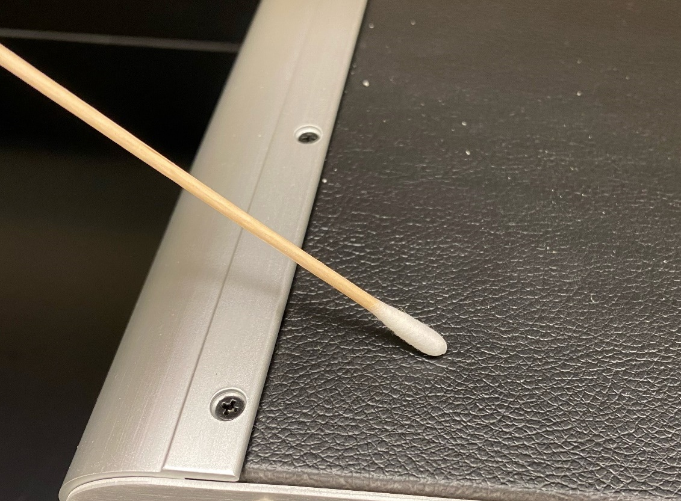
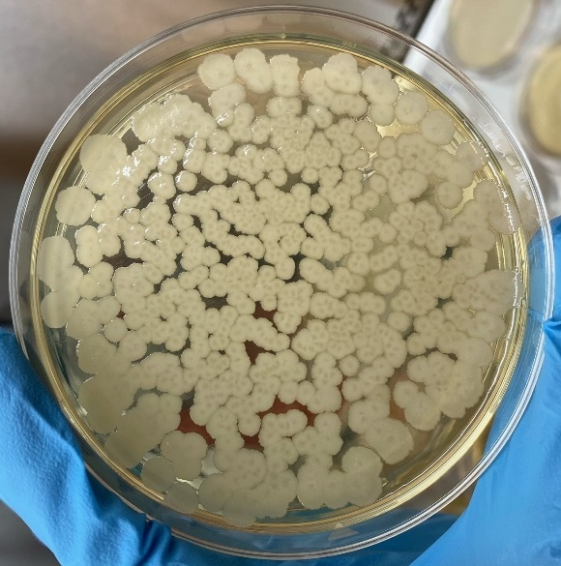
Sampling During Assembly and Integration
To monitor and maintain low bioburden in accordance with NASA requirements
Notes:
Image: Mastcam-Z Final Lens Cleaning | NASA Image and Video Library
Mars is 140 million miles away from Earth

Slide 25
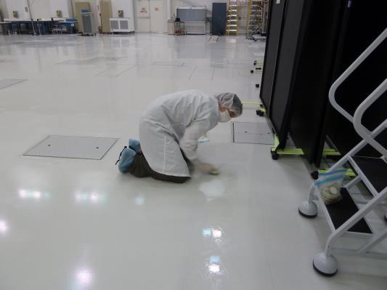
Monitoring cleanroom environment for biological contamination (including air and surfaces)
Image Credit: NASA/JPL-Catlech
Notes:
Image: Looking for Microbes in a Spacecraft Assembly Clean Room | NASA Image and Video Library

Slide 26
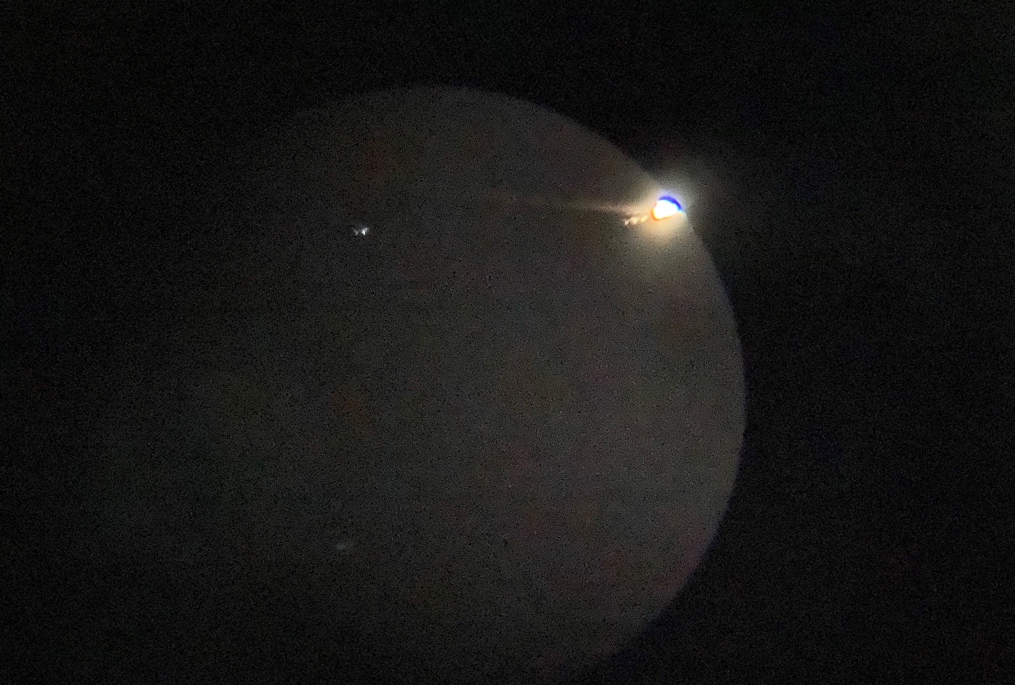
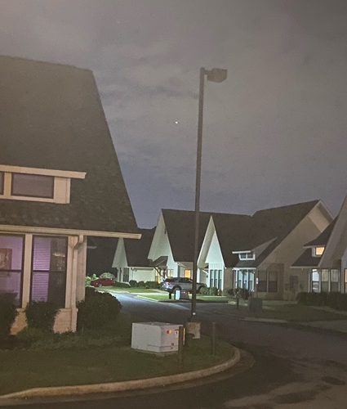
Questions?
Callisto
Jupiter
Ganymede
Europa
9.27.2021

