Slide 1
Methodology and Development of SLS Liftoff Loads
David Alldredge
Dynamic Concepts, LLC
AIAA SciTech Forum, Jan 3-7, 2022
Copyright © by David Alldredge/Dynamic Concepts, LLC
Published by the American Institute of Aeronautics and Astronautics, Inc., with permission.

Slide 2

Methodology and Development of SLS Liftoff Loads
Liftoff analysis captures loads from Core Stage Engine (CSE) start until tower clear
Analysis is broken into 3 sub-events
  Build up (BU) – CSE start to T=0
  Ignition (IG) – Booster ignition (T=0) through tower clear (~7sec)
  Shutdown (SD) – on-pad CSE shutdown prior to booster ignition
Credit: NASA/MSFC via nasa.gov

Slide 3

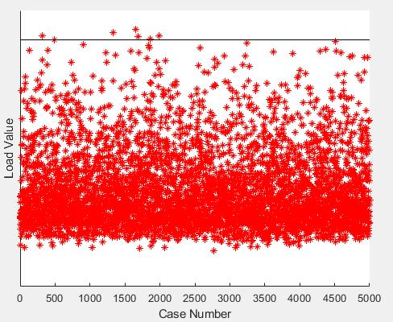
Methodology and Development of SLS Liftoff Loads
Analysis is performed using a Monte Carlo(MC) approach
  Build up and Ignition utilize a 5000 case MC
    Analyzed separately but each MC case represents one continuous liftoff event
  Shutdown uses a 2000 case MC
3σ
Credit: NASA via nasa.gov
Loads are determined using ordered statistics to the desired enclosure level

Slide 4

Methodology and Development of SLS Liftoff Loads
Craig-Bampton (CB) reduced models are provided to the liftoff analysis team
A secondary reduction with residual vector augmentation is performed
BU and SD use coupled vehicle/ML models
  Connected at Vehicle Support Post (VSP) and Vehicle Stabilizer (VS)
IG uses separate vehicle and ML models
  “Coupled” through interface forces
Credit: NASA via nasa.gov

Slide 5
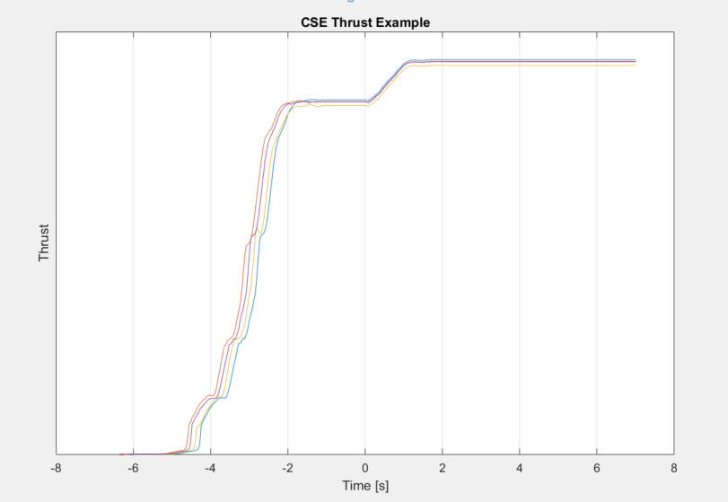
Methodology and Development of SLS Liftoff Loads
External environments
  Wind
  CSE thrust, side loads, hydrogen pop and thrust oscillation
  Booster thrust including igniter shock
  Control forces from integrated GN&C stand alone controller
  CSE and Booster produced overpressure
  Dynamically released stacking and cryo preloads
BU
IG
Notes:
GN&C = Guidance, Navigation, and Control

Slide 6
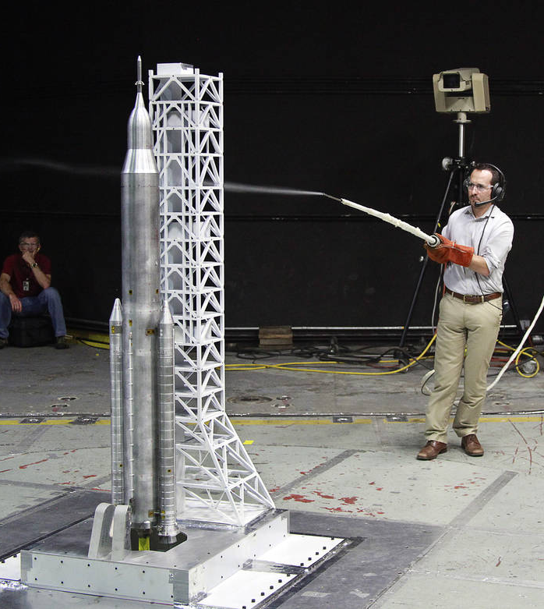
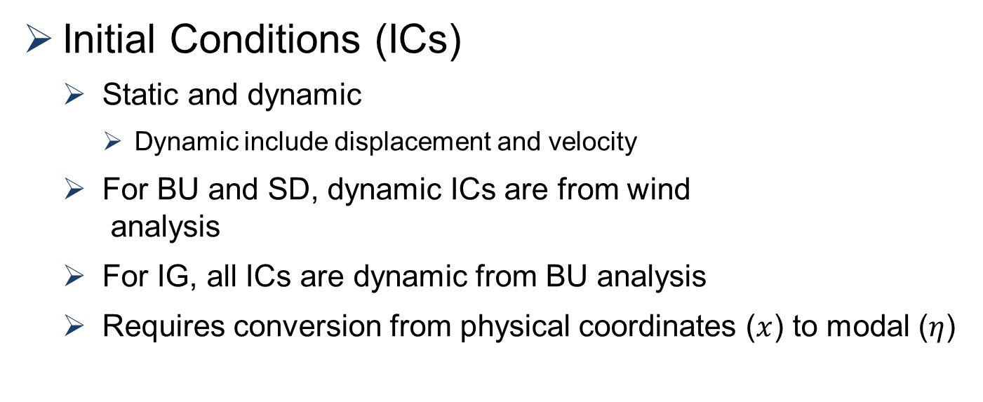


Methodology and Development of SLS Liftoff Loads
Initial Conditions (ICs)
  Static and dynamic
    Dynamic include displacement and velocity
  For BU and SD, dynamic ICs are from wind
  analysis
  For IG, all ICs are dynamic from BU analysis
  Requires conversion from physical coordinates ($x$) to modal ($η$)
Credit: NASA/LaRC via nasa.gov
$$\left\{\ddot{η}\right\}={\left[\left[φ^{T}\right]\left[φ\right]\right]}^{−1}\left[φ^{T}\right]∗\left\{\ddot{x}\right\}$$
$$\dot{\left\{η\right\}}={\left[\left[φ^{T}\right]\left[φ\right]\right]}^{−1}\left[φ^{T}\right]∗\left\{\dot{x}\right\}$$
$$\left\{η\right\}={\left[ω^{2}\right]}^{−1}∗\left(\left[φ^{T}\right]\left\{F\right\}−\left[C\right]\left\{\dot{η}\right\}−\left[M\right]\left\{\ddot{η}\right\}\right)$$

Slide 7
Methodology and Development of SLS Liftoff Loads
Results
  Computed ~200K responses from Load Transformation Matrices (LTMs)
  Ordered statistics used on each row independently
  Following slides show select FRAC section load results compared to the previous cycle (VAC1R) and to the design loads (SLS-RQMT-045-01, Rev. E)
Notes:
FRAC = Flight Readiness Analysis Cycle, VAC1R = Verification Analysis Loads Cycle 1 - Reintegration

Slide 8
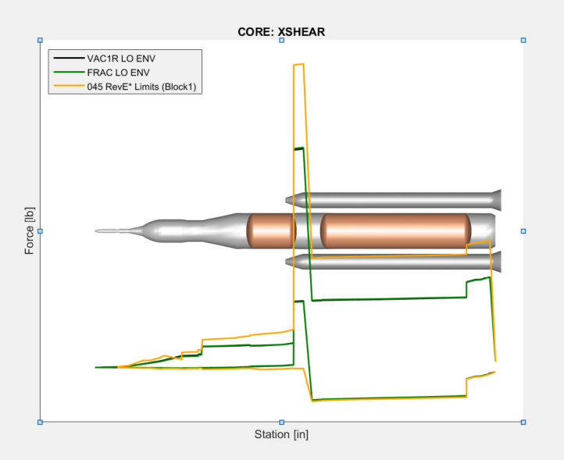
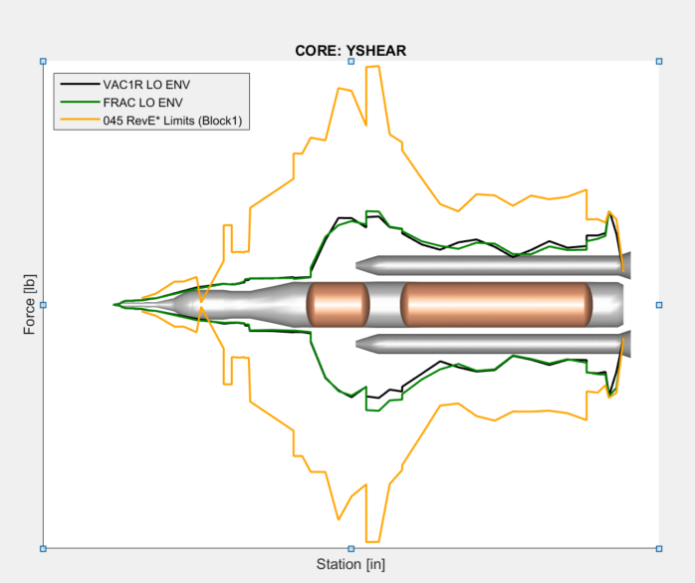
Methodology and Development of SLS Liftoff Loads
Results

Slide 9
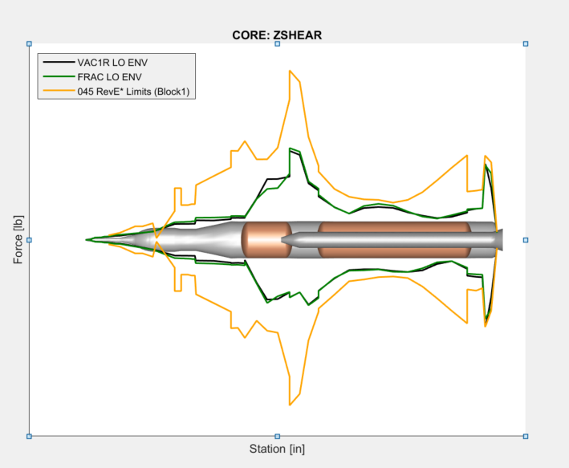
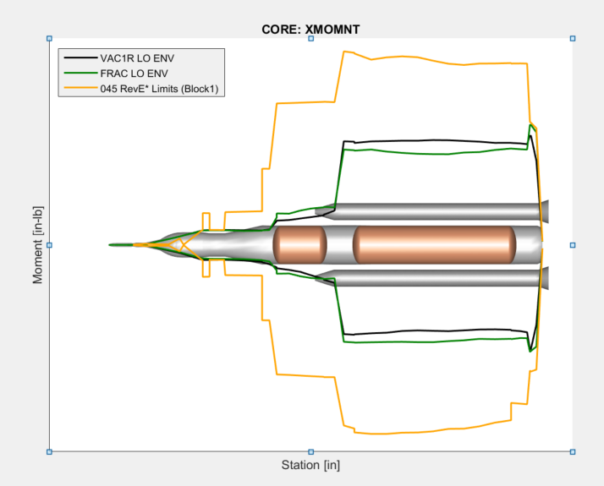
Methodology and Development of SLS Liftoff Loads
Results

Slide 10
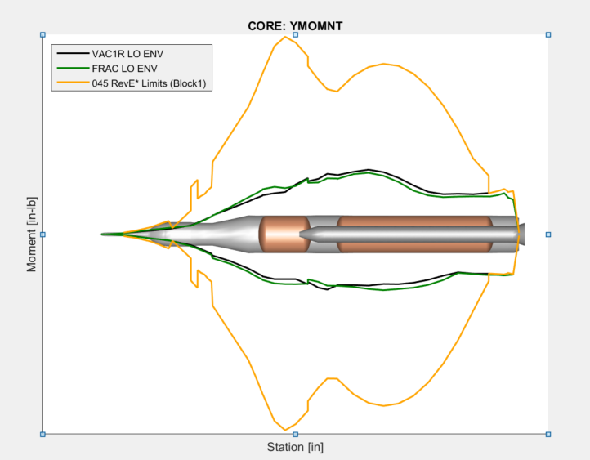
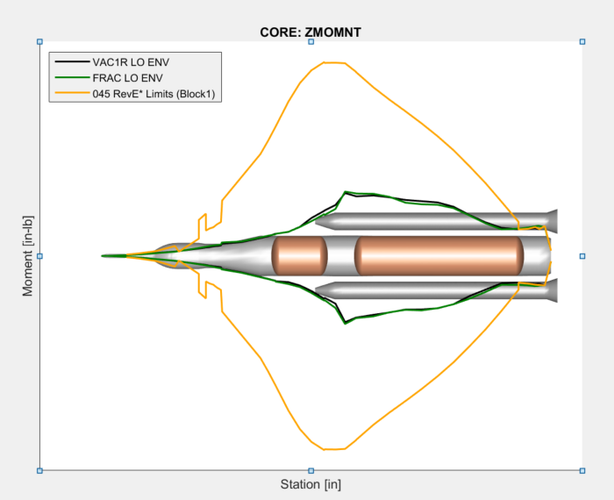
Methodology and Development of SLS Liftoff Loads
Results

