Slide 1
US side Magnetic nozzle computational modeling efforts update cont.
12/6/2021
Nathan Schilling

Slide 2
Nozzle naming convention - example
Aside about input file naming convention
axNozz_32s_30MA__250cm_5
Prefix specifies nozzle configuration
(“axNozz” for axial and
“solNozz” for solenoidal)
Mixture ratio
“5” indicates a mixture ratio of 5kg of lithium for 1kg of Tungsten
Number of struts/coils
“32s” means 32 struts.
Solenoidal nozzles use coils
Distance from the center of the plasma to the nozzle exit. A distance of 0 m indicates the center of the plasma is in the same place as the nozzle exit In this case, the underscore indicates a negative, so “_250cm” means the plasma is -250cm away from the nozzle exit, or 2.50 m inside the nozzle. For the 3.5 m long nozzle, this means the plasma is 1 m away from the nozzle vertex
Strut/coil current
So this nozzle used
a current of 30 MA

Slide 3
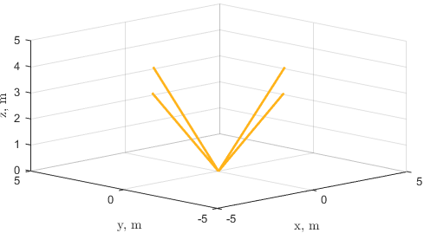
Axial nozzle results

Slide 4
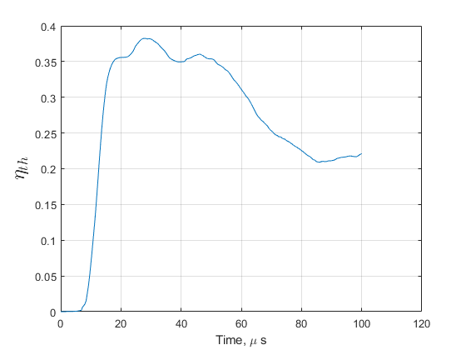
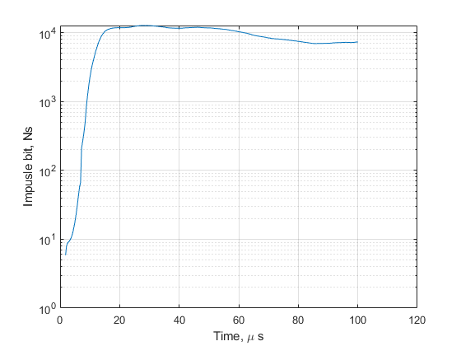
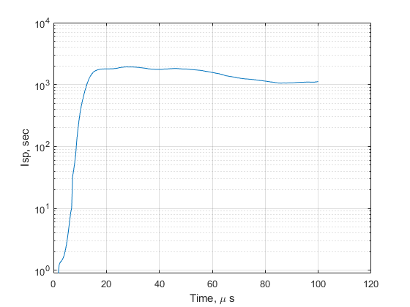
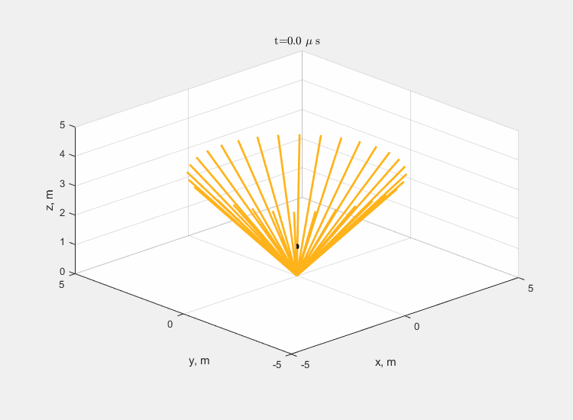
Results from axNozz_32s_30MA__250cm_5
Performance is mediocre
  Higher nozzle efficiency initially, then decreases
  Specific impulse and thrust follow general trend of nozzle efficiency
    Increase as particles start to leave the nozzle, but decreases as particles get turned around and sucked back into the nozzle
    See animation

Slide 5
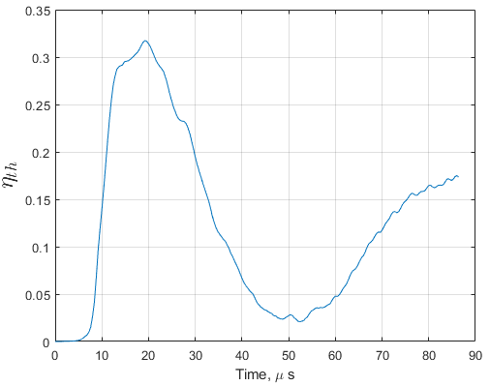
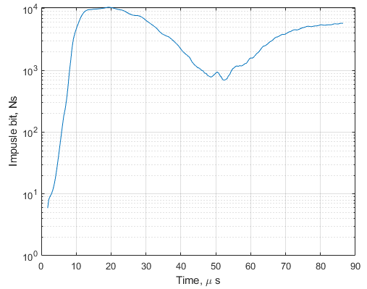
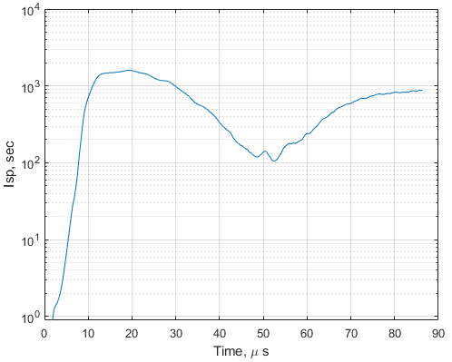
Double Current - axNozz_32s_60MA__250cm_5
Case isn’t technically done running but overall results are obvious
Plasma very clearly gets sucked back into the nozzle
  Shown in animation and all performance plots
  Performance increases, then decreases, then increases again
Peak performance less than before

Slide 6
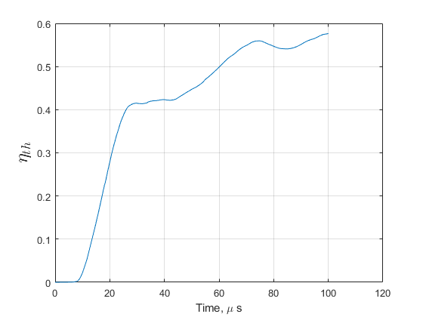
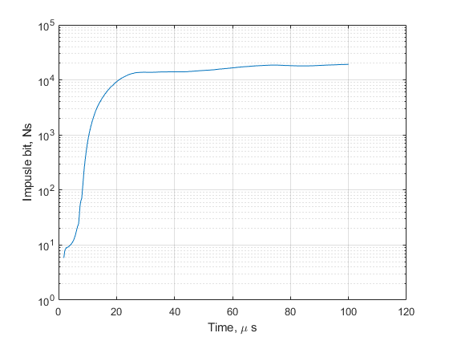
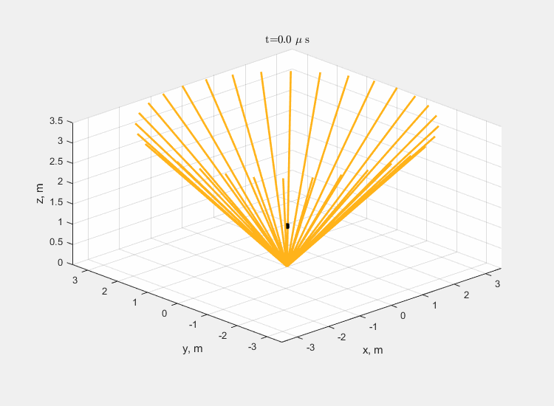
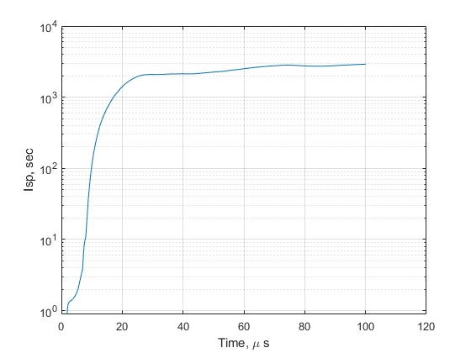
Half Current - axNozz_32s_15MA__250cm_5
Better performance than any other nozzle tested to date
  Better than 0.5 nozzle efficiency
  Isp around ~3000 sec which is better than a Hall thruster
  Impulse bit ~2 kNs which gives a thrust to weight for PuFF closer to 0.01

Slide 7
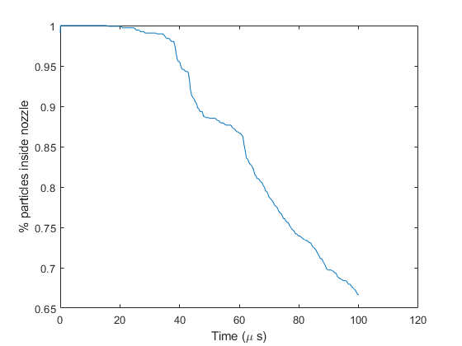
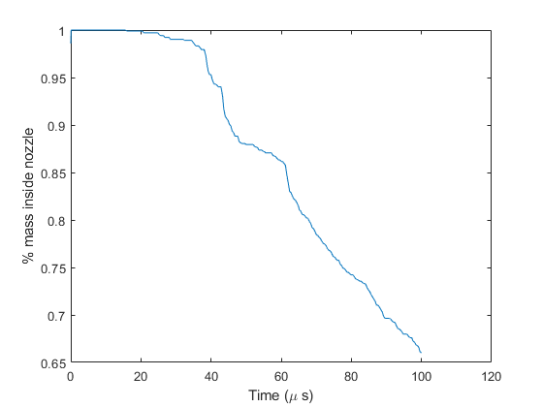
Half Current - axNozz_32s_15MA__250cm_5
Still performance left in nozzle
  Less than half the mass/particles have escaped
Is it worth chasing this performance down?

Slide 8
Solenoidal nozzle Results

Slide 9
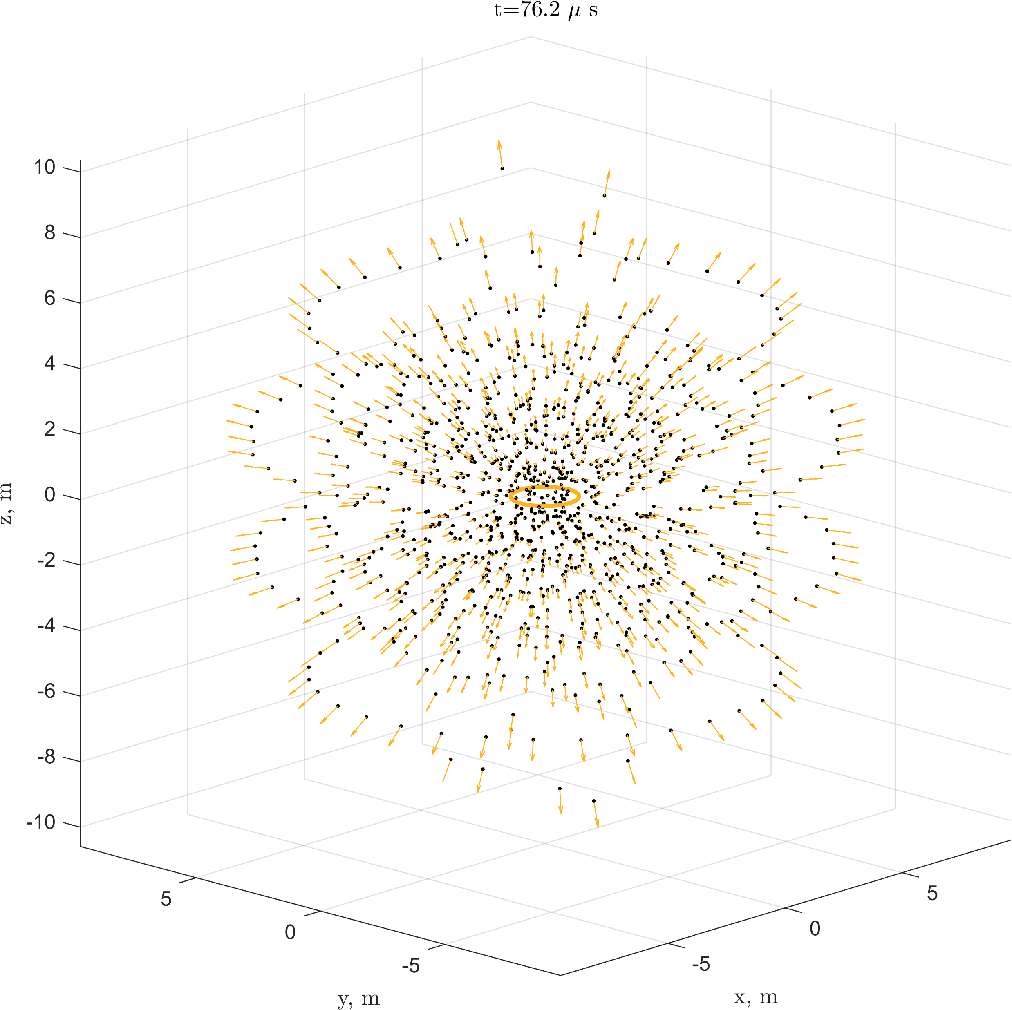
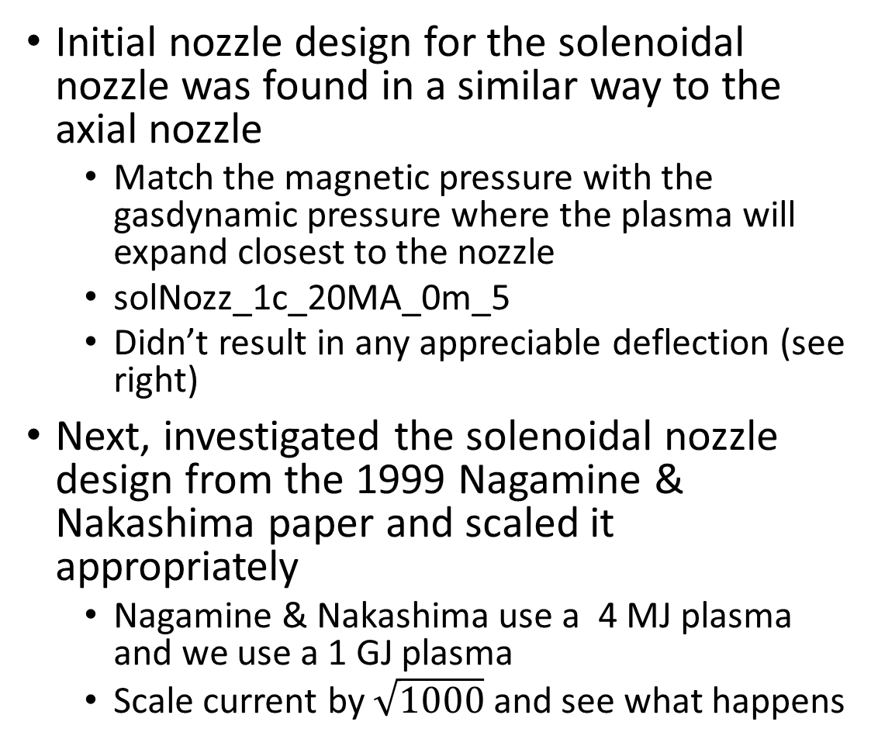
Initial nozzle run
Initial nozzle design for the solenoidal nozzle was found in a similar way to the axial nozzle
  Match the magnetic pressure with the gasdynamic pressure where the plasma will expand closest to the nozzle
  solNozz_1c_20MA_0m_5
  Didn’t result in any appreciable deflection (see right)
Next, investigated the solenoidal nozzle design from the 1999 Nagamine & Nakashima paper and scaled it appropriately
  Nagamine & Nakashima use a 4 MJ plasma and we use a 1 GJ plasma
  Scale current by $\sqrt{1000}$ and see what happens

Slide 10
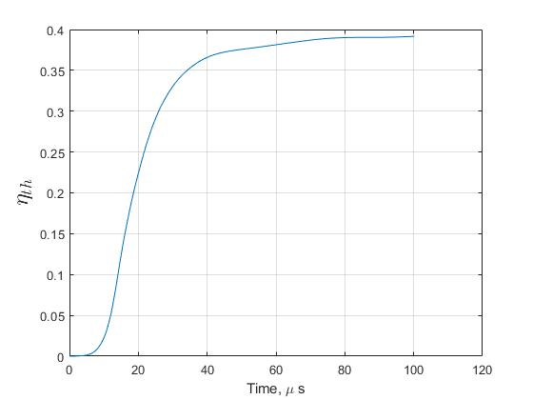
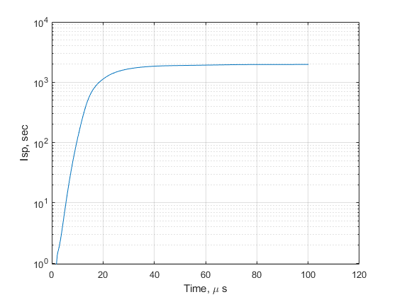
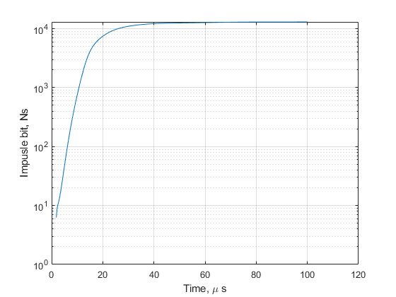
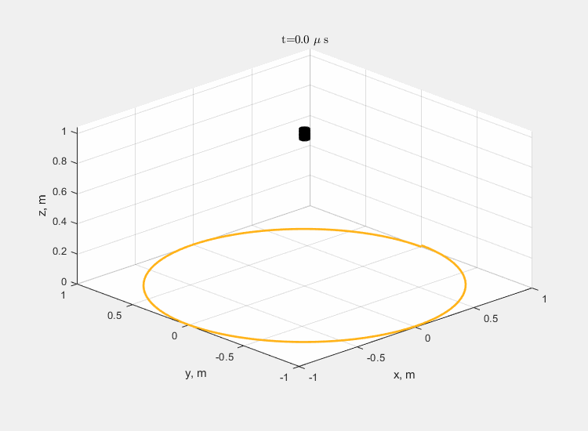
Scaled nozzle run (solNozz_1c_113MA_1m_5)
Appreciable performance/deflection
  Peak efficiency isn’t as good as the axial nozzle (only around 40%) but it’s respectable
  Trends in the right direction (increases before saturation)

Slide 11
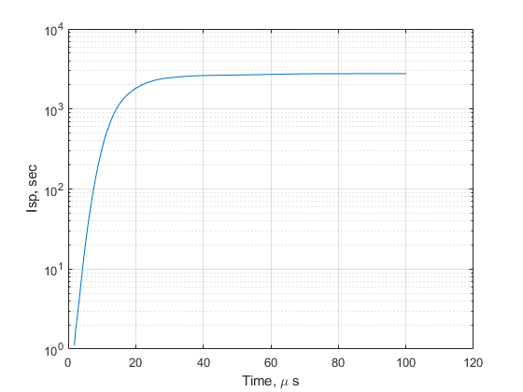
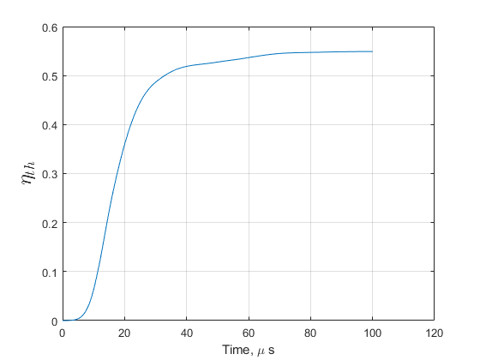
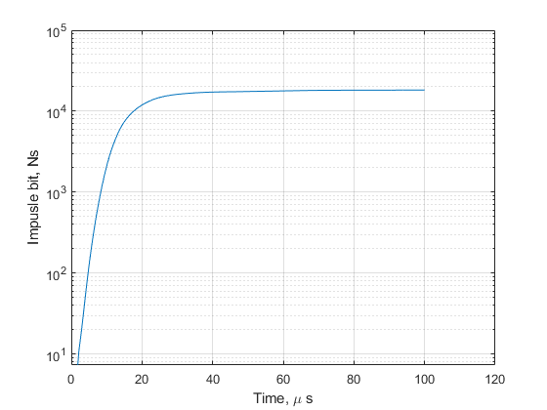
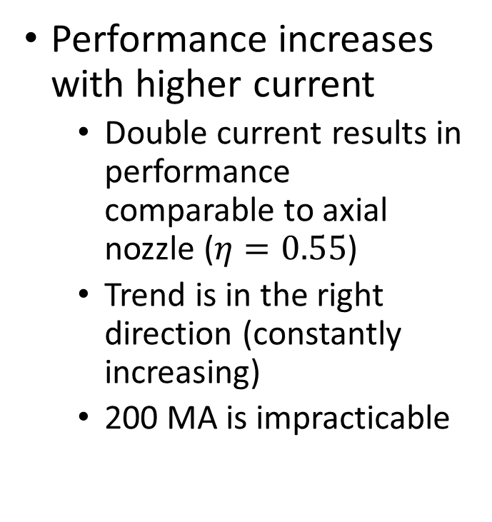
Double current (solNozz_1c_200MA_1m_5)
Performance increases with higher current
  Double current results in performance comparable to axial nozzle ($η=0.55$)
  Trend is in the right direction (constantly increasing)
  200 MA is impracticable

Slide 12
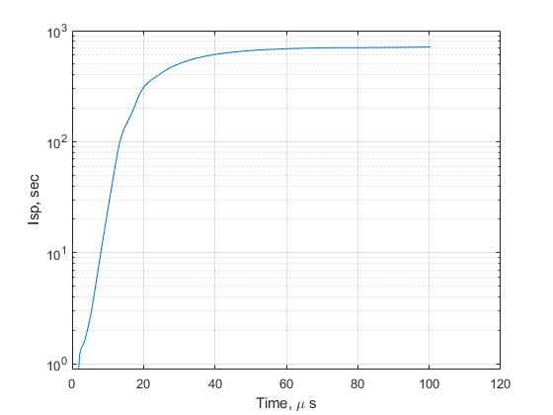
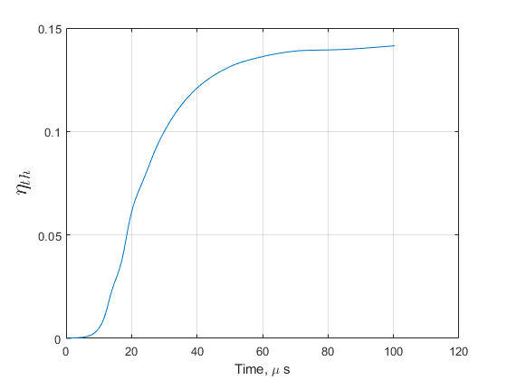
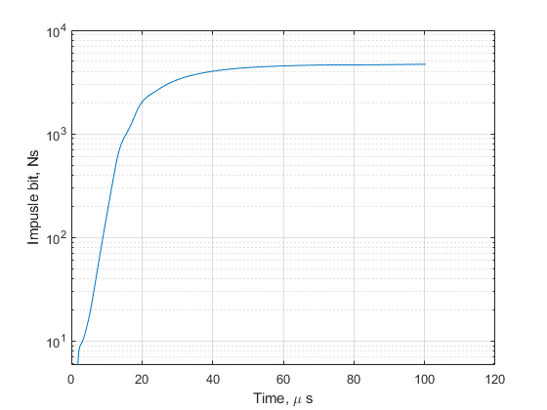
Half current (solNozz_1c_50MA_1m_5)
Performance isn’t as good here
  Peak efficiency is only around 15%
Seems that efficiency scales to the ½ power with current

