Slide 1


Mars Entry Instrumentation Flight Data and Mars 2020 Entry Environments
AIAA SciTech Conference,
Mars 2020 EDL Performance and Instrumentation:
Atmosphere, Aerodynamics, and Trajectory (AFM-02/TP-01)
January 3rd, 2022
Todd White, Milad Mahzari, Chun Tang, Josh Monk, Jose Santos
NASA Ames
Chris Karlgaard
AMA Incorporated at NASA Langley
Hannah Alpert
AMA Incorporated at NASA Ames
Henry Wright, Chris Kuhl
NASA Langley

Slide 2
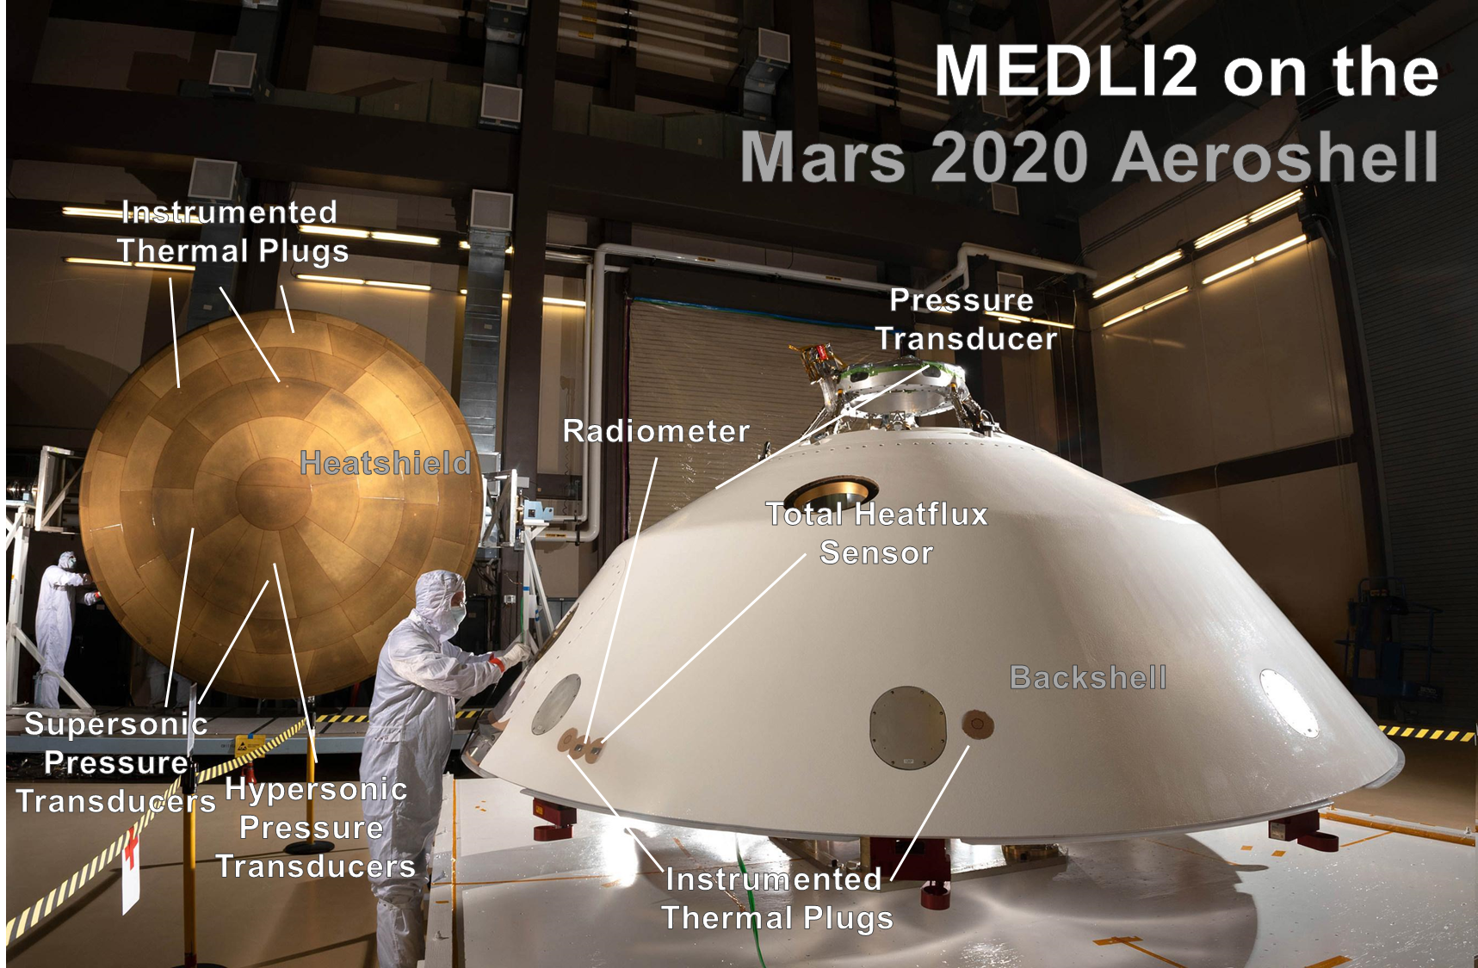
Background on EDL Instrumentation
Planetary entry probe missions are complex, costly, and infrequent.
It is important to the Entry Descent and Landing (EDL) and planetary exploration community to understand the entry environments, performance of the entry vehicle, and atmospheric density and winds.
Flight Instrumentation provides a valuable dataset to understand:
  The as-flown environment, beyond a binary “it worked” or “it failed”,
  Areas of design conservatism,
  Accuracy and limitations of our state-of-the-art predictive simulations and experiments.
This data can be used for improved reliability, Thermal Protection System (TPS) mass reductions, and more accurate landing operations for future vehicles.
Today’s talk describes the most recent EDL instrumentation suite (MEDLI2), which will be the focus of the other papers and presentations in this session.
The Mars 2020 included MEDLI2 instrumentation suite focused on entry atmospheric, aerodynamic, aerothermal, and thermal protection system measurements.
MEDLI2 was a collaboration between LaRC (PM, Pressure Sensors, Electronics, SE), ARC (PI, Thermal Sensors), and JPL (accommodation aboard M2020).

Slide 3
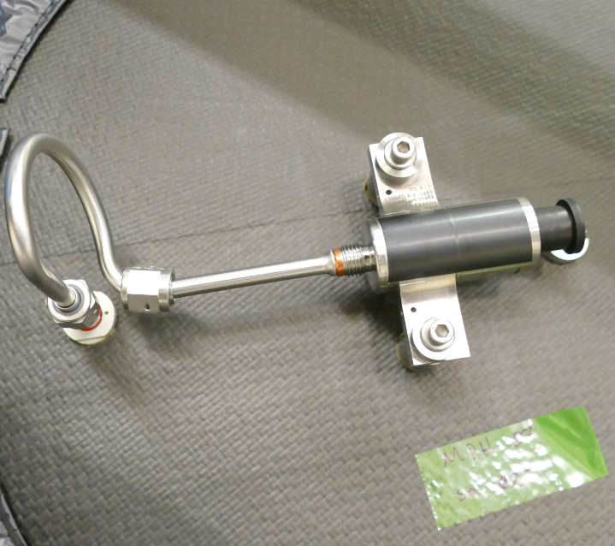
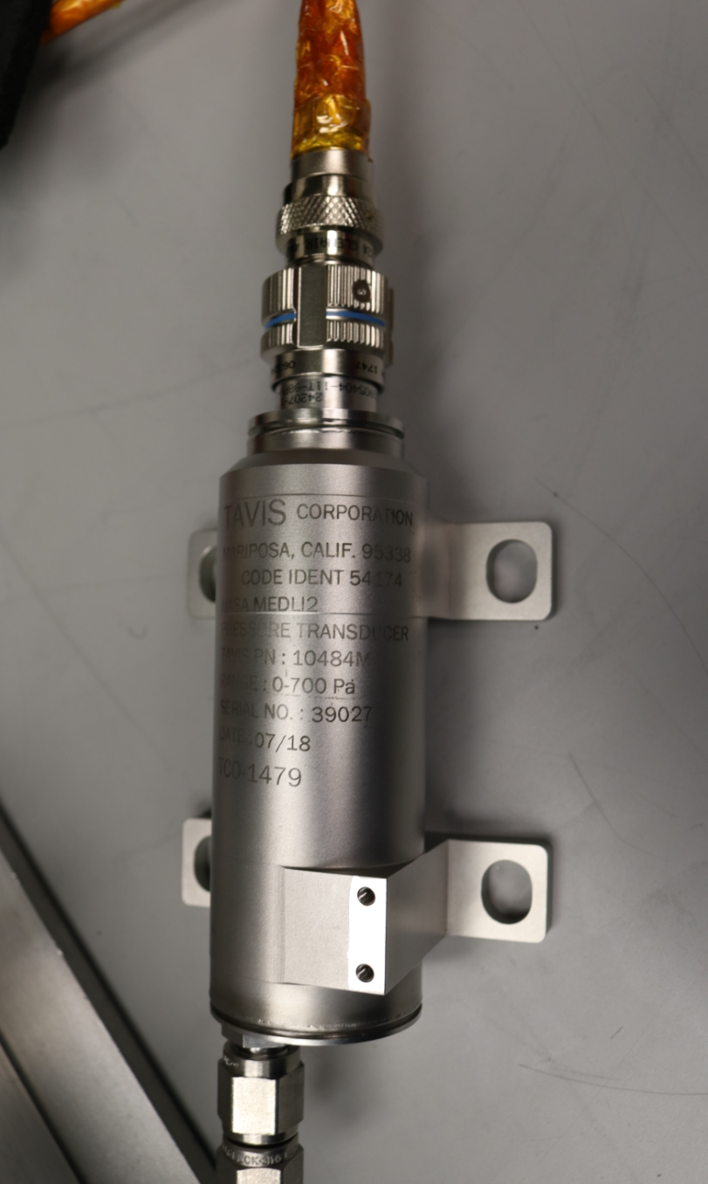
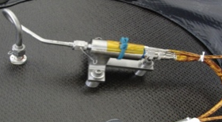
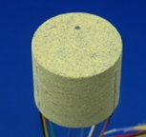
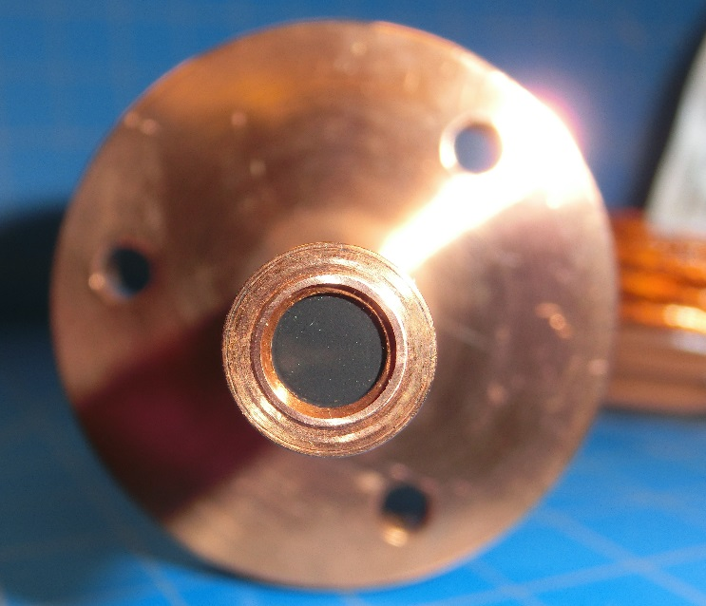
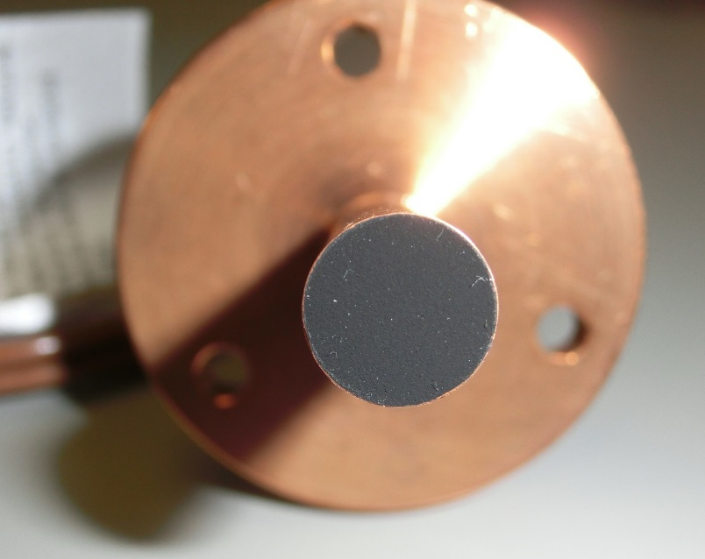
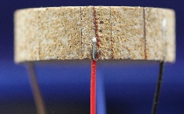
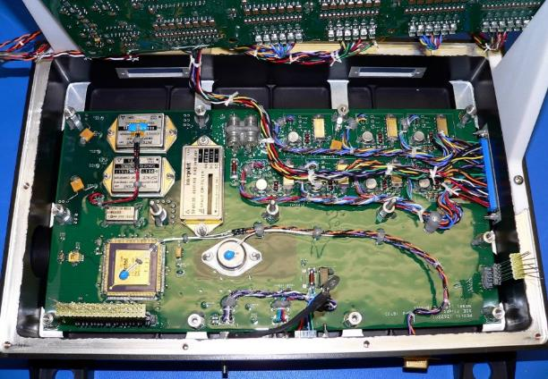
Instrumentation on M2020 Aeroshell
MEDLI2 builds on success of MSL/MEDLI, and greatly extends the range, coverage, and type of measurements to be made during Martian entry.
Like MSL/MEDLI, MEDLI2 has three major hardware components for sensing and processing the entry environment:
MEADS (Mars Entry Atmospheric Data System):
  Network of pressure transducers on the heatshield and backshell,
  These were a combination of Hypersonic, Supersonic, and low-pressure sensors.
MISP (MEDLI2 Instrumented Sensor Plugs):
  Network of high-temperature thermocouples (TCs) embedded in thermal protection system plugs, installed across the PICA heatshield and SLA-561V backshell.
  Two types of sensors for directly measuring incident heating on the backshell (total heating and radiative only).
SSE (Sensor Support Electronics):
  Multiplexing avionics for gathering, processing, and transferring MISP and MEADS sensor data to the Mars 2020 Descent Stage Power and Analog Module (DPAM).
  Also included harness between SSE and sensors, and from SSE to the DPAM.
Backshell
Transducer
Supersonic
Transducer
Hypersonic
Transducer
Radiometer
PICA plug
SLA plug
Heatflux
Sensor
Digital and Analog
Boards

Slide 4
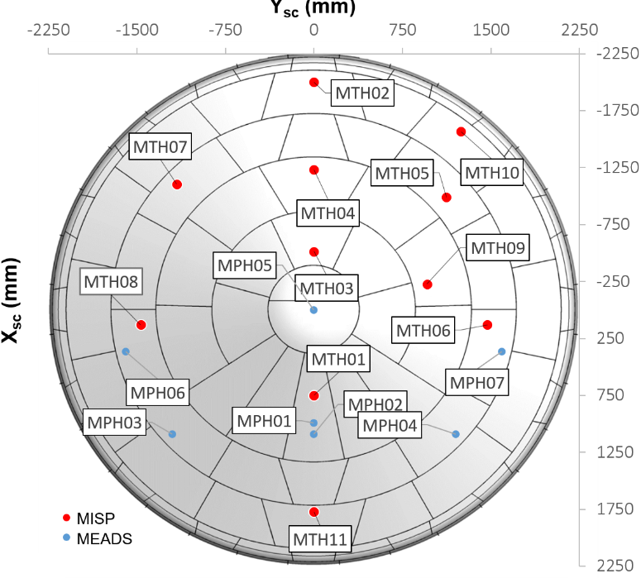
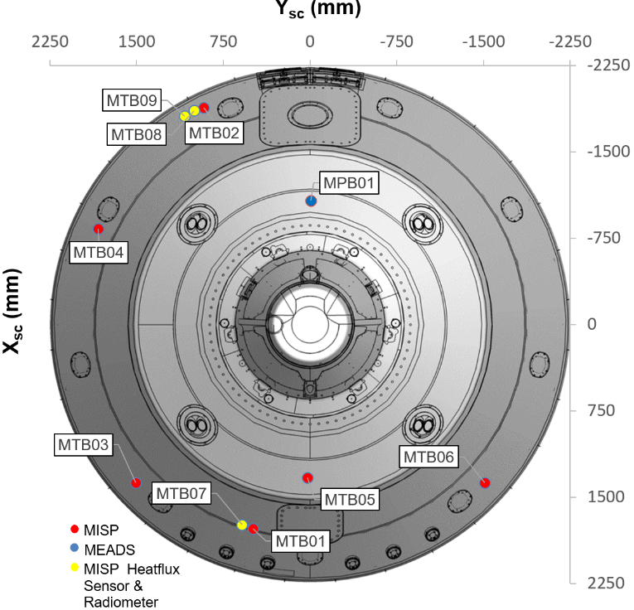
MEDLI2 Sensor Locations on Mars 2020
Heatshield
Measurement priorities and sensor locations were informed by MSL/MEDLI flight data.
Mars Entry Atmospheric Data System (MEADS)
  MEADS heatshield sensors were placed to optimize reconstructed vehicle angle of attack (α), sideslip (β), and atmospheric density.
  Backshell MEADS port location was informed by earlier instrumented ballistic range testing.
MEDLI2 Integrated Sensor Plug (MISP)
  MISP sensors on the heatshield were placed to capture acreage turbulent flowfield transition,
    Most plugs include on single TC, some include multiple TCs to evaluate in-depth ablator performance,
  Backshell MISP were placed to capture different types aeroheating in regions of attached and detached flow.
    Particular focus on measuring radiative heating, predicted to be the dominant heating mechanism for much of the backshell.
MEDLI2 naming convention designate sensor locations and type, e.g.
  MPB01: MEADS Pressure on Backshell
  MTH11: MISP Thermal on Heatshield
  Multiple measurements at location noted with dashes, e.g.
    MTH01-2 is second T/C from surface at MTH01 location.
Leeside
Stagnation
Region
Windside
Backshell
Leeside
Windside

Slide 5
MEDLI2 Science Channels
MEDLI2 recorded ~10 minutes of EDL data up to heatshield separation
  Most sensors data returned at 8Hz, with slower responding temperature measurements at 4-1Hz
  Pressure transducers were filtered*, Heatflux sensors and Radiometer at 16Hz
  MEDLI2 limited Real-time Data Product (RTDP) was telemetered at 1Hz during entry shown in green in case of failure during or after EDL
RTDP Priorities
Name | Type | Data Rates (Hz) | Notes
MPH01 | Hypersonic Pressure Transducer | 8*, 1 | MEDLI spare hypersonic transducer, Strain-gage based
MPH02 | Supersonic Pressure Transducer | 8*, 1 | Piezo Resistive Transducer with internal temperature sensor
MPH03 | Supersonic Pressure Transducer | 8*, 1 | Piezo Resistive Transducer with internal temperature sensor
MPH04 | Supersonic Pressure Transducer | 8*, 1 | Piezo Resistive Transducer with internal temperature sensor
MPH05 | Supersonic Pressure Transducer | 8*, 1 | Piezo Resistive Transducer with internal temperature sensor
MPH06 | Supersonic Pressure Transducer | 8*, 1 | Piezo Resistive Transducer with internal temperature sensor
MPH07 | Supersonic Pressure Transducer | 8*, 1 | Piezo Resistive Transducer with internal temperature sensor
MTH01 | 3-TC PICA Plug | 8, 4, 1 | Type R TCs at 1.905mm, Type K at 5.08mm and 10.16mm
MTH02 | 3-TC PICA Plug | 8, 4, 1 | Type R TCs at 1.905mm, Type K at 5.08mm and 10.16mm
MTH03 | 3-TC PICA Plug | 8, 4, 1 | Type R TCs at 1.905mm, Type K at 5.08mm and 10.16mm
MTH04 | 1-TC PICA Plug | 8 | Type K TC at 2.54mm
MTH05 | 1-TC PICA Plug | 8 | Type K TC at 2.54mm
MTH06 | 1-TC PICA Plug | 8 | Type K TC at 2.54mm
MTH07 | 1-TC PICA Plug | 8 | Type K TC at 2.54mm
MTH08 | 1-TC PICA Plug | 8 | Type K TC at 2.54mm
MTH09 | 1-TC PICA Plug | 8 | Type K TC at 2.54mm
MTH10 | 1-TC PICA Plug | 8 | Type K TC at 2.54mm
MTH11 | 1-TC PICA Plug | 8 | Type K TC at 2.54mm
MPB01 | Low Pressure Transducer | 8* | Variable Reluctance Transducer, with external RTD for temperature
MTB01 | 2-TC SLA-561V Plug | 8, 4 | Type K TCs at 2.54mm, 6.35mm
MTB02 | 1-TC SLA-561V Plug | 8 | Type K TC at 2.54mm
MTB03 | 1-TC SLA-561V Plug | 8 | Type K TC at 2.54mm
MTB04 | 1-TC SLA-561V Plug | 8 | Type K TC at 2.54mm
MTB05 | 1-TC SLA-561V Plug | 8 | Type K TC at 2.54mm
MTB06 | 1-TC SLA-561V Plug | 8 | Type K TC at 2.54mm
MTB07 | Heatflux Sensor | 16, 1 | Schmidt-Boelter with surface TC
MTB08 | Heatflux Sensor | 16, 1 | Schmidt-Boelter with surface TC
MTB09 | Radiometer | 16, 1 | Sapphire window over Schmidt-Boelter with surface TC
Stagnation Pressure
Stagnation and
Turbulent Heating
Symmetric Acreage
Heating
Backshell Pressure
and heating
Backshell Radiation

Slide 6
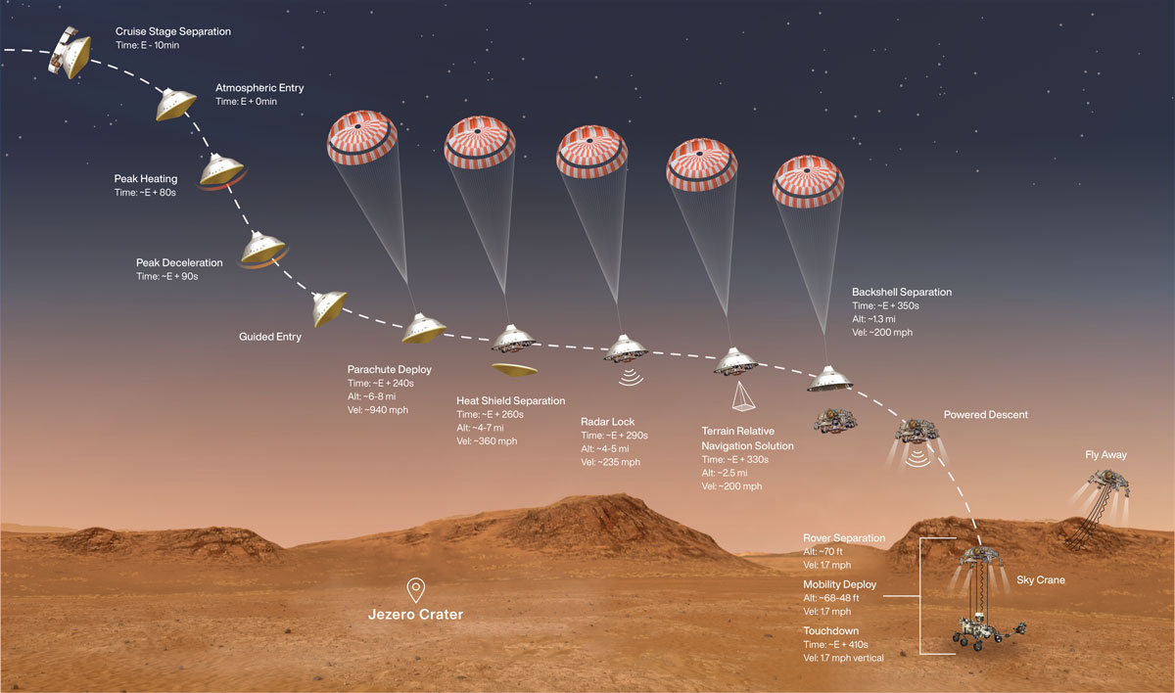
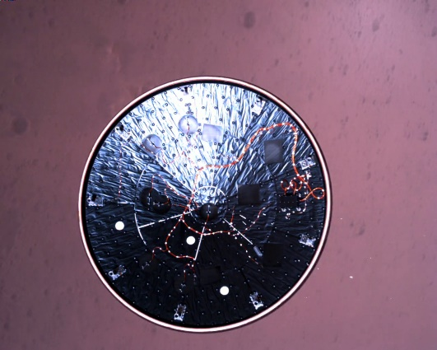
Mars 2020 Entry Descent & Landing (EDL)
M2020 Cameras Operate
MEDLI2
Thermal
Plug
MEDLI2 Operates
MEDLI2
Pressure
Transducers
MEDLI2 Intra-instrument
Harnessing
MEDLI2
Electronics (SSE)
MEDLI2 Sensor Support Electronics (SSE) measured 20 minutes of data, including events such as cruise stage separation, entry, peak heating, deceleration, and parachute deployment.

Slide 7
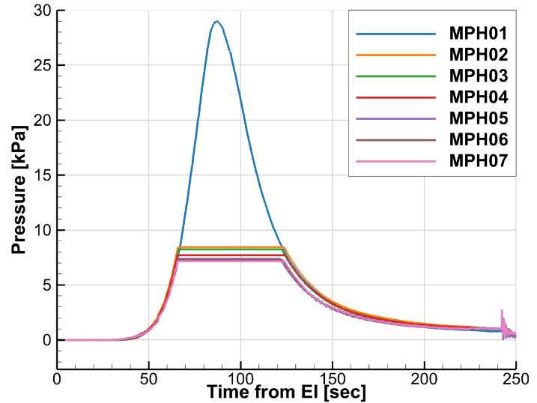
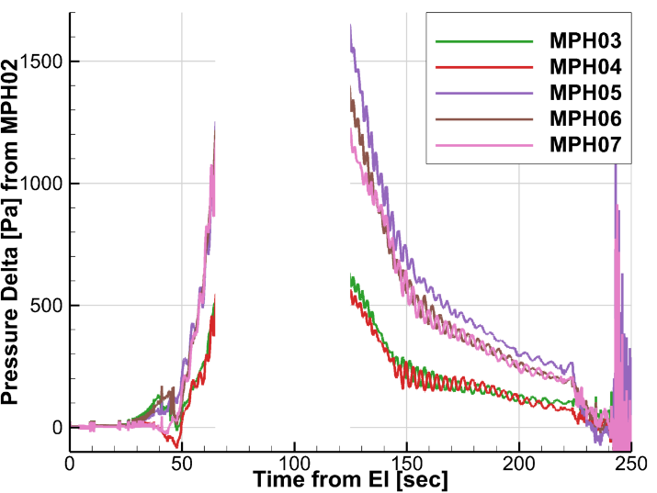
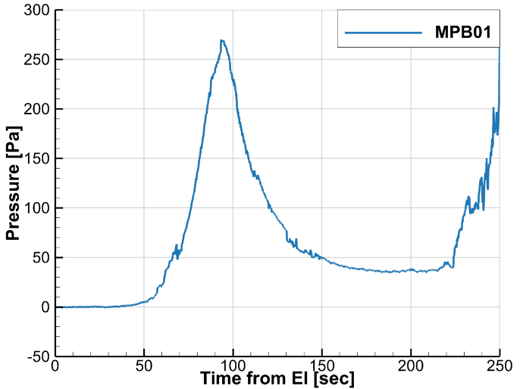
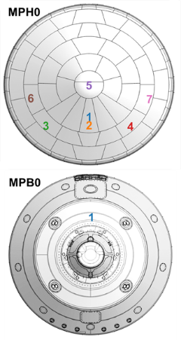
Flight Data: MEADS Pressures
Final processed Heatshield Pressures
Heatshield Pressures Deltas
Backshell Pressure
Transducers
Saturated
On chute
Vehicle
Attitude
Changes
SUFR
α = 0
Transducers
Saturated
RCS firings
Pressure transducer magnitudes and relative values consistent with pre-entry predictions
  Supersonic transducers saturated as expected around 7-8.5 kPa, returned clean data pre and post pressure pulse,
  In-Flight zeros were consistent with cruise checkouts,
  Vehicle attitude changes clearly observable in deltas between supersonic stagnation point (MPH02) and other supersonic transducers (MPH03 through MPH07)
Backshell pressure transducer (MPB01) measurement excellent
  Measurements have already fed into an updated drag model for flight mechanics simulations
Processing of mV to kPa includes calibration accounting for both temperature and transducer hysteresis, removal of spikes due to pyro-shock events
  Hysteresis effects (from dynamic pressure pulse testing) were determined after entry on flight spares
  CFD predictions of surface pressure are used for minor corrections to the final MEDLI2 values.
See Karlgaard, “Mars Entry, Descent, and Landing Instrumentation 2 Trajectory, Aerodynamics, and Atmosphere Reconstruction”

Slide 8
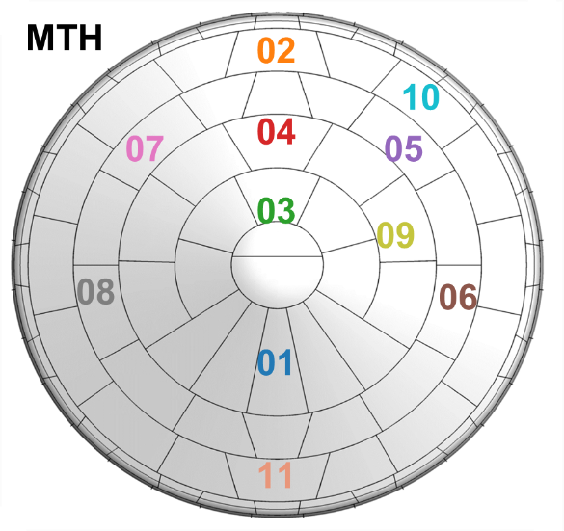
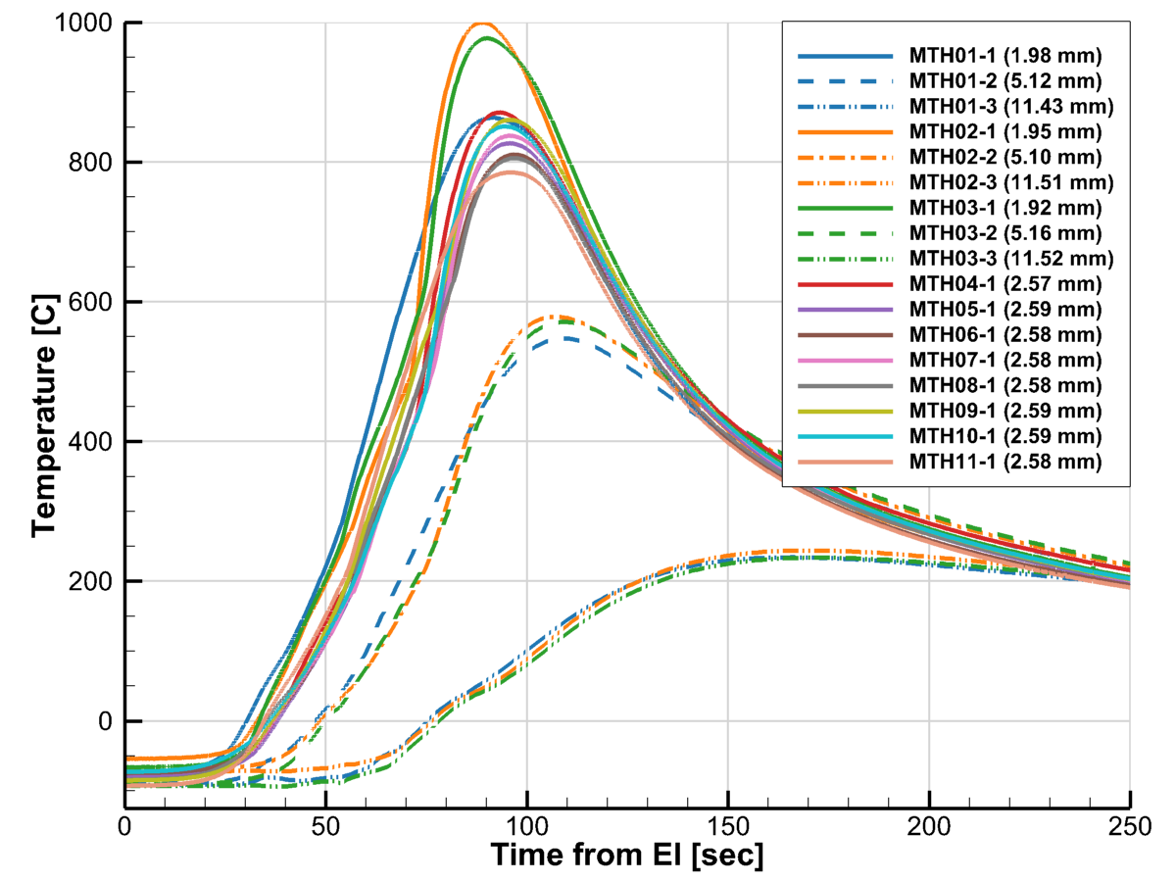
Flight Data: MISP Heatshield Temperatures
Flight data TC signals were smooth, with peak TC temperatures remaining under 1000° C, and all TCs remained within their measurement ranges
  Clearly indicates recession << 0.075 – 0.1” at all MISP locations
  Consistent with observed behavior of the NuSil coating on PICA, which inhibits recession
Heating across the heatshield appeared to be symmetric as well,
  MTH08-MTH06, and MTH07-MTH10 pairs within 5° C prior to transition, 20° C after
Final Heatshield TC Data
Flight TC data interpreted with direct and inverse estimated techniques*
From Direct, we observe model predictions of deeper T/C from flight data much better with MEDLI2-refined model (45 deg!) but still over-predict flight data.
From Inverse: Heatshield external surface temperatures peaked at 1427 °C at 79 W/cm².
  For reference, design heatflux is 220 W/cm², though best-estimated analysis has peak at ~65 W/cm².
Flow field transition shows up clearly as well, and order of transition at MTH plugs as expected:
  Transition starts at 70 seconds from EI at the leeside shoulder MTH02 and to the most outboard forward locations (MTB06 and MTB08) 8-11 seconds later.
For more details, see papers by Monk, Tang, Alpert, and Edquist in this session.
Shallowest
TCs in
high-heating
region
Laminar to
Turbulent
Transition
In-depth TCs
Water phase
transition

Slide 9
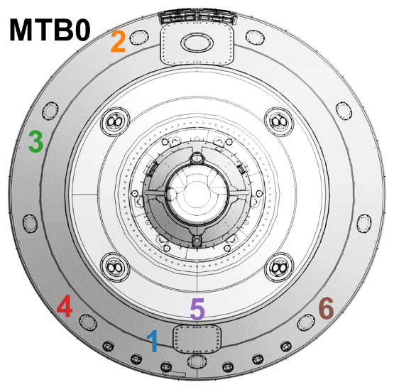
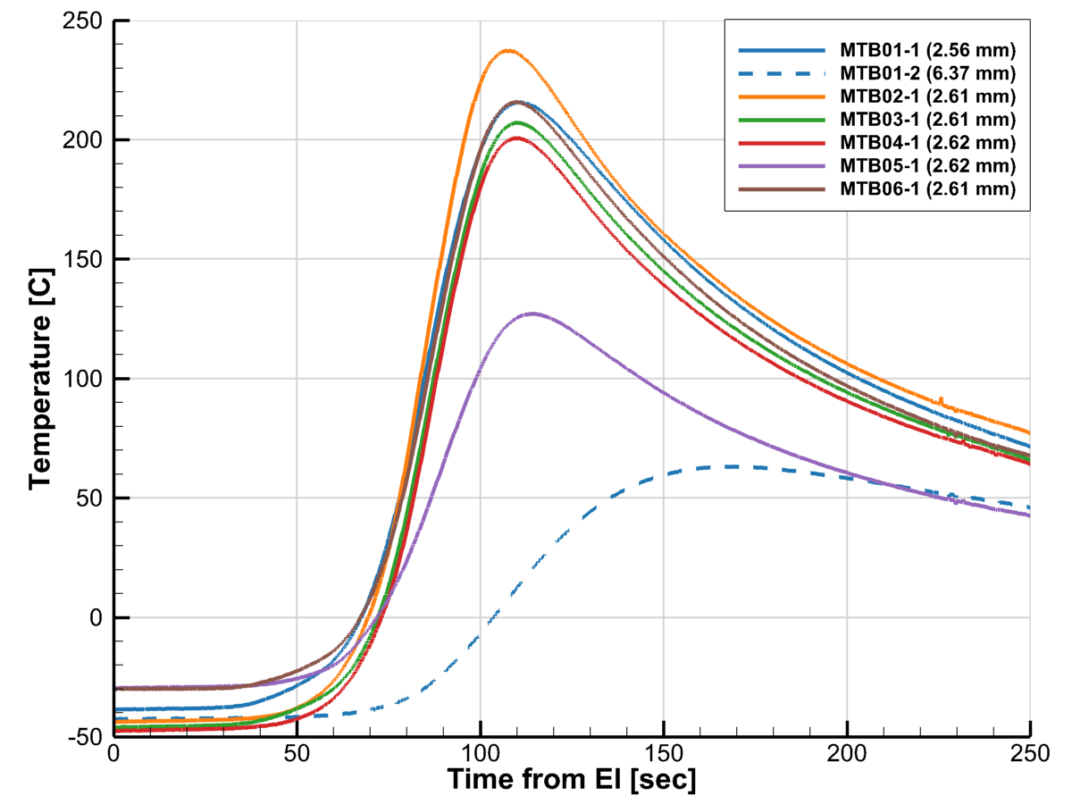
Flight Data: MISP Backshell Temperatures
Backshell flight TC signals were smooth with peak TC temperatures remaining under 250° C
  Variation in initial temperature is noticeable, due to M2020 attitude relative to the sun prior to entry.
  Mild gradient through TPS at MTB01: ~4° C cooler 3.81mm deeper into TPS.
MTB02 (leeside centerline) saw greatest temperature rise during entry aeroheating pulse
  The leeside clearly experienced higher heating than the windside
  Lowest peak temperature at MTB05, on centerline on the second cone.
Final Backshell TC Data
Trend is increasing peak temperatures moving from windside to leeside from MTB03, MTB04, and MTB02,
  Consistent with estimates of increasing importance of radiative heating moving from windside to leeside.
No obvious signs of rapid changes due to transition or separation line movement during entry
From direct analysis, can only directly compare at MTB02, but observe good model agreement with peak, though overpredicting flight data.
From Inverse estimation: hot-wall backshell surface temperatures peaked at 630° C at 4.5 W/cm².
  For reference, design heatflux is ~200 W/cm², though best-estimated analysis has peak at ~58 W/cm².
More detail in Monk, Tang, Alpert, and Edquist in this session.
Leeside
hottest
Second cone cooler
In-depth TC

Slide 10
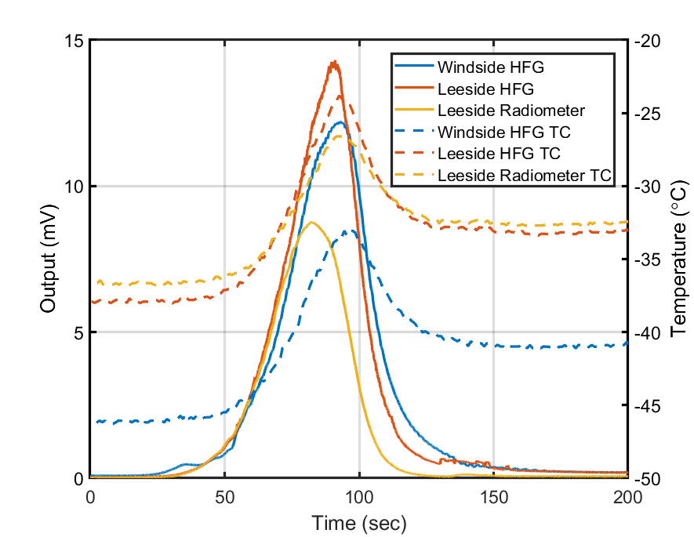
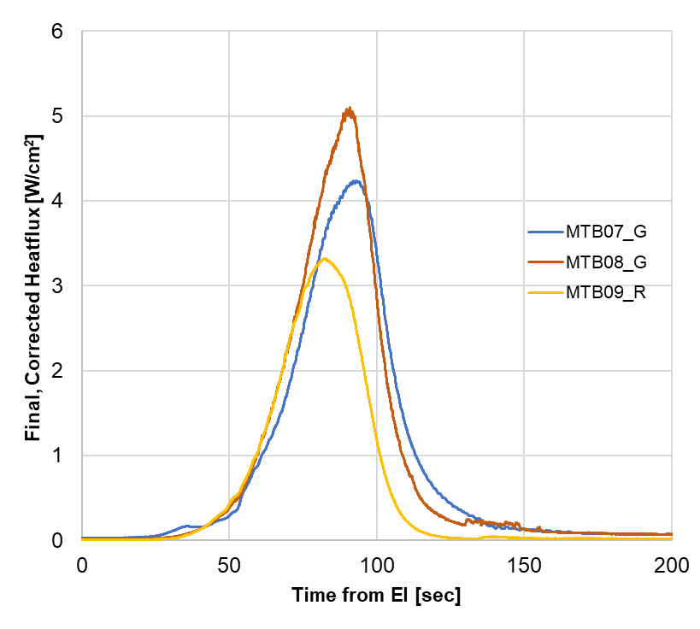
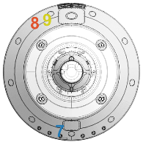
MISP Backshell Direct Heatflux Flight Data
Backshell Direct Sensor signals and tip temperatures
Backshell Heatflux
Bounds on
Peak Radiation
RCS firings
Like the backshell TCs, the heatflux sensor measurements confirm the leeside of the backshell experienced higher peak heating than the windside
  The measured peak total heating on the windside and leeside of the M2020 heatshield are well predicted by current state of the art models (DPLR/NEQAIR) when tip and surrounding TPS temperatures are included in the simulations.*
The radiometer clearly measured backshell radiation, solidly confirming the importance of CO₂ Mid-Wave infrared radiation at Mars.
Open questions as to the exact degree of ablation products blockage on MEDLI2 radiometer
  Estimate degree of blockage during flight is inferred at 42 - 53%, though a wider range of blockage has been observed in other ground tests. [Ruth].
However, the combination of heatflux sensor (MTB08) and radiometer (MTB09) effectively bound aftbody leeside radiation
  MTB08 Heatflux sensor, measures total heating, and is insensitive to ablation products: Upper bound of 5.1 W/cm² on radiation.
  MTB09 Radiometer provides a lower bound of radiation as ablation products only decrease measurement of true radiation. Lower bound on peak at 3.3 W/cm².
* More details in Miller, “MEDLI2: MISP Measured Aftbody Aerothermal Environments”

Slide 11
Implications for Modeling and Future Missions
Characterization of flight sensors is key
  Pressure transducers: Due to schedule issues, MEDLI2 performed dynamic pressure pulse testing after entry on flight spares.
    This complicated reconstruction, and future missions should perform before launch.
  Instrumented TPS plugs: MEDLI2 conducted material property testing and refined model development for PICA and SLA-561V. This turned out to be key to reducing uncertainties
    However, complications remain due to the thin NuSil layer coating PICA plugs.
Even with refined material-specific ablator models, we still observe bias towards over-predicting in-depth TPS temperatures
  Could be partially attributable to water phase change
Backshell environments are clearly radiation dominated, as predicted.
  The inverse estimated heating magnitudes and profiles are consistent with un-margined CFD and radiation predictions
MEDLI2 heatshield TC data make a compelling case for accurately predicting onset of transition for MSL-class entry vehicles
  Especially when combined with MSL/MEDLI dataset

Slide 12
Conclusions
MEDLI2 represented NASA’s most ambitious EDL instrumentation effort at Mars, to provide crucial insights into the EDL performance of the heaviest Mars lander to date.
  All MEDLI2 sensors and electronics performed as designed, and the sensors confirmed the excellent overall entry performance of the Mars 2020 aeroshell.
The MEDLI2 sensor suite returned a wealth of entry pressure, temperature, and heating information to improve the next generation of EDL models and entry missions.
  The MEDLI2 data and reconstruction revealed supersonic winds, blunt body wake drag, spatially-resolved heatshield transition, and backshell radiative heating.
MEDLI2 has provided an incredibly useful engineering dataset for immediate assessment of Mars 2020 performance and will be a further resource for improving future EDL missions and modeling.
  MEDLI2 Flight Data will be made publicly available following this AIAA conference.

Slide 13
Questions?
For more information, check out these papers and presentations:
Atmosphere and Trajectory Reconstructoin Focus
  Post-flight Analysis of Atmospheric Properties from Mars 2020 Entry, Descent, and Landing (Dutta, Karlgaard, Kass, Villar, Mischna)
  Assessment of the Mars 2020 Entry, Descent, and Landing Simulation (Way, Dutta, Zumwalt, Blette)
  Mars Entry, Descent, and Landing Instrumentation 2 Trajectory, Aerodynamics, and Atmosphere Reconstruction (Karlgaard, Schoenenberger, Dutta, Way)
Aerothermal and TPS Focus
  MEDLI2 Material Response Model Development and Validation (Monk, Feldman, Mahzari, White, Prabhu, Alpert)
  Inverse Estimation of Mars 2020 Entry Aeroheating Environments Using MEDLI2 Flight Data (Alpert, Mahzari, Saunders, Monk, White)
  MEDLI2: MISP Measured Aftbody Aerothermal Environments (Miller , Tang, White, Cruden)
  MEDLI2: MISP Inferred Aerothermal Environment and Flow Transition Assessment (Tang, Mahzari, Prabhu, Alpert, Cruden)
  Mars 2020 Reconstructed Aerothermal Environments and Design Margins (Edquist, Mahzari, Alpert)

Slide 14
Backup Materials

Slide 15

First View of MEDLI2 After Launch
MEDLI2 Intra-instrument
Harnessing

Slide 16

Backside of Heatshield After Jettison
MEDLI2
Thermal
Plug
MEDLI2 Intra-instrument
Harnessing
MEDLI2
Pressure
Transducers
MEDLI2
Electronics (SSE)

Slide 17
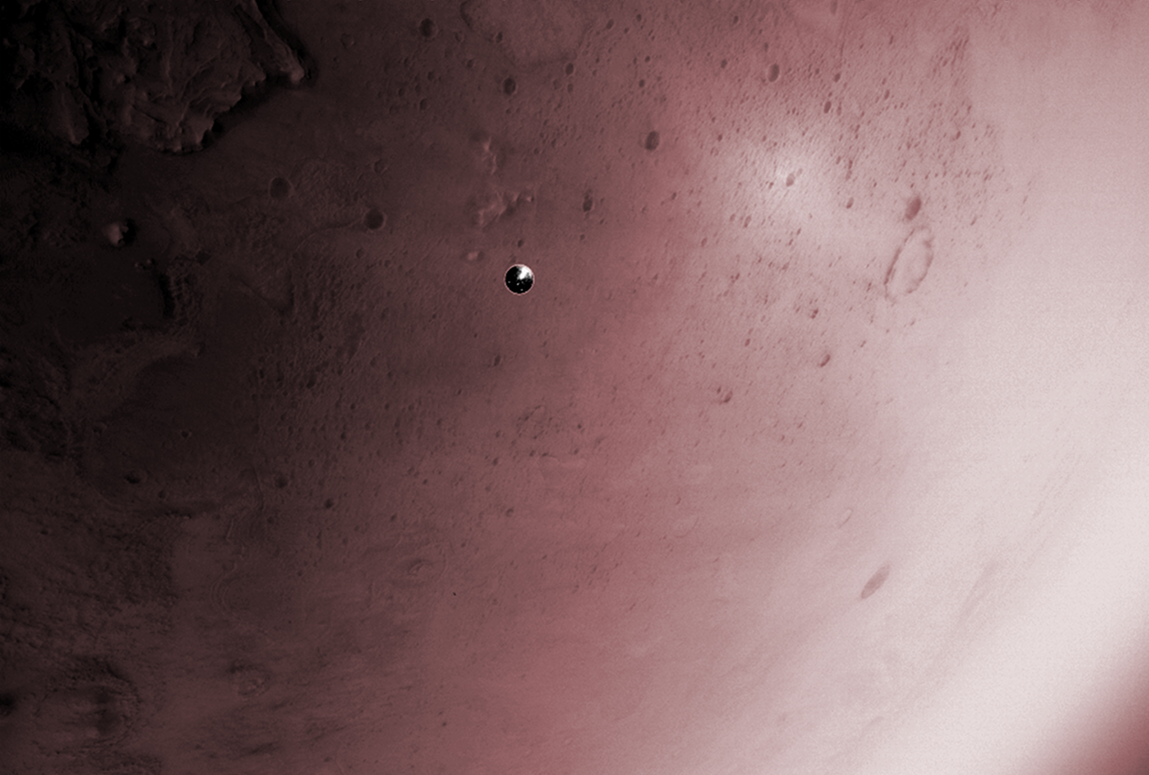
Lander Vision System Watches Heatshield

Slide 18
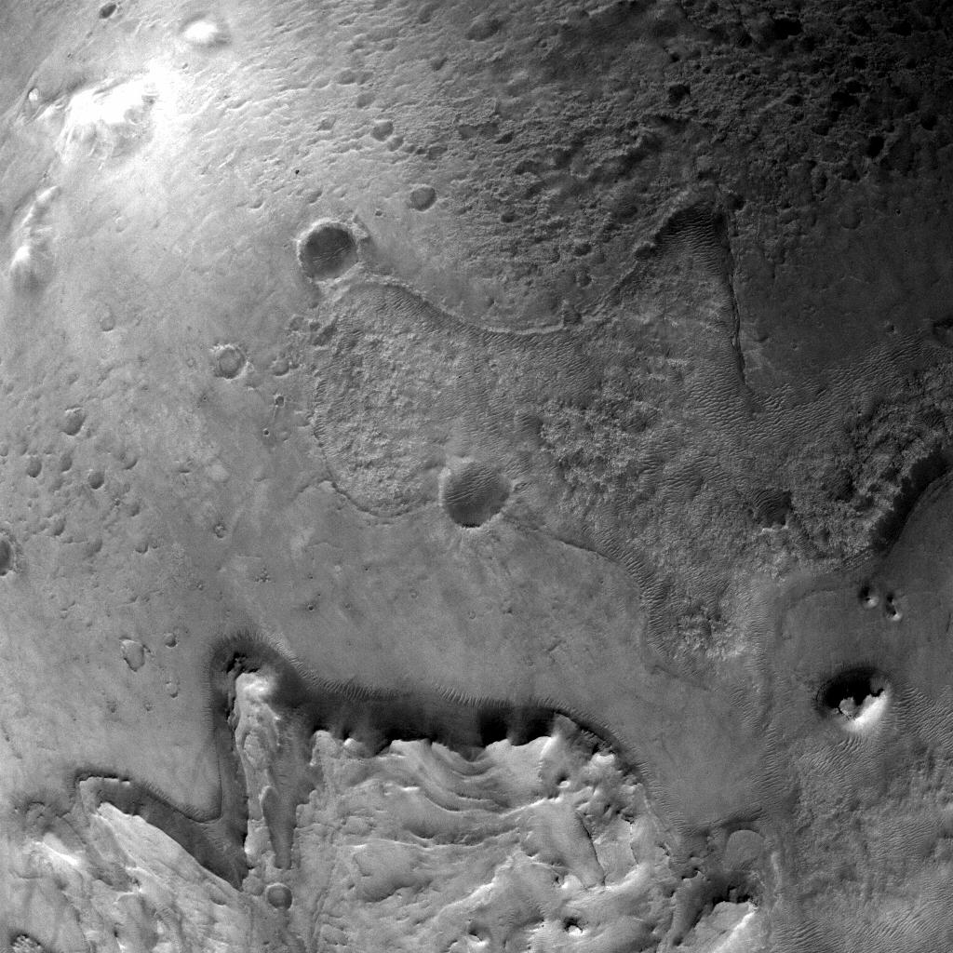
Going, Going…
M2020
Heatshield

Slide 19
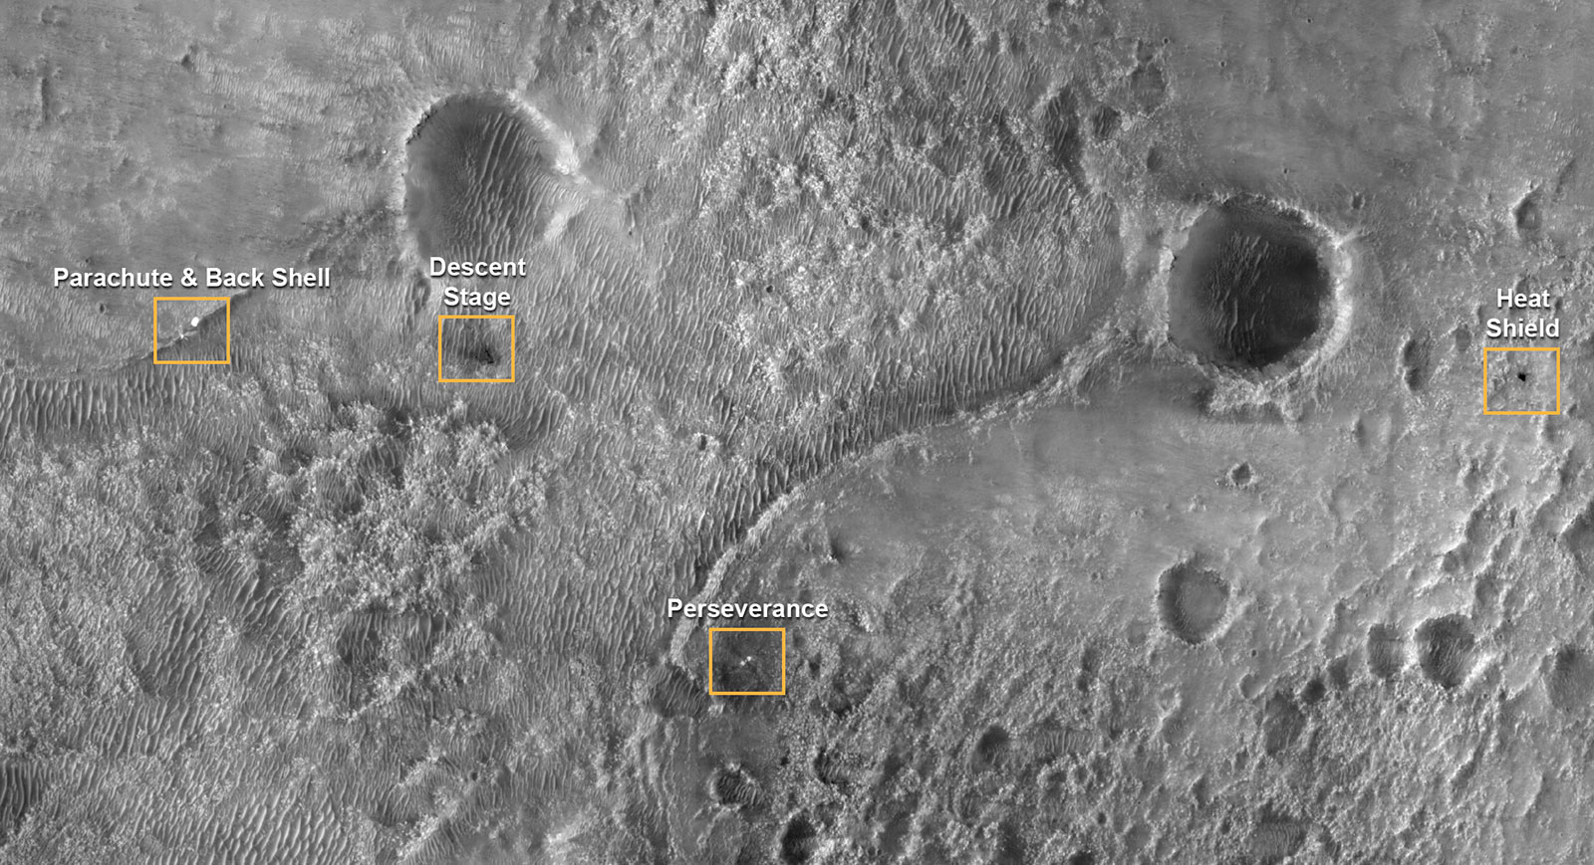
Gone!

