Slide 1
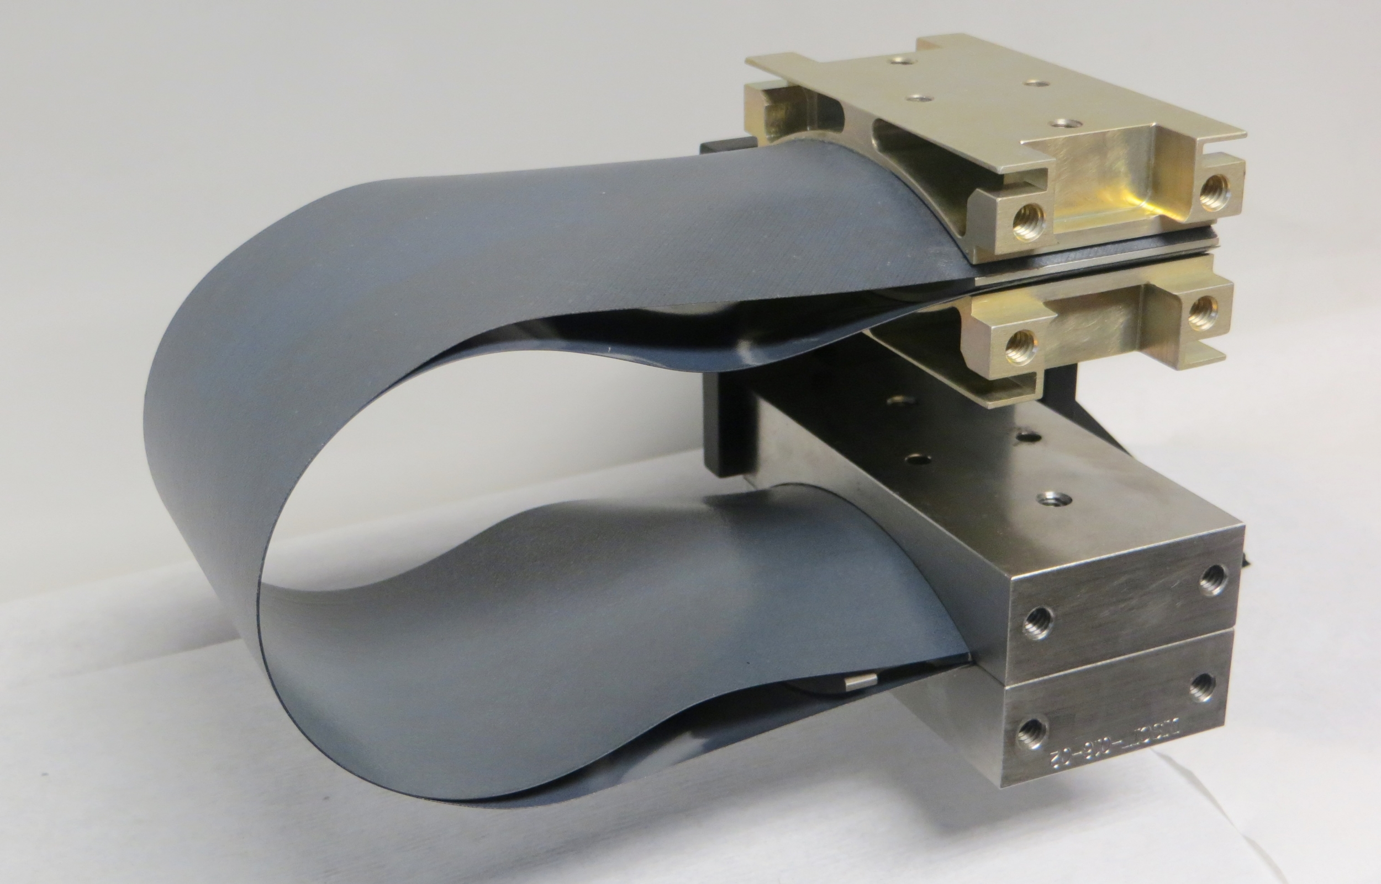
Mechanics of Structure Genome (MSG)-Based Nonlinear Shell Analysis
AIAA SciTech 2022, SCS-04/MAT-17, High Strain Composite Materials and Structures III
01/04/2022
Yufei Long, Wenbin Yu
School of Aeronautics & Astronautics, Purdue University
Juan M. Fernandez, Andrew C. Bergan
NASA Langley Research Center

Slide 2
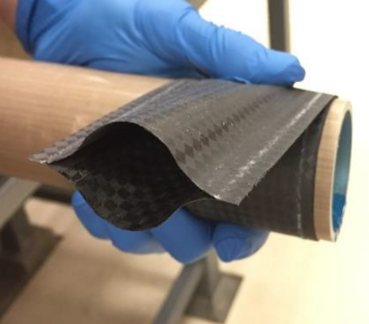
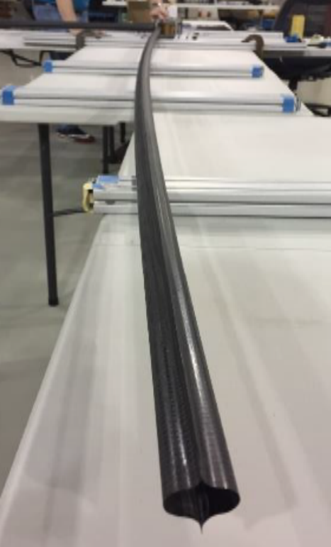
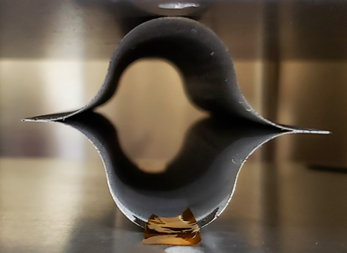
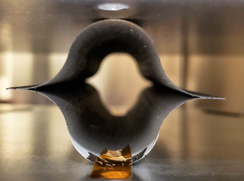
Introduction
[1]
Thin-ply High Strain Composite (TP-HSC) deployable booms
Coiled for stowage, long stowage time
Observed permanent deformation, yielding initiated during stowage
MSG-based nonlinear shell homogenization
High efficiency compared with solid models, incremental analysis
Avoid information loss from converting 3D models
Δh
[1] Coiled TP-HSC boom
[2] Permanent deformation of the boom cross section
[3] Permanent deformation in the boom longitudinal direction
[2]
[3]

Slide 3
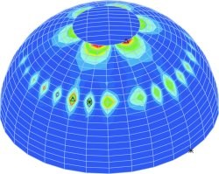
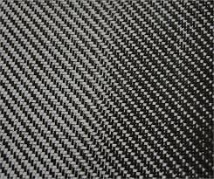
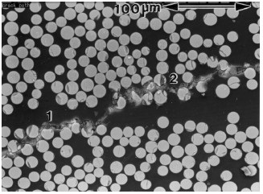
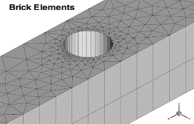
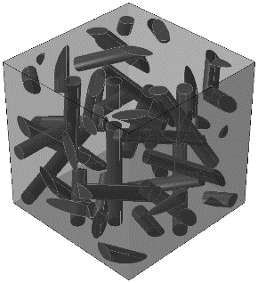
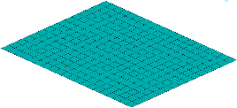

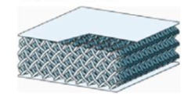
MSG-based Nonlinear Shell Analysis
Structural elements
SwiftComp
MSG-based general purpose constitutive modeling
3D solid & plate/shell analysis
Nonlinear homogenization, incremental analysis
Microstructures
Mechanics of structure genome
Principle of minimum
information loss

Slide 4




Euler-Newton Combined method
3D strain rate
From last increment
Material model
Functional to be minimized
1st iteration
Other iterations
Euler step
Newton step
Euler predictor step
Dehomogenization and updating state variables
Newton corrector step
To next increment if converged

Slide 5
2-Step Homogenization of Plates/Shells
Independent analysis: load prescribing, multiple loading step
2-Step homogenization multiscale analysis: 1) 3D solid step for lamina/yarn; 2) shell step for laminate/woven composites
Read inputs for both plate/shell & 3D models
Preprocessing for both models
3D model: compute homogenized tangent stiffness
3D model: solve fluctuating functions, dehomogenization
3D model: compute tangent stiffness at each integration point
Shell model: call 3D model at each integration point
Shell model: fluctuating function, dehomogenization
Shell model: compute homogenized tangent stiffness
Output

Slide 6
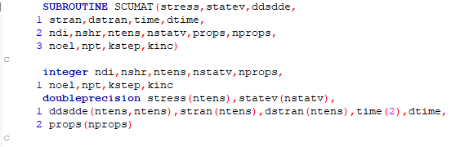
User-material for Nonlinear SwiftComp
Define nonlinear material model via user-material SCUMAT
Customize user-defined material properties & state variables
Minimize conversion efforts using Abaqus UMAT-like interface
Variables to be updated:
stress — stresses at each integration point
statev — user defined state variables
ddsdde — tangential stiffness

Slide 7
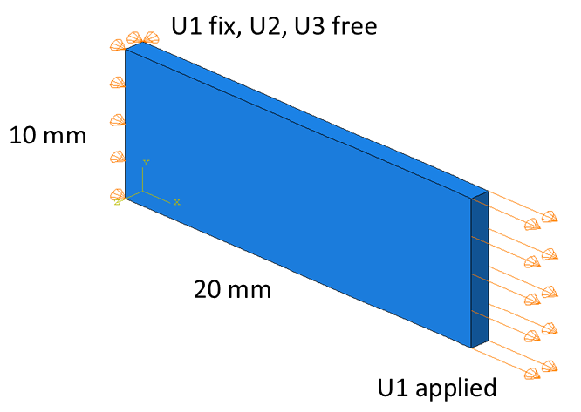
User Material for Nonlinear SwiftComp
Validation with different existing nonlinear material models
Compared with Abaqus solid model with UMAT
Homogeneous material, thickness 1 mm
Section force N and moment M: calculated from the stresses at the center through the thickness
Multiscale Structural Mechanics
cdmhub.org/groups/yugroup

Slide 8
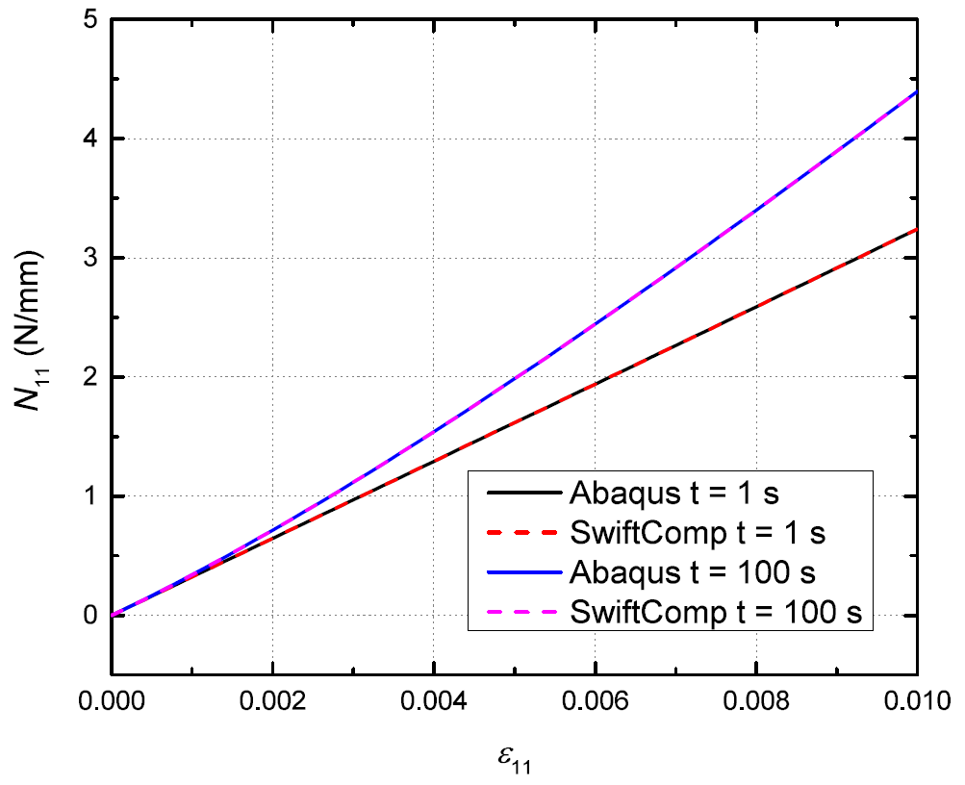
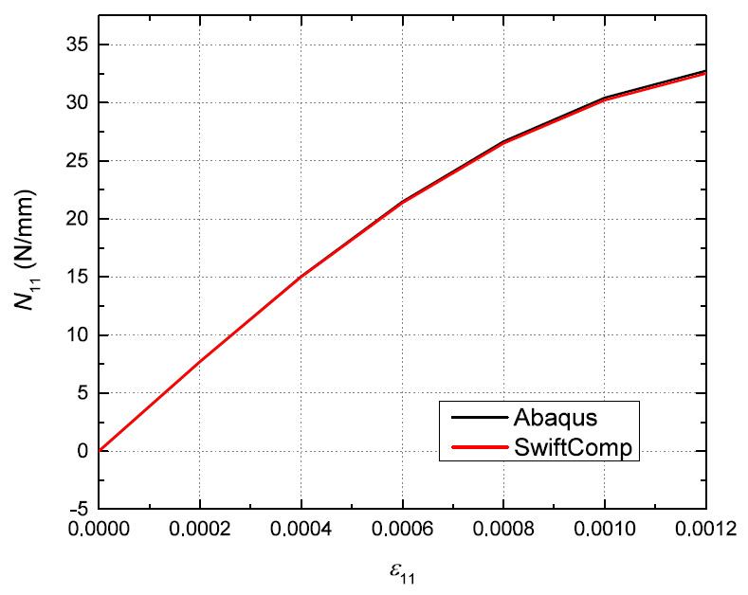
User Material for Nonlinear SwiftComp
Simple viscoelastic model [1]
Continuum damage model [2]
[1] Abaqus, 2017 Documentation, Dassault Systèmes Simulia Corporation, 2017.
[2] Zhang, L., and Yu, W., “Constitutive modeling of damageable brittle and quasi-brittle materials,” International Journal of Solids and Structures, Vol. 117, 2017, pp. 80–90.
Multiscale Structural Mechanics
cdmhub.org/groups/yugroup

Slide 9
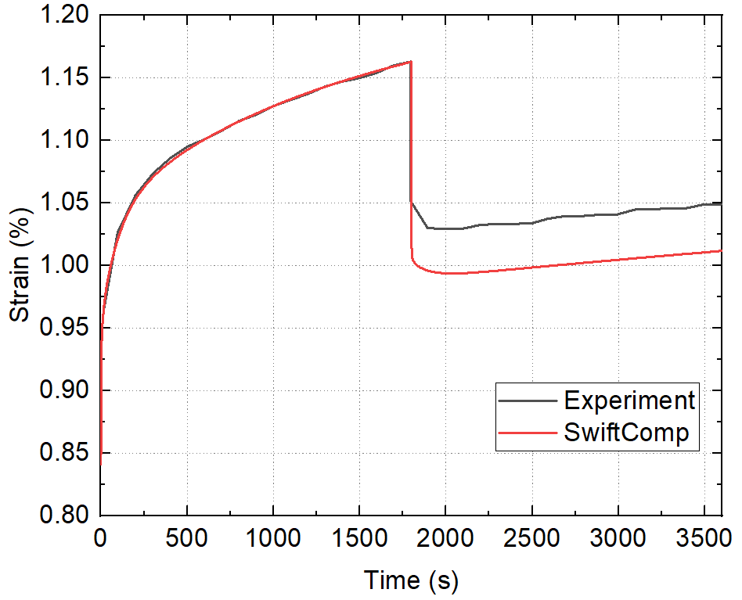
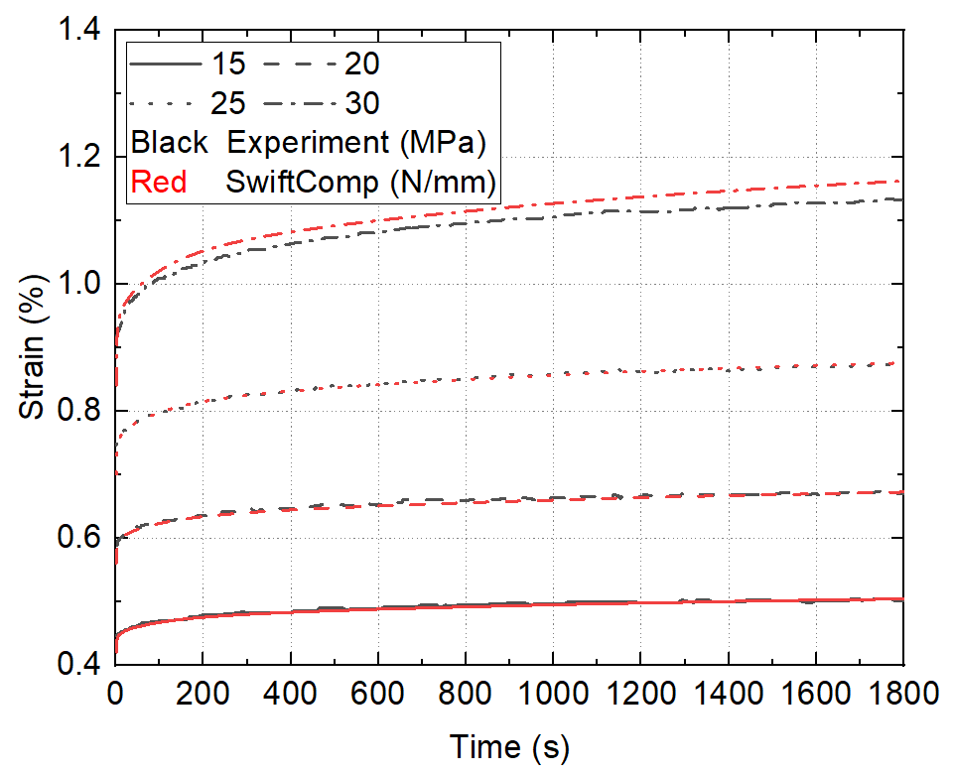
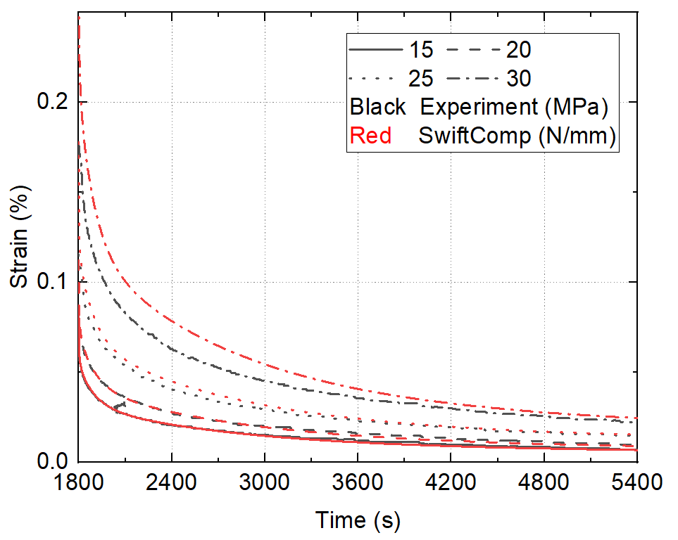
Shell Analysis with Nonlinear Viscoelasticity Model
Model developed for analyzing permanent deformation of TP-HSC [1]
1 mm thickness polymethyl methacrylate (PMMA) plastic shell: compared with experiment [2]
30 N/mm creep – 25 N/mm creep recovery
Creep under different load magnitudes
Recovery under different load magnitudes
[1] Zhang, L., Klimm, W., Kwok, K., Fernandez, J. M., Bergan, A. C., and Yu, W., “A Nonlinear Viscoelastic-Viscoplastic Constitutive Model for Epoxy Polymers,” AIAA SciTech 2022 Forum, American Institute of Aeronautics and Astronautics, San Diego, California, 2022.
[2] Lai, J., and Bakker, A., “3-D Schapery representation for non-linear viscoelasticity and finite element implementation,” Computational mechanics, Vol. 18, No. 3, 1996, pp. 182–191.
Multiscale Structural Mechanics
cdmhub.org/groups/yugroup

Slide 10
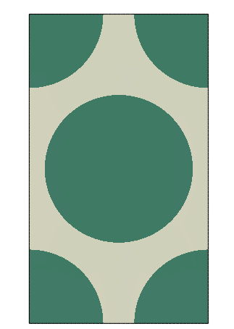
3D Homogenization with Nonlinear Viscoelasticity Model
Choose the 2D SG of a hexagonal pack
Compute effective 3D properties
Matrix:
Nonlinear viscoelastic model [1]
Fiber:
Orthotropic, linearly elastic with elastic constants listed below
E₁ (MPa) | E₂ (MPa) | E₃ (MPa) | ν₂₃ | ν₁₃ | ν₁₂ | G₂₃ (MPa) | G₁₃ (MPa) | G₁₂ (MPa)
2.94E5 | 2.91E4 | 2.91E4 | 0.2 | 0.2 | 0.46 | 1.13E4 | 1.13E4 | 1.00E4
[1] Zhang, L., Klimm, W., Kwok, K., Fernandez, J. M., Bergan, A. C., and Yu, W., “A Nonlinear Viscoelastic-Viscoplastic Constitutive Model for Epoxy Polymers,” AIAA SciTech 2022 Forum, American Institute of Aeronautics and Astronautics, San Diego, California, 2022.
Multiscale Structural Mechanics
cdmhub.org/groups/yugroup

Slide 11
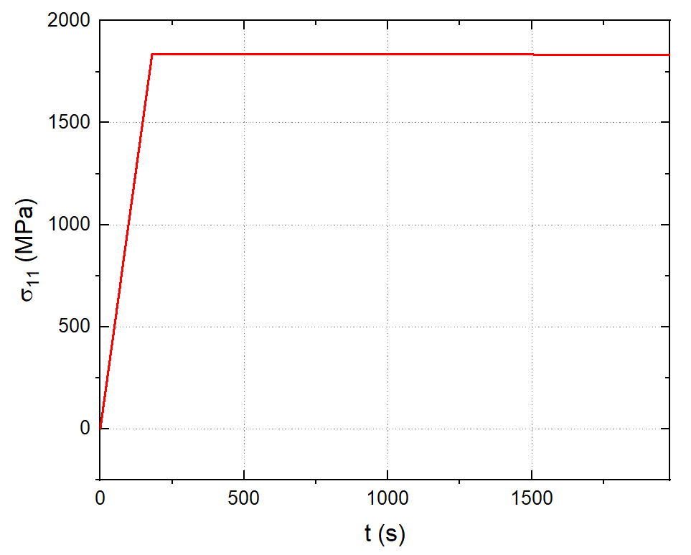
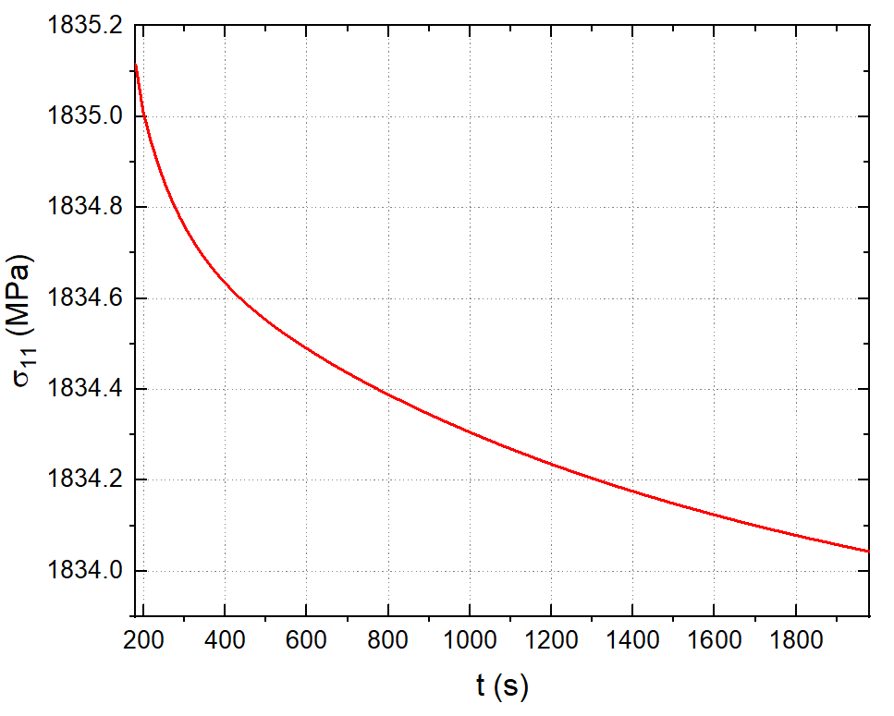
3D Homogenization with Nonlinear Viscoelasticity Model
* Relaxation: load to 1% strain in fiber direction over 180 s, then keep for 1800 s
Multiscale Structural Mechanics
cdmhub.org/groups/yugroup

Slide 12
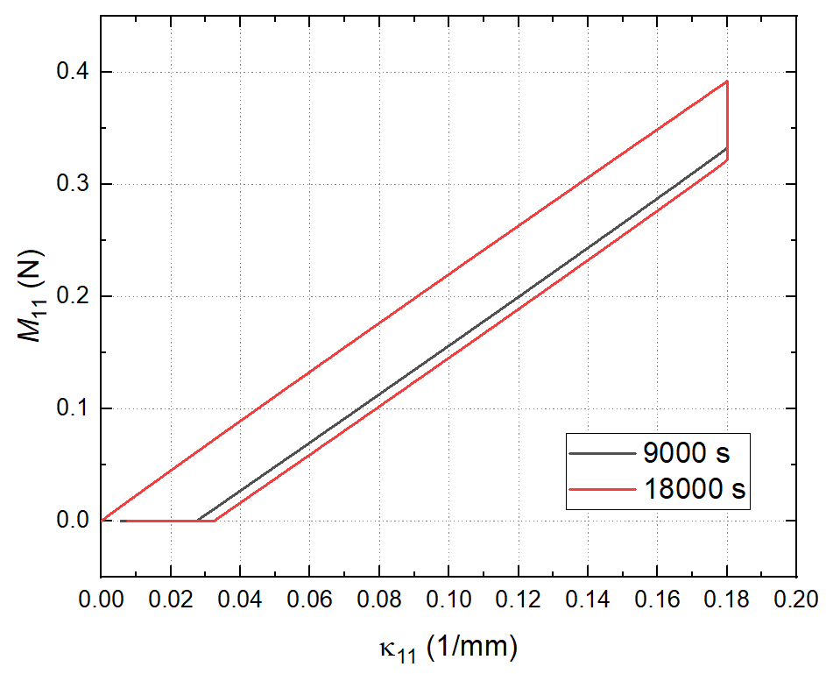
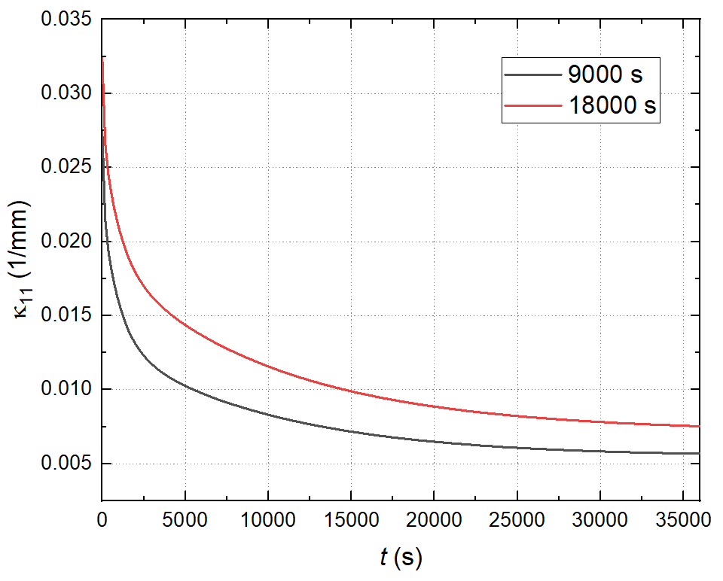
Bending of Viscoelastic–Viscoplastic PMMA Plate/Shell
Moment–curvature
Residual curvature during recovery
κ₁₁ = 0.18 mm^{–1}, thickness 0.2 mm, 9,000 vs. 18,000 s relaxation, 36,000 s recovery
Multiscale Structural Mechanics
cdmhub.org/groups/yugroup

Slide 13
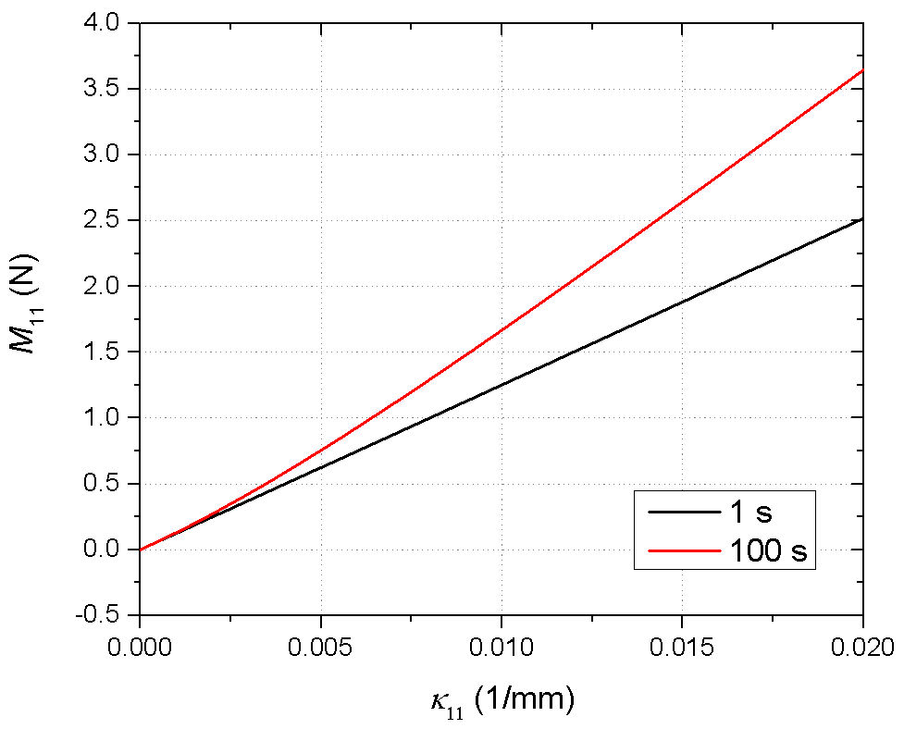
2-Step Homogenization Example
Simple viscoelastic material model from Abaqus manual for the matrix
3D homogenization:
hexagonal pack lamina
Shell homogenization:
for single-layer unidirectional laminate
Prescribed curvature 0.02 mm^{–1} in the normal direction to the fiber
Moments at different curvature rates
Multiscale Structural Mechanics
cdmhub.org/groups/yugroup

Slide 14
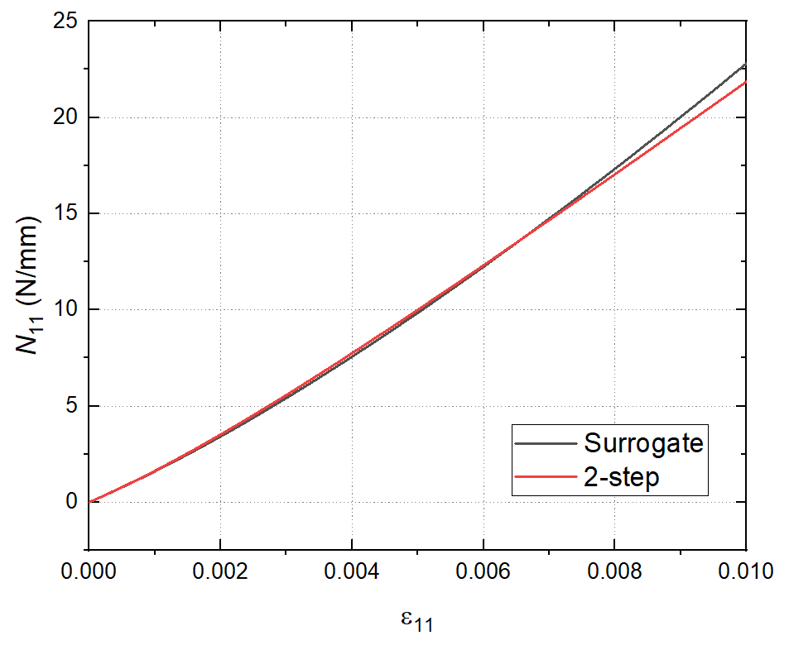
SwiftComp with Surrogate Model
Same example viscoelastic material
Loaded in the normal direction to the fiber, 1.0% strain over 100 seconds
Construct surrogate model:
Polynomial based
Input — 3 strain components
Output — 3 stress components & 21 stiffness components
2-step homogenization: 6 hours
Surrogate model: 1 hour
Multiscale Structural Mechanics
cdmhub.org/groups/yugroup

Slide 15
Summary
Nonlinear shell model: MSG-based, Euler-Newton combined method
Nonlinear SwiftComp: 3D solid & shell, load prescribing, multiple analysis steps, SCUMAT
  Validation with Abaqus UMAT: almost exact match
  Nonlinear viscoelastic-viscoplastic model: 4% error compared with experiments
Two-step homogenization: laminates & woven composites, 3D step for lamina/yarn, shell step for laminate/woven composites
Surrogate models: improve the computational efficiency, 6 hours to 1 hour in the example
Future work: Machine learning-based general-purpose surrogate modeling

Slide 16
Thank You!

