Slide 1
AIAA SciTech-2022
Micro-Spectrometer (µ-SM) for Resource Mapping in Extreme Environments
Sang H. Choi
Robert W. Moses
NASA Langley Research Center
Hampton, VA
January 5, 2022
sang.h.choi@nasa.gov robert.w.moses@nasa.gov

Slide 2
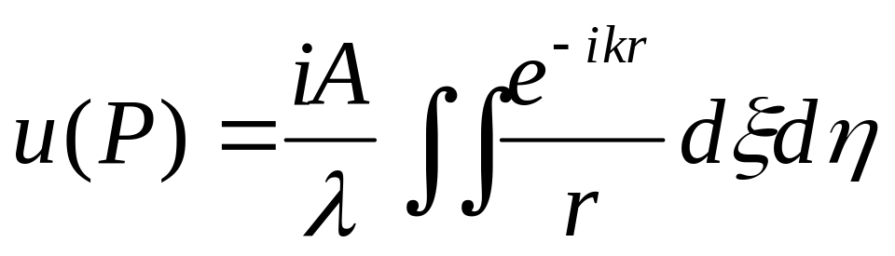
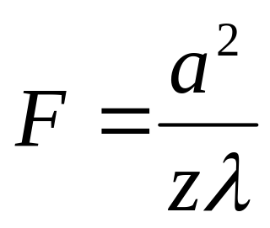
Diffraction & Fresnel Number
x
P(xyz)
ξ
y
a = radius of aperture
z = distance along OA
λ = wavelength
r
O’
A
r’
O
η
The value of F determines the valid diffraction approximation.
F << 1 ; Fraunhofer Diffraction
F >> 1 ; Fresnel Diffraction
Most modern conventional spectrometers use the Fraunhofer diffraction because the resolution improves with a longer optical path.

Slide 3


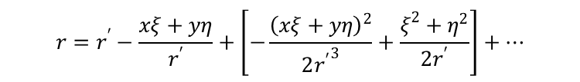




Approximation of Diffraction Phenomena
S(η,ξ,0) at a coordinate (η,ξ,0) on an aperture and illuminates a point, P(x,y,z) at a coordinate (x,y,z) on a screen.
x
P(x,y,z)
x
ξ
r’
r
O’
y
α
z
Approximation
with r’
S(ξ,η,0)
Screen (Detector)
Fraunhofer Terms
O
β
η
Aperture
Fresnel Terms
where λ = wavelength, k = wavenumber of light.
$r$ is a temporary variable for integration,
$r′$ is a fixed engineering parameter.

Slide 4
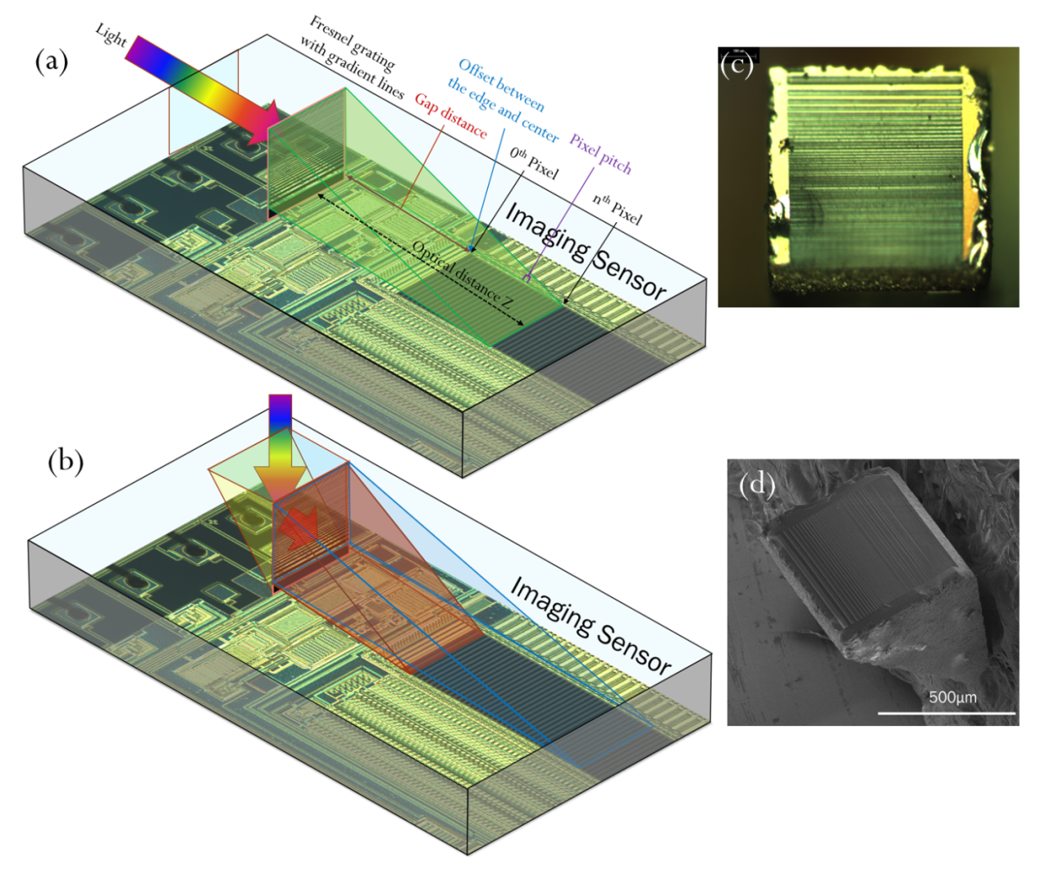
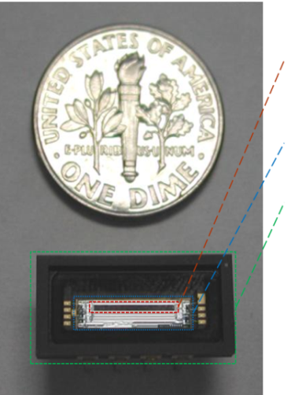
Spectrometer Chip
Active Area: 6.4 mm x 0.5 mm
(Spectrum Area)
Die Size: 9.5 mm x 2.5 mm
Packaging: 15.8 mm x 7.87 mm
700 μm
500 μm

Slide 5
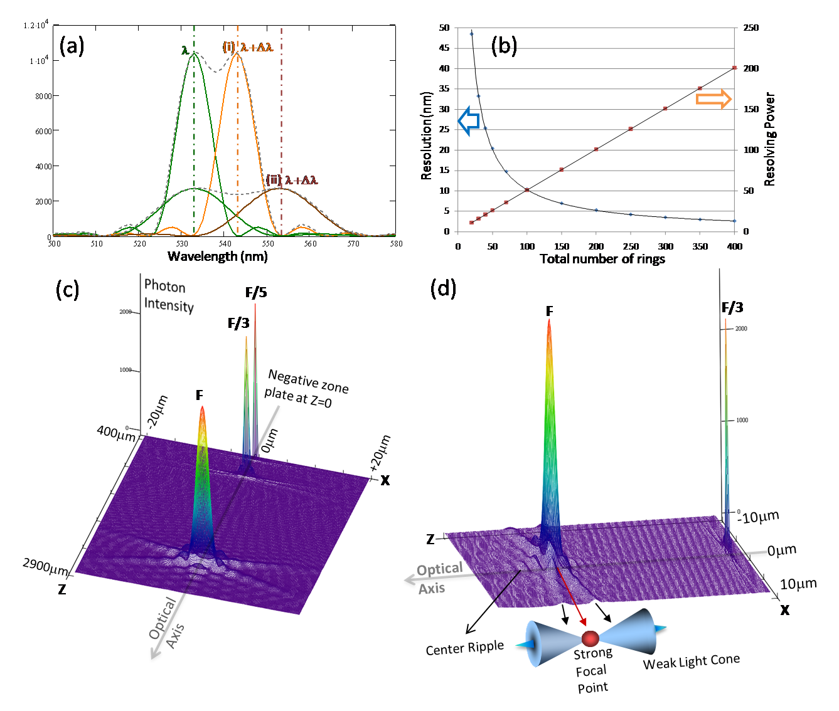
Spectral Data & Resolution of Differential Line Fresnel Grating
50
250
45
40
200
35
30
150
25
Resolving Power
Resolution, nm
20
100
15
10
50
5
0
0
0
50
100
150
200
250
300
350
400
Total Number of Lines per 2 mm

Slide 6
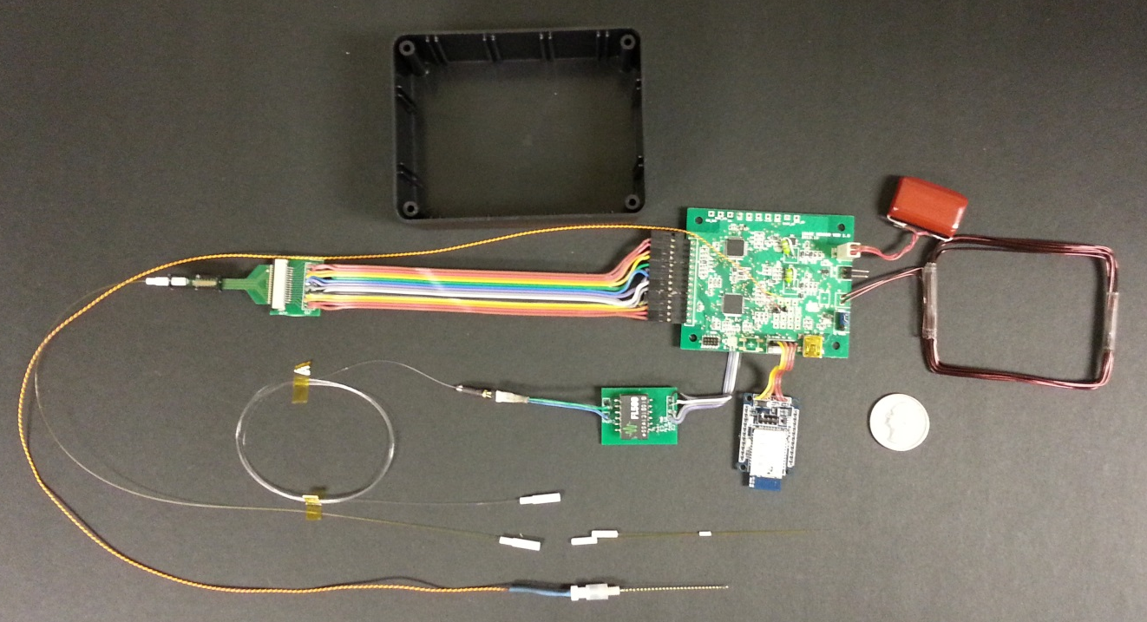
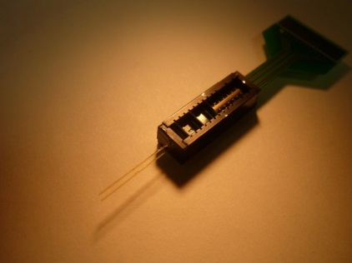
1-D Scan Prototype System
Micro-Spectrometer
Supercapacitor
System Electronics
Surface Enhanced Raman Spectrometer
WPT Coil
Coin-25¢
Bluetooth
Opto-Coupler
Optical Sensing Probe
Laser Diode Driver
Electrical Stimulation Electrode
Laser Diode

Slide 7
Dopamine Sensing Results
Arbitrary Unit
Pixel

Slide 8
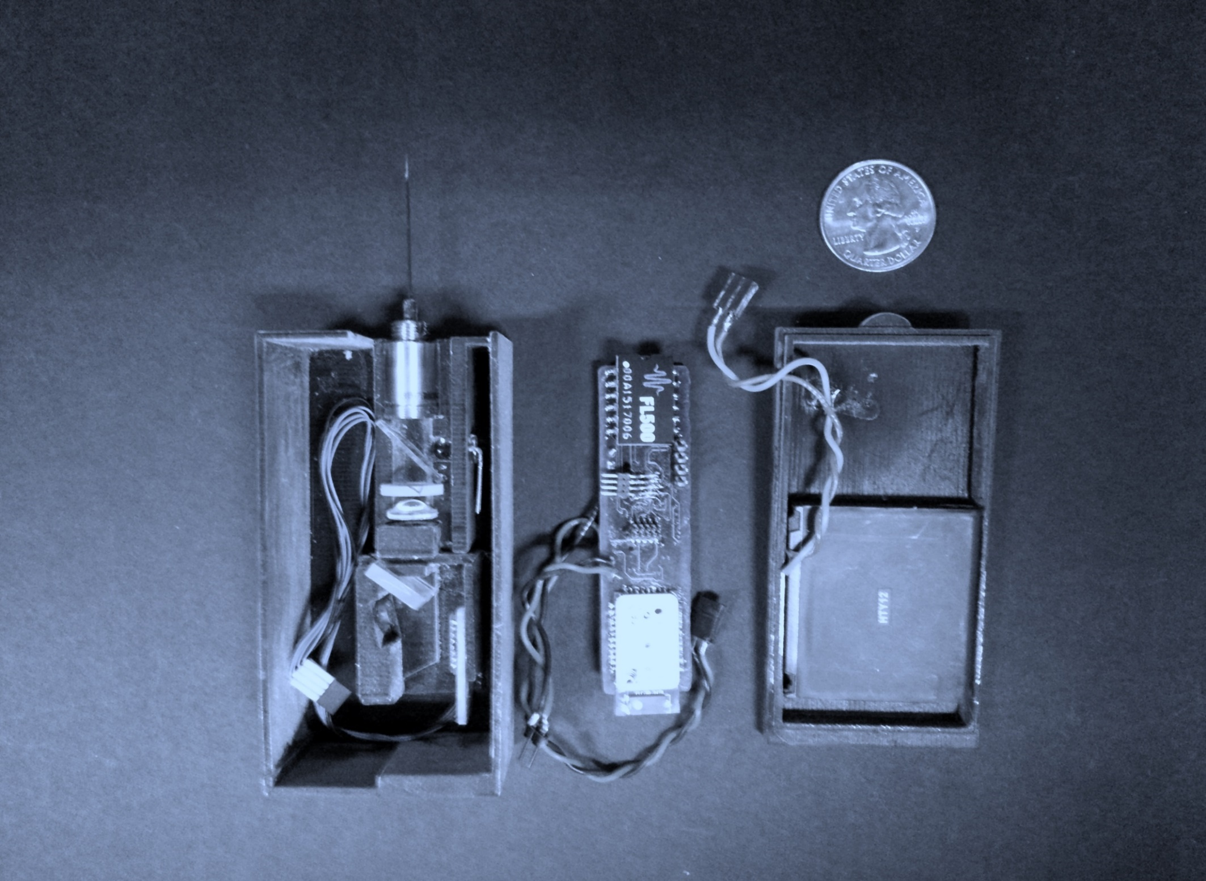
1-D Scan Prototype System
Sensing Probe
Laser Diode Driver
Beam Collimator
Microcontroller
Dichroic Filter
Battery
Linear Grating
Bluetooth Module
CMOS Image Sensor

Slide 9
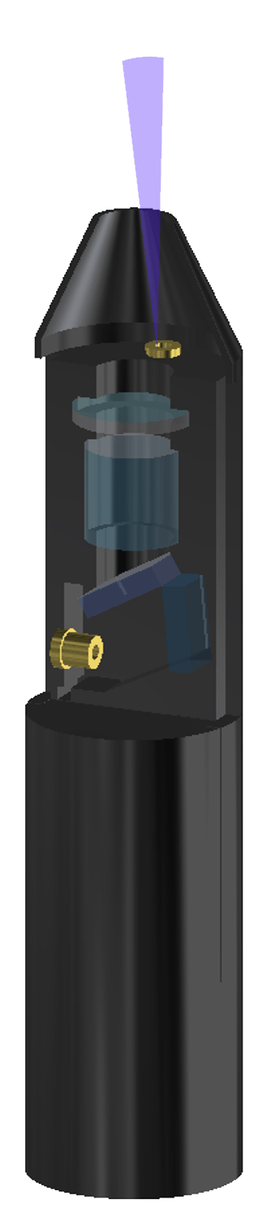
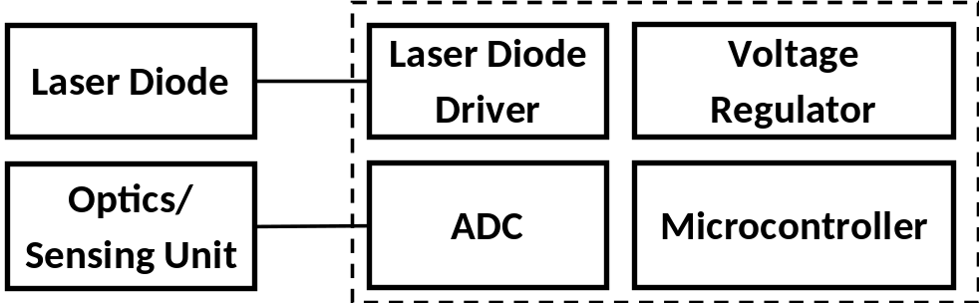
Bullet Micro-Spectrometer
Charging Coil
Releasable Antenna Coil
Super-capacitor
Laser or LED
Light
Target
Laser Diode
or LED
LD or LED
Driver
Telemetry System
Optics/
Sensing Unit
Optical Window
Fluorescence or
Luminescence

Slide 10
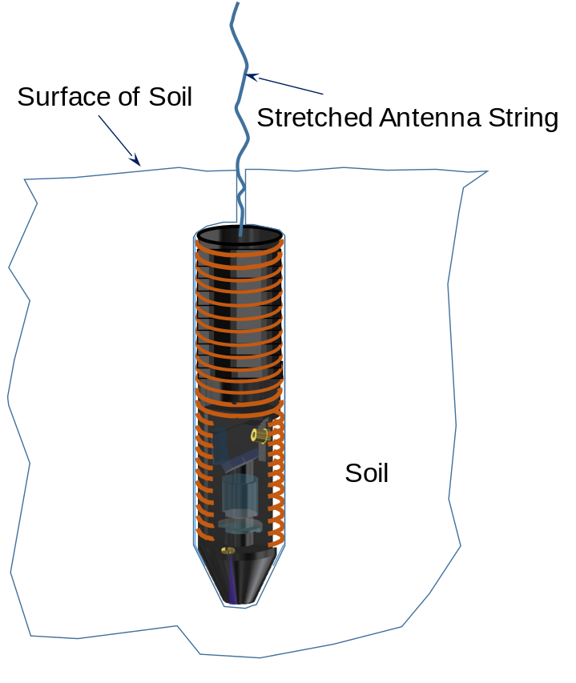
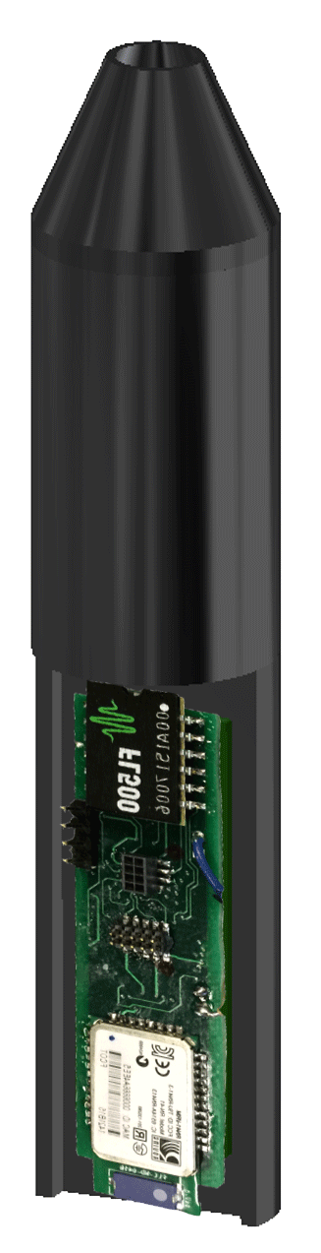
Bullet Micro-Spectrometer
Micro-Spectrometer
Principle of Fresnel diffraction
Light source: Deep or vacuum UV from burst-mode LED
Pulse mode power feed from super-capacitor
Bullet-like consumable micro-spectrometers (< $100)
Shooting by compressed air gun
Super-capacitor with
Control & Telemetry
Electronics
Micro-Spectrometer
Optics
< 7.5 cm
Soil
< 2.5 cm
Langley invented micro-spectrometer meets ​
NASA Roadmap 12 Science Instruments and Sensors.

Slide 11
Gas Gun for Bullet Micro-Spectrometer
Array of Circumferentially
Arranged Magnets
Barrel
Compressed Gas
Gas Release Trigger
Magazine of
Micro-Spectrometer Bullets
Load Spring

Slide 12
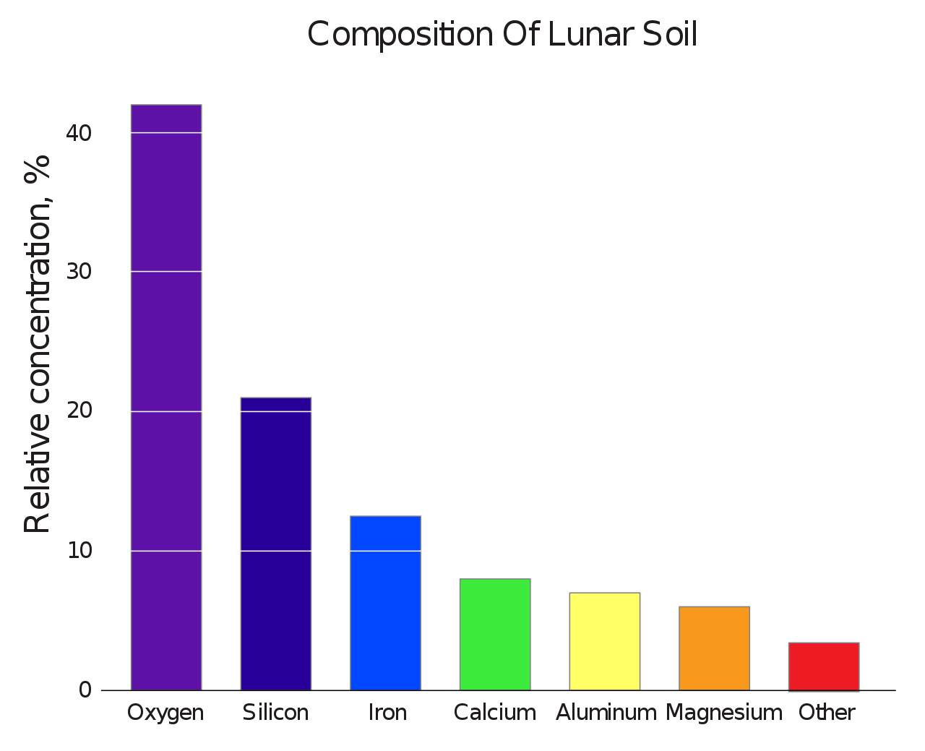
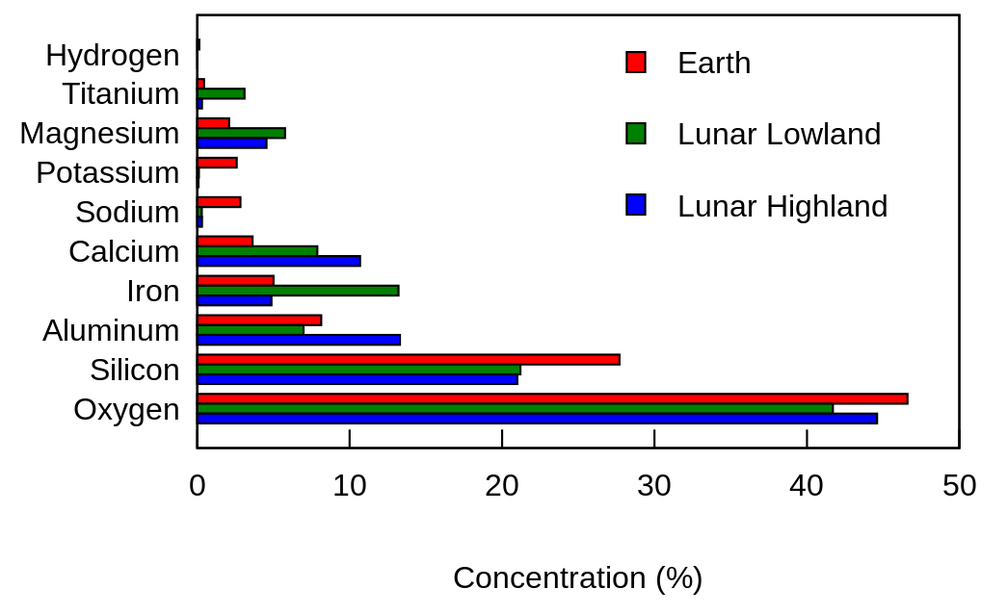
Composition of Lunar Regolith
https://en.wikipedia.org/wiki/Lunar_soil#/media/File:Moon_vs_earth_composition.svg
https://en.wikipedia.org/wiki/Lunar_soil#/media/File:Composition_of_lunar_soil.svg

Slide 13
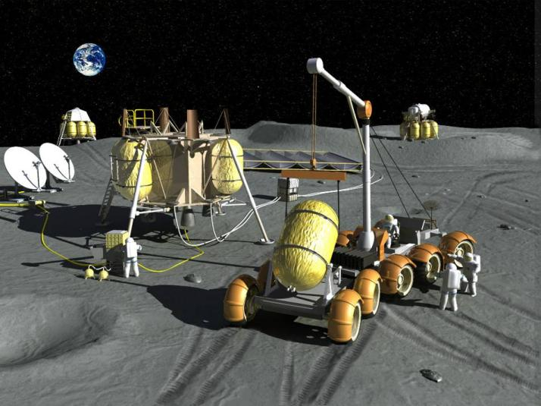
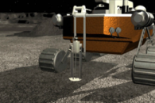
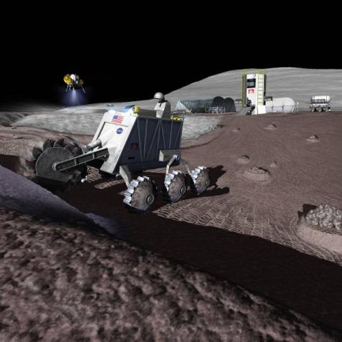
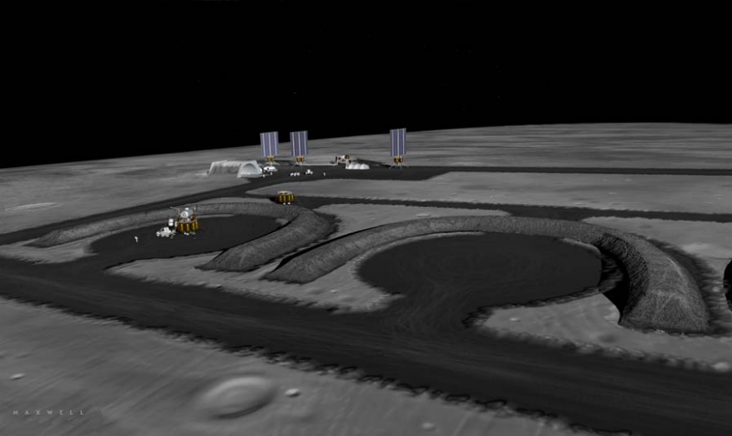
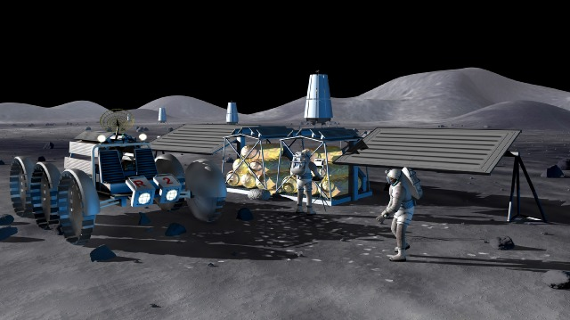
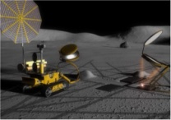
Excavation & Regolith Processing for H₂ & O₂ Production, Binders & Aggregates
All Images credit: NASA
Resource Prospecting – Looking for Resources
Propellant Processing with Lander & Pad Infrastructure
Thermal Energy Storage Construction
Construction of Consumables Depots for Crew & Power ( O₂, H₂)
Habitat, Hangars, Dust Free Zones, Landing Pads, Berm, and Road Construction

Slide 14
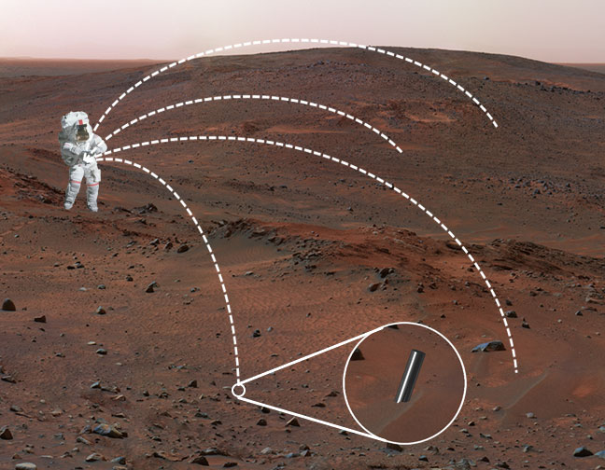
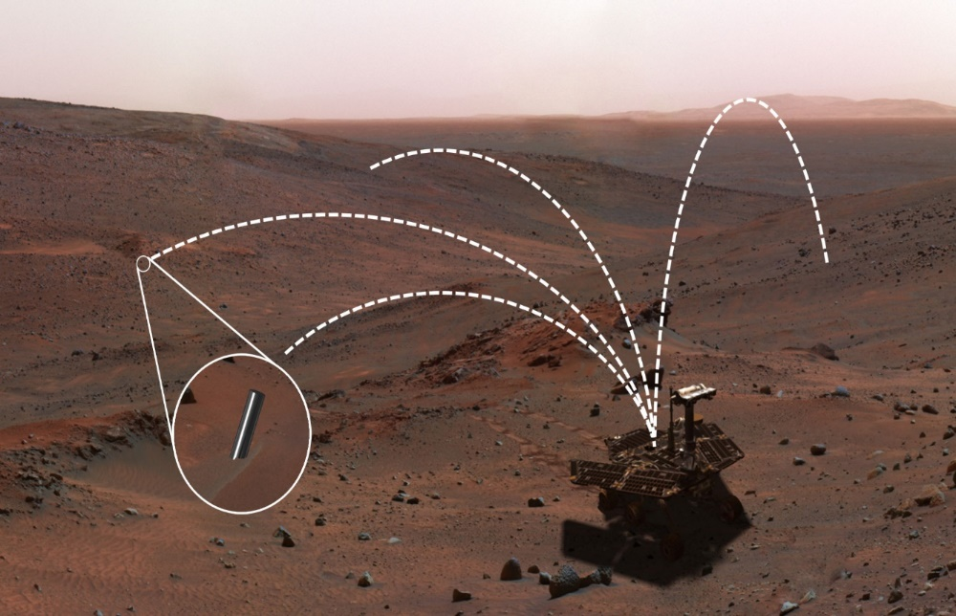
Mars Soil Assay by Bullet Micro-Spectrometer
Astronaut with Micro-Spectrometer Gun
Rover with Micro-Spectrometer Gun
Image Credit NASA
Image Credit NASA
Bullet-like micro-spectrometers are shot out broadly to assay organic and inorganic components of Lunar/Mars/Asteroids soils.

Slide 15
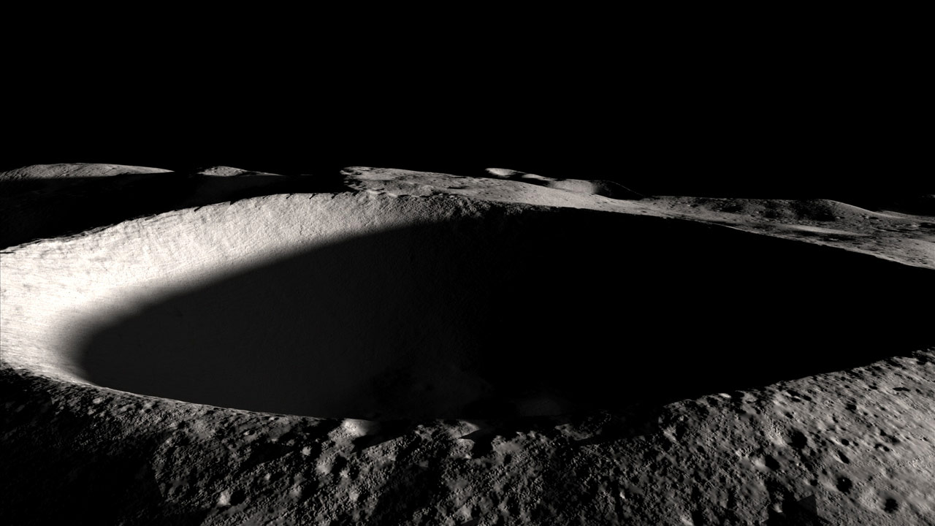
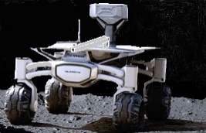
Lunar Soil Assay by Bullet Micro-Spectrometer
Penetration of Bullet Micro-Spectrometer into Steep Hillside and Bottom of Crater
Image Credit NASA

Slide 16
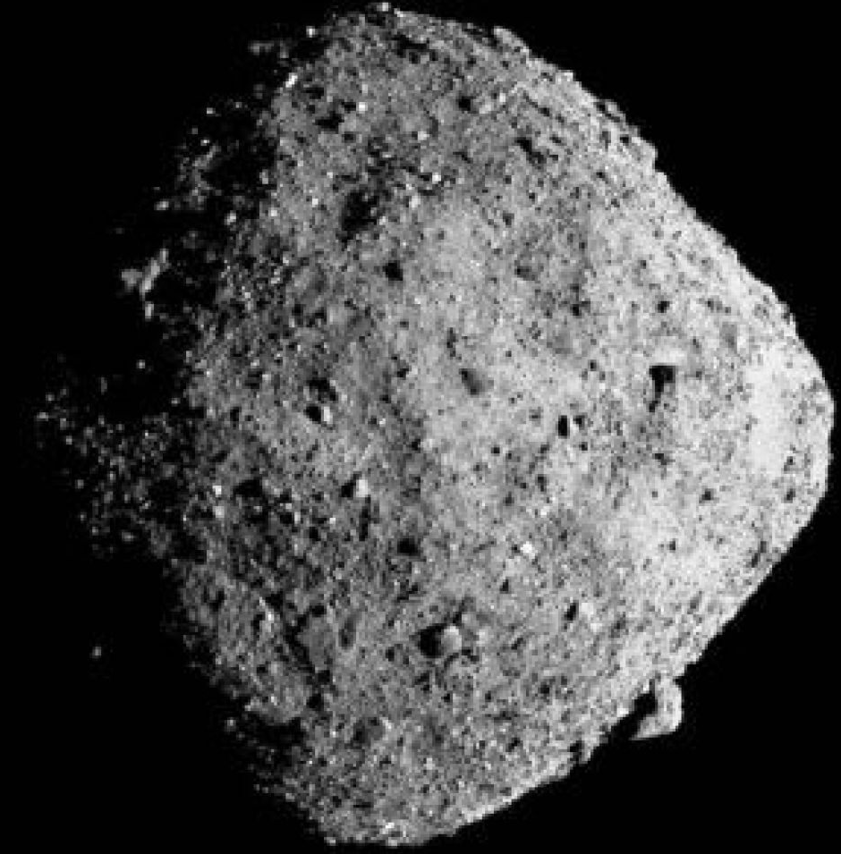
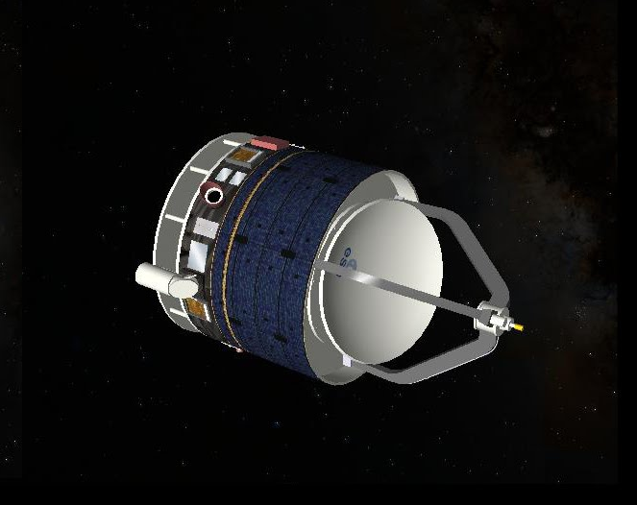
Asteroid Soil Assay by Bullet Micro-Spectrometer
Penetration of Bullet Micro-Spectrometer
into Asteroid
Image credit: NASA

Slide 17
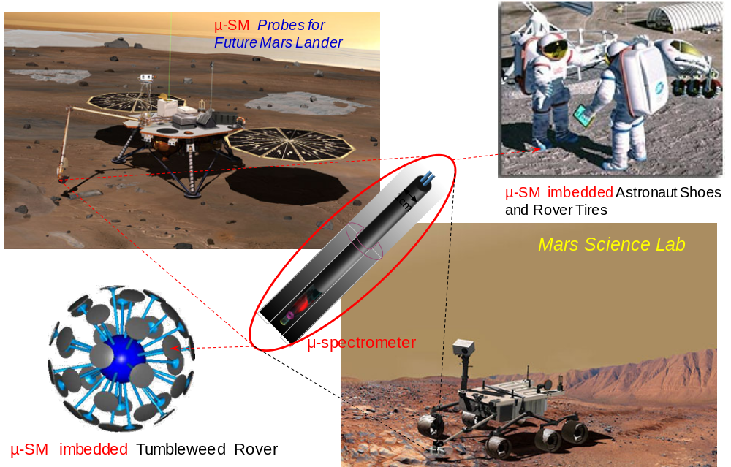
Micro-Spectrometer for Lunar & Mars Exploration
Image Credit NASA
Image Credit NASA
Image Credit NASA

Slide 18
Concluding Remarks
  Bullet type micro-spectrometer and deployment gun were designed for space applications.​
  Applications of micro-spectrometer bullets include mineral mapping on the Moon and Mars, especially hillsides and deepened bottom floor of craters.​
  Laboratory prototype was fully developed and tested for dopamine detection at several concentrations.​
  Based on the spectral data of the minerals of interest, line and pixel densities of the micro-spectrometer can be tailored for measurement accuracy and clarity.​
  Device components, such as avalanche photo-diode, burst-mode LED, cylindrical super-capacitor, and telemetry device require further development for enhanced and versatile performance of bullet shape micro-spectrometers.​

