Slide 1
Summary: Cloud-optimized access to HDF5/NetCDF4 files using the Zarr API and the OPeNDAP DMR++
Earthdata Cloud Services
Patrick Quinn
EED-3 / Element 84
patrick@element84.com
James Gallagher
EED-3 / OPeNDAP
jgallagher@opendap.org
This work was supported by NASA/GSFC under Raytheon Technologies contract number 80GSFC21CA001.
This document does not contain technology or Technical Data controlled under either the U.S. International Traffic in Arms Regulations or the U.S. Export Administration Regulations.
Notes:
How generic is the approach used by Zarr? Can we use this approach in contexts other than a WOS?

Slide 2
Cloud-Optimized =
Able to fetch lots of data in a small number of reads
But operating at a scale where you can’t just fetch everything

Slide 3
Conclusions
Cloud access optimization demands read latency optimization
      Combine many smaller reads into fewer larger reads (metadata & data)
      Skip expensive network actions such as auth or redirects, if possible, via cookies and caching
      Parallelize reads
This work was supported by NASA/GSFC under Raytheon Technologies contract number 80GSFC21CA001.

Slide 4
Full presentation

Slide 5
Cloud-optimized access to HDF5/NetCDF4 files using the Zarr API and the OPeNDAP DMR++
Earthdata Cloud Services
Patrick Quinn
EED-3 / Element 84
patrick@element84.com
James Gallagher
EED-3 / OPeNDAP
jgallagher@opendap.org
This work was supported by NASA/GSFC under Raytheon Technologies contract number 80GSFC21CA001.
This document does not contain technology or Technical Data controlled under either the U.S. International Traffic in Arms Regulations or the U.S. Export Administration Regulations.
Notes:
How generic is the approach used by Zarr? Can we use this approach in contexts other than a WOS?

Slide 6
Let’s step waaaaaaay back
2021 Fall AGU

Slide 7
I have a file location. How do I get the data I care about from it?
Locate parts of the file I need to read to get the data I care about
Read the parts of the file that have my data
Translate bytes I got into the data I wanted, usually decompressing and throwing away things I had to read but didn’t want

Slide 8
Files on a hard drive
Latency is very low, under 0.1ms for SSD
Throughput is very high, > 200 MB/s.
Parallelism is low, usually one CPU
Consequences for file formats:
Optimal formats favor many small reads getting only the necessary data.
SSD: Solid State Drive
CPU: Central Processing Unit

Slide 9
Files in the cloud
Latency is very high, 70ms or more for S3
Throughput is very high, up to 25G/s
Parallelism is very high
Consequences for file formats:
Optimal formats emphasize using fewer reads, even if it means fetching extra data only to discard it.
Too many reads makes it faster to download the whole file and process offline.
S3: Simple Storage Service

Slide 10
Cloud-Optimized =
Able to fetch lots of data in a small number of reads
But operating at a scale where you can’t just fetch everything

Slide 11
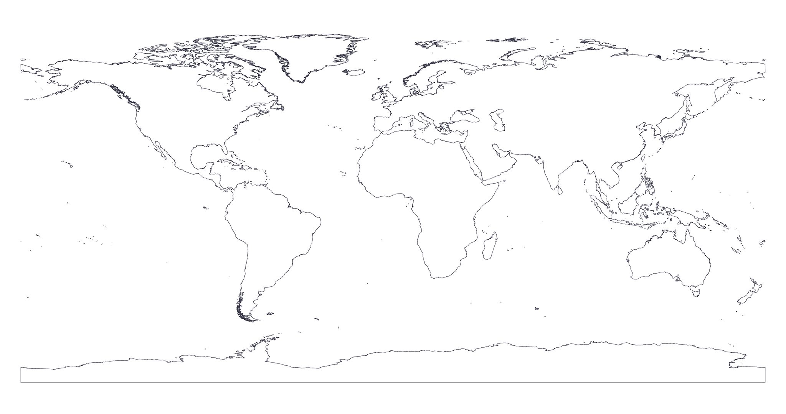
Easy Win: Metadata in one read
Typical NetCDF4 (Network Common Data Form) Data File
File Metadata
Dimension 1 Metadata
Dimension 1 Data
Dimension 2 Metadata
Dimension 2 Data
Variable A
Variable B
Variable A Metadata
Variable B Metadata
Variable A Data
Variable B Data
Coastline Image © OpenStreetMap contributors

Slide 12
OPeNDAP DMR++
Zarr Metadata
Variable A Metadata
Variable A Metadata
Variable B Metadata
File Metadata
Dimension 1 Metadata
Variable B Metadata
File Metadata
Dimension 1 Metadata
Variable C Metadata
Variable C Metadata
Dimension 2 Metadata
Dimension 2 Metadata
Variable D Metadata
Variable D Metadata
Byte Offsets of Chunks of Data
Byte Offsets of Chunks of Data
(USGS + The HDF Group Prototype)
Typical NetCDF4 (Network Common Data Form) Data File
File Metadata
Dimension 1 Metadata
Dimension 1 Data
Dimension 2 Metadata
Dimension 2 Data
Variable A
Variable B
Variable A Metadata
Variable B Metadata
Variable A Data
Variable B Data
Coastline Image © OpenStreetMap contributors

Slide 13
The Hard Work: Data Locality
Easy Case: latitude, longitude, time. 3 Dimensions.
On disk: Always 1 dimension.
You must collapse your data dimensions to 1D. There are fundamental trade-offs that no one can solve for you.
Optimizing for analysis on one dimension hurts analysis on the others.

Slide 14
The Hard Work: Data Locality
“Chunking”, some extreme examples:
Pangeo recommends 100-megabyte chunks, roughly equal dimension sizes for in-cloud processing, mostly for huge model datasets. Huge minimum data transfer but low request count.
GEDI (Global Ecosystem Dynamics Investigation) and ICESat-2 (Ice, Cloud and land Elevation Satellite) often have ~10-kilobyte chunks for granules approximately 1 gigabyte in size. Huge request count but low minimum data transfer.
Even if they were in the same format, these would perform very differently on different systems for different use cases. Your mileage may vary!

Slide 15
We provide this
Typical NetCDF4 (Network Common Data Form) Data File
File Metadata
Dimension 1 Metadata
Dimension 1 Data
Dimension 2 Metadata
Dimension 2 Data
Variable A
Variable B
Variable A Metadata
Variable B Metadata
Variable A Data
Variable B Data
Coastline Image © OpenStreetMap contributors

Slide 16
We provide this
I want this
Typical NetCDF4 (Network Common Data Form) Data File
File Metadata
Dimension 1 Metadata
Dimension 1 Data
Dimension 2 Metadata
Dimension 2 Data
Variable A
Variable B
Variable A Metadata
Variable B Metadata
Variable A Data
Variable B Data
Coastline Image © OpenStreetMap contributors

Slide 17
We provide this
I want this
To get it, libraries need this
Typical NetCDF4 (Network Common Data Form) Data File
File Metadata
Dimension 1 Metadata
Dimension 1 Data
Dimension 2 Metadata
Dimension 2 Data
Variable A
Variable B
Variable A Metadata
Variable B Metadata
Variable A Data
Variable B Data
Coastline Image © OpenStreetMap contributors

Slide 18
We provide this
I want this
To get it, libraries need this
Typical NetCDF4 (Network Common Data Form) Data File
File Metadata
Dimension 1 Metadata
Dimension 1 Data
Dimension 2 Metadata
Dimension 2 Data
Variable A
Variable B
Variable A Metadata
Variable B Metadata
Variable A Data
Variable B Data
The Challenge:
We need a small percentage of the file, but we don’t know where to find the bytes we need without reading a significant percentage of the file.
Variable D Metadata
Coastline Image © OpenStreetMap contributors

Slide 19
Zarr Metadata
Variable A Metadata
File Metadata
Dimension 1 Metadata
Variable B Metadata
Variable C Metadata
Dimension 2 Metadata
Variable D Metadata
Byte Offsets of Chunks of Data
(USGS + The HDF Group Prototype)
Typical NetCDF4 (Network Common Data Form) Data File
File Metadata
Dimension 1 Metadata
Dimension 1 Data
Dimension 2 Metadata
Dimension 2 Data
Variable A
Variable B
Variable A Metadata
Variable B Metadata
Variable A Data
Variable B Data
The Challenge:
We need a small percentage of the file, but we don’t know where to find the bytes we need without reading a significant percentage of the file.
Coastline Image © OpenStreetMap contributors

Slide 20
Zarr Metadata
Variable A Metadata
File Metadata
Dimension 1 Metadata
Variable B Metadata
Variable C Metadata
Dimension 2 Metadata
Read this all up front in a single, fast read.
Directly read only data of interest
Variable D Metadata
Byte Offsets of Chunks of Data
(USGS + The HDF Group Prototype)
Typical NetCDF4 (Network Common Data Form) Data File
File Metadata
Dimension 1 Metadata
Dimension 1 Data
Dimension 2 Metadata
Dimension 2 Data
Variable A
Variable B
Variable A Metadata
Variable B Metadata
Variable A Data
Variable B Data
The Challenge:
We need a small percentage of the file, but we don’t know where to find the bytes we need without reading a significant percentage of the file.
Coastline Image © OpenStreetMap contributors

Slide 21
OPeNDAP in the Cloud and the DMR++
How the server reads/subsets data from S3
DMR++: Dataset Metadata Response with extensions
S3: Simple Storage Service
OPeNDAP: Open-source Project for a Network Data Access Protocol

Slide 22
OPeNDAP DMR++
Variable A Metadata
File Metadata
Dimension 1 Metadata
Variable B Metadata
!
Variable C Metadata
Dimension 2 Metadata
Variable D Metadata
Byte Offsets of Chunks of Data
Zarr Metadata
Variable A Metadata
File Metadata
Dimension 1 Metadata
Variable B Metadata
Variable C Metadata
Dimension 2 Metadata
Variable D Metadata
Byte Offsets of Chunks of Data
(USGS + The HDF Group Prototype)
Typical NetCDF4 Data File
File Metadata
Dimension 1 Metadata
Dimension 1 Data
Dimension 2 Metadata
Dimension 2 Data
The Challenge:
We need a small percentage of the file, but we don’t know where to find the bytes we need without reading a significant percentage of the file.
Variable A
Variable B
Variable A Metadata
Variable B Metadata
Coastline Image © OpenStreetMap contributors
Variable A Data
Variable B Data
Variable C
Variable D

Slide 23
Optimization 1: Allow Reading EOSDIS NetCDF from Zarr Python
EOSDIS Cloud
zarr-eosdis-store
OPeNDAP DMR++
Typical EOSDIS Data File
Read Metadata
Read Data
Zarr Python Library

Slide 24
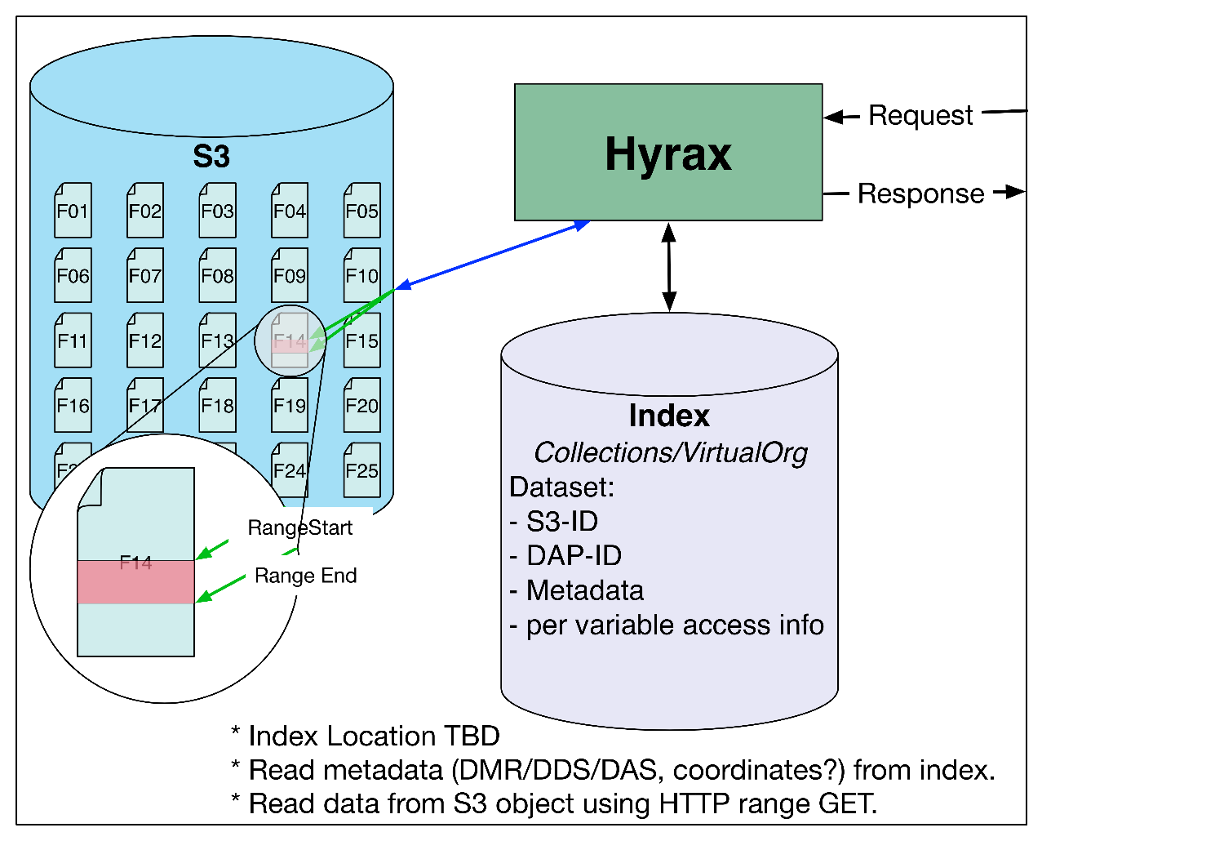
Arch 2: Files with HTTP Range GETs
HTTP Range-Get access to whole files in S3
HTTP: Hypertext Transfer Protocol
DDS: Data Access Protocol (DAP) Dataset Descriptor Structure
DAS: DAP Dataset Attribute Structure

Slide 25
Hyrax/DMR++ Use: Set up
First, build the DMR++ metadata file
  Choose options that alter the appearance of the file
  DMR++ documents are (now) XML
Store the Data and DMR++ metadata in S3, or another web object store (WOS)
  We use CMR to find these S3 objects
XML: eXtensible Markup Language
WOS: Web Object Store
CMR: Common Metadata Repository

Slide 26
Hyrax/DMR++ Use: Optimization
Combine adjacent ‘chunks’ to maximize transfer volume per request
Issue parallel reads
Decompress ‘chunks’ in parallel

Slide 27
Optimization 2: Cache Handshaking Information
EOSDIS Cloud
EOSDIS Zarr Storage Library
(New)
OPeNDAP DMR++
Typical EOSDIS Data File
Read Metadata
Read Data
Get Data
Internet Services
Egress App
Needs Auth
Get Token
Login
Zarr Python Library
Redirect toToken Check
Check Token
EOSDIS Zarr Storage Library
(New)
Internet Services
Egress App
Redirect to Get Data
Get Data
Internet Services
Egress App
Redirect to Pre-Signed S3 URL
Get Data
AWS S3
Actual Bytes
By default, for every request, often hundreds or more

Slide 28
Optimization 2: Cache Handshaking Information
EOSDIS Cloud
EOSDIS Zarr Storage Library
(New)
OPeNDAP DMR++
Typical EOSDIS Data File
Read Metadata
Read Data
Get Data
Internet Services
Egress App
Needs Auth
Get Token
Login
Keep this Cookie
Zarr Python Library
Redirect toToken Check
Check Token
EOSDIS Zarr Storage Library
(New)
Internet Services
Egress App
Redirect to Get Data
Cache this URL
Get Data
Later requests skip to here
Egress App
Internet Services
Redirect to Pre-Signed S3 URL
Get Data
AWS S3
Actual Bytes
By default, for every request, often hundreds or more

Slide 29
It’s open source!
https://github.com/nasa/zarr-eosdis-store

Slide 30
Conclusions
2021 Fall AGU

Slide 31
Conclusions
Cloud access optimization demands read latency optimization
      Combine many smaller reads into fewer larger reads (metadata & data)
      Skip expensive network actions such as auth or redirects, if possible, via cookies and caching
      Parallelize reads

Slide 32
Questions?
James Gallagher
EED-3 Software Engineer
jgallagher@opendap.org
Patrick Quinn
EED-3 Software Engineer
patrick@element84.com

Slide 33
This work was supported by NASA/GSFC under Raytheon Technologies contract number 80GSFC21CA001.

