Slide 1
AIAA SciTech-2022
Nuclear Thermionic Avalanche Cell (NTAC) Augmented Nuclear Thermal Propulsion (NTP) & Nuclear Electric Propulsion (NEP)
Sang H. Choi
Dennis M. Bushnell
Robert W. Moses
NASA Langley Research Center
January 5, 2022
sang.h.choi@nasa.gov

Slide 2
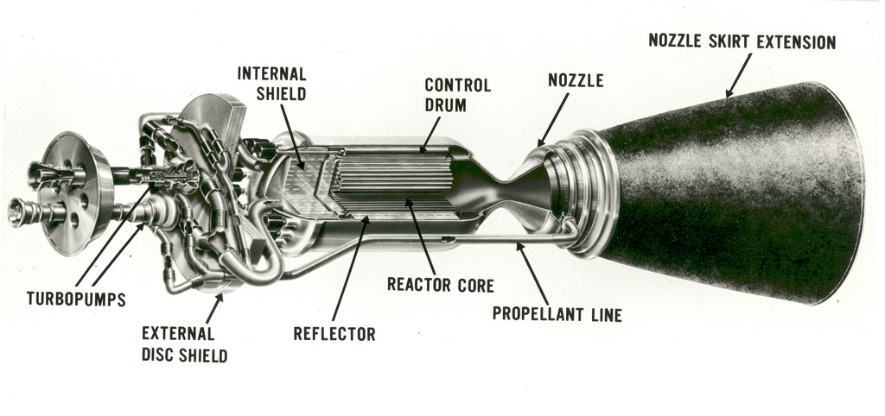
Nuclear Engine for Rocket Vehicle Application (NERVA) Engine
Image Credit NASA

Slide 3
Maximum performance results of the Rover/NERVA programs
Parameter | Reactor (test date) | Peak performance achieved
Power | PHOEBUS 2A (July 1968) | 4100 MWt
Peak fuel temperature | PEEWEE (November 1968) | 2750 K
Specific impulse | PEEWEE (November 1968) | 848 s
Maximum restarts | XE’ (June 1969) | 28 times
Accumulated time at full power | NF-1 (June–July 1972) | 109 min
Continuous operation | NRX-A6 (December 1967) | 62 min
Alloys Considered for Reactor Chambers
Binary alloy | Melting temperature (K)
NbC | 3873 ± 25 K
TaC | 4258 K
UC | 2803 K
ZrC | 3813 K

Slide 4
Comparison of rocket propulsion system characteristics
Theoretical
Specific
Impulse
440 s
980 s
2600 s
6700 s
1.3∼3 Ms
Mass Ratio*,
Earth Escape
15
3.2
1.5
1.2
Energy Source
Combustion Chamber
LH₂
Chemical
Reaction
Lox or LF₂
H₂-solid core, 2800 K
Reactor Core
Nuclear
Fission
Reaction
LH₂
H₂-molten core, 5250 K
H⁺ + e⁻
H₂-gaseous core, 10000 K
Fusion
Materials
Reaction Chamber
Nuclear
Fusion
Annihilation
> 200000 K
*Ratio of take-off to final mass

Slide 5
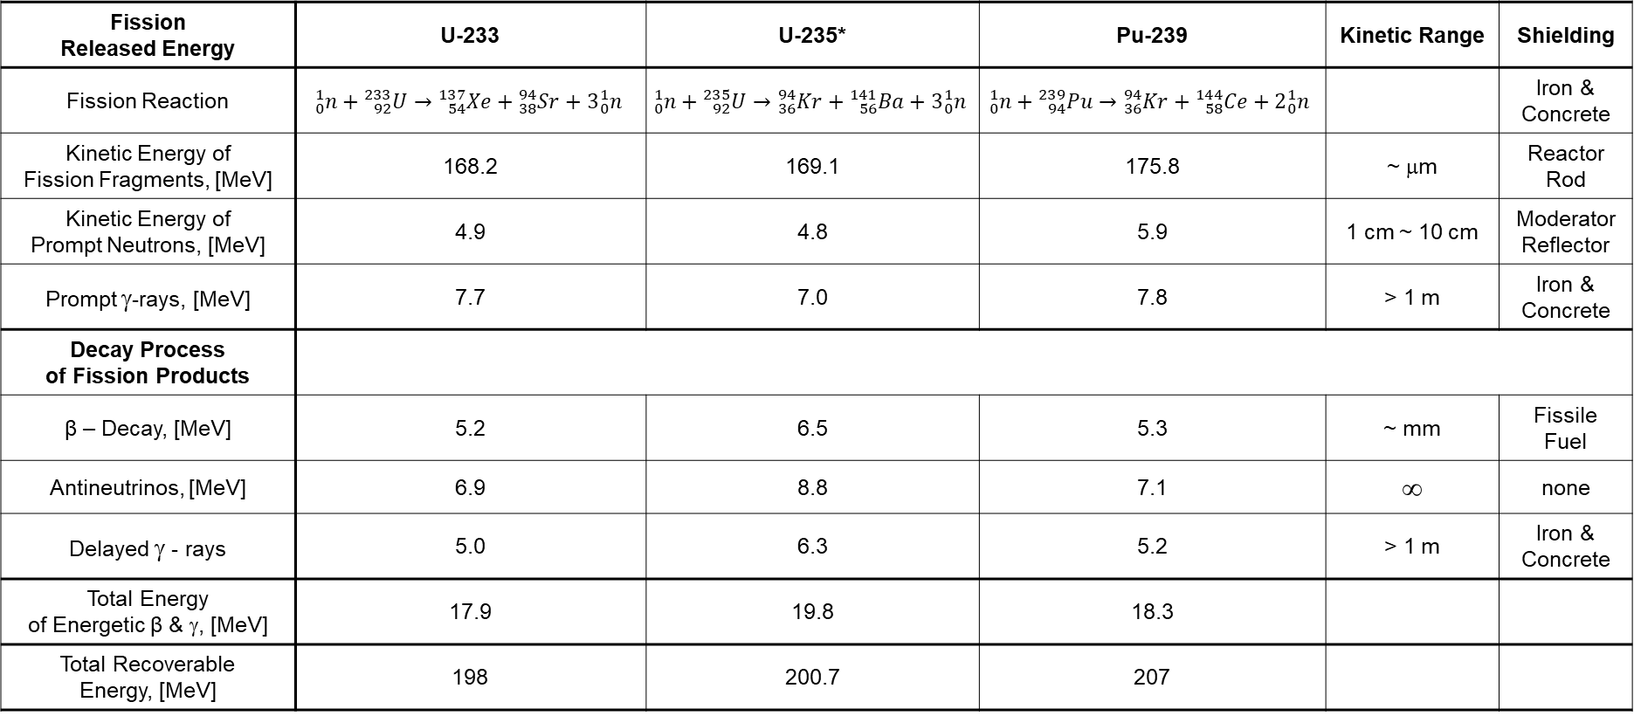
Nuclear Fission Patterns
Fission Released Energy | U-233 | U-235* | Pu-239 | Kinetic Range | Shielding
Fission Reaction | $${}_{0}^{1}n+{}_{92}^{233}{U→{}_{54}^{137}{Xe+{}_{38}^{94}{Sr+3{}_{0}^{1}n}}}$$ | $${}_{0}^{1}{n+{}_{92}^{235}{U→{}_{36}^{94}{Kr+{}_{56}^{141}{Ba+3{}_{0}^{1}n}}}}$$ | $${}_{0}^{1}{n+{}_{94}^{239}{Pu→{}_{36}^{94}{Kr+{}_{58}^{144}{Ce+2{}_{0}^{1}n}}}}$$ |  | Iron & Concrete
Kinetic Energy of Fission Fragments, [MeV] | 168.2 | 169.1 | 175.8 | ~ μm | Reactor Rod
Kinetic Energy of Prompt Neutrons, [MeV] | 4.9 | 4.8 | 5.9 | 1 cm ~ 10 cm | Moderator Reflector
Prompt γ-rays, [MeV] | 7.7 | 7.0 | 7.8 | > 1 m | Iron & Concrete
Decay Process of Fission Products
β – Decay, [MeV] | 5.2 | 6.5 | 5.3 | ~ mm | Fissile Fuel
Antineutrinos, [MeV] | 6.9 | 8.8 | 7.1 | ∞ | none
Delayed γ - rays | 5.0 | 6.3 | 5.2 | > 1 m | Iron & Concrete
Total Energy of Energetic β & γ, [MeV] | 17.9 | 19.8 | 18.3
Total Recoverable Energy, [MeV] | 198 | 200.7 | 207
*U-235 has 3 other fission patterns
Concrete - high density

Slide 6

Principles and Concept
Fission Reaction Rate
where Φ - neutron flux [neutrons/cm²⋅s]
σ - microscopic cross section [barn, cm²]
N - atomic number density [atoms/cm³]
The reaction rate for various types of interactions includes the total Σ_{t}⋅Φ, the absorption Σ_{a}⋅Φ, the radiative capture Σ_{c}⋅Φ, and the fission Σ_{f}⋅Φ. The rate of energy release (power) due to the fission reaction is given by following equation:
P = R_{R} ⋅ E_{r} ⋅ V = Ф ⋅ Σ_{f} ⋅ E_{r} ⋅ V = Ф ⋅ NU₂₃₅ ⋅ σ_{f}²³⁵ ⋅ E_{r} ⋅ V
where P – reactor power [MeV/s]
Ф – neutron flux [neutrons/cm²∙s]
σ – microscopic cross section [cm²]
N – atomic number density [atoms/cm³]
E_{r} – the average recoverable energy per fission [MeV/fission]
V – total volume of the core [m³]
$$RR=Φ∙Σ=Φ∙N∙σ or RR=\int_{0}^{∞}{Σ(E)∙Φ\left(E\right)dE}$$

Slide 7
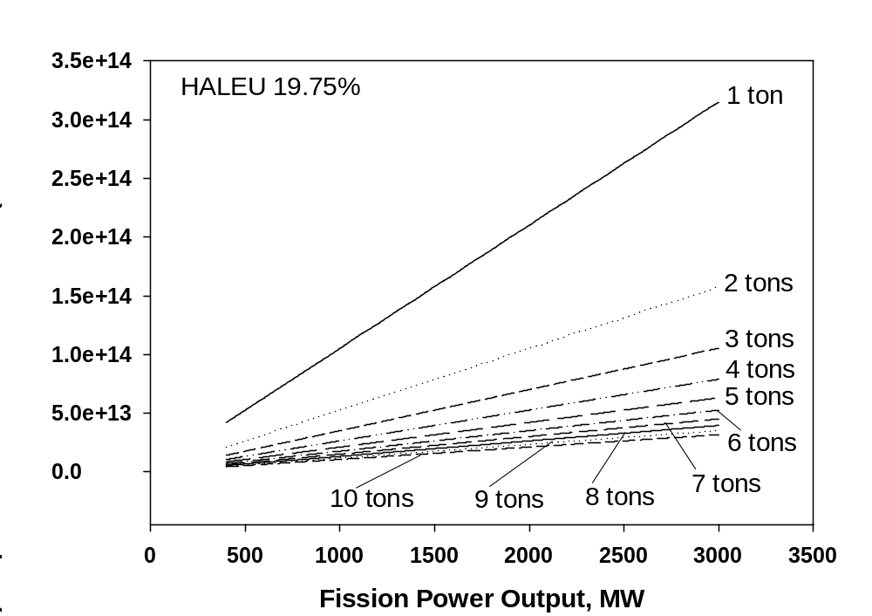
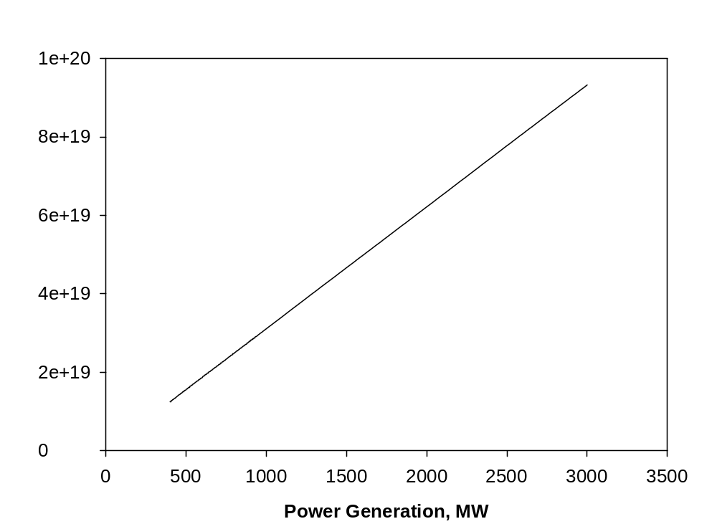
Nuclear Fission Reaction Rates for NTP and NEP
Neutron flux required to sustain nuclear fission reaction
for generation of fission power from HALEU
nuclear fuel (19.75% U-235 and 80.25% U-238) wrt. fuel
mass from 1 thru 10 tons
Power output from nuclear fission process requires a rate of
thermal neutron triggered nuclear fission reaction within HALEU
nuclear fuel (19.75% U-235 and 80.25% U-238)
HALEU: High-Assay Low-Enriched Uranium

Slide 8
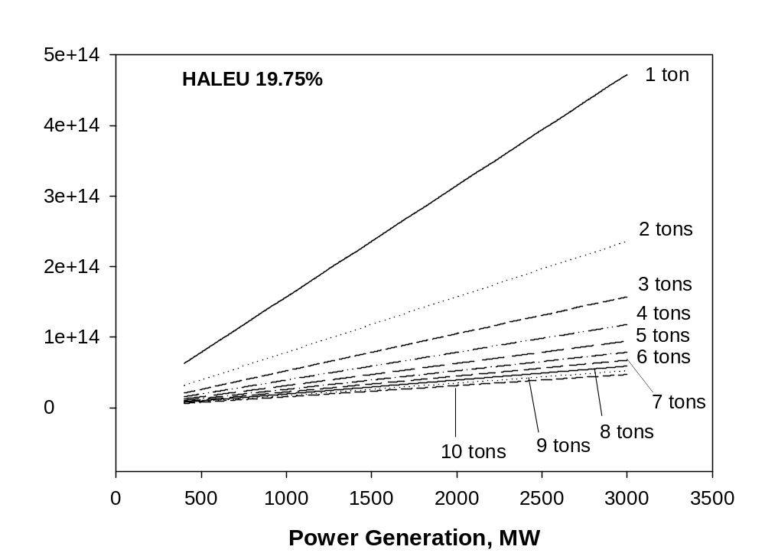
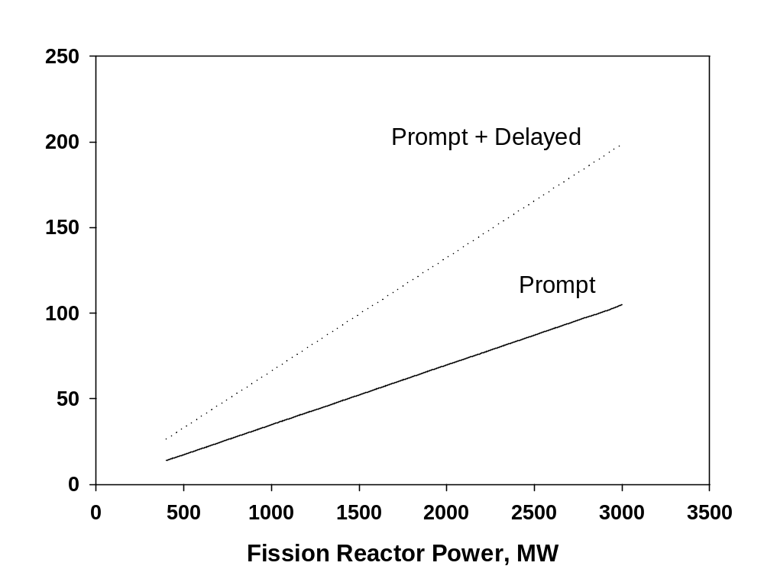
Gamma Ray Emission and Associated Power
Rate of gamma ray emission from nuclear fission reaction
of HALEU nuclear fuel (19.75% U-235 and 80.25% U-238)
wrt. fuel mass from 1 thru 10 tons
Photon power of gamma ray from nuclear fission reaction of
HALEU nuclear fuel (19.75% U-235 and 80.25% U-238).

Slide 9
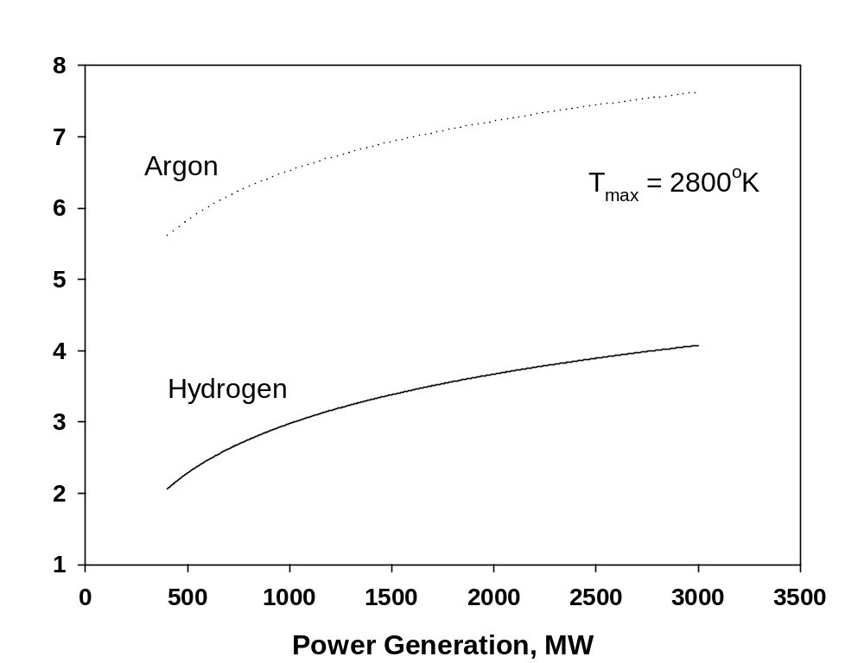
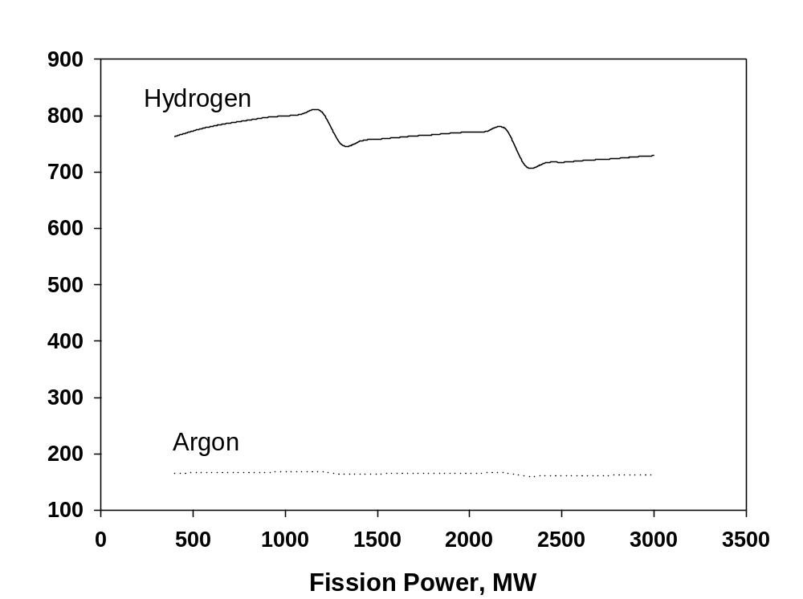
Propellant Flowrates and Isp for NTP
Flowrates of propellants (H₂ and Ar) required to keep the reactor
temperature at 2800 ºK based on reactor power output.
Specific impulse (Isp) of hydrogen and argon propellant at 2800 ºK
reactor temperature.

Slide 10
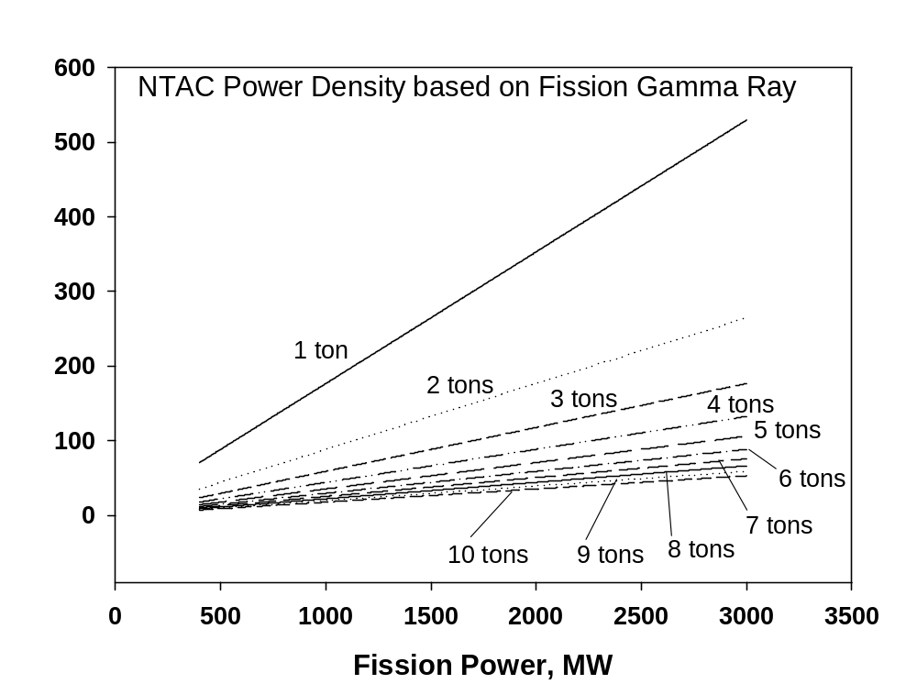
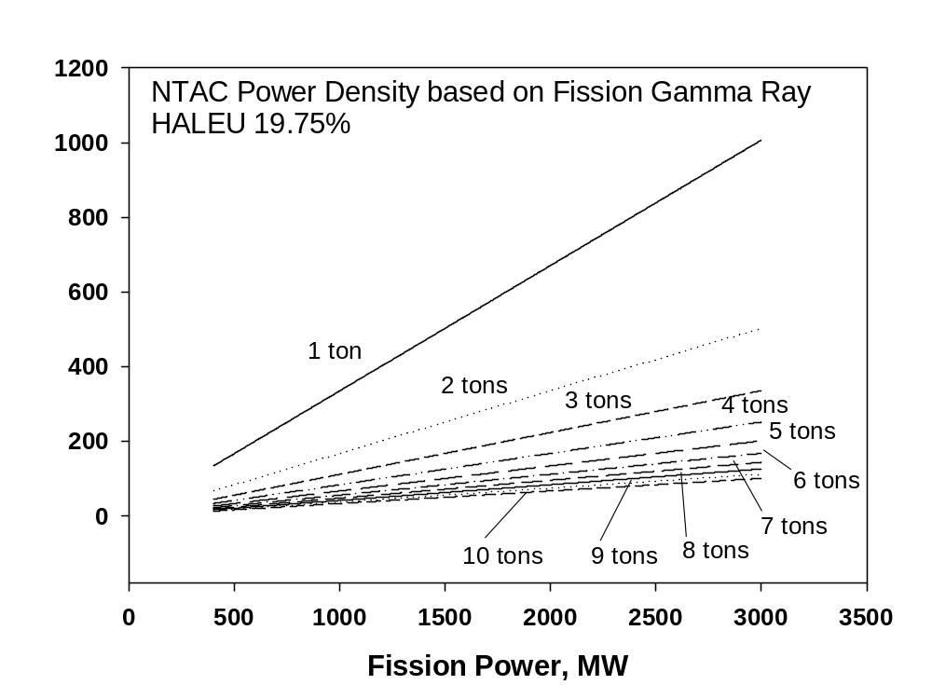
Specific power of NTAC augmented NTP
Prompt Gamma Ray Only
Prompt & Delayed Gamma Rays
Specific power of NTAC augmented NTP system considering
only prompt gamma rays based on nuclear reactor power output
from HALEU nuclear fuel (19.75% U-235 and 80.25% U-238)
for fuel mass from 1 thru 10 tons
Specific power of NTAC augmented NTP system considering
prompt and delayed gamma rays together based on nuclear reactor power output from HALEU nuclear fuel (19.75% U-235 and 80.25% U-238) for fuel mass from 1 thru 10 tons.

Slide 11
Fission Reactor Parameters
Uranium Fuel: HALEU (19.75% of U-235)
Fuel Weight: Cases of 1 ton, 2 tons, 3 tons, 4 tons, 5 tons, 6 tons, 7 tons, 8 tons, 9 tons, and 10 tons
H₂ & Ar Temperature: 2800 K
 | 500 MW | 600 MW | 700 MW | 800 MW | 900 MW | 1000 MW | 1500 MW | 2000 MW | 2500 MW | 3000 MW
H₂ Flowrate | 9.83 | 11.79 | 13.76 | 15.72 | 17.69 | 19.66 | 29.48 | 39.31 | 49.14 | 58.97
Ve, m/s | 7577 | 7653 | 7714 | 7334 | 7394 | 7214 | 7426 | 7237 | 7189 | 7140
Isp, s | 773 | 781 | 787 | 748 | 754 | 736 | 758 | 738 | 734 | 729
Ar Flowrate | 20.60 | 41.21 | 61.81 | 82.42 | 103.02 | 123.63 | 144.23 | 164.84 | 185.44 | 206.04
Ve, m/s | 1432 | 1503 | 1535 | 1476 | 1497 | 1472 | 1487 | 1432 | 1408 | 1386
Isp, s | 166 | 166 | 167 | 164 | 164 | 163 | 164 | 163 | 162 | 162

Slide 12
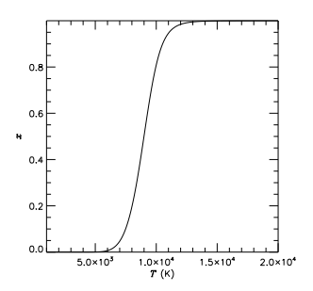
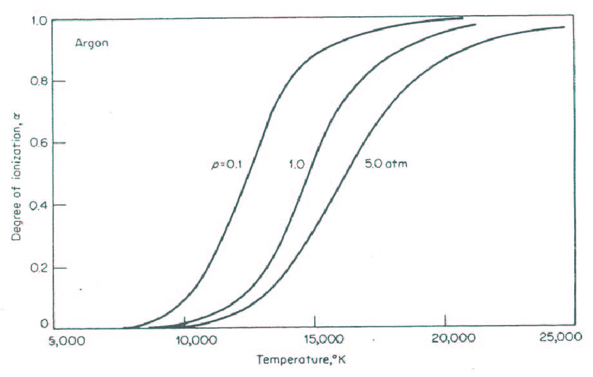
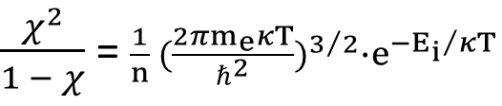
Ionization Fraction of H₂ and Ar
Saha Equation of Ionization Fraction;
$\frac{χ^{2}}{1 − χ}$= $\frac{1}{n} {(\frac{2πm_{e}κT}{ℏ^{2}})}^{3/2}∙e^{{−E_{i}}/{κT}}$
0.86 eV
0.86 eV
Ionization fraction of hydrogen. At 10000 ºK,
80% of hydrogen can be ionized.
Ionization fraction of argon. At 10000 ºK, Only 10% of argon
can be ionized even though argon has a large collision
cross-section.

Slide 13
New Concepts of Nuclear Powered Rockets
Hybrid thruster of NTP and NEP
powered by NTAC
NTP combined with MPD thruster
powered by NTAC

Slide 14
NTP with Two Different Nuclear Reactor Cores
Preheated Propellant
Control Rods
Preheated Propellant
Control Rods
Rocket Chamber
Rocket Chamber
NTAC
NTAC Cell
Structure
Neutron
Reflector
TRISO Pebble-bed: HALEU 19.5
Reactor Core: HALEU 19.5
Inner Layer & Neutron Reflector
Heated
Propellant
Heated
Propellant
Propellant from Pump
Propellant
from Pump
Exhaust Gas
Exhaust Gas
Reactor Core: TRISO Pebble-bed
Reactor Core: Pellet-stacked rods

Slide 15
Hybrid Thruster of NTP and NEP powered by NTAC
Nuclear Reactor Core
Neutron Reflector
Nuclear Thermal Thruster
Pump
Electric Thrusters
NTAC
Propellant Feed Line
Preheated Propellant Line

Slide 16
NTAC Augmented NEP
Pellet or Pebble Nuclear Reactor
Propellant Feed Line
Electric Thrusters
Turbo Pump
①
NTAC
⊕
Power Feed Line
for Electric Thrusters
Pre-heated Propellant
Neutron Reflector

Slide 17
Concluding Remarks
NTP and NEP can be paired with NTAC to create additional power
NTAC can add 10% more power to NTP and 30% more to NEP since NEP requires one more step-down power conversion from thermal to electric which ends up with 30% of thermal. NTAC can add electric power (10% of thermal) amounting of 30% level of NEP electric power.
Possibility of mixed mode of NTP and NEP with NTAC exists
Additional power by NTAC improves the overall specific power of a system

