Slide 1
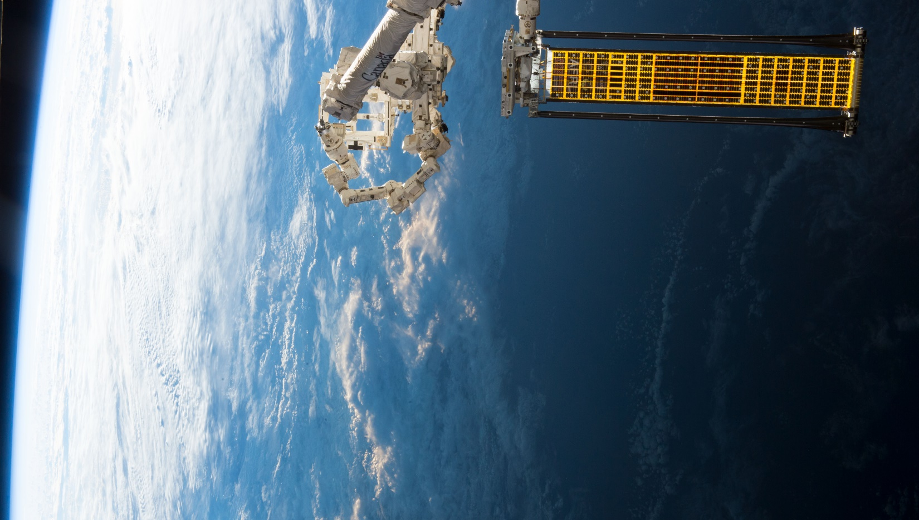

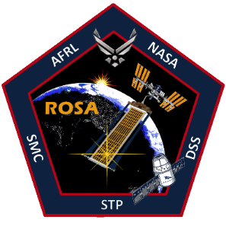
AIAA SciTech 2022
On-Orbit Structural Dynamics Testing of the Roll-Out Solar Array
Thomas W. Jones, Race Kramer, Kevin Moyer
Matt Chamberlian
NASA Langley Research Center
Donn A. Liddle
NASA Johnson Space Center
Mark R. Shortis
RMIT University, Melbourne Australia
and
Jeremy A. Banik
Air Force Research Laboratory, Space Vehicles Directorate
Notes:
Special Thanks … NASA JSC Imagery Science and Analysis Group;
Air Force Research Laboratory Space Vehicles Directorate
Department of Defense Space Test Program …
Deployable Space Systems (DSS)

Slide 2
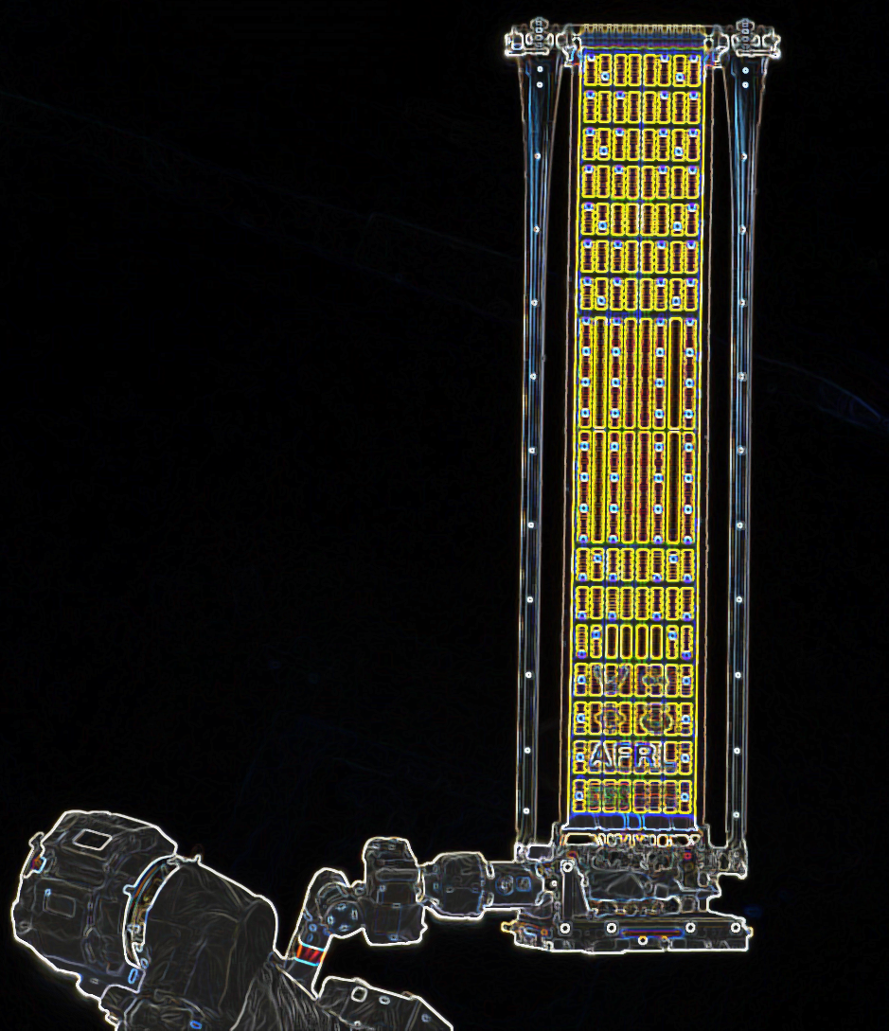
Outline
ROSA Background
Pre-flight Preparations
ROSA Instrumentation & Targeting
Photogrammetric Simulation
  ISS Camera Geometry
Image Processing Methodology
Photogrammetric Tracking
Results – Comparison (Accelerometer)
Conclusion
Notes:
Focus of this paper: Structural Dynamics
Look for other upcoming papers:
Mission overview (IEEE Space 2018)
FEM Modeling
Photogrammetry

Slide 3
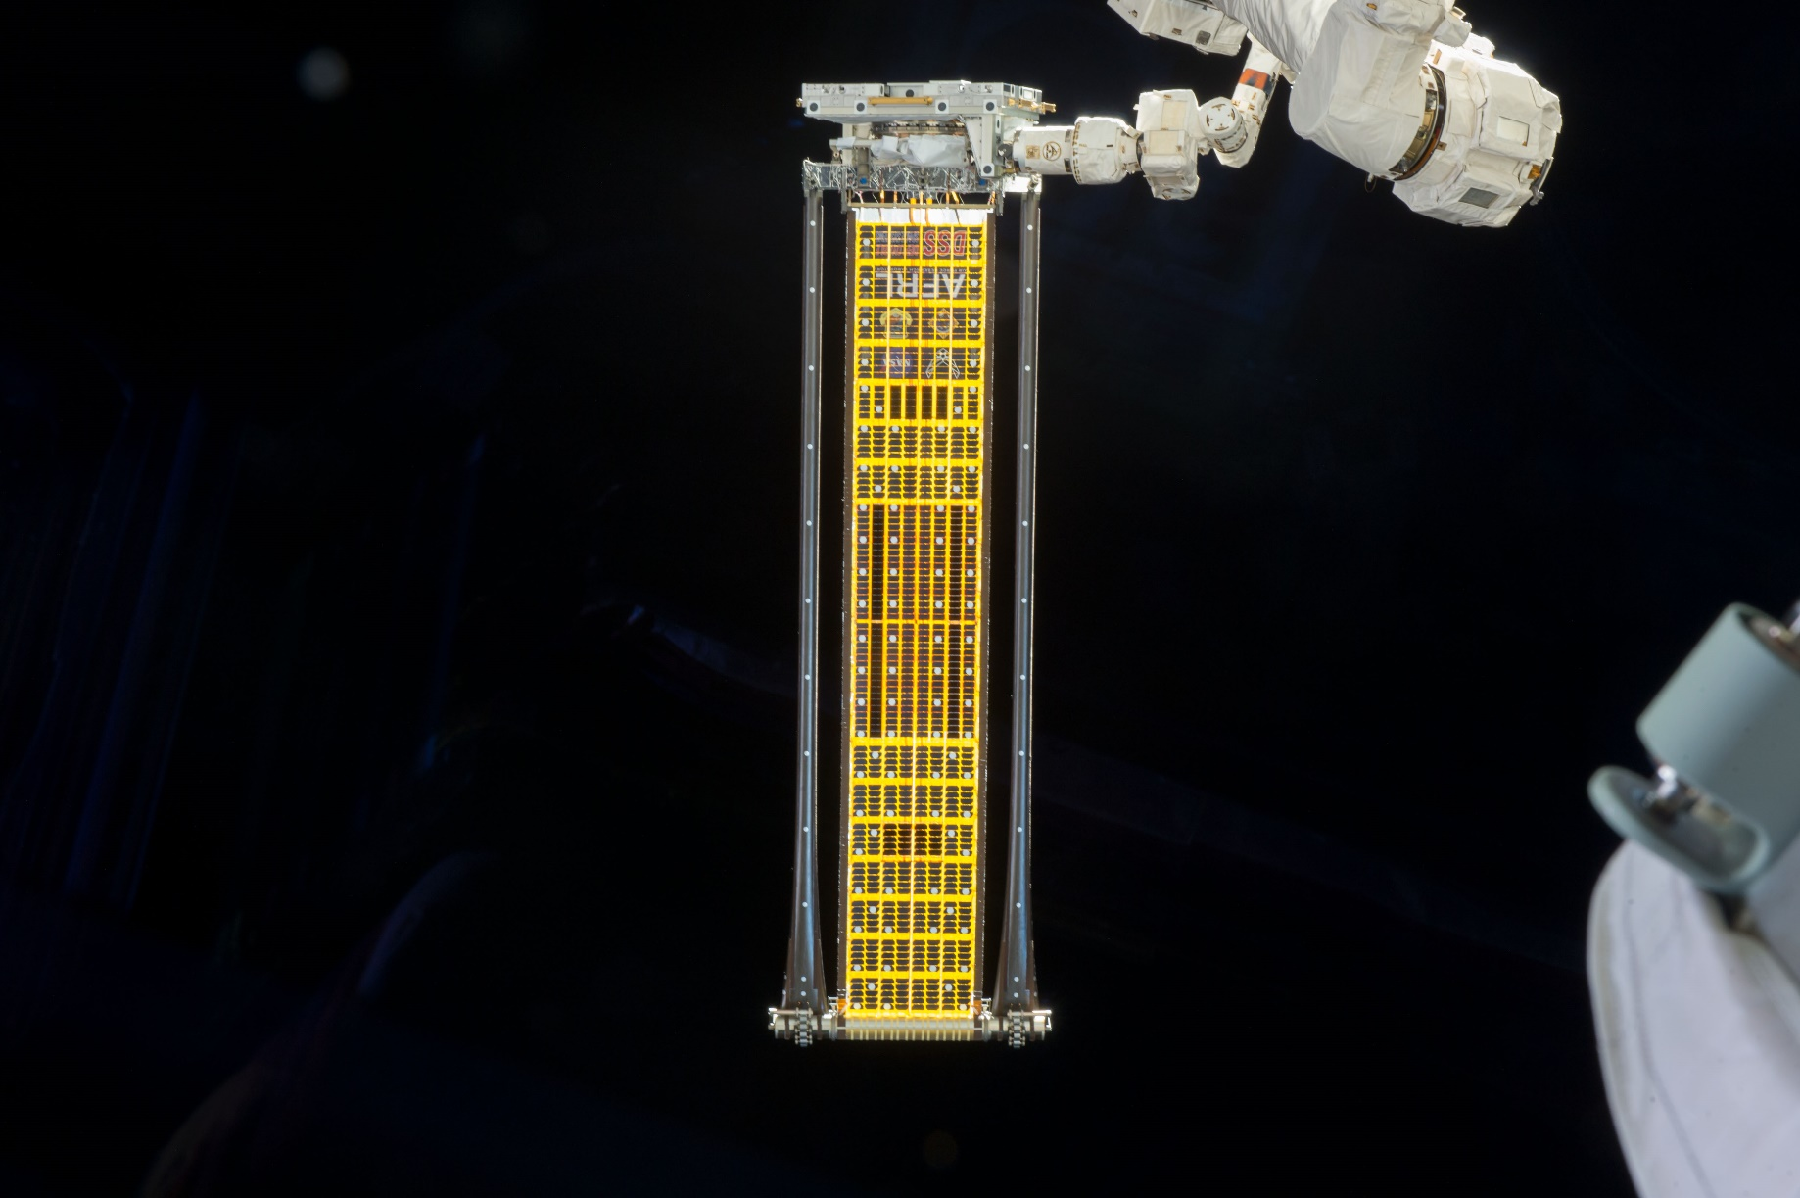
Why the Roll-Out Solar Array?
State of the art for satellite solar arrays: Rigid deployable panels
NASA and DoD are interested in lighter, smaller arrays:
  Satellites
  Deep space solar electric propulsion (Mars, Moon, etc)
ROSA is an inexpensive, rollable solar array concept that is 20 % lighter, takes up only 25% the stowage space of a standard rigid solar array
Design overview
  High-strain composite slit tube booms
  Integrated Modular Blanket Assembly (IMBA or “blanket”) made up of lightweight photovoltaics attached to mesh substrate
  Booms and IMBA roll up on mandrel for launch
  No motors required for deployment (strain energy used exclusively)
Direction of
deployment

Slide 4
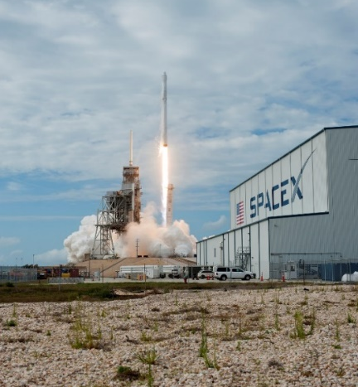
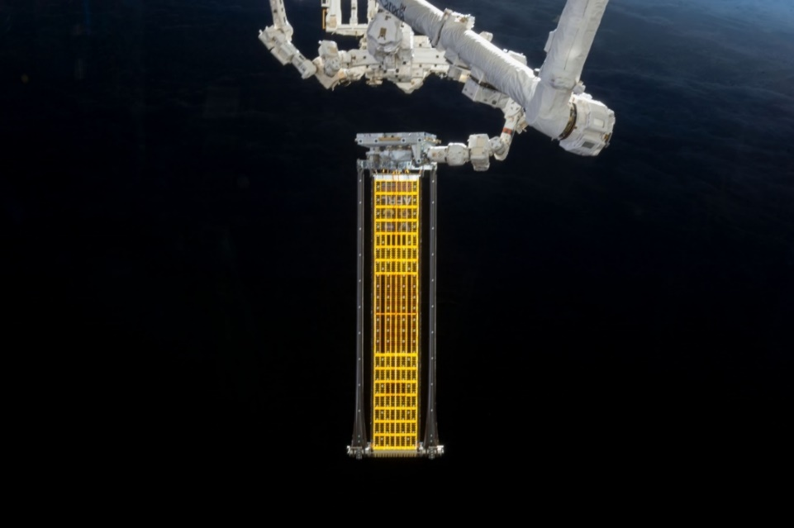
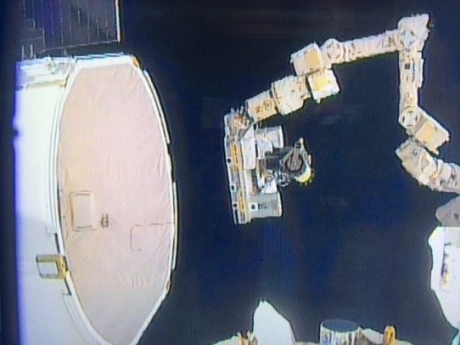
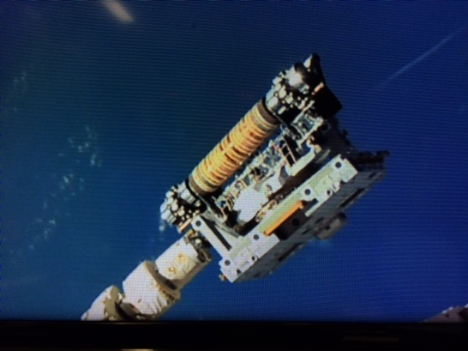
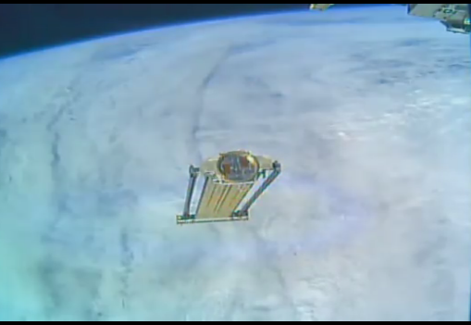
ROSA Flight Experiment Overview
Launch from KSC
Deployment Complete
Extraction from Dragon Trunk
Positioned for Deployment
Jettison
June 3, 2017
June 17, 2017
June 17, 2017
June 18, 2017
June 26, 2017
Goals:
  Demonstrate efficacy of high-strain composites for use in structures AND stored-strain deployments
  Characterize dynamic characteristics of ROSA: modes, mode shapes, and damping
  Verify functionality of photovoltaics after rolled storage
  Measure vibration response to day/night transition
7-Day window for all experiments

Slide 5
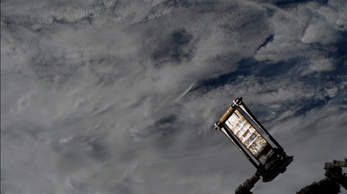
Deployment: June 18th, 2017 (sped up ~20x)
Actual Deployment Time: 3.5 minutes

Slide 6
ROSA Structural Dynamics …
Any engineered structure has natural frequencies
For lightweight solar arrays, these frequencies can be quite low
For deep space SEP (e.g. cargo to Mars), solar arrays would be HUGE with very low frequencies
Control of such a spacecraft could be difficult
Solutions:
  Model
  Test
  Fly
Finite Element Models
Hard to do on the Ground
Very Expensive
Notes:
Why is it hard to test on the ground?
Gravity
Air
No large spaces to deploy
No great systems for offloading, especially during deployment and especially for the soft pieces of the array.
What was special about this project was that we got to do all three of these things.

Slide 7
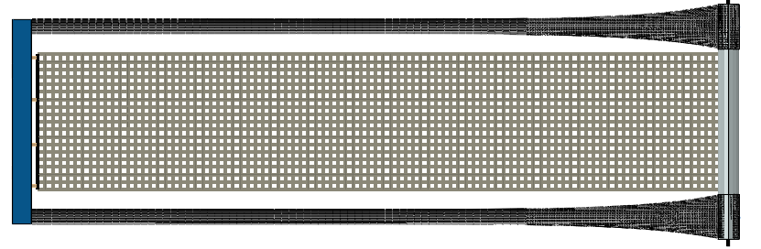
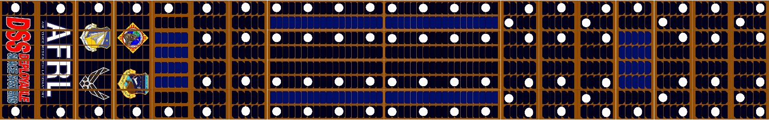
ROSA: Instrumentation & PG Targeting
Direction of Deployment
Root Structure
Composite STEM Booms
Integrated Modular Blanket Assembly (IMBA)
FRAM
Mandrel
Photovoltaics
Accelerometers
Photogrammetry Targets
Resistance Temperature Detectors (RTDs)
Cameras (Not Shown):
4 on ROSA root structure
2 on SPDM
Various on ISS (HD and SD)
Linear Actuator

Slide 8
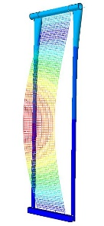
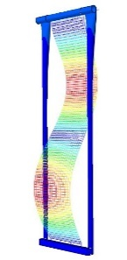
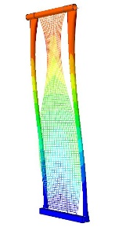
Photogrammetry Measurement Goals: Modes of Interest (Model Predictions)
Shell-Based Blanket Model (ANSYS)
Mode | Frequency (Hz) | Shape
5 | 0.94 | Blanket Drum
9 | 1.79 | 2nd Order Blanket Drum
13 | 2.06 | 4th Order Lateral Blanket Drum
Notes:
Add animation of target zones

Slide 9
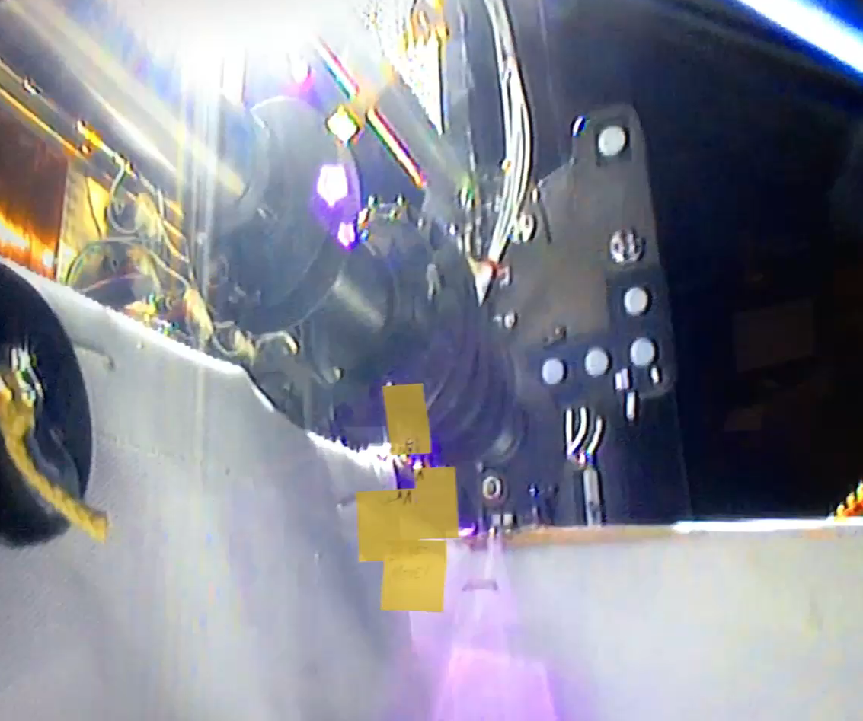
Dynamics Test Plan
Driven motion:
  Drive base with sinusoidal out-of-plane motion
  Sweep through expected frequency ranges of modes
  Carry out repeated night and day “science” runs around measured modes
  Roughly 30 experiments
90+

Slide 10
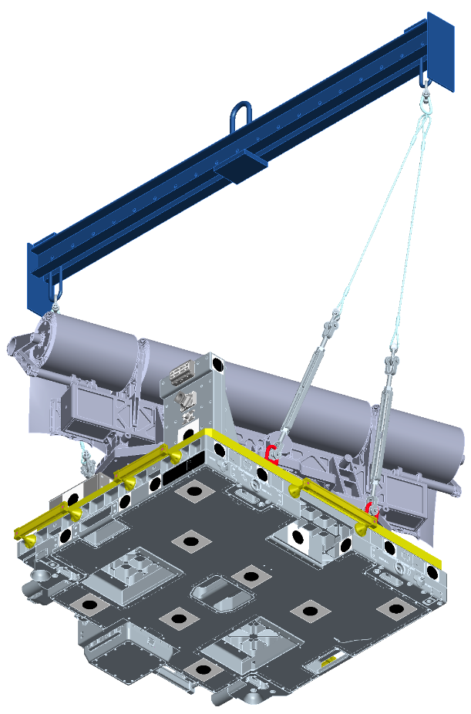
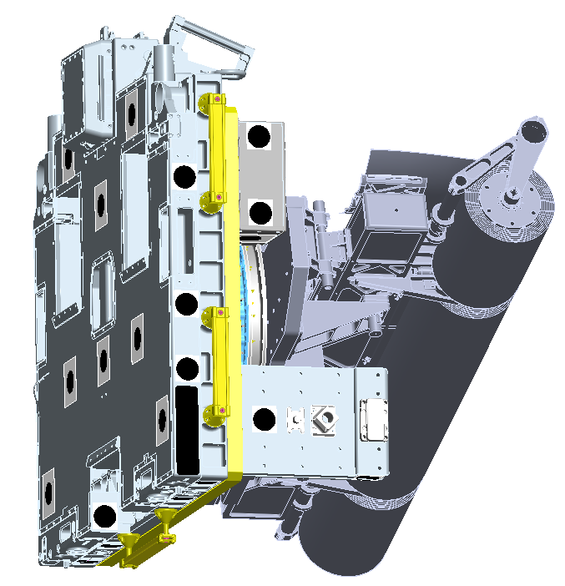
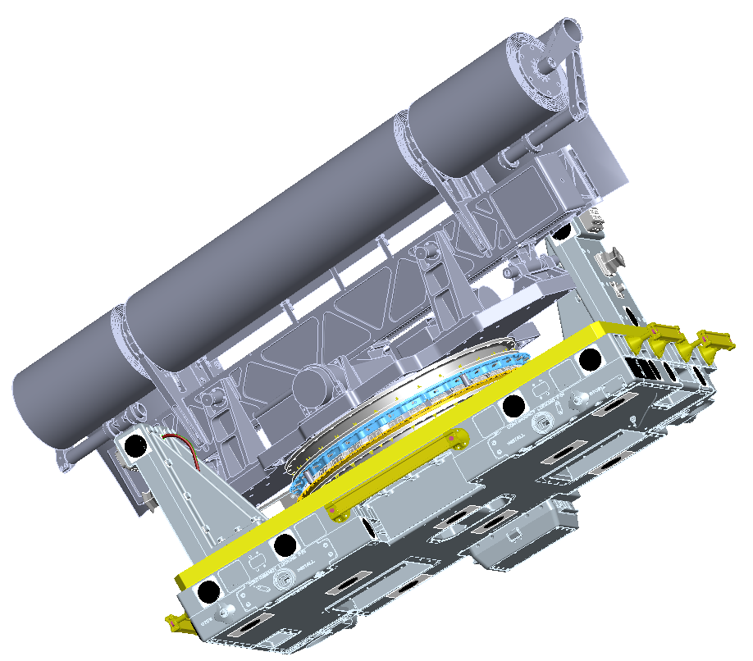
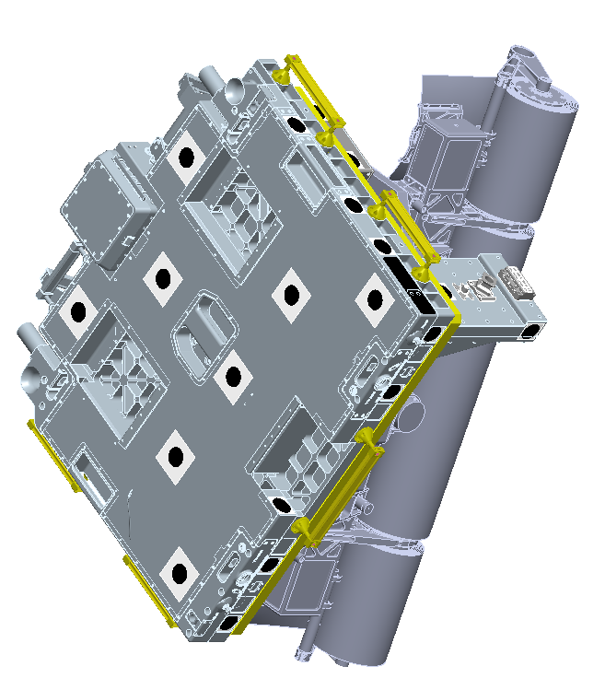
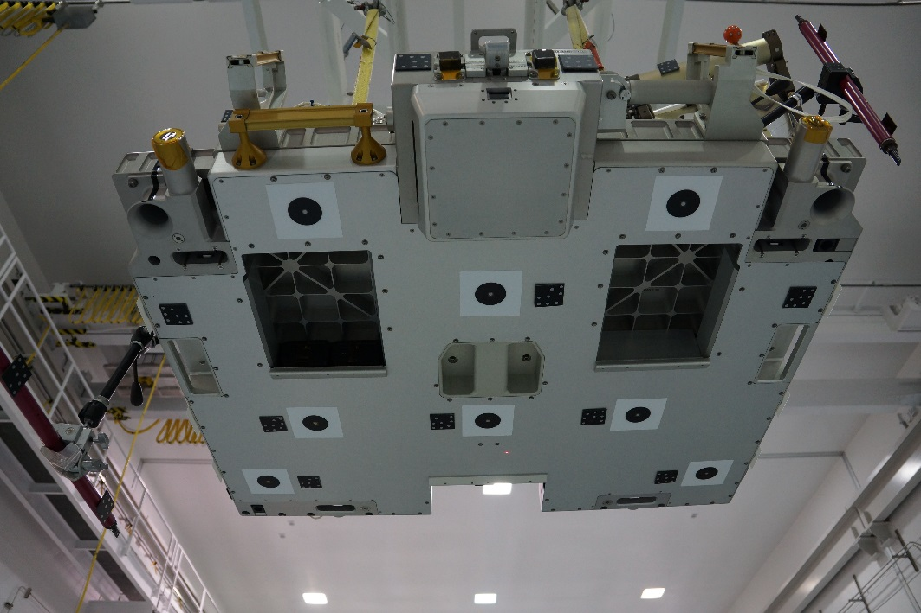
CP-13
Photogrammetric Simulation:
ISS In-Flight Camera Coordinate Definition
Refence Points Mapped to ROSA Coordinate System Definition During Ground Ops
CP-3
CP-9

Slide 11
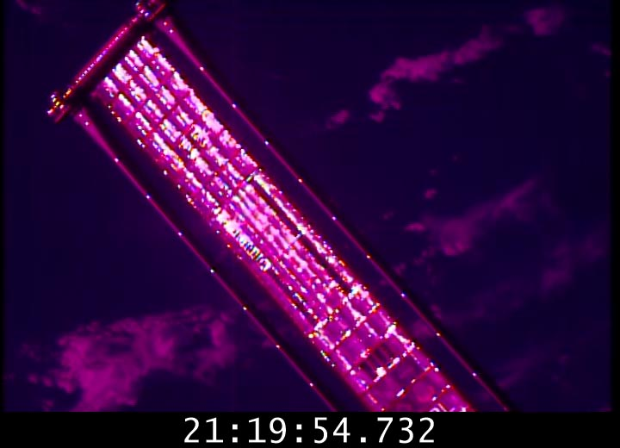
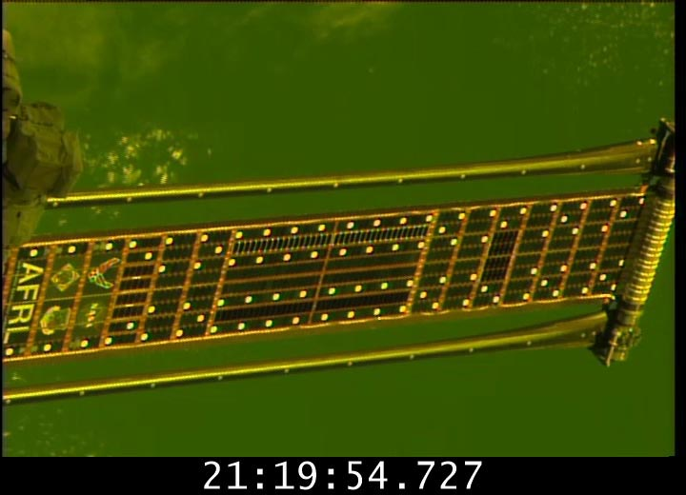
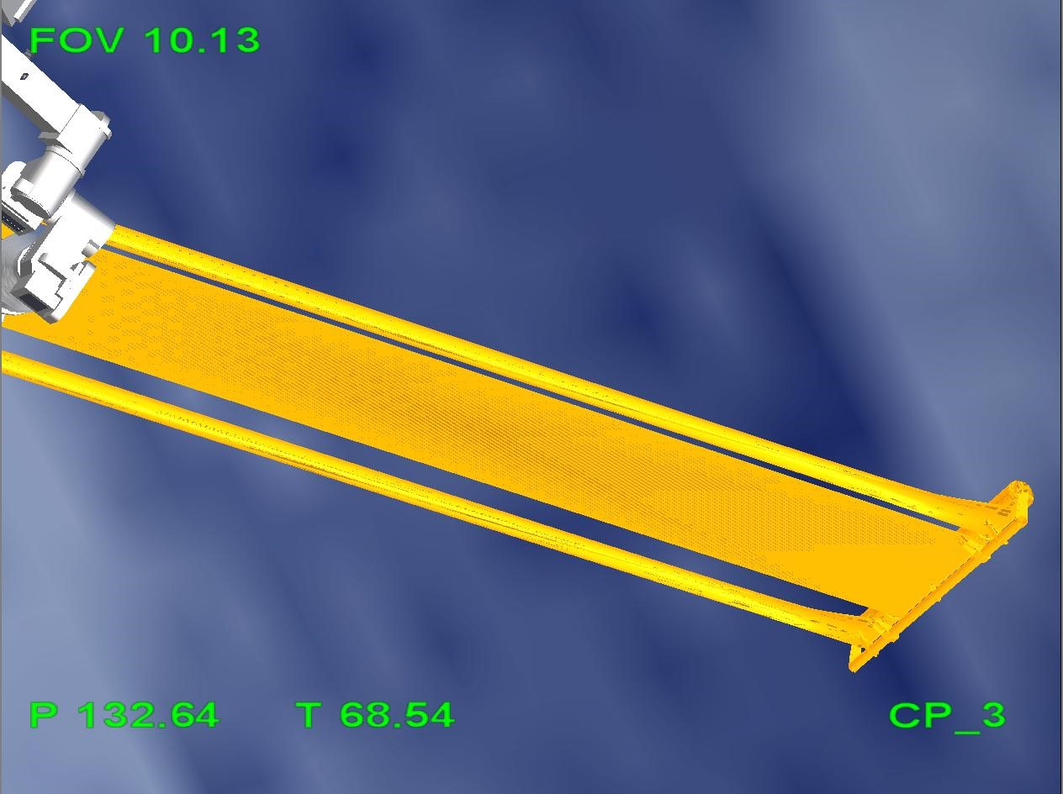
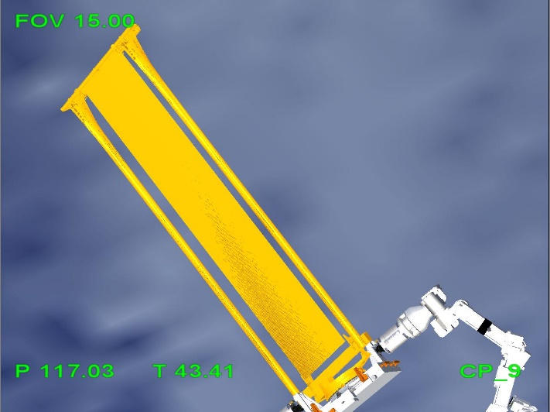
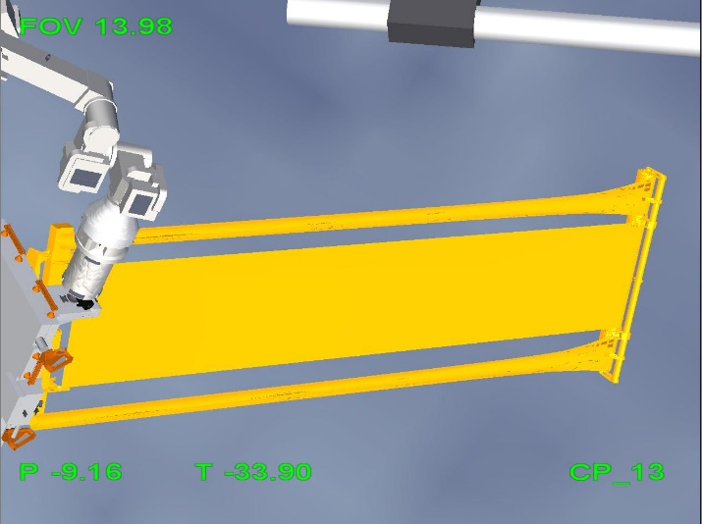
Photogrammetric Simulation:
ISS In-Flight Camera Modeling-Perspective

Slide 12
ROSA: Day/Night Target Visibility & Contrast

Slide 13
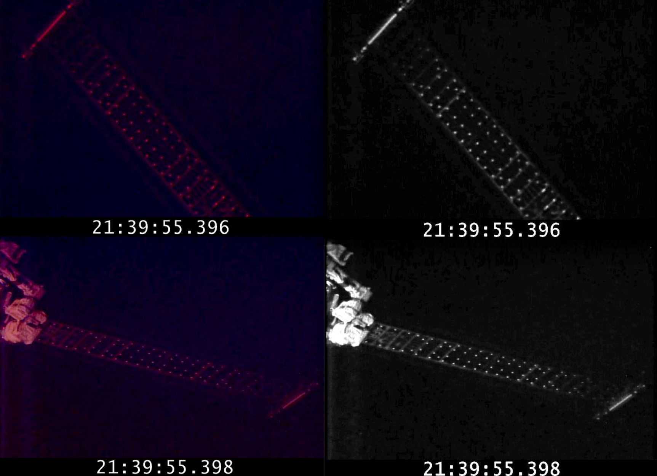
Image Processing: Contrast Enhancement (Matlab)

Slide 14
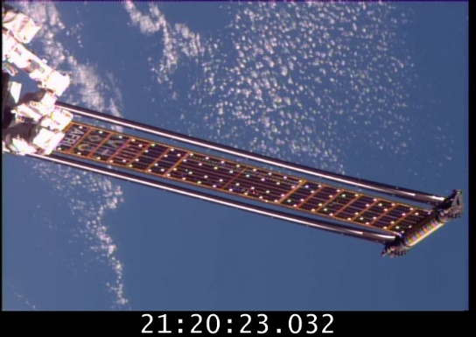
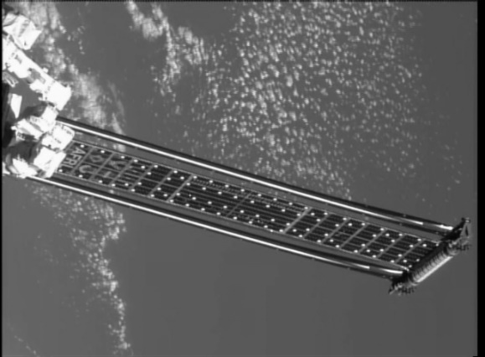
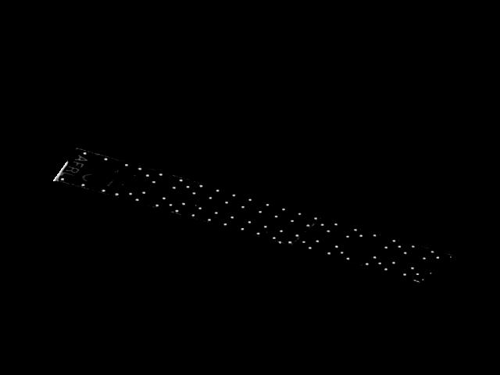
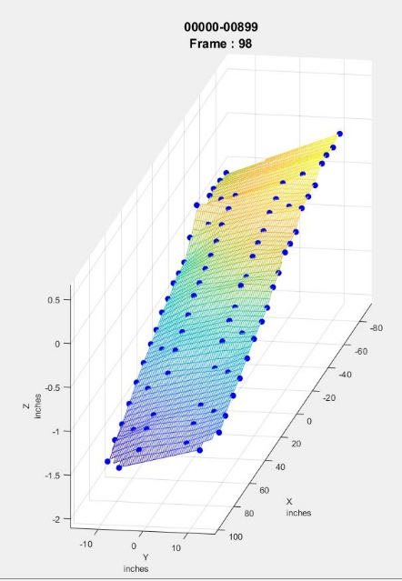
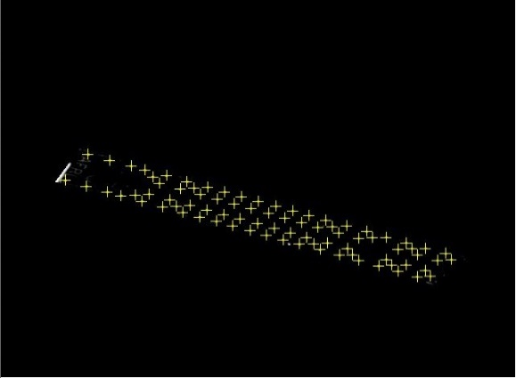
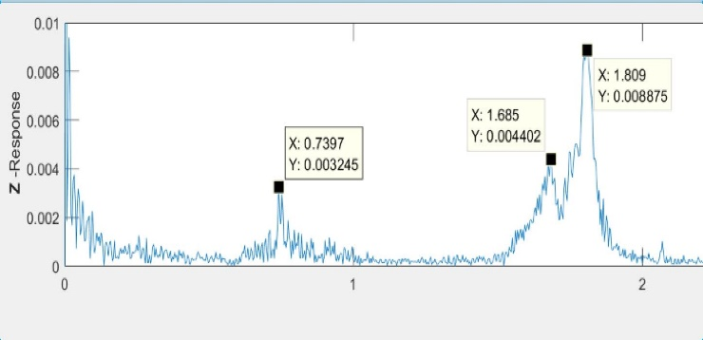
Photogrammetric Processing:
Steps:
Video Conversion (.TIF) 9000 images/cam (Typical ea. Test)
  Grayscale Conversion (optimize file size)
    MATLAB: ROI for background extraction
      MATLAB: Histogram equalization to balance brightness
        Photogrammetric Processing: Vision Measurement System (VMS).
          VMS: Target Identification and Tracking
            MATLABL: Annimated Point Cloud for Mode shape definition
              MATLAB: FFT >> Peak Freq. Response

Slide 15
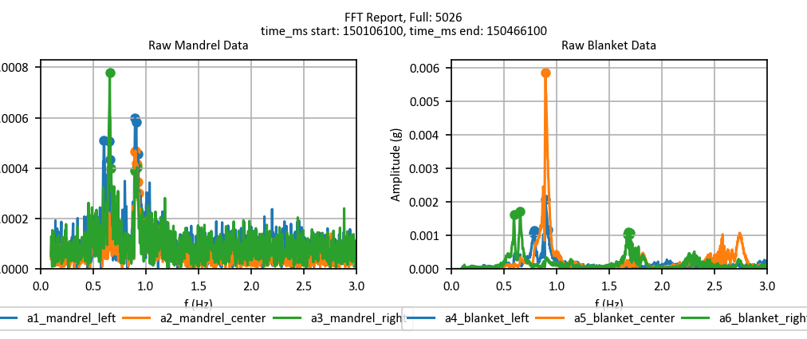
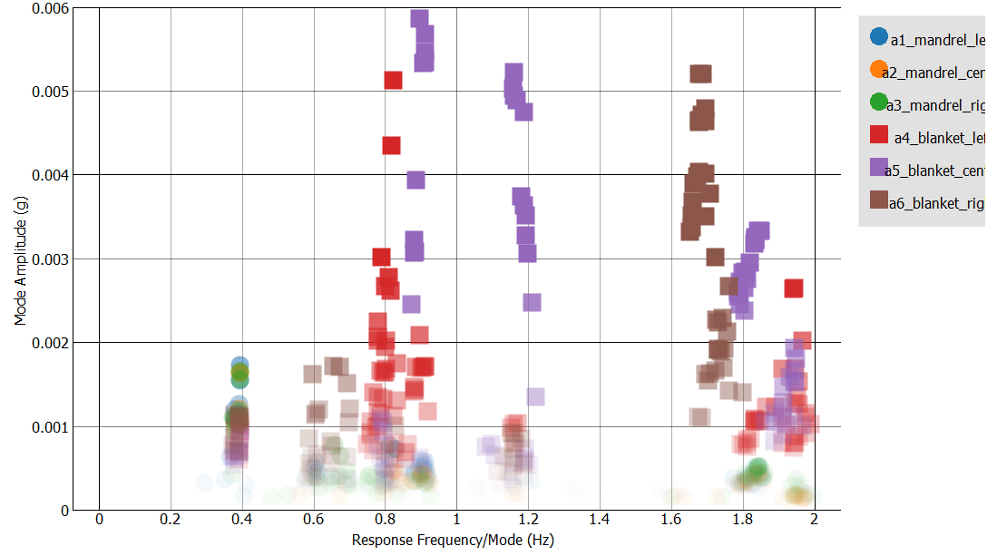
Overview of Post-flight Analyses
FFTs of filtered accelerometer data for one run
Video recorded for photogrammetry analysis for key experimental runs (Day Light)
Huge quantities of PG/Accelerometer data processed
  90+ runs recorded
Post-Flight Photogrammetry Goals:
  Identify ROSA frequencies and mode shapes below 2 Hz
  Calculate structural damping
  Reconstruct mode shapes
Conglomeration of FFT peaks from all runs

Slide 16
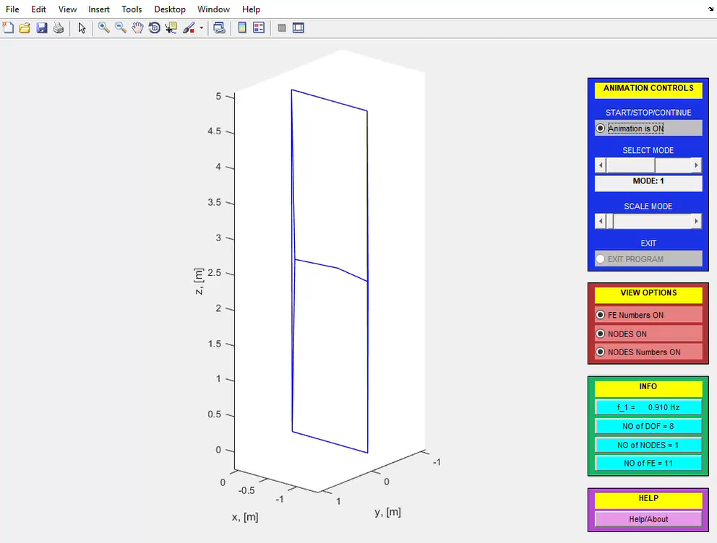
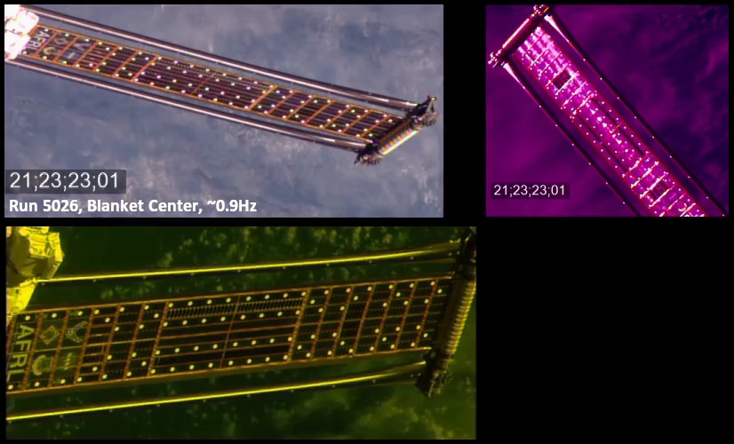
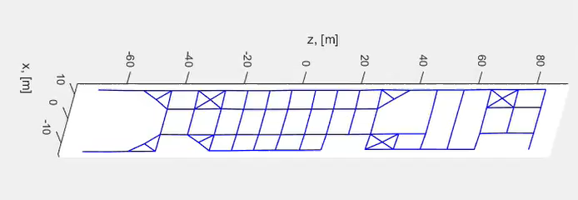
ROSA: Reconstructed 0.91 Hz (Target/Accelerometer) Blanket Mode Shape
Reconstruction from Accelerometer Data
Mandrel
Reconstruction from Photogrammetry Data

Slide 17
Summary of Driven Dynamics Results
Mode | Average FEM Predicted Frequency (Hz) | Average Measured Frequency (Hz) | Estimated Damping (%) | Shape
1 | 0.52 | 0.40 | 3.5 | Structural bending
2 | 0.65 | 0.62 | 3.9 | Structural torsion
3 | * | 0.68 | 1.6 | Blanket right edge w/ torsion
4 | * | 0.81 | 1.7 | Blanket left edge and center
5 | 0.93 ** | 0.91 | 0.8 | Blanket saddle
6 |  | 1.21 | 1.5 | Blanket saddle
7 | * | 1.70 | 0.7 | Blanket right edge
8 | * | 1.77 | 1.0 | Blanket right edge
* Indicates a mode shape spoiled by uneven blanket tension
** Saddle mode appears at different frequencies between day and night
Takeaways:
Unanticipated situations spoiled preflight FEM predictions:
  Low 1st bending mode
  Loose right edge
Good FEM prediction of first blanket mode
Higher damping on 1st and 2nd modes
Notes:
We would like to say, “hey our models did such a good job” but the reality is that they didn’t and we are just trying to understand what happened and what we could do better in the future.
Takeaways:
Low first structural mode
Uneven blanket modes
Higher damping on first structural modes than expected
Those two factors muddle our preflight FEM predictions but provide us with some interesting analytical problems.
We do predict the first blanket mode pretty well and hopefully the process of tweaking our preflight models will help explain why we see these results.

Slide 18
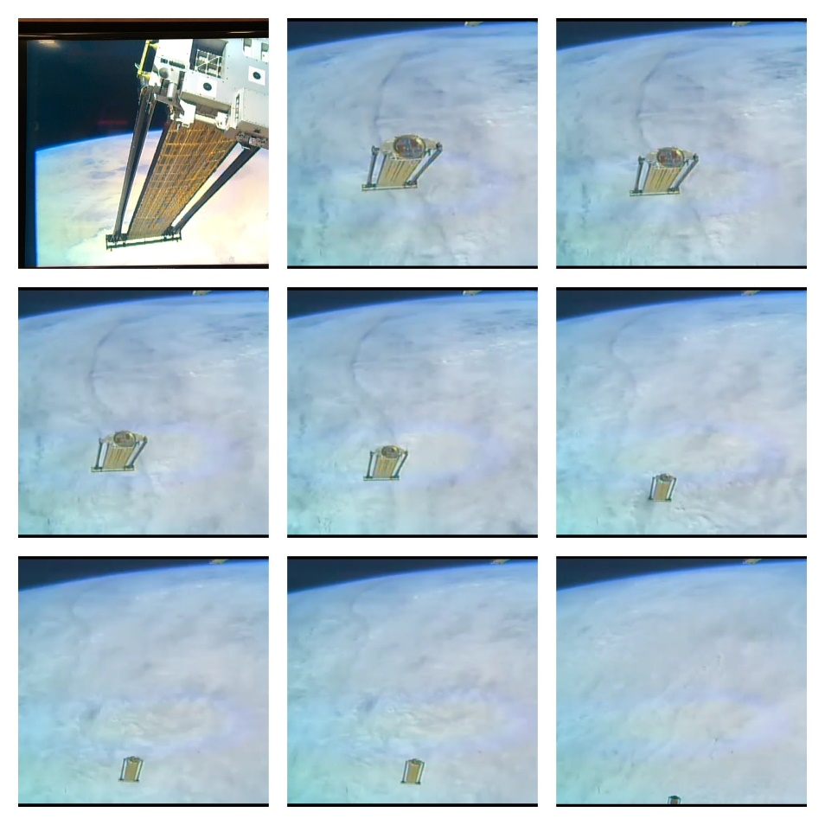
Summary of ROSA Photogrammetry
Farewell, ROSA…
Photogrammetric measurements
  Coverage typically with stereo views (ie. 2 Cameras)
  Image processing required to enhance target contrast
  Dynamics consistent with Accelerometer data (200+ orbits)
  Most modes only measurable during day
ROSA flight experiment achieved all scientific objectives:
  Successful deployment
  At least 10 structural modes identified
  Eclipse entry / exit dynamics measured
Notes:
Mention accuracy of deployment torque predictions, deployment time.
There is variability in data, but no time-dependent variability over the 4.5 days of experimentation and 200 orbits

Slide 19
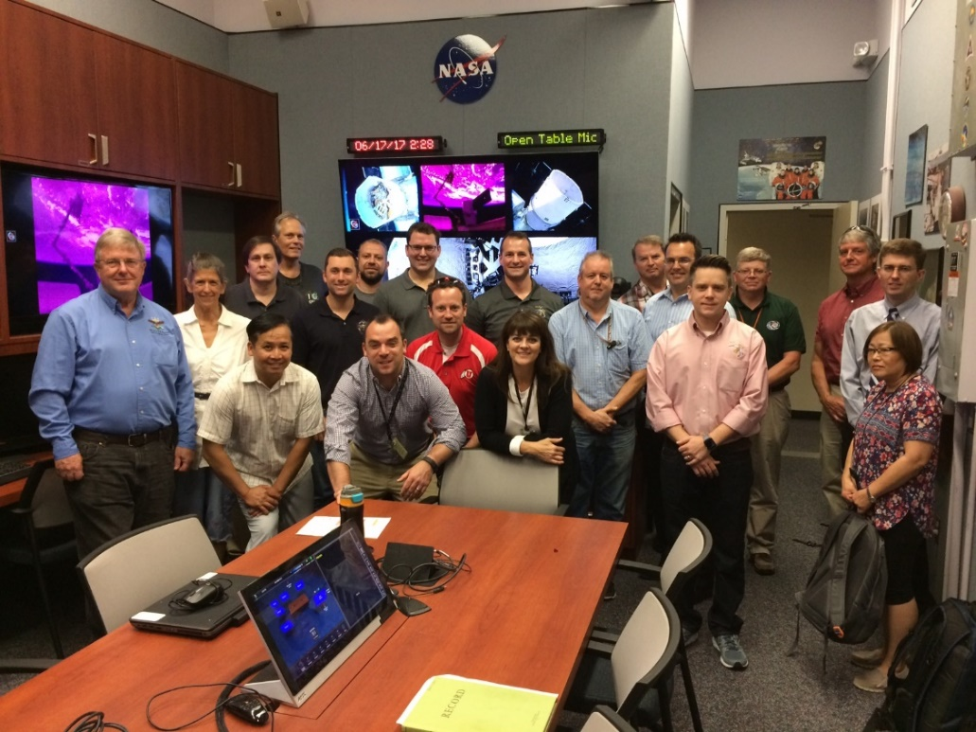
ROSA: Highly Successful Collaboration
LaRC/JSC are centers of excellence for photogrammetry
  Inflatable structures
  Solar sails
  Crash impact dynamics
LaRC is agency lead for lightweight solar array structures and high strain composites:
  STMD Solar Arrays Structures project (through Glenn)
  STMD Solar Arrays With Storage project (through Glenn)
  ROSA Flight Experiment (through AFRL)
  Deep Space Gateway Power Propulsion Element solicitation (through Glenn)
  Upcoming major LEO gov’t use of ROSA (through Glenn)
ISS Platform & Assets ideal for experimental validation of large deployable structures experiments
This project serves as a Great example of effective interagency cooperation
ROSA Flight Ops Team in DoD POCC

Slide 20
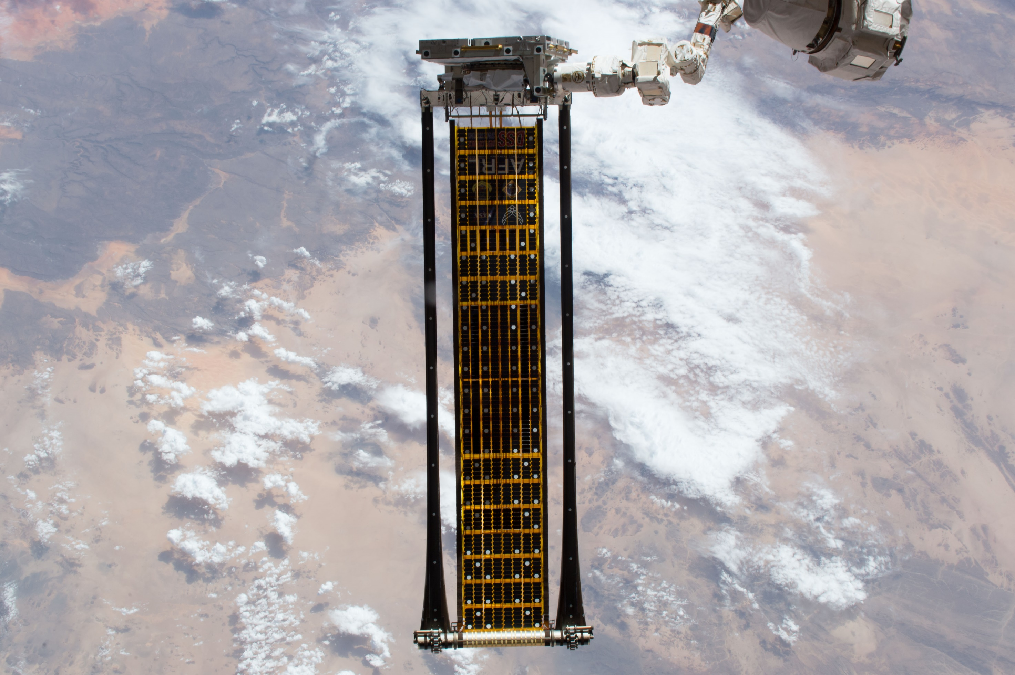



Thank You!
This was a team effort supported by the following groups (and many more):
U.S. Air Force Research Laboratory Space Vehicles Directorate
U.S. Air Force Space and Missile Systems Center
Department of Defense Space Test Program Houston
NASA Langley Structural Dynamics Branch
NASA Langley Advanced Measurement and Data Systems Branch
NASA Johnson Image Science and Analysis Group
Deployable Space Systems, Inc.
Ecliptic Enterprises Corp
LoadPath, LLC

