Slide 1



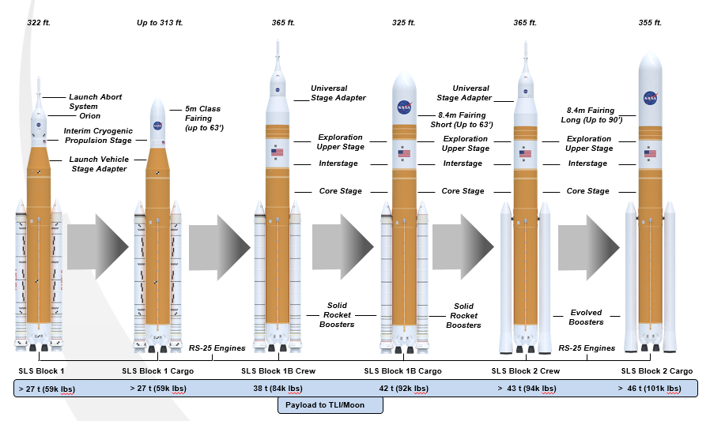
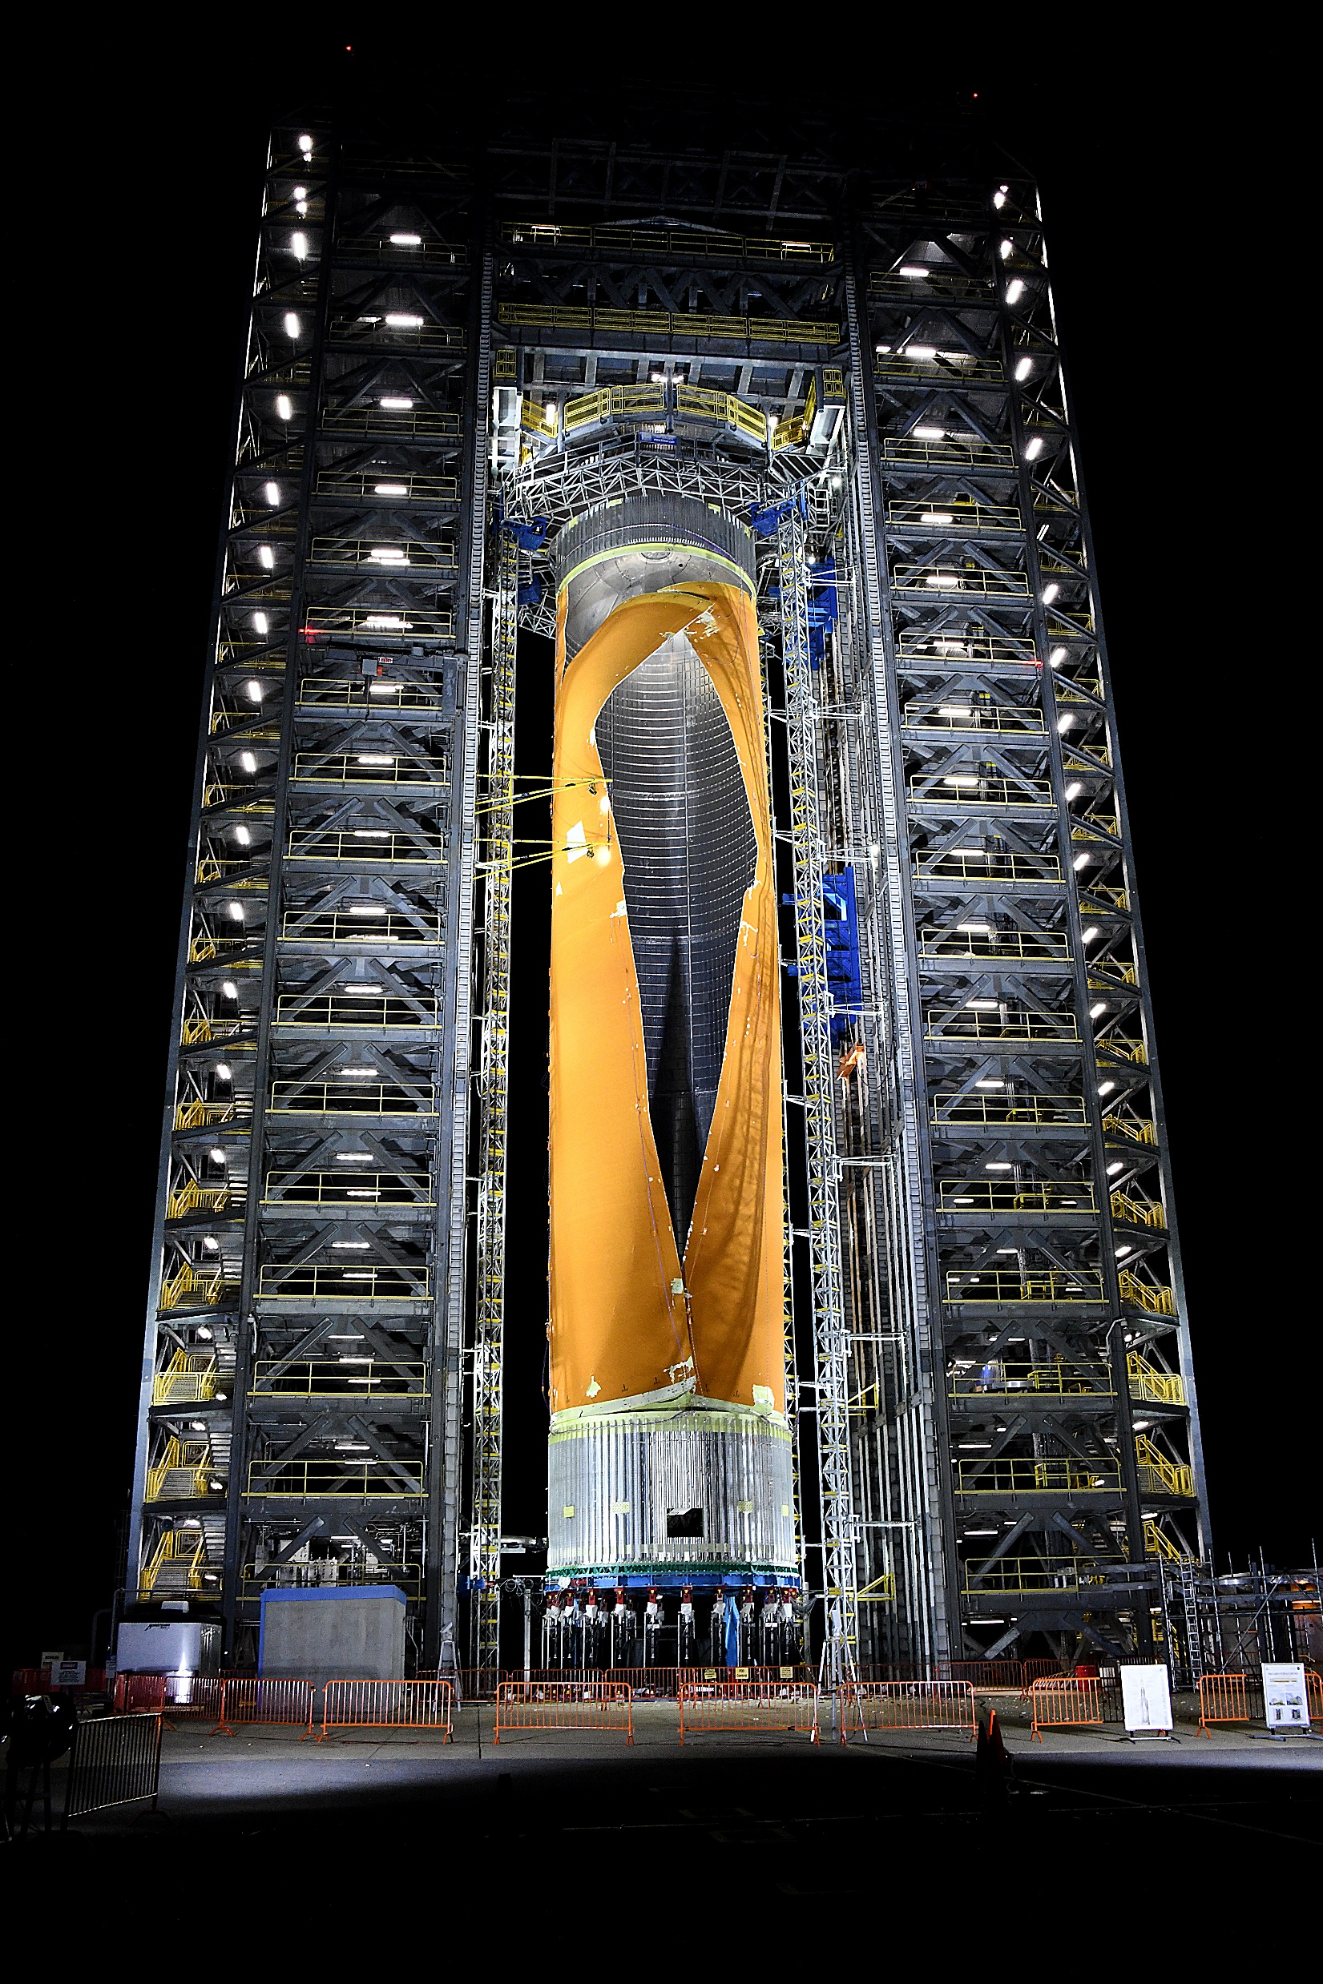
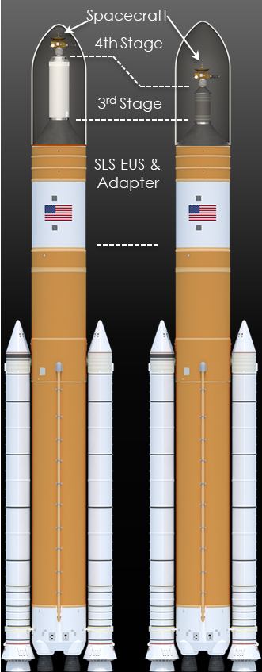
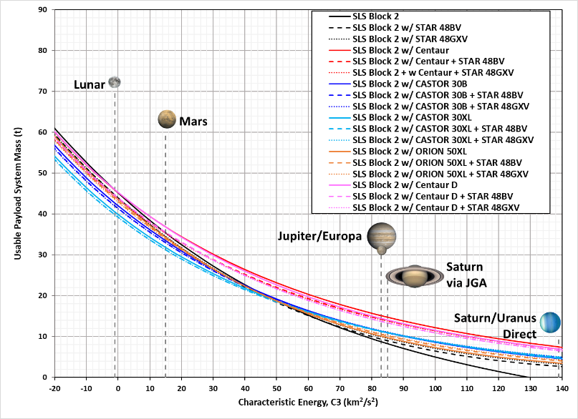
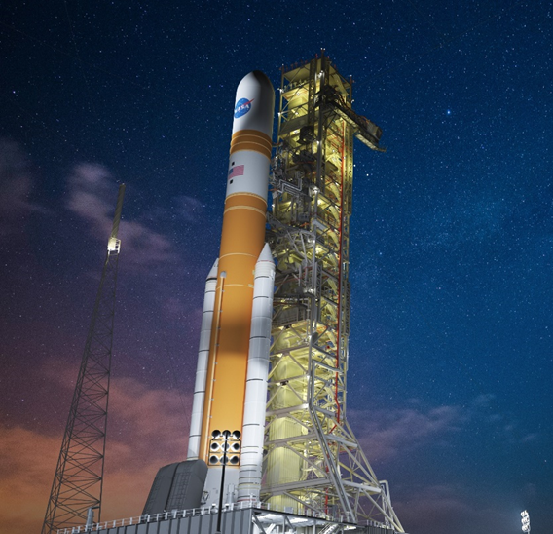
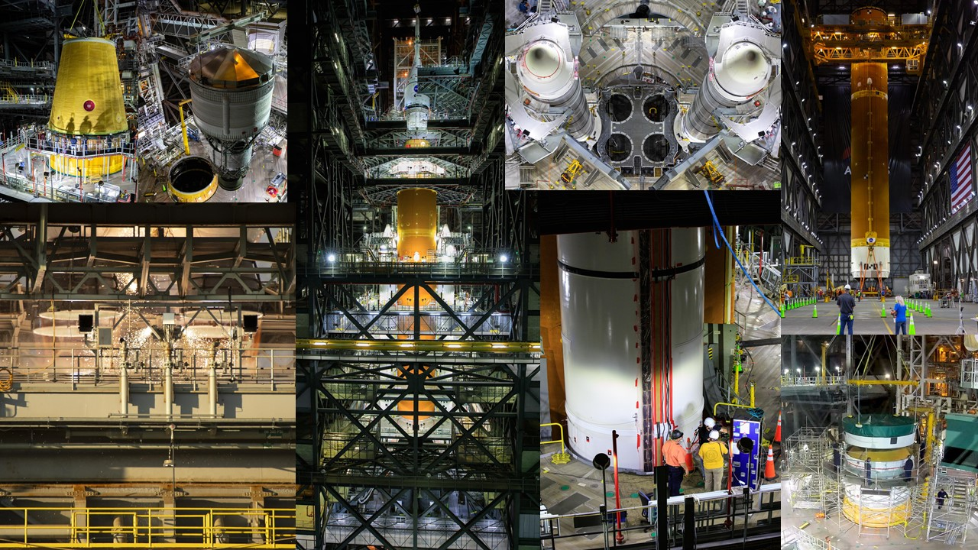


The Space Launch System: Powerful New Launch Capability for Exploration
Robert W. Stough
NASA’s Space Launch System Program, NASA Marshall Space Flight Center
Study on Performance When Adding Third, Fourth Stages to SLS Block2
The initial vehicle to fly, Block 1, will send at least 27 metric tons (t) to TLI
Block 1B will introduce a more powerful four-engine upper stage and increase performance to TLI to at least 42 t
The ultimate variant, Block 2, will incorporate a new generation of solid rocket boosters to increase mass delivered to TLI to 46 t
We studied C3 performance using combinations of commercially available LH2/LOX and upper stages and solid motor kick stages encapsulated within the 8.4 m diameter, 19.1 m shroud
The Space Launch System: Powerful New Launch Capability for Exploration
NASA’s Space Launch System is an evolvable super heavy-lift vehicle
SLS will evolve to progressively more powerful variants
Block 1B and Block 2 vehicles are designed to integrate with 8.4 m fairings in varying lengths. Engineers are preserving the option for a 10 m-diameter payload fairing
The baseline vehicle, powered by twin five-segment solid rocket boosters and four LH2/LOX RS-25 engines, is optimized for lunar missions at C3=-.99
Recent studies have modeled the performance of the Block 2 vehicle with a variety of LH2/LOX upper stages and a solid rocket boosters that are currently in production
SLS Block 2, with additional stages, offers significant benefits and flexibility for ultra-high C3 missions
SLS with third and fourth stages, encapsulated with the spacecraft in the 8.4 m shroud, can achieve C3 of 300 ${km}^{2}$/$\sec^{2}$ or more
SLS Block 2 is able to achieve high C3 launches to provide the science community with new capabilities for sending probes to the outer solar system – or even interstellar space.
Study Methodology
A balanced approach was employed to predict the vehicle payload system mass capability to a given C3.
Approach involved assuming mean vehicle mass (predicted mass - manufacturing variation), nominal liquid engine performance, and low-performing booster
Pproduced a somewhat conservative approach, with performance slightly below the nominal performance prediction.
Specifically, for this study, two LH2/LOX upper stages were assessed: the Atlas V Centaur and a shortened Centaur with a smaller propellant load, similar to the Centaur D.
For the solid stages, the study assumes nominal performance with regard to solid rocket motor impulse.
The stages analyzed for this study include:
  CASTOR 30B
  CASTOR 30XL
  Orion 50 XL
  Centaur
  Centaur D
  Star 48BV
  Star 48GXV
Adapter designs considered launch loads and a
maximum desired payload mass
A manager’s reserve is allocated to all the upper stages
based on its “wetted” mass.
Rigorous Testing for Verification, Reliability
Rigorous testing program on all elements of the vehicle to ensure reliability and performance
Completed largest structural testing campaign since the Space Shuttle Program and several vital tests on the Artemis I core stage and integrated stack
The Green Run test series evaluated the core stage, culminating in a full-duration hot fire test of
the stage
The integrated stack also
underwent power-up on the
mobile launcher and the modal
test campaign.
Continue to conduct test
programs leading up to the
Wet Dress Rehearsal, scheduled
for early 2022
Evaluating components of the
new production RS-25 engines
and advancements for the new
generation solid rocket boosters
Path to the Pad: Initial SLS Launch in 2022
SLS is scheduled for first launch in early 2022.
All elements have been delivered to Kennedy Space Center and are stacked on the mobile launcher The rocket is currently undergoing a series of tests at in High Bay of the Vehicle Assembly Building (VAB) at KSC. Roll-out to Launch Pad 39B is scheduled for late 2021 for Wet Dress Rehearsal (WDR) with launch following in early 2022.
The solid rocket boosters began stacking in Kennedy's Vehicle Assembly Building (VAB) in late 2020 and completed in March 2021.
The core stage, Interim Cryogenic Propulsion Stage, and adapters were stacked in summer 2021
The uppermost adapter that connects to Orion's adapter will carry 10 6U form factor CubeSats on the Artemis I flight.
Program is actively producing the second and third Block 1 vehicles and is making progress on the Block 1B and Block 2 vehicles. Contract instruments are in place to support flights through the end of the decade.
Conclusion: C3 of 300 km2/sec2 and Higher is Possible
Adding an LH2/LOX third stage enabled SLS to nearly double its performance to Jupiter.
The performance increased from 8 t to 15 t of delivered payload mass to a C3 of 83 ${km}^{2}$/$\sec^{2}$.
Highest C3 on record is the New Horizons spacecraft
at 157 ${km}^{2}$/$\sec^{2}$.
We show that adding an LH2/LOX upper stage, such as
the Centaur, and a solid motor, such as Northrop’s
Star 48BV, to SLS Block 2 enables a spacecraft with a
mass similar to New Horizons (~0.8 t) to reach a
C3 greater than 300 ${km}^{2}$/$\sec^{2}$ -- nearly double the
New Horizons mission.
Results for various combinations of LH2/LOX upper
stages and solid motor kick stages are shown here
Achieving C3 performance in this range offers mission
planners a never-before available flexibility in mission
planning.

