Slide 1

Overview of NASA’s Extensible Traffic Management (xTM) Research
Jaewoo Jung, Joseph Rios, Min Xue, Jeffrey Homola and Paul Lee
AIAA SciTech January 2022

Slide 2
NASA's xTM Effort
Developing Extensible Traffic Management (xTM) from Unmanned Aircraft Systems (UAS) Traffic Management
Building an xTM system for upper Class E operations
Gaining insight on xTM-ATC interactions for improving the interoperability between xTM systems and ATS

Slide 3
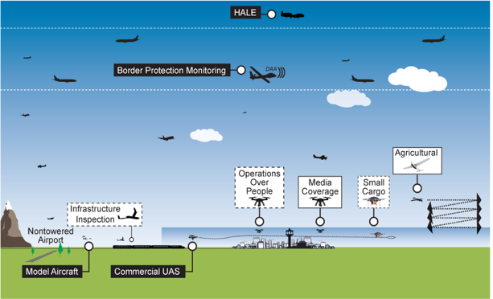
What is UAS Traffic Management?
UTM is an “air traffic management” ecosystem for uncontrolled airspace
UTM utilizes industry’s ability to supply services under FAA’s regulatory authority where these services do not exist
UTM development will ultimately enable the management of large scale, low-altitude UAS operations
ATM
Established policies & procedures
UTM
Cooperative interaction
Credit: FAA
            Operational concept will address beyond visual line of sight UAS operations under 400 ft. AGL, Class G airspace
  Roles/responsibilities of FAA and operators
  Information architecture, data exchange protocols, software functions
  System performance requirements

Slide 4

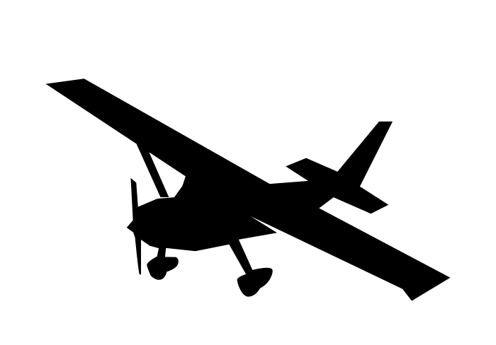




UTM Core Operating Principles
banana
banana
4444-8888-44441234ABCD
cat
apple
?
Notes:
Next slide: how are we actualizing these principles?

Slide 5







Simplified UTM Architecture
My UAS Service Supplier (USS)
Flight Information Management System, FIMS
USS A
USS B
Operator
Discovery

Slide 6
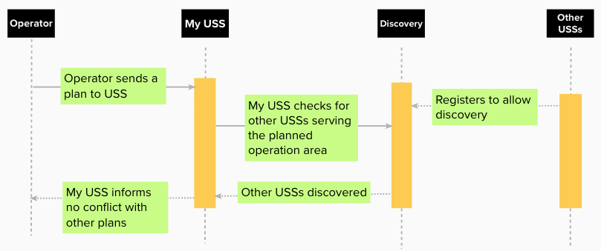
Operation Planning in UTM

Slide 7
Generalizing UTM to Extensible Traffic Management (xTM)
banana
banana
4444-8888-44441234ABCD
cat
apple
?

Slide 8
xTM Requirements
ID | xTM Requirements | Original UTM Requirements
xTM-REQ-01 | An xTM System SHALL aid in UAS staying clear of each other | The UTM System SHALL aid in small UAS staying clear of each other
xTM-REQ-02 | An xTM System SHALL aid in UAS staying clear of traditional aviation | The UTM System SHALL aid in small UAS staying clear of traditional aviation
xTM-REQ-03 | An xTM System SHALL support authentication and identification of UAS | The UTM System SHALL support authentication and identification of small UAS
… | … | …

Slide 9
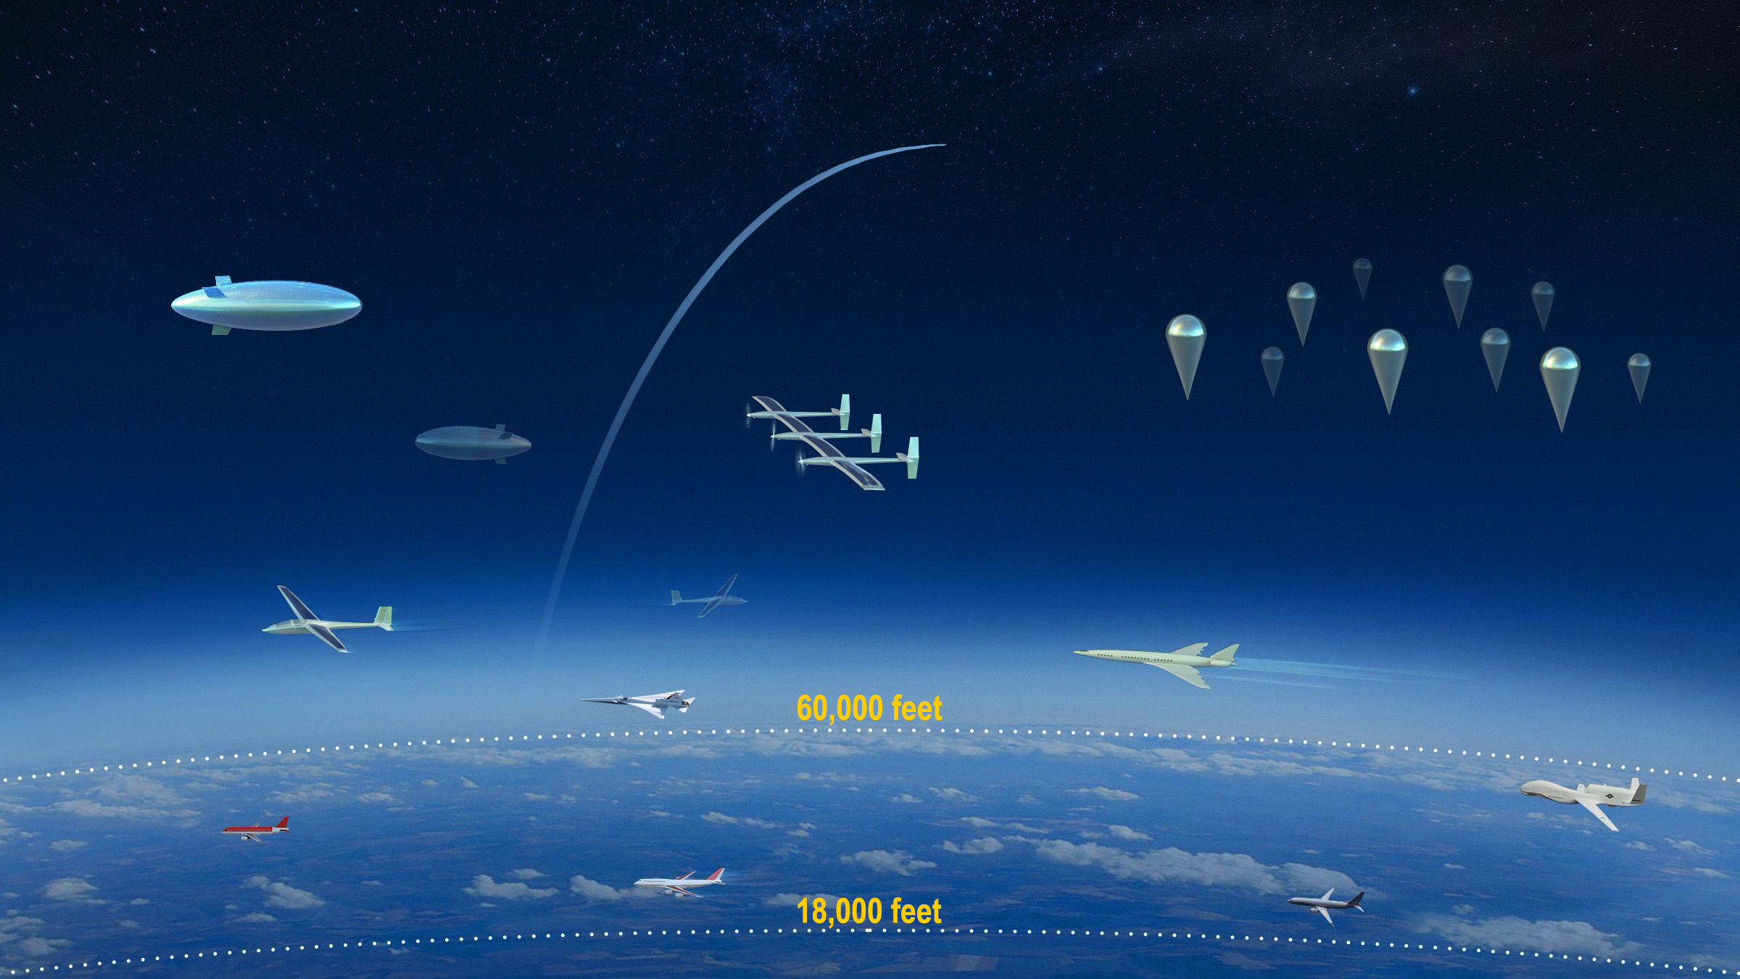
Building an xTM System for Upper Class E Operations
Operations in Upper Class E airspace have traditionally been relatively few in number
Recent development in aircraft technology enabling multiple civil missions
Expanding traditional air traffic service likely takes time and cost, cooperative operations through xTM system desired

Slide 10

Simplified xTM System Architecture for
Upper Class E Traffic Management (ETM)
ETM meets xTM requirements and tailored to reflect operational environments in high altitudes
My ETM Service Supplier (ESS)
Gateway to the National Airspace System
ESS A
ESS B
Operator
Discovery

Slide 11
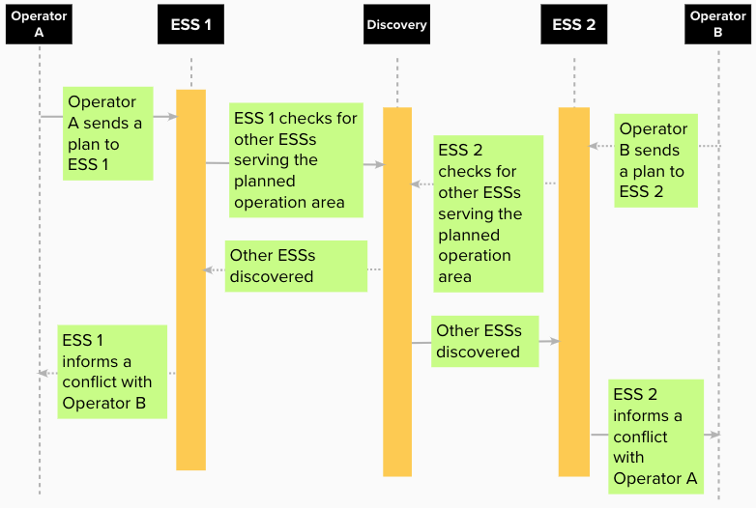
Operation Planning in ETM

Slide 12
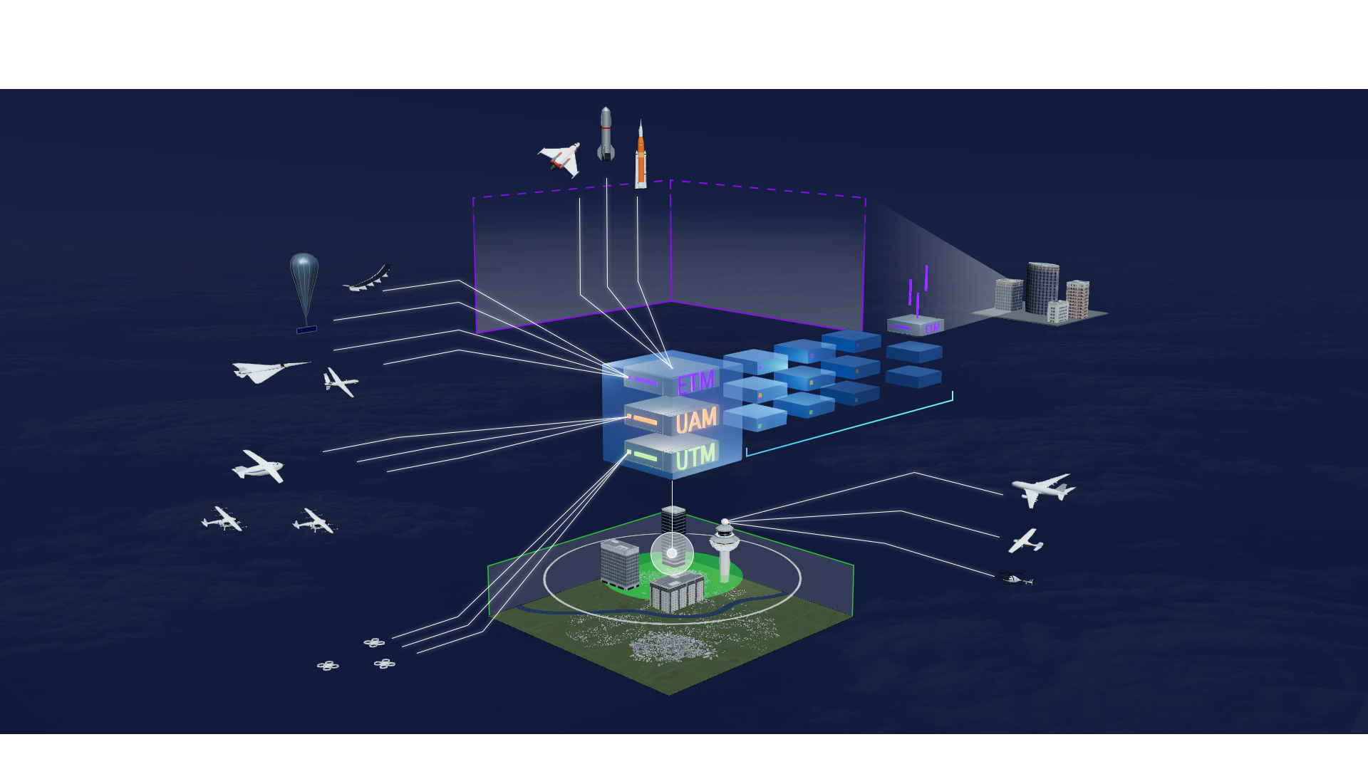
xTM Systems and New Entrants Operations
xTM for upper Class E operations
INDUSTRY DRIVEN
INNOVATION & INFRASTRUCTURE
SCALABLE
AUTOMATED OPERATIONS
xTM for Urban Air Mobility Operations
xTM for small UAS Operations

Slide 13
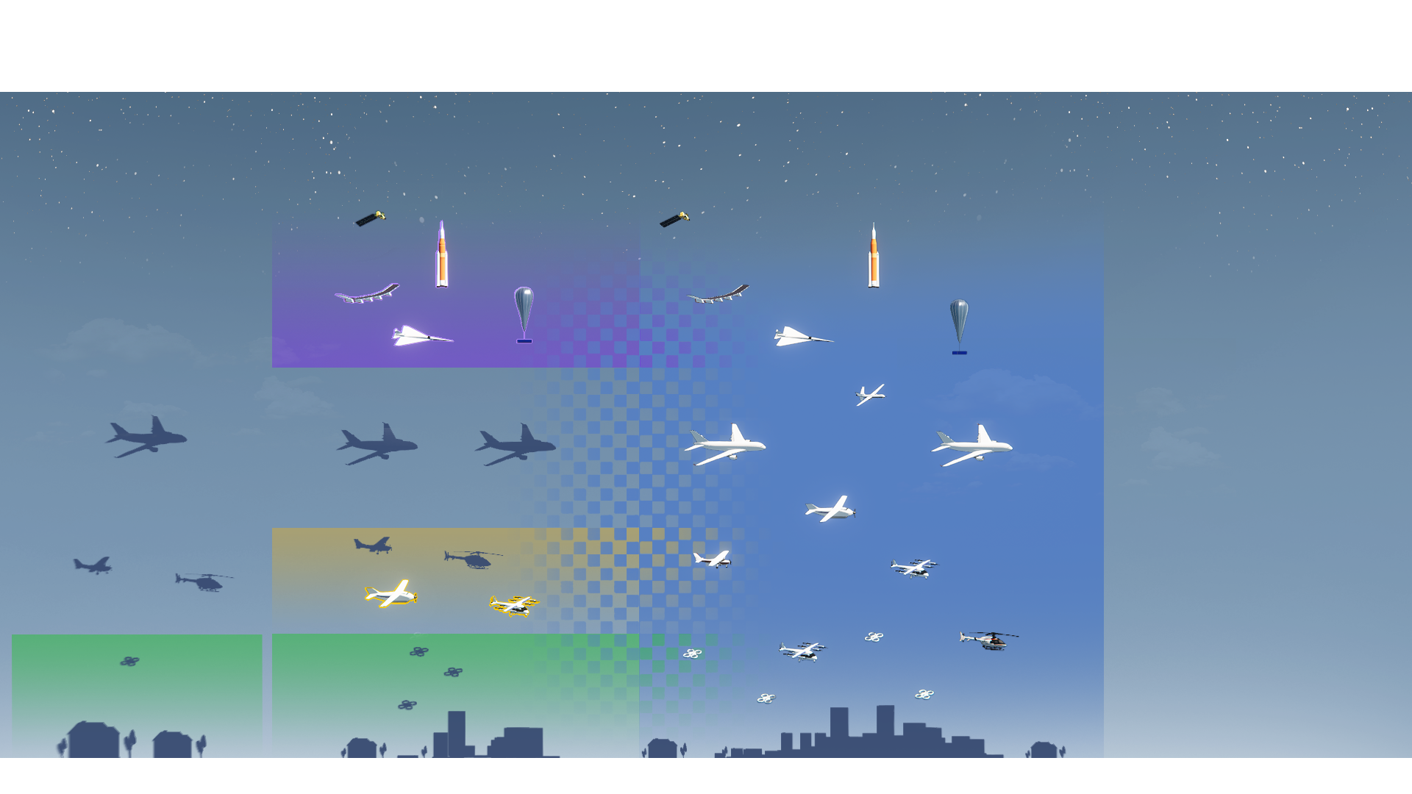
Investigating xTM and ATC Interactions
TODAY
SEGREGATED
NEAR TERM
HYBRID
FUTURE
INTEGRATED
Upper-E Traffic Management
UAM Traffic Management
UAS Traffic Management
Planned research to examine xTM/ATC coordination procedures, roles and responsibilities, and data exchange requirements to increase the interoperability between xTM and ATC served operations
13

Slide 14
Summary
xTM is generalized UTM that meets the same core principles
An xTM system for upper Class E operations, ETM, is in development
Performing research to gain insight on xTM-ATC interactions for improving the interoperability between xTM systems and ATS

Slide 15
NASA's xTM Publications
"Define Minimum Safe Operational Volume for Aerial Vehicles in Upper Class E Airspace" | M. Xue and A. K. Ishihara | AIAA Aviation2021, Virtual event | August 2-6, 2021
"Cooperative Upper Class E Airspace: Concept of Operations and Simulation Development for Operational Feasibility Assessment" | H. Yoo, J. Li, J. Homola, and J. Jung | AIAA Aviation2021, Virtual event | August 2-6, 2021
"Identifying Common Use Cases across Extensible Traffic Management (xTM) for Interactions with Air Traffic Controllers" | P. Lee, R. Chartrand, R. Oseguera-Lohr, and C. Brasil, C. Gabriel, and M. Evans | AIAA Scitech 2022, San Diego, CA | January 3-7, 2022
"Intent Modeling and Conflict Probability Calculation for Operations in Upper Class E Airspace" | M. Xue, J. Jung, J. Homola, and H. Yoo | AIAA Scitech 2022, San Diego, CA | January 3-7, 2022
"Optimal Conflict Management Strategies for Balloon-Airship Encounters in ETM" | A. Ishihara and M. Xue | IEEE Aerospace 2022, Big Sky, Montana | March 5-12, 2022

