Slide 1
AIAA SciTech2022
Lunar Volatiles Collector
Sang H. Choi
Robert W. Moses
NASA Langley Research Center
Hampton, Virginia
January 5, 2022

Slide 2
Problem/Need – The Importance of the Idea
The capture, collection, and onsite supply of volatiles on the Moon, Mars, and asteroids are the key aspects of technology needed as a post process of H₂O, H₂, O₂, or other gases for propellant and habitats. The capture of volatiles is extremely difficult at lunar vacuum (i.e., 10⁻¹² torr on the moon). No existing equipment for volatile capture is available to date.
  The lunar volatile collector (LVC) concept based on Bessel Tube (BT) enables the capture and collection of volatiles at extremely low vacuum pressure using the unique principle of ring-field harmonic generator (which is typically used for heavy ion accelerator, i.e., Large Hadron Collider).
The Problem of Current Arts
  No current arts are available to capture and collect volatiles at extremely low vacuum. Any volatiles extracted at the vacuum pressure of 10⁻¹² torr level can freely fly away with their initial kinetic energy in all directions. A special tool like BT is definitely required.
  NASA and the aerospace community lack resource acquisition tools technology, such as Bessel Tube, for volatile capture to support production of H₂O and propellants (H₂ and O₂) or any other volatiles from regolith.
The Need
  BT is quite suitable for harvesting volatiles (H₂O, O₂, H₂, or He-3) at extreme vacuum environment (10⁻¹² torr).

Slide 3
Space Environment of the Moon
Atmospheric Pressure: < 10⁻¹² torr
Micro-meteorite Impact: Velocities to > 10⁵ km/hr (28 km/sec)
Radiation: Galactic, Cosmic, Solar-ray particles
Proton- 3x10⁸ cm⁻²∙s⁻¹
Electrons- 10⁵ ~ 10⁷ cm⁻²∙s⁻¹
Temperatures: Equator- -20ºC ± 120ºC
South Pole- Light -50ºC ± 20ºC
Dark -220ºC ± 20ºC

Slide 4
Lunar Dust Composition
- Elemental Analysis
Solar Wind (0.5 ~ 10 keV av.) & Solar Flare (> 28 keV)
Proton: 3x10⁸ cm⁻²∙s⁻¹
Electron: 10⁵ ~ 10⁷ cm⁻²∙s⁻¹
~ 1 pA/cm²
O ~ 6x10⁴ cm⁻²∙s⁻¹
Oxide
60.71 Atomic %
70%
Secondary
electrons
Metal
elements
5.25, 4.48, 3.23 At%
7.70At%
Magnesium, Calcium, Iron
17.36 At%
Silicon
Aluminum
Snowden et al., The Astrophysical Journal, 610:1182–1190, August 1, 2004.
Mukherjee, N.R., Earth, Moon, and Planets, Vol. 21, No. 3, 307-317, 1979.

Slide 5
Chemical Bonding Energy
Single & Multiple Bonds | Bonding Energy (kJ/mol) | Bonding Energy (eV) | Bond Length (pm)
H―H | 432 | 4.49 | 74
C―H | 413 | 4.29 | 109
C―C, C═C, C≡C | 347/614/839 | 3.61/6.38/8.72 | 154/134/121
C―O | 358 | 3.72 | 143
C═O | 745 | 7.74 | 123
N―H | 391 | 4.06 | 101
N―N, N═N | 160/418 | 1.66 | 146/122
N―O | 201 | 4.35 | 144
O―H | 467 | 4.85 | 96
O―O | 204 | 2.12 | 148
O═O (O₂) | 498 | 5.17 | 121
Si―O | 368 | 3.83 | 161
Al―O | 102 | 1.06 | 17
Energy needed to breakdown

Slide 6
Helium-3 Mining
Helium-3
Neutrons 1
Protons 2
Parent Isotopes ³H (β-decay)
Isotope Mass 3.016 u
Half Life stable
Spin ½+
Availability 0.000137% in Atm
Helium-3 in regolith
Dangling bond – van der Waals
Electrostatic
Trapped
Resources
Earth Mantle ~ 10⁶ tons
Ocean Floor 4000 tons
Lunar Regolith ~ 10⁶ tons
Needs
U.S.A. 20 tons/yr ($60B worth)
Others together 80 tons/yr
Price: $3B/ton
Rationale
Fusion reactions involving Helium-3
Reactants |  | Products | Q
First Generation Fuels
²₁H + ²₁H | → | ³₂He + ¹₀n | 3.268 MeV
²₁H + ²₁H | → | ³₁H + ¹₁p | 4.032 MeV
²₁H + ³₁H | → | ⁴₂He + ¹₀n | 17.571 MeV
Second Generation Fuel
²₁H + ³₂He | → | ⁴₂He + ¹₁p | 18.354 MeV
Third Generation Fuel
³₂He + ³₂He | → | ⁴₂He+ 2¹₁p | 12.86 MeV
Aspiration (Richard B. Bilder, Fordham International Law Journal, Vol. 33, Iss. 2, 2009)
U.S.A. One of the justifiable space expeditions (2015)
China Officially stated goal of Chinese lunar exploration program
Russia Helium-3 mining plan by Russia’s RKK Energia by 2020
Japan ???
India Officially, but no details

Slide 7
Challenges for Lunar Volatile Collection (LVC)
LVC must work under Lunar’s extreme environmental conditions.
Capture capability of LVC must be assured with high rate for collecting atoms and molecules.
Guiding channel of collected volatiles must be integrated with storage containers to keep volatiles (H₂O, H₂, O₂, He-3) selectively and separately.
Power (thermal and electrical) must be secured as an autonomous unit.

Slide 8
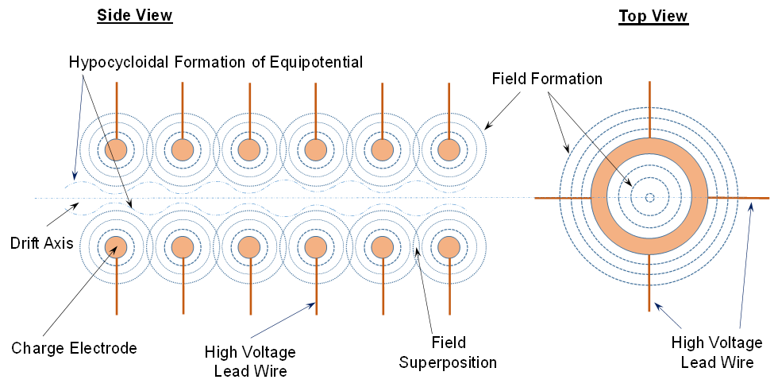
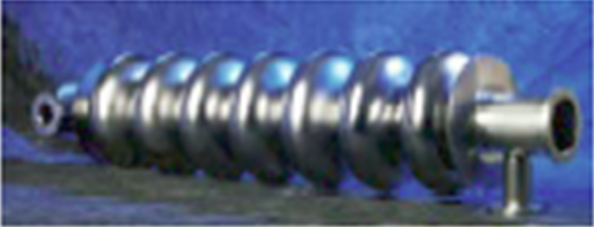
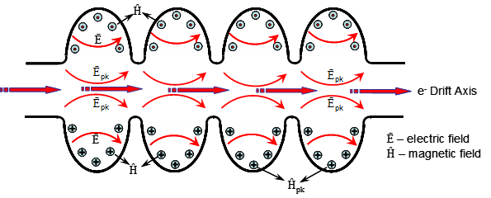
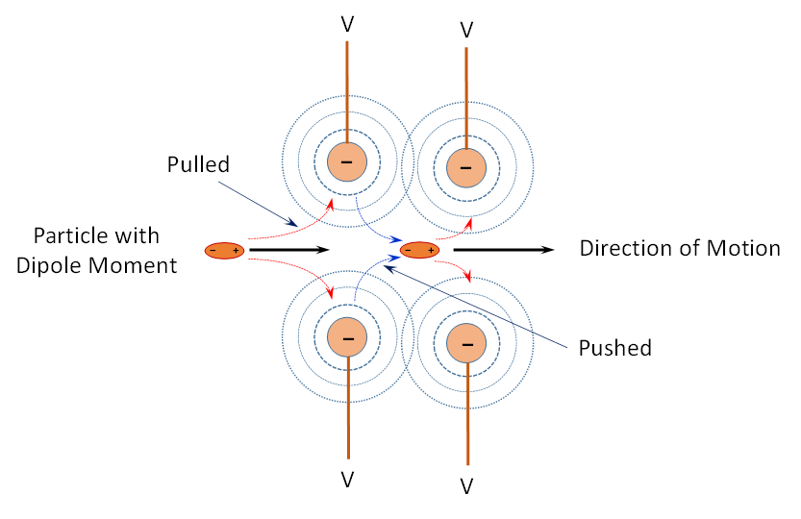
Bessel Tube (BT) Concept for Volatile Collection
Electron Accelerating Cavity
Bessel Tube
Cylindrical harmonic generator in a hypocycloidal mode used for accelerating electrons in electron Accelerator laboratory.
Hypocycloidal field formation is described by the equipotential lines within which any particles ionized or with dipole moment are captured and accelerated along the drift axis by ring field. The ring electrodes are charged with high voltage sequentially with time interval to create ring field.
Particle capture by cylindrical harmonic generator in a hypocycloidal mode.

Slide 9
Hypocycloidal Formation of Equipotential
Field in BT
Linear Array of Ring Electrodes
D_{G}
Hypocycloidal Formation of Equipotential
Wide Field Channel
D_{R}
Drift Axis
Narrow Field Channel
Ring Electrode
High Voltage
Lead Wire (V)
D_{G}: Gap distance between the ring electrodes
D_{R}: Diameter of ring electrodes

Slide 10

BT with Distributed Voltages
Voltages are all equal (V_{n}=V_{n-1}) or in a gradient (V_{n} > V_{n-1} or V_{n} < V_{n-1})
V
V₁
V₂
V₃
V₄
V₅
V₆
Particle with
Dipole Moment
−
−
−
−
−
−
V
V
Pulled
−
−
−
−
−
−
Pushed
V
V₁
V₂
V₃
V₄
V₅
V₆

Slide 11
BT with Sequentially Applied Voltages
Ionized or Dipole
Particles
Capturing Mode
Straightening Mode
Acceleration Mode
Particles converge into drift axis
by cylindrical harmonic field (CHF)
Particles converge further into
drift axis by CHF
Particles accelerate along with
drift axis by CHF
Acceleration Mode
Acceleration Mode
Ejection Mode
Particles accelerate along with
drift axis by CHF
Particles accelerate along with
drift axis by CHF
Particles are ejected out along with
drift axis by CHF

Slide 12
Helium-3 Mining Technology
E-Beam/Thermal
Dissociation
EM Kicker with BT
Flight Distributer
Crack Feeder
Gobbler
Mass-Drop Collector
Regolith

Slide 13
O₂ Separation
Cassegrain System
Quadruple Pole
Driver
BT
E-Beam
Gun
Regolith In:
Oxides
O₂
Heated Regolith Out
Array of Volatile
Storage
Metal Sludge

Slide 14
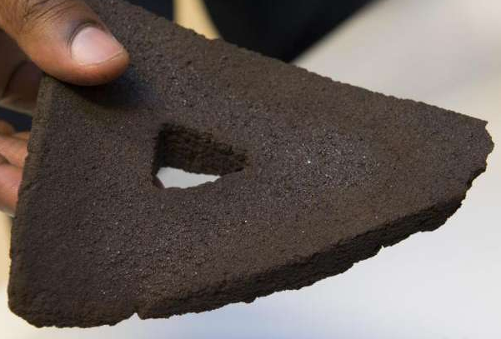
Melting Time of 8-cm Thick Regolith
Focal Plane Diameter
Courtesy of NASA KSC
Time to Sinter a 32 cm thick, 30 meter diameter landing pad using 0.3 m focal plane diameter:
• 120 days by a 10 meter aperture diameter
• 30 days by a 20 meter aperture diameter
• 13 days by a 30 meter aperture diameter
• 8 days by a 40 meter aperture diameter
m
m
m
m
sec
sec
sec
sec
sec
sec
sec
sec
sec
sec
sec
sec
sec
sec
sec
sec

Slide 15
Summary: Volatile harvesting from lunar regolith by BT
Description and Objectives Description: The invented BT (LAR-19538-1) is a unique device to capture and accelerate gaseous particles through drift axis of circularly harmonic field or ring-field generator. Circularly harmonic field establishes the cylindrical harmonic condition on the axially symmetric electric polar arrangement. The axially symmetric electric polar arrangement is used at the electron accelerator to create the drift axis of E-field equipotential in a cylindrical harmonic. The capture and collection of gas molecules under the extreme vacuum condition (i.e., 10⁻¹² torr on the Moon) are extremely difficult. No equipment is available to date. The proposed BT is able to capture and collect the volatiles (H₂O, He-3, and/or other gaseous molecules) for enabling lunar onsite supply. The captured gaseous elements are then accelerated and eventually stored selectively into a bottle by induction field at the other end of BT. Objectives: To develop BT array to effectively capture and collect gaseous molecules, such as H₂O, He-3, or other gaseous molecules, for potential onsite supply. | State of the Art The Bessel Tube is totally a new invented device technology. There are NO comparable or better technologies available to date. Reference current SOA, (solely NASA Langley invented technology) S.H. Choi, H.S. Choi, R.W. Moses, and K. Kim, “Bessel Tube for Driving Gaseous Molecules and Nanoparticles into Linear Motion”, NASA Case No. LAR 19538-1, e-NTR #: 1539786201, Oct. 17, 2018. “Where are we now?” A preliminary design of BT was done.
Customers/Infusion, Alignment: Customers/Infusion Current - Lunar and Mars exploration under ISRU Potential Vacuum pump application with BT for extreme vacuum pump (< 10⁻⁸ torr) Partners Existing Collaborator – None Potential – Vacuum pump manufacturers | Technical Approach Technical development perspective how the mission or project will be approached. Process of design and fab for laboratory model and test performance in high vacuum (TRL 4) Fabrication of BT array with differential field controller of electric potential on each ring-field coil (TRL 6) Validation of BT array performance (TRL 7) On-going effort by the proposal team. Design study of the components of BT. Technology involved and how it will be used to solve the problem. An array of multiple ring-field generators for differential field generation “to-be-developed” subsystems: Subsystem requires a storage bottle of collected volatiles by BT. Maturity of component technologies: TRL 7, Suitability for the mission: very high Interface requirements Power modulation on each ring-field coil.

