Slide 1
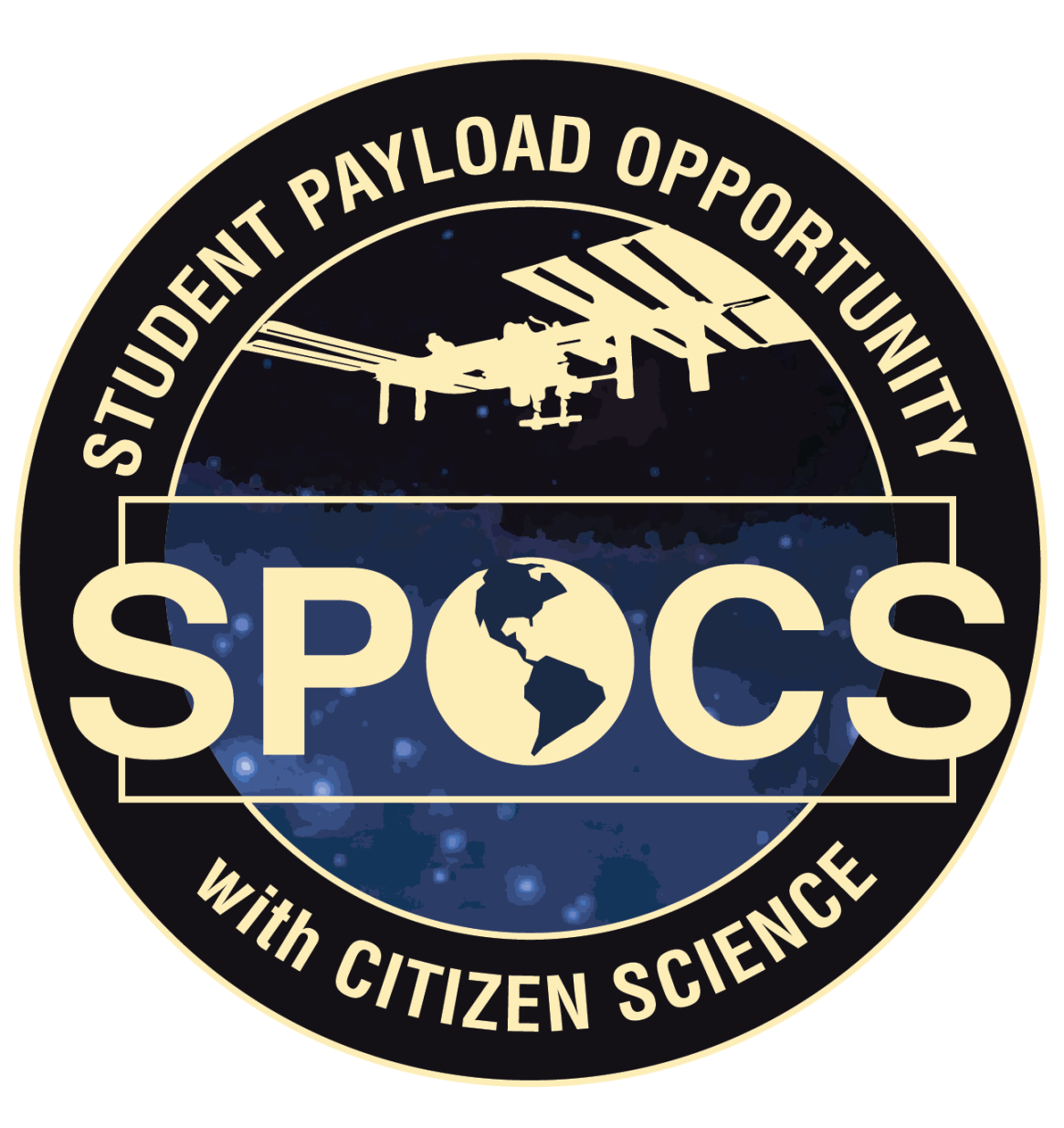
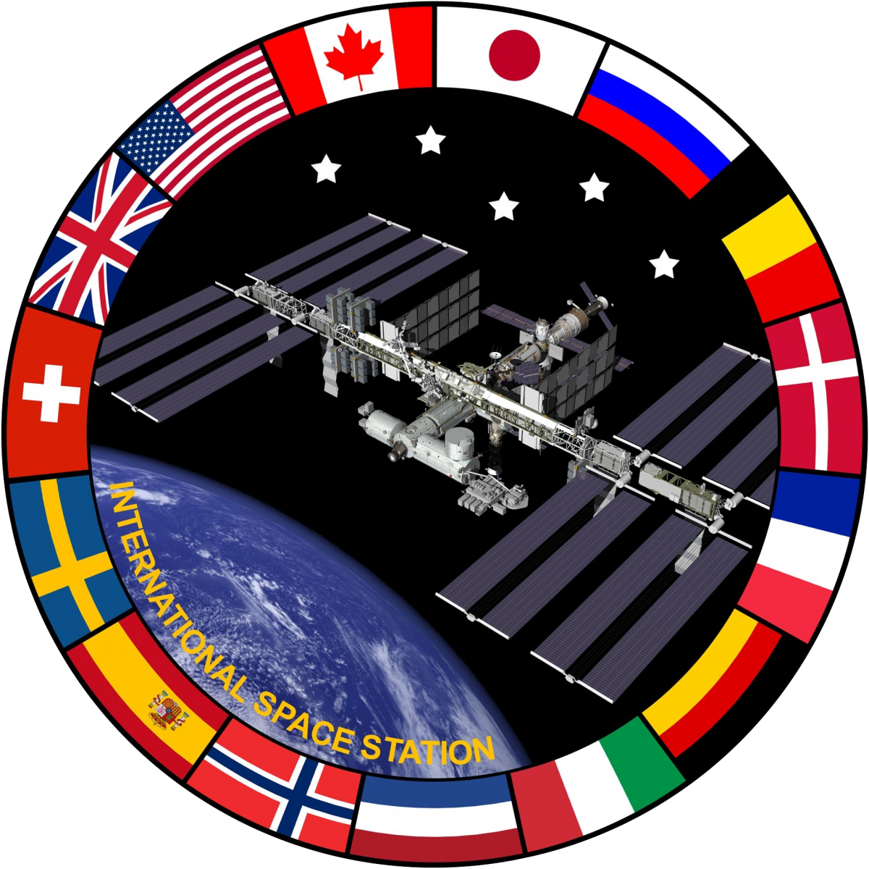

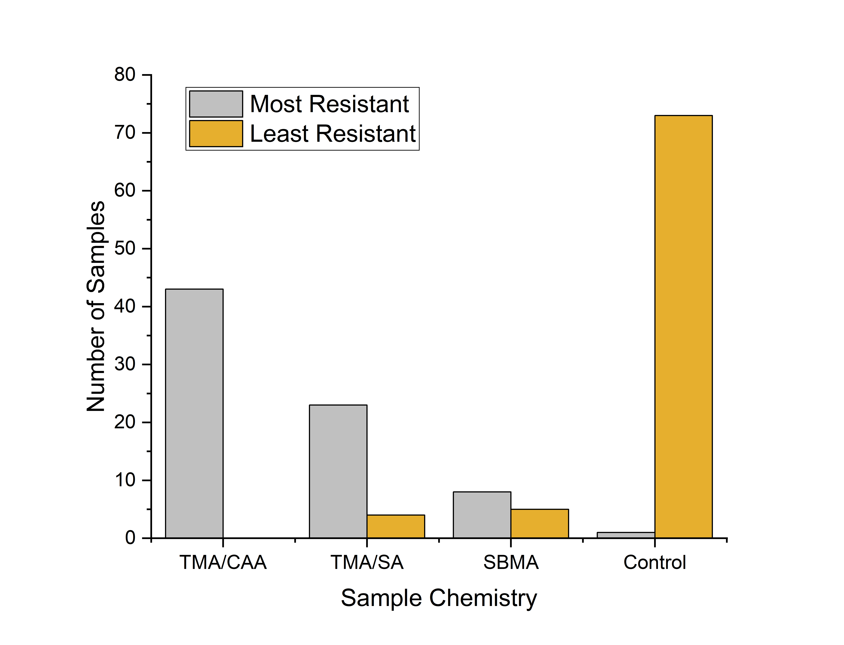
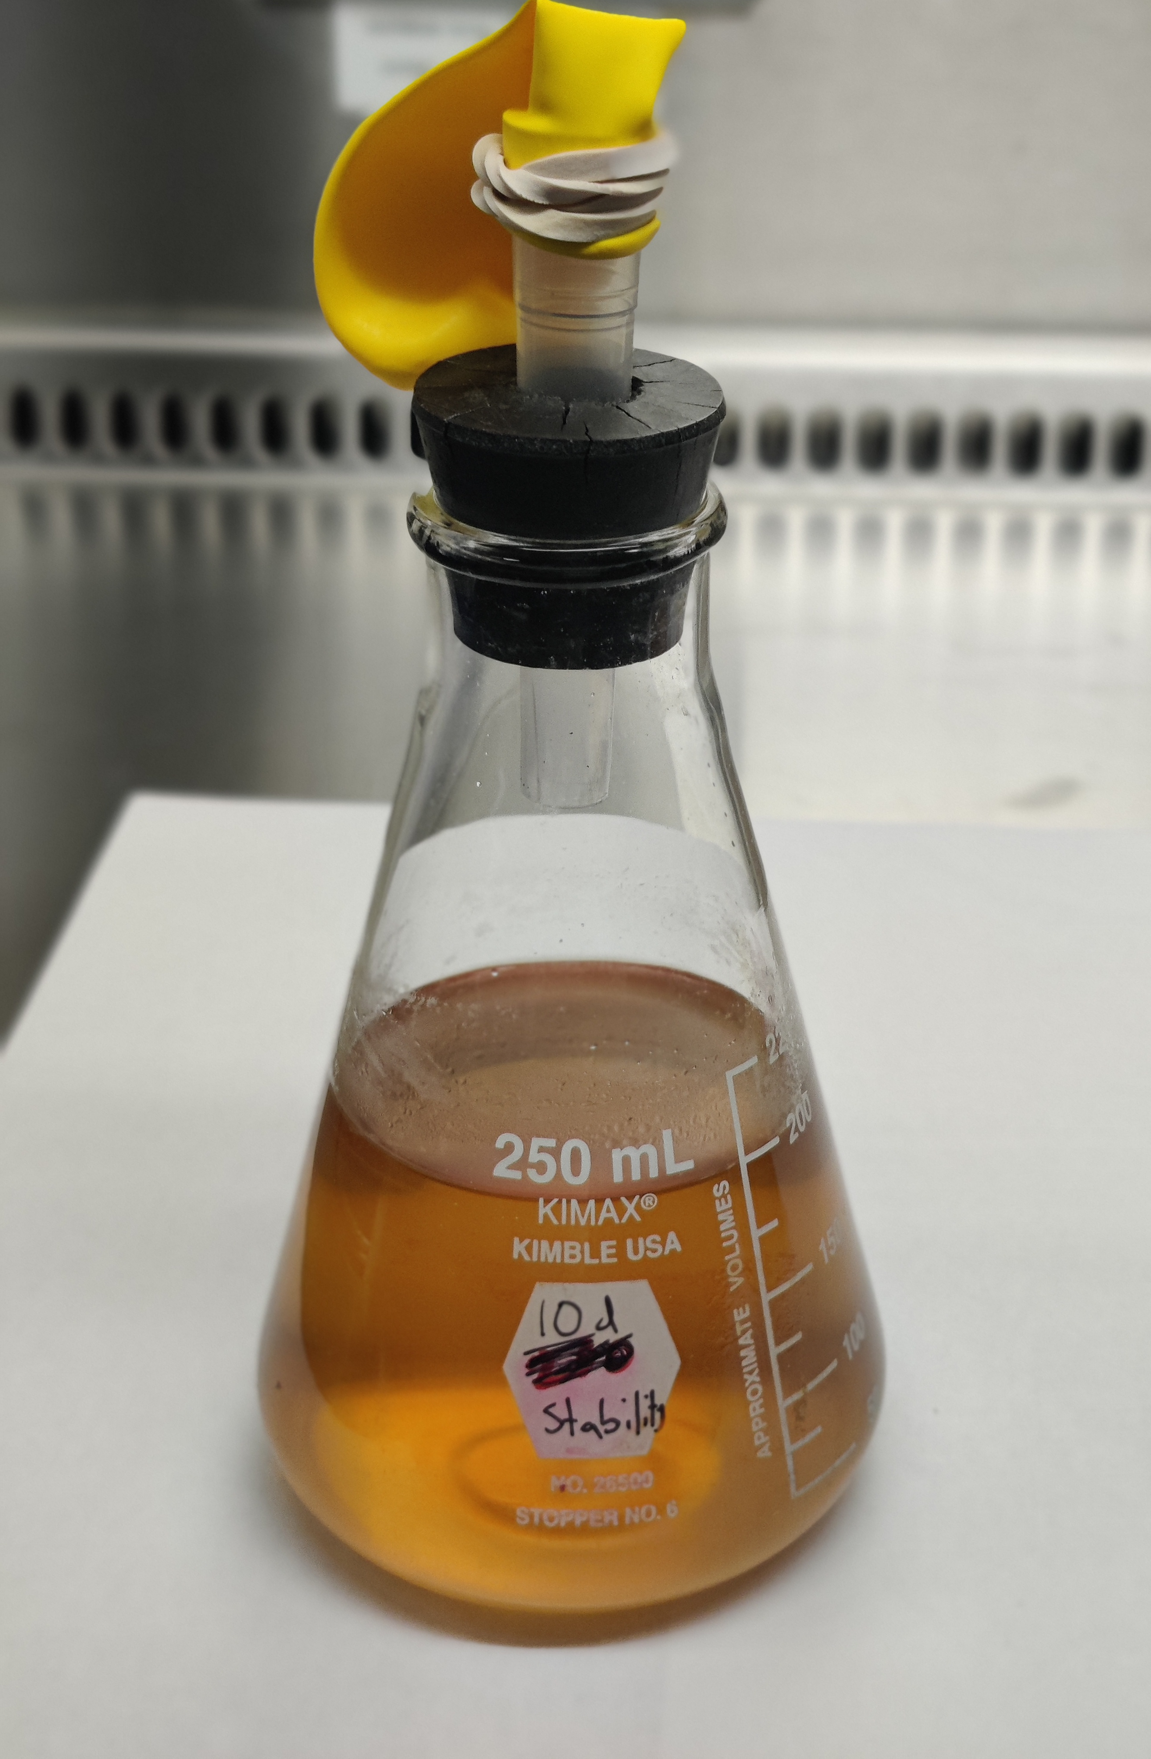
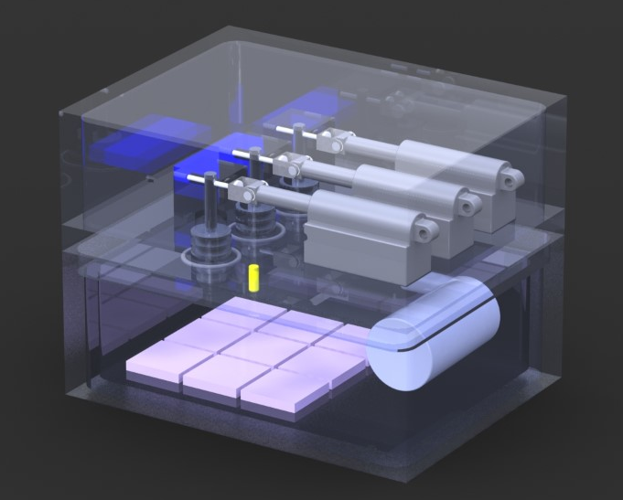
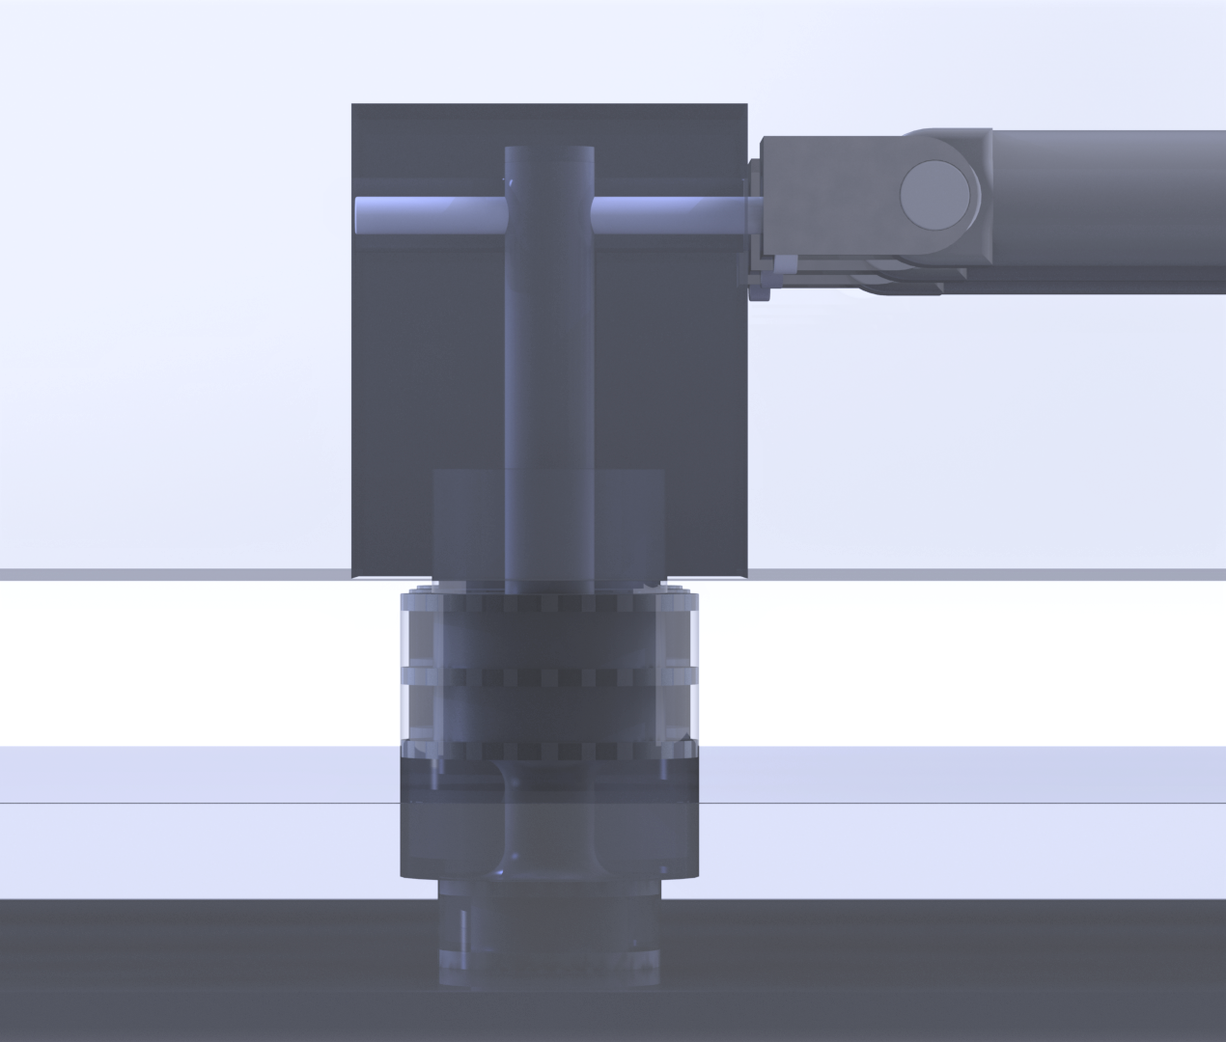
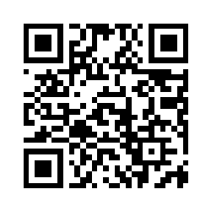
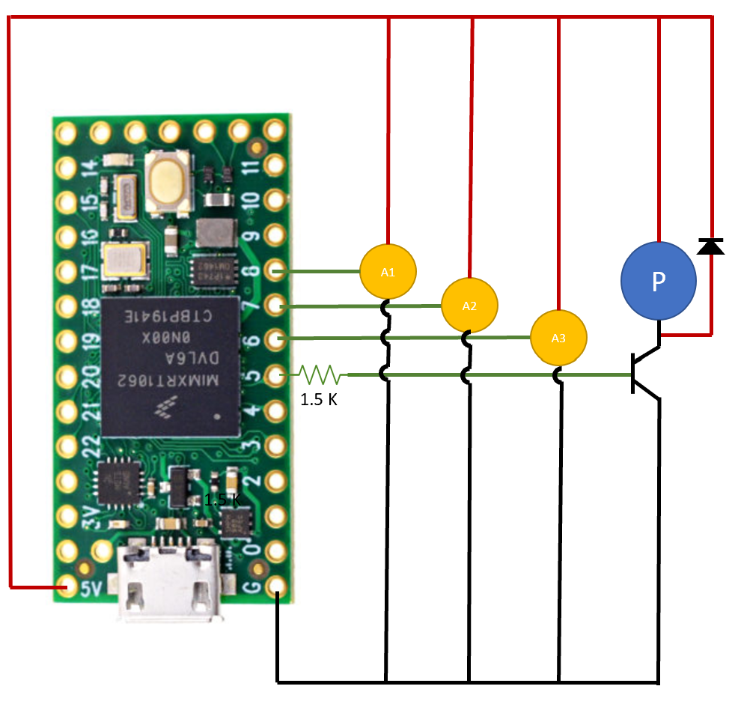
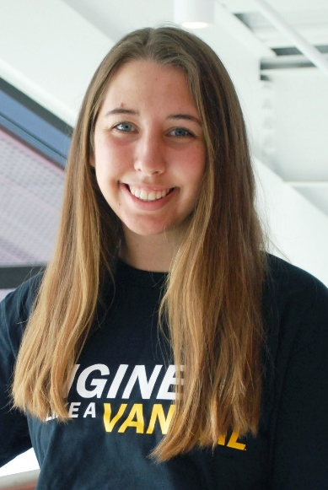
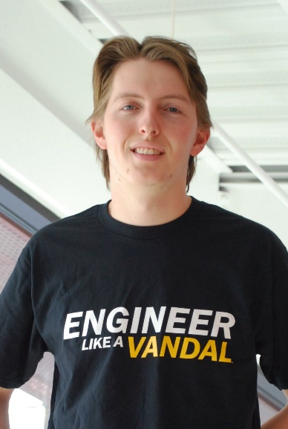
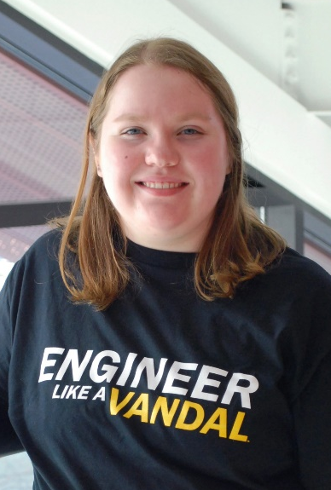
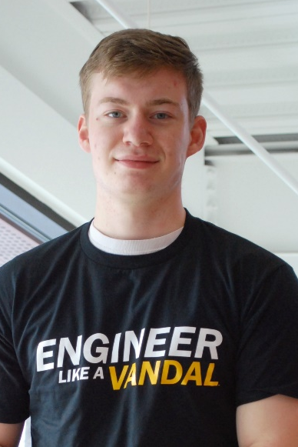
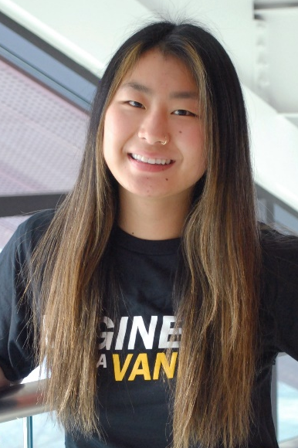
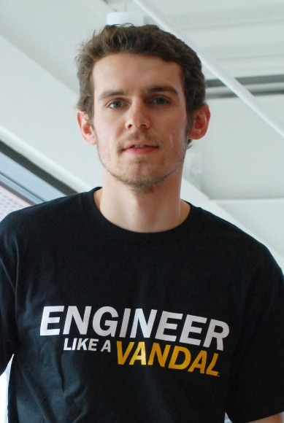
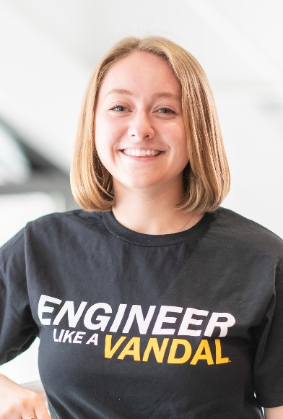
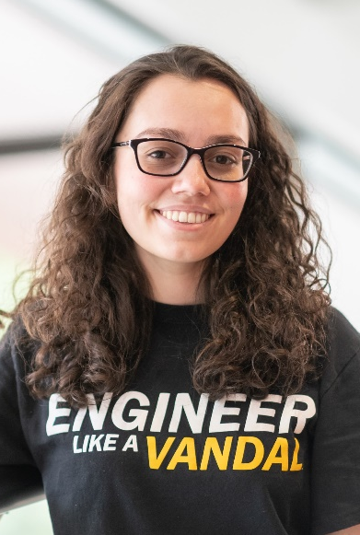
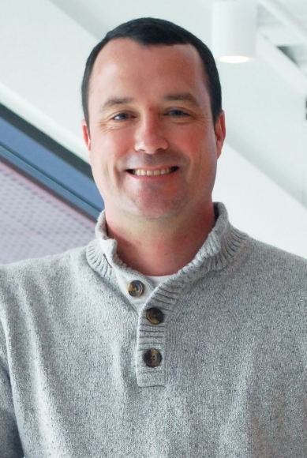

Testing Bacteria Resistant Polymers Onboard the ISS
ABSTRACT
EXPERIMENTAL BUILD
POLYMER COATINGS
Student Payload Opportunity with Citizen Science (SPOCS) is a program funded by NASA to inspire the Artemis generation
Scientific Question: How does microgravity impact the efficacy of bacteria resistant polymers?
Experimental apparatus to be sent to ISS with 2 polymer chemistry candidates coated on Al 6061 alloy coupons
Staphylococcus Epidermidis bacteria strain to simulate growth of superficial dermal bacteria
The build is constrained to a 10cm x 10cm x 15cm housing and 1.5 kg per program regulations
Two compartment design made of Delrin with a dry electronics space in the top, and wet nutrient broth space below
Total of 16 Al 6061 coupons for replicate trials of selected polymer coatings and control
Three bacteria introduction devices (BIDs) for redundancy in design
The BID mechanism uses compressive force from a spring to drive piston downward, introducing stored bacteria to the nutrient broth compartment
Polyampholyte and zwitterionic polymer coatings have been shown to resist bacteria adhesion
A silane initiator is used for surface modification of Al 6061 for adhesion of the polymers to aluminum
FTIR verifies successful polymerization on Al 6061 substrate
Figure 4: FTIR of polymer coatings on Al 6061
CITIZEN SCIENCE
Utilized citizen scientists grades 3-5 as a resource to determine the two best polymer candidates
A total of 220 citizen science kits distributed containing polymer chemistry and control agar growth trials
BACTERIA TESTING
Staphylococcus Epidermidis
Biosafety Level 1 (BSL) requires two levels of containment on ISS
Facultative anaerobe
Human microbiome presence
Isolated from ISS surfaces
Factors being tested:
Storage stability
Gas production rate
Acid production
Bacterial adhesion and staining
Figure 1: Results from citizen science experiments
Figure 2: CAD of overall build (left) and BID mechanism (right)
A total of 98 citizen science data sets returned
Figure 5: Bacteria stability experiment
idahospocs.org
OUTREACH
Electrical Schematics
The team
Created focal project website that
features details and weekly update
blog posts
Facilitated @uidaho Instagram
takeover that reached 9,543 users
Created and handed off an adapted project for Engineering Ambassadors high school visits
Official NASA Tumblr Answer Time June 2021
Operational Constraints
5V Power source
400 mA maximum current
Full automation required
Components utilized
PJRC Teensy 4.0
Actuonix PQ12-4 Micro Linear actuators
Gikfun DC microfluidic pump
Hannah Johnson
Niko
Hansen
Roslyn
McCormack
Kael
Stelck
Adriana
Bryant
Travis
Lindsay
Acknowledgements: Dr. David MacPherson, Charles Cornwall, Dr. Stephanie Haag,
Nanoracks LLC, NASA SPOCS
Figure 3: Experiment circuit diagram
Kaitlyn
Harvey
Ashley
Keeley
Dr. Matthew Bernards
Trade names and trademarks are used in this report for identification only. Their usage does not constitute an official endorsement, either expressed or implied, by the National Aeronautics and Space Administration.

