Slide 1


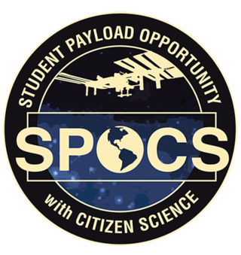








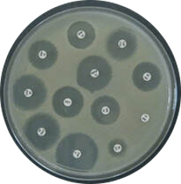
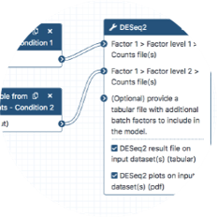
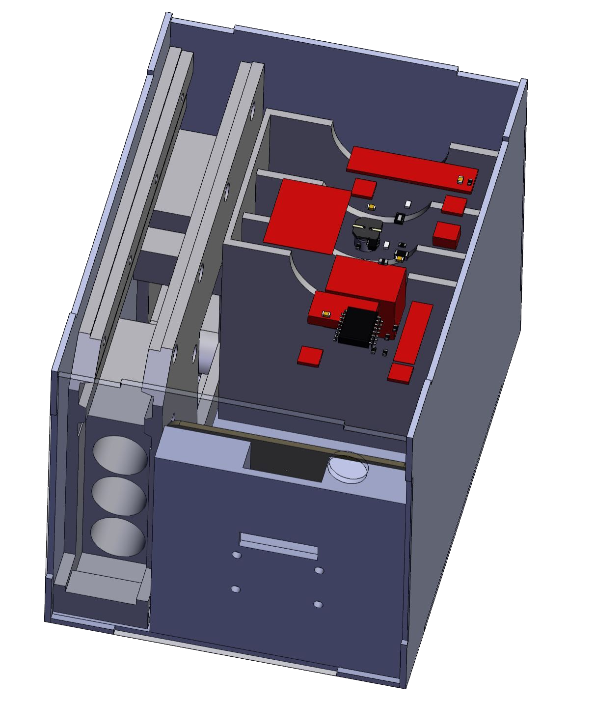
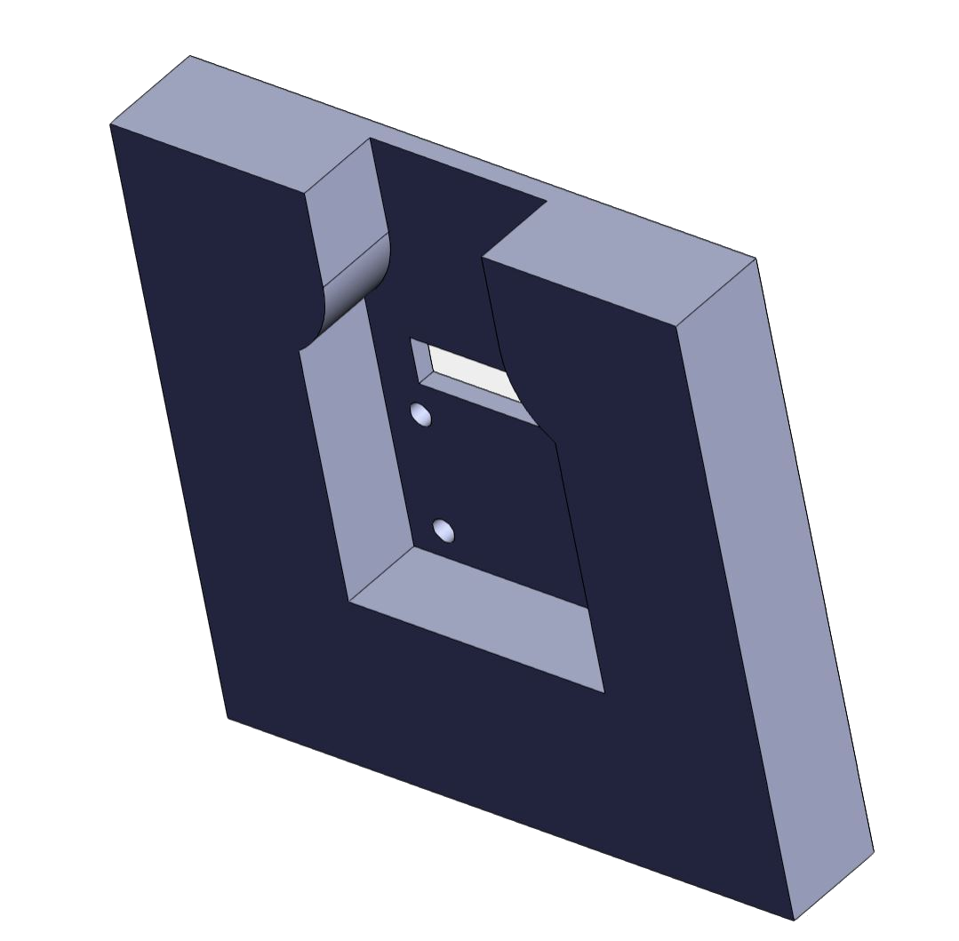
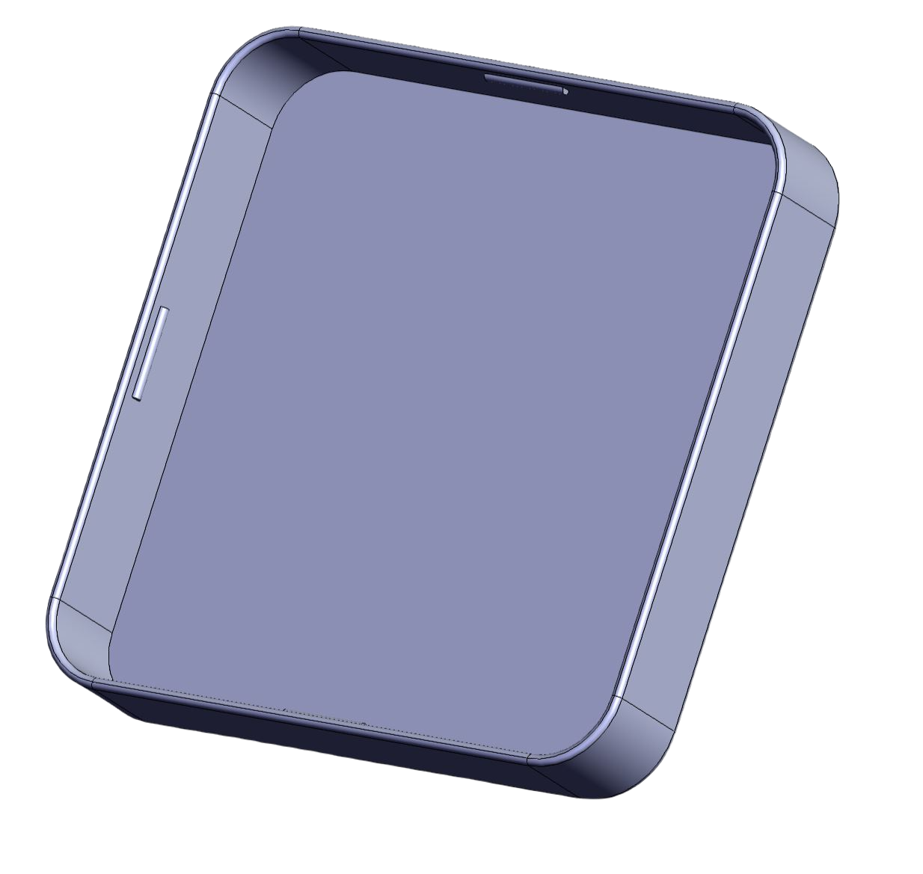
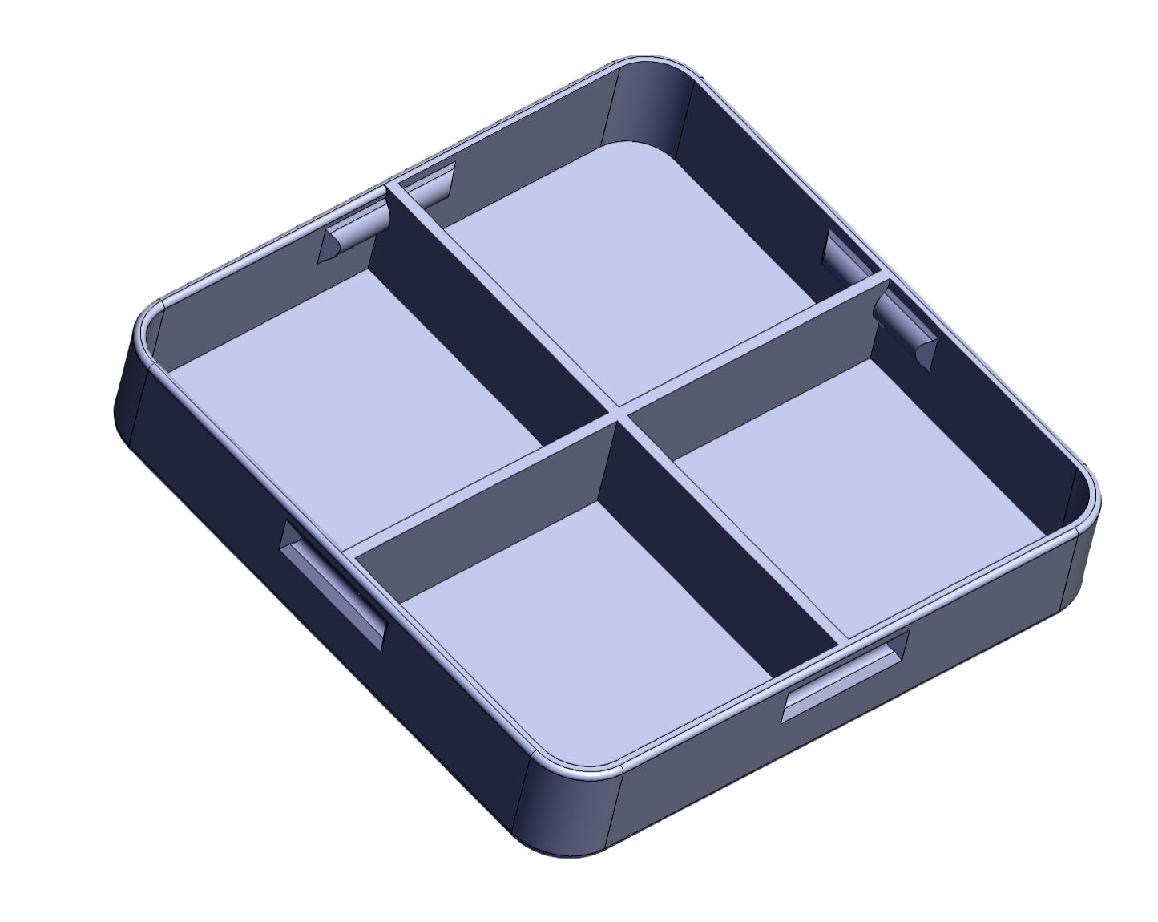
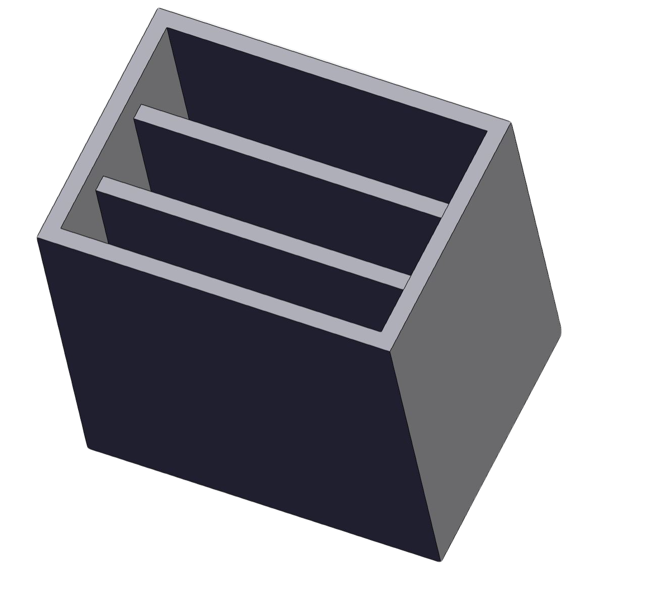
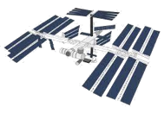
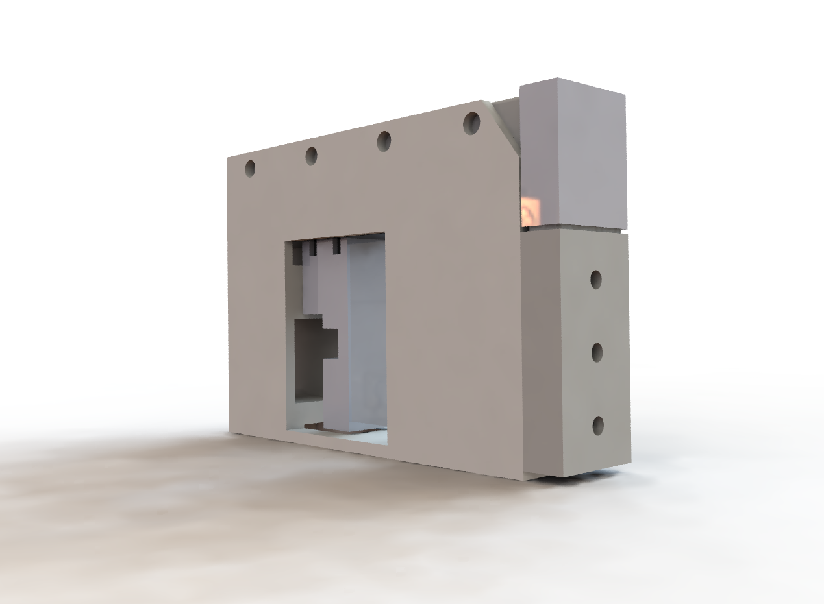



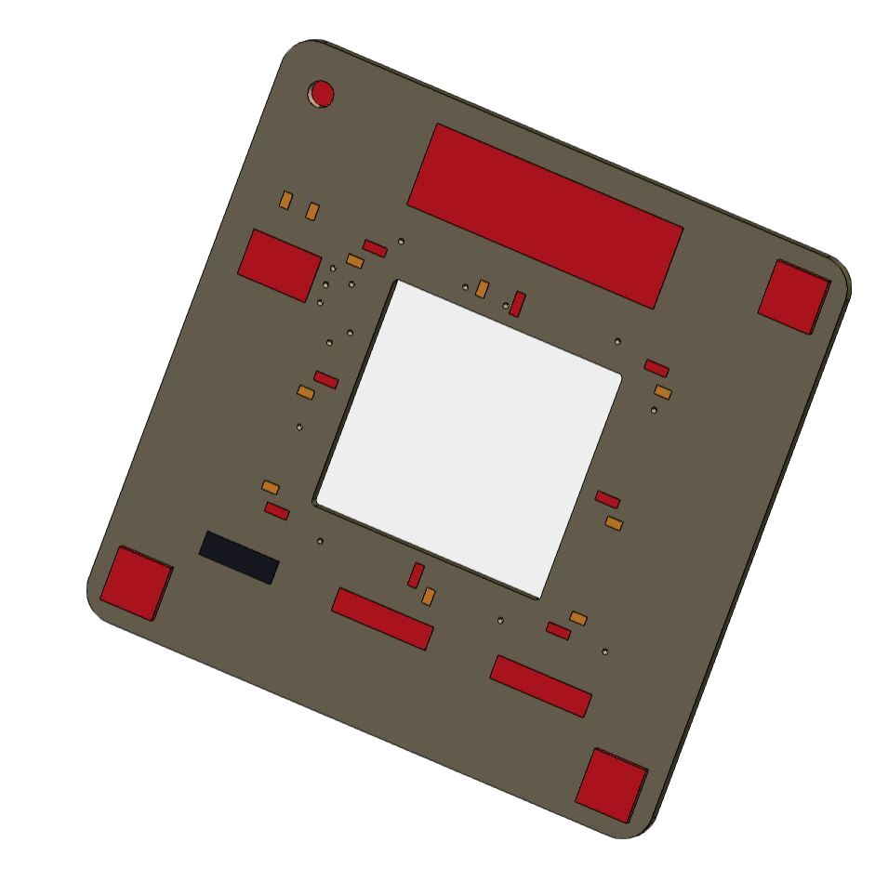
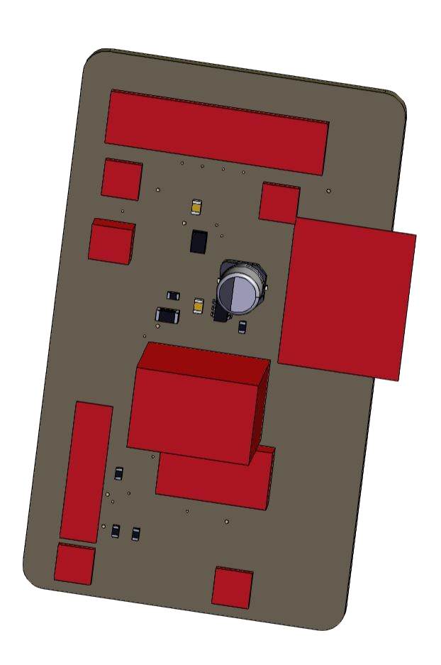

Characterizing Antibiotic Resistance in Microgravity Environments
Kalpana Ganeshan¹, Swati Ravi^{1,2}, Alfonso Ussia¹, Leonardo Arvan¹,
Bryan Wang², Hugo Favila¹, Theodore Nelson¹, Myra Dada¹
¹Columbia Space Initiative, Columbia University in the City of New York
²Department of Biological Sciences, Columbia University in the City of New York
ABSTRACT
SCIENCE DESIGN METHODOLOGY
ISS OPERATIONS
From these design considerations, an operations timeline is developed.
At L-48 hrs, biological samples are prepared at Columbia, handed off to KSC and stowed at 4 ⁰C.
At U-8 days, the payload is removed from 4 ⁰C and plugged into a Nanoracks framework, which begins the process of sensor data and image collection.
At U-2 days, data collection and imaging is halted, and a fluid injection system injects RNAProtect that stops cell growth and the cells enter a dormant state.
At U-1 days, the payload is returned to 4 ⁰C and stored until payload pickup.
The gram-positive bacterium Staphylococcus aureus and the gram-negative Pseudomonas aeruginosa are two of NASA’s designated “medically important microorganisms” commonly co-isolated from spaceflight environments like the International Space Station (ISS). Prior studies demonstrate evidence of increased virulence and antibiotic resistance of each bacterium when grown as single species in space. “Characterizing Antibiotic Resistance in Microgravity Environments” (CARMEn) is an autonomous 30-day ISS payload experiment probing the phenotypic changes of S. aureus and P. aeruginosa biofilms grown together in microgravity. Phenotypic changes are probed through three parallel experiments measuring Extracellular Matrix (ECM) production, antibiotic tolerance, and RNA expression respectively. The ECM experiment uses time-lapse imaging to collect observational morphological data from biofilms stained with Congo Red and Coomassie Blue, the antibiotic tolerance experiment utilizes E-strip testing once samples return to Earth, and RNA expression is measured through RNAseq of samples treated with RNAProtect® during spaceflight.
Pseudomonas aeruginosa strain PA14 and Staphylococcus aureus strain USA300LAC will be inoculated from respective streak plate colonies and grown in 2 mL of lysogeny broth (LB) at 37°C shaking at 250 RPM for 12-16 hours. Thirty μL of this culture will then be added to 3 mL of fresh LB to achieve a 1:100 ratio and grown again at 37°C with shaking at 250 RPM for 2.5 hours to create cultures at mid-exponential phase. These cultures will be OD500nm corrected using a spectrophotometer and further diluted cultures with fresh LB.
Cultures will be spotted onto 3% TSB, 1% agar medium immediately before handoff to NASA for L-72 for the SpaceX CRX-24 mission. Samples will be stored at 4±2°C for the duration of pre-flight, launch, and the majority of time aboard the ISS.
On U-8, samples will be removed from the from cold stow and transferred to the Nanoracks Nanode kept at ambient (~25°C) for plugin when ambient temperature, pressure, oxygen, and humidity are measured along with 2-hour interval time lapse images. A U-2 RNAProtect® is injected into selected samples, and the payload is then returned to 4±2°C for return to Earth until handoff to Columbia University.
CARMEn will run identical parallel experiments on the ISS and on Earth to serve as experimental controls. Both sets of experiments will additionally include single-species controls and triplicate samples for additional comparison.
On Earth
On the ISS
Ground Controls
Monomicrobial Controls​​
Experimental Cells
P. aurugenosa
S. aureus
P. aurugenosa
(RNAProtect)
S. aureus
(RNAProtect)
Dual-Species Biofilm
(RNAProtect)
Dual-Species Biofilm
P. aurugenosa
(Stowage)
S. aureus
(Stowage)
Dual-Species Biofilm
(Stowage)
OUTREACH
Data Collection Modes
CARMEn involves citizen scientists in its data and science analysis!
An audience of 500 middle school students, in conjunction with Sophie Gerson Healthy Youth, will analyze CARMEn Kirby Bauer Disk Diffusion images to measure antibiotic resistance.
An audience of 100 high school students will utilize the Google Colaboratory platform to perform analysis on RNA sequencing data produced by CARMEn.
We hope to build out a virtual platform with space curriculum accessible to a larger virtual audience
PURPOSE
On the ISS
Post-Flight
The gram-positive bacterium Staphylococcus aureus and the gram-negative Pseudomonas aeruginosa are opportunistic pathogens commonly co-isolated from spaceflight environments. Both bacteria are among the five NASA-designated “medically important microorganisms” isolated from crewmembers of Apollo lunar spaceflights, with P. aeruginosa causing an astronaut infection during the Apollo 13 mission and S. aureus composing up to 10% of the bacteria isolated from routine microbial monitoring of the International Space Station (ISS). Given the clinical relevance of S. aureus and P. aeruginosa co-infections and the frequent co-isolation of both species from spaceflight environments, the 30-day autonomous ISS experiment “Characterizing Antibiotic Resistance in Microgravity
Environments” (CARMEn) studies antibiotic and phenotypic changes of S. aureus and P. aeruginosa grown together in microgravity.
Sensor
Data
Camera
Imaging
Antibiotic
Resistance
Genomic Sequencing
ENGINEERING DESIGN METHODOLOGY
Main compartment
Mechanical systems
The payload fits dimensions 10cm x 10cm x 15cm, with an outer aluminum enclosure
It has two main parts: a fluid system and a main compartment.
The fluid injection system design allows for an electro-mechanical fluid displacement from syringe reservoirs into an RNAProtect tray.
The main compartment contains the payload’s electronics, petri dishes and holder (for cold stowage), and camera with mount.
It has been tested for structural integrity at Columbia University’s Carleton Laboratory.
The system has undergone extensive fluid and biological containment testing to adhere to NASA safety regulations.
Kirby Bauer Disk Diffusion
RNA Sequencing Analysis​
OBJECTIVES
REFERENCES
Maximize the relevant biological data which could be collected from experiments within a 10x10x15 cm Aluminum enclosure.
Design autonomous systems to introduce new conditions and maintain constant environmental conditions under strict electrical and technical constraints.
Maintain proper ground controls to ensure that biological variation is attributed solely to ISS microgravity
Preserve bacteria with either RNAProtect® and 4°C storage to test hypotheses with sequencing analysis and antibiotic testing
Camera and mount
1. Yamaguchi, N., Roberts, M., Castro, S., Oubre, C., Makimura, K., Leys, N., … Nasu, M. (2014). Microbial Monitoring of Crewed Habitats in Space—Current Status and Future Perspectives. Microbes and Environments, 29(3), 250–260. https://doi.org/10.1264/jsme2.me14031
2. Dunbar, B. (2015, April 07). Spacebound Bacteria Inspire Earthbound Remedies. Retrieved January 12, 2021, from https://www.nasa.gov/home/hqnews/2011/mar/HQ_11-080_Bacteria_Research.html
3. Checinska Sielaff, A., Urbaniak, C., Mohan, G.B.M., et al. (2019). Characterization of the total and viable bacterial and fungal communities associated with the International Space Station surfaces. Microbiome 7(50). https://doi.org/10.1186/s40168-019-0666-x
+
Fluid system
Petri dishes and holder
ACKNOWLEDGEMENTS
+
+
Both cultures have been studied separately on the ISS​
Increased resistance​
Higher mutation rate
P. aurugenosa
S. aureus
1
+
The dual-species biofilm has been studied on Earth​​
Increased resistance​
Increased virulence​
Electrical systems
The experiment runs autonomously, requiring no astronaut interaction and controlled by a Raspberry Pi Zero.
The electronics are set up to interface with a Nanoracks Nanode module for data transfer.
A camera, sensors and an actuator for the fluid system are supported by two connected custom printed circuit boards (PCBs) designed by electrical engineering team members.
Dual-Species Biofilm
Sensor PCB
Main PCB
+
CARMEn will study the dual-species biofilm on the ISS​
Dual-Species Biofilm
Trade names and trademarks are used in this report for identification only. Their usage does not constitute an official endorsement, either expressed or implied, by the National Aeronautics and Space Administration.

