Slide 1
Emergent ETF – Kodiak LIDAR High Fidelity Simulation
Nuno Filipe
December 16, 2021

Slide 2
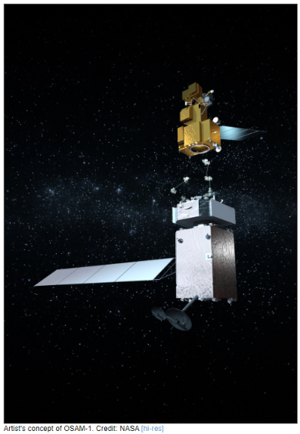
The OSAM-1 Mission
Kodiak is a LIght Detection And Ranging (LIDAR) sensor flying on the OSAM-1 mission (previously called Restore-L)
Kodiak is part of OSAM-1’s Rendezvous and Proximity Operators (RPO) sensor suite
OSAM-1 stands for On-Orbit Servicing, Assembly and Manufacturing-1
Servicing: OSAM-1 will rendezvous with, grasp, refuel, and relocate the government-owned satellite Landsat-7
Assembly: OSAM-1’s Space Infrastructure Dexterous Robot (SPIDER) payload will assemble in-orbit a functional 3-meter Ka-band communications antenna using a robotic arm
Manufacturing: SPIDER will also manufacture a 10-meter composite beam to demonstrate the capability to construct large structures in orbit
https://nexis.gsfc.nasa.gov/osam-1.html

Slide 3
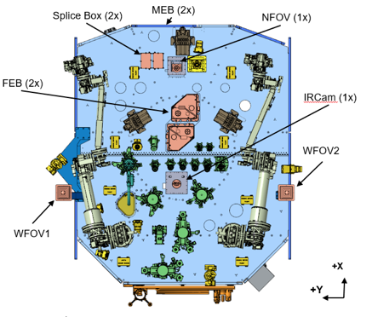
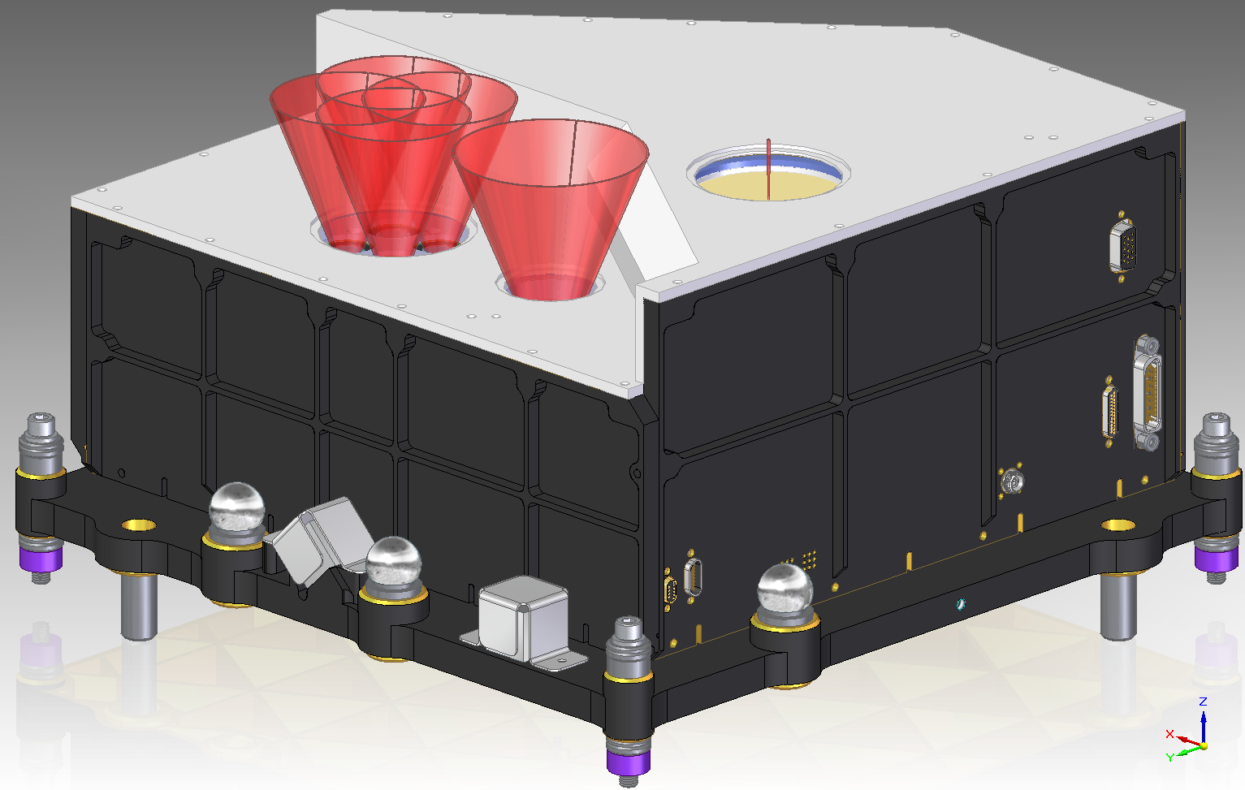
The Kodiak LIDAR
The Kodiak LIDAR is being developed in-house at Goddard
Based on the Goddard Reconfigurable Solid-state Scanning LIDAR (GRSSLi) introduced in 2014
The Kodiak LIDAR will provide relative range and bearing measurements between OSAM-1 and Landsat 7 during rendezvous and proximity operations
Kodiak has two main modes of operation:
Laser Range Finder (LRF) mode: 25 m to 1.2 km, 1.36-deg FOV, >0.1 Hz, 435 pixels
Imager mode: 1.2 m to 35 m, 40-deg FOV, 3.0 Hz, 40k pixels
Each Kodiak unit is composed by 2 boxes: 1 Front End Box (FEB) and 1 Main Electronics Box (MEB)
Kodiak Engineering Model (EM) completed in 2018. Long range test conducted at NASA Wallops Flight Facility.
Engineering Testing Unit (ETU) completed and TRL6 reached by LiDAR CDR in 2022
A modified version of Kodiak has been selected to fly on APL’s Dragonfly mission to Titan
A modified version of Kodiak is also being developed for surface rovers

Slide 4
Kodiak’s Key Performance Requirements
Requirement | Value
Measurement rate in LRF mode | ≥0.1 Hz
Measurement rate in Imager mode | ≥3.0 Hz
Range bias error per pixel | ≤2 cm or 0.1% of range
Range noise error per pixel | ≤2 cm or 0.1% of range, 1-sigma
Bearing knowledge per pixel | ≤0.2 deg
FOV in LRF mode | ≥1.36 deg circular full angle
FOV in Imager mode | ≥40 deg circular full angle
Spatial resolution | resolve features with a diameter of 1 cm at 1.2m
LRF mode received peak optical power | ≥1 uW
Relative linear velocity | ≤0.5 m/s
Relative angular velocity | ≤2 mrad/s
Environment | Space qualified

Slide 5
LIDAR Modelling
RPO subsystem is developing two different models of the Kodiak LiDAR. Development by RPO engineer integrated into the Kodiak team.
LiDAR High Fidelity (HiFi) Simulation
Main objectives:
Support Kodiak’s development and testing
Predict compliance of design with L5 LiDAR requirements before Engineering Test Unit (ETU) testing. Early prediction of possible problems and design solutions.
Provide a benchmark for the Verification and Validation (V&V) of the Reduced LiDAR Model
Simulates FPGA processing of digital signals at 24.64 GHz
Simulates range and bearing measurements in Laser Range Finder (LRF) mode and Imager mode
Standalone model
Runs slower than real time
Model parameters identified from and validated against Kodiak ETU test data
Validation completed by LiDAR CDR
Simulates the different components of Kodiak: LRF and Imager Receiver (RX) cards, backend RX card, Analog-to-Digital Converters (ADCs), Position-Sensitive Diode (PSD), Field Programmable Gate Arrays (FPGAs), etc
Relies on RPO’s Freespace Raytracer for optical power waveforms at the receivers’ photo diodes
Reduced LiDAR Model
Main objectives:
Emulate the Kodiak LiDAR in RPO’s High Fidelity Simulation with enough fidelity to V&V L4 RPO requirements
Simulates LiDAR’s outputs at >0.1 Hz (LRF mode) and 3.0 Hz (Imager mode)
Model integrated into RPO’s High Fidelity Simulation
Runs faster than real time
Will be validated against the LiDAR HiFi simulation

Slide 6
LIDAR HiFi Sim High-Level Block Diagram
*Includes effect of RX optics (e.g., FOV and efficiency vs AOI) and of TX optics
Kodiak
Client
Pre-calculated (optical) impulse response*
Transmitted power waveform
Laser Transmitter Model
Convolution
Freespace Raytracer
Model of TX Optics
Model of RX Optics
PSD Model
HG
HG
LRF Frontend Model
FPGA Model
RX ADC Model
RX Backend Model
+
Imager Frontend Model
Received power waveform at PDs
Pre-calculated power at Photo-Diodes (PDs) due to background-light
LG
LG
Outputs/
Telemetry
Commands
RPO FSW Model
Space Vehicle (SV) Flight Software

Slide 7
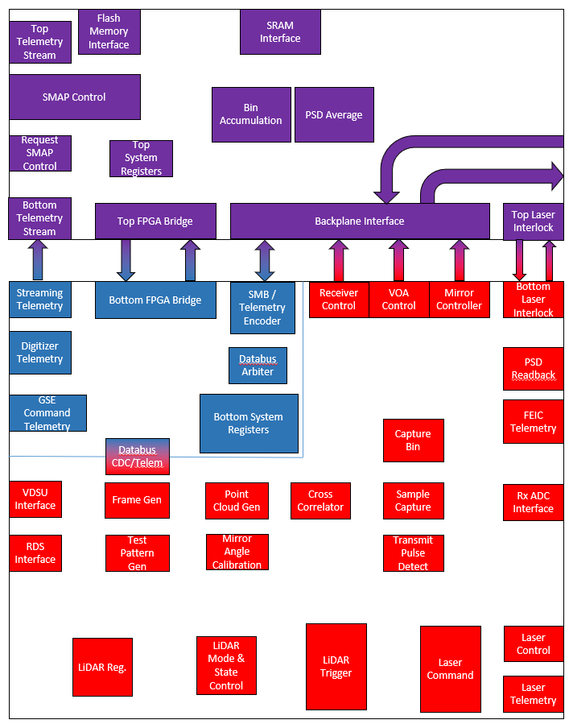
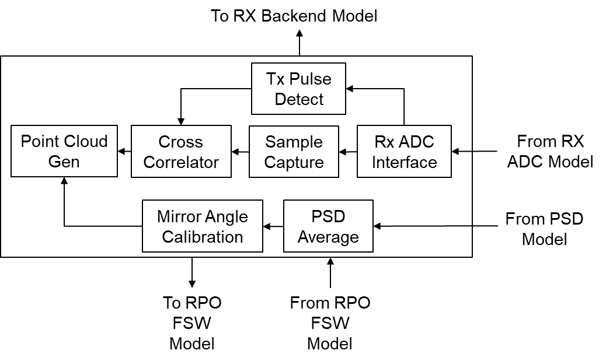
FPGA Model in the LIDAR HiFi Simulation
The block diagram of the FPGA model of the LiDAR HiFi simulation follows the functional diagram of Kodiak’s FPGAs:
Same input/output files used to validate FPGA VHDL code were used to validate LiDAR HiFi sim
Functional diagram of Kodiak’s FPGAs
Block Diagram of the FPGA Model in the LiDAR HiFi Sim

Slide 8
Main Results (1)
Coarse acquisition in LRF mode eliminated:
The baseline at LiDAR PDR was to have two processes running in parallel in the FPGAs in LRF mode:
Fine ranging: produced range measurements meeting performance requirements, but required previous knowledge of the range accurate to within 50 m and previous knowledge of a pixel aligned with the client
Coarse acquisition: seeded fine ranging
LIDAR HiFi sim showed that coarse acquisition was sensitive to range-rate in that, at a range-rate of 0.5 m/s, every 39 min, in average, there would be a period of 20 sec with no measurements due to low Signal-to-Noise Ratio (SNR)
Compelled by these results, the baseline design was changed and the coarse acquisition process was eliminated
Fine ranging can now process the entire operational range in LRF mode and all the pixels of a frame, simplifying the design, decreasing sensitivity to range-rate, and enabling compliance with requirement “LIDAR-538 Boresight Relative Velocity”

Slide 9
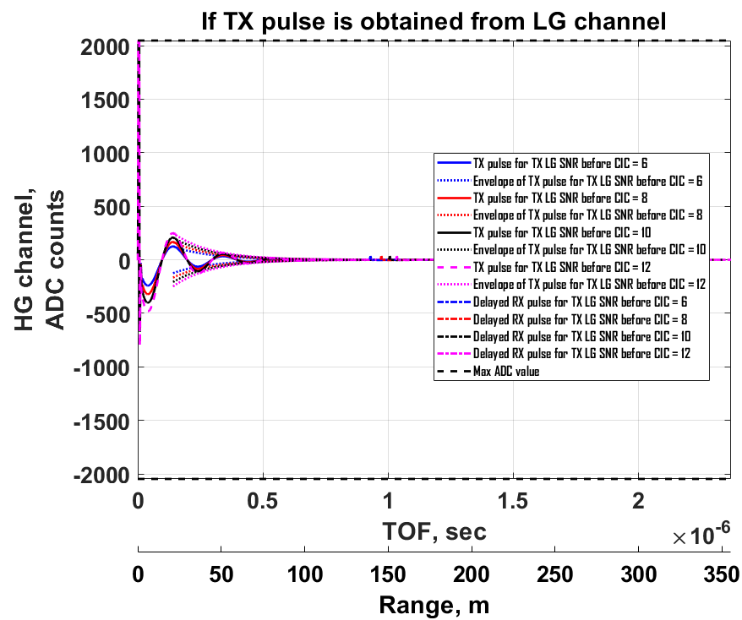
Main Results (2)
Fiber optical delay between TX pulse and RX pulse increased
LIDAR HiFi sim showed that baselined fiber optical delay to separate the TX pulse from the RX pulse was insufficient to prevent the voltage ringing after the TX pulse from affecting the detection of the peak of the RX pulse
Fiber optical delay btw TX and RX pulses increased so that minimum optical power can be detected at minimum range
Enables compliance with requirements “LIDAR-532 LRF Mode Received Peak Optical Power” and “LIDAR-535 Imaging Mode Received Peak Optical Power”
TX pulse
RX pulse

Slide 10
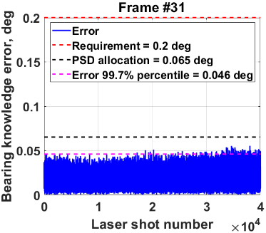
Main Results (3)
Changes to raster scan used in LRF mode
LiDAR HiFi sim showed that with the baselined number of rows of 15 and the baselined number of laser shots per pixel of 16, the Client would be undetectable under certain relative motions due to low SNR
The number of rows was increased to 29 and number of laser shots per pixel was increased 1024
Enables compliance with requirement “LIDAR-539 Transverse Relative Velocity”
LIDAR HiFi sim showed that allocation to the PSD of the bearing knowledge error (requirement “LIDAR-20 Bearing Requirements”) can be met with averaging of PSD measurements with ~30% margin
Number of samples
averaged = 16

Slide 11
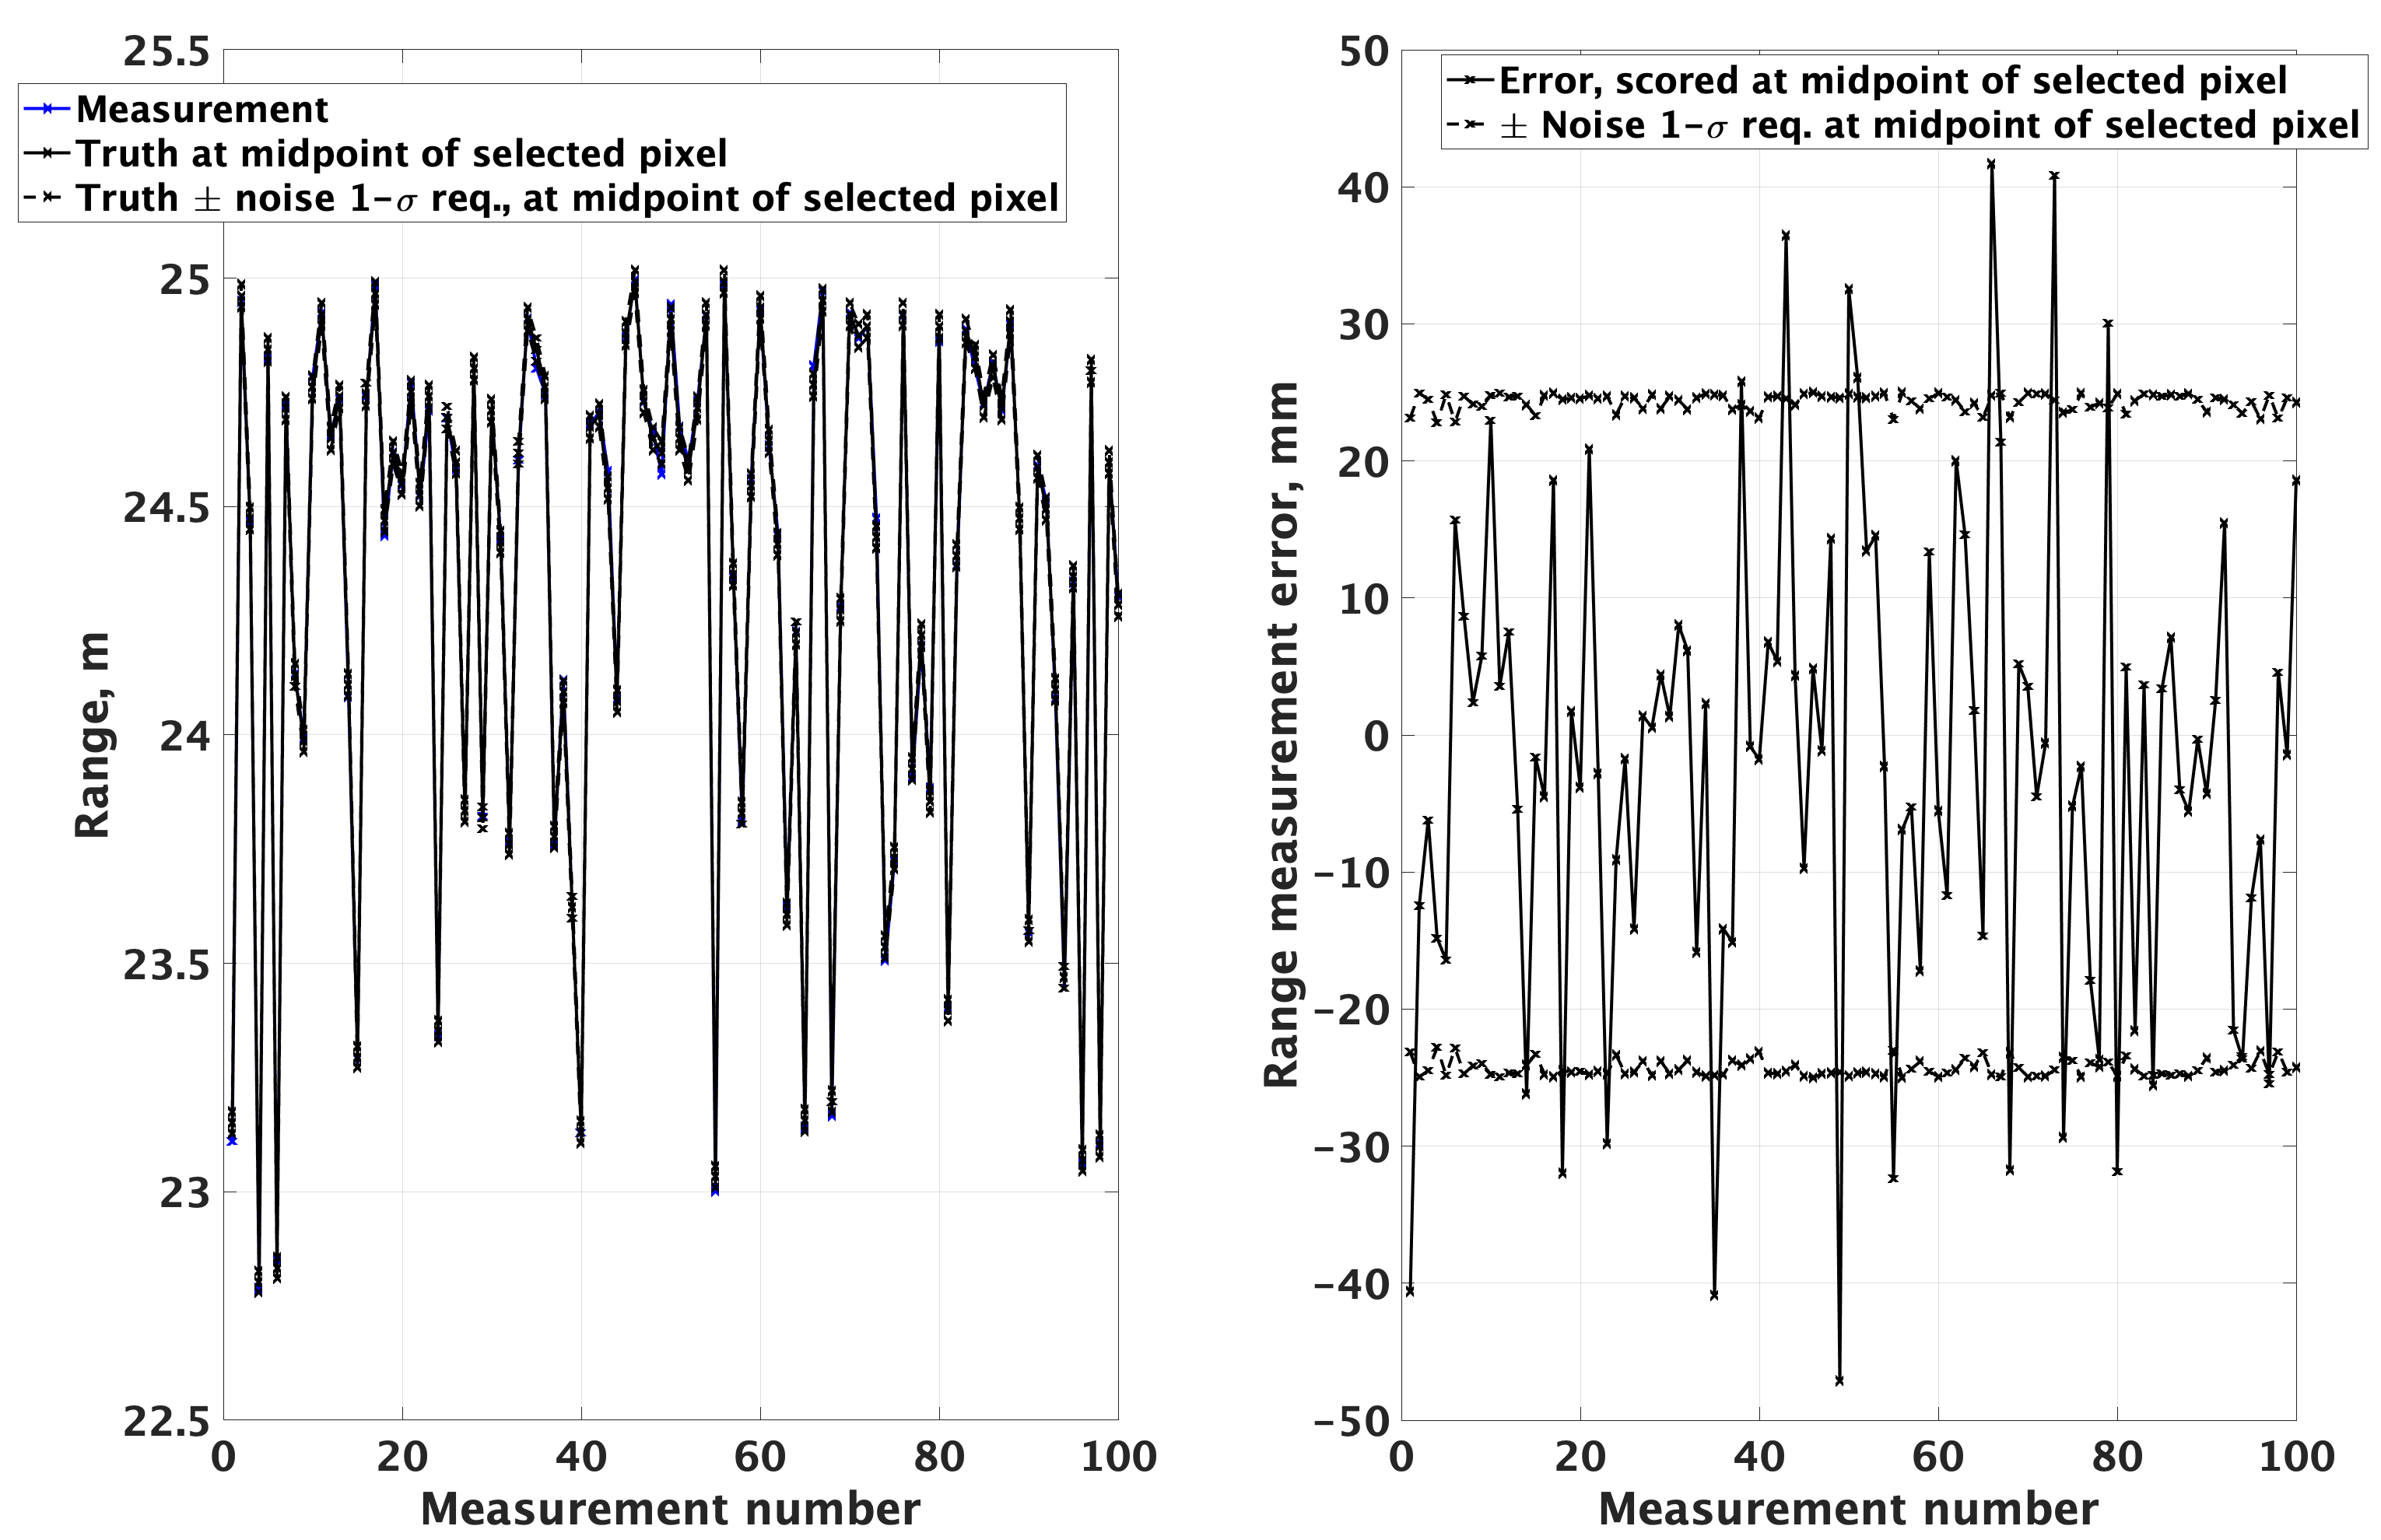
Main Results (4)
LiDAR HiFi sim showed that requirement LIDAR-18 on the range measurement noise is expected to be met in LRF mode with a margin of ~29% (at 25 m)
For a minimum returned power of 0.5 µW (50% margin wrt requirement “LIDAR-532 LRF Mode Received Peak Optical Power”) and for relative rates up to 2 mrad/s and 0.5 m/s

Slide 12
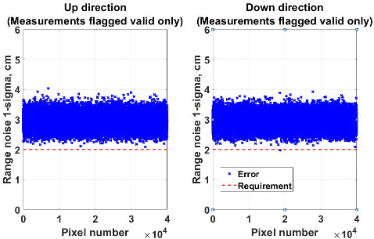
Main Results (5)
LiDAR HiFi sim showed that requirement LIDAR-18 on the range measurement noise is NOT expected to be met in Imager mode for a minimum returned power of 5 µW (TBR)
More analysis is necessary after the LiDAR HiFi sim is integrated with the Freespace Raytracer to determine the expected minimum returned power

Slide 13
Path Forward for the LiDAR Models
Complete component-level validation of LiDAR HiFi sim as more Kodiak ETU test data becomes available
Complete system-level validation of LiDAR HiFi sim as more Kodiak ETU test data becomes available
Integrate LiDAR HiFi sim with Freespace Raytracer
Validate Reduced LiDAR model against LiDAR HiFi sim
As necessary for the validation of the L4 RPO requirements, increase fidelity of the Reduced LiDAR model based on lessons-learned from LiDAR HiFi sim and Kodiak ETU test data

