Slide 1
Materials and Structures Research Within the Lunar Surface Innovation Consortium
Joshua Crawford
Dr. Cheol Park & Dr. Sang-hyon Chu
2021 Fall Student Research Symposium

Slide 2

Introduction
Joshua Crawford
School: Georgia Institute of Technology
Year: 3rd year
Major: Chemical & Biomolecular Engineering
Past Internships: Modeling & Simulation Procter & Gamble R&D, Technology Development Procter & Gamble R&D

Slide 3
Challenge
Lunar Surface Innovation Consortium (LSIC) is created to support NASA’s Artemis Program to send the first woman and next man to the Lunar surface by 2024 with a budget over $20B
In order to enable future exploration of the Moon, current shortcomings, technology readiness, and novel future technologies must be identified across the Space Technology Mission Directorate programs
LSIC offers the opportunity to bridge industry, academia, and government to act as a clearinghouse of information and encourage development and deployment of the technologies required for successful lunar exploration
Reference: https://lsic.jhuapl.edu/

Slide 4
Objective
NASA has been developing lightweight, structural, and multifunctional materials and structures, which can serve in extreme space environments for sustainable long-duration exploration with minimum repair and maintenance needs
  Investigate LSIC activities to collect resources and information relevant to materials and structures to help NASA’s ongoing programs
  Glean valuable data and information and identify collaboration opportunities with academia, industry teams, and NASA colleagues

Slide 5
Approach
What did I do?: Researched key topics within In-Situ Resource Utilization (ISRU), Excavation and Construction (E&C), and Dust Mitigation (DM) that are relevant to AMPB
How did I do it?
Identify Potential Interest Areas
Refine Topics to Those Applicable to Materials and Structures
Info-gathering through LSIC, literature, and NASA colleagues

Slide 6
Approach
ISRU/E&C Themes
Resource extraction
  Carbon, metals, and silicon/silicates
Sintering
  Microwave, laser, solar, etc.
Composite materials
  Self-propagating high-temperature synthesis reaction or molten casting
Low-resource concretes/cements
  Polymers, sulfur, geopolymers, thermosets, etc.
3D printing with molten regolith
DM Themes
Origins of lunar dust
Dust charging
Tribocharging
  Metals vs insulator mechanisms
  Contributing factors
Causes of dust adhesion
  van der Waals (vdW) forces
  electrostatic image forces
Dust mitigation methods
  Active, passive, architectural, and how to quantify

Slide 7
Results
ISRU
  Identification of construction methods that are low-resource/low-energy to construct effective structures
DM
  Understanding of dust adhesion
  Current dust mitigation techniques
Overall
  A foundational understanding of important aspects of lunar exploration was developed
  Continue to identify important questions to improve and develop lunar surface systems and technologies

Slide 8
ISRU
Sintering produces ceramic-like materials using heat and/or pressure
  Microwave Sintering
  Laser sintering
  Solar sintering
Lunar cements and concretes require binder materials
  Sulfur-based concretes
  Polymers (ex. epoxy) - substitute binder in concretes
  Geopolymers require alkali solutions to make geopolymer binding gels
Composite ceramics require no Earth inputs, but require heat and in some cases pressure
  Fabricated using a self-propagating, high-temperature synthesis reaction
Additive manufacturing with molten regolith requires heat inputs
Reference: https://lsic-wiki.jhuapl.edu/display/ISRU/Extracting+Materials+Other+Than+H2O+and+O2, https://lsic.jhuapl.edu/uploadedDocs/focus-files/612-E&C Presentation by ICON.pdf, Scientific Reports, 7, “Direct Formation of Structural Components Using a Martian Soil Simulant”, (2017)., Experimental Study of Waterless Concrete for Lunar Construction, pp 1098, (2010)., J. Aerosp. Eng., 20(4), pp 220, (2007)., Advances in Space Research, 56(6), pp 1212, (2015)., Chemical Engineering Journal, 193–194, pp 410, (2012).

Slide 9

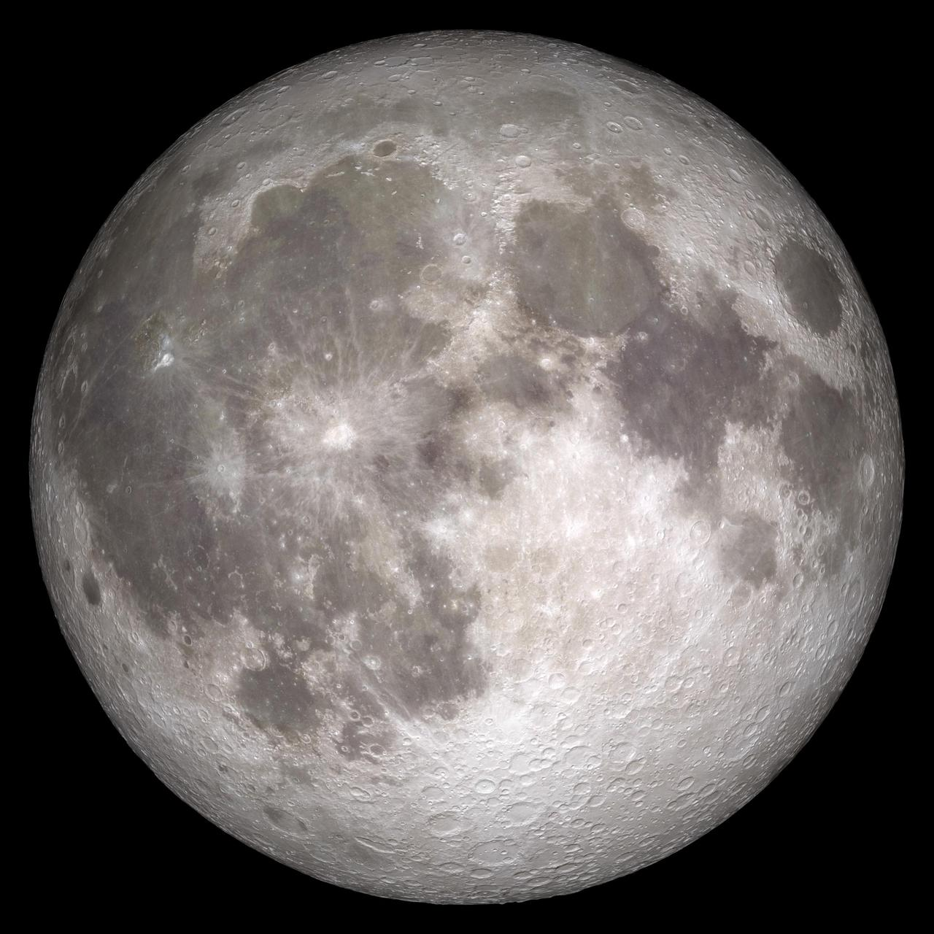
Dust Mitigation
Galactic Cosmic Rays
Cause of lunar dust
  Solar particles and galactic cosmic rays
  Micrometeorites smaller than 1mm with high velocity
  Large thermal cycles on lunar surface from -183°C to 107°C
  Ultra-high vacuum from 10⁻¹² torr (night) to 10⁻¹⁰ torr (day)
Solar Wind
Micrometeorites
Image credit NASA/GSFC
Figure 1. Depiction of the energetic environment on the lunar surface
Reference: Electrostatic Phenomena on Planetary Surfaces, Chapter 6, pp 1, (2017), NASA Lunar Surface Charging: A Global Perspective Using Lunar Prospector Data, (2007).

Slide 10
Dust Mitigation
Tribocharging:
Before
Charging
Separation
+
+
-
-
Figure 2. Tribocharging process in which materials contact one another, rub, and then separate, each coming away with an opposite resulting charge
Reference: Encyclopedia of Inorganic and Bioinorganic Chemistry, “Tribocharging and the Triboelectric Series”, (2021).

Slide 11
Dust Mitigation
Tribocharging is a complicated process that’s not well understood
  Metal-metal charging is well understood via electron transfer based on work function of the materials
Metal #1
Metal #2
Metal #1
Metal #2
Metal #1
Metal #2
e⁻
e⁻
Figure 3. Work function of metal 1 is less than the work function metal 2. Electron transfer occurs from low to high work function until the energy required to add one electron to either body is equal
Reference: Encyclopedia of Inorganic and Bioinorganic Chemistry, “Tribocharging and the Triboelectric Series”, (2021).

Slide 12
Dust Mitigation
Tribocharging is a complicated process
  Insulator charging is less understood
    Electron transfer
    Ion transfer
    Material transfer
    Mechanochemical reaction, applied stress leads to the breaking of bonds and formation of radicals or ions that are then transferred between surfaces
  Contact charging is observed even in identical materials → Likely that more than one property or mechanism drives charge transfer
Reference: Encyclopedia of Inorganic and Bioinorganic Chemistry, “Tribocharging and the Triboelectric Series”, (2021)., J. Phys. D: Appl. Phys., 44(45), pp 15, (2011).

Slide 13
Dust Mitigation
Trying to understand tribocharging has led to the identification of several possible influences
  Acid-base correlation
  Particle size
  Surface roughness
  Humidity
  Temperature
Reference: Encyclopedia of Inorganic and Bioinorganic Chemistry, “Tribocharging and the Triboelectric Series”, (2021)., ADEM, 19(12), “Temperature Effect on Performance of Triboelectric Nanogenerator”, (2017)., J. Phys. D: Appl. Phys., 44(45), pp 15, (2011)., Wear, 168(1-2), pp 91, (1993).

Slide 14
Dust Mitigation
Charging of lunar dust
  Charging trend based on size
    The charging of identical particles is generally based on collision frequency/probability and electron transfer
      Non-ideal insulator: Defect sites and electron transfer through collisions
    Larger particles (>400 μm) tend to charge positively while smaller particles (<200 μm) charge negatively
Reference: Geophysical Research Letters, 36(13), “Particle-size dependent bipolar charging of Martian regolith simulant”, (2009)., J. Phys. D: Appl. Phys., 44(45), pp 15, (2011).

Slide 15
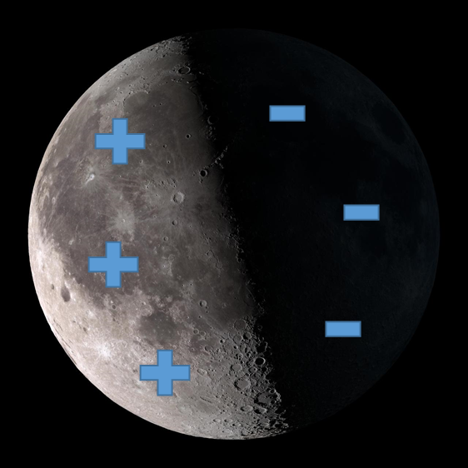
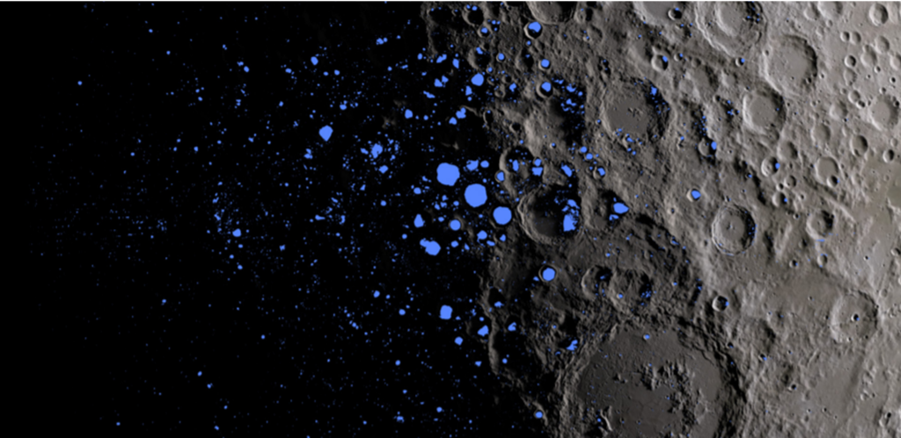
Results: Dust Mitigation
Charging of lunar dust
  Charging based on environment
Image credit NASA/GSFC
Figure 4. Lunar surface charging on the sun-lit versus night side
Image credit NASA/GSFC
Figure 5. Permanently shadowed regions on the lunar surface
Reference: NASA Lunar Surface Charging: A Global Perspective Using Lunar Prospector Data (2007)

Slide 16
Results: Dust Mitigation
Tribocharging of lunar dust
  Charging based on environment
Solar Wind
Photoelectrons
Image credit NASA/GSFC
Figure 6. Sources of charging on the moon
Plasma/Secondary electrons
Reference: Geophysical Research Letters, 35(19), “Concerning the dissipation of electrically charged objects in the shadowed lunar polar regions”, (2008).

Slide 17
Results: Dust Mitigation
Causes of Dust Adhesion
  Van der Waals Forces
    Short range forces that are sensitive to parameters like surface roughness
    These forces persist over time and quicken degradation of mechanical parts and suit weave
  Static-electric-image forces
    Coulombic forces acting on charged particles
    Scale with square of particles charge
    Can scale inversely with particle size
(a)
(b)
Figure 7. Depiction of (a) van der Waals attraction and (b) electrostatic image forces on a conducting surface
Reference: Planetary and Space Science, 59(14), pp 1784, (2011).

Slide 18
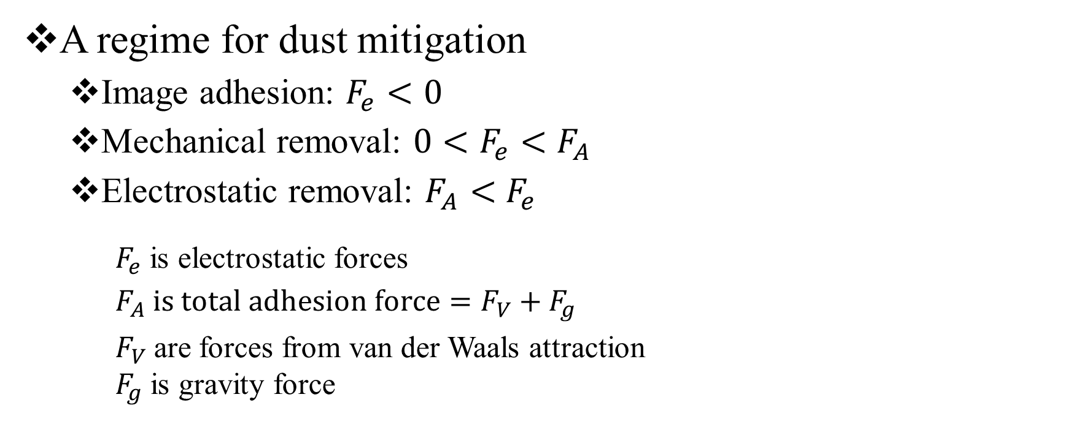
Dust Mitigation
A regime for dust mitigation
  Image adhesion: $F_{e}<0$
  Mechanical removal: $0<F_{e}<$ $F_{A}$
  Electrostatic removal: $F_{A}<$ $F_{e}$
  $F_{e}$ is electrostatic forces
  $F_{A} is total adhesion force=F_{V}+F_{g}$
  $F_{V}$are forces from van der Waals attraction
  $F_{g}$ is gravity force
Reference: Particles on Surfaces, 1, pp 143, (1988).

Slide 19
Dust Mitigation
Identified Mitigation Strategies
Surface modification
  Lithography, ablation, plasma treatment, and chemical coatings
  Reduce surface energy or contacting area
Dissipative suits
  Use of conductive fibers or weaves in suits for enhanced charge dissipation
Mechanical removal with brushes, air, or vibration
  Effective to combat cohesive forces but not a robust system
Electrostatic fields to repel dust from suits and mechanical surfaces
  Electrostatic mechanism that repels dust off surface
  Smaller particles (<10 microns) persist
Reference: J. of Electrostatics, 69(4), pp 365, (2011)., J. of Aerospace Engineering, 24(4), pp 442, (2011)., NASA The Apollo Experience Lessons Learned for Constellation Lunar Dust Management, (2006)., https://lsic.jhuapl.edu/uploadedDocs/focus-files/970-DM Monthly Meeting - 2021 08 August_Presentation - University of Maryland.pdf, The Impact of Lunar Dust on Human Exploration, “Lunar Dust-to-Suit Electrostatic Interactions: Insulating vs. Conductive Space Suits”, (2020)., Planetary and Space Science, 59(14), pp 1784, (2011).

Slide 20
Value Added
Greater understanding of ISRU and construction capabilities → foundation on which to develop new capabilities that require fewer inputs from Earth
Identification of key factors that influence dust adhesion and an understanding of what methods have been employed in the past or are currently being proposed to mitigate dust adhesion
New collaborations between LSIC and NASA to share valuable information relevant for upcoming lunar surface missions
Several new questions surrounding understanding low-resource/energy construction methods through ISRU and understanding better how dust interacts with surfaces on the moon to be able to then prevent dust accumulating on surfaces

Slide 21
Outlook
What would you do if you had 4 more weeks?: Continue research into current and future technologies and ideas
What would you do if you had 4 more months?: Downselect identified topics to create an experimental plan to develop and test ISRU/DM concepts to determine what technologies are viable and could be brought into NASA
There is still much to learn about the lunar surface and lunar surface technology in order to enable successful exploration in the future
  How can we reduce the influence of both vdW forces and electrostatic forces to offer full spectrum dust mitigation?
  How can new low-energy/low-resource construction methods can be developed to allow sustainable lunar construction ?
  How can we predict hoe charging will occur between surfaces?

Slide 22
Acknowledgements
Mentors: Cheol Park & Sang-Hyon Chu
NIFS Group: Calista Lum, Jenna Frey, Scott Phan
AMPB: Catharine Fay, Terryl Wallace, Chris Wohl, Larry Thomsen
Intern Coordinators: Jessica Gangitano, Jalisa Thomas, Patricia Sanchez
Additional acknowledgments: Bill Farrell, University Space Research Association, LSIC members/collaborators

