Slide 1
Composite Overwrap Processing for
Rapid Analysis and Manufacturing Propulsion Technology (RAMPT) Project
Scott Phan
Dr. Cheol Park and Dr. Sang-Hyon Chu
2021 Fall Student Research Symposium

Slide 2
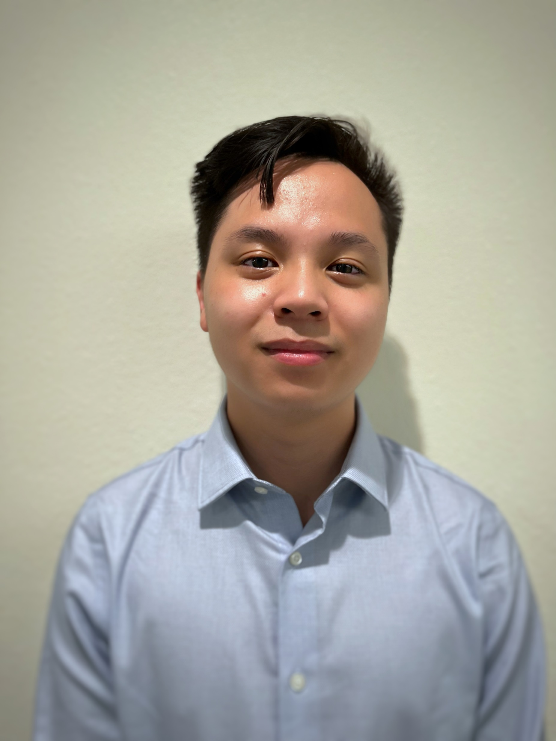
About Me
School | University of California, Santa Barbara
Major | Chemical Engineering
Interesting fact | I am expanding my knowledge of composites by investigating ceramic matrix composites next quarter with my university's Materials department!

Slide 3
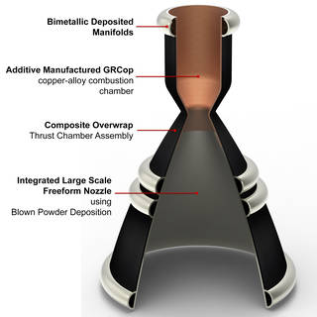
Overview of RAMPT
The combustion chamber (copper alloy) and nozzle (iron-nickel alloy) are additively manufactured
Bimetallic joints fuse the combustion chamber and nozzle
The composite overwrap provides structural support, reduces weight, and reduces production costs
Fig. 1: Technologies of RAMPT
(Image Credit: NASA)

Slide 4
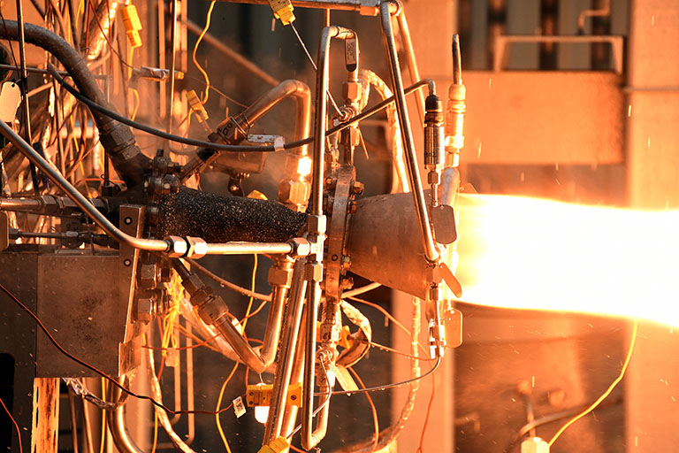
Challenge
The Rapid Analysis and Manufacturing Propulsion Technology (RAMPT) project has been an ongoing effort to advance manufacturing methods of thrust chambers and to improve structural performance
  Multiple resin systems have been evaluated for the project, and the bismaleimide (BMI) resin was chosen due to its excellent thermal and mechanical properties
  The relevant literature on BMI resins and their composite processing is to be compiled for the project
The processing of polymer matrix composites containing BMI resin system has not been fully characterized for the RAMPT project conditions and involves multiple process variables
  Scaling up the RAMPT engines also causes more residual stresses to be incurred during processing.
Multiple mechanical and thermal tests have been performed to characterize both the composite and neat BMI resins
Fig. 2: Hot-fire test of the 7k-lbf thrust class
(Image Credit: NASA)

Slide 5
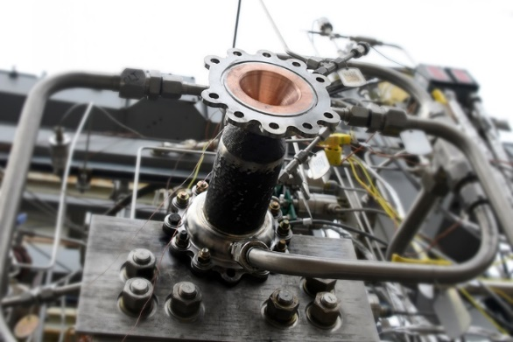
Objective
The objective of the RAMPT project is to advance manufacturing methods that will improve the performance and reduce the costs of thrust chamber assemblies
The objective of the work this fall was to optimize the processing of the composite through surveying the literature and learning more about the current trends in composite and BMI research
Scaling up the RAMPT thrust engines will induce more residual stresses from processing, so it is important to reduce these through improved processing methods and modifications
Fig. 3: Test Stand for the 7k-lbf thrust class
(Image Credit: NASA)

Slide 6
Approach
Literature of BMI resins and composites was surveyed to compile information on processing, cyclic tests, and modifications
Literature provided important details about improving composite processing and properties (resin modifiers, and mechanical/thermal properties)
The glass transition temperature (T_{g}) was studied as a principal material property.
  T_{g} is the temperature where an amorphous material transitions from a brittle “glassy” state into a viscous, rubbery state.
  The load transferring properties of the resin and the fiber/matrix (resin) interface is compromised in its viscous state, so a high T_{g} is desirable
Notes:
Resin matrix transfer load to the fibers, which handle almost all of the loads

Slide 7
Weekly Research Progress
Week | Topic | Description
Week 1 | Introduction | The mentors assigned projects.
Week 2 | Overview of RAMPT | An overview of the RAMPT project and its developments was performed
Week 3 | Composite Overwrapped Pressure Vessels (COPV’s) Overview | A history of COPV’s, comparison with RAMPT, and COPV failure modes was surveyed.
Week 4 | Overview of Composite Materials | Composite material properties and BMI resin properties were summarized.
Week 5 | Polyimide Resins and Overview of Vacuum Assisted Resin Transfer Molding (VARTM) and Resin Transfer Molding | Void content, fiber volume, VARTM and RTM processes, and material properties of resin systems were studied.
Week 6 | Comparison of Two BMI Resins | Defect formation, processing methods, and material properties of two BMI resins and their composites were compared.
Week 7/8 | Lifing Philosophy, Filament Winding, and Netting Analysis | An overview of lifing composite structures, winding methods, cylindrical stresses, and winding angles were studied
Week 9 | Finite Element Analysis (FEA) of COPV’s | An overview of FEA, failure theories, how winding sequences affect maximum burst pressure, and evaluation of experimental vs computational results was conducted.
Week | Topic | Description
Week 10 | Residual Stresses, Stacking Sequence Optimization using Algorithms, and Basics of Dynamic Mechanical Analysis (DMA) | An overview of FEA, failure theories, how winding sequences affect maximum burst pressure, and evaluation of experimental vs computational results was conducted.
Week 11 | Basic Rocket Mechanics and Current Status of RAMPT | Studied hot fire tests using flash thermography, and 40K-lbf winding challenges
Week 12 | Modifying BMI Resins | An analysis of BMI synthesis, addition of bulky groups (e.g. hydrogen silsesquioxane), and their influence on mechanical and thermal properties was conducted
Week 13 | Further Investigation of Modified BMI’s and Cyanate Esters (CE) | Theory of segmental motion, addition of benzoxazine (BOZ), and comparison with cyanate ester enhanced with epoxy resins
Week 14 | Cryogenic Cycling of BMI Composites | Cryogenic cycling apparatus and method, formation of microcracks during cycling, and analysis of winding sequences vs microcrack density
Week 15 | Modified BMI Resins with ultra-high glass transition temperatures | BMI resins modified with allyl ethers a demonstrate a remarkable increase in Tg
Week 16 | Modified BMI Resins and affects of cryogenic environments on composites. Exit Presentation. | Further investigation of how cryogenic environment influence the properties and damage growth of BMI composites

Slide 8
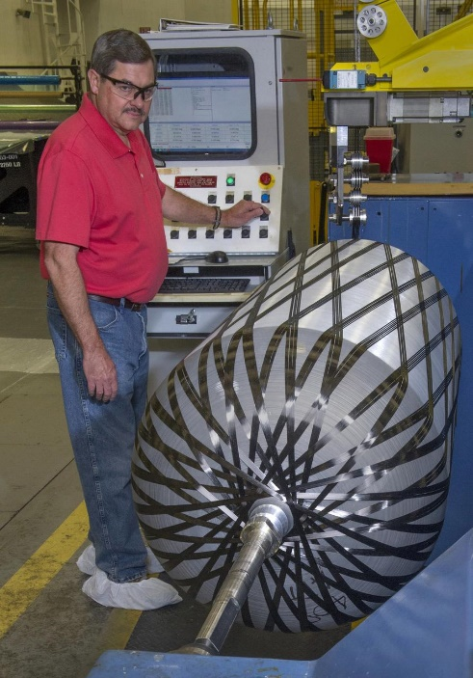
Stress-Rupture and Comparison with COPV’s
Stress-rupture is a major failure mode and is a function of the maximum burst pressure
  This is mitigated through stress-rupture data; testing is expensive, so sufficient computational and analytical methods are attractive
RAMPT chamber is similar to a Type III composite overwrapped pressure vessel (COPV)
  There are well-defined failure analysis methods for monolithic metals but not for bimetallic configurations
 | Type I | Type II | Type III | Type IV
Description | All-metal construction | Mostly metal with a glass fiber overwrap in the hoop direction | Metal liner with a full composite overwrap | All-composite construction or an extremely thin metal liner
Fig. 4: Winding process
(Image Credit: NASA)
Table 1: Description of COPV Types
Notes:
Explain what a Type III COPV is

Slide 9
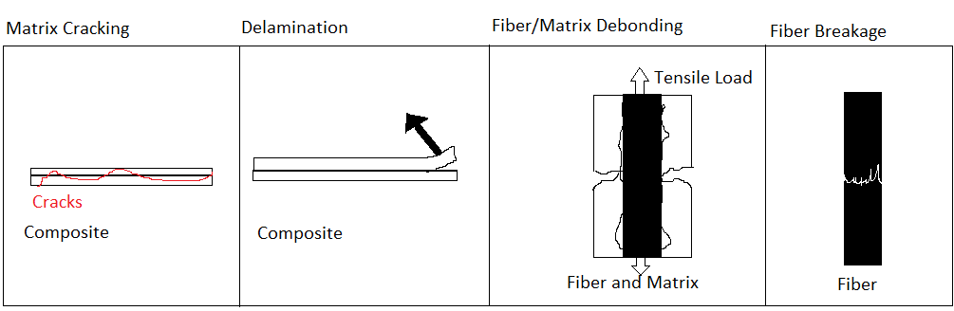
Tensile Loading and Damage Modes in COPV
Predominant damage modes (tensile loading)
  Residual stresses can be reduced during processing
    Parameters:
      Cooling rate
      Fiber/matrix bond weakness
      Coefficient of thermal expansion (CTE) mismatch
      Fiber volume fraction
      Composite length
      Stacking sequence
Fig. 5: Damage modes dominant in tensile loading
Notes:
Explain what the residual stress parameters are (cooling rate, CTE mismatch, etc.)

Slide 10
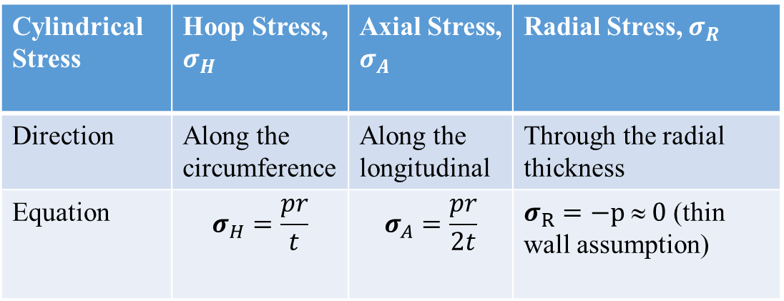
Cylindrical Stresses of COPV
Table 2: Cylindrical stresses
Hoop stresses are twice that of axial stresses
  Finite Element Analysis (FEA) generally agrees with experimental data, but there is not yet a universal damage model for composites
Stress parameters
  p = internal pressure
  r = radius of cylinder
  t = thickness of cylinder wall (assumed to be much less than the radius of the cylinder)
Thin wall assumption: the ratio between r and t is very large, so the contribution made by the radial stress is assumed to be negligible
Cylindrical Stress | Hoop Stress, $σ_{H}$ | Axial Stress, $σ_{A}$ | Radial Stress, $σ_{R}$
Direction | Along the circumference | Along the longitudinal | Through the radial thickness
Equation | $$σ_{H}=\frac{pr}{t}$$ | $$σ_{A}=\frac{pr}{2t}$$ | $σ_{R}=−p  0$ (thin wall assumption)
Table 3: Winding Types
Winding Type | Hoop | Helical
Fiber Placement | Around the circumference of the cylinder | Along the longitudinal axis at an angle

Slide 11
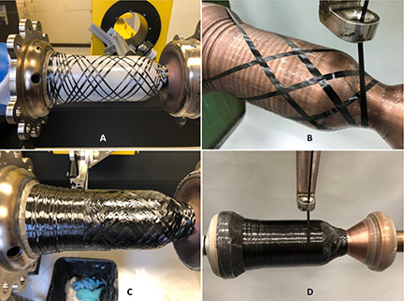
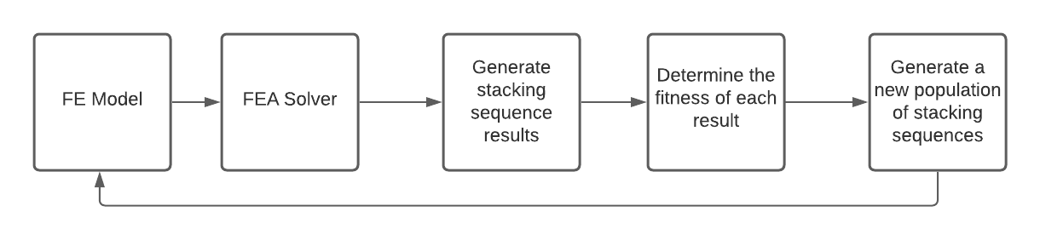
Filament Winding Sequence Optimization
A 90° winding angle difference between layers helps to contain residual stresses
Hoop stresses are twice that of axial stresses
  FEA generally agrees with experimental data, but there is not yet a universal damage model for composites
Genetic algorithm
Fig. 9: Genetic Algorithm Approach
Source: M. Safarabadi, M. M. Shokrieh. Residual Stresses in Composite Materials (Second Edition), Ch. 7 - Understanding residual stresses in polymer matrix composites, https://doi.org/10.1016/B978-0-12-818817-0.00011-1, pp 221-222
Fig. 10: Winding of RAMPT chamber
(Image Credit: NASA)

Slide 12
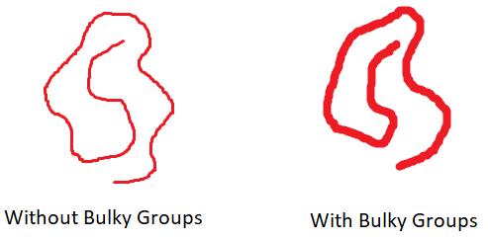
Glass Transition Temperature
Factors that increase T_{g} of a resin: greater crosslinked density, addition of bulky or polar groups, and higher molecular weight
  These factors restrict the movement of polymer network by reducing free volume
Fig. 11: Two competing factors: Addition of bulky groups to the polymer network reduces the empty space (“free volume”) of the network and restricts movement (i.e., flow of polymer), but may also prevent polymer packing density from increasing, causing the opposite results
Source: https://coatings.specialchem.com/coatings-properties/glass-transition-temperature#:~:text=Thermosets%20and%20Thermoplastics%20%20%20Molecular%20Weight%20,Presence%20of%20polar%20groups%20increases%20inter%20...%20

Slide 13
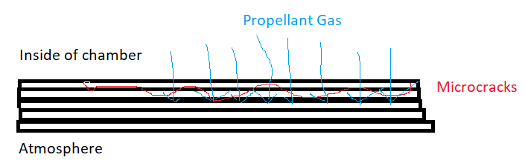
Cryogenic Cycling
The formation of microcracks under cryogenic conditions starts to occur throughout the plies after many cycles, although at least two plies in the inner surface remain crack-free
Fig. 12: Layers without microcracks provide a sufficient barrier against leaks
Source: Bechel, V. T., & Kim, R. Y. (2004). Damage trends in cryogenically cycled carbon/polymer composites. Composites Science and Technology, 64(12), 1773–1784. https://doi.org/10.1016/j.compscitech.2003.12.007. pp. 1777

Slide 14
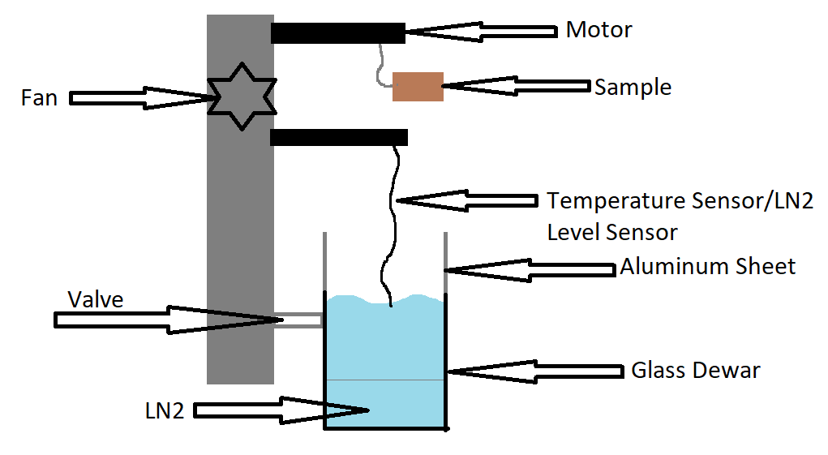
Cryogenic Cycling Apparatus
Proposed automated cryogenic cycling apparatus
  The sample lowered through a motor controlled by a computer
  Liquid nitrogen (LN2) levels are maintained with sensors
Source: Bechel, V. T., Fredin, M. B., Donaldson, S. L., Kim, R. Y., & Camping, J. D. (2003). Effect of stacking sequence on micro-cracking in a cryogenically cycled carbon/bismaleimide composite. Composites Part A: Applied Science and Manufacturing, 34(7), 663–672. https://doi.org/10.1016/s1359-835x(03)00054-x. pp. 664-665
Fig. 13: Cryogenic cycling apparatus

Slide 15
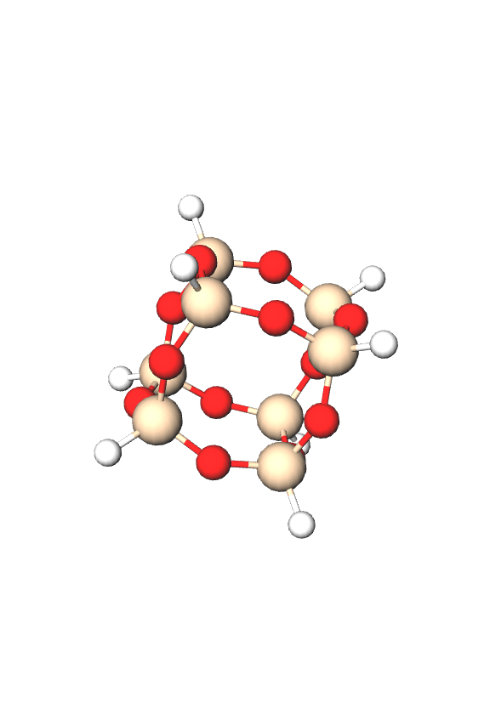
Analysis/Summary
Combined bimetallic and composite properties as inputs for computational methods
  Damage models are generally more accurate for monolithic metallic vessels (due to the addition of a CTE mismatch between two metals in a bimetallic joint); data on both bimetallic and composite vessels is much less common
Incorporation of bulky molecules
  The current resin system can be kept, which reduce costs and time
  This is an easy way to improve thermal properties if compatible with the BMI resin
  There is a need to test material properties and defects formation (microcracking, delamination, etc.) under both cryogenic and high temperature conditions as most of the literature only tests under one condition
Cryogenic cyclic tests & apparatus
  If at least one ply is damage-free, the composite can still provide structural support and prevent leaks
  The cryogenic cycling apparatus is an important tool for determining the impact of cycle tests on the durability of pressure vessels and rupture failure
Stacking sequence
  There are multiple approaches to optimizing winding angles. One method is implementing a genetic algorithm
  FEA provides a good but flawed approximation since some models use assumptions such as neglecting load bearing contributions from the matrix and liner. There is a need to take in account all constituents to obtain a full approximation
  Hoop windings provide strength against the high load contribution from hoop stresses
Fig. 14: Hydrogen Silsesquioxane (HSQ)
Source: https://molview.org/
Notes:
One layer without cracks = reusable space structures

Slide 16
Next Steps/Outlook/Future Work
Conduct a deeper investigation of BMI modifiers and cryogenic testing
Perform mechanical and thermal tests on modified BMI resins and composites. Observe material behavior and performance
  Literature does not observe modified BMI resins under cryogenic conditions
Research on BMI resins is extensive and still ongoing
  Mechanical and thermal properties under various conditions and cycles.
  Performance when incorporated into a composite; very complicated due to the need for new analytical and characterization methods
Validate current computational methods through hot-fire and burst tests.
  Literature on both bimetallic and composite performance is sparse
  Further thermal analysis of the throat area of the chamber is of extreme importance due to the bimetallic joint (CTE mismatch). Hot-fire tests confirm that it is a problem area

Slide 17
Acknowledgements
Intern Coordinators
  Jessica Gangitano
  Jalisa Thomas
  Patricia Sanchez
RAMPT Composite Overwrap Team
NIFS Intern Group
  Joshua Crawford
  Jenna Frey
  Calista Lum
Universities Space Research Association
Mentors
  Dr. Cheol Park
  Dr. Sang-Hyon Chu

