Slide 1
Building Strong Communities Around Open-Source Software and Open Science
Winter ESIP 2022
Jeff Siarto
EED-3 Design Lead
jeff@element84.com
This work was supported by NASA/GSFC under Raytheon Technologies contract number 80GSFC21CA001.
This document does not contain technology or Technical Data controlled under either the U.S. International Traffic in Arms Regulations or the U.S. Export Administration Regulations.

Slide 2
Update: Community Development Best Practices Guide

Slide 3
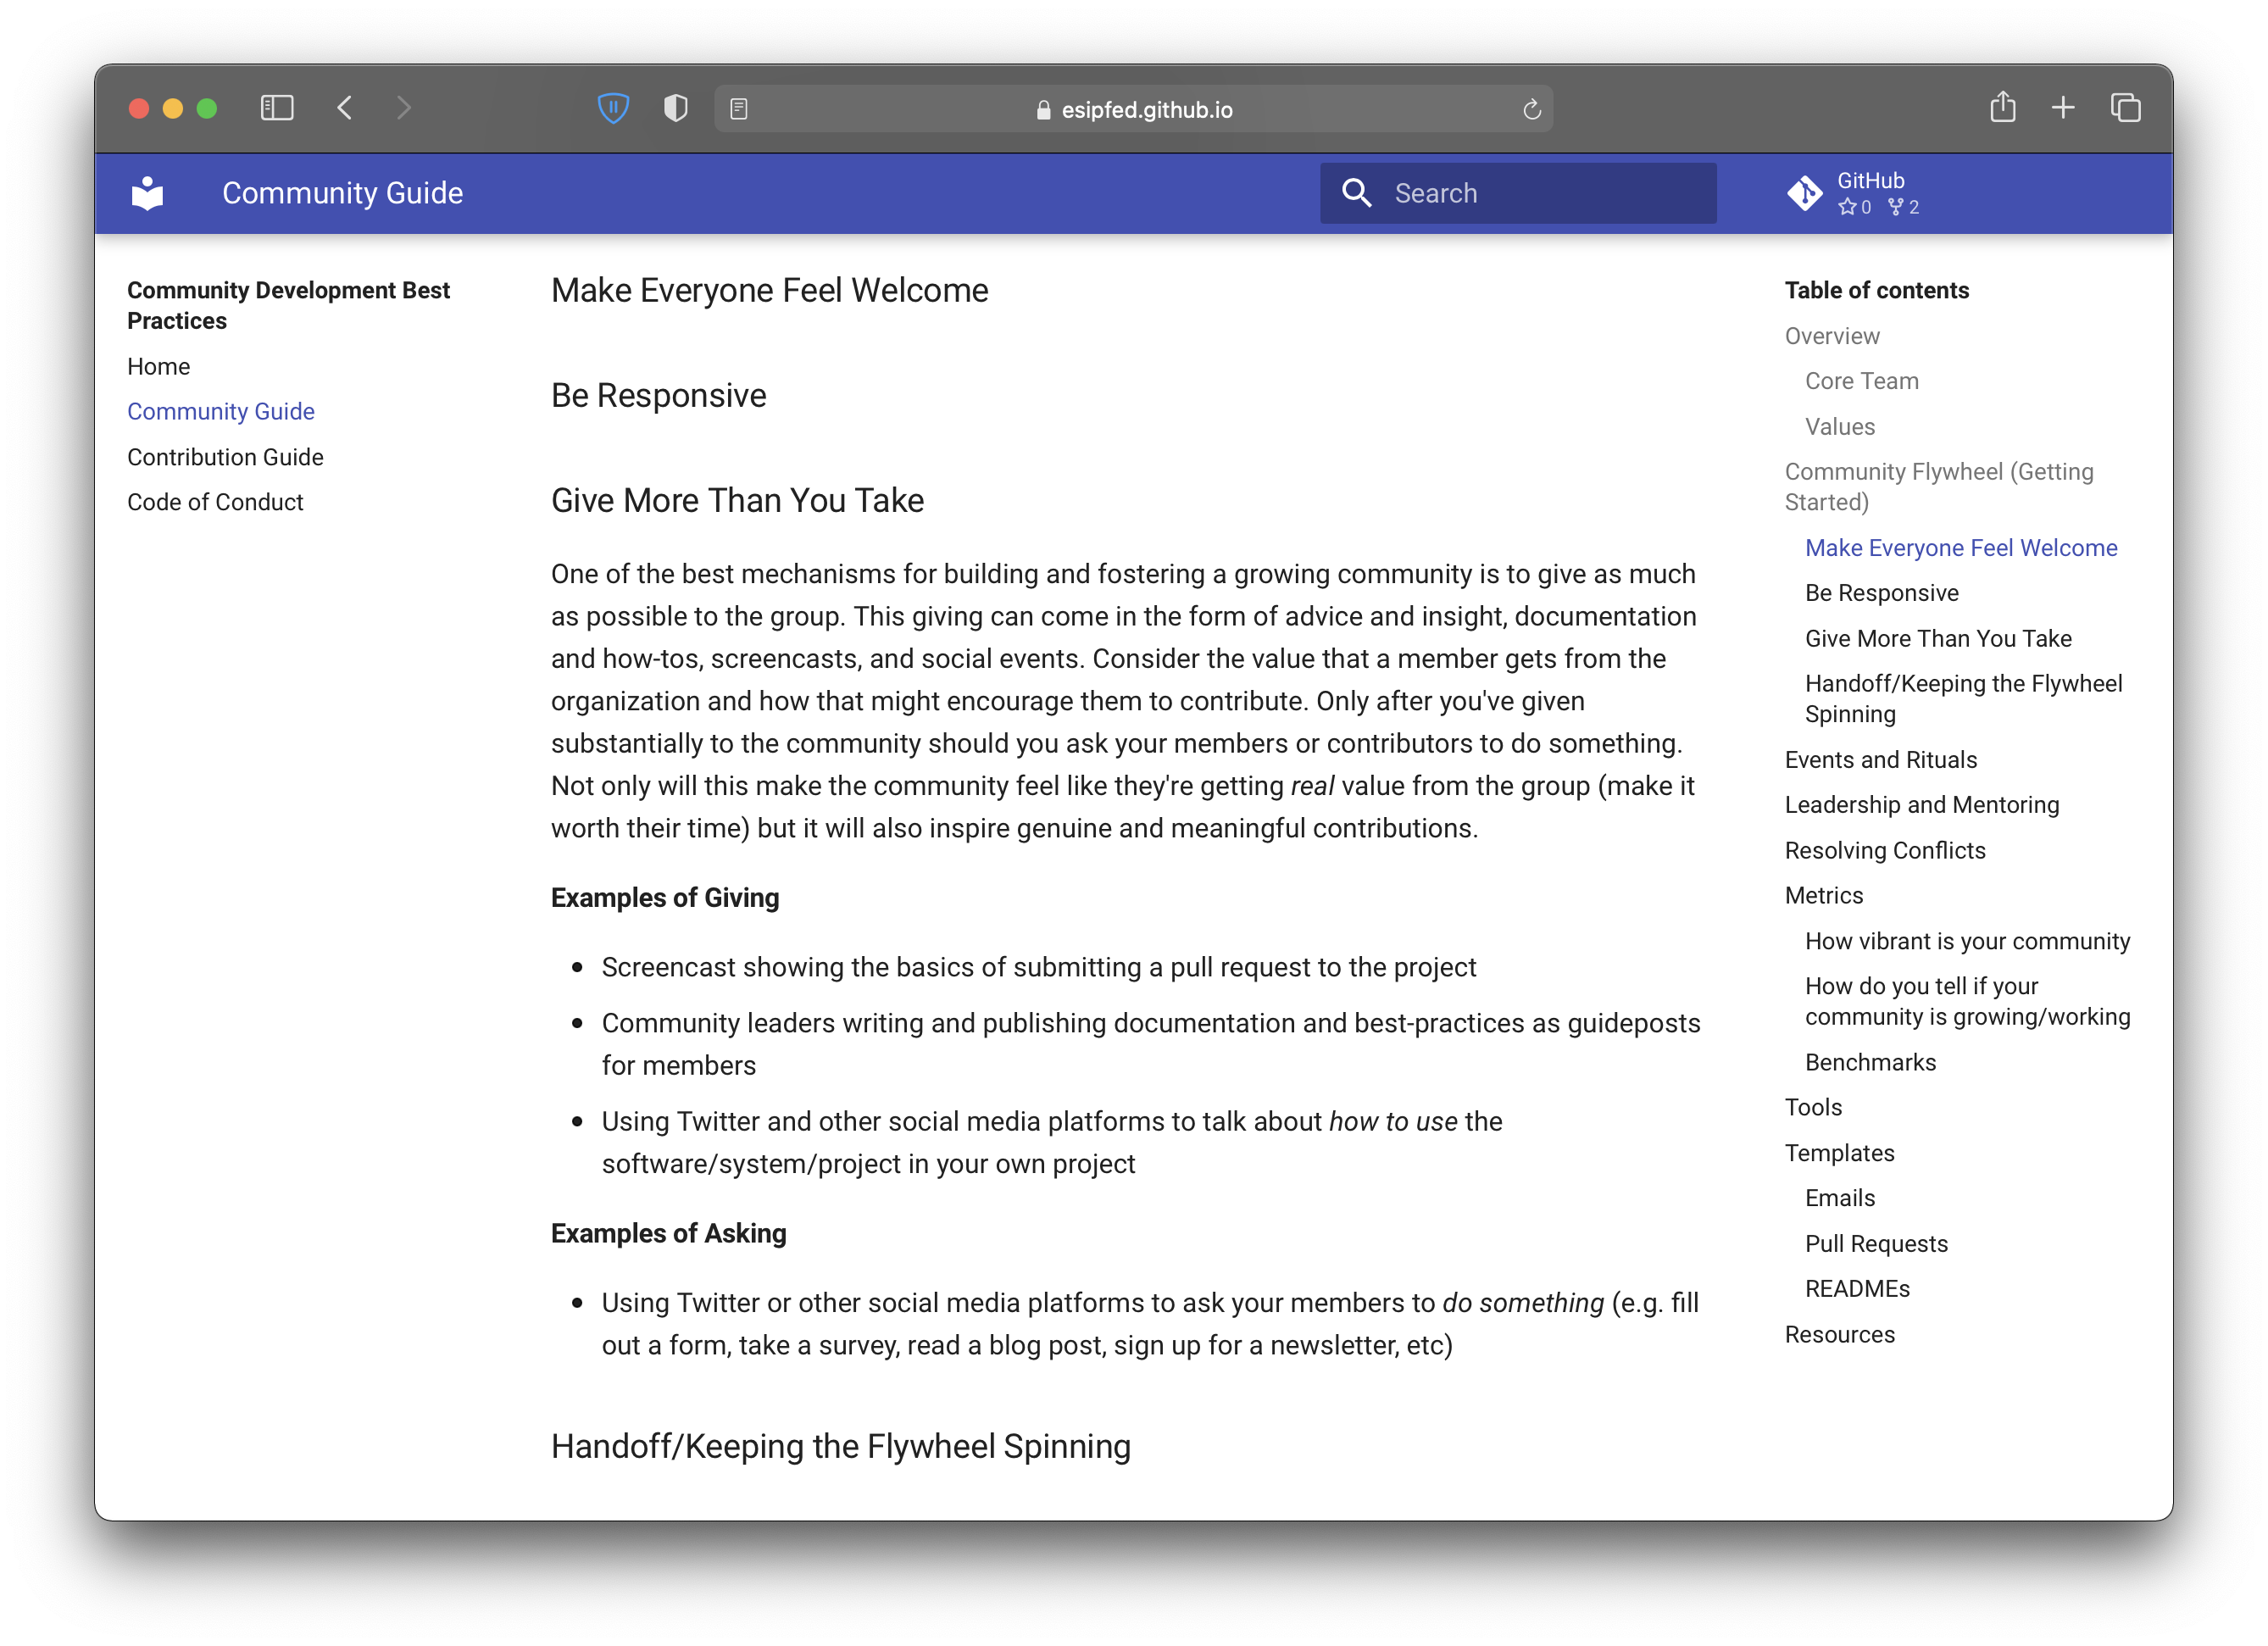
https://esipfed.github.io/esds-community-guide/community-guide/

Slide 4
Breakout Rooms

Slide 5
Frustration Brainstorm
What are your major pain points when interfacing with Open-source Software as a user?
What are your major pain points when interfacing with Open Science projects as a user?
What are the major pain points of interfacing with these projects as a developer or scientist?

Slide 6
Where is Your Community?
Discussion about the “where” the community lives
  What are the differences between the open-source software and open science cohorts?

Slide 7
Metrics Brainstorm
How do we measure a successful community in the open source and open science world?

Slide 8
Community Book Club
Share and discuss books and resources for community building

Slide 9
Conflict Resolution
Share tips and tricks for conflict resolution

Slide 10
This work was supported by NASA/GSFC under Raytheon Technologies contract number 80GSFC21CA001.

