Slide 1
Implementation of a SysML Model-Based Concept of Operations for Level of Care IV: Long-Duration Lunar Orbital and Surface Operations
Human Research Program
Exploration Medical Capability Element
HRP IWS
January 2022
Mary Susan Kaetzer, Sarah Lumpkins, David Rubin, Jeffrey Cohen, Geoffrey Powers, Jared Heiser, Kerry McGuire
“Expanding the Boundaries of Space Medicine and Technology”

Slide 2

Agenda
Concept of Operations Overview
Purpose and scope
Mission description and assumptions
Environments
Scenarios
Model-Based Concept of Operations Construction Lessons Learned
Standardize Model Layout
Some Things are Best Started Outside of the Model
Implementation of Scenario Patterns
Model-Based Concept of Operations Reporting Lessons Learned
Iterative Reviews of the User Interface
Organization of Content and Display

Slide 3
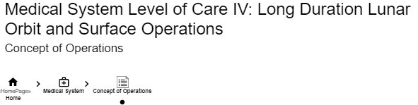
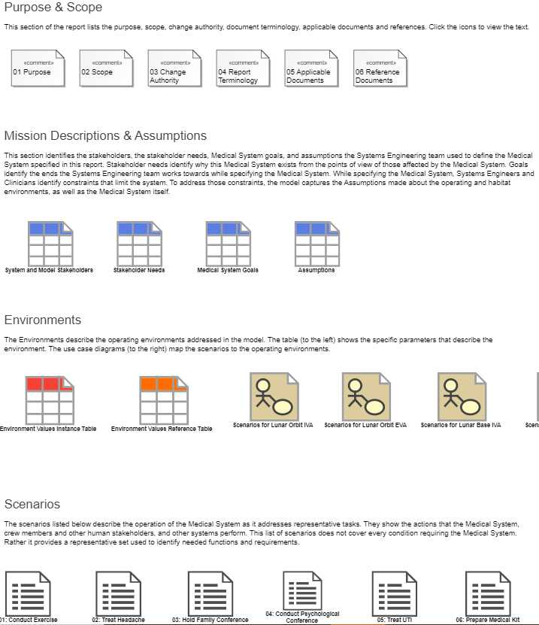
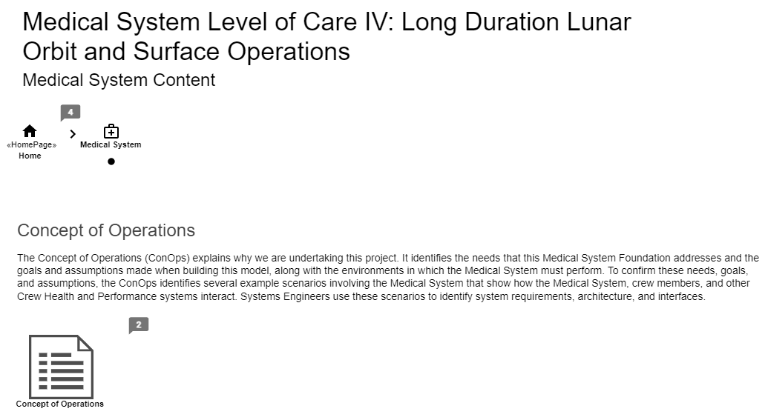

Concept of Operations Overview
Notes:
Introductory slide that will show an overview of the Concept of Operations in the model.
I will explain that the concept of operations is part of the Medical System Level of Care IV: Long Duration Lunar Orbital and Surface Operations Foundation Model that will also include the Functions, Requirements, System Architecture, and Capabilities, similar to the Medical System Level of Care IV: Short Duration Foundation Model – however, that model had a link to a document-version of the Concept of Operations, and for this project, ExMC replaced the traditional document-based approach and built the concept of operations directly into the model.
Building the concept of operations directly into the model had several advantages including the ability to hyperlink references, the consolidation of all information into one centralized location and format, and a more efficient ability to represent content through information-dense images providing less opportunity for misinterpretation rather than text alone.
This methodology also had challenges and we used those challenges to create lessons learned from the project to improve our process for creating concept of operations in a model-based way – I’ll touch on these later on in the presentation.
I’ll also explain how we implemented the content of each of the four sections of the concept of operations into the model in detail in the next few slides.
Notes throughout:
Content matches the order of the content in previous ConOps
Cookie Crumbs is shown here and in each of the different sections

Slide 4
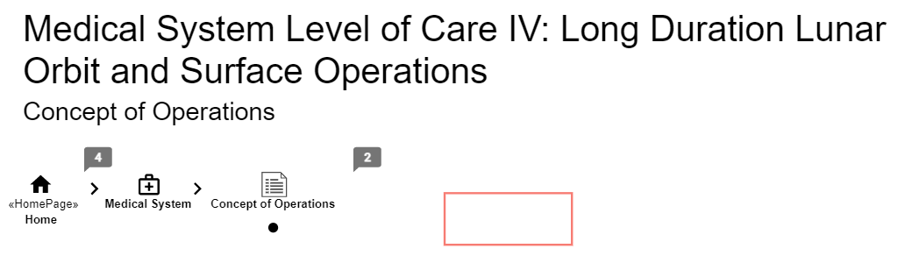
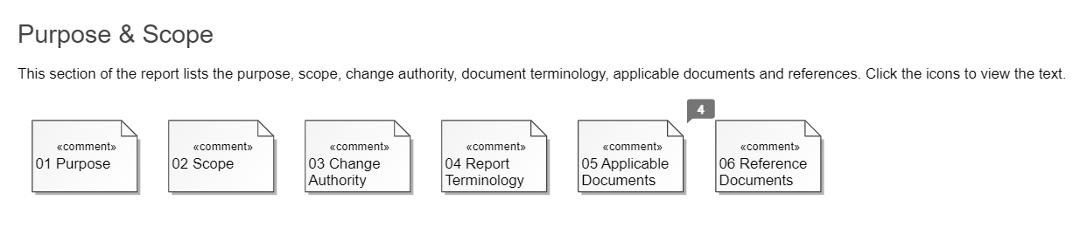
Overview: Purpose and Scope Display

Slide 5
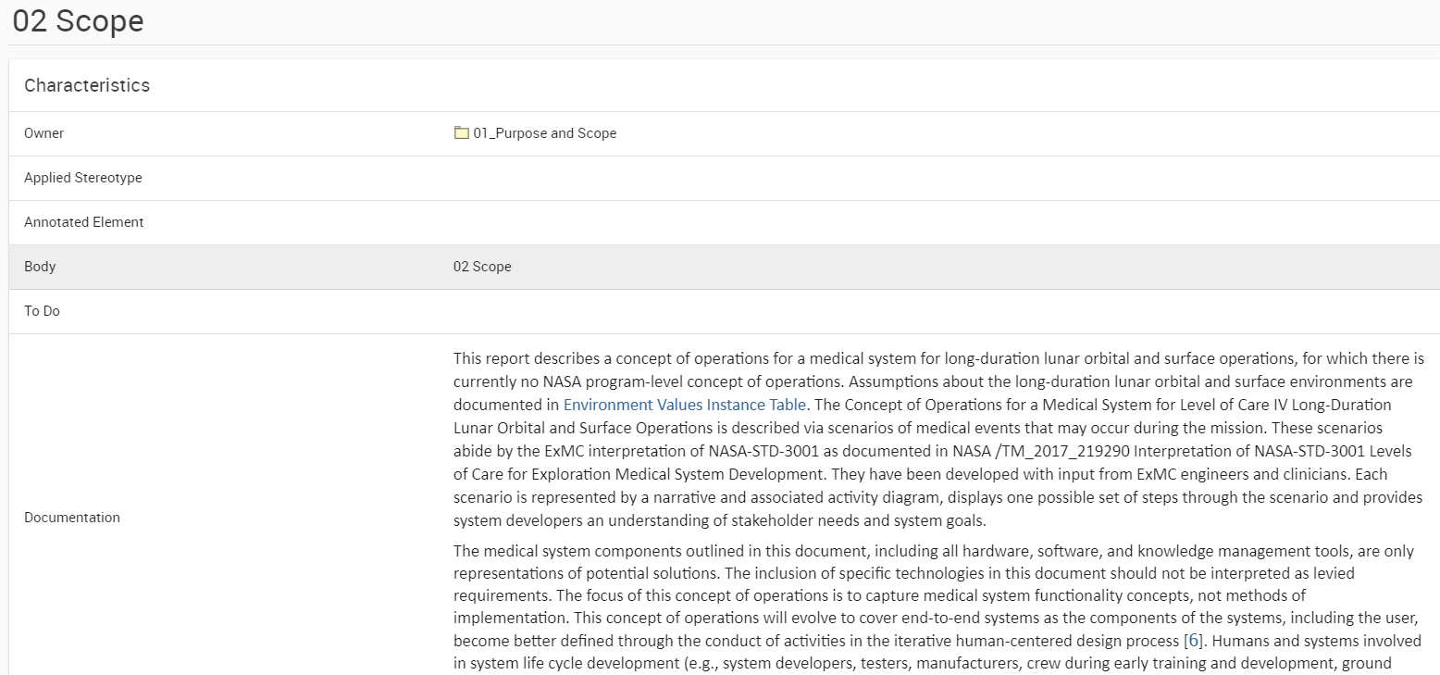
Overview: Purpose and Scope Display
Notes:
Make sure to remind the audience that we are program agnostic and currently tied to level of care.
Also, when discussing the scope of the long-duration make sure to bring up that this is a continuation of the short-duration and will point out some specific differences from that project (surface operations, new information in regards to orbital, EVA environments)

Slide 6
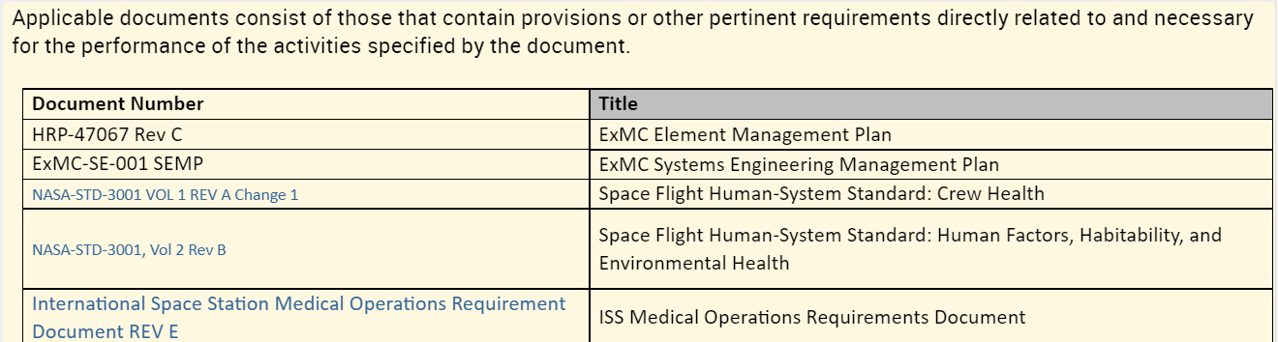
Overview: Purpose and Scope Display
Notes:
The last 3 slides are to show how the content is displayed in the model, with clickable icons to each of the different subsections of “Purpose and Scope”. I selected this one to show that we can hyperlink the links to the applicable documents

Slide 7
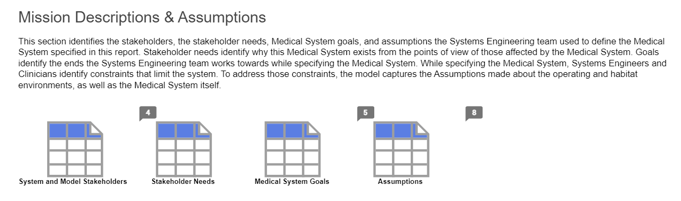
Overview: Mission Descriptions and Assumptions Display
Notes:
Highlight difference of these needs / goals versus the short duration model -- since this model is a continuation of the short duration it helps the viewer understand the overlap and new information based on the scope of the long-duration.

Slide 8
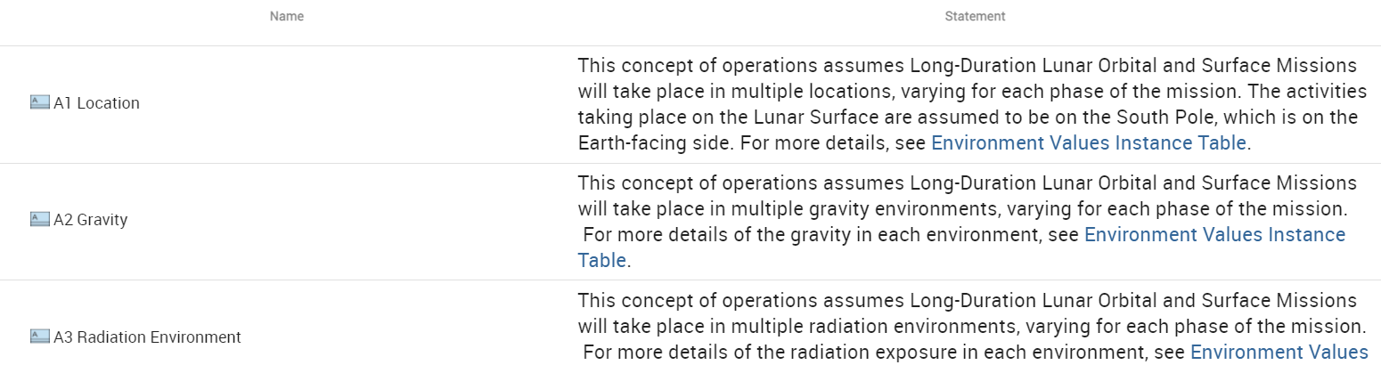
Overview: Mission Descriptions and Assumptions Display

Slide 9
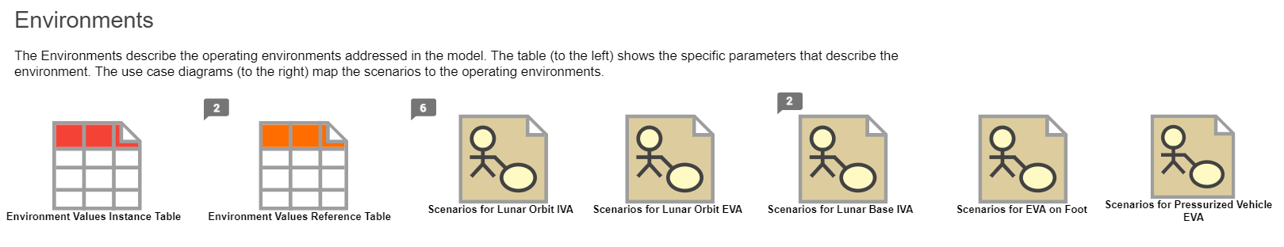
Overview: Environments Display
Notes:
Highlights for the next couple slides:
Differences between this model and short duration -- longer overall duration, more mission environments,
reviewed the instances table with Artemis SME’s with an agile mindset so that even though we are program agnostic, we do follow the agency’s direction

Slide 10
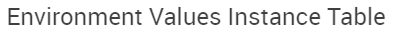
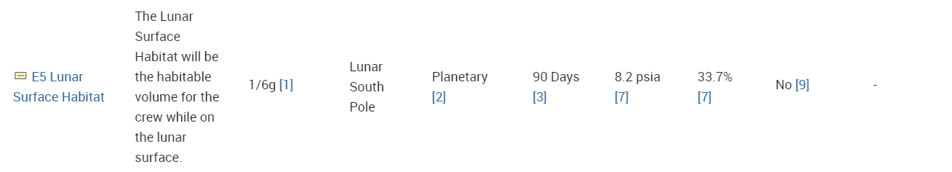
Overview: Environments Display
Notes:
Another place where hyperlinks are used -- this time within the model. All of the information in the environment values instances table has a hyperlinked number to the environment values reference table

Slide 11
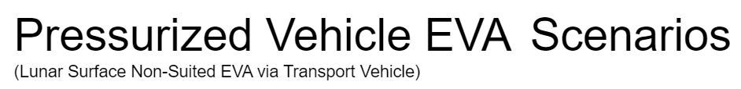
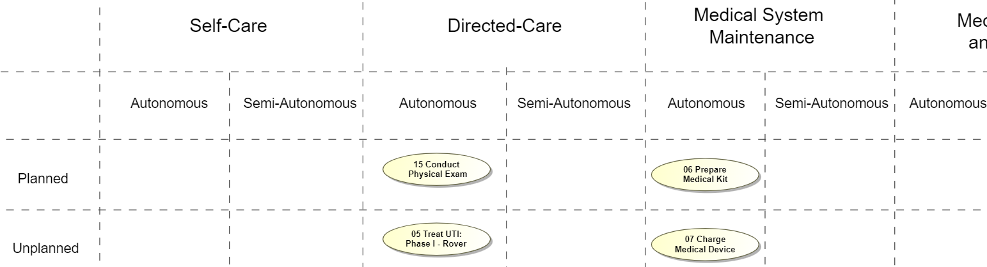
Overview: Environments Display

Slide 12
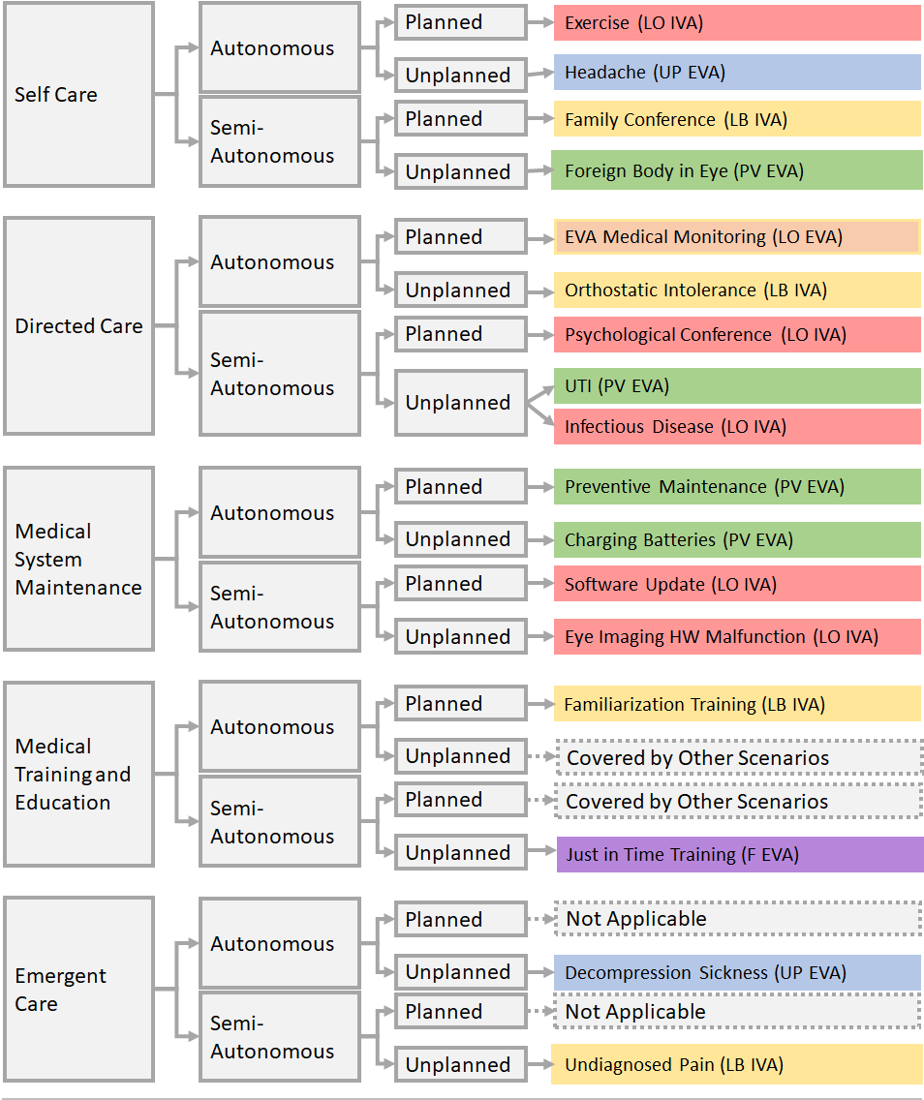
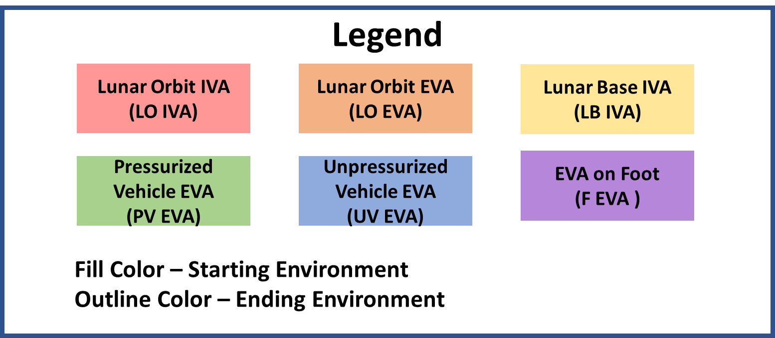
Overview: Scenarios
16 scenarios total
Each scenario includes:
Narrative
Assumptions
Activity Diagram
Notes:
Discuss the process used to determine which scenarios would be created and how the topics of the scenarios were chosen

Slide 13
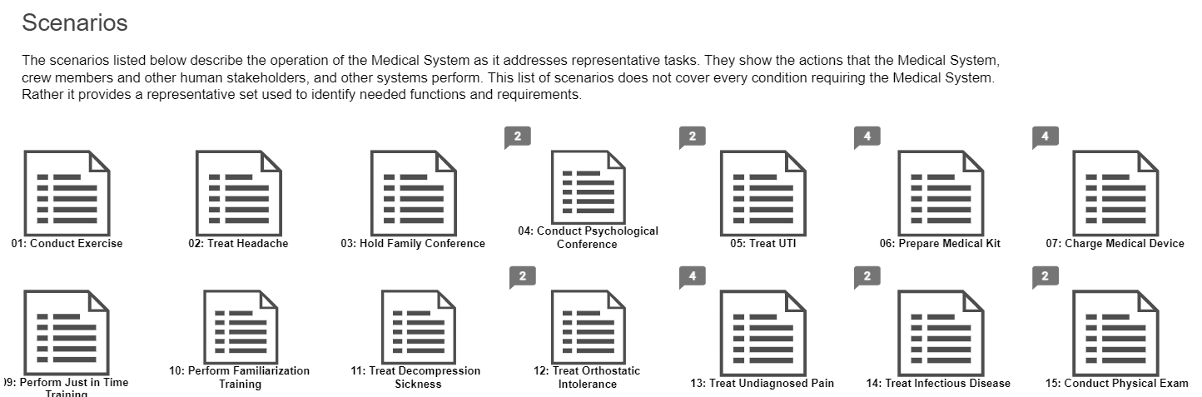
Overview: Scenarios

Slide 14
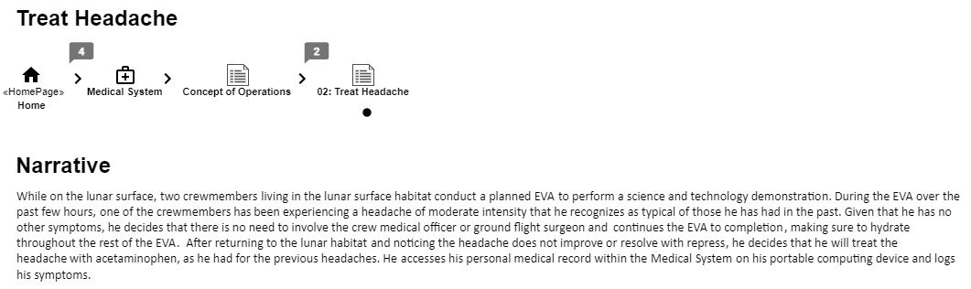
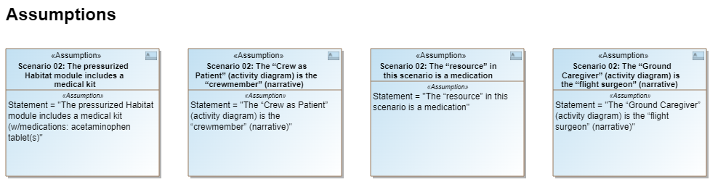
Overview: Scenarios

Slide 15

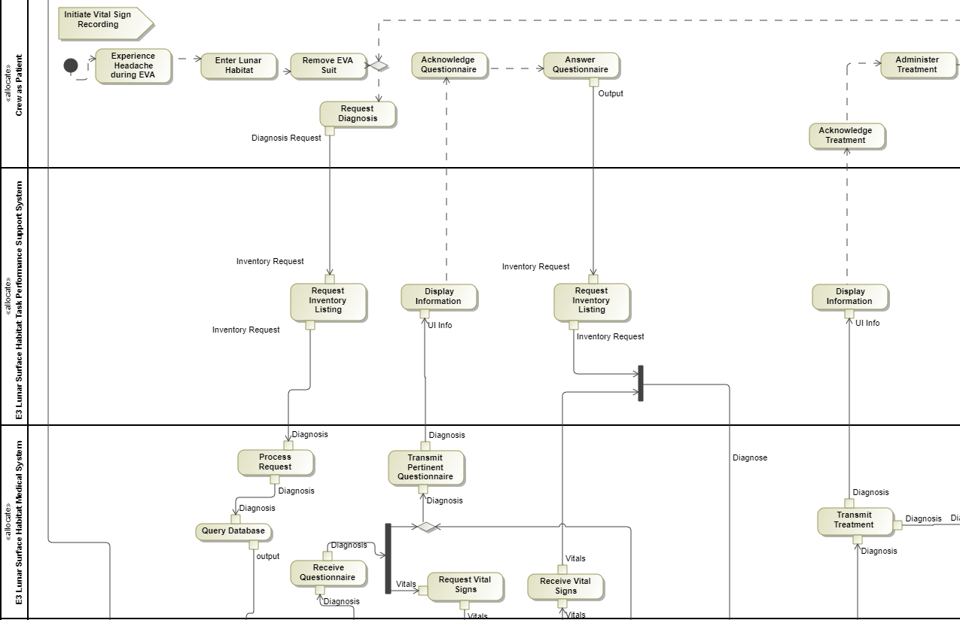
Overview: Scenarios

Slide 16
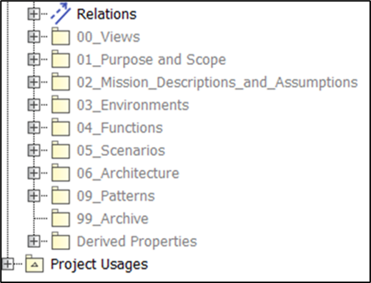
Lessons Learned: Standardize Model Layout
All ExMC products adopt a similar model organization
First step in any project is to create the preliminary infrastructure
Facilitates cross-project work and large teams
Benefit for both team members and stakeholders
Notes:
I'd also add in that this layout is not specific to ExMC and could be used by other projects outside of ExMC as a starting point.
Standardizing the model layout allows for SE teammembers to work on different model-based ConOps projects and quickly be familiar with the structure. For example, I work on the Medical Database project and the Long Duration project, and when we set up the Medical Database project, we intentionally followed a similar layout. So working on one benefited the other because I was familiar with the structure and features of the ConOps model. Similarly, when we had reviewers that had to review both models, they saw different content presented in similar ways. So the layout was not completely new to them which helps transition away from the traditional document review process. I was planning to say stuff like this in the actual presentation and will add in additional notes as a reminder

Slide 17
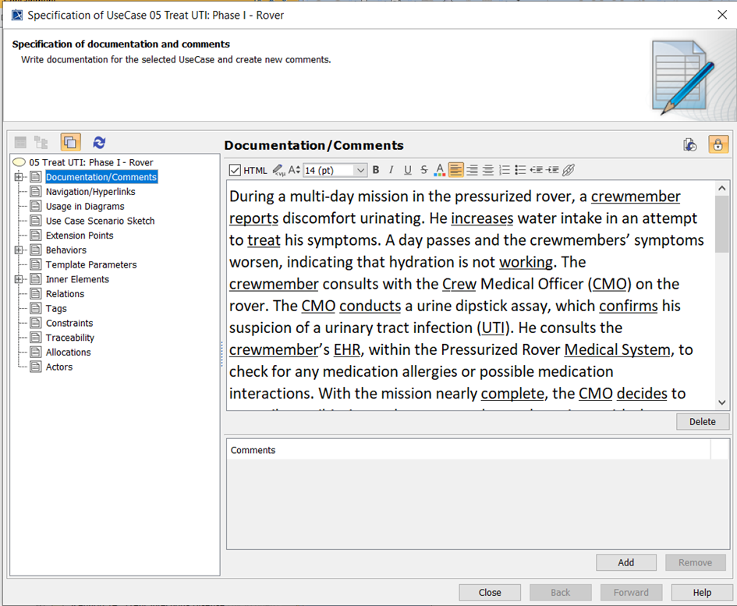
Lessons Learned: Start Somethings Outside of Model
ConOps prefatory content and scenario narratives have a significant amount of text
Subject Matter Experts are not trained MBSE users
Starting content outside of the model allows for early and frequent reviews without extra training
Notes:
Something we have started to be able to do (not yet for the ConOps) is create macros to pull in content from documents (such like excel and word) into the model. This is something that our team will explore on how to expedite importing of information.

Slide 18
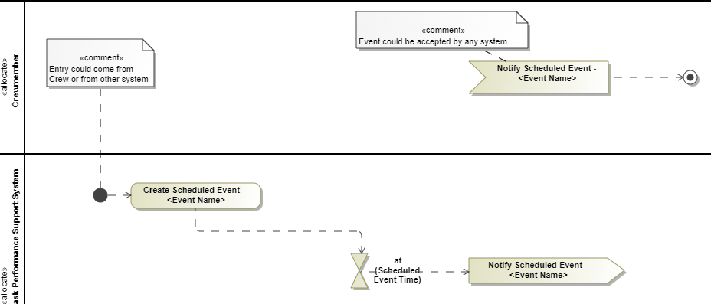
Lessons Learned: Implementation of Scenario Patterns
Originally each SE team member drafted activity diagrams independently
Common functionality was implemented differently
Design Patterns allowed for harmonization of the activity diagrams
Scenario Activity Diagrams were easier to understand
Team identified missing functionality of the system
Future projects will implement patterns before drafting activity diagrams
Example: Scheduling

Slide 19
Lessons Learned: Organization of Content and Display
Originally did not impose a standard model report format
Follow the structure of a document-based Concept of Operations
Commonality between projects and emulating the traditional document-format facilitates stakeholders’ review

Slide 20
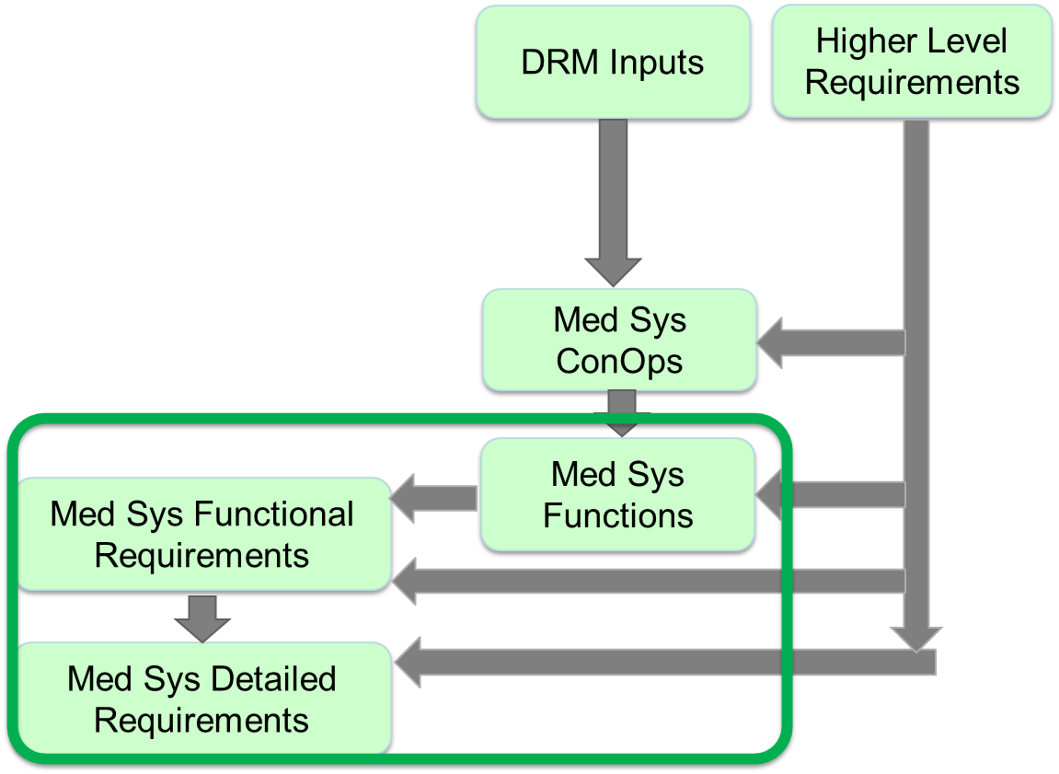
Summary and Next Steps
Medical System Foundation
System Engineering Activities
Concept of Operations was approved by ExMC Control Board
Completed Functional Decomposition
Continue Development on Requirements
Generate HTML Report for Medical System Foundation
Collaborate with other NASA projects that are utilizing MBSE for Concept of Operations

Slide 21
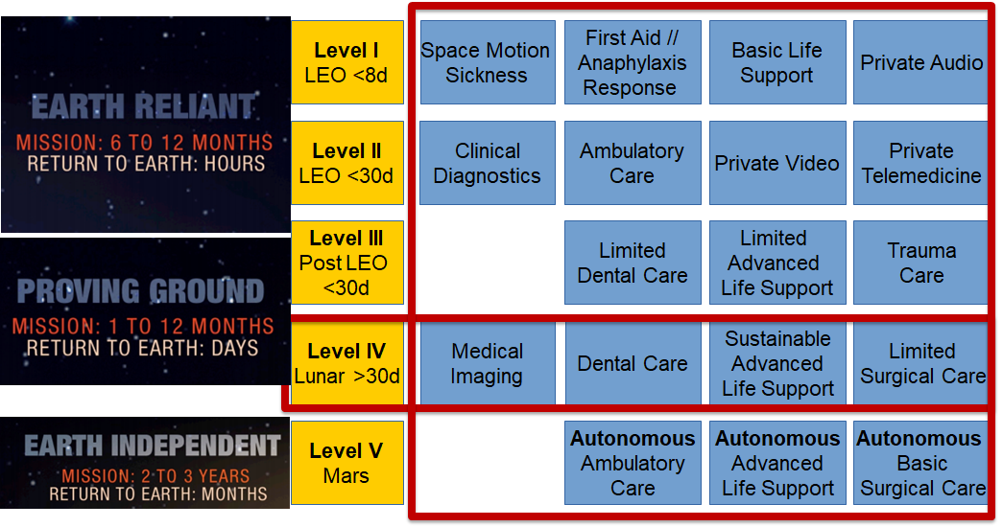
REFERENCE -- Level of Care IV Explanation
Notes:
Most complex ExMC SE ConOps to date
Must maintain the Level of Care IV in all of these said environments

