Slide 1
Study of Spacecraft Deployables
Failures
Alejandro Rivera
Deployables Analysis Engineer
NASA Goddard Space Flight Center
Space Systems Anomalies and Failures (SCAF) Workshop 2022
January 11th, 2022

Slide 2
MOTIVATION
Deployables failures still taking place at an average of 1 every two years
Loss of mission goals and spacecraft performance
Desire to understand what have historically been the most common modes of failure of deployables
Role of the Space Environment on Deployment Anomalies & Failures
How can we prevent these anomalies/failures from happening
Share our findings with SCAF Community

Slide 3
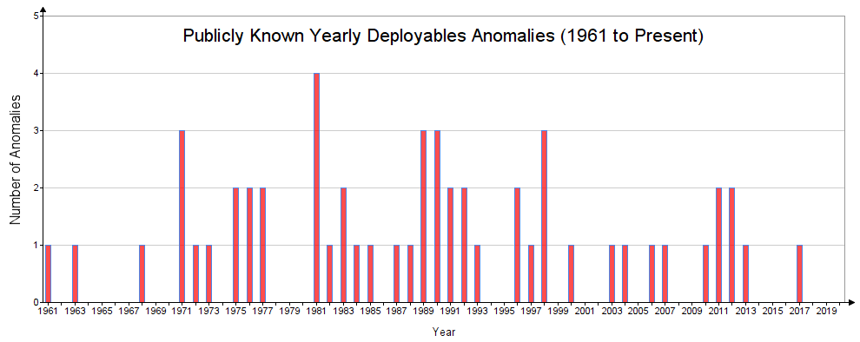
YEARLY ANOMALIES DISTRIBUTION

Slide 4
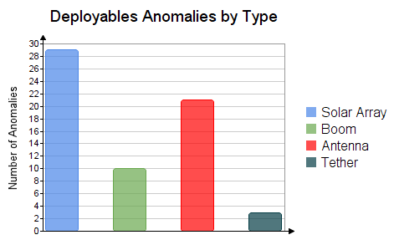
ANOMALIES BY TYPE
Solar Array anomalies most common (54%)
Antennas (37%)
Booms (18%)
Note: Some SC had issues on more than
one type of deployable.
* Based on published information. Actuals may differ.

Slide 5
SPACE ENVIRONMENT & DEPLOYMENT ANOMALIES, 1of 2
Two key Space Environments can affect Deployments
Vacuum:
  Poor venting of sealed structures:
    Honeycomb panels → explosive decompression
    Blankets → inflation
  Cold Welding
    Clean surfaces of similar metal in contact and under vacuum → strong adhesion
  Water desorption:
    Polymers used in composites → contraction
Notes:
Consider offering an authors perspective as to why solar and antenna have higher failure percentage rates.
Example, these systems are generally needed first in mission. Also, their failure may prevent knowing if other systems will fail to deploy due to lack of power and/or communication

Slide 6
SPACE ENVIRONMENT & DEPLOYMENT ANOMALIES, 2 of 2
Two key Space Environments can affect Deployments
Thermal:
  Orbital eclipse thermal extremes → approx. -173°C to +123°C for LEO (Δ=296°C)
    SC appendages → jamming due to expansion and contraction
    Materials selection → CTE mismatches
    Clearances between moving parts → interferences due to thermal expansion
    Lubricants selection
      Cold Temps → COF increase / stiction, bearing friction, galling
      Hot Temps → wet lubricant depletion
    Harnesses → Increase in bending stiffness across hingeline
  SPACE ENVIRONMENTAL TESTING OF DEPLOYABLES IS ABSOLUTELY CRITICAL FOR MISSION SUCCESS
Notes:
Consider offering an authors perspective as to why solar and antenna have higher failure percentage rates.
Example, these systems are generally needed first in mission. Also, their failure may prevent knowing if other systems will fail to deploy due to lack of power and/or communication

Slide 7
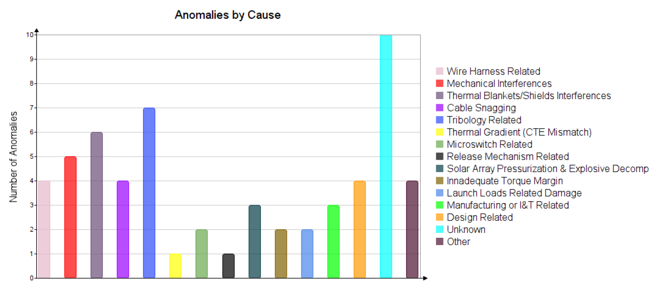
MAIN ANOMALIES AND FAILURES CAUSES
Interferences
CAN BE DUE TO THE SPACE ENVIRONMENT
* Based on published information. Actual root causes may differ.

Slide 8
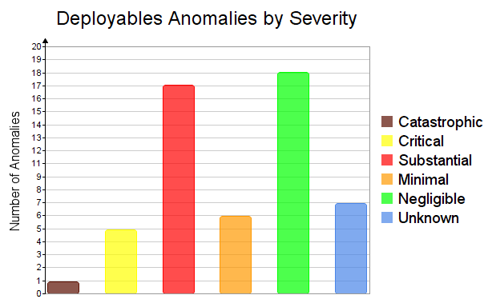
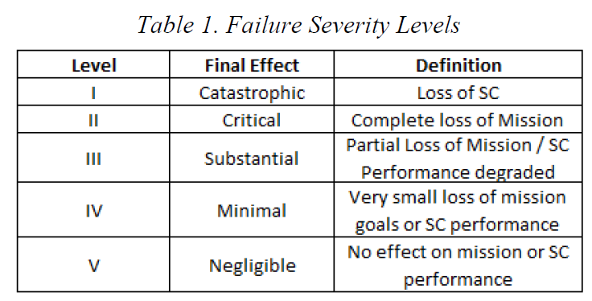
SEVERITY
54% of anomalies result in some degree of mission and/or SC performance degradation (minimal, substantial, critical or catastrophic)
31% of anomalies results in substantial reduction of spacecraft performance and or loss of mission goals
* Based on published information. Actuals may differ.

Slide 9
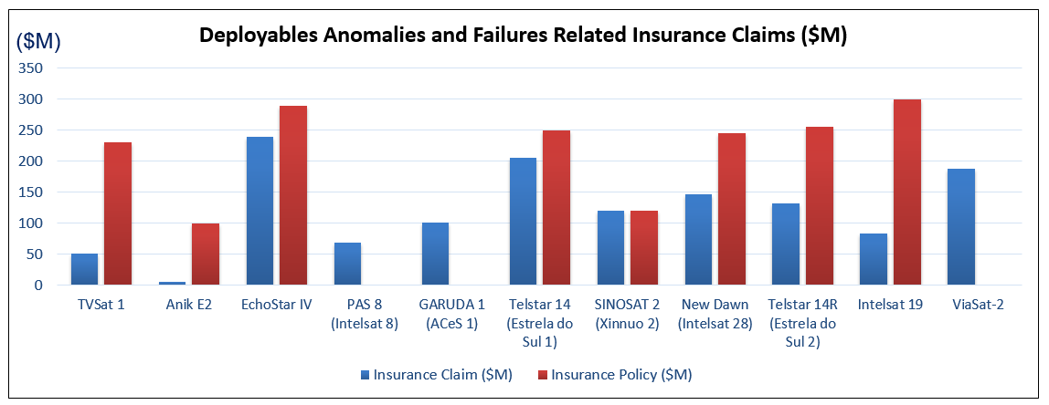
INSURANCE CLAIMS
* Based on published information. Actuals may differ.

Slide 10
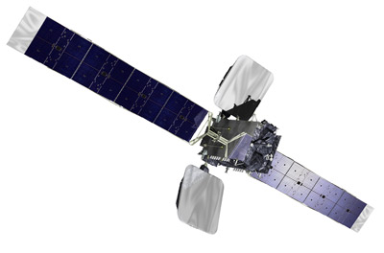
Thermal Blankets / Shields Interferences New Dawn / Intelsat 28
Launch Date: April 22, 2011
Anomaly #1: Ku-band antenna fails to deploy
Cause: deployment mechanisms interference with sunshield
Resolution: motor-driven deployment mechanism moved up and down to free antenna from sunshield
Anomaly #2: unable to deploy its C-band reflector antenna
Cause: antenna’s spring-loaded deployment mechanism got caught in the billows of its sunshield
Resolution: Shaking of the SC unsuccessful
Consequences: Mission Life reduced by 2 years
Insurance Claim: $146M

Slide 11
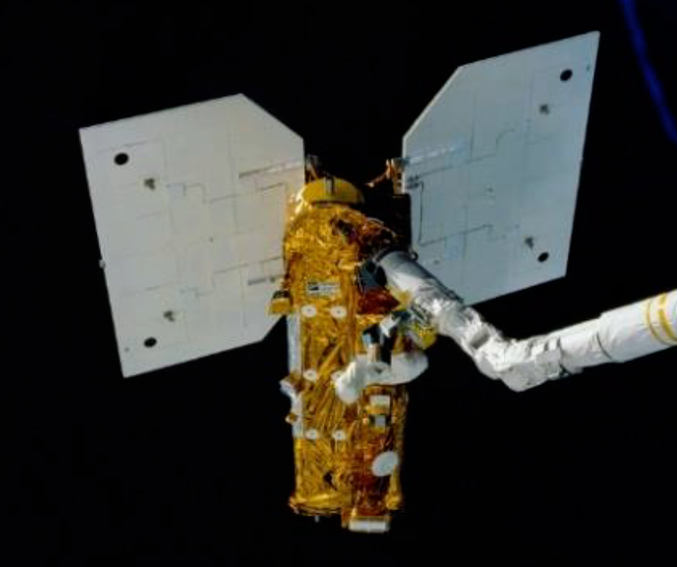
Solid Lubricant Earth Radiation Budget Satellite
Launch Date: October 10, 1984
Anomaly: One of the Solar Arrays failed to deploy
Cause: MoS2 exposed to excessive humidity before launch resulting in excessive bearing friction in the space environment
Trouble shooting: exposure to sun until temperature above 0 °C

Slide 12
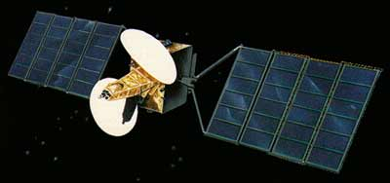
Ground Handling TV-Sat 1
Launch Date: Nov 21, 1987
Anomaly: One of the Solar Arrays failed to deploy
Trouble shooting: Attempts to free it by spinning or shaking the satellite not successful.
Cause: Some of the hold down clips used to secure the SA panel during ground handling were not removed
Consequences: SC placed on a graveyard orbit. Total Mission Loss
Insurance Claim: $51M

Slide 13
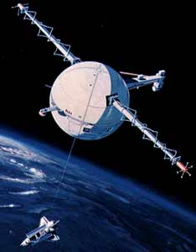
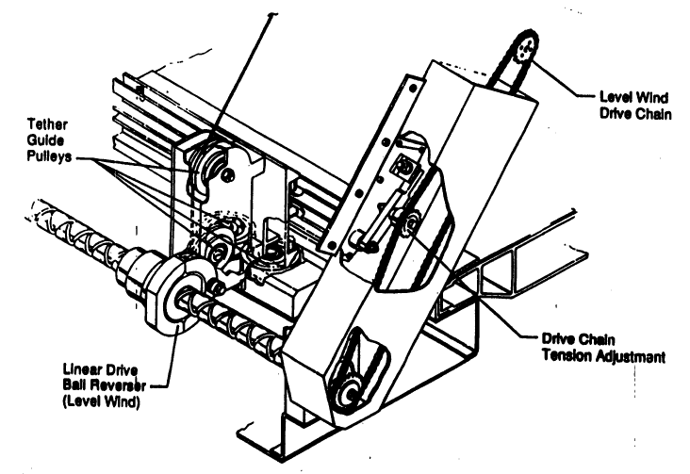
Last Minute Changes Tethered Satellite System (TSS-1)
Launch Date: July 31st, 1992
Anomaly: Reel-out mechanism jammed. Tether only released to about 256 m out of the planned 20.1 Km.
Cause: Bolt added for structural margin to address a last minute concern interfered with the reel out mechanism. Protruding bolt interfered with a traveling ball nut and thwarted satellite deployment.
Consequences: Total Mission Loss
Tether
Added Bolt

Slide 14
Space Environment Tethered Satellite System (TSS-1R)
Launch Date: Feb 22nd, 1996
Anomaly: Five hours after deployment began on February 25, 1996, with 19.7 km (of 20.7 planned) of tether released, the tether cable suddenly snapped near the top of the deployment boom (within 12 m). The TSS satellite separated from the orbiter and shot away into a higher orbit
Cause: The TSS-1R Mission Failure Investigation Board established that the tether failed as a result of arcing and burning of the tether (electrical discharge through a break in the insulation), leading to a tensile failure after a significant portion of the tether had burned away.
Consequences: TSS instruments could be re-activated and produced science data for three days until battery power ran out
Partial Mission Loss

Slide 15
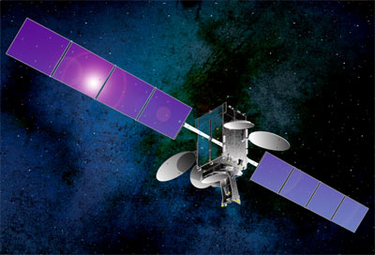
SA Explosive Decompression Telstar14, 14R, Intelsat 19
Launch Dates: 2004, 2011, 2012
Anomaly: SA partially deployed (14, 14R) or failed to deploy (IS-19)
Cause: Inadvertent solar array pressurization and explosive decompression damaged the arrays’ deployment mechanism
Consequences: all of them remained in service but with serious reductions in capacity
Insurance Claims: $205M, $132.7M, $84M
($421.7M total)

Slide 16
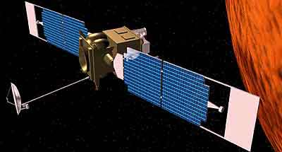
Mechanisms Failure Mars Global Surveyor
Launch Date: November 7, 1996
Anomaly: Solar Array fails to latch
Cause: input shaft of the damper sheared during SA deployment as input torque to damper was applied via a ‘damper arm’ which also applied a shear force the damper was not designed for.
Consequences: Aerobraking maneuvers had to be modified to put less pressure on solar panels.
New aerobraking schedule delayed reaching final polar science mapping orbit by 1 year.

Slide 17
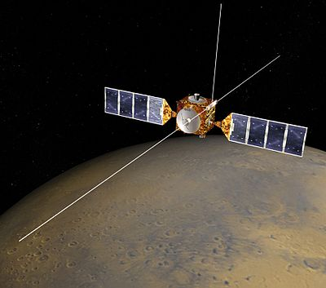
Dynamic Analysis Simulations Mars Express Issues
Launch Date: June 2, 2003
Anomaly: MARSIS antenna booms’ deployments delayed
Cause: Simulation enhancements on similar antenna indicated potential risk that booms could back lash and damage SC
Trouble shooting: additional contingency simulations performed to assess risks; Mitigation scenarios defined.
Resolution: 1st boom failed to deploy until after exposure to sun; 2nd and 3rd deployed successfully.

Slide 18
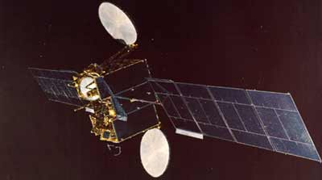
Contingency Maneuvers Anik E2
Launch Date: April 4, 1991
Anomaly: Ku-Band Antenna deployed after 2 days
C-Band Antenna did not fully deploy
Cause: Thermal blanket interference
Trouble shooting: long list of SC contingency maneuvers supported by remarkable ground team analysis and technical ingenuity
Resolution: C-band antenna deployed and mission saved
Consequences: Rescue maneuvers used a year’s worth of fuel
Insurance Claim: $5M

Slide 19
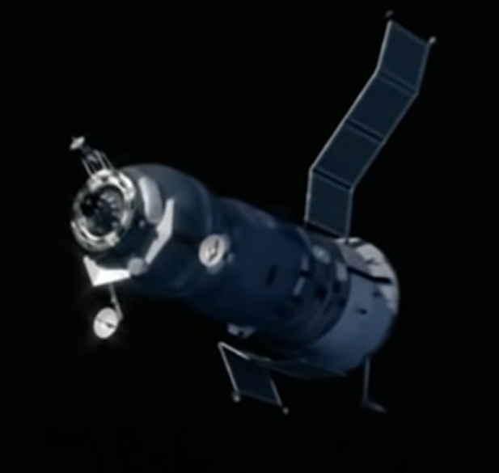
Manned Spacecraft Failure Soyuz-1
Launch Date: April 23, 1967
Anomaly: Left Solar Array and backup antenna of telemetry system did not deploy; Cover of star sensor did not open due to obstruction of the undeployed SA.
Cause: SA deployment mechanism stuck
Trouble shooting: without star sensor Soyuz-1 could not maintain attitude control necessary for stabilization. Automatic and manual attempts by cosmonaut Vladimir Komarov to stabilize the SC failed. Komarov even knocked with his feet on the left side of the SC where the deployment mechanism was located.
Consequences: lack of power forced premature re-entry. Due to asymmetry of SC with just one SA opened, attitude control thrusters were not able to maintain proper orientation during braking maneuver and deviation from the nominal attitude exceeded 8 degrees. Reentry capsule descended on a ballistic trajectory and without an aerodynamic lift. Re-entry capsule crashed and burned killing Komarov.

Slide 20
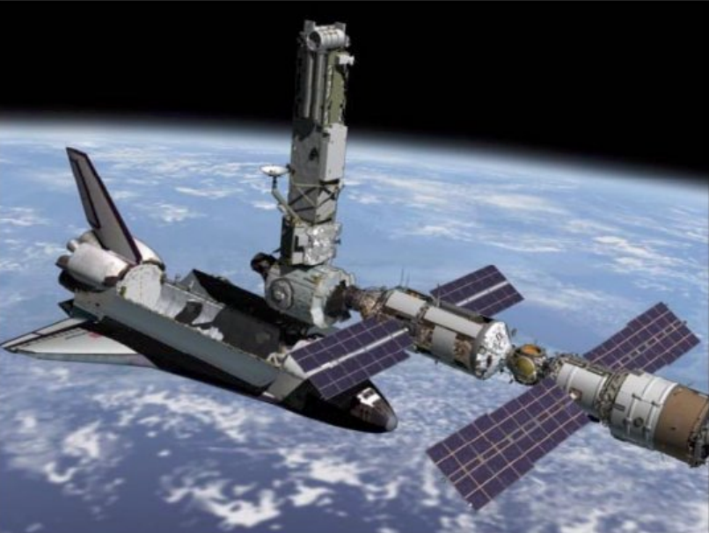
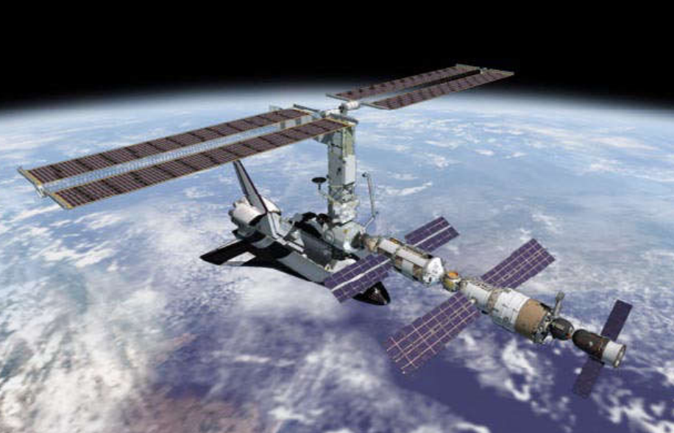
Astronauts to the Rescue International Space Station
Date: December 4th, 2000
Anomaly: Two rows of SA panels at the ISS Port Wing stuck together.
Cause: Snagging
Trouble shooting: Endeavour astronauts had to deploy the second of two 120ft x 38ft solar wings. The deployment which took several hours was completed, after two rows of solar panels stuck together were shaken lose by slightly retracting, then extending the arrays again.
The other solar array, the starboard wing, was deployed nonstop in about 13 minutes.

Slide 21
Prevention and Resolution Failures & Anomalies
Good Practices
Interferences
Pre-Flight Contingency Ops
Computer simulations of contingency and worst case scenarios
In-Space Contingency Ops
Firing of thrusters to spin or shake the SC
Tribology
Torque Margin
Space Environment
Launch Loads
Assembly & Integration
Testing
Modeling / analysis/ simulation
Orienting SC to sun
Commanding motor back and forth (if motor driven)
Inertial load maneuvers supported by dynamic simulation analysis and ground testing if deployable mockup available
Final Stow Inspections
FUTURE: Robotic Servicing ?
  Preliminary studies conducted at NASA GSFC

Slide 22
FINAL THOUGHTS
Spacecraft Deployables anomalies are a complex problem
Sharing of information would be very beneficial
Collaboration between space agencies
Public disclosures by manufacturers that have experienced anomalies
Reference: SC Anomalies paper with full database and anomalies, details and best practices to prevent them:
https://esmats.eu/esmatspapers/pastpapers/pdfs/2021/rivera.pdf

