Slide 1

How to Educate Decision Makers on the Value and Necessity of Modal Testing and Model Correlation: Tips for Young Engineers IMAC XL
Jim Akers & Kim Otten – NASA Glenn Research Center
Mark Ankrom – Virgin Orbit
Michael Hale – Redstone Test Center
Joel Sills – NASA Johnson Space Center
Natalie Spivey – NASA Armstrong Flight Research Center
Curtis Larsen – Texas Christian University
Ralph Brillhart – ATA Engineering, Inc
Matthew Stefanski - Air Force Research Lab, Wright-Patterson AFB

Slide 2
Motivation
In many organizations there is a communication gap between Engineering and Decision Makers (i.e., program management), which appears to be growing.
Decision Makers not coming up through the engineering ranks as much as in the past.
Differences in the terminologies used by both groups, which on their surface appears to be unrelated.
However, Engineers need to be able to bridge this communication gap and effectively communicate to Decision Makers the justification and value of their modal testing and model correlation for programs to achieve Mission Success consistent with the program’s Risk Tolerance.

Slide 3

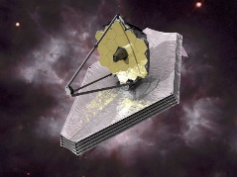
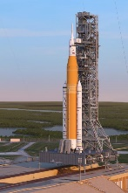




Decision Makers Role & Responsibility
Decision makers have the daunting task of determining how to utilize the program’s resources while ensuring the program meets its mission objectives consistent with the program’s risk tolerance defined by its Cost, Schedule, and Risk metrics.
Allocate the engineering resources for analysis and testing.
Actual Funding Profile (costs increase due to redesign and retesting)
CDR
Budget ($)
Planned Flat Funding Profile
Mission Success
Risk
Ideal Funding Profile (avoids need for redesigns and retesting)
Time

Slide 4
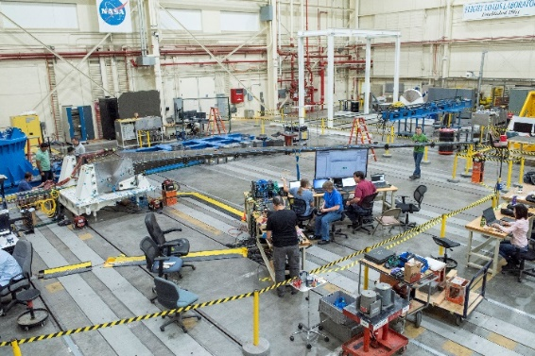
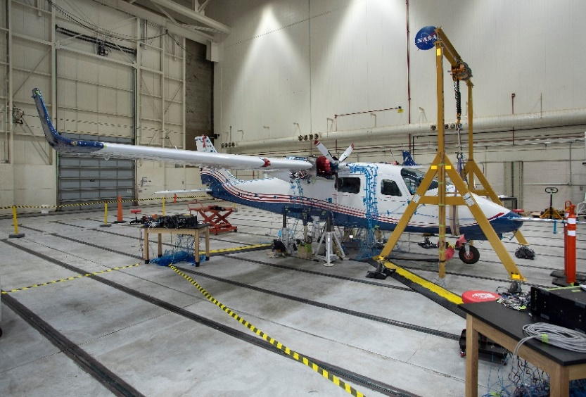
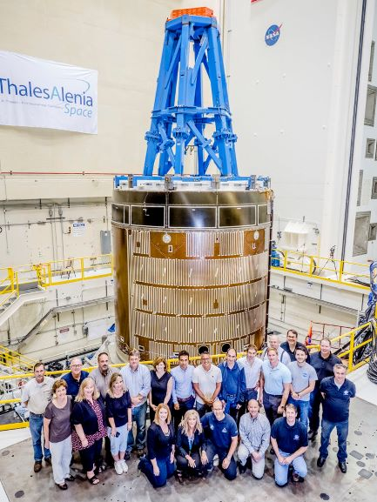
Engineers Role & Responsibility
Engineering at its core is about designing, analyzing, and testing in order to understand systems and to be able to predict their behavior with an acceptable level of accuracy.
Engineers perform modal testing and model correlation to reduce model uncertainties and perform modal analysis to accurately predict a systems response.
PAT Wing GVT
X-57 Mod II GVT
E-STA Vib Test

Slide 5


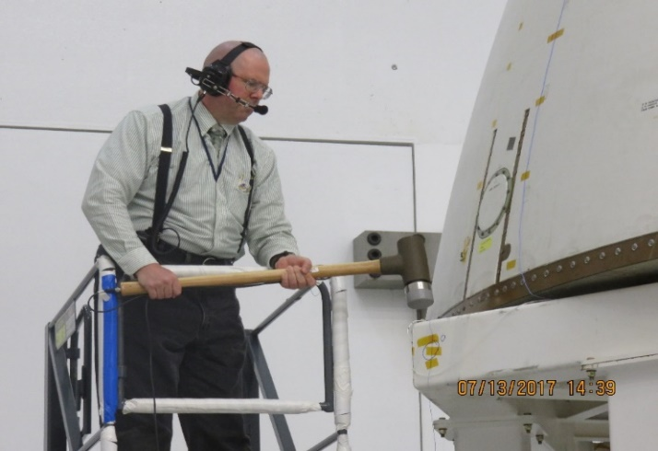
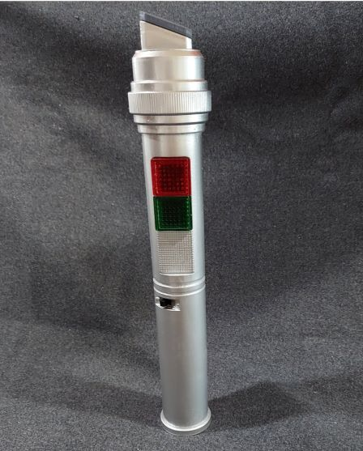
Communication Challenge 1
Decision Makers and Engineers speak different languages.
Decision Makers
Engineers
Risks:
Cost (budget)
Schedule
Mission Success
Safety
Performance
Finite Element Model (FEM)
Modal Frequency, Modal Damping, Mode Shapes, Frequency Response Function (FRF), Complex Mode Indicator Function (CMIF), Poles, Residues, Eigenvectors, Eigenvalues
Universal Translator ?

Slide 6
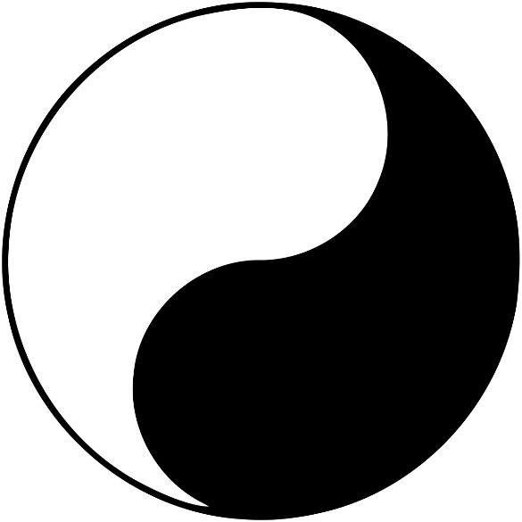
Communication Challenge 2
While Decision Makers and Engineers may speak different languages, they have a Common Goal.
Mission Success
The uncertainties Engineers identify and the analysis and testing they propose and perform to reduce those uncertainties goes to the heart of reducing risks:
Exceeding the budget
Not meeting schedule
Mission not being successful
Not safe and/or not meeting performance requirements
Risk
Uncertainty

Slide 7
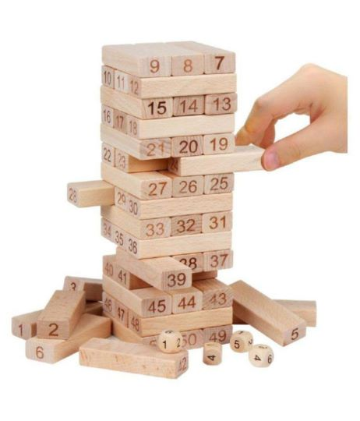
Communication Challenge 3
Engineers rely upon technical standards, handbooks, and best practices for the design, testing, and analysis required for mission success.
Unfortunately, the technical standards and handbooks were not written in the form of an a la cart menu.
Challenge is selectively picking (i.e., tailoring) only the design, analysis, and testing that are consistent with program’s risk tolerance.
Engineers need to develop an awareness of a program’s risk tolerance.
Engineers need to clearly communicate to Decision Makers the risks associated with different tailoring approaches.
NASA-STD
NASA-HDBK
MIL-STD-810H
SMC-S-016
ECSS

Slide 8
Consequences Of Not Performing Sufficient Modal Testing And Model Correlation
Ideally, modal testing and model correlation is performed starting at the component level, then the subassembly level, and finally at the integrated spacecraft system level (i.e., Building Block Approach).
The collective model uncertainty (and the inaccuracy in the analytical predictions) in the integrated system level model gradually decreases over the course of the program.
Typically, a Model Uncertainty Factor (MUF) of 1.5 is initially applied during the initial design phase and this MUF is gradually reduced based upon the quality of the modal testing and model correlation and may approach a final value close to 1.0.
However, if not sufficient modal testing and model correlation are performed, maintaining a MUF of 1.5 throughout the program may not be conservative.
Unable to accurately predict loads, fatigue life, structural margins, etc., and therefore may not be able to show the spacecraft can meet its mission performance objectives.

Slide 9
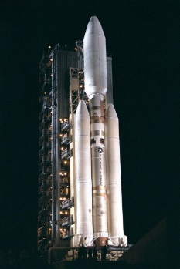

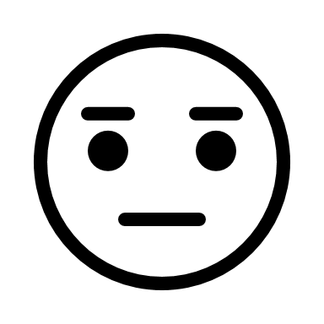

Need For Thorough Documentation
While a program’s risk tolerance should remain constant, the Decision Makers aversion to risk many times will increase as the spacecraft starts to undergo system level qualification/acceptance testing and approaches launch.
Particularly true on multi-year programs where Decision Makers shift positions, and they are not fully cognizant of or agree with the risks accepted or rejected by their predecessors.
Engineers need to keep thorough documentation of the modal testing and model correlation choices and their associated rationale, which is key to bringing new Decision Makers quickly and succinctly up to speed.
Risk Aversion
Time
Notes:
Titan IV-B rocket carrying the Cassini-Huygens space research mission, launching from Launch Complex 40 at Cape Canaveral on October 12, 1997.
https://en.wikipedia.org/wiki/Titan_IV

Slide 10
Not Knowing What You Don’t Know
“There are known knowns; there are things we know we know. We also know there are known unknowns; that is to say we know there are some things we do not know. But there are also unknown unknowns - the ones we don't know we don't know.” Donald Rumsfeld as Secretary of Defense.
Engineers, especially young engineers, need to recognize they don’t know what they don’t know.
Should not hesitate to ask questions or seek out help from colleagues for fear of appearing weak.
Should not be afraid to request the appropriate resources (e.g., training) to gain the needed technical expertise to answer their questions.
It is more important to get the right answer than how it was obtained.
Asking for help and guidance are hallmarks of a professional engineer and a strong mentoring culture is a sign of a strong professional engineering organization.

Slide 11
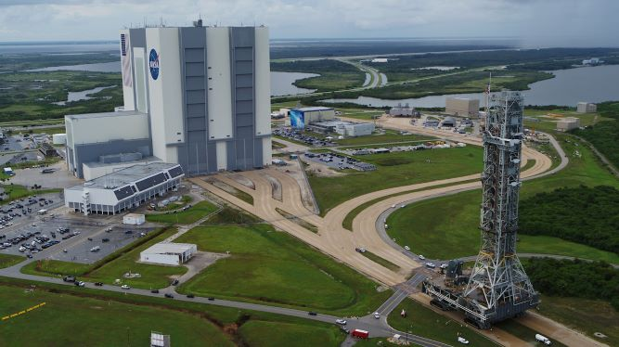
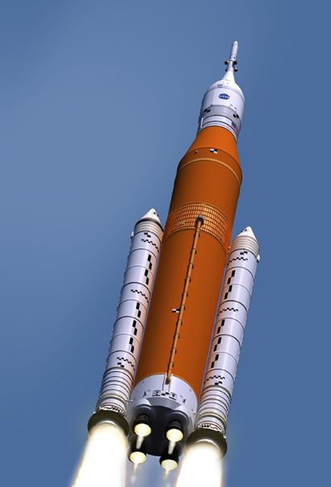
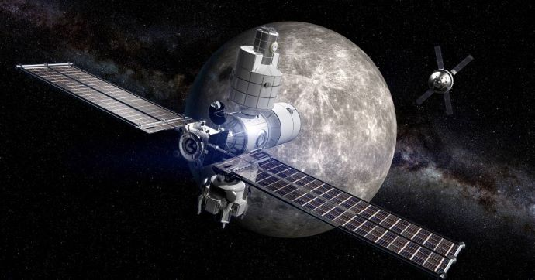
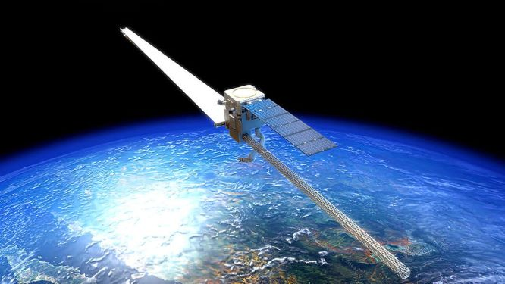
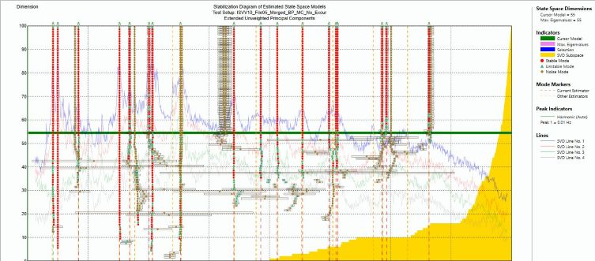
Future Communication
Engineers effectively communicating to Decision Makers the importance of modal testing and model correlation will only become more critical as systems become more complex, larger scale, and designed to operate in space (and possibly manufactured in space) such that traditional ground based Experimental Modal Analysis (EMA) testing may not be feasible.

Slide 12

End

