Slide 1


Stakeholder Engagement Program Activities Supporting the
Satellite Needs Working Group
AGU Fall Meeting 2021 / SY34A-01
December 15, 2021
Andrew Molthan^{1,2}, Cerese Albers^{1,2}, Brian Freitag^{1,2}, Andrew Weis^{1,3},
Katrina Virts^{1,3}, Gerald Bawden⁴, and Rahul Ramachandran^{1,2}
¹Interagency Implementation and Advanced Concepts Team (IMPACT)
²NASA Marshall Space Flight Center, Huntsville, AL
³University of Alabama Huntsville, Huntsville, AL
⁴NASA Headquarters, Washington, D.C.

Slide 2
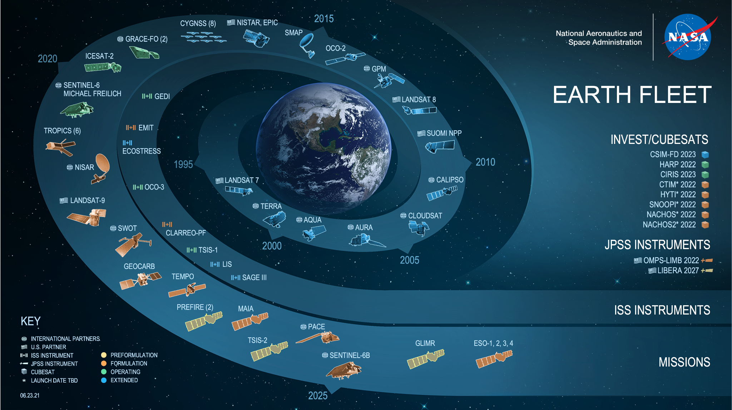
Satellite Needs Working Group: Missions to Measurements and Solutions
NASA’s Earth Science Division and Earth Science Data Systems drive missions to measurements.
The Satellite Needs Working Group (SNWG) develops measurements into solutions for U.S. federal agencies.
The SNWG Management Office leads NASA’s efforts to manage and execute SNWG activities.

Slide 3



Satellite Needs Working Group
White House National Science and Technology Council
U.S. Group on Earth Observations (USGEO)
Satellite Needs Working Group (SNWG)
Distribute Survey
Gather Inputs
The 20XX Cycle: Assessment
Congressional Appropriations and Selections
SNWG Management Office Roles
The 20XX Cycle: Solutions
Implementation and Stakeholder Engagement
Sustained Operations
Lessons Learned
Next Survey
New Opportunities
New Solutions for Agencies

Slide 4
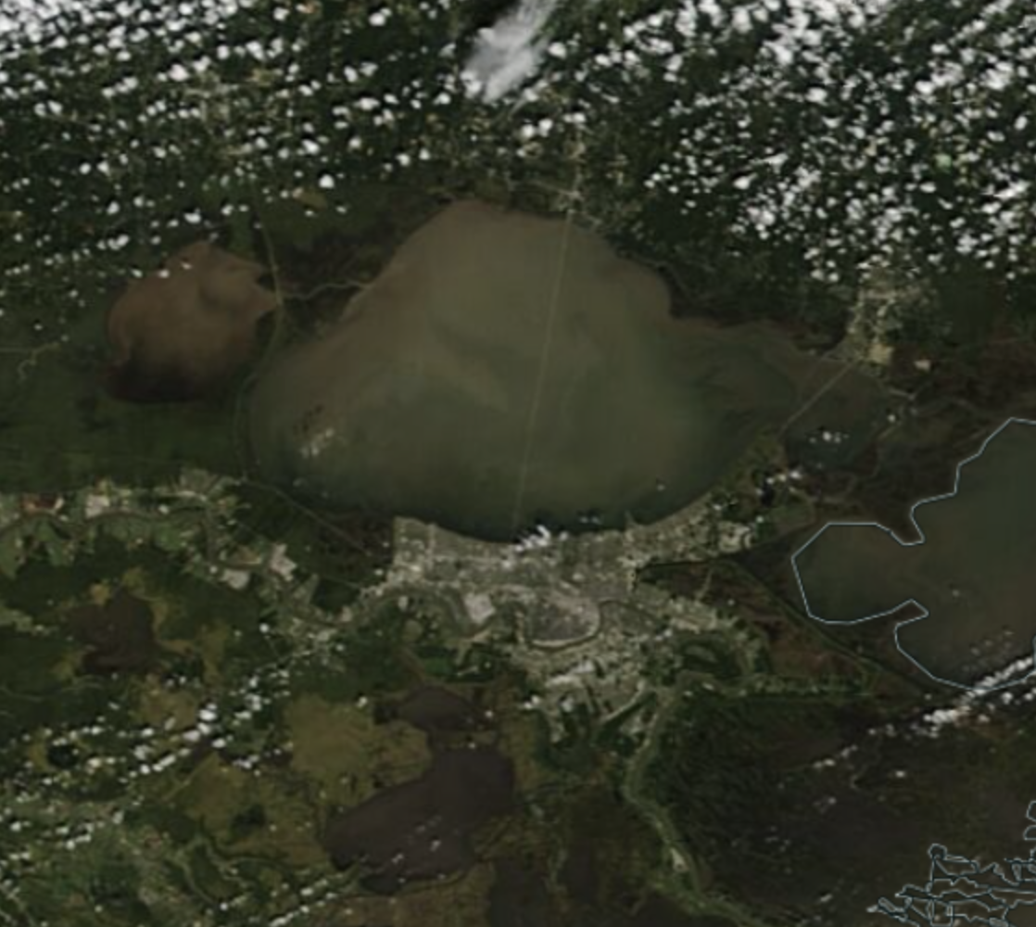
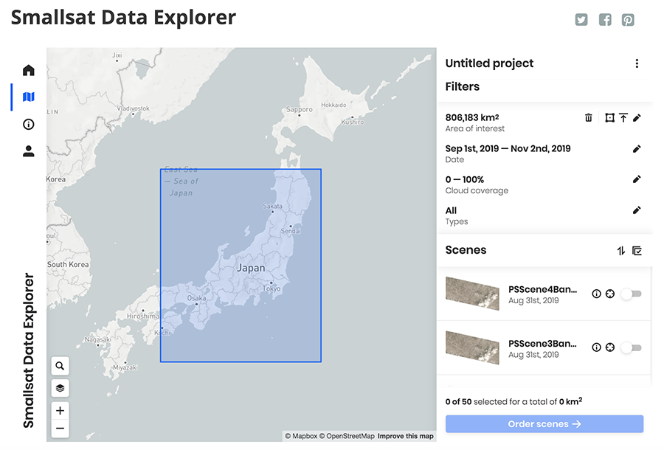
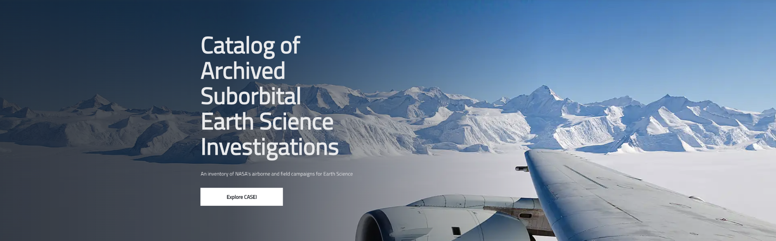
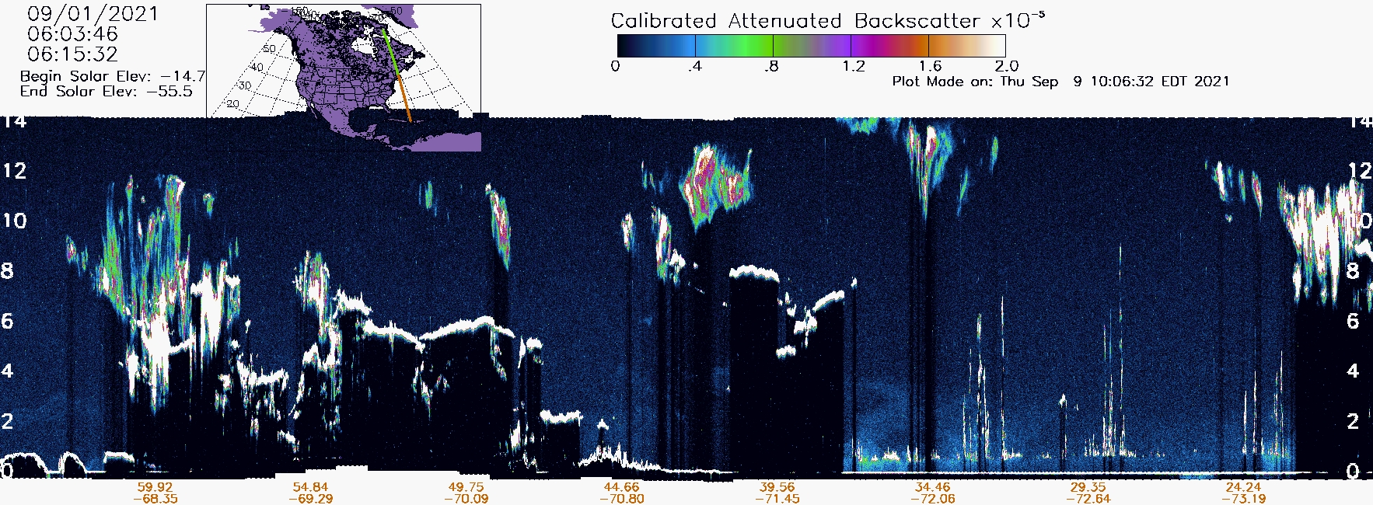
SNWG Cycle Highlights
Harmonized Landsat Sentinel-2 Data (HLS)
Cloud migration of operational processing with tools and tutorials offered by LP DAAC.
Access to Commercial Satellite Products
New license agreements with commercial vendors for Planet and Maxar imagery plus tools for search and acquisition of NASA holdings
Curation of Suborbital Field Campaigns
Development of a new Catalog of Archived Suborbital Earth Science Investigations (CASEI) for uniform access to past field campaign data
Expedited Products from ICESat-2
New suite of products with substantially reduced latency (~3 days) for cloud and ice analysis
*ICESat-2 QLs in early 2022 with support from NSIDC and LANCE

Slide 5
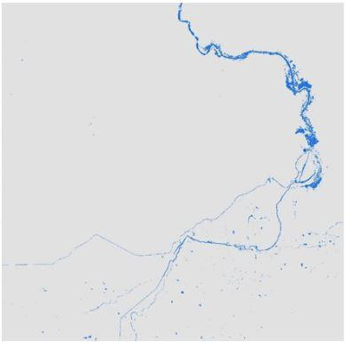
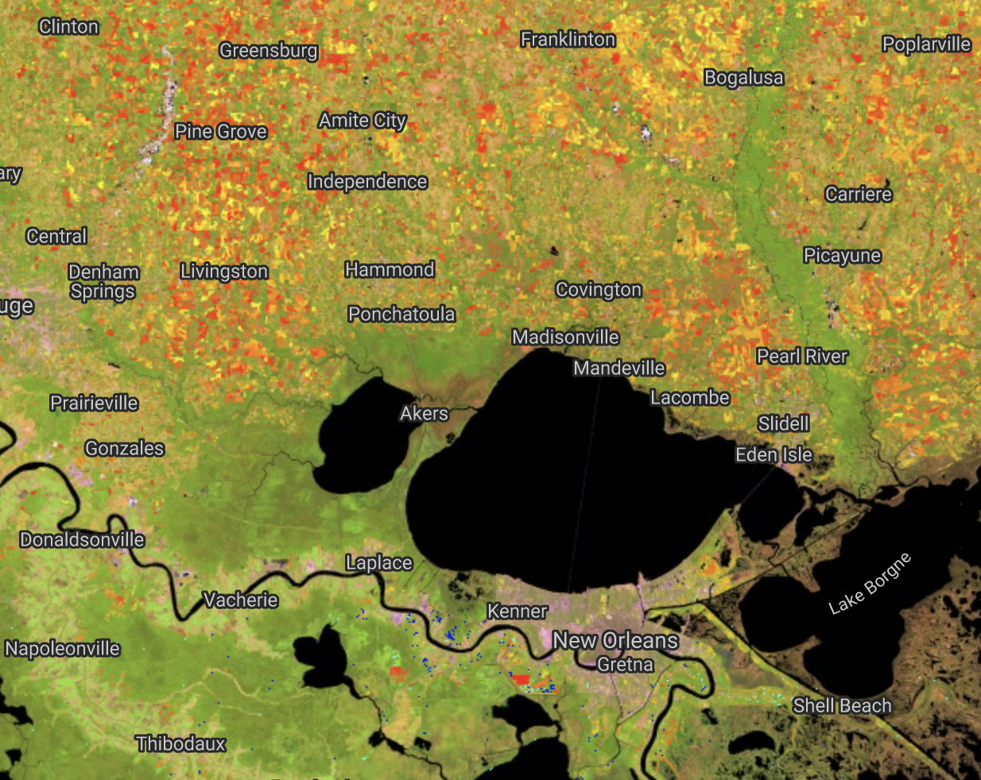
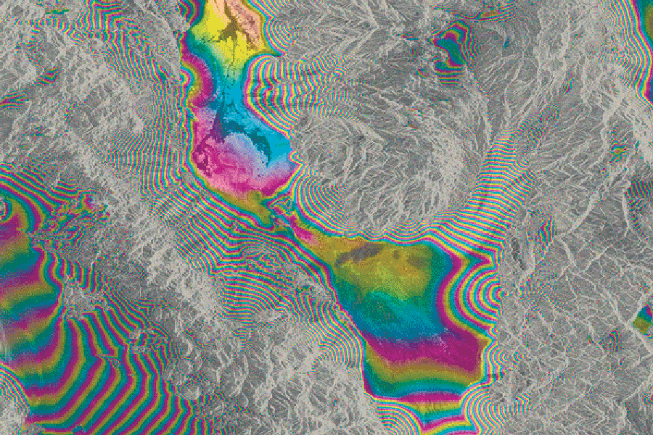
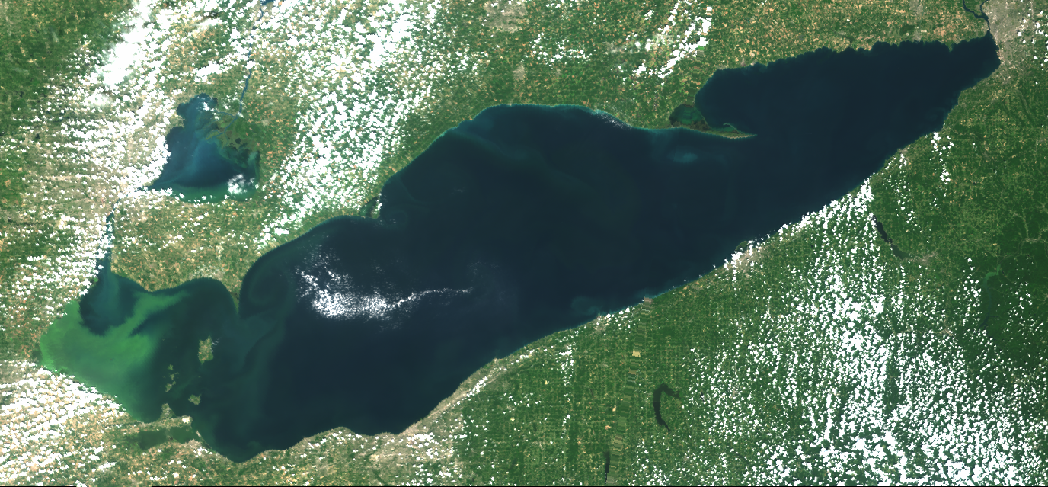
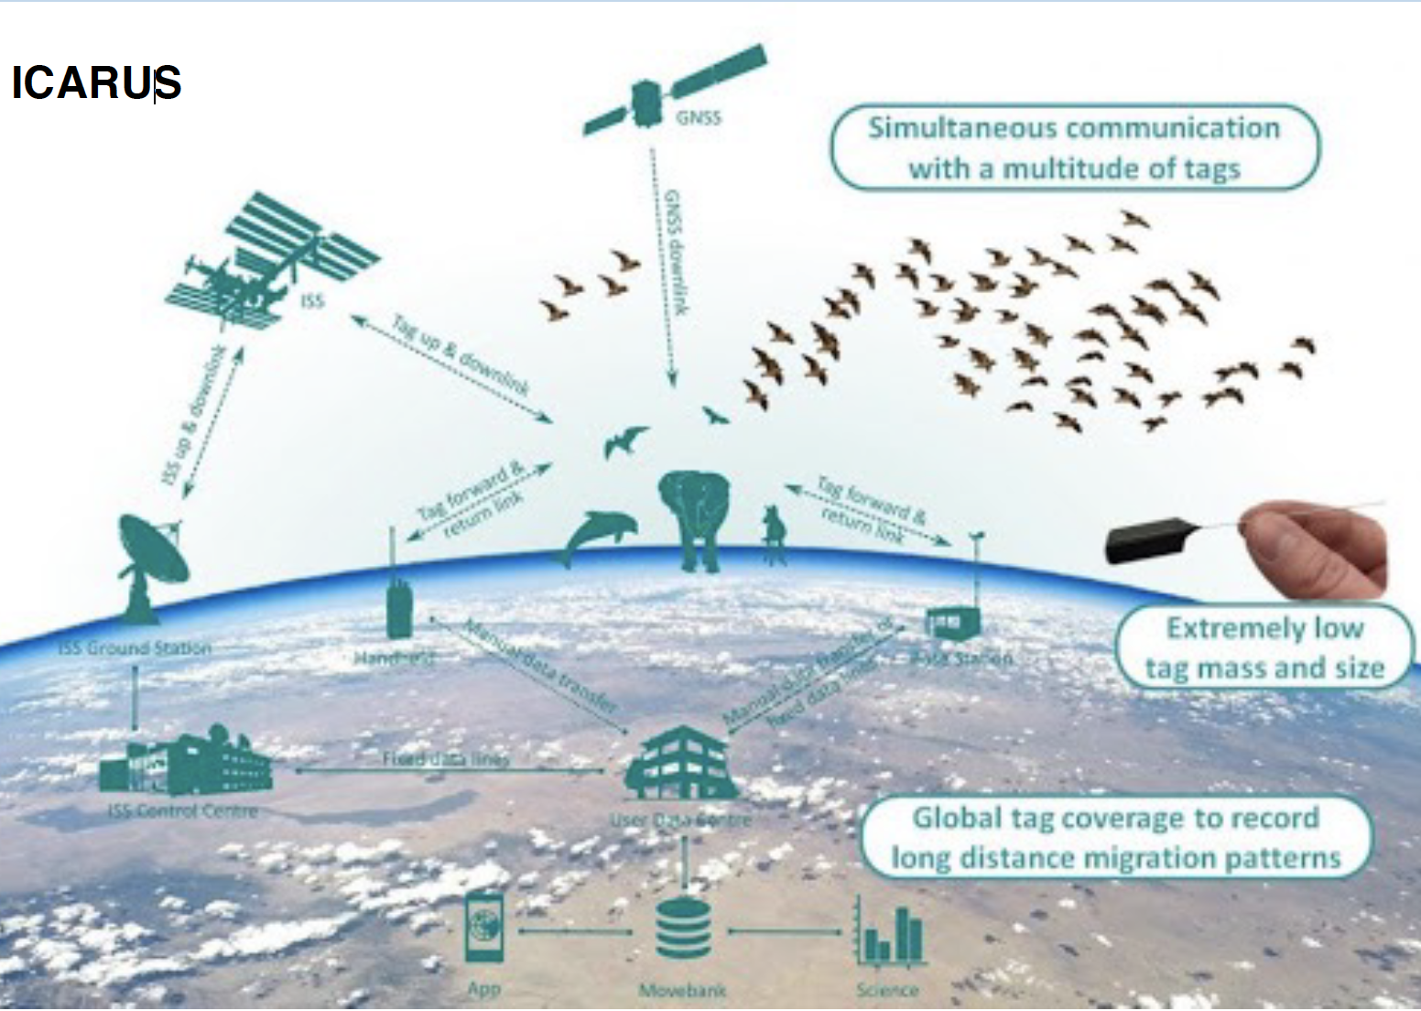
SNWG Cycle Highlights
Dynamic Surface Water Extent
(future release)
Land Surface Disturbance
(future release)
Observational Products for End-Users from Remote Sensing Analysis
(OPERA) will implement new products for:
  Global surface water extent
  Global land surface disturbance
  Surface displacements in North America
Surface Displacement
(future release)
Water Quality Products from Sentinel-3
Additional Sentinel-3 imagery and products for ocean and inland water bodies are now available and provided by LAADS DAAC
Animal Tracking via ICARUS (Internet of Animals)
Developing concept plans for a new and improved ability to track migratory species from space
Understand their linkages to biodiversity as measured from remote sensing
Internet of Animals
(In Development)
Sentinel-3 Water Quality Products (LAADS DAAC)
Images of products shown are representative examples only; specific products are in formulation stages.

Slide 6
Roles for Stakeholder Engagement
Manage and develop communities of users around SNWG Solutions
Gather information about user interests specific to products, encourage collaboration among agencies with common applications, and look to improve solution adoption
Identify, understand, and respond to training or capacity building needs expressed by agencies
Inventory the remote sensing and programming training available within NASA and other agencies, curate content, and link to relevant SNWG solutions or other NASA services
Ensure uniform efforts for engagement between SNWG solutions and stakeholders
Help solution teams develop effective engagement plans that ensure all solutions are adequately represented in terms of outreach, training, and feedback
Demonstrate the value of SNWG to the broader federal agency communities and to NASA
Share stories about the benefit of SNWG outcomes, and demonstrate the benefit of these solutions to research and applications communities supporting SNWG agencies

Slide 7
Stakeholder Engagement in the SNWG Cycles
Receive Surveys
Survey Assessment
Propose Solutions
Formulation
Implementation
Operations
SNWG Stakeholder Engagement Program (SEP)
Build a customer management system to retain information on participants and interests
Use information to develop communication strategies, updates about products, etc.
Participate in Agency interviews to understand needs for training and new capacity
Capture training needs from surveys and interviews
Identify gaps and new opportunities
Incorporate engagement requirements for a proposed solution
Identify what will be needed for training, outreach, workshops and costs
Plan new training modules, workshops, hackathons, and outreach
Product fact sheets and use case white papers
Open curation and sharing of training
Share training and workshop updates and get feedback
Get feedback on beta, provisional products to make adjustments as needed
Coordinate on workshops and hackathons to build open source tools
Build community, identify and share success stories
Curate SNWG outcomes for community usage
Training, code, and open sharing
Transition of products and capabilities to DAACs

Slide 8
Expected Training Needs
 | Inform |  | Provide |  | Broaden
 | Reference | Explanation | How-To Guides | Tutorials | Outreach
oriented to | information | understanding | achieving a goal | learning | collaborating
must | describe characteristics | explain scientific basis; uncertainties | address a specific, narrow challenge | start from scratch or advanced users apply new skills | sustain and grow a cadre of users who share their expertise and knowledge
its form | specifications | details of physical processes and relationships to applications | well-commented and stepwise instructions focused on an incremental task | comprehensive lesson with learning goals and measurement of new understanding; combines multiple how-to steps | in-person or virtual workshops, or conference sessions, focused on open sharing and collaboration
analogy | nutrition facts | instructions for how to use an appliance | a recipe for a single dish | culinary school; a learned set of skills allowing for self-direction | sharing your recipes online and learning new dishes from family and friends
Categorical breakdowns inspired by documentation software provider ‘divio’ (https://documentation.divio.com/introduction/)

Slide 9
Expected Training Needs
 | Inform |  | Provide |  | Broaden
 | Reference | Explanation | How-To Guides | Tutorials | Outreach
 | Product Quick Guides | ARSET: Fundamentals | DAAC Training: Data Access / APIs | Interactive Use Stories “Data in Action” | Hands-on Workshops
 | Provisional Sample Products | ARSET: SNWG Product Training | DAAC Training: Manipulate few files, plot | DEVELOP Projects NASA Internships | Virtual or Recorded Workshops
 | Communications: product availability, releases, updates, list-servs | ARSET: Product Uses | DAAC Training: Code examples / git repo | Jupyter Notebooks | Conference Sessions
 | Peer-Reviewed publications; ATBDs | White Papers and Use Stories | Data Training: Complex Analyses | Hackathons Competitions | Town Hall Meetings
Stakeholder Engagement Activities
Categorical breakdowns inspired by documentation software provider ‘divio’ (https://documentation.divio.com/introduction/)

Slide 10
NASA and Interagency Collaborations
Solution Teams and SNWG/SEP
Earth Science R&A and Applied Sciences
Earth Science Data Systems
 | Inform |  | Provide |  | Broaden
 | Reference | Explanation | How-To Guides | Tutorials | Outreach
 | Product Quick Guides | ARSET: Fundamentals | DAAC Training: Data Access / APIs | Interactive Use Stories “Data in Action” | Hands-on Workshops
 | Provisional Sample Products | ARSET: SNWG Product Training | DAAC Training: Manipulate few files, plot | DEVELOP Projects NASA Internships | Virtual or Recorded Workshops
 | Communications: product availability, releases, updates, list-servs | ARSET: Product Uses | DAAC Training: Code examples / git repo | Jupyter Notebooks | Conference Sessions
 | Peer-Reviewed publications; ATBDs | White Papers and Use Stories | Data Training: Complex Analyses | Hackathons Competitions | Town Hall Meetings
Stakeholder Engagement Activities
Categorical breakdowns inspired by documentation software provider ‘divio’ (https://documentation.divio.com/introduction/)

Slide 11

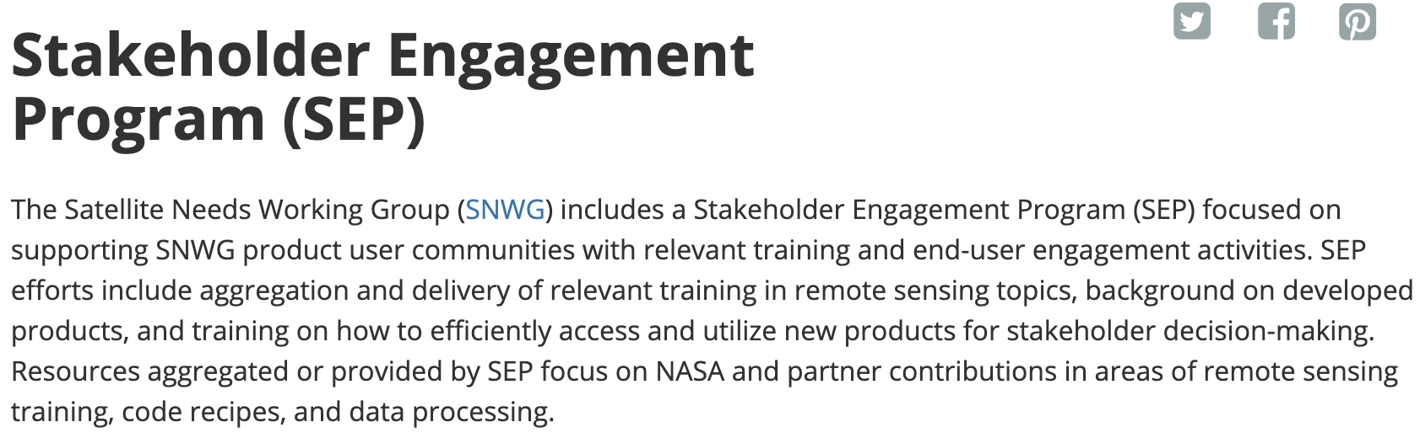
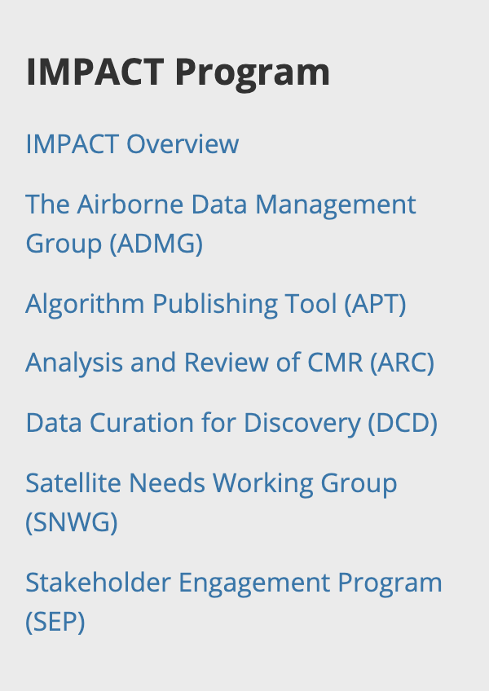
Training Materials Available Online
Our SEP web presence is under construction but will continue to grow with links to new Solutions and materials…
Search “IMPACT SNWG SEP” or visit https://earthdata.nasa.gov/esds/impact/snwg/sep

Slide 12
Upcoming Activities
Several activities continue to be planned for Stakeholder Engagement in 2022, including:
Presentations and outreach at the American Meteorological Society’s Annual Meeting
Revisions to the SNWG/SEP web page that will continue adding additional content
Upcoming workshops to engage SNWG users around initial OPERA product releases
Official release of quick-look ICESat-2 products and associated training materials
Development of user engagement workshops broadly around SNWG solutions from the 2016 and 2018 cycles, along with improved communications and outreach to end users
We expect that Congress and OMB will offer guidance on new solutions from the 2020 Cycle, and we will be kicking off a new 2022 survey and assessment cycle beginning in June of next year!

Slide 13
SNWG-Related Content at AGU
Monday, 4-6 pm Poster Hall, D-F | Brian Freitag B15I-1547 | Update on the Production of Global Harmonized Landsat-8/Sentinel-2 Data Products
Monday, 4-6 pm Poster Hall, D-F | Katrina Virts B15I-1539 | A Survey of Earth Observation Data Needed by U.S. Federal Agencies
Tuesday, 12:57-1:03 Convention Center 286-287 | Aaron Kaulfus IN23A-03 | Data system for NASA’s Commercial Smallsat Data Acquisition Program
Wednesday, 2:35-2:40 Convention Center 291-292 | Andrew Molthan SY34A-01 | Stakeholder Engagement Program Activities Supporting the Satellite Needs Working Group (this full presentation, online!)
Thursday, 10:15-10:20 Convention Center 350-351 | David Bekaert G42A-07 | Introducing the OPERA Project for Systematic Surface Water, Surface Deformation, and Surface Disturbance Data Products from Satellite Observations
Thursday, 4-6 pm Poster Hall, D-F | Cerese Albers IN45F-0493 | Best Practices from NASA’s Open Science Response to the Satellite Needs Working Group (SNWG) Process
Missed a talk? Be sure to check out these speakers and their online content!

Slide 14

Thank you.
Contact info:
Andrew Molthan
NASA Marshall Space Flight Center
andrew.molthan@nasa.gov

