Slide 1
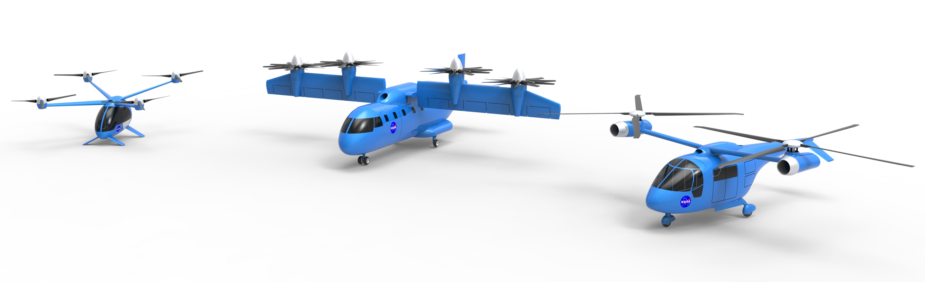
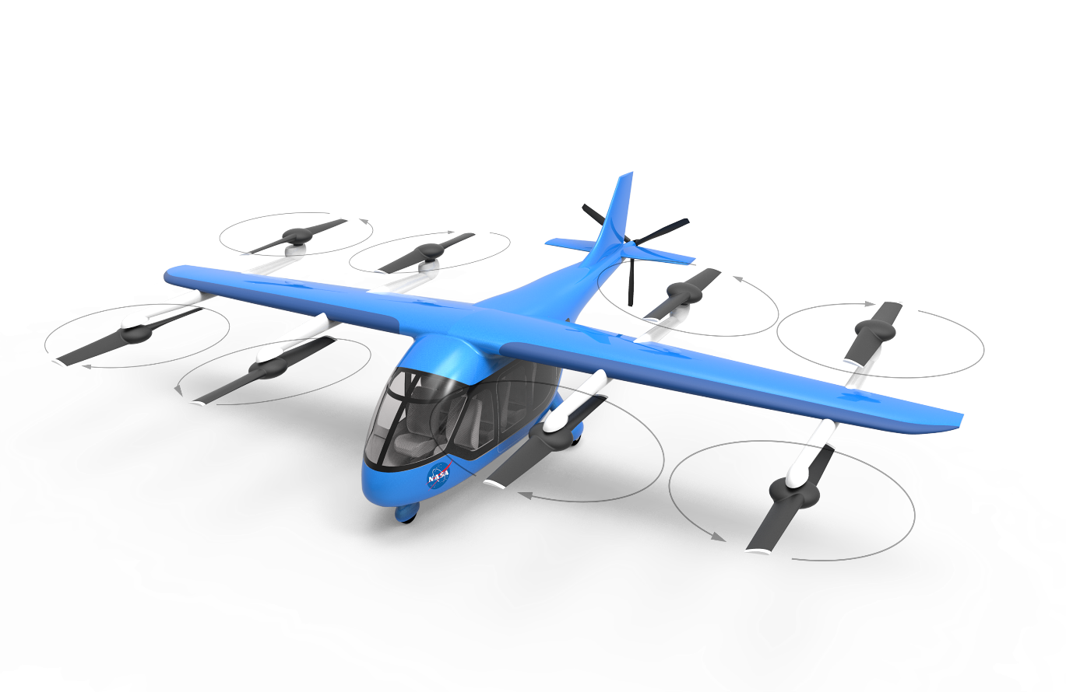
NASA / FAA eVTOL Crashworthiness Workshop Series:
Summary and going Forward
Vertical Flight Society
Transformative Vertical Flight
January 27, 2022
San Jose, CA
Cross Agency / Industry Working Group Presentation by
Justin Littell Ph.D.
Research Aerospace Engineer
Structural Dynamics Branch
NASA Langley Research Center
Justin.D.Littell@nasa.gov
Joseph Pellettiere Ph.D.
Chief Scientific and Technical Advisor
Crash Dynamics
FAA Aviation Safety
Joseph.Pellettiere@faa.gov

Slide 2
The Need for Crashworthiness in eVTOL Vehicles:
Why Now?
Now is the time
  Early in the vehicle development cycle
  Will pay great dividends in the future
Expect that accidents will happen
  Protect the occupants to ensure continued growth and acceptance
Current regulatory framework is based upon other designs
  This may change in the future depending on performance
  Attention to system level safety now, will prepare for the future
Notes:
Design for system level now as these airframes will be around for a long time.

Slide 3
Why another Workshop series?
Intent
  Information share and disseminate technical knowledge to relevant stakeholders in the world of crashworthiness and occupant protection
  Show some of the smaller partners what kind of research is out there that can be used for vehicle development
  What types of crashworthy features are available for use for companies that they may not have otherwise known about
  Network and connect to the community

Slide 4
Four Virtual Workshops (April 2020 through April 2021)
https://nari.arc.nasa.gov/crashworthiness
  April 7, 2020 - Provided the historical perspective and overall regulatory considerations as an introduction to eVTOL crashworthiness
  October 9, 2020 - Considered certification requirements
  January 19, 2021 - Reviewed the considerations for vehicle crashworthiness from the perspective of the Department of Defense
  April 13, 2021 – Current government and academic research into eVTOL crashworthiness
Worldwide participation in both presentations and attendees
NASA | FAA | EASA | CIRA
GAMA | VFS | USAF | NAVAIR
ASTM | UBER | DLR | USAF AP

Slide 5
Workshop #1 Summary
Welcome – Justin Littell / NASA
Introduce the concept of crashworthiness from a historical perspective – Joseph Pellettiere / FAA
Introduce a series of case studies that capture crashworthiness themes – Amanda Taylor / FAA
Introduce potential paths toward certification regarding crashworthiness – Robert Stegeman / FAA

Slide 6
Workshop #1 – Highlighted Discussion (taken from chat log)
“Can you consider adding some material specific to the certification of integrating large battery packs? e.g. pack drop test requirements, firewall req'ts between the battery and occupant, etc. What considerations are being made for BRS systems”
“Where does something like emergency parachute systems fit? (Like BRS from civil aircraft)”
“Were rotorcraft standards not developed from testing, but only from actual crash data?”
  This was followed by a handful of links to NTSB and DoD reports with accident data
“Does it exist a certification specifications for eVTOL aircrafts? I think no, at the moment”
  Several comments were posted regarding how eVTOL would be certified
“Is there work with an industry group to develop a complete standard for eVTOL seats ? Will there be a new TSO?”
Summarized as:
  Crashworthiness is important and can leverage existing knowledge and technology

Slide 7
Workshop #2 Summary
Speaker | Organization | Presentation Title
Justin Littell / Joseph Pellettiere | NASA / FAA | Introduction and the Need for Crashworthiness in eVTOL applications
Mike Hirschberg | Vertical Flight Society (VFS) | Enabling a Safe Electric VTOL Revolution
Lowell Foster | General Aviation Manufacturers Association (GAMA) | Opportunities for Crashworthiness Features in New Aircraft
Ryan Naru | Uber | Operational Expectations of eVTOL Aircraft
Bob Stegeman | Federal Aviation Administration (FAA) | EVTOL Crashworthiness Moving Forward
Aiko Duehne | European Union Aviation Safety Agency (EASA) | General Presentation: Special Condition VTOL
Eric Nottorf | ASTM International | ASTM F44 as Means of Compliance for Part 23

Slide 8
Workshop #2 – Highlights – ConferenceIO questions (highest upvotes)
“Fully VTOLs are FUNDAMENTALLY different to traditional Airplanes and Helicopters, they cannot glide nor autorotate. Should they be defined as SAFER at LOWER altitudes”
“What do you think are the most important features for eVtol aircraft companies to incorporate to achieve crashworthy aircraft”
“I’m from an automotive crash background and sounds like you need an aerospace equivalent to the NHTSA and Euro NCAP crashworthiness testing criteria. Specific impact scenarios with measured dummy loading a and occupant space protection requirements”
“Some ASTM F44 discussions involve introducing "point systems" that encourage including multiple safety features. Would a point system somehow describing the "hollistic" crashworthiness system be a potential approach to demonstrate compliance (in the future)?”
Summarized as ? -
  Crashworthy systems needs to be present
  There is a common consensus that a defined level of safety needs to be addressed and how to measure it

Slide 9
Workshop #3 Summary
Speaker | Organization | Presentation Title
Justin Littell / Joseph Pellettiere | NASA / FAA | Introduction and the DoD Crashworthiness background
Col. Nathan Diller | AFWERX | Agility Prime
Brandon Hall | NAVAIR | Research Topics Related to Naval Aviation Crashworthy Systems
Lindley Bark | NAVAIR | Crashworthiness and Qualification of Rotorcraft Seats by Modeling and Simulation
Casey Pirnstill / Nathan Wright | AFRL | USAF Needs/Difference, Current Research and Identified Knowledge Gaps with Future eVTOL Systems.

Slide 10
Workshop #3 Highlights – ConferenceIO questions (upvotes not recorded)
“Is the AF and the other DoD components working on a common set of requirements for eVtol crashworthiness”
“FAA has certain emergency conditions and seats loads conditions defined based on historical data. Are these conditionsloads are sufficient to be applied on eVOTL If yes, can you please elaborate why Thank you.”
“Will the Navy accept M&S data submitted as meeting the occupant protection requirements”
“What are the potential solutions you see that are available to reduce occupant flail”
Summarized as:
  How will the DoD rules differ than civilian rules
  What type of tech will the DoD use to mitigate occupant injury
  Is modelling and simulation acceptable?

Slide 11
Workshop #4 Summary
Speaker | Organization | Time (Eastern) | Presentation Title
Justin Littell / Joseph Pellettiere | NASA / FAA | 12:00 – 12:15 | Current Research in eVTOL Crashworthiness overview
Francisco Capristan | FAA | 12:15 – 12:45 | Current FAA AAM/UAM Research
Amanda Taylor | FAA Civil Aerospace Medical Institute (CAMI) | 12:45 – 13:15 | CAMI Rotorcraft Research
Justin Littell / Jacob Putnam | NASA Langley Research Center | 13:15-13:45 | NASA Crashworthiness Technical Challenge Overview
Break |  | 13:45-14:00
Gerardo Olivares | National Institute for Aviation Research (NIAR) | 14:00-14:30 | Integrated Safety for EVTOL Crashworthiness : from Conceptual Design to Certification
Matthias Waimer | DLR, German Aerospace Center | 14:30-15:00 | Conceptual design phase study on eVTOL Crashworthiness
Luigi Di Palma Francesco Di Caprio Marika Belardo | CIRA, Italian Aerospace Research Center | 15:00-15:30 | NextGen Civil Tiltrotor Crashworthiness Approaches

Slide 12
Workshop #4 – Highlights – ConferenceIO questions (highest upvotes)
Test conditions
  “What was the rate of change of velocity 37fts or 44fts or 50 fts” regarding testing of rotorcraft seats by the FAA
  “What were you results with combined vertical load cases?”
  “What is the difference in injury numbers between ATDs and human body model? Please explain any one of the injury criteria”
  “How will the Energy Absorbing Landing Gears shown function in case of crash with Fwd Speeds and Roll and Pitch?”
Batteries
  “Along the lines of electrical fires after impact, what are the issues that might arise from high voltage systems on-board How do we protect occupants and first responders”
  “Have you looked at expected injuries due to post crash electrical fires How do the expectations of injuries change depending on the placement of batteries w.r.t. the crewpassengers”
  “In the NASA full scale crash test vehicle, where are the batteries located and is their protection being assessed as well?”
Simulation
  what were you results with combined vertical load cases?
  For the different modeling approach, which shell elements meshing size is used?
  What is the difference in injury numbers between ATDs and human body model? Please explain any one of the injury criteria

Slide 13
Workshop #4 – Highlights – ConferenceIO questions (highest upvotes or variants)
General
  “What is the industry requiring for occupant protection for eVTOL with rotary wing”
  “Will future safety requirements again focusing just on seats”
  “Do you think the existing test infrastructures are adequate for the objectives of your research activity?”
    This questions arose in two different talks
Other factors
  Can you talk a bit about the weather aspect of flying eVTOL?
    Multiple variants of this questions arose in two different talks
  “So this part (Tasks 1,2,3) is like developing an SOP for proceeding a post-crash data collection”
Summarized as
  What are the conditions that must be tested
  Battery performance
  Simulation
  Facilities/Testing capability
  Weather

Slide 14
Going Forward
Break out session – San Jose / Santa Clara 1:30 – 5:00
  Agenda
    Discuss comments/feedback/questions into a plan moving forward
    Discuss appropriate forum going forward

