Slide 1

PD11: A Physics of Failure Approach to Evaluate Printed Circuit Board Reliability
Bhanu Sood, Ph.D.
NASA Goddard Space Flight Center
bhanu.sood@nasa.gov
Sunday, January 23, 2022
IPC APEX EXPO 2022

Slide 2
Disclaimer
The material herein is presented “for guidance only”. We do not warrant the accuracy of the information set out on this presentation. It may contain technical inaccuracies or errors and/or non-updated data.
Information may be changed or updated without notice.

Slide 3
PDC Outline
Section 0: Intro
Section 1: What is reliability?
Section 2: PCB/PCBA failure mechanisms
Section 3: Quality and Reliability Analysis
Section 4: Risk-Based PCB Assurance
Section 5: Summary and closure

Slide 4
About Me
Member of ~40 IPC Subcommittees and Task Groups. Chair IPC-7092: Design and Assembly Process Implementation for Embedded Components.
Member of IPC A-Teams
  Microvia Weak Interfaces
  J-STD-001 X-ray Requirements
  IPC-6017 Embedded Circuits Spec
NRL/CALCE/NASA
Bachelors/Masters/PhD Metallurgy, Electronics Materials, Risk/Reliability

Slide 5


Slide 6





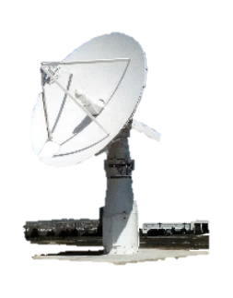

NASA GSFC One World-Class Organization
What makes Goddard one-of-a-kind?
World leader in understanding the Sun’s impact on Earth
NASA’s leading science center, with cross-disciplinary, end-to-end capabilities
Executing NASA’s most complex missions
Communications backbone – 98% of NASA’s data
is transmitted
via Goddard infrastructure
Independent Verification and Validation Facility assures NASA’s most complex software functions as planned
1 of 2 US routes for ISS cargo; 1 of 4 US orbital launch facilities
2
Notes:
We have engineers and scientists living together to answer really big questions.

Slide 7

Who We Are
THE GODDARD COMMUNITY
More than 10,000 People
Technicians and Others 6%
Clerical 5%
GSFC Workforce
3,000+ Civil Servants
6,000+ Contractors
1,000s of Others*
Professional & Administrative 28%
Scientists & Engineers 61%
The Nation’s largest community of
scientists, engineers, and technologists
*Including off-site contractors, interns, and Emeritus

Slide 8

GSFC: A Diverse Mission Portfolio
Wind
Voyager
QuikSCAT
EO-1
Stereo
ACRIMSAT
ERBS
RHESSI
TRMM
TOMS
SOHO
Geotail
Aqua
ICESat-2
TIMED
THEMIS
TRACE
Landsat 7
TOPEX
CALIPSO
ACE
Terra
GRACE
Cluster
SORCE
POES
IMAGE
SDO
Aura
AIM
FAST
GPM
GOES
Polar
Solar-B
MMS
IBEX
NPP
Aquarius
Osiris-Rex
(Sample Return)
TDRSS
LDCM
CloudSat
TWINS
(Instrument)
RBSP
WMAP
Cassini
NuSTAR
JWST
WISE
HST
GALEX
New Horizons
Messenger
Spitzer
SWAS
Galileo
Astro-H
IUE
RXTE
Juno
MAVEN
Integral
Pioneer
EUVE
Mars Science
Laboratory
FUSE
Swift
COBE
Fermi
Compton
GRO
LADEE
LRO
Notes:
8

Slide 9
What is Reliability?
Reliability is the ability of a product to properly function, within specified performance limits, for a specified period of time, under the life cycle application conditions
  Within specified performance limits: A product must function within certain tolerances in order to be reliable.
  For a specified period of time: A product has a useful life during which it is expected to function within specifications.
  Under the life cycle application conditions: Reliability is dependent on the product’s life cycle operational and environmental conditions.

Slide 10
Definitions
Failure | A product no longer performs the function for which it was intended
Failure Mode | The effect by which a failure is observed.
Failure Site | The location of the failure.
Failure Mechanism | The physical, chemical, thermodynamic or other process that results in failure.
Failure Model | Quantitative relationship between lifetime or probability of failure and loads
Load | Application/environmental condition needed (electrical, thermal, mechanical, chemical...) to precipitate a failure mechanism.
Notes:
The failure mechanism is a process; not a physical condition or a failure site. Usually you can assign “overstress” or “wearout” to a failure mechanism.
A quality condition (e.g., void in a material) is not a failure mechanism although it can accelerate the precipitation of a failure.
Overheat is not a failure mechanism.
Failure of glue is not the mechanism but a failure site
When the failure mechanism is not identified, it is better to record it as “unknown” or “not yet determined” rather than making an uninformed decision.

Slide 11
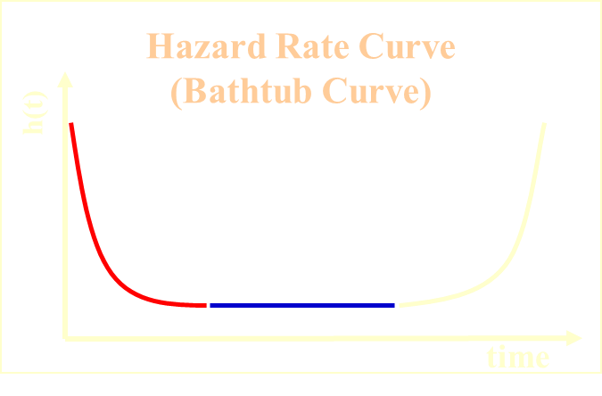
Physics of Failure Perspective of Reliability
Failure Distribution
(Weibull)
f(t)
Hyper-exponential
Reliability statisticians are interested in tracking system level failure data during the service life for logistical purposes, and in determining how the hazard rate curve looks.
β <1
β > 1
infant mortality
wearout
exponential
β =1
“random” failures
time
PoF reliability engineers are interested in understanding and controlling the individual failures that cause the curve.
PoF engineers do so through systematic and detailed assessment of
  influence of hardware configuration and life-cycle stresses…
  root-cause failure mechanisms…
  the materials at potential failure sites.
‘Defective’ population
&
random overstress events
Nominal population
f(t)
time

Slide 12
Classification of Failures
It is helpful to distinguish between two key classes of failure mechanism:
  overstress: use conditions exceed strength of materials; often sudden and catastrophic
  wearout: accumulation of damage with extended usage or repeated stress
It is also helpful to recognize early life failures:
  infant mortality: failures occurring early in expected life; should be eliminated through process control, part selection and management, and quality improvement procedures

Slide 13
General Methods for Reliability Prediction
Handbooks
Field data analysis
Similarity analysis
Test data analysis
Load-damage simulation analysis (Physics of Failure)
Notes:
Handbook - curve fitting a mathematical model to historical field failure data of electronic systems to determine the failure rate of electronic parts. The failure rate was expressed as a function of a generic failure rate and a set of adjustment factors to modify this failure rate.
The objective of a reliability prediction using field data is to find a failure distribution that best fits the measured field performance. To do so, the categories of field data that need to be obtained are:
the actual number of units in operation
individual operating times
the age of the unit at the time of failure (in terms of usage time, number of cycles, or number of operating hours)
Similarity analysis is a structured comparison of the elements of a product being assessed (or under development) with those of a similar product designed and produced for a similar application, for which in-service reliability data is available. A similarity analysis requires an assessment of end-item field experience; i.e., field data. Then, a comparison of fielded products to new products is made to assess similarities and differences. Then, an algorithm is used to predict reliability metrics for new products based on the degree of similarity between the new product and in-service products.
Test data can be used to predict the reliability of parts in situations where field failure data is not available or the part is new. The objective of the method is to find a life distribution that best fits the measured test performance and extrapolate it (if necessary) to the intended field conditions.
Reliability prediction tests are essentially of two types:
non-accelerated tests: Tests that involve measuring the performance of the test system at loads or stresses that are similar to those that would normally be encountered in field use.
accelerated tests: Tests that involve measuring the performance of the test system at loads or stresses that are more severe than would normally be encountered, in order to enhance the damage accumulation rate within a reduced time period.
The objective of a stress and damage analysis is to determine when a specific failure mechanism will occur for an individual part in a given environment in terms of time or number of cycles. A prediction based on stress and damage models looks at each individual failure mechanism to estimate the time to part failure distribution and associated confidence intervals.
The stress and damage model approach involves:
identifying potential failure modes, failure sites, and failure mechanisms;
identifying appropriate failure models for the specific failure mechanisms and sites, including inputs associated with material characteristics, damage properties, relevant geometries at failure sites, manufacturing flaws and defects, and environmental and operational loads;
determining the variability for each design parameter and
computing the effective reliability function.

Slide 14
Load Damage Simulation (PoF) Methodology
Environmental
Loads
Ranking of potential
failure
mechanisms
and sites
Sensitivity Analysis
Design
tradeoffs
Hardware Configuration
Stress Analysis
Reliability Assessment
Risk mitigation
solutions
Accelerated
test conditions
System Level Aggregation
Life Cycle Loading
Reliability Assessment

Slide 15
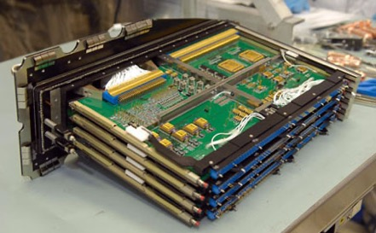
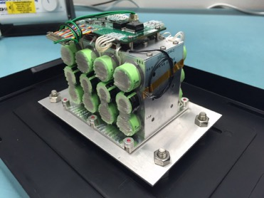
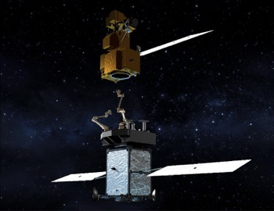
Our Systems are complex…

Slide 16
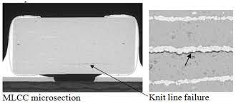
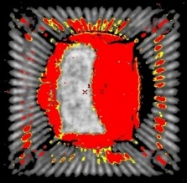
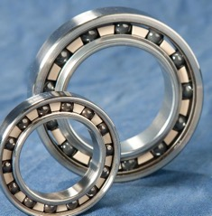
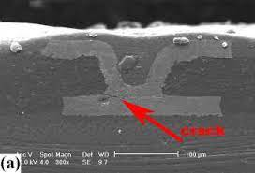
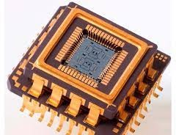
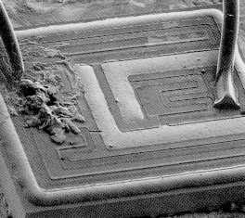

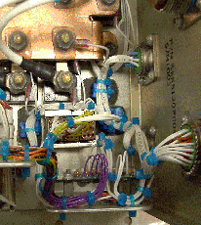
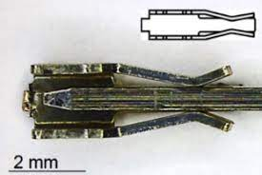

Competing failure mechanisms..

Slide 17
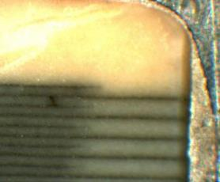
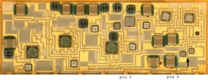
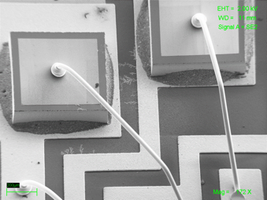
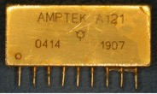
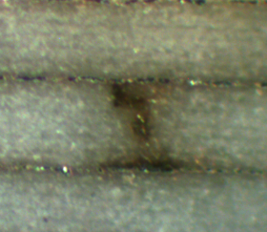
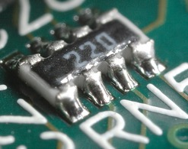
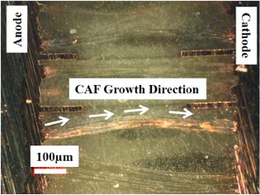
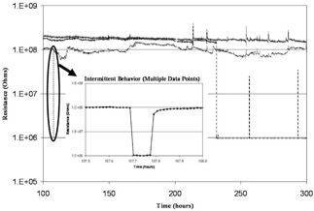
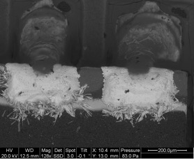
MLCC¹
45 µm
Actives²
20 µm
1 – NTRS 20210009630
2- Sood et. al.
2016 IEEE ASTR
Resistors³
PCB⁴
3 - 2012 IPC APEX
4 – NTRS 20200077449

Slide 18
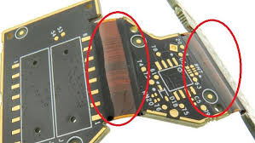
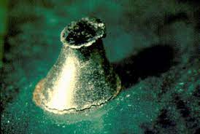
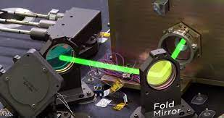
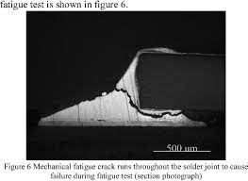
On assembly level..

Slide 19

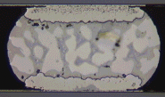
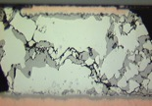
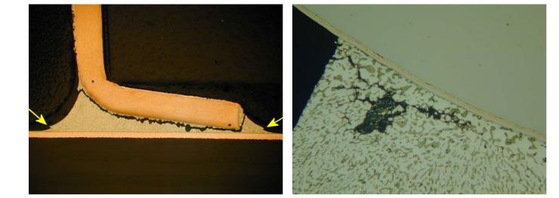
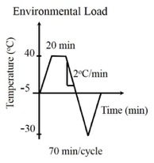
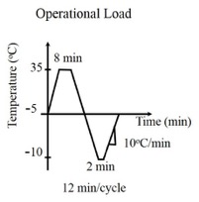
Cumulative Damage to Solder Joints Under Cyclic Thermo-mechanical Stresses¹
Damage accumulation
NTRS TN58543
Notes:
There are two fundamental forces that drive grains in polycrystalline materials to grow.
Grains coarsen because grain boundaries are areas of high potential energy.
This is the primary driving force in single-phase materials. During grain coarsening, as grains grow larger, the total grain boundary area decreases, which, in turn lowers the free energy of the system. Particles with smaller size tend to combine into a larger particle one with lower total interfacial energy. Grain growth is driven by the local boundary curvature and the presence of triple junctions, which remain in equilibrium and act as anchors to grain boundary mobility [1]. Grain boundary mobility is highly dependent upon grain orientations across the boundary.
In multiphase systems, the thermodynamic basis of phase coarsening is a combination of the driving force for grain coarsening and the Thomson-Freundlich solubility relationship [2].
Coarsening due to the application of mechanical energy occurs when the stress levels result in plastic deformation. Plastic deformation results in the production of an excess concentration of vacancies, which creates additional paths for material transport across phase boundaries. In binary alloys, coarsening during temperature cycling below the eutectic may also occur because of changes in the miscibility of the two phases [3].

Slide 20
A Diverse Set of Failure mechanisms
Overstress Mechanisms
Wearout Mechanisms
two key classes:
  overstress: strength; often sudden and catastrophic
  wearout: accumulation, extended usage or repeated stress
early life failures
  infant mortality: early in expected life
July 9, 2021

Slide 21
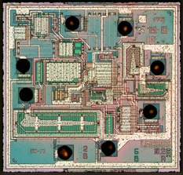
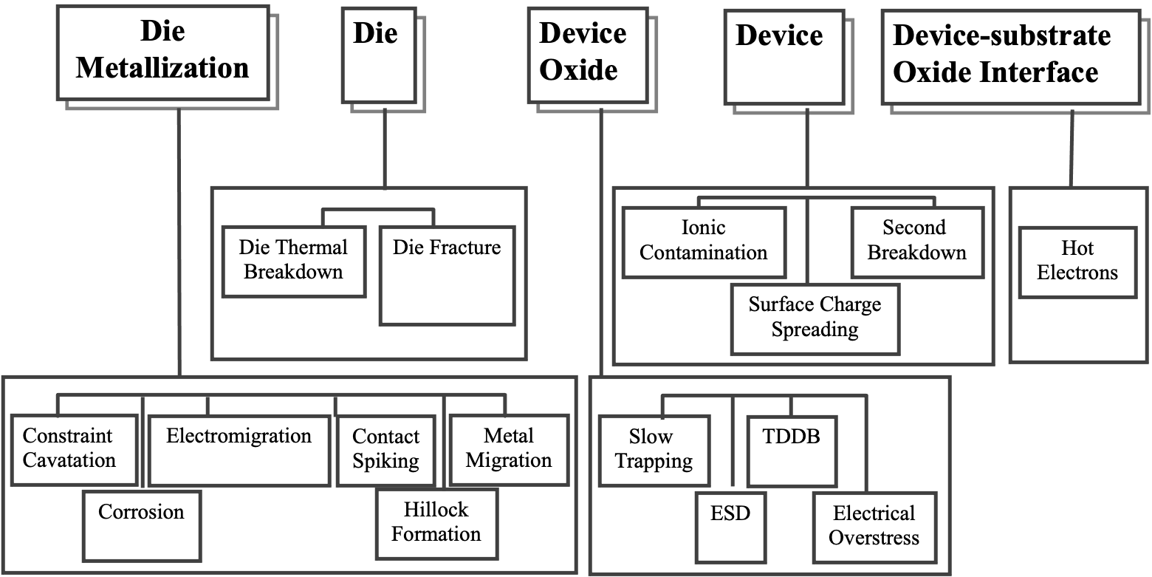
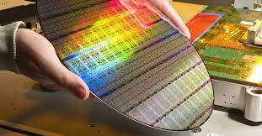
Failure mechanisms within devices

Slide 22
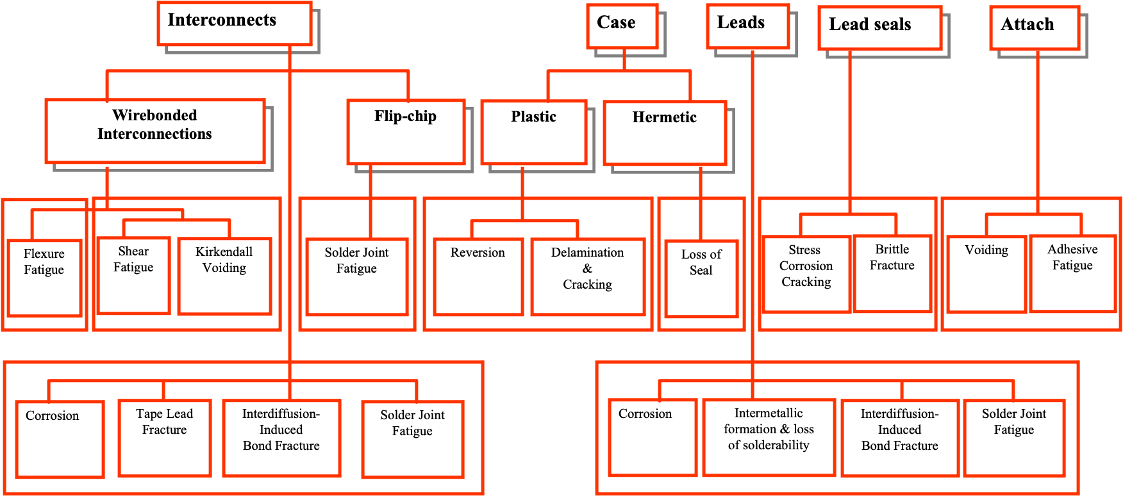
Package Level Failure mechanisms

Slide 23
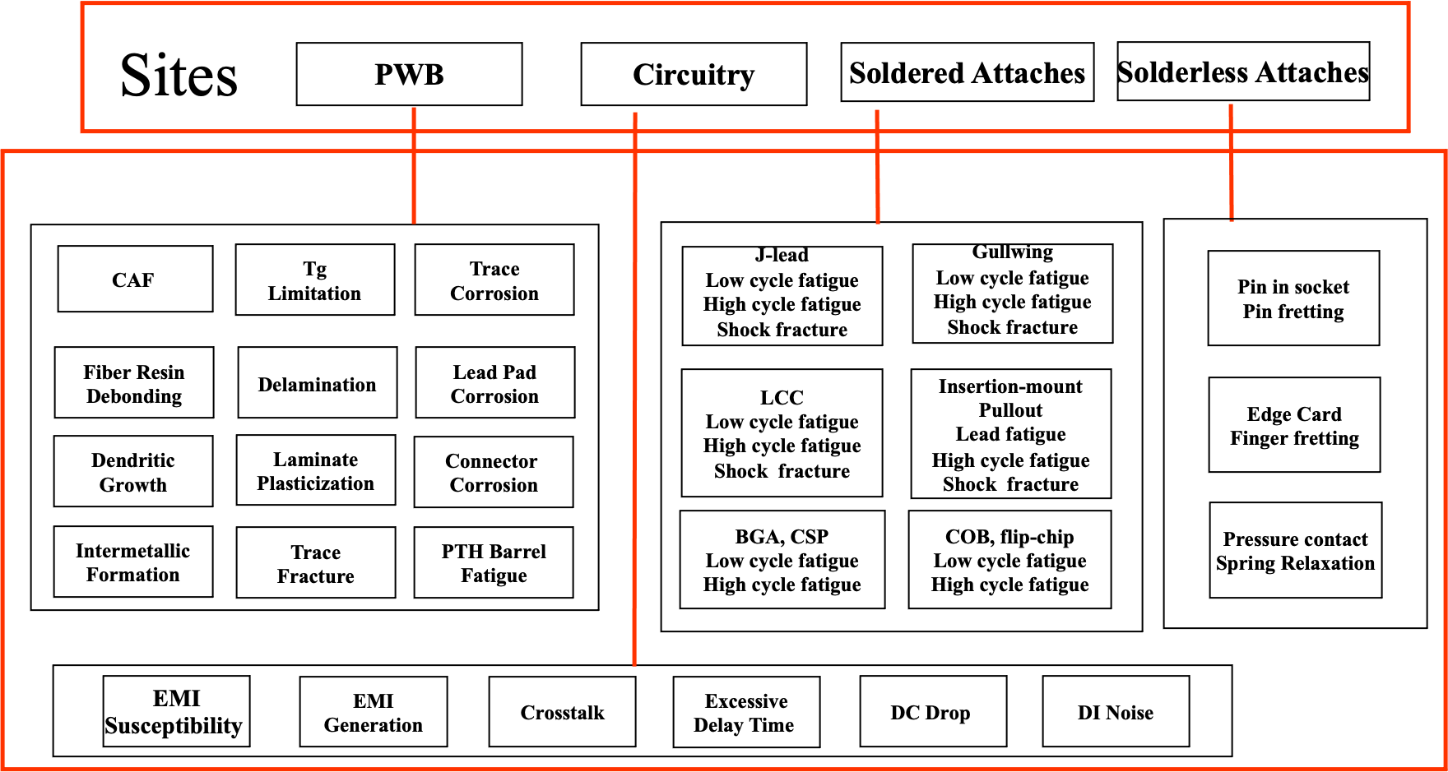
Failure Mechanisms in Populated Circuit Assemblies

Slide 24
System-level view of failures: ‘Bathtub’ curve
Why does the bathtub curve look the way it does?
What are the failures causes?
How to reduce failures and improve reliability?
Failure Distribution
(Weibull)
f(t)
le bain
Hyper-exponential
β <1
β > 1
exponential
β =1
Causes:
wearout
random
stress
time
Normalized pdfs
defective
nominal
strength

Slide 25
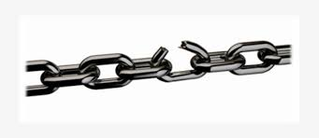
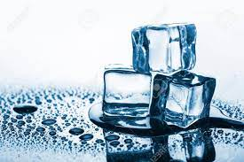

Durability versus Reliability
stress-strength interference
Interference Distribution
strength
stress
pdf
failures
change in mean
Durability contributes to reliability
Degradation
Physical parameter values
Property
Single event
cyclic
% Life
Notes:
https://www.youtube.com/watch?v=M-WMBctrlRg

Slide 26
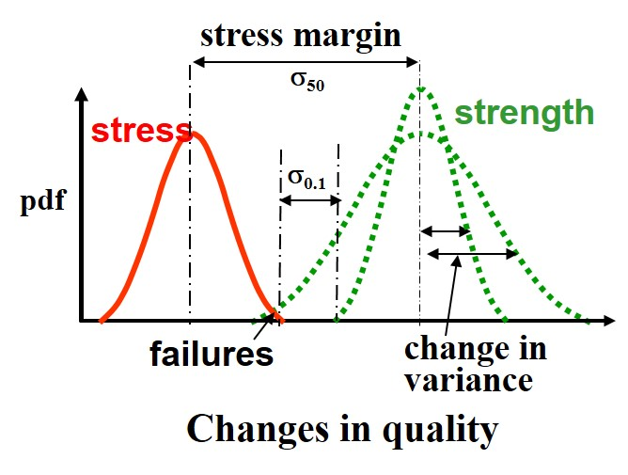
‘Quality’ versus ‘Reliability’

Slide 27

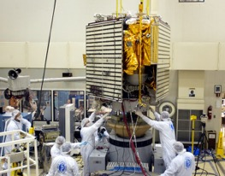
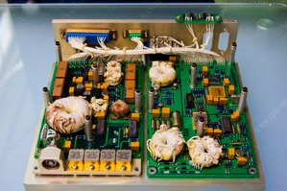
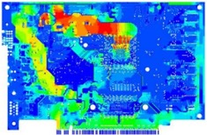
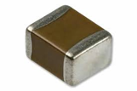


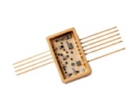
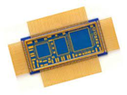
Upfront Reliability Assessment
Launch and post-launch
Life Cycle environmental and
Operational stresses
testing, storage, shipping, handling, transportation and usage
Manufacturing,
Assembly
Reliability estimates
Geometry, defects
materials, and
operational behavior
Failure Modes
Failure Mechanisms
Uncertainties across the supply chain

Slide 28
Failure Mechanism Identification
Overstress Mechanisms
Wearout Mechanisms
Mechanical
Fatigue,
Creep, Wear
Mechanical
Yield, Fracture,
Interfacial de-adhesion
Stress driven diffusion voiding (SDDV)
Glass transition (T_{g})
Phase transition
Thermal
Thermal
TDDB, Electromigration,
Surface charge spreading, Hot electrons, CAF, Slow trapping
Dielectric breakdown,
Electrical overstress,
Electrostatic discharge,
Second breakdown
Electrical
Electrical
Radiation
Radiation embrittlement,
Charge trapping in oxides
Radiation
Single event upset
Corrosion,
Dendrite growth,
Depolymerization,
Intermetallic Growth
Chemical
Chemical
Contamination

Slide 29
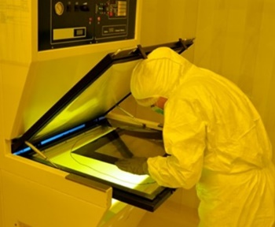
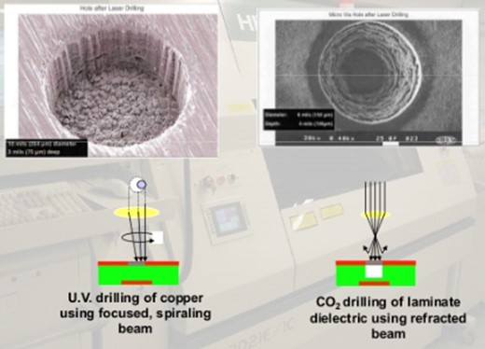
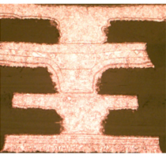
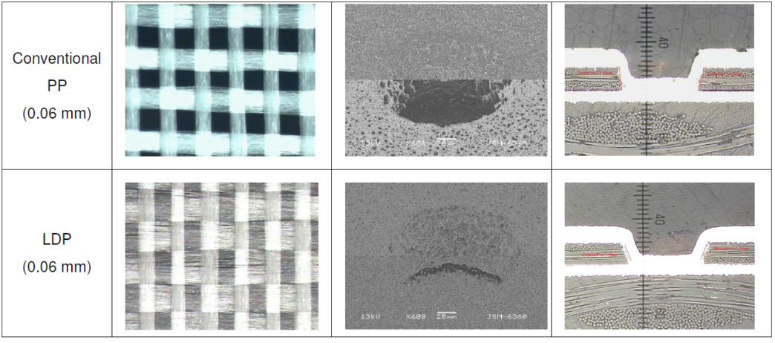
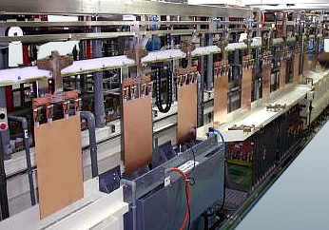

Quality Assurance Functions
In today’s compressed development cycles where rapid and cost-effective testing and analysis are key, a properly designed and executed quality assurance function (with appropriate reliability analysis) can enable products with robust design margins.
If the mission conditions are not well understood or the reliability analysis and accelerated testing are not conducted right, cost and schedule impacts, along with unexpected failures will add risk to a Project development cycle.
SOURCE: Industrial Laser Solutions. PCBShop.org

Slide 30


Printed Circuit Boards and Classification
Printed circuit boards are the baseline in electronic packaging – they are the interconnection medium upon which electronic components are formed into electronic systems.
  PCB materials are generally glass reinforced organic polyimide (epoxy, BT, ceramic are also used).
Classified on the basis of
  Dielectrics used
  Reinforcement
  Circuit type
  Component types
  Board construction
  Design complexity
Examples of Bare PCBs
Populated PCBA

Slide 31
Polyimide PCBA Supply Chain*
Glass Raw Materials
(Silica, Limestone, Clay, Boric Acid)
Glass Fiber Production
(Formation, Coating/Binders, Yarns)
Polyimide Raw Materials
(Petrochemical Derivatives)
Raw materials suppliers
E-Glass Plies/Fabrics
Prepregs/Cores
Flame Retardants
Fillers and Additives
Laminate suppliers
Copper Foil
Laminates
Consumables (e.g., etchants, cleaners)
Oxide Coatings
Printed Circuit
Board Panels w/Coupons
Drill Bits
Solder Mask/Silk Screen
ENIG/HASL/ENEPIG/OSP/other Plating
Design and Coupon Data
Board fabricators
Active/Passive/Discrete Electronic parts, HW
Assembly
Processes
AOI and Inspections
Solder, flux, cleaning chemistries
ICT, Tests, Burn-in
Assembly houses
* - Sood, Bhanu, and Michael Pecht. "Printed Circuit Board Laminates." Wiley Encyclopedia of Composites (2011).

Slide 32
Major Constituents of Laminates*
Constituent | Major function (s) | Example material (s)
Reinforcement | Provides mechanical strength and electrical properties | Woven glass (E-grade) fiber
Coupling agent | Bonds inorganic glass with organic resin and transfers stresses across the structure | Organosilanes
Matrix | Acts as a binder and load transferring agent | Polyimide
Curing agent | Enhances linear/cross polymerization in the resin | Dicyandiamide (DICY), Phenol novolac (phenolic)
Flame retardant | Reduces flammability of the laminate | Halogenated (TBBPA), Halogen-free (Phosphorous compounds)
Fillers | Reduces dissipatation (high frequency), thermal expansion and cost of the laminate | Silica, Aluminum hydroxide
Accelerators | Increases reaction rate, reduces curing temperature, controls cross-link density | Imidazole, Organophosphine
* - Sood, Bhanu, and Michael Pecht. "Printed Circuit Board Laminates." Wiley Encyclopedia of Composites (2011).
Notes:
32
Each of these constituents are important in its own, and in combination they determine the properties of the laminates

Slide 33






Supply Chain Example: Glass Treatments *
Glass Weave Style
Glass Weave Style
Glass Weave Style
1080 Style
2116 Style
7628 Style
Fiber/resin interphase delamination occurs due poor glass treatment.
* - Sood, Bhanu, and Michael Pecht. "The effect of epoxy/glass interfaces on CAF failures in printed circuit boards." Microelectronics Reliability (2017).

Slide 34


CAF in Printed Circuit Boards
PCB vendors continue to provide high performance materials that are represented to be resistant to conductive anodic filament (CAF), fiber pullout and laminate cracking.
In space applications, instances of CAF are rare due to the lack of adequate precursors and the controls applied during hardware development.
Halogen-free PCB Reliability Test and Failure Analysis, IST Group
Hu, Chaohui. "Study on the factors which affecting the conductive anodic filament reliability for packing substrate." Electronic Packaging Technology (ICEPT), 2017 18th International Conference on. IEEE, 2017.
Sood, Bhanu, and Pecht, Michael. "The effect of epoxy/glass interfaces on CAF failures in printed circuit boards." Microelectronics Reliability 82 (2018): 235-243.
Notes:
Contain electrical interconnects.
Primary structure to support components.
Conduct away heat.

Slide 35
Formation of Conductive Filaments ^{[1] [2]}
+
Oxidation Sites
−
Epoxy Resin
PTH
PTH
Glass Fiber
Low pH
Cu salt
Cu salt
Cu²⁺
Cu salt
Cu²⁺
Cu²⁺
Delamination
Cu salt
Cu salt
Cu salt
Cu²⁺
Low pH
Epoxy Resin
Low pH
Reduction Sites
Water Monolayers
CAF is a two step process: t_{failure} = t₁ + t₂ t₁>>t₂
t₁ - time for glass/epoxy degradation, t₂ - related to rate of electrochemical reaction
[1]. Rogers, Keith Leslie. An analytical and experimental investigation of filament formation in glass/epoxy composites. Diss. 2005.
[2]. Sood, Bhanu, and Pecht, Michael. "Conductive filament formation in printed circuit boards: effects of reflow conditions and flame retardants." Journal of Materials Science: Materials in Electronics 22.10 (2011): 1602.
Notes:
35
ANODE
The terminal or electrode from which electrons leave a system. In a battery or other source of direct current the anode is the negative terminal, but in a passive load it is the positive terminal. For example, in an electron tube electrons from the cathode travel across the tube toward the anode, and in an electroplating cell negative ions are deposited at the anode.
CATHODE
Negative terminal or electrode through which electrons enter a direct current load, such as an electrolytic cell or an electron tube, and the positive terminal of a battery or other source of electrical energy through which they return. This terminal corresponds in electrochemistry to the terminal at which reduction occurs. Within a gas discharge' tube, electrons travel away from the cathode, but positive ions (current carriers) travel toward the cathode.
The most common corrosion path is between a glass fiber and the epoxy resin. More details on this failure accelerator later in the presentation. Once this delamination occurs, the first and most important step is the introduction of the electrolyte – water. Monolayers of moisture, thickness of which is dependent upon the humidity and the moisture absorption properties of the epoxy resin, form along this delamination. Its even possible that water will condense. Ions present in the water. The corrosion mechanism initiates. Since humidity tends to be cyclic, or the level of electrolyte might vary along the path, the formation of a conductive path is cyclic. Copper aglomerates will form, due to a reduction reaction of copper ions. When the moisture level increases, an oxidation reaction will occur, forming copper ions, which under bias will drive towards the cathodic conductor. Eventually

Slide 36
Glass Fibers and Sizing Agents
Coupling agents are part of the sizings, they are functionally graded materials that act as adhesion promoters. [1] [2] [3]
  Sizing agents are typically composed of antistats, lubricant, surfactant, silanes and film formers.
  Silane act as molecular bridges between two chemically different materials (glass and epoxy matrix).
  Organo-functional group bonds to the organic resin and inorganic groups bond to the glass surface.
Sizing formulation chemistries and their proportions are closely held by glass suppliers and PCB suppliers
  “…we are not allowed to discuss any sizing or glass chemistry related topics outside by company policy. Hope for your understanding…” – Senior Staff Scientist, PPG Glass.
Optimizing the sizing layer is a complex art involving a compromise of manufacturing, marketing, technical and economic factors.
[1]. Mishra, Debasmita, and Alok Satapathy. “An investigation on the dielectric properties of epoxy filled with glass micro-spheres and boron nitride." (2012).
[2]. Mack, H. Choosing the Right Silane Adhesion Promoters for SMP Sealants, Adhesive and Sealant Council Meeting, Orlando, Fl, Spring 2001. Gelorme, J. D., & Kuczynski, J. (2010).
[3]. U.S. Patent Application No. 12/694,005.
Notes:
Hitachi uses a coupling agent called “FICS - filler interphase control systems”.
the various components for a typical coupling agents for thermosetting resins are as follows: antistats 3%, lubricant 4%, surfactant 4%, silane agent 10%, and film former 79%
X₃-Si-R
R- group includes vinyl, g-aminopropyl, and g-methacryloxypropyl that can react with the resin
X is such a group as chloro, methoxy, or ethoxy that can hydrolyze to form a silanol group in aqueous solution
and thereby react with a hydroxyl group of the glass surface.

Slide 37
Coupling Agents Used in FR4^{[1] [2]}
Dow Corning, BGF, Gelest are key suppliers.
Main silane types are:
  Aminosilanes
  Epoxy Silanes
  Vinyl Silanes
  Methacryl Silanes
  Alkylsilane
  Phenyl Silane
  Chlorosilane
Dow Corning Z-6032 tends to dominate the market (Vinylbenzylaminoethylaminopropyltrimethoxysilane).
Not all supply chains re-validate compatibility with changes in resin [2].
OH
HO
HO
Si
(CH₂)₃
OH
+
(CH₂)₃
NH₂
OH
HO
Hydrolyzable
group
Organofunctional group
Glass surface
Aminosilane
O
Si
(CH₂)₃
NH₂
O
(CH₂)₃
[1] Mittal, K. L., & Pizzi, A. (Eds.). (1999). Adhesion Promotion Techniques: Technological Applications. CRC Press.
[2] Scott Crane (personal communication, November 26, 2018).
O
Notes:
Dow Corning’s Z-6032 tends to dominate the market
Vinylbenzylaminoethylaminopropyltrimethoxysilane
[C6H4-CH2-NHC2H4NHC3H6-Si(OCH3)3)]
High water resistance and universal coupling agent
(pretty much works on all epoxy formulations)

Slide 38


Resin-Glass Interface/Interphase ^{[1] [2]}
The region between the glass and resin is a three-dimensional region between the bulk fiber and bulk resin, this includes:
  Area of contact (interface) between the fiber and the matrix
  Region of some finite thickness extending on both sides of the interface in both the fiber and resin matrix (interphase).
Sizing Application
Glass-resin interphase [2]
[1] Drzal, Lawrence T., Michael J. Rich, and Pamela F. Lloyd. "Adhesion of graphite fibers to epoxy matrices: I. The role of fiber surface treatment." The Journal of Adhesion 16.1 (1983): 1-30.
[2] Petersen, Helga Nørgaard, et al. Investigation of sizing-from glass fibre surface to composite interface. Diss. DTU Nanotech, 2017.
Notes:
mechanical winders or choppers pull the fibres at velocities up to 60 m/s
The sizing pickup occurs over a contact distance of less than 10 mm and therefore occurs in less than 0.5 ms.

Slide 39


FIB Experiments
Focused ion beam (FIB) removes the glass fibers selectively from the earlier mechanical planar microsection.
Beams with successively lower currents are then used to trim the face of the cut until the interphases of interest are imaged in the scanning electron microscopy (SEM).
Slight adjustments in the position of each trim cut are made based on observation of the progress.
Sood, Bhanu, and Pecht, Michael. "The effect of epoxy/glass interfaces on CAF failures in printed circuit boards." Microelectronics Reliability 82 (2018): 235-243.

Slide 40


FIB Sections – Glass/Resin Separation
FIB sectioning confirmed the presence of separation between a glass fiber and the epoxy in the PCB laminate.
Sood, Bhanu, and Pecht, Michael. "The effect of epoxy/glass interfaces on CAF failures in printed circuit boards." Microelectronics Reliability 82 (2018): 235-243.

Slide 41
Inter-penetrating Networks ^{[1] [2] [3]}
Diffused
O
Si
O
Si
O
O
O
Si
Time
O
Si
Glass Surface
O
Glass Surface
O
O
Si
O
Si
O
O
O
Si
O
Si
Chemically Bonded
Silane
Epoxy
Chemically Bonded
Hydrolyzed
Silane
Polymer
Sood, B., & Pecht, M. (2017). The effect of epoxy/glass interphases on CAF failures in printed circuit boards. Microelectronics Reliability.
Tomlin, Andrew Dermot. "Self-sensing composites: cure monitoring." (2010).
Halvorson, Rolf H., Robert L. Erickson, and Carel L. Davidson. "The effect of filler and silane content on conversion of resin-based composite." Dental Materials 19.4 (2003): 327-333.
Notes:
Whats is the M?

Slide 42
Hydrolysis of Siloxane Bonds
O
OH
HO
Si
(CH₂)₃
NH₂
Glass Fiber
O
(CH₂)₃
Glass Fiber
HO
Si
(CH₂)₃
OH
+
(CH₂)₃
NH₂
H₂O
O
OH
HO
Si₂O + H₂O → 2SiOH
As the PCBs absorb moisture and combined with the residual stresses at the glass-resin interphase, the hydrolysis reaction at the interphase between the glass and resin drives an “unzipping” of the bonded region.

Slide 43

Results of the Hydrolysis
Bulk Epoxy
H₂O
Covalently bonded siloxane and glass
H₂O
H₂O
H₂O
Glass Fiber

Slide 44
Printed Circuit Board Supplier Capability Overview

Slide 45
Bare PCB Suppliers*
* - “Challenges and Opportunities: State of the U.S. Bare Printed Circuit Board Industry” Crawford M. and Botwin B., IPC APEX Expo, February 11-16, 2017, San Diego CA. Reproduced with permission.
Notes:
U.S. Department of Commerce
Bureau of Industry and Security
Office of Technology Evaluation
Under Section 705 of the Defense Production Act of 1950 and Executive Order 13603, ability to survey and assess:
•Economic health and competitiveness
•Defense capabilities and readiness
Mandatory data collection authority under Section 705 of the DPA with data exempt from Freedom of Information Act (FOIA) requests

Slide 46
Support to U.S. Government Agencies*
* - “Challenges and Opportunities: State of the U.S. Bare Printed Circuit Board Industry” Crawford M. and Botwin B., IPC APEX Expo, February 11-16, 2017, San Diego CA. Reproduced with permission.
Notes:
About 30 suppliers providing PCBs indirectly
Approx. 20 providing the boards directly
3:2 ratio

Slide 47
Bare PCB Supplier Capabilities*
* - “Challenges and Opportunities: State of the U.S. Bare Printed Circuit Board Industry” Crawford M. and Botwin B., IPC APEX Expo, February 11-16, 2017, San Diego CA. Reproduced with permission.

Slide 48
Material Supply Chain Disruptions*
* - “Challenges and Opportunities: State of the U.S. Bare Printed Circuit Board Industry” Crawford M. and Botwin B., IPC APEX Expo, February 11-16, 2017, San Diego CA. Reproduced with permission.

Slide 49
Factors Causing PCB Production Bottlenecks*
* - “Challenges and Opportunities: State of the U.S. Bare Printed Circuit Board Industry” Crawford M. and Botwin B., IPC APEX Expo, February 11-16, 2017, San Diego CA. Reproduced with permission.

Slide 50



PCB Quality
In a vast majority of cases, NASA uses IPC standards (e.g., IPC-6012, 6013)
  IPC-6012 for rigid, IPC-6013 flex, IPC-6018 high speed etc..
Inspection include:
  Microsection evaluation (coupons)
  Surface finish evaluation (coupons)
Test include:
  External visual examination
  Electrical continuity and isolation
  Solderability (not 100% cases)
  Cleanliness
* - Eurocircuits
In some cases MIL, ESA or “in-house” standards are applied.
XRF Spectrum
PTH in Cross-section

Slide 51
Significance of Printed Circuit Board Requirements
The requirements and coupons are a “front door”.
Examples:
  Internal Annular Ring:
    Egregious violations indicate there may have been a serious problem in development of the board (layup or lamination).
    Other NCs don’t indicate any risk at all (example: application of IPC-6012 Rev B. vs IPC-6012 Rev. D)
  Negative etchback v/s positive etchback:
    Modern cleaning processes and flight experience result in equal reliability with both etchback conditions or no etchback.
  Wicking of copper:
    Requirements are conservative based on broad statistics.
    A basic analysis of the board layout can indicate directly if there is risk or not, regardless of requirements violations.

Slide 52
PCB Supplier Evaluation Study

Slide 53
Study Objective
  Evaluate a subset of GSFC PCB suppliers (direct or indirect) and corresponding PCB coupon microsection testing data.
  Develop a methodology for data generation and collection to provide trend analysis
    Identifies/predicts violation of a process limit criteria (in case of an egregious NC).
  Provide analysis for severity categories of the nonconformance.
  Provide recommendations to the suppliers (i.e., supplier quality engineering, continuous process monitoring, quality metrics definition).

Slide 54

Microsectioning
Suppliers perform microsectioning and inspect per specifications.
IPC - PCB Multi-Issue Microsection Wall Poster*
Secondary GSFC independent microsection analysis yielded 20-30% inspection rejects, caused by:
  Screening escapes:
    Test sample quality not consistent
    Supplier microsection process, inadequate coupons
  Requirement interpretations
  Requirements flow-down issues
    Alternative specifications (MIL, ECSS)
    Buying heritage and off-the-shelf designs
* - https://blog.ipc.org/2010/11/22/pcb-multi-issue-microsection-wall-poster/

Slide 55
Requirements, Nonconformance, Data Generation and Collection
Present study evaluates only the microsections performed by GSFC.
  PCB coupon microsection evaluation in accordance to IPC Standard (IPC-6018B Class 3, IPC-6012C Class 3/A).
  Coupon evaluation reports were generated, identified non-conformances.
All PCB coupon testing results from all GSFC suppliers were recorded for 3 years (from 2015 – 2017):
  Data include nonconformance and conformances in accordance with IPC Standards.
  Total number of data points are approximately 882 jobs.
  Each job has number of nonconformance with different severity.

Slide 56
Study Methodology
Since 2015, received and analyzed 882 PCB coupon submissions from PCB suppliers.
Top ten suppliers sent 638 submissions.
Total nonconformance observed: 260
For each supplier, analyzed nonconformance (s)
  Identify severity trend across top 10 GSFC suppliers by analyzing submission rate and nonconformance spread.
  Classifying and analyzing top 5 severity categories.

Slide 57

Data Analysis –Submission and Nonconformance for Supplier
638 submissions

Slide 58

Classification and Analysis - Top 5 Nonconformances
Twenty one distinct conformances observed among the ten suppliers

Slide 59
Analyzing Top 5 Severities of Supplier’s Nonconformance
Observations show the nonconformances with the most occurrences (7 out of 10 Suppliers) are D and F.
Investigated the contributors to implement techniques which may eliminate theses nonconformances from at least 7 suppliers.
(A) Inner layer separations/inclusions
(D) Separation/inclusions between plating layers
(E) Copper wicking in excess of 2.0 mil
(F) Internal annular ring less than 2.0 mil
(J) ENIG is less than the minimum requirements
Chart from: “Challenges and Opportunities: State of the U.S. Bare Printed Circuit Board Industry” Crawford M. and Botwin B., IPC APEX Expo, February 11-16, 2017, San Diego CA. Reproduced with permission.

Slide 60

Inner Layer Separations or Inclusions
Separation of inner-layer foil and the plated through hole barrel.
Inclusion - contaminant material that is present in an area where it is not expected.
Risk: intermittent electrical open or complete open after board is subjected to thermal excursions (reflow, wave soldering or rework)
IPC-6012 – Qualification and Performance Specification for Rigid Printed Boards.
Swirbel, Tom, Adolph Naujoks, and Mike Watkins. "Electrical design and simulation of high density printed circuit boards." IEEE transactions on advanced packaging 22.3 (1999): 416-423.

Slide 61
Inner Layer Separations or Inclusions
Contributors
Resolution
Improper lamination press or cure cycles whether it be pressure, time, temperature.
Others include inadequate coverage of inner layer oxide, moisture not completely removed in pre-lamination bake cycle.
Bad batch of prepreg and or laminate.
Post-electroless copper cleaning residues, contaminated pretreatment prior to electrolytic plating, or an out-of-control electrolytic copper process.
Consistency in drilling processes.
Reduce the resin content in the stack up.
Good desmear, with adequate texture.
Provide adequate copper border for support and resin venting.

Slide 62

Separation or Inclusions Between Plating Layers
Plating separation -The separation between a plating layer and foil.
Risk: intermittent electrical open or complete opens due to mechanical or thermal stresses.
IPC-6012 – Qualification and Performance Specification for Rigid Printed Boards.
Yung, Edward K., Lubomyr T. Romankiw, and Richard C. Alkire. "Plating of Copper into Through‐Holes and Vias." Journal of the Electrochemical Society 136.1 (1989): 206-215.

Slide 63
Separation or Inclusions Between Plating Layers
Contributors
Resolution
Incomplete wrap plating
Overly-aggressive cleaning process
Insufficient cleaning
Adjust plating parameters
Optimize cleaning processes

Slide 64

Copper Wicking in Excess of 2.0 mil
The extension of copper from a PTH along the glass fiber fabric.
Risk: intermittent electrical shorts or complete shorts due to bias driven migration of copper towards non-common conductors.
Sood, Bhanu, and Michael Pecht. "Printed Circuit Board Laminates." Wiley Encyclopedia of Composites (2011).
Tummala, Rao R., Eugene J. Rymaszewski, and Y. C. Lee. "Microelectronics packaging handbook." (1989): 241-242.
IPC-6012 – Qualification and Performance Specification for Rigid Printed Boards.

Slide 65
Copper Wicking in Excess of 2.0 mil
Contributors
Resolution
Optimize desmear parameters.
Improve drilling operation (feed and speed).
Ensure sufficient resin wet-out of glass fibers (siloxane treatment).
Dull drill bits or broken drill bits that cause a crack in the laminate.
Incompatible laminate material.
Insufficient glass etch.
Poor glass to organic adhesion.

Slide 66

Internal Annular Ring (IAR) Less Than 2.0 mil
This occurs, when the inner layer copper pad (measured from the hole wall plating to its outer most length) is less than 2 mils.
Risk: inner layer breakouts after the board is subjected to thermal excursions (reflow, wave soldering or rework) leading to intermittent electrical or complete open behavior.
These IAR non-conformances are to an older revision of the spec. IPC 6012 transitioned to 1mil IAR in Rev C.
Need more work to understand risk associated with < 1mil IAR.
IAR NC is a common one when working with high density design features. Most of our designs are high density.
Sood, Bhanu, and Sindjui, N. "A Comparison of Registration Errors Amongst Suppliers of Printed Circuit Boards“, Proceedings, IPC APEX Expo (2018).
IPC-6012 – Qualification and Performance Specification for Rigid Printed Boards.

Slide 67
Internal Annular Ring Less Than 2.0 mil
Contributors
Resolution
Drilled-hole pattern not matching the lands on the internal layers (Misregistration).
Lamination process.
Prelamination treatments that involve scrubbing or bending may stretch the thin laminate, which will then shrink after it is etched and baked dry.
Application of specification or drawing notes.
Better material selection of laminate, improved cleanliness, and reduction in the amount of volatiles.
Confirm whether or not it is operator error.
Update drawing notes to bring the notes in line with current industry maturity levels.

Slide 68
ENIG (Au or Ni) Less than the Minimum
Electroless nickel and/or immersion gold plating thickness (ENIG) is less than the minimum requirements (118 micro-inches for Ni and 2 micro-inches for Au).
XRF Spectrum
Risk: (1) solderability and, (2) excessive dissolution of copper into the bulk solder (forming brittle intermetallic) when nickel is thin.
Johal, Kuldip, and Jerry Brewer. "Are you in control of your electroless nickel/immersion gold process?." Proc. Of IPC Works. No. S03-3. 2000.
Meng, Chong Kam, Tamil Selvy Selvamuniandy, and Charan Gurumurthy. "Discoloration related failure mechanism and its root cause in Electroless Nickel Immersion Gold (ENIG) Pad metallurgical surface finish." Physical and Failure Analysis of Integrated Circuits, 2004. IPFA 2004. Proceedings of the 11th International Symposium on the. IEEE, 2004.
IPC-4552 – Specification for Electroless Nickel/Immersion Gold (ENIG) Plating for Printed Circuit Boards

Slide 69
ENIG Less than Minimum
Contributors
Resolution
Improper cleaning of surfaces.
Improper or inadequate rinsing.
Bath parameters not being followed (pH and chemical).
Bath temperature too low.
Copper surface not clean of oil or inhibiting film.
Re-clean copper using chemical cleaners or mechanical.
Scrubbing Institute micro-etch step to improve cleaning.
Improve rinsing( Check flow, agitation and water quality).
Raise temperature per supplier specifications.
Readjust to supplier operational parameters.

Slide 70
Summary - PCB Supplier Study
The test data is analyzed using statistical method to provide trend analysis for all suppliers.
  Root cause(s) and key contributors are identified.
  Mitigation plan is included for the root cause of nonconformance.
Provide recommendations to the supplier’s process, identification and prediction of nonconforming process limit criterion, and improve test standards.
New technologies (example: smaller annular rings, via-in-pads, thinner laminates or newer plating) are implemented on the basis of supplier maturity and reported NCs.

Slide 71
Reliability Topics - Failure Analysis
Notes:
71

Slide 72

What Causes Products to Fail?
Generally, failures do not “just happen.”
Failures may arise during any of the following stages of a product’s life cycle:
The damage (failure mode) may not be detected until a later phase of the life cycle.

Slide 73
What is Root Cause Analysis?
Root Cause analysis has four major objectives:
    Verify that a failure occurred;
    Determine the symptom or the apparent way a part has failed (the mode);
    Determine the mechanism and root cause of the failure;
    Recommend corrective and preventative action.
While generally synonymous, “Failure analysis” is commonly understood to include all of this except determination of root cause.

Slide 74
What is a Root Cause?
The root cause is the most basic causal factor or factors that, if corrected or removed, will prevent the recurrence of the situation.*
The purpose of determining the root cause(s) is to fix the problem at its most basic source so it doesn’t occur again, even in other products, as opposed to merely fixing a failure symptom. Identifying root causes is the key to preventing similar occurrences in the future.
    Ref: ABS Group, Inc., Root Cause Analysis Handbook, A Guide to Effective Incident Investigation, ABS Group, Inc., Risk & Reliability Division, Rockville MD.
Notes:
Root cause is defined in terms of corrective actions to prevent reoccurance.
Resoldering doesn’t prevent the recurrence

Slide 75
Root Cause Analysis is
Different from Troubleshooting
Troubleshooting is generally employed to eliminate a symptom in a given product, or to identify a failed component in order to effect a repair.
Root cause analysis is dedicated to finding the fundamental reason why the problem occurred in the first place, to prevent future failures.

Slide 76
From Symptoms to Root Causes
Symptoms are manifestations of a problem; signs indicating that a failure exists.
  Example: a symptom of printed circuit board failure could be the measurement of open circuits after fabrication.
An apparent cause (or immediately visible cause)
is the superficial reason for the failure.
  Example: the apparent cause of open circuits could be that traces have discontinuities that result in open circuits.
Root Cause is the most basic casual factor(s).
  Example: the root cause could arise during the manufacturing process if the circuit boards are stacked improperly, resulting in scratches to circuit traces. Another possible root cause could be the presence of contaminants during the copper trace etching process, which resulted in discontinuities in the traces.

Slide 77
Root Cause Analysis
Root cause analysis is a methodology designed to help:
  1) Describe WHAT happened during a particular occurrence,
  2) Determine HOW it happened, and
  3) Understand WHY it happened.
Only when one is able to determine WHY an event or failure occurred, will one be able to determine corrective measures, and over time, the root causes identified can be used to target major opportunities for improvement.
Uncovering ROOT CAUSE may require 7 iterations of “Why?”
Notes:
Think in terms of the manufacturing

Slide 78
Root Cause Analysis Process
Preplanning: Establish Root Cause Culture with Management Support and Responsibilities
Policy/procedures for notification
Classification system
Trained investigation team
Analysis procedures
Hypothesization Tools
Risk Analysis
The
Incident!
Alert / Notification : Begin Investigation
Secure evidence (data collection)
Assess immediate cause(s)
Interview witnesses
Hypothesize causes using tools such as Ishikawa (fishbone) diagram, and failure modes, mechanisms, and effects analysis (FMMEA)
Analyze and Interpret Evidence
Review documents and procedures, and check against standards
Conduct physical evaluation
(core of the FA process)
Validate hypotheses
Identify Root Cause (s)
Identify Restart Criteria
Implement Corrective Actions and/or Document Resolutions
Conduct a Follow-up Audit, Confirm Effectiveness, then Critique and Modify Process
Develop Corrective Actions
Notes:
Draw Ishikawa diagram cause + effect sides (materials, machines, measurements, method, environment)
Did I go through this process
Did I conduct a fish bone
Elliot may want to walk me through this with Apple perspective
Based on: Root Cause Analysis Handbook
Shows how the process should be done, not done in this case

Slide 79
Hypothesizing Causes
Hypothesizing causes is the process of applying knowledge of risks associated with a product’s design and life cycle to the data gathered about the failure event, in order to postulate a root cause.
Tools for hypothesizing causes:
  Failure modes, and effects analysis (FMEA)
  Fault tree analysis (FTA)
  Cause and effect diagram – Ishikawa diagram (fishbone analysis)
  Pareto analysis

Slide 80
Reliability Tools for Hypothesizing Root Causes

Slide 81
FMEA Methodology
Failure modes and effects analysis is an approach for identifying all possible failures in a design, a manufacturing or assembly process, or a product or service.
Knowledge of stresses is combined with failure models to prioritize failure mechanisms according to their severity and likelihood of occurrence.
Step 1. Identify a failure mode
Step 5. Calculate a RPN (=S*O*N)
Step 2. Identify a severity number
Step 4. Establish a likelihood of detection.
Step 3. Identify a probability of occurrence
Notes:
Failure Modes and Effects Analysis (FMEA) is an approach used to examine potential failures and prevent their occurrence.
FMEA was developed in the early 60s by NASA and later adopted by US navy in the 70’s and in the late 80’s by the automotive industry.
FMEA provides a system of ranking, or prioritization of potential failure modes associated with the designing and manufacturing of a new product or a change to an existing product.
FMEA does not identify the failure mechanisms that affect the product.
Failure Modes, Effects and Criticality Analysis (FMECA) is an extension of FMEA and was developed to include techniques to assess the probability of occurrence and criticality of potential failure modes.
Failure Modes, Mechanisms and Effects Analysis (FMMEA) uses life cycle profile of a product along with the design information to identify the critical failure mechanisms affecting a product.
Knowledge of the causes and consequences of these critical failure mechanisms helps in:
Product design
Qualification
Accelerated testing
Root cause analysis

Slide 82
Fault Tree Analysis
Blackout
In contrast with the “bottom up” assessment of FMEA, fault-tree is a “top down” analysis that starts qualitatively to determine what failure modes can contribute to an undesirable top level event.
It aims at developing the structure from which simple logical relationships can be used to express the probabilistic relationships among the various events that lead to the failure of the system.
AND
Off-site power loss
Emergency system failure
OR
Voltage monitor failure
Diesel generator failure
Notes:
Fault-tree analysis (FTA) is a deductive methodology for determining the potential causes of failures and for estimating the failure probabilities.
A blackout occurs if both the off-site power and the emergency power fail. The emergency power fails if either the voltage monitor or the diesel generator fail.
(The voltage monitor signals the diesel generator to start when the offsite voltage falls below a threshold level.)

Slide 83
Cause and Effect Diagram (Electrical Opens in PCBs)
Ref: Coombs C. F. "Printed circuits handbook." Printed Circuits Handbook. McGraw-Hill Professional Publishing (2007).
Notes:
The “cause and effect” diagram allows a team to identify, explore, and graphically display the possible causes related to a problem or condition.
It also:
Enables a team to focus on the content of the problem, not on the history of the problem or differing personal interests of team members.
Creates a snapshot of the collective knowledge and consensus of a team around a problem. This builds support for the resulting solutions.
The “cause and effect” diagram is also called a “Fishbone” diagram or an “Ishikawa” diagram.

Slide 84
Cause and Effect Diagram (Electrical Shorts in PCBs)
Ref: Sood B., and Pecht M., 2011. Printed Circuit Board Laminates. Wiley Encyclopedia of Composites. 1–11.

Slide 85
Cause and Effect Diagram (Delamination in PCBs)
Ref: Sood B., and Pecht M., 2011. Printed Circuit Board Laminates. Wiley Encyclopedia of Composites. 1–11.

Slide 86
Pareto Chart Example
- Failure Causes in Electronic Devices -
Ref: Pecht M. and V. Ramappan: “Review of Electronic System and Device Field Failure Returns,” IEEE Transactions on CHMT, Vol. 15, No. 6, pp. 1160-1164, 1992.
Notes:
Pareto Chart displays the problems that offer the greatest potential for improvement by showing their relative frequency or size.
The Pareto Chart:
Helps prevent “shifting the problem” where a “solution” can remove some causes but worsen others.
Helps a team to focus on those causes that will have the greatest impact if solved.
Does not take specific circumstances of a particular failure event into account, but helps guide root cause analysis efforts based on prior history.

Slide 87
Collecting Supporting Evidence
Even if a root cause has been hypothesized, additional evidence is often required to assess (i.e., prove or invalidate) the hypotheses formulated.
Evidence can be gathered by
  undertaking sample physical evaluation.
  reviewing documents and procedures against standards, and
  interviews

Slide 88
Analysis and Interpretation of Evidence
Reviewing in-house procedures
  (e.g., design, manufacturing process, procurement, storage, handling, quality control, maintenance, environmental policy, safety, communication or training procedures)
…against corresponding standards, regulations, or part- and equipment vendor documentation
  (e.g., part data sheet and application notes, equipment operating and maintenance manuals)
….can help identify causes such as misapplication of equipment, and weakness in a design, process or procedure.
  Example 1: misapplication of a component could arise from its use outside the vendor specified operating conditions (e.g., current, voltage, or temperature).
  Example 2: equipment (e.g., assembly, rework or inspection equipment) misapplication can result from uncontrolled modifications or changes in the operating requirements of the machine.
  Example 3: a defect may have been introduced due to misinterpretation of poorly written assembly instructions.

Slide 89
General Approach Used for Failure Analysis
The overriding principle of failure analysis is to start with the least destructive methods and progress to increasingly more destructive techniques.
The potential for a nominally non-destructive technique to cause irreversible changes should not be underestimated.
  For example, the simple act of handling a sample, or measuring a resistance, can cause permanent changes that could complicate analysis further down the line.
Each sample and failure incidence may require a unique sequence of steps for failure analysis. The process demands an open mind, attention to detail, and a methodical approach.

Slide 90
Example of Failure Analysis Process Flow
Occurrence of
Failure
Preservation of Failure
Investigation of Failure
Occurrence Circumstances
Non-Destructive Analysis
of Failure
Electrical Test/
Verification of Failure/
Classification of Failure Mode
Intermittent
Reliability Test/
Simulation of
Failure Circumstances
Deprocessing (Destructive
Physical Analysis
In-Circuit Evaluation
Identification of Failure Site
Physical Analysis
Hypothesis of
Failure Mechanism
Root Cause Determination
Corrective Action
Verification &
Documentation

Slide 91
Non-Destructive Testing (NDT)
Visual Inspection
Optical Microscopy
X-ray imaging
X-ray Fluorescence Spectroscopy
Acoustic microscopy
Residual gas analysis
Hermeticity Testing

Slide 92
External Inspection
Visual inspection of external condition
  Differences from good samples
  May require exemplars
Detailed inspection: appearance, composition, damage, contamination, migration, abnormalities
  Low power microscope
  High power microscope
  Scanning electron microscope (SEM)

Slide 93
Electrical Testing
Electrical characteristics/performance
DC test
Parametrics (current-voltage characteristic)
Simulated usage conditions
Electrical probing

Slide 94

Deprocessing:
Destructive Physical Analysis (DPA)
Modification of specimen in order to reveal internal structures and analyze failure site. May involve:
  Cross-sectioning and metallography
  Decapsulation or delidding
  Residual Gas Analysis for internal gases

Slide 95
Fault Isolation
Electrical Probing
Time Domain Reflectometry (TDR)
Electron Beam Testing
  electron beam induced current (EBIC),
  voltage contrast (VC),
  cathodoluminescence (CL)
Emission Microscopy
Scanning Probe Microscopy
Thermal Analysis

Slide 96
Physical Analysis of Failure Site
Notes:
96
Ideas here are fuzzy

Slide 97
Root Cause Identification
Testing may be needed to determine the effect of hypothesized factors on the failure.
A design of experiment (DoE) approach is recommended to incorporate critical parameters and to minimize the number of tests.
This experimentation can validate a hypothesized root cause.

Slide 98
Reliability Topic – Failure Mechanisms

Slide 99
Review: Failure Definitions
Failure | A product no longer performs the function for which it was intended
Failure Mode | The effect by which a failure is observed.
Failure Site | The location of the failure.
Failure Mechanism | The physical, chemical, thermodynamic or other process that results in failure.
In principle, it should be possible to develop a failure model for a specific failure mechanism, expressing the likelihood of failure (time-to-failure, probability of failure, strength, etc.) as a function of the stresses and characteristics of the material.

Slide 100
Review: Classification of Failures
Key classes of failure:
  overstress: use conditions exceed strength of materials; often sudden and catastrophic
  wearout: accumulation of damage with extended usage or repeated stress
  infant mortality: failures early in expected life; typically related to quality issues.

Slide 101
Examples of Failure Models
Failure Mechanism | Failure Sites | Relevant Stresses | Sample Model
Fatigue | Die attach, Wirebond/TAB, Solder leads, Bond pads, Traces, Vias/PTHs, Interfaces | Cyclic Deformations ( Δ T, Δ H, Δ V) | Nonlinear Power Law (Coffin-Manson)
Corrosion | Metallizations | M, ΔV, T, chemical | Eyring (Howard)
Electromigration | Metallizations | T, J | Eyring (Black)
Conductive Anodic Filament Formation | Between Metallizations | M, ΛV | Power Law (Rudra)
Stress Driven Diffusion Voiding | Metal Traces | σ, T | Eyring (Okabayashi)
Time Dependent Dielectric Breakdown | Dielectric layers | V, T | Arrhenius (Fowler- Nordheim)
Δ: Cyclic range V: Voltage
Λ: gradient M: Moisture
T: Temperature J: Current density
H: Humidity σ: Stress

Slide 102
ESD/EOS Induced IC Failure Modes and Sites
Electrostatic discharge (ESD)/Electrical overstress (EOS) damage to an electrical circuit occurs due to electrical or thermal overstress during a transient electrical pulse.
Electrically, ESD and EOS can manifest as
Opens
Shorts
Increased leakage
Parametric shift
Physically, ESD and EOS can cause
Melted bonding wires
Molding compound burning
Junction failure
Gate oxide breakdown
Discoloration
Contact spike
Gate metal fusing
Gate metal fusing
Junction burnout
Gate oxide rupture
Gate oxide rupture
Lee, T. W., ‘ESD and EOS- There Is a Difference’, Commercialization of Military and Space Electronics Conference, pp. 49-65, 2002.

Slide 103
Board Level Failures (examples)
Plated Through Hole (PTH)/Via
1. Fatigue cracks in PTH/Via wall
2. Overstress cracks in PTH/Via wall
3. Land corner cracks
4. Openings in PTH/Via wall
5. PTH/Via wall-pad separation
Electrical
6. Electrical overstress (EOS)
7. Signal interruption (EMI)
Board
8. CAF (hollow fiber)
9. CAF (fiber/resin interface)
10. Electrochemical migration (ECM)
11. Buckling (warp and twist)
Copper Metallization
12. Cracks in internal trace
13. Cracks in surface trace
14. Corrosion of surface trace

Slide 104
Assembly Level Failures (examples)
Solder Interconnect
Poor Solderability/Wettability
  Tombstoning; Can accelerate other solder failure mechanisms
Overstress Interconnect Failures
  Solder Fracture (accelerated by intermetallic formation)
Wearout Interconnect Failures
  Solder Fatigue, Solder Creep
Solder Bridging
Component Failure due to Handling

Slide 105


ECM: Surface and Sub-surface Mechanisms
Positive
Anode
Negative
Cathode
Positive
Anode
Positive
Anode
150 µm
Negative
Cathode
300 µm
ECM | Conductive Anodic Filament (CAF) | Dendritic Growth
Growth Direction | Anode to cathode | Cathode to anode
Filament Composition | Metallic salt | Pure metal
Growth Position | Internal | Surface
Ref: Sood, Bhanu, Michael Osterman, and Michael Pecht. "An Examination of Glass-fiber and Epoxy Interface Degradation in Printed Circuit Boards.“ and Zhan, Sheng, Michael H. Azarian, and Michael Pecht. "Reliability of printed circuit boards processed using no-clean flux technology in temperature–humidity–bias conditions." Device and Materials Reliability, IEEE Transactions on 8.2 (2008): 426-434.
Notes:
Conductive anodic filament formation (CAF), also referred to as metallic electromigration, is an electrochemical process which involves the transport of a metal across a nonmetallic medium under the influence of an applied electric field.
CAF can cause current leakage, intermittent electrical shorts and dielectric breakdown between conductors in printed wiring boards.
Because of its nature of self-healing and the initiation of electrical shorts, it is a common cause of Can Not Duplicate (CND) or Can Not Find (CNF) failures and ignition and burning on PCBAs.

Slide 106
Formation of Conductive Filaments ^{[1] [2]}
+
Oxidation Sites
−
Epoxy Resin
PTH
PTH
Glass Fiber
Cu
Cu
Cu²⁺
Cu
Cu²⁺
Cu²⁺
Delamination
Cu
Cu
Cu
Cu²⁺
Epoxy Resin
Reduction Sites
Water Monolayers
A two step process: t_{failure} = t₁ + t₂ t1>> t2
Rogers, K. L. (2005). An analytical and experimental investigation of filament formation in glass/epoxy composites (Doctoral dissertation).
Sood, B., & Pecht, M. (2011). Conductive filament formation in printed circuit boards: effects of reflow conditions and flame retardants. Journal of Materials Science: Materials in Electronics, 22(10), 1602-1615.
Notes:
106
Factors that influence CAF include conductor spacing, hollow fibers, drill defects, poor epoxy wet-out, bias, moisture and ion concentration.
The most common corrosion path is between a glass fiber and the epoxy resin. More details on this failure accelerator later in the presentation. Once this delamination occurs, the first and most important step is the introduction of the electrolyte – water. Monolayers of moisture, thickness of which is dependent upon the humidity and the moisture absorption properties of the epoxy resin, form along this delamination. Its even possible that water will condense. Ions present in the water. The corrosion mechanism initiates. Since humidity tends to be cyclic, or the level of electrolyte might vary along the path, the formation of a conductive path is cyclic. Copper aglomerates will form, due to a reduction reaction of copper ions. When the moisture level increases, an oxidation reaction will occur, forming copper ions, which under bias will drive towards the cathodic conductor. Eventually

Slide 107

PTH-PTH (6 mil) 10V, 85°C/85% RH ^{[1]}
Factors
Voltage gradient
Humidity
Conductor spacing
Ion concentration in epoxy resin
Contributors
Fiber/resin separation
Thermal excursions
Hollow fibers
Wicking
Drilling damage
[1] Sood, B., & Pecht, M. (2011). Conductive filament formation in printed circuit boards: effects of reflow conditions and flame retardants. Journal of Materials Science: Materials in Electronics, 22(10), 1602-1615.

Slide 108



Importance of the Epoxy/Glass Interface ^{[1] [2]}
Path formation for CAF is often along the glass fiber to epoxy matrix interphase.
Hollow fiber
2um
Path formation step (t₁) for CAF is eliminated when hollow glass fibers are present.
Fiber/resin interphase delamination occurs due to coefficient of thermal expansion (CTE) mismatch (shear) induced weakening or bond degradation.
[1] IPC-9691, User guide for the IPC-TM-650, method 2.6.25, conductive anodic filament (CAF) resistance and other internal electrochemical migration testing.
[2] Shukla, A. (1997). Hollow fibers in woven laminates. Print Circ Fab, 20(1), 30-32.
Notes:
Mention CFF path configurations, PTH-PTH, trace to trace or PTH to plane (or trace)

Slide 109



CAF Paths
A. Between two plated-through holes (PTHs)
B. Between two traces
C. Between a trace and a plated-through hole (PTH)
Ref: Rogers, Keith, et al. "Conductive filament formation failure in a printed circuit board." Circuit World 25.3 (1999): 6-8.

Slide 110


Factors Affecting CAF:
PCB Internal Conductor Spacings
PTH-to-PTH spacings
PTH to plane spacings
Ref: Rogers, Keith, et al. "Conductive filament formation failure in a printed circuit board." Circuit World 25.3 (1999): 6-8.

Slide 111



Factors Affecting CAF:
Board Orientation Respective to Fabric Weave
The initial set of parallel fiber bundles, known as the warp, lie in the machine direction
90 degrees
A second set of parallel fiber bundles, known as the fill or weft, is woven through the first set
45 degrees
Ref: Rogers, Keith Leslie. "An analytical and experimental investigation of filament formation in glass/epoxy composites." (2005).

Slide 112

Effect of Voltage and Humidity on
Time to Failure
Solder mask over bare copper with post coat
Ref: Rogers, Keith Leslie. "An analytical and experimental investigation of filament formation in glass/epoxy composites." (2005).

Slide 113

Fiber/Resin Interface Delamination
Fiber/resin interface delamination occurs as a result of stresses generated under thermal cycling due to a large CTE mismatch between the glass fiber and the epoxy resin
(ratio of 1 to 12).
Delamination
Delamination can be prevented/resisted by selecting resin with lower CTE’s and optimizing the glass surface finish. Studies have shown that the bond between fiber and resin is strongly dependent upon the fiber finish.
Ref: Rogers, Keith Leslie. "An analytical and experimental investigation of filament formation in glass/epoxy composites." (2005).

Slide 114
Hollow Fibers
Hollow fibers are vacuous glass filaments in E-glass laminates that can provide paths for CAF.
With the appearance of hollow fibers inside the laminates, CAF can happen as a one step process. In this case, the number of hollow fibers inside the laminates is most critical to reliability.
Ref: Rogers, Keith Leslie. "An analytical and experimental investigation of filament formation in glass/epoxy composites." (2005).

Slide 115


Images of Hollow Fibers
Ref: Rogers, Keith Leslie. "An analytical and experimental investigation of filament formation in glass/epoxy composites." (2005).

Slide 116

Drilling
Drilling damage can accelerate CAF through
Fiber/resin delamination,
Creation of paths for moisture to accumulate
Wicking due to cracking of the board material
Drilling Damage
Ref: Rogers, Keith Leslie. "An analytical and experimental investigation of filament formation in glass/epoxy composites." (2005).

Slide 117

PTH-Resin Separation
In both of these SEM pictures, a separation can be seen at the copper plating to fiber epoxy resin board interface. These gaps provide an accessible path for moisture to accumulate and CAF to initiate. These voids can be adjacent to inner-layer copper foil or to the PTH barrel and normally result from contraction of the epoxy (resin recession) due to the heat of thermal stress.
Ref: Rogers, Keith Leslie. "An analytical and experimental investigation of filament formation in glass/epoxy composites." (2005).

Slide 118
Background on Dendritic Growth
Dendritic Growth is a form of electrochemical migration (ECM) involving the growth of conductive filaments on or in a printed circuit board (PCB) under the influence of a DC voltage bias. [IPC-TR-476A]
+
-
DC voltage source
Plating
Solder alloy
Anode (Cu)
Ion transport
Cathode (Cu)
Substrate
Adsorbed Moisture
Necessary Conditions for ECM
  Electrical carriers (ions).
  A medium, usually water, to dissolve the ionic materials and sustain them in their mobile ionic state.
  Electrical potential between the electrodes to establish an ionic current in the liquid medium.
Stages of ECM
  Path formation
  Electrodissolution
  Ion transport
  Electrodeposition
  Filament growth
He, Xiaofei, M. Azarian, and M. Pecht. "Effects of solder mask on electrochemical migration of tin-lead and lead-free boards." IPC printed circuit Expo, APEX & Designer summit proceedings.

Slide 119


Electrochemical Migration
Ref: He, Xiaofei, M. Azarian, and M. Pecht. "Effects of solder mask on electrochemical migration of tin-lead and lead-free boards." IPC printed circuit Expo, APEX & Designer summit proceedings and Ambat, Rajan, et al. "Solder flux residues and electrochemical migration failures of electronic devices." Eurocorr proceedings, Nice 10.1.3321953 (2009).

Slide 120
Contaminants
Halide residues, such as chlorides and bromides, are the most common accelerators of dendritic growth.
Chlorides are more detrimental, but easier to clean
Bromides can resist cleaning; often require DI water with saponifier
In general, an increased risk of ECM will tend to occur once the levels of chloride exceed 10μg/in² or bromide exceeds 15μg/in²
Rapid failure can occur when contaminant levels exceed 50μg/in²
Ref: He, Xiaofei, M. Azarian, and M. Pecht. "Effects of solder mask on electrochemical migration of tin-lead and lead-free boards." IPC printed circuit Expo, APEX & Designer summit proceedings and Ambat, Rajan, et al. "Solder flux residues and electrochemical migration failures of electronic devices." Eurocorr proceedings, Nice 10.1.3321953 (2009).

Slide 121
What Are the Sources of Contaminants?
Board Manufacturing
  Flame-proofing agents
  Copper plating deposits
  Etchants
  Cleaners
  Fluxes (for HASL coatings)
  Poorly polymerized solder masks
  “Fingerprints”
Assembly
  Fluxes
  Solder paste residues
  “Fingerprints”
Environmental
  Liquid (e.g., salt spray)
  Gaseous (e.g., Cl₂)
Ref: He, Xiaofei, M. Azarian, and M. Pecht. "Effects of solder mask on electrochemical migration of tin-lead and lead-free boards." IPC printed circuit Expo, APEX & Designer summit proceedings and Ambat, Rajan, et al. "Solder flux residues and electrochemical migration failures of electronic devices." Eurocorr proceedings, Nice 10.1.3321953 (2009).

Slide 122
Plated Through Hole (PTH) Failures
Circumferential cracking
  Single event overstress
  Cyclic fatigue
Openings (voids, etch pits) accelerate circumferential cracking
Wall-Pad Separation
  Also known as “breakout of internal lands” or “plated-barrel separation”
Pad
corner crack
PTH
Etch pit
Wall-Pad
separation
Ref: Bhandarkar, S. M., et al. "Influence of selected design variables on thermo-mechanical stress distributions in plated-through-hole structures." Journal of Electronic Packaging 114.1 (1992): 8-13.
Circumferential crack
Board
Pad
delamination

Slide 123


1. Circumferential Cracking –
Single Event Overstress
Since the difference in the coefficient of thermal expansion (CTE) of the copper plating and the resin system in the PWBs is at least a factor of 13, stress exerted on the plated copper in the plated-through holes in the z-axis can cause cracking.
Ref: Bhandarkar, S. M., et al. "Influence of selected design variables on thermo-mechanical stress distributions in plated-through-hole structures." Journal of Electronic Packaging 114.1 (1992): 8-13.

Slide 124
Single Event Overstress (cont.)
Failure Mode
  Complete electrical open
Failure History
  Primarily occurs during assembly; may not be detected until after operation
Root-Causes
  Excessive temperatures during assembly
  Resin Tg below specification
  Insufficient curing of resin
  Outgassing of absorbed moisture
  Plating folds
  PTH wall recession
  Resin-rich pockets adjacent to PTH
  Insufficient mechanical properties of deposited copper
  Plating voids
  Etch pits
  Insufficient PTH wall thickness

Slide 125
Design Considerations to Avoid Fatigue Damage in PTHs
PTH Spacing
  Decreasing spacing improves mechanical reliability
Aspect Ratio
  Decreasing board thickness more effective than increasing hole diameter
Plating Thickness
  Increasing leads to increasing in fatigue strength
Nonfunctional Internal Pads
  Minimal effect. Results in localized stress relief; most effective when results in elimination of resin-rich areas
Ref: Kapur, Kailash C., and Michael Pecht. Reliability engineering. John Wiley & Sons, 2014.

Slide 126
Root-Cause Analysis of Circumferential Fatigue Cracking
Failure Mode
  Intermittent to complete electrical open
Failure History
  Requires an environment with temperature cycling; often occurs after extended use in the field (“child” or “teenage” mortality)
Root-Causes
  Resin CTE below specification
  Plating folds
  PTH wall recession
  Resin-rich pockets adjacent to PTH
  Customer use exceeds expected environment
  Insufficient mechanical properties of deposited copper
  Presence of overstress crack
  Plating voids
  Etch pits (“mouse bites”)
  Insufficient PTH wall thickness

Slide 127


2. Openings in PTH Walls
Optical micrograph of cross section of PTH with etch damage
Electron micrograph of same PTH shown on left
Overetching can cause electrical opens or induce overstress circumferential cracking
Ref: Bhandarkar, S. M., et al. "Influence of selected design variables on thermo-mechanical stress distributions in plated-through-hole structures." Journal of Electronic Packaging 114.1 (1992): 8-13.

Slide 128


Evidence of Overetching
Optical micrograph of cross section of PTH with etch damage (bright field)
Optical micrograph of cross section of PTH with etch damage (dark field)
Evidence of overetching can include reduced plating thickness and discoloration of PTH barrel walls
Ref: Bhandarkar, S. M., et al. "Influence of selected design variables on thermo-mechanical stress distributions in plated-through-hole structures." Journal of Electronic Packaging 114.1 (1992): 8-13.

Slide 129
Opening in PTH/Via
Failure Mode
  Complete electrical open
Failure History
  Often occurs during assembly; may not be detected until after operation
Root-Causes
  Openings in PTH’s/Vias are etch pits or plating voids and often occur because the following manufacturing processes are not optimized:
    Drilling
    Desmear/Etchback
    Electroless copper plating or direct metallization
    Electrolytic copper plating
    Tin resist deposition
    Etching
  Openings can also occur due to poor design (i.e., single-sided tenting of vias, resulting in entrapment of etchant chemicals)
Ref: Bhandarkar, S. M., et al. "Influence of selected design variables on thermo-mechanical stress distributions in plated-through-hole structures." Journal of Electronic Packaging 114.1 (1992): 8-13.

Slide 130


3. PTH/Via Wall-Pad Separation
Wall-Pad Separation
Optical micrograph of cross section perpendicular to the PTH axis
Optical micrograph of cross section parallel to the PTH axis
Ref: Bhandarkar, S. M., et al. "Influence of selected design variables on thermo-mechanical stress distributions in plated-through-hole structures." Journal of Electronic Packaging 114.1 (1992): 8-13.

Slide 131
PTH/Via Wall-Pad Separation
Failure Mode
  Intermittent or complete electrical open
Failure History
  Will primarily only occur during assembly
Root-Causes
  Insufficient Curing of Resin.
  Outgassing of absorbed moisture
  Excessive temperatures during assembly
  Resin CTE or Resin Tg below specification
  Number of nonfunctional lands (only useful for failures during assembly)
  Drilling process resulting in poor hole quality
  Insufficient desmearing process.
  Substandard processes or materials in electroless copper plating
Ref: Bhandarkar, S. M., et al. "Influence of selected design variables on thermo-mechanical stress distributions in plated-through-hole structures." Journal of Electronic Packaging 114.1 (1992): 8-13.

Slide 132
Failure Mechanisms due to Handling
Affects leadless components
  Ball grid arrays (BGAs), Flip Chip on Board
Affects brittle components
Insidious
  Failures due to handling tend to difficult to screen and intermittent in nature
  Often occur after testing

Slide 133
When Do Handling Failures Occur?
Assembly
  Transfer of product between lines; during rework
Heatsink Attachment
  Use of screws
Connector Insertion
  Large press-fit connectors; daughter boards into mother boards
Electrical Testing
  Bed-of-Nails testing can bend local areas
Packaging
Transportation
Customer Site
  Slot insertion

Slide 134

Evidence of Damage Due to Handling -- BGAs
BGA Bond Pad
Intermetallic Layer
BGA Solder Ball
10µm
Ref: SEM Lab.

Slide 135


Evidence of Damage – Ceramic Capacitors
Keimasi, Mohammadreza, Michael H. Azarian, and Michael G. Pecht. "Flex Cracking of Multilayer Ceramic Capacitors Assembled With Pb-Free and Tin–Lead Solders." Device and Materials Reliability, IEEE Transactions on 8.1 (2008): 182-192.

Slide 136
Intermittent Failures
An intermittent failure is the loss of some function in a product for a limited period of time and subsequent recovery of the function.
If the failure is intermittent, the product’s performance before, during, or after an intermittent failure event may not be easily predicted, nor is it necessarily repeatable.
However, an intermittent failure is often recurrent.
Ref: Qi, Haiyu, Sanka Ganesan, and Michael Pecht. "No-fault-found and intermittent failures in electronic products." Microelectronics Reliability 48.5 (2008): 663-674.

Slide 137
No Fault Found
  No-Fault-Found (NFF): Failure (fault) occurred or was reported to have occurred during product’s use. The product was tested to confirm the failure, but the testing showed “no faults” in the product.
  Trouble-Not-Identified (TNI): A failure occurred or was reported to have occurred in service or in manufacturing of a product. But testing could not identify the failure mode.
  Can-Not-Duplicate (CND): Failures that occurred during manufacture or field operation of a product cut could not be verified or assigned.
  No-Problem-Found (NPF): A problem occurred or was reported to have occurred in the field or during manufacture, but the problem was not found during testing.
  Retest-OK: A failure occurred or was reported to have occurred in a product. On retesting the product at the factory, test results indicated that there was no problem.
Qi, Haiyu, Sanka Ganesan, and Michael Pecht. "No-fault-found and intermittent failures in electronic products." Microelectronics Reliability 48.5 (2008): 663-674.

Slide 138
The Impact of Intermittents
Can not determine root cause and thus the reason for the failure (NFF)
Reliability modeling analysis can be faulty
Potential safety hazards
Decreased equipment availability
Long diagnostic time and lost labor time
Complicated maintenance decisions
Customer apprehension, inconvenience and loss of customer confidence
Loss of company reputation
Increased warranty costs
Extra shipping costs

Slide 139
Intermittent Failures in Electronic Assemblies
Cause-and-Effect Diagram
Ref: Qi, Haiyu, Sanka Ganesan, and Michael Pecht. "No-fault-found and intermittent failures in electronic products." Microelectronics Reliability 48.5 (2008): 663-674 and Bakhshi, Roozbeh, Surya Kunche, and Michael Pecht. "Intermittent Failures in Hardware and Software." Journal of Electronic Packaging 136.1 (2014): 011014.

Slide 140
Characteristics of Intermittent Failures
May indicate that a failure has occurred. Intermittent failure may be due to some extreme variation in field or use conditions.
May indicate the imminent occurrence of failure.
May not leave a failure signature making it difficult to isolate the site.

Slide 141
Example: Intermittent Failures Due to
Fretting Corrosion
Initial
Tin alloys are soft metals on which a thin but hard oxide layer is rapidly formed.
Being supported by a soft substrate, this layer is easily broken and its fragments can be pressed into the underlying matrix of soft, ductile tin-lead alloy.
The sliding movements between contact surfaces break the oxide film on the surface and expose the fresh metal to oxidation and corrosion.
The accumulation of oxides at the contacting interface due to repetitive sliding movements causes contact resistance to increase, leading to contact open.
Tin-based lead-free solders are expected to show similar fretting corrosion susceptibility as tin-lead solder coatings.
Normal Force
Broken oxide films
Micromotion
New oxide films
Fretting Amplitude
Micromotion
New oxide films
Ref: Wu, Ji, and Michael G. Pecht. "Contact resistance and fretting corrosion of lead-free alloy coated electrical contacts." Components and Packaging Technologies, IEEE Transactions on 29.2 (2006): 402-410.
Accumulated Oxide layer

Slide 142

Electrical Contact Resistance vs. Fretting Cycles
100000
10000
1000
Failure Criterion
100
Contact Resistance (mΩ)
10
Intermittents
1
0.1
0.01
10
100
1000
10000
Fretting Cycles
Ref: Wu, Ji, and Michael G. Pecht. "Contact resistance and fretting corrosion of lead-free alloy coated electrical contacts." Components and Packaging Technologies, IEEE Transactions on 29.2 (2006): 402-410 and Antler, Morton, and M. H. Drozdowicz. "Fretting corrosion of gold-plated connector contacts." Wear 74.1 (1981): 27-50.

Slide 143

Intermittent Failure Due to Improper Micro-via Plating in PCB
A computer graphics OEM was experiencing intermittent failures on printed circuit boards with chip scale packages (CSPs) and ceramic ball grid array packages (CBGAs).
High magnification metallurgical microscope imaging of micro-etched cross sections of micro-vias in the printed circuit board showed a separation of the via plating from the target pad [Nektek Inc. Service Report, 2004].
The plating separation was found to be the cause of intermittent failure.
Via
Plating separation
Plating separation at base of micro via [Nektek Inc. Service Report]

Slide 144





Known µvia Failures in the Literature
  Failure modes:
  Interfacial separations [1]
  Barrel cracks [3]
  Corner/knee cracks [1]
  Target pad cracks [2]
    Failures can be caused by
      CTE mismatch driven thermomechanical stresses
      Design – stacked/staggered
      Laser parameters
      Processes and chemistries
[1] B. Birch, “Reliability Testing for Microvias in Printed Wire Boards”, Circuit World, Vol 35, No. 4, pp.3 – 17, 2009
[2] Heer, Hardeep, and Ryan Wong. "Reliability of stacked microvia." Proc. IPC APEX Technical Conference. 2014.
[3] Lesniewski, Thomas. "Effects of dielectric material, aspect ratio and copper plating on microvia reliability." Proc. IPC APEX Technical Conference. 2014.
[4] Magera, J, “Copper Filled Microvias The New Hidden Threat Links of Faith Are Not Created Equally”, IPC APEX 2019.
[5] Baccam J, “Microvia Reliability”, IPC High Reliability Forum 2018.
Notes:
Note: I’ll redraw the picture on the bottom right and replace the current one.

Slide 145



Impact of Laser Scan Parameters
UV-CO₂-UV
50µm
UV-CO₂
50µm
Pattern Plated Cu + Alternative Oxide
Core Construction
One UV Pulse
Multiple UV Pulses
Sood, Bhanu, Craig B. Arnold, and Alberto Pique. "Depth and surface roughness control on laser micromachined polyimide for direct-write deposition." Micromachining and Microfabrication Process Technology VIII. Vol. 4979. International Society for Optics and Photonics, 2003.
Duley, W. W., UV Lasers: effects and applications in materials science, Cambridge University Press, 1996.
Magera, J, “Copper Filled Microvias The New Hidden Threat Links of Faith Are Not Created Equally”, IPC APEX 2019.

Slide 146

Example: Intermittent Failure Due to Open Trace in PCB
Open trace can also cause intermittent failures in PCB under environmental loading conditions.
Under thermal cycling or vibration loading, the open trace may reconnect with intermittent electrical continuity observations.
Open Trace
Ref: A Study in Printed Circuit Board (PCB) Failure Analysis, Part 2, Insight Analytical Labs, Inc

Slide 147

Example: Intermittent Failures Due to
Electro-chemical Migration (Surface Dendrites)
Electrochemical migration (ECM) can cause shorts due to the growth of conductive metal filaments in a printed wiring board (PWB).
Surface dendrites can form between the adjacent traces in the PWB under an applied voltage when surface contaminants and moisture are present.
It is often difficult to identify the failure site because the fragile dendrite structure will burn upon shorting, often leaving no trace of its presence.
Dendritic growth during an ECM test
Ref: Zhan, Sheng, Michael H. Azarian, and Michael Pecht. "Reliability of printed circuit boards processed using no-clean flux technology in temperature–humidity–bias conditions." Device and Materials Reliability, IEEE Transactions on 8.2 (2008): 426-434.

Slide 148

Example: Intermittent Failures Due to Electro-chemical Migration
(Conductive Anodic Filament Formation)
Conductive filament is formed internal to the board structure.
In CAF, the filament is composed of a metallic salt, not neutral metal atoms as in dendritic growth.
One of distinct signatures of CAF failures is intermittent short circuiting. The conductive filament bridging the two shorted conductors can blow out due to the high current in the filament, but can form again if the underlying causes remain in place.
Positive Anode
Conductive filament
Negative Cathode
A conductive filament bridging two plated through holes in a PWB
Ref: Sood, Bhanu, Michael Osterman, and Michael Pecht. "An Examination of Glass-fiber and Epoxy Interface Degradation in Printed Circuit Boards.“

Slide 149
Electrical Resistance vs. Time Due to CAF
Intermittents
Ref: Sood, Bhanu, Michael Osterman, and Michael Pecht. "An Examination of Glass-fiber and Epoxy Interface Degradation in Printed Circuit Boards.“

Slide 150

Example: Intermittent Failures Due to Creep Corrosion
Definition
  Creep corrosion is a mass transport process in which solid corrosion products migrate over a surface.
Failure mode
  On IC packages, creep corrosion can eventually result in electrical short or signal deterioration due to the bridging of corrosion products between isolated leads.
  Depending on the nature of the environment, the insulation resistance can vary and cause intermittents.
Ref: Thesis “Reliability challenges in airside economization and oil immersion cooling”, Jimil Shah, 2016.

Slide 151

Intermittent Failures Due to Tin Whiskers
Whiskers are elongated single crystals of Sn which grow spontaneously out of the surface. Internal stresses within the plated deposit drives growth.
Tin (and other conductive) whiskers or parts of whiskers may break loose and bridge isolated conductors, resulting in an intermittent short circuit. These field failures are difficult to duplicate or are intermittent because at high enough current the conductive whisker can melt, thus removing the failure condition. Alternatively, disassembly or handling may dislodge a failure-producing whisker.
Failure analysis concluded that tin whiskers initiated the current surge to the ground. Once a whisker bridged a terminal stud to the armature, plasma arcing could occur with enough voltage and current to damage the relay.
Whiskers
Failed relay due to tin vapor arcing
Whiskers on the armature of a relay
Accelerator position sensor board connections
Tin whisker on the edge of an acceleration position sensor
board connection terminal of a 2002 Toyota Camry
Davy, Gordon. "Relay Failure Caused by Tin Whiskers." (2002).
Sood, Bhanu, Michael Osterman, and Michael Pecht. "Tin whisker analysis of Toyota's electronic throttle controls." Circuit World 37.3 (2011): 4-9.
Leidecker, H., L. Panashchenko, and J. Brusse. "Electrical failure of an accelerator pedal position sensor caused by a tin whisker and investigative techniques used for whisker detection." 5th International tin whisker symposium. 2011.

Slide 152

Intermittent Failures Due to Black Pad
The ‘Black Pad’ phenomenon in Electroless Nickel over Immersion Gold (ENIG) board finish manifests itself as gray to black appearance of the solder pad coupled with either poor solderability or solder connection, which may cause intermittent electrical ‘opens.’
Bulwith et al. [2002] identified numerous Ball Grid Array (BGA) package intermittent electrical open failures to be black pad related.
Black Pad
Nickel
Copper Pad
Zeng, Kejun, et al. "Root cause of black pad failure of solder joints with electroless nickel/immersion gold plating." Thermal and Thermomechanical Phenomena in Electronics Systems, 2006. ITHERM'06. The Tenth Intersociety Conference on. IEEE, 2006.

Slide 153
Non-Destructive Techniques
Electrical Testing
Scanning Acoustic Microscopy (SAM)
X-ray Inspection
X-ray Fluorescence (XRF)
Optical Inspection

Slide 154
Electronic Testing Equipment
Digital meters
  Multimeters
  Specialized parametric meters, such as LCRs, high resistance meters, etc.
Oscilloscopes, Spectrum Analyzers
Curve tracer/Parameter Analyzers
Time Domain Reflectometers
Automated Test Equipment (ATE)
Notes:
154
Maybe remove measurement bridges and counter circuits? Add TDR; what about ESD/EOS?

Slide 155
Automated PCB Test Equipment
Dedicated Wired Grid – test probes wired to the grid. High cost.
Universal Grid (“Bed of Nails”) –Low cost, reusable. Spring loaded or rigid test probes in mechanical contact to the grid.
Flying Probe or Fixtureless System with moveable single or double probes. Expensive. Empirical techniques applied on capacitance /impedance data to determine a good board. Good for micro products. Issues with pad damage.

Slide 156






C-SAM Common Applications
Die Top Delamination
Mold compound voids
Flip Chip Underfill Voids
Die Tilt, B-Scan
Die Pad delamination
Die Attach Voids
Ref: Moore, T. M. "Identification of package defects in plastic-packaged surface-mount ICs by scanning acoustic microscopy." ISTFA 89 (1989): 61-67 and Briggs, Andrew, ed. Advances in acoustic microscopy. Vol. 1. Springer Science & Business Media, 2013.

Slide 157



Scanning Acoustic Modes
A-Scan: Raw ultrasonic data. It is the received RF signal from a single point (in x,y).
B-Scan: Line of A-scans. (Vertical cross-section)
C-Scan: Data from a specified depth over the entire scan area. (Horizontal cross-section).
Notes:
Scanning acoustic microscopes typically image using three modes:
A-Scan: transducer remains stationary at a single point above the sample and is focused to a specific depth within the sample.
B-Scan: transducer mechanically rasters in the x direction and scans increments in the z direction; B‑mode scanning generates a vertical cross-section image.
C-Scan: transducer mechanically rasters in the x-direction and scans increments in the y-direction; C-mode generates an x-y planar image at a specific depth within the sample.

Slide 158
C-SAM Limitations of the Techniques
Materials and interfaces of interest have to be flat (i.e., not useful on solder balls or joints unless at flat interconnection sites.
Materials have to be relatively homogeneous (not practical for PWB internal examination, hence not applicable for BGAs on PWB substrates, but allowable for BGAs on ceramic).
Metals tend to interfere with the acoustic signal (i.e., unable to examine underneath of metal layers such as a copper die paddle or an aluminum heat sink. The copper metallization on PWBs is another hindrance for their internal examination).
Operator needs to be highly skilled to correctly acquire and interpret data.
Since resolution and penetration depth are inversely related, a trade off must be made.

Slide 159




X-ray Radiography - Applications and Examples
Typical applications include:
Internal structures of electronic devices
Connection techniques (Flip Chip, µBGA, BGA, MCM, COB)
Inner layers of PCBs
Notes:
X-ray radiography is used in degradation and failure analysis, for assessment of internal damage, defects, and degradation in microelectronic devices and printed wiring boards.
X-ray can be potentially destructive in some integrated circuits (ICs) such as electrically erasable programmable read only memories (EPROMs) and may alter natural quartz crystal frequency.
Illuminating a sample with X-ray energy provides images based on material density that allow characterization of failures and quality issues.
Anomalies such as solder voiding, wirebond sweep, and wirebond breakage can be detected using X-ray. In addition, using an X-ray microscope to inspect a sample from a die-attachment process can reveal anomalies such as die-attach voiding, solder pooling, or die shifting, that can be corrected quickly.
Under a high-voltage potential, electrons are emitted from a heated tungsten filament and are accelerated and focused onto a metal (e.g., tungsten or copper) anode.
Primary beam electrons decelerate as they collide with the atoms of the target anode, and X-rays are generated due to the energy released by these collisions.
Generated X-rays are emitted in all directions, so the X-ray beam is directed onto the sample by allowing the X-rays to escape from the tube only through carefully positioned windows.
X-ray tubes are usually evacuated to pressures on the order of 10-4 Torr to minimize the collision of electrons with gas molecules, and permanently sealed tubes are often used to avoid the need for a vacuum pumping system.
The quantity of X-rays emitted by the tube is controlled by varying the current heating the tungsten filament, while the lower wavelength limit of the X-rays is determined by the magnitude of the accelerating voltage.

Slide 160



Applications: CT Visualization and Software
Use of voiding calculation software enables the estimation of voided area observed in die attach. Given a nominal size area, voids can be color coded for easier visualization of areas larger than or smaller than these dimensions. The yellow represent normally sized voids, whereas, the red ones are larger.
The computed tomography (CT) technique enables 3-dimensional inspection of planar components as seen in this BGA assembly.

Slide 161
Limitations of X-ray Techniques
Although considered a non-destructive test, X-ray radiation may change the electrical properties of sensitive microelectronic packages such as EPROMS, and hence should not be used until after electrical characterization has been performed on these devices.
For samples on or below thick metal layers such as large heat sinks as seen in power devices, X-ray imaging is more difficult and requires high voltages and currents.
Magnification using contact X-ray equipment can only be done externally by a magnified view of the 1:1 photo, or from an enlarged image of the negative. Hence, resolution will decrease as the image is enlarged.
The operator may have to experiment with voltage settings and exposure times, depending on the type of sample and film used, to obtain proper contrast and brightness in the photos.

Slide 162

X-Ray Fluorescence (XRF) - Types of Analysis
Spectrum analysis to determine the elements and the composition of an unknown sample.
Material analysis for bulk samples (one layer sample)
Thickness analysis to determine the thickness and the composition of different layers.
Pure element and alloy standards (such as Ni, Cu, Ag, Sn, Au, Pb and SnAgCu or SnPb alloys) can be used to calibrate the spectrometer.
XRF is a powerful tool to analyze composition and coating thickness on a variety of electronic products
A non-destructive tool, does not require sample preparation, provides quick analysis results
Users should be aware of the issues related to the automated analysis software
Compositional Analysis
Comparative Analysis

Slide 163

Background on X-Ray Fluorescence
Incident x-ray
K_{β}
Incident x-ray is incident on sample
Core electron is ejected
Electron from outer shell falls down to fill up the vacancy
X-ray photon is emitted (energy equal to the difference between the two levels involved in the transition), which is characteristic of the element and the electronic transition
K_{α}
M L K
Ejected electron

Slide 164

External Visual Inspection
Low power stereo macroscope (up to 65x)
  Overview
  Package level
  PCB level
Higher power light optical microscopes
Inverted
Upright
Typical stereo macroscope
Notes:
Inverted Metallograph
No leveling device needed
Observations of large specimens or entire holder possible
Upright Microscope
More economical
Easier viewing
Limited in terms of specimen height

Slide 165
Analytical Techniques
Environmental Scanning Electron Microscopy (ESEM)
Energy Dispersive Spectroscopy (EDS)
Thermo-mechanical Analysis
Microtesting (Wire Pull, Ball Bond and Solder Ball Shear, Cold Bump Pull)
Decapsulation / Delidding
Dye Penetrant Inspection (Dye and Pry)

Slide 166
Scanning Electron Microscopy

Slide 167






Applications and Examples
Excessive wicking of copper in PTHs of a PWB
Separation at the interface between the copper plating and the fiber epoxy resin board interface
Fiber/resin interface delamination
Corrosion and intermetallic growth at the bondpad under the gold ball bond
Stress-driven diffusive voiding and hillock formation of Al metallization lines
Metallization corrosion
Wirebond fracture
Passivation cracking
Delamination at the die/die paddle interface
Dendritic growth
Electrostatic discharge/electrical overstress
Wire fatigue
Solder fatigue
Notes:
The environmental SEM or ESEM was developed in the mid-1980s. Its primary advantages lie in permitting the operator to vary the sample environment through a range of pressures, temperatures, and gas compositions.
The environmental SEM retains all of the performance advantages of a conventional SEM, but removes the high vacuum constraint on the environment. Wet, oily, dirty, nonconductive samples may be examined in their natural states without modification or preparation such as the conductive coating necessary for SEM viewing.
The ESEM offers high-resolution secondary electron imaging in a gaseous environment of practically any composition at pressures as high as 50 Torr and temperatures as high as 250°C.

Slide 168
Applications
By eliminating the need for a conductive coating, SEM allows imaging of delicate structures and permits subsequent energy-dispersive X-ray spectroscopy (EDS) compositional analysis.
An ESEM (a variant of SEM) can image wet, dirty, and oily samples. The contaminants do not damage the system or degrade the image quality.
The ESEM can acquire electron images from samples as hot as 1500ºC because the detector is insensitive to heat.
ESEM can provide materials and microstructural information such as grain size distribution, surface roughness and porosity, particle size, materials homogeneity, and intermetallic distribution.
ESEM can be used in failure analyses to examine the location of contamination and mechanical damage, provide evidence of electrostatic discharge, and detect microcracks.

Slide 169
Limitations
Large samples have to be sectioned to enable viewing in a SEM or an E-SEM, due to the limited size of the sample chamber.
Only black and white images are obtained. Images can be enhanced with artificial color. Thus, different elements in the same area, having close atomic numbers may not be readily distinguished as in optical viewing.
Samples viewed at high magnifications for extended periods of time can be damaged by the electron beam (e.g., fiber/resin delamination can be initiated this way).
Areas having elements with large atomic number differences are not easily viewed simultaneously; increasing the contrast to view the low atomic number element effectively makes the high atomic number element appear white, while decreasing the contrast allows a clear view of the high atomic number element, the image of the low atomic number element is drastically compromised.
Variations in the controllable pressure and gun voltage can allow samples to appear differently. Lower pressure and voltage give for more surface detail; the same surface can look smoother by just increasing the pressure. Therefore, sample comparisons before and after experiments, especially cleaning treatments should always be examined under the same conditions.
Image quality is determined by scan rate; the slower the scan rate, the higher the quality. However, at lower scan rates, the image takes a longer time to be fully acquired and displayed. Therefore, sample movement appears visually as jerky motions. A trade off must be made between image quality and visual mobility.

Slide 170
X-ray Spectroscopy

Slide 171
Applications
X-ray analysis can be used to detect:
Surface contamination (chlorine, sulfur)
Presence of native oxides
Corrosion
Concentrations of phosphorus, boron, and arsenic
Compositional analysis (i.e., Sn to Pb ratio)
Conductive filament formation
Intermetallic growth
Elemental distribution using mapping techniques
Notes:
Electron probe X-ray microanalysis techniques (Wavelength Dispersive Spectroscopy and Energy Dispersive Spectroscopy, WDS and EDS, respectively) use the characteristic X-rays generated from a sample by bombardment with electrons to identify the elemental constituents comprising the sample.
Both techniques generate a spectrum in which the peaks correspond to specific X-ray lines and the elements can be identified. Quantitative data can also be obtained by comparing peak heights or areas in the unknown with a standard material.
Of the two methods, EDS is more commonly employed. Data collection and analysis with EDS is a relatively quick and simple process because the complete spectrum of energies is acquired simultaneously. Using WDS, the spectrum is acquired sequentially as the full wavelength range is scanned.

Slide 172




X-ray Mapping
Pb
Sn
An X-ray mapping of Tin (Sn) distribution (right) and Lead (center) in a eutectic solder. The associated spectrum is shown on left bottom.

Slide 173

Acquired Spectrum Using EDS
The bromine and aluminum peaks overlap, at 1.481 and 1.487 KeV respectively. It is not clear, using EDS, whether or not aluminum is in this sample. Bromine is present, as evidenced by its second identified peak at 11.91 KeV. The elemental KeV values can be found on most periodic tables.

Slide 174
Limitations of EDS
Resolution is limited, therefore it is possible to have uncertainties for overlapping peaks (i.e., tungsten overlap with silicon and lead overlap with sulfur)
Cannot detect trace elements
Limited quantitative analysis
No detection of elements with atomic number < 6
If a Beryllium window is used, cannot detect light elements such as carbon, nitrogen and oxygen with atomic number < 9
Specimen must be positioned in such a manner that an unobstructed path exists from the analysis site to the detector.

Slide 175
Thermal Analysis Techniques
DSC – Differential Scanning Calorimetry
  Measures changes in heat capacity
  Detects transitions
  Measures Tg, Tm, % crystallinity
TGA – Thermogravimetric Analysis
  Measures changes in weight
  Reports % weight as a function of time and temperature
  Helps determine composition
TMA – Thermomechanical Analysis
  Measures changes in postion
  Detects linear size changes
  Calculates deflection, CTE, and transition temperature
DMA – Dynamic Mechanical Analysis
  Measures changes in stiffness
  Measure deformation under oscillatory load
  Determines moduli, damping, and transition temperature
Notes:
175

Slide 176




Thermal Techniques - Use
All techniques are destructive to the sample
  Sample will be heated above transitions
  Will have to be cut to fit in instrument
All techniques use small samples
  10 mg or so for DSC and TGA
  Samples from 5 to 40 mm long for TMA and DMA
TMA
DMA
DSC

Slide 177


TMA (Samples A and B)*
Coefficient of thermal expansion before glass transition temperature (alpha 1) and after glass transition temperature (alpha 2) is determined.
Glass transition temperature (Tg) is also determined.
Sample A
Constant stylus force applied on the sample: 2 mN.
Typical scan setup:
Hold 1 minute at 25 C.
Heating from 25°C to 280°C at 20°C/minute.
Sample B
Larger Transition temperature range as compared to A
* - Sample preparation and test refer to IPC TM-650 2.4.24
Notes:
Coefficient of Thermal Expansion is slightly higher for Sample B than Sample A
In case of sample B, transition takes place over a larger temperature range.

Slide 178
Metallographic Sample Preparation*
*- Adapted from Buehler Limited/ITW

Slide 179



What Is Micro-sectioning of Printed Circuit Board?
Technique used to evaluate printed wiring board quality by exposing a cross-section at a selected plane such as
Plated through-holes
Plating thickness
Via
Soldered connections
Delamination in PCB
Inner layer connections
Notes:
179

Slide 180
Primary Purpose of Micro-sectioning
To monitor the processes rather than to perform final inspection because it makes no sense to add value to a product that is already rejectable!
Therefore, the objective is to detect any deviations from normal in the manufacturing processes as early as possible to avoid incurring additional cost on a defective product.
Corrections to the process should then be made as soon as possible.
Notes:
180

Slide 181
Goal of Specimen Preparation
Reveal the true microstructure of all materials
  Induce no defects during specimen preparation
  Obtain reproducible results
  Use the least number of steps in the shortest time possible
  Achieve a cost effective operation
Notes:
181

Slide 182
Preparation Steps
‘Each step is equally important”
Documentation
Sectioning
Mounting
Grinding and Polishing
Visual Examination
Etching
Analysis
See back for additional info.
Notes:
182

Slide 183

Dye Penetrant (Dye and Pry)
Identify failed components (electrical measurement)
Boards are immersed in stripping agent (Miller-Stephenson MS-111) for 25 min at room temperature to remove the solder mask. IPA can be used for a final rinse. Dry in air.
Dye is applied to the board (DYKEM steel red layout fluid) with a pipette. Important: Flip the board, so that the dye flows into the cracks
Place boards in vacuum for 5 minutes so that the dye penetrates into fine cracks that otherwise would be blocked by trapped air pockets. A strong vacuum pressure is not important for this process (Typical 220 mm Hg)
Place the board on a hot plate for 30min 80°C to dry the dye (as prescribed by DYKEM).
Picture: “Solder joint failure analysis” Dye penetrate technique
BY TERRY BURNETTE and THOMAS KOSCHMIEDER

Slide 184

Dye and Pry Steps
Flex the board with a pair of pliers until the components peel away.
Remove the components with tweezers and fix with double sided tape on the board, because it is important to see the component side and the substrate side to identify the failure site.
Picture: “Solder joint failure analysis” Dye penetrate technique
BY TERRY BURNETTE and THOMAS KOSCHMIEDER

Slide 185





Solder Joint Fail (component side)
Solder Joint Fail (substrate side)
Pad Lift/Crater
Trace Fail
Potential Nonconformities
(For BGAs)
Failure site- Crack on board side
Failure site- Crack on component side
Failure on board side
Component
Trace failure
1
Failure on component side
BGA
4
2
Trace failure
Pad
Trace
3
Pad Crater
Substrate
Pad crater

Slide 186
Focused Ion Beam
Introduction
Focused ion beam (FIB) processing involves directing a focused beam of gallium ions onto a sample.
FIB etching serves as a supplement to lapping and cleaving methods for failure. The beam of ions bombarding the sample's surface dislodges atoms to produce knife-like cuts.

Slide 187



FIB Cross-section of Bumps
SEM image of a die-bump interface after FIB etching. Overview of the interface in
shows the bump, die and silver antenna,
and (c) show close up of the bump at two sides.
Ag antenna
20µm
Bump
Die Metallization
(a)
Die
5µm
5µm
Bump
Bump
Ag antenna
Ag antenna
Passivation
Passivation
(b)
Pad
(c)
Pad
Ref: Sood, Bhanu, et al. "Failure site isolation on passive RFID tags." Physical and Failure Analysis of Integrated Circuits, 2008. IPFA 2008. 15th International Symposium on the. IEEE, 2008.
Notes:
FIB was initially used to precisely alter circuits. For example, metal lines could be milled away and new metal could be configured in a different way, as a way of fixing design problems.
Today FIB systems are used in many failure analysis labs. FIB can be used to locally cross-section sub-micron areas on devices to identify defects, with in situ imaging to assist in localization of the analysis site.
Precision edge placement provides accuracy difficult to match by other means. FIB offers multiple successive sectioning ability and tilt imaging. FIB can yield a thin slice ideally suited for TEM imaging.

Slide 188
Focused Ion Beam Limitations
Equipment is relatively expensive
Large scale cross-sectional analysis is impractical
since the milling process takes such a long time
Operator needs to be highly trained
Samples could be damaged or contaminated with gallium
Different materials are etched at different rates, therefore uniform cross-sectioning using ion milling is not always possible

Slide 189
Superconducting Quantum Interference Device (SQUID) Microscopy Magnetic Imaging Used to Locate Failures
Ref: Sood, Bhanu, and Michael Pecht. "Conductive filament formation in printed circuit boards: effects of reflow conditions and flame retardants." Journal of Materials Science: Materials in Electronics 22.10 (2011): 1602-1615.
Notes:
SQUID microscopy is a technique that uses detection of magnetic fields to image current paths within electronic devices.
This technique is useful for non-destructive location of shorts and leakage current paths. It can be used even when the failure site is internal to a PCB, as in the case of CAF.
The low voltage and low current provides an advantage over thermal imaging, which can cause damage to the failure site and mask the root cause of failure.

Slide 190


Site Isolation of CAF in PCBs Using SQUID^{[1]}
Scanning quantum interference device (SQUID) microscope is a sensitive near-field magnetic imaging system.
System can detect magnetic fields as faint as 20 picotesla. Its sensitivity is high enough to image currents as small as 600nA at a 100 mm working distance with 30 ms averaging.
Bias is applied to the test boards suspected of CAF failures.
Magnetic field produced by a sample can be imaged by rastering the sample in close proximity to the SQUID, magnetic field maps are generated.
[1] Sood, Bhanu, and Michael Pecht. "Conductive filament formation in printed circuit boards: effects of reflow conditions and flame retardants." Journal of Materials Science: Materials in Electronics 22.10 (2011): 1602.

Slide 191

Fourier Transform Infrared Spectroscopy – Spectrum Production
Non-absorbed Light
(e.g., Reflected or Transmitted)
Sample
Incident Light
Detector
Fourier Transform
Interferogram
Spectrum
(Time
Domain)
(Frequency
Domain)
Notes:
When light interacts with the atoms
making up molecules, the bonds
between the atoms deform at
specific frequencies, absorbing
much of the light having those
frequencies – the remainder of the
light is reflected or transmitted.
These frequencies fall within the
range of infrared light, which lies
roughly between 3 x 10¹¹ and 3 x
10¹⁴ Hz.

Slide 192

Properties of an Infrared Spectrum
An infrared spectrum contains absorption peaks corresponding to the frequencies of vibration of the atoms of the molecules making up the sample.
1.0
0.8
Infrared Spectrum of Acetic Acid Butyl Ester
0.6
0.4
0.2
0.0
3500
3000
2500
2000
1500
1000
500
Notes:
Since each material has a unique combination of molecules, no two materials produce the same infrared spectrum; hence, infrared spectroscopy can identify the material (qualitative analysis).
The size of the peaks gives an indication of the amount of material present (quantitative analysis).

Slide 193

Fourier Transform Infrared Spectroscopy – Spectrum Interpretation
Correlation with charts of
characteristic absorption
frequencies
Identification of
material
Ref: ChemAnalytical LLC: FT-IR Spectra

Slide 194
Engineering Applications of FTIR
Materials identification and evaluation
  Identification of unknown inorganic and organic materials by comparison to standards and by molecular structure determination
  Determination of the locations of known and unknown materials
  Determination of material homogeneity
Failure analysis
  Identification of contaminants
  Identification of corrosion products
  Identification of adhesive composition change
Quality control screening
  Comparison of samples to known good and known bad samples
  Comparison of materials from different lots or vendors
  Evaluation of cleaning procedure effectiveness
  Identification of contaminants

Slide 195
Ion-exchange Chromatography
Ion exchange chromatography exploits ionic interactions and competition to realize analyte separation.
It can be further classified into
  cation exchange chromatography (CEC): separates positively charged ions; and
  anion exchange chromatography (AEC): separates negatively charged ions.
The output of an IC test is a graph of conductivity versus time.
Calibration is with standards of known composition (elution time) and concentration (peak area).
Notes:
195
Chromatography
- A physical separation method in which the components to be separated are selectively distributed between two immiscible phases: a mobile phase is flowing through a stationary phase bed.
Chromatography process
- Repeated sorption/desorption process
The separation is due to the differences in distribution coefficients of individual analytes in the sample.
The differences in retention times of different analytes are multiplied by the thousands of cycles of adsorption/desorption.
Based on different mobile phases
Gas chromatography (GC)
- Advantages: cheaper and faster
- Disadvantages: Limited by sample volatility or thermal stability
Liquid chromatography (LC)
- Advantages: not limited by sample volatility or thermal stability; readily achieving difficult separations; ease of sample recovery
- Disadvantages: expensive and time consuming
Supercritical fluid chromatography (SFC)

Slide 196
Example of IC Results on a Mixture of Anions
The eluent was 0.01 mol/L NaOH.
The column used was an Dionex AS11.
Based on the retention time, the type of ions can be determined with comparison to standard ions.
Based on the area under the peaks, the concentration of the ions can be determined.
Standard 1
Position 15
10.0
µS
2 - Chloride - 2.400
8.0
6.0
3 - Nitrite - 2.650
4.0
1 - Fluoride - 1.775
5 - Nitrate - 3.992
4 - Bromide - 3.808
7 - Sulfate - 6.508
2.0
6 - 4.817
8 - 7.783
-1.0
min
0.00
0.50
1.00
1.50
2.00
2.50
3.00
3.50
4.00
4.50
5.00
5.50
6.00
6.50
7.00
7.50
8.00
Ref: Dionex AS11 Carbon Eluent Anion-Exchange Column

Slide 197
Applications of Ion Chromatography in Electronics Reliability
1. Tests on assembled or bare printed wiring boards (PWBs) to relate cleanliness to electrochemical migration.
2. Determination of amount and type of extractable ions present in encapsulation materials to relate amount and type of ionic content to corrosion failure.
3. Electroplating chemistry analysis to relate breakdown products to plating adhesion failure.
Ref: IPC-TM-650 Test Method No. 2.3.28

Slide 198
Risk Based Assurance and Summary

Slide 199
What is Risk?
Risk is an expectation of loss in statistical terms.
Definition: the combination of
  the probability (qualitative or quantitative) that an undesired event will occur, and
  the consequence or impact of the undesired event
Flavors of risk (consequences)
  Technical (failure or performance degradation on-orbit)
  Cost ($ it will take to fix the problem)
  Schedule (time to fix the problem)
  Safety (injury, death, or collateral damage)
Communicating risk is key to portraying the status of a new technology and project in development.
Notes:
It is important to be explicit about what we mean when we say risk. This will be clear when we contrast risk with “possibility”.

Slide 200

Why Do We Worry About Risk?
We don’t want bad things to happen
The only way to avoid risk is to avoid doing anything
Understanding risk is key to engineering the system
  Establishing requirements
  Responding to undesired or
  unexpected events
  Choosing between different
  options
Communicating risk is key to
portraying the status of a
project in development
Photo: Tsenki TV Webcast
Proton Failure
Notes:
Risk is not just a general catchall for the things that we worry about in a project, but it is also a means to guide how we prioritize activities.

Slide 201

Risk vs. Possibility
Failure modes and mechanisms can appear through
  Analysis and simulation
  Observation
  Prior experiences
  Brainstorming “what if” scenarios
  Speculation
These all constitute possibilities
There is a tendency to take action to eliminate severe
consequences regardless of the probability of occurrence
When a possibility is combined with an environment, an operating regime, and supporting data, a risk can be established.
Lack of careful and reasoned analysis of each possibility in terms of the conditions that results in the consequence and the probability of occurrence will result in excessive cost and may increase the overall risk
Notes:
When we become overwhelmed by trying to eliminate the possibilities, we end up driving up our risk posture, although we may intend to be acting conservatively.

Slide 202
Balanced Risk
(maintaining a level waterbed)
A systems approach of looking across all options to ensure that mitigating or eliminating a particular risk does not cause much greater risk somewhere in the system
Try to maintain the level waterbed
Pushing too hard on individual risks can cause other risks to be inordinately high
Notes:
This is not to imply that all risks will be the same level in our desire to maintain a level waterbed, but too much attention on individual risks or possibilities will frequently cause some risks to inflate undesirably, because resources are always limited.

Slide 203
What is Risk Classification?
Establishment of the level of risk tolerance from the stakeholder, with some independence from the cost
  Cost is covered through NPR 7120.5 Categories
If we were to try to quantify the risk classification, it would be based on a ratio of programmatic risk tolerance to technical risk tolerance.
  For Class A, we take on enormous levels of programmatic risk in order to make technical risk as close to 0 as possible. The assumption is that there are many options for trades and the fact is that there must be tolerance for overruns.
  For Class D, there will be minimal tolerance for overruns and a greater need to be competitive, so there is a much smaller programmatic risk “commodity” to bring to the table.
The reality is that the differences between different classifications are more psychological (individual thoughts) and cultural (longstanding team beliefs and practices) than quantitative.

Slide 204
Risk Classification— (NASA NPR 7120.5 Projects)
Class A: Lowest risk posture by design
  Failure would have extreme consequences to public safety or high priority national science objectives.
  In some cases, the extreme complexity and magnitude of development will result in a system launching with many low to medium risks based on problems and anomalies that could not be completely resolved under cost and schedule constraints.
  Examples: HST and JWST
Class B: Low risk posture by design
  Represents a high priority National asset whose loss would constitute a high impact to public safety or national science objectives
  Examples: LUCY, JPSS, and OSIRIS-REX
Class C: Moderate risk posture by design
  Represents an instrument or spacecraft whose loss would result in a loss or delay of some key national
  science objectives.
  Examples: LRO, MMS, TESS, and ICON
Class D: Cost/schedule are equal or greater considerations compared to mission success risks
  Technical risk is medium by design (may be dominated by yellow risks).
  Many credible mission failure mechanisms may exist. A failure to meet Level 1 requirements prior to minimum lifetime would be treated as a mishap.
  Examples: LADEE, IRIS, NICER, and DSCOVR

Slide 205
Risk Classification—(Non-NPR 7120.5 Projects)
NPR 7120.8 “class”—Technical risk tolerance is high
  Some level of failure at the project level is expected; but at a higher level (e.g., program level), there would normally be an acceptable failure rate of individual projects, such as 15%.
  Life expectancy is generally very short, although instances of opportunities in space with longer desired lifetimes are appearing.
  Failure of an individual project prior to mission lifetime is considered as an accepted risk and would not constitute a mishap. (Example: ISS-CREAM)
“Do No Harm” Projects—If not governed by NPR 7120.5 or 7120.8, we classify these as “Do No Harm”, unless another requirements document is specified
  Allowable technical risk is very high.
  There are no requirements to last any amount of time, only a requirement not to harm the host platform (ISS, host spacecraft, etc.).
  No mishap would be declared if the payload doesn’t function. Note: Some payloads that may be self-described as Class D actually belong in this category. (Example: CATS, RRM)
7120.8 and “Do No Harm” Projects are not Class D

Slide 206
Risk of Conformance vs.
Risk of Nonconformance
Were requirements imposed based on an understanding of the risks within a project?
What are the risks associated with the enforcement of requirements?
What is the risk associated with a particular nonconformance?
Should we immediately assume that a nonconforming item is risky for the application?
In many cases there is a good reason why a product is nonconforming
Do not reject a nonconforming item without understanding the risk.
Determine the cause of NC before reproducing the item.

Slide 207

Impact of Non-conformances
Bare boards cost $$ and build schedules – expensive!!
But failures are even more expensive!
Test sample nonconformance is not the same as PCB failure.
Risk-based decisions are used for disposition of non-conformances.
Non-conformances may have little to no impact per application.
Begin to explore origins and merit of requirements (more later).

Slide 208
PCB Assurance At NASA Goddard
Days-weeks
PCB Design and Layout Activities
Rebuild
PCB Manufacture
Coupon Manufacture
2-8 weeks
1-2 weeks
Coupon Assessment (GSFC Lab)
Coupon Assessment (3rd Party Lab)
Non-Conforming Coupon
Rebuild
Conforming Coupon
Days/weeks
CRAE Risk Assessment
Cover Letter and Report
Risk Statements
Accept risk
PCB Acceptance and Project Use
Project Review/MRB
Rebuild
Waiver
Safety and Mission Assurance determines the risk, Project decides whether to accept the risk.

Slide 209
Risk Assessment Approach
X
Reliability Requirements
Coupon Assessment (GSFC Lab or 3rd Party Lab)
Non-Conforming Coupon
Redundancy
Drawing
3-7 days
Coupon Report and Cover Letter to Project
Expected Stresses
No ¹
CRAE Risk Assessment
Materials*
Processes*
Yes
Research Risk/ Consequence*
Specification
Design
Days/weeks
PCB Fabricator Input (thru Project)
Project CSO Review/MRB
Risk Statement
1 - Relief through alternate Specifications, interpretation of the Lab inconsistent with interpretation.
Days/weeks
X
Accept risk
Waiver
RCA
Rebuild
X

Slide 210
Sampling of Risk Assessments – 1
Copper wicking in excess of 2.0 mil
Capped via with fill less than 75%
The wicking is well-enclosed within the annular rings with significant margin, and should not violate electrical spacing. When inspected with IPC-6012 DS, these boards would be compliant (max 3.5 mil wicking + etchback).
Voiding is contained and enclosed within the fill material (with matches in CTE with the PCB laminate), and does not appear to have an interface with the cap where contaminants could potentially trap.

Slide 211
Sampling of Risk Assessments – 2
Dielectric layer less than 3.0 mil
Internal Annular Ring (IAR) less than the minimum 5.0 mil
A 40kV dielectric breakdown strength, combined with a 28V service voltage provides a sufficient dielectric clearance at 2.8mil. There are at least two layers of dielectric material present.
Out of date drawing notes containing a minimum 5.0mil annular ring and other requirements.

Slide 212


PTH Copper Wrap Thickness Requirement
Per IPC-6012D for through-holes:
Class 1 | AABUS
Class 2 | 5 µm [197 µin]
Class 3 & 3/A | 12 µm [472 µin]
AABUS = As Agreed Between User and Supplier
Thermal cycle stresses act on interfaces, outer layers experience the greatest stress.
Reason: materials selection and geometry.

Slide 213
PTH Copper Wrap Thickness: Disposition
GSFC Mission had populated and integrated board with zero wrap, wrap planarization can cause 0.3mil or more variance in panel; manufacturers must target more wrap.
  Wrap cannot be achieved at required thickness for designs with tight line-width spacing and/or with multiple lamination/plating steps
Requirement was introduced to IPC with minimal data
  Reliability reported to be better with wrap vs. butt joint
  Half of barrel plating thought to be “good enough”
  Higher quality limit used as safety margin against manufacturing variation during planarization
GSFC Published - Sood, Bhanu, et al. "A Study on Effects of Copper Wrap Specifications on Printed Circuit Board Reliability." IEEE Transactions on Reliability 68.1 (2018): 248-266.
GSFC Studies: Determined the impact of copper wrap plating thickness on PCB reliability, as characterized by thermal cycles to failure.
  Able to determine acceptability of wrap defect based on reliability testing and analysis in context of mission environment and duration.
  IPC voted to change the requirement (amendment in Rev. D and revisions in Rev. E).

Slide 214
Concerns with IST Specifications
High density interconnect (HDI) testing is performed with interconnect stress testing (IST) using a methodology documented in the IPC test methods manual TM650, Method 2.6.26.
Elevated temperatures exceeding 220°C are sometimes used to cause HDI failures.
Although IST can be an effective screen for process, materials, design and workmanship, it is not recommended as a predictor of reliability.
Increasingly, IST test results that are generated at elevated and highly accelerated test condition are being used for predicting operational reliability of HDI PCBs.

Slide 215
Summary
Risk is a central element of space system development.
Understanding of risk is key to effectively engineering the system.
Lessons learned are at the core of the methodology.
This understanding is used to prioritize resources in development and to convey the status to the project stakeholders.
Confusion between severity of consequence, scenarios, probability and relationship to other categories (safety, technical, and programmatic) can lead to unnecessarily high costs, unbalanced risk, and an overall higher risk posture for a project.

Slide 216
Acknowledgements
NASA GSFC SMA Mission Assurance Directorate
Reliability, Maintainability, and Availability Assessment Branch, NASA Goddard Space Flight Center
NASA Workmanship Technical Standards Program
Discussions with Academia and other Research Institutions

Slide 217
Thank you!
Bhanu Sood, PhD
Safety and Mission Assurance (SMA) Directorate
NASA Goddard Space Flight Center
Phone: (301) 286-5584
bhanu.sood@nasa.gov

Slide 218

Questions?

Slide 219
Backup

Slide 220

Documentation
Process data: vendor, material, batch #, part #, sampling
Description of specimen orientation, location, cut area, Macro image
Type of analysis and defect, area of interest
Record mounting, polishing, etching parameters
Record microstructure data: inclusions, porosity, grain size, etc.
Notes:
220

Slide 221
Sectioning
Equipment
Blade, wheel (SiC, alumina, diamond)
Load
Blade RPM
Feed rate
Coolant
Delicate materials may require encapsulation or chuck padding for holding
221
Notes:
Reducing a material down to a size suitable for preparation – typically under 2 inches
Sub-surface mechanical or thermal damage is to be minimized during the cutting process
Aggressive cutting methods will require excessive damage to be removed by:
Re-sectioning the specimen
Grinding beyond the deformation depth
Cut plane should be as close to the location of interest as possible
Delicate samples may need to be encapsulated prior to sectioning
Sectioning materials, examples
Resin or Rubber bonded Silicon Carbide Wheel (For soft material like Copper, Lead)
Resin or Rubber bonded Aluminum Oxide Wheel (Hard material like steel)
221

Slide 222
Methods
Method
Comments
Shearing
Severe torsion damage to an undetermined distance adjacent to the cutting edges.
Hollow punch (Saved hole)
Convenient and rapid but limited to boards 0.08” thick or less.
Routing
Rapid and versatile with moderate damage but noisy and hard to control.
Band saw
Rapid, convenient moderate damage and easy to control when a 24-32 pitch blade is used at 3500-4500 ft./min.
Low speed saw
Least damage of any method allowing cuts to be made even into the edge of the plated through-hole barrel. However, it is too slow for high volume micro-sectioning.
Precision table saw
Least destructive method of removing specimens from component mounted boards for soldered connection analysis.
Notes:
222

Slide 223
Sectioning damage
Method | Type of damage | Possible depth
Shearing | Deep mechanical damage | 5 mm
Band / hack saw lubricated not cooled | Moderate thermal and mechanical damage | 2.5 mm
Dry abrasive cutting | Moderate to severe thermal damage | 1.5 mm
Wet abrasive cut-off saw | Minimal thermal and mechanical damage | 250 μm
Diamond / precision saw | Minimal thermal and mechanical damage | 50 μm
Notes:
1/6/2022
223

Slide 224
Mounting Principles
Sample encapsulated in epoxy, acrylic or other compound
Sample edges protected during polishing process
Delicate samples protected from breakage
Smooth mount edges increase life of polishing surfaces
Allows automation and ability to prepare multiple samples simultaneously
Uniform pressure on mount maximizes surface flatness
Safety
Notes:
1/6/2022
224

Slide 225
Mounting Method Selection
  Castable (cold) mounting
  Resin/hardener selection
  Vacuum
  Additives for edges, conductivity
  Compression (hot) mounting
  Compound selection
  Pressure
  Heat
Specimen characteristics to consider:
  Softening/melting temperature
  Sample thickness, ability to withstand pressure
  Brittleness, friability
  Porosity
  Hardness & abrasion resistance relative to mounting compound
  Importance of edge retention
Notes:
1/6/2022
225

Slide 226
Potting Compounds
Resin of Choice?…EPOXY!
Low shrinkage and moderate hardness are important for microelectronics. - Less surface relief - Better edge protection
Uncured epoxy typically has low viscosity for filling small cavities.
Epoxy can be cast while under vacuum. This enhances its cavity filling ability.
Notes:
Acrylic
Rapid cure
Moderate hardness
High exothermic heat development
High shrinkage
Strong odor
Epoxy
Low shrinkage
Semi-transparent
Higher hardness
Solvent resistant
Moderate to slow cure
Polyester
Transparent
Fair hardness
Slow cure
Solvent sensitive
Strong odor
226

Slide 227
Damage
Coarse Grind
Deformation
Fine Grind
Deformation
Coarse Polish
Fine Polish
Incremental Removal of Damage
Each abrasive step leaves deformation. As abrasive size is reduced, less deformation is left behind.
Notes:
Damage Vs. Deformation look through presentation

Slide 228
Grinding Steps
The initial grinding surface depends on the condition of the cut surface – more damaged surfaces require coarser first-step grinding
For excessive damage, re-sectioning with an abrasive or precision saw is recommended
A single grinding step is adequate for most materials sectioned with an abrasive or precision saw
Softer materials require multiple grinding steps and smaller abrasive size increments
Remove damage with progressively smaller abrasive particle sizes
With decreasing particle size:
  Depth of damage decreases
  Removal rate decreases
  Finer scratch patterns emerge
Notes:
Remove the damage resulting from the sectioning process
Extent of sectioning damage determines the selection of the initial abrasive size
Establish a planar surface
Reach a specific plane close to a desired area/feature
Establish a uniform and fine scratch pattern suitable for subsequent polishing
1/6/2022

Slide 229
Polishing Principles
Polishing
Further refinement of ground surface using resilient cloth surfaces charged with abrasive particles
Depending on material characteristics, cloth selected may be woven, pressed or napped
Commonly used abrasives are diamond and alumina
The polishing process consists of one to three steps that:
  Remove damage from the last grinding step
  Produce progressively finer scratches & lesser depth of damage
  Maintain edges and flatness
  Keep artifacts to an absolute minimum
229
Notes:
1/6/2022

Slide 230
Time
Each step must remove the surface scratches and sub-surface deformation from the previous step
Increase time to increase material removal
Smaller increments in abrasive size require shorter times at each step
Increases in surface area may require longer times
Too long times on certain cloths can produce edge rounding and relief
Notes:
1/6/2022

Slide 231
Additional Considerations
Bevel mount edges to increase cloth life
Clean specimens and holder between steps to prevent cross contamination of abrasives
Ultrasonic cleaning may be required for cracked or porous specimens
Dry thoroughly with an alcohol spray and a warm air flow to eliminate staining artifacts
Remove polishing debris by rinsing cloth surface after use to increase cloth life
Notes:
1/6/2022

Slide 232
Final Polishing Principles
Removes remaining scratches, artifacts and smear
Produces a lustrous, damage-free surface
Maintains edge retention
Prevents relief in multiphase materials
Notes:
1/6/2022

Slide 233
Etching Principles
Etching is a process of controlled corrosion
Selective dissolution of components at different rates reveals the microstructure
Completion of etching is determined better by close observation than timing
Etching is best performed on a freshly polished surface before a passive layer can form
A dry surface produces a clearer etched structure than a wet one
An under-etched surface may be re-etched but an over-etched surface requires re-polishing
Notes:
1/6/2022

Slide 234
Etching Techniques
Immersion – sample immersed directly into etchant solution
  Most commonly used method
  Requires gentle agitation to remove reaction products
Swab – polished surface swabbed with cotton ball soaked with etchant
  Preferred method for materials in which staining is a problem
Electrolytic – chemical action supplemented with electric current
  Attack controlled by chemical selection, time, amps
Notes:
1/6/2022

Slide 235
PWB Etchants
(For Copper)
Equal parts 3% H₂O₂ and ammonium hydroxide, swab for 3 to 10 seconds, use fresh etchant to reveal grain boundaries of plating and cladding copper material.
5 g Fe(NO₃) ₃, 25 mL HCl, 70 mL water, immerse 10 – 30 seconds, reveals grain boundaries very well.
Notes:
235

