Slide 1
Optimization of Aerogels for High Temperature Applications ICACC 2022
Rebecca C. Walker¹
Jamesa L. Stokes², Frances I. Hurwitz², Haiquan Guo³, James K. Ferri¹
¹Virginia Commonwealth University, Department of Chemical & Life Sciences Engineering, Richmond, VA
²NASA Glenn Research Center, Cleveland, OH
³Universities Space Research Association, Cleveland, OH
January 24th, 2022
This work was funded by NASA Fellowship 80NSSC18K1697.

Slide 2
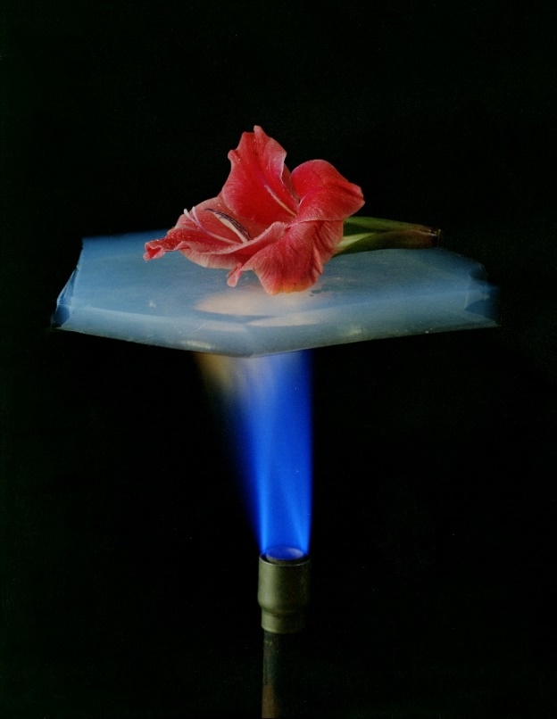
Aerogel Background
Gel in which all of the liquid has been replaced with gas
95 – 99% air by volume, lightest synthetic solid in existence
Mesoporous solid made of connecting nanostructures
Pores between 2 and 50 nm
Exhibit many extreme material properties
Low bulk density
High specific surface area
High porosity
Low thermal conductivity
Thermal Management
http://www.aerogel.org

Slide 3
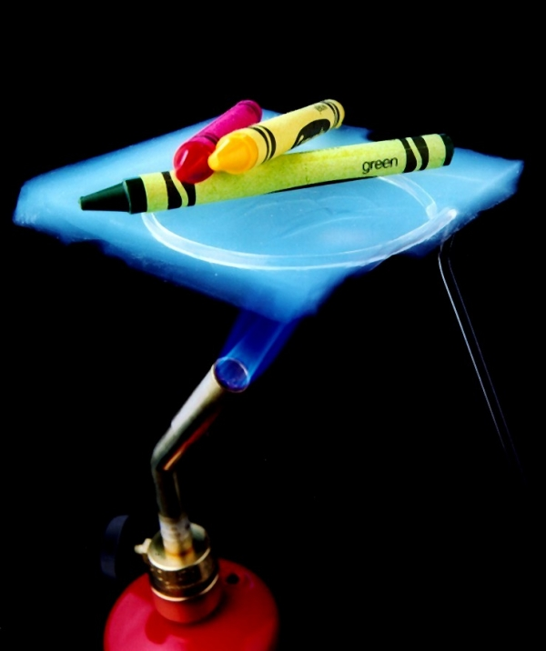
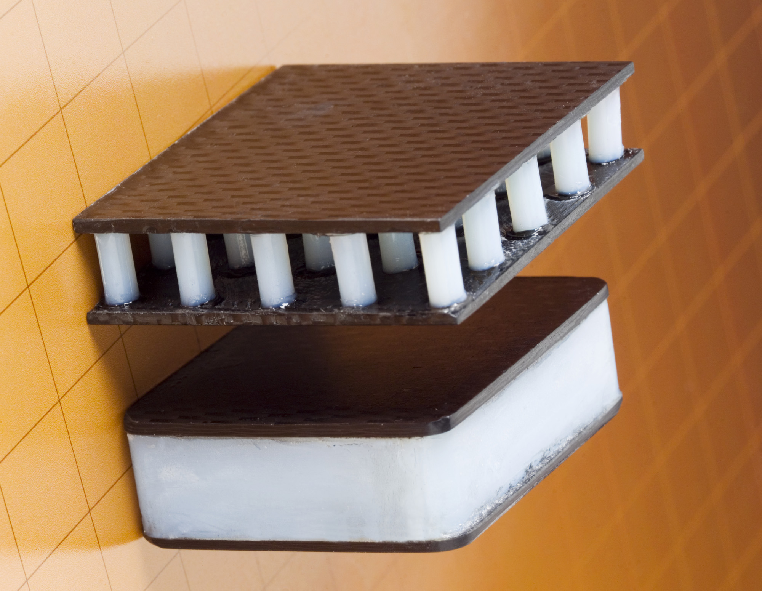
Aerogels as Thermal Insulators
Excellent insulators due low thermal conductivity (k)
High porosity, high amounts of air (low k)
Large pore volume/surface area, mesoporous structure → high porosity
Higher porosity → lower k
Small pores inhibit gas movement, suppress gas convection
Tortuous path for heat transfer through solid pore walls
Made from insulating solids (ex: YSZ)
Composite of air + YSZ, both have low k
Low amounts of solid for conduction
Material | k (W/m∙K)
Air | 0.02 – 0.03
YSZ | 0.50 – 2.36
Zr Aerogel | 0.02 – 0.18
Si Aerogel | 0.01 – 0.02
Notes:
Convection: transfer of thermal energy through the movement of a liquid or gas
Small pores in aerogel do not allow convection, less gas movement
AIR
Conduction: transfer of thermal energy through direct contact
Aerogels have low amounts of solid, so barely any material for conduction
Suppressing solid conduction by providing a very long path for heat transfer through the solid pore walls
The solid used YSZ is also insulating

Slide 4
Aerogels at High-Temperature
High-temperature exposure leads to sintering and densification of aerogels
Pore collapse, surface area reduction
Conduction increases → Effectiveness as insulators decreases
Must optimize the aerogel formulation to retain mesoporous structure and high surface area upon high-temperature exposure to increase effectiveness at high temperature
Temperature Increases
Surface Area, Pore Volume Decreases
Notes:
SEM image: 20% Y, 2x H2O, 2x CTAB YSZ aerogels

Slide 5
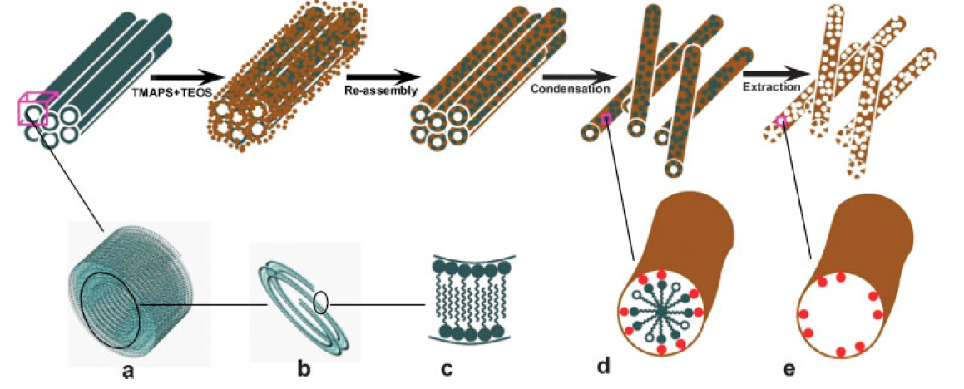
Templating Methods
Structure directing agents can be used to control the pore structure of materials in the mesopore range
Leads to well-ordered structures, uniform pore diameters
Hard (porous membrane) vs. Soft (surfactant) templates
Used to produce hollow spheres or fibers, nanotubes, mesoporous silica, gels, aerogels, etc.
Example: Formation of mesoporous silica nanotubes
Yu et al., https://doi.org/10.1002/adfm.200700593
Notes:
Materials in the mesopore range, from 2 to 50 nm, such as aerogels
Silica nanotubes have radially oriented mesoporous channels perpendicular the central axis of the tube
Surfactants can be used as structure directing agents

Slide 6
Surfactant Templating
Surfactants (Surface-active-agent)
Amphiphilic molecules, preferentially adsorbing at an interface
Assemble at interfaces and in the bulk, forming micelles at the critical micelle concentration (CMC)
Micelles can be used as templating agents for aerogels
Enable retention of mesoporous structure and high specific surface area, minimize shrinkage at high-temperature
Surfactant interaction with aerogel matrix could be a potential negative consequence of surfactant templating
Surfactants control precursor size and crystalline growth via capping effect
https://www.stolaf.edu
Notes:
Surfactants: Consist of two parts, a hydrophilic head and a hydrophobic tail
Micelle size and CMC are influenced by the solution composition, pH, and temperature

Slide 7
Surfactant Templating
Surfactants template the aerogel structure
Added to sol prior to gelation (multiple of CMC)
Washed out during supercritical drying and oxidized during heat treatment, leaving pores behind
Not all pores are directly templated by surfactant
Notes:
Surfactant templating during sol-gel synthesis of aerogels. Following formulation of the sol, precursors aggregate surrounding surfactant micelles, forming a solid gel network; surfactants are removed from the aerogel network through supercritical drying and/or heat-treatment, leaving behind tunable, uniform pores.
Mesoporous structure depends on type and concentration of surfactant, as this dictates surfactant assembly at interfaces in the bulk

Slide 8
Cationic Surfactants
Prior work: Cationic surfactant
Hydrophilic head has a positive charge
Chosen surfactant: Cetrimonium Bromide (CTAB)
Motivation: Known to form smaller nanoparticles with higher surface area after heat-treatment compared to other surfactants
Experimental: Synthesis & characterization of YSZ aerogels with 0x, 0.5x, and 2x CTAB with various heat-treatment
Results: 0.5x CTAB synthesized aerogels with higher surface area and pore volume following exposure to 600°C and 1000°C

Slide 9
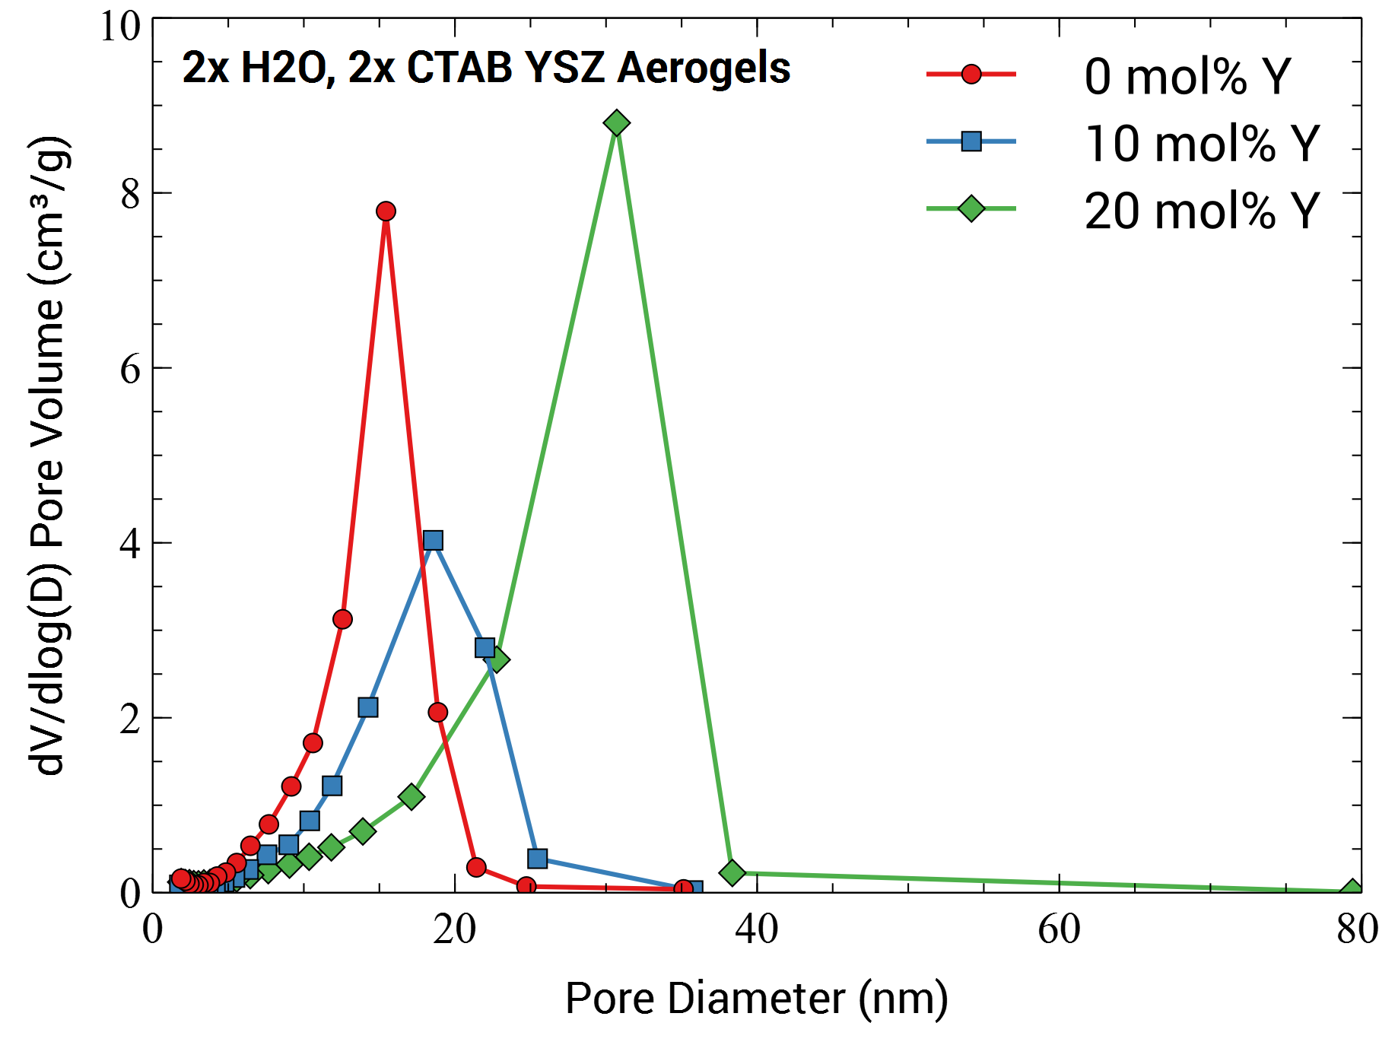
YSZ Aerogel Formulation
20 mol% Y → increasing Y content increased pore size, as well as retained mesoporous structure and smaller particle size after high-temperature exposure compared with lower dopant levels (Hurwitz)
2x H₂O → synthesized aerogels with higher surface area and pore volume at high temperature than 6x H₂O
20% Y, 2x H₂O
 | BET Surface Area (m²/g) |  | BJH Desorption Cumulative Pore Volume (cm³/g)
CTAB | 0.5x | 2x | 0.5x | 2x
As-Dried | 403 | 260 | 1.95 | 1.22
600°C | 257 | 181 | 1.35 | 0.88
1000°C | 52 | 47 | 0.36 | 0.21
20% Y, 6x H₂O
 | BET Surface Area (m²/g) |  | BJH Desorption Cumulative Pore Volume (cm³/g)
CTAB | 0.5x | 2x | 0.5x | 2x
As-Dried | 434 | 393 | 1.63 | 1.89
600°C | 148 | 107 | 0.83 | 0.49
1000°C | 37 | 43 | 0.09 | 0.11
Notes:
**Main goal: to minimize experimental variables

Slide 10
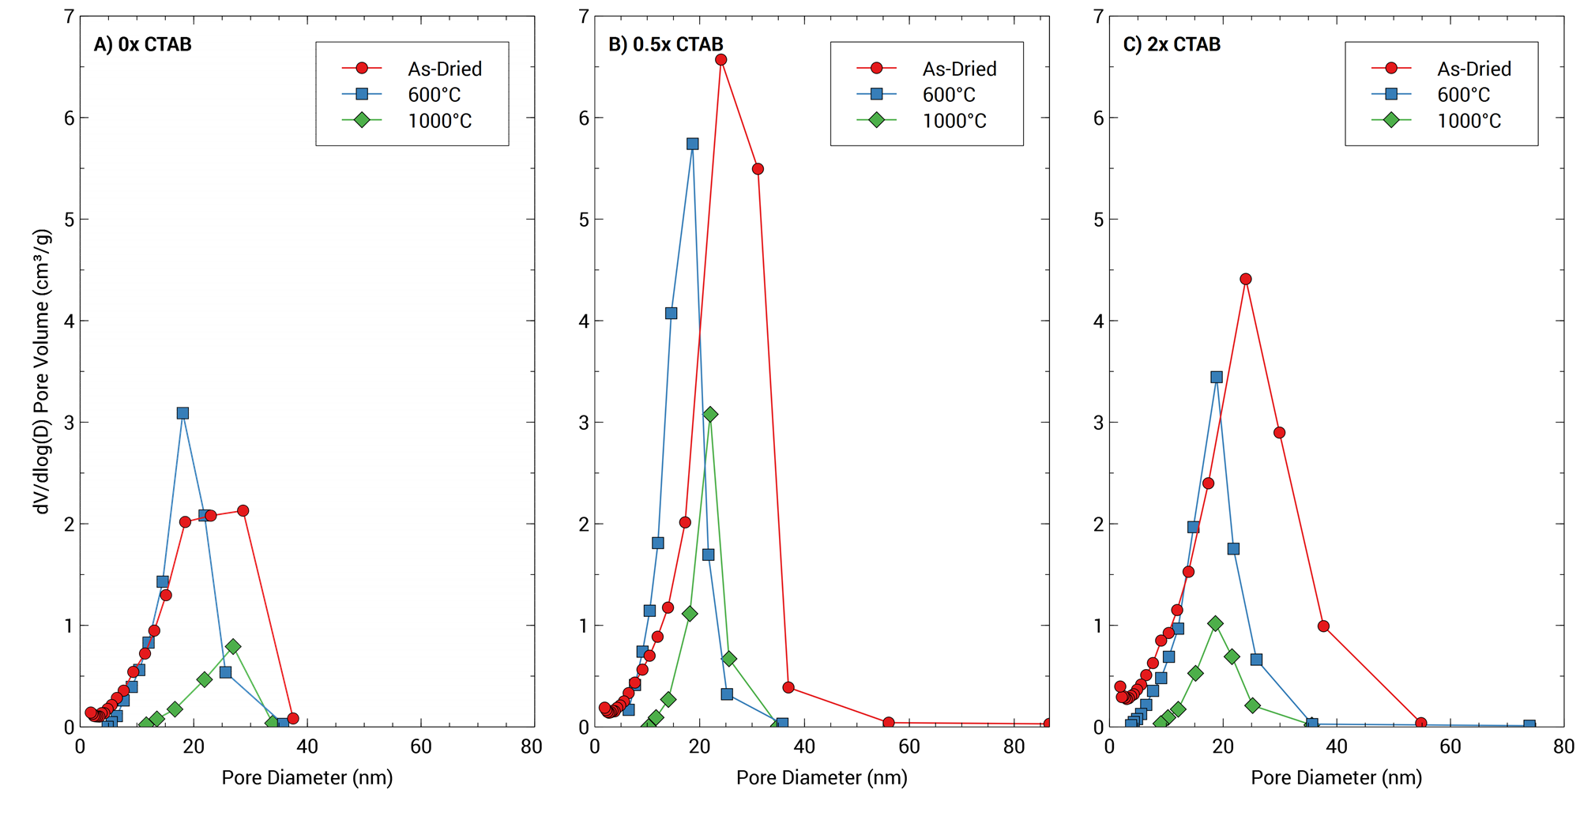
Surface Area & Pore Volume
BJH Desorption Cumulative Pore Volume (cm³/g)
0.5x CTAB had the highest surface area and the highest pore volume of heat-treated aerogels
BET Surface Area (m²/g)
 | 0x CTAB | 0.5x CTAB | 2x CTAB
As-Dried | 263 | 403 | 407
600°C | 149 | 257 | 181
1000°C | 37 | 52 | 47
0x CTAB | 0.5x CTAB | 2x CTAB
0.97 | 1.95 | 1.43
0.77 | 1.35 | 0.88
0.2 | 0.36 | 0.21
Notes:
As-dried aerogels: aerogels with CTAB had wider pore size distributions
600°C aerogels: all had similar pore sizes, regardless of CTAB content
1000°C aerogels: major pore size distributions shifted to smaller pore sizes with increasing CTAB amount
Heat-treatment deceased surface area and pore volume
0.5x CTAB was most effective at inhibiting surface area decrease and pore collapse following high-temperature exposure

Slide 11
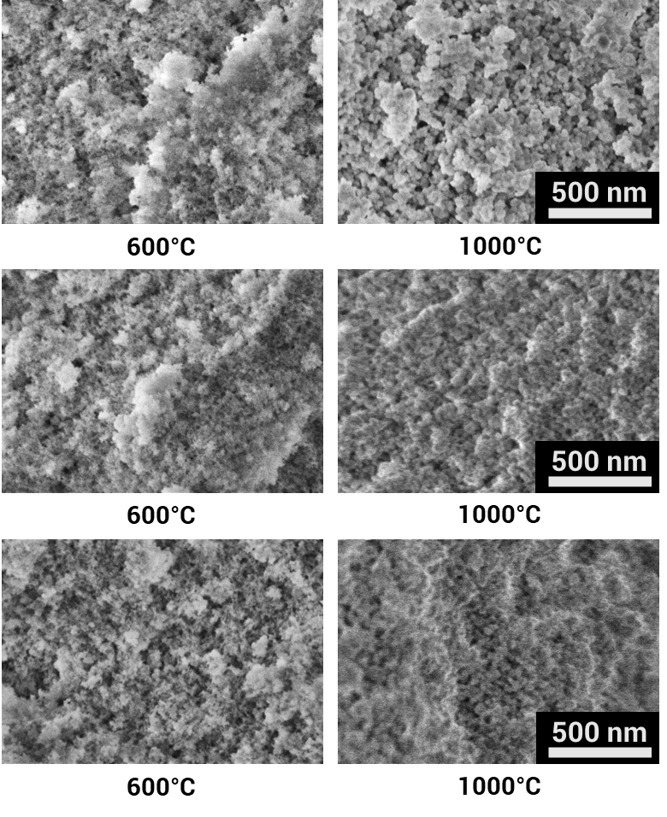
Pore Structure
Sintering and densification is evident, especially at 1000°C.
With the addition of CTAB, the aerogels are less dense or coarse, particularly at 1000°C.
Differences of the pore size in aerogels without CTAB and aerogels with CTAB were difficult to distinguish.
0x CTAB
0.5x CTAB
2x CTAB
Notes:
Sintering and densification was expected and is typical for metal oxide materials exposed to high temperatures.
It was expected that the addition of CTAB would template distinct pores within the aerogel structure, even after exposure to 1000°C.
While a slight shift in pore size can be observed, it is difficult to assign statistical significance to the difference.

Slide 12
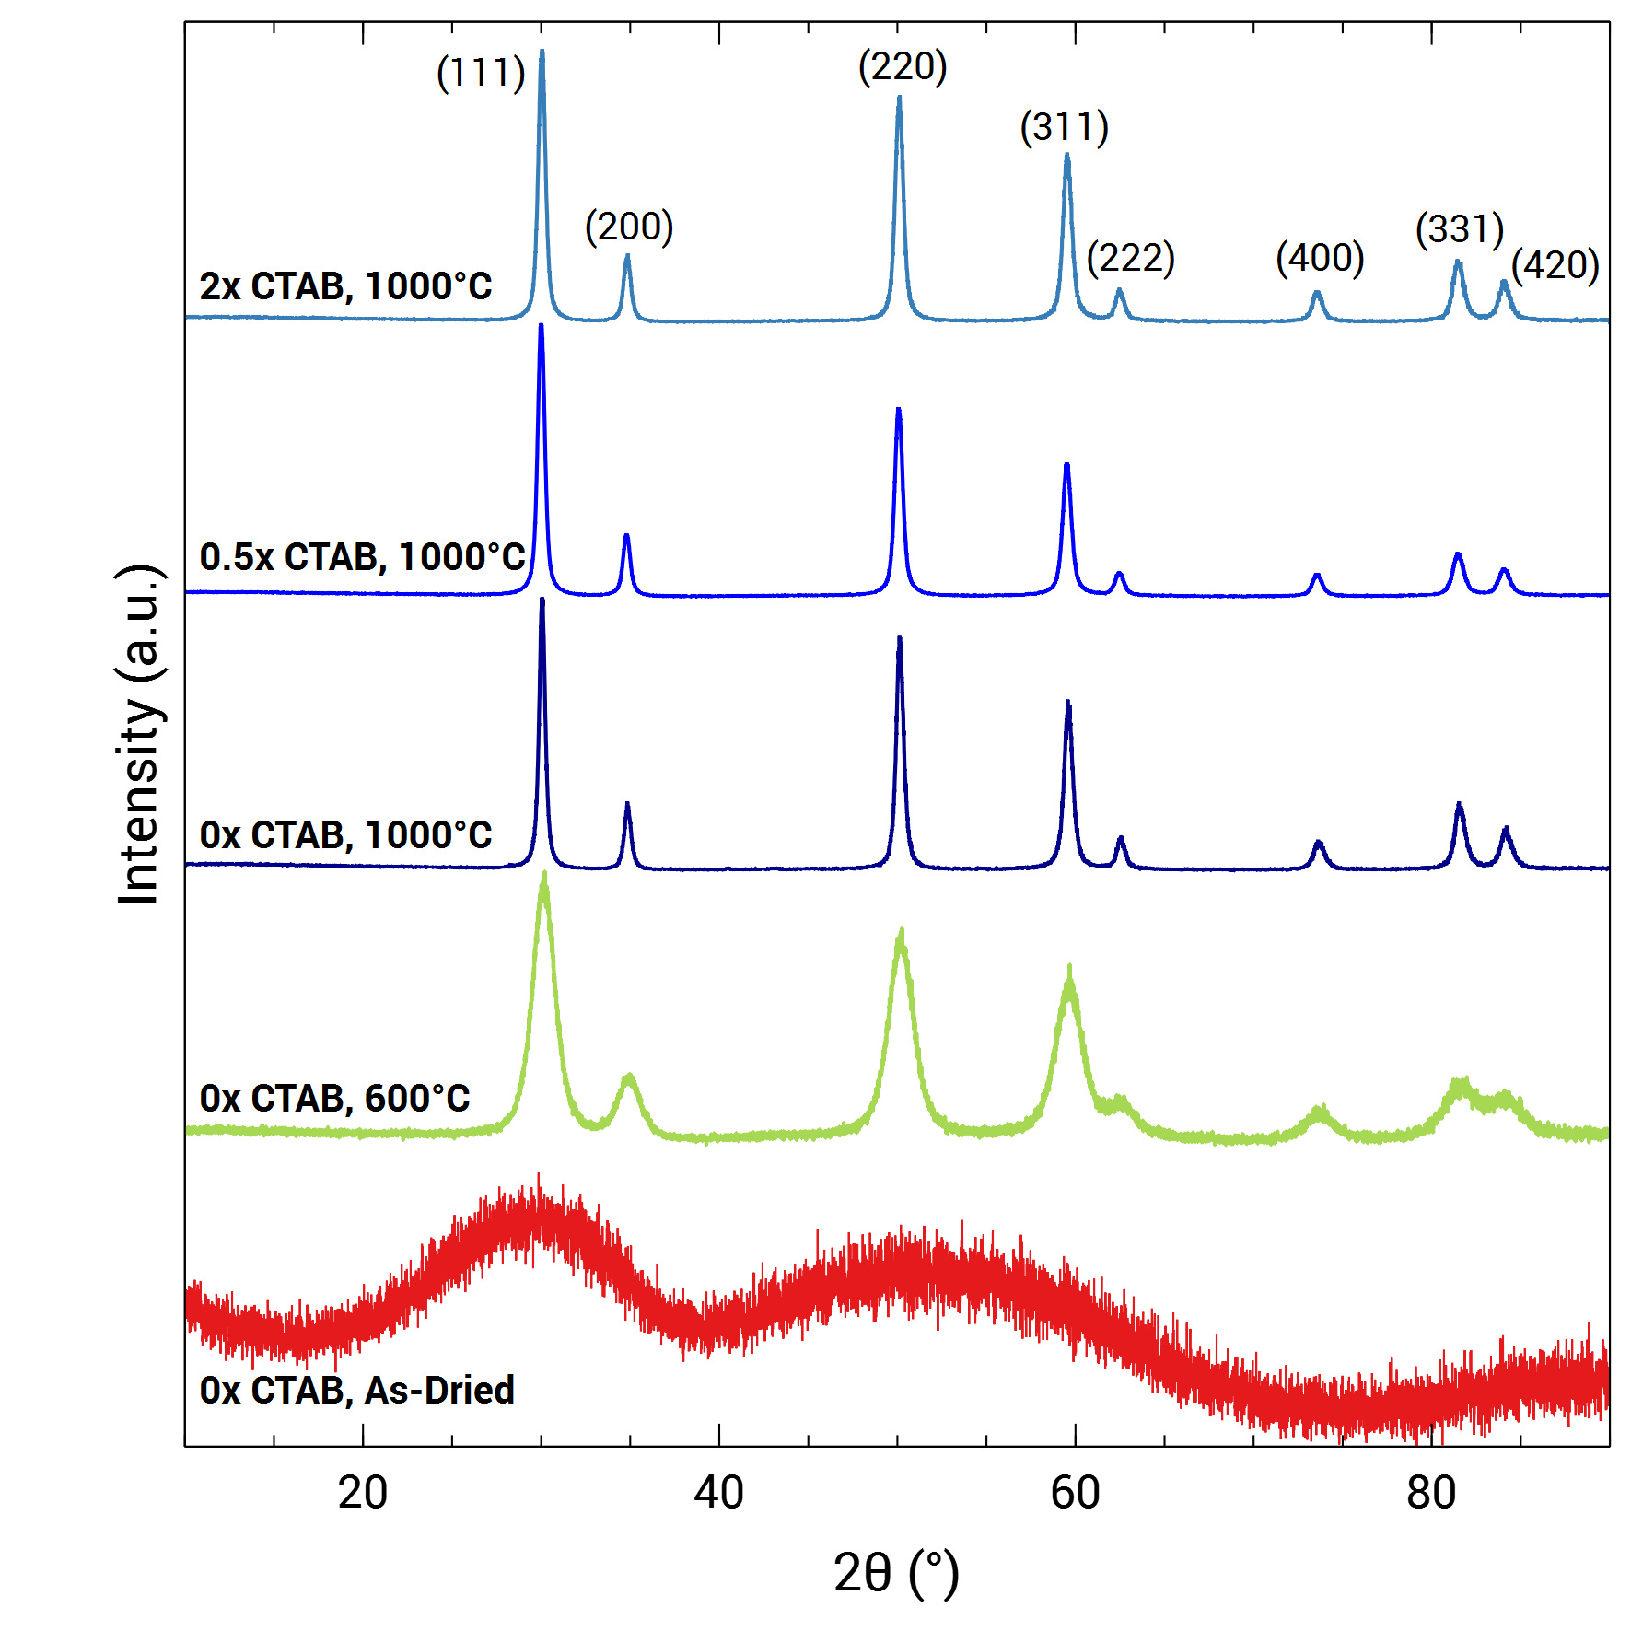
Crystalline Structure
CTAB inhibited crystallite growth at 1000°C, which may have hindered surface area and pore volume decrease, as well as shrinkage
TEM images (100k magnification) heat-treated at 600°C and 1000°C (inset)
 |  | Average Crystallite Size (Å)
CTAB | Temperature (°C) | Scherrer | Monshi-Scherrer (M-S) | Williamson-Hall (W-H) | Size-Strain-Plot (SSP) | TEM Analysis
0x | 600 | 55 | 60 | 68 | 63 | 61
 | 1000 | 197 | 227 | 283 | 250 | 270
0.5x | 600 | 56 | 60 | 65 | 62 | 73
 | 1000 | 195 | 210 | 225 | 205 | 217
2x | 600 | 55 | 59 | 64 | 60 | 76
 | 1000 | 193 | 200 | 207 | 201 | 210
Notes:
Four different equations were used to determine the crystallite size following XRD analysis

Slide 13
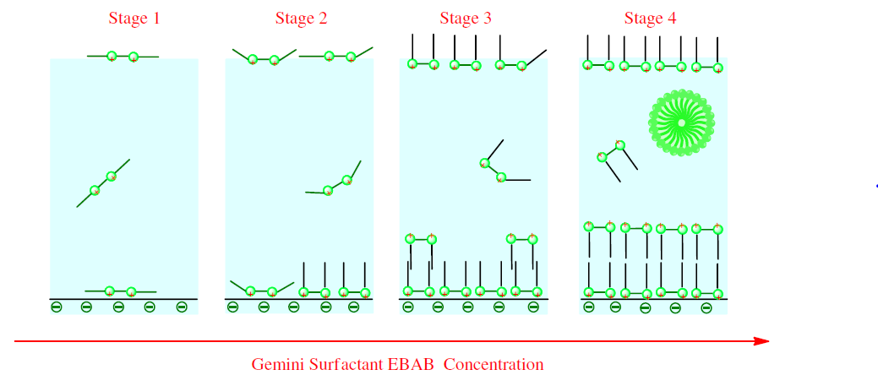
Surfactant Interaction
0.5x CTAB showed the overall highest surface area and pore volume following heat-treatment, which was unexpected
Result influenced by?
Estimation of the critical micelle concentration of CTAB
Adsorption could have constrained gelation, reducing the aerogel skeleton strength and increasing shrinkage
Gemini surfactant (+) adsorbed onto quartz surface (-); increasing surfactant concentration led to build-up on surface through, first, electrostatic interactions and, then, hydrophobic chain interactions
Huang et al., https://doi.org/10.1016/j.cej.2014.07.057
Notes:
The effect of ethanol was considered when estimating the CMC values; however, other factors, including the inorganic salt concentration, could have influenced the CMC, but were not considered in the estimate. The pore size distribution in BET was narrower at 0.5x CTAB than at 2x CTAB for as-dried aerogels, pointing to a more homogenous pore structure during synthesis, and suggesting that 0.5x CTAB may have been closer to the actual CMC.

Slide 14
Charge Effects with Precursor
Proposed work: understand interactions of surfactants with the zirconia aerogel matrix
Experimental: anionic and nonionic surfactants added to YSZ aerogels; QCM experiments to understand interactions
Anionic (negative charge): Sodium dodecyl sulfate (SDS)
Nonionic (no apparent ionic charge): Pluronic® P-123
Results: Is surface area & mesoporous structure retained in YSZ aerogels after heat-treatment?
Notes:
SDS Motivation: maintained high surface area and pore size in silica aerogels at 600°C; also lowered density and thermal conductivity
P123 Motivation: low HLB value, 7 - 9

Slide 15
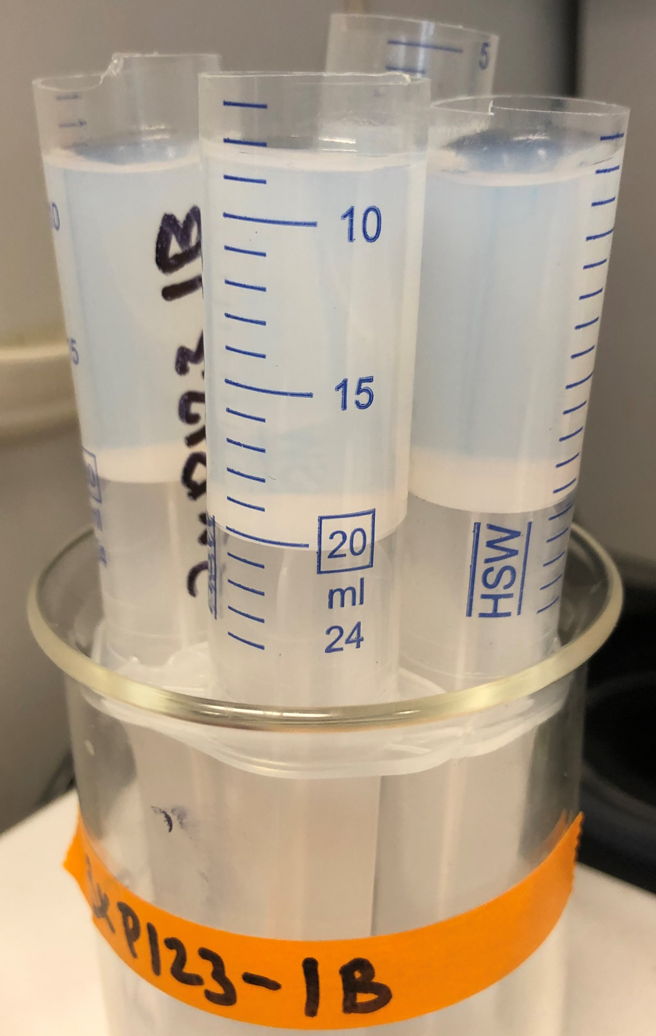
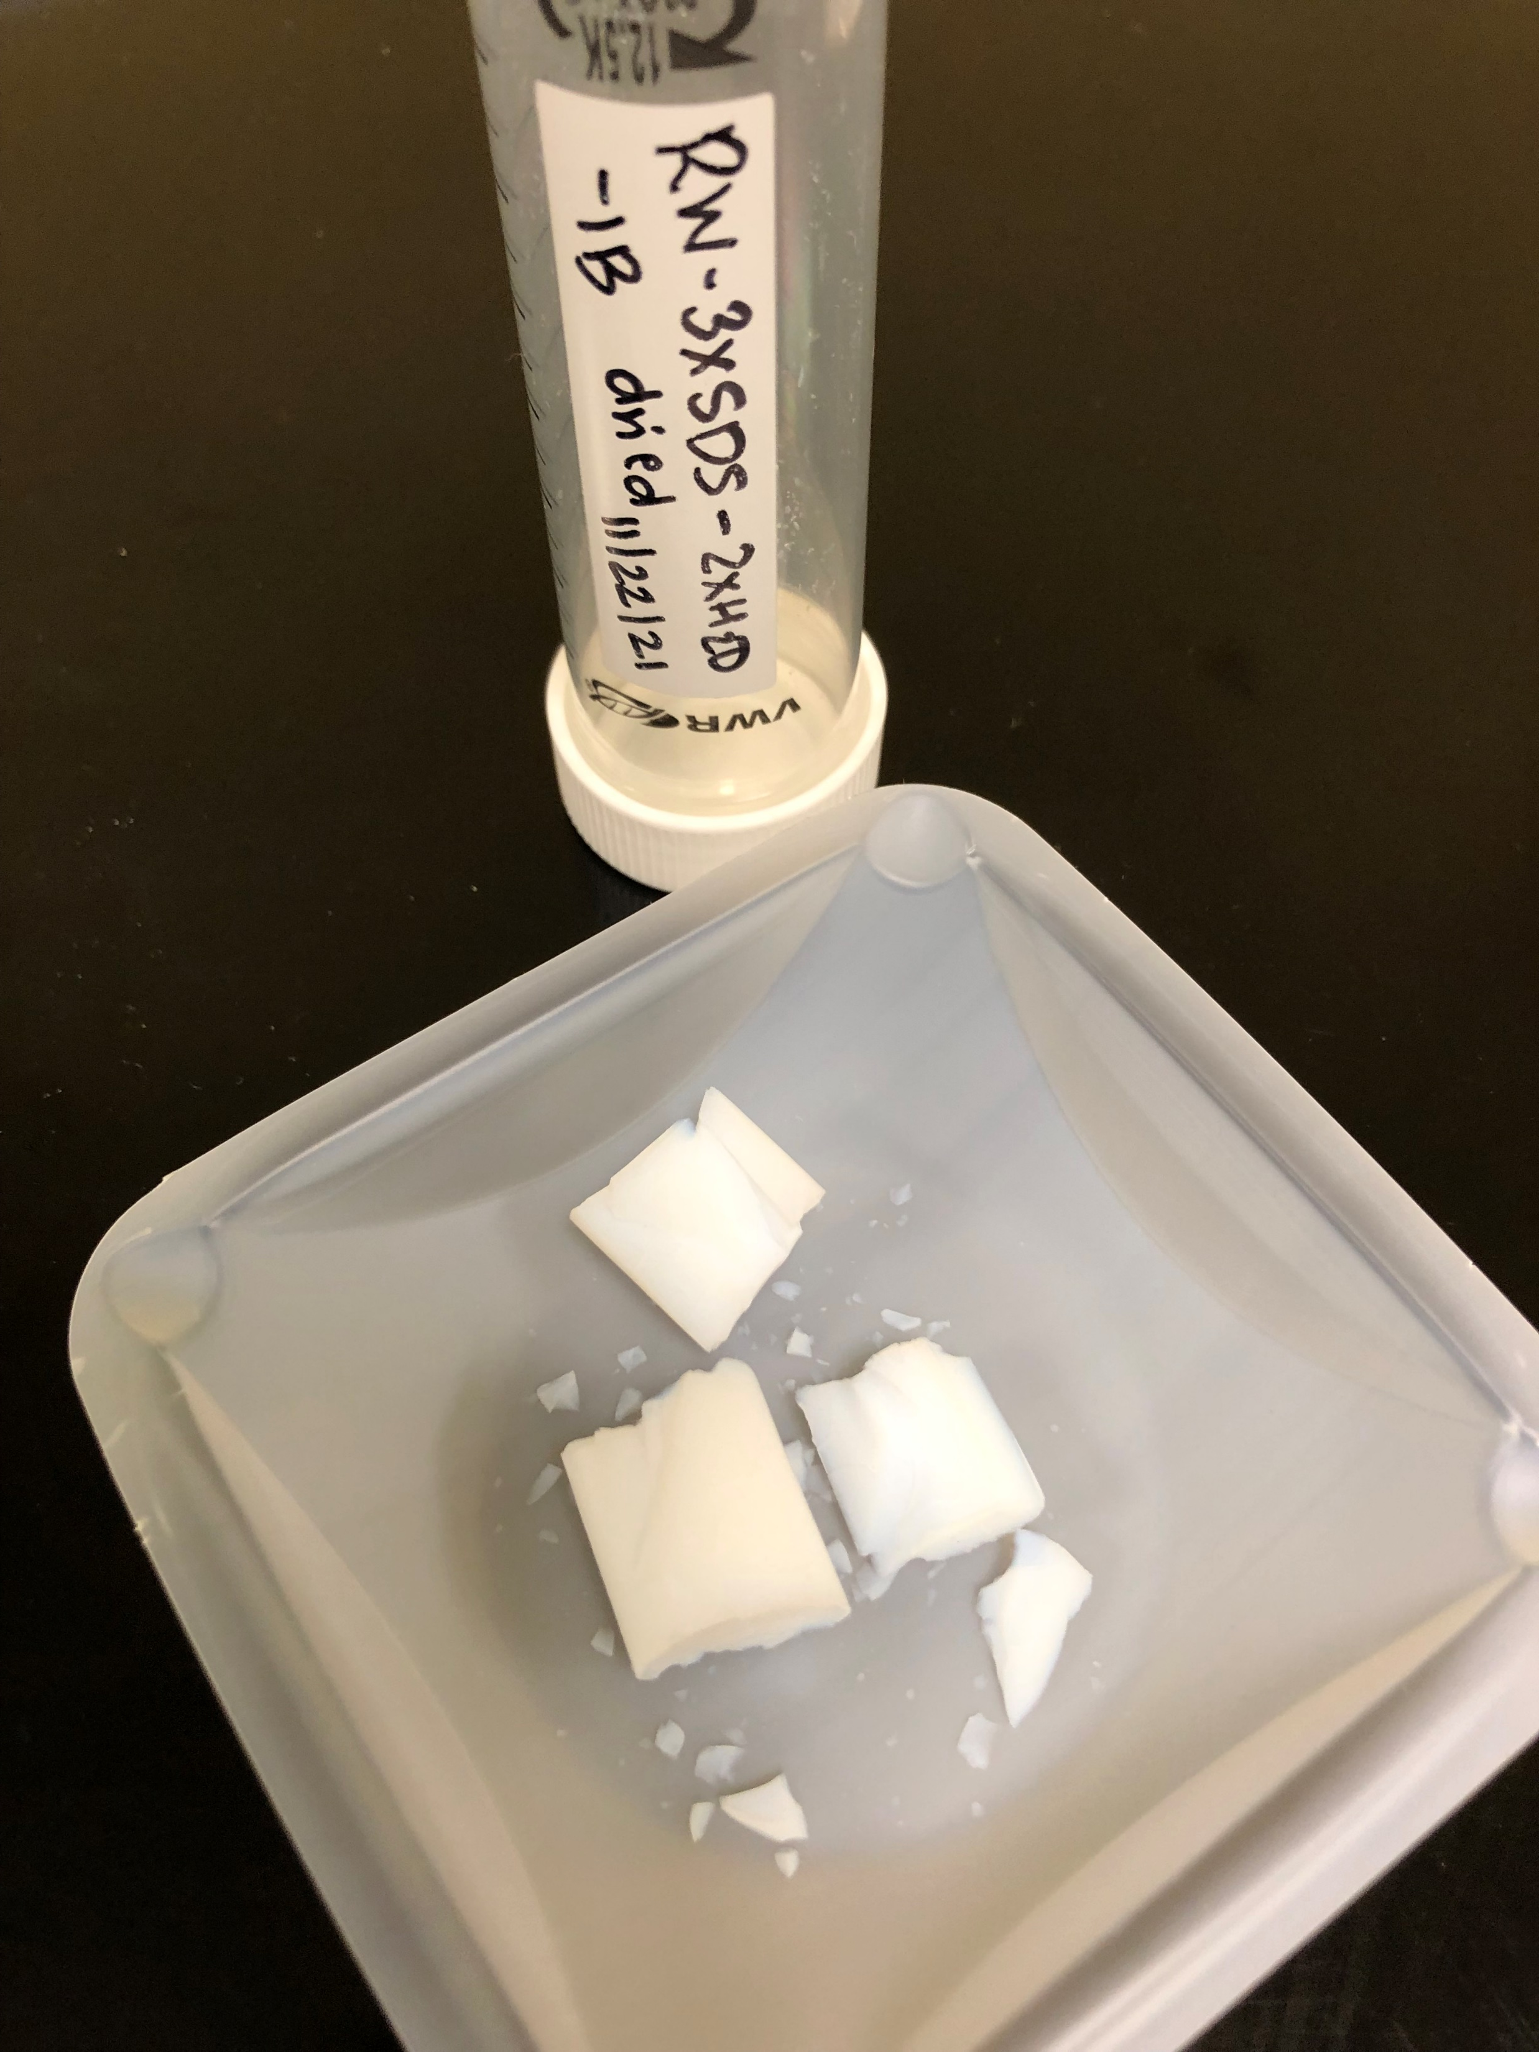
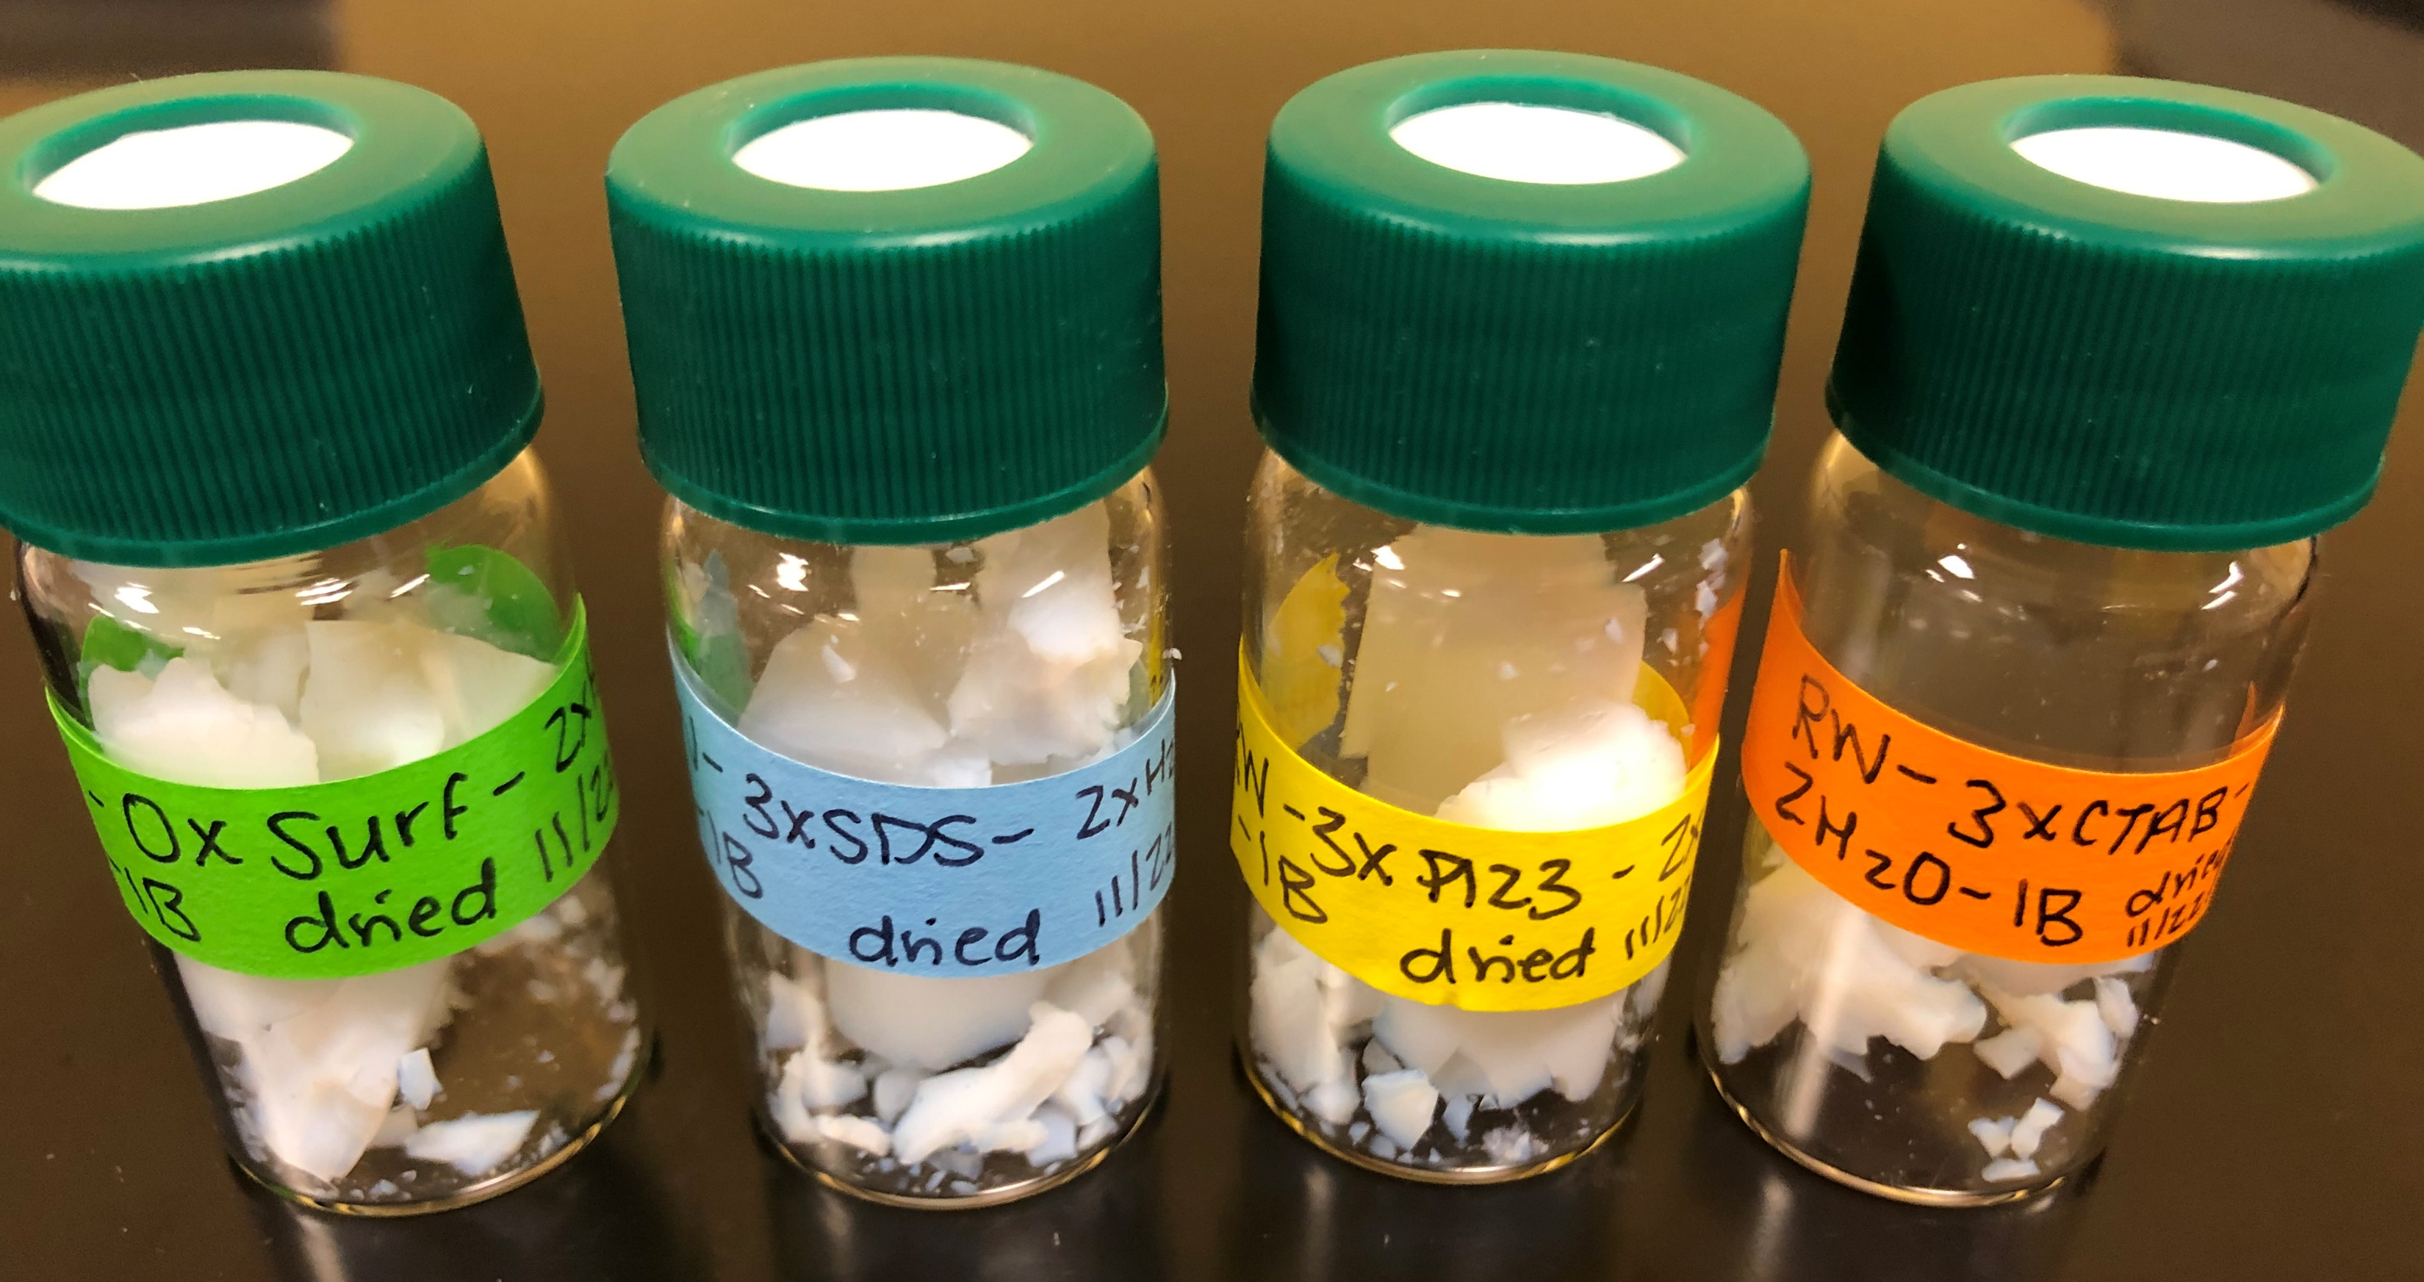
Preliminary Experiments
Sample | Gel? | Aerogel? | Shrinkage (%) | Density (g/cm³)
No surfactant |  |  | 17.39 | 0.23
SDS, Below CMC*
SDS, Above CMC* |  |  | 17.54 | 0.25
SDS, Above CMC**
P-123, Below CMC*
P-123, Above CMC* |  |  | 16.79 | 0.27
CTAB, Above CMC* |  |  | 20.38 | -----
20 mol% Y, 2x H2O YSZ aerogels
*CMC in water
**CMC in 30 wt% solvent EtOH
Notes:
20 mol% Y, 2x H2O YSZ aerogel are at approx. 82 wt% solvent EtOH

Slide 16
Project Goal Summary
Project Goal: Optimize the formulation of YSZ aerogels using surfactant templating
Synthesize surfactant-templated aerogels with high porosity
Cationic, anionic, and nonionic surfactant templates
Higher porosity → lower thermal conductivity
Increased effectiveness when used as thermal management systems
Determine surfactant selection criteria
Use a set of experiments in a limited sub-space
Characterize results
How is this criteria translated to other aerogel materials?

Slide 17
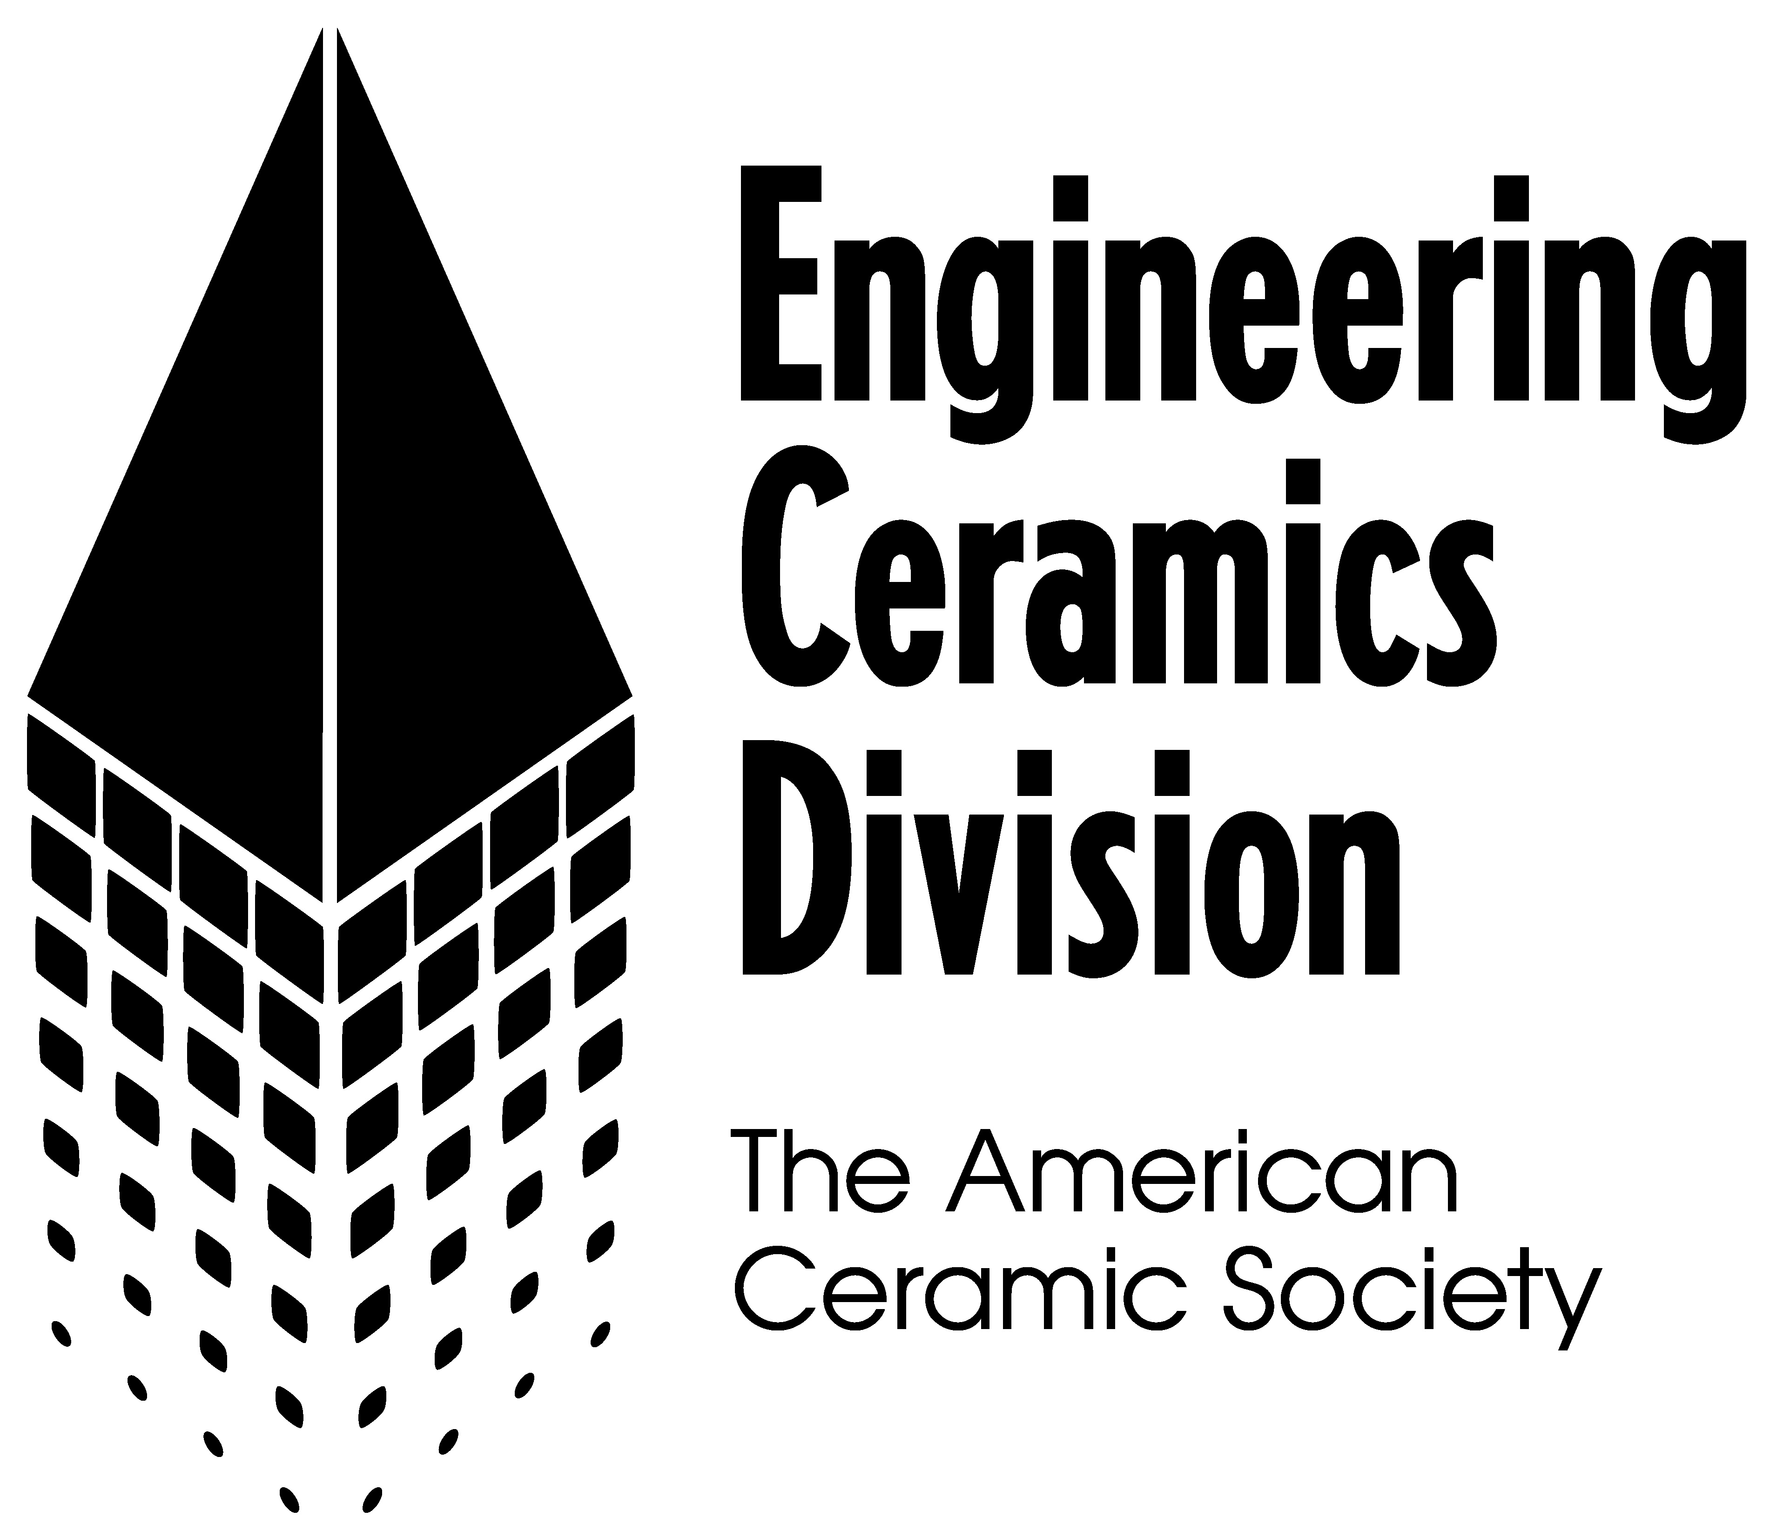
Acknowledgements
Virginia Commonwealth University
Dr. Massimo Bertino (TEM, SC dryer)
Dr. Dmitry Pestov (SEM/XRD)
Dr. Carl Mayer (XRD)
Dr. Michael Burkholder (BET)
NASA Glenn Research Center
Dr. Richard Rogers (XRD)
Dr. Wayne Jennings (SEM)
Jessica Cashman (Synthesis)
This work was funded by NASA Fellowship 80NSSC18K1697.
Thank you to ACerS Engineering Ceramics Division (ECD) for conference attendance support.

Slide 18
Supplemental Slides

Slide 19
Charge Effects with Precursor
Proposed work: Quartz Crystal Microbalance Experiments
Zirconia-sputtered QCM sensors will be placed in the sol solution containing the surfactant
The gel will form around the QCM sensor
Using cationic, anionic, and nonionic surfactants
Are the surfactants solely forming micelles? Or are the surfactants interacting with zirconia through adsorption onto the gel?
Following an enhanced understanding of surfactant interaction with the zirconia matrix, selected surfactants will be used in the synthesis of zirconia aerogels

Slide 20
Anionic Surfactants
Proposed work: Anionic surfactants
Hydrophilic head has a negative charge
Chosen surfactant: Sodium dodecyl sulfate (SDS)
Motivation: maintained high surface area and pore size in silica aerogels at 600°C; also lowered density and thermal conductivity
Additional surfactant: Sodium dodecylbenzene sulfonate (SDBS)
Motivation: influenced the final structure of carbon aerogels

Slide 21
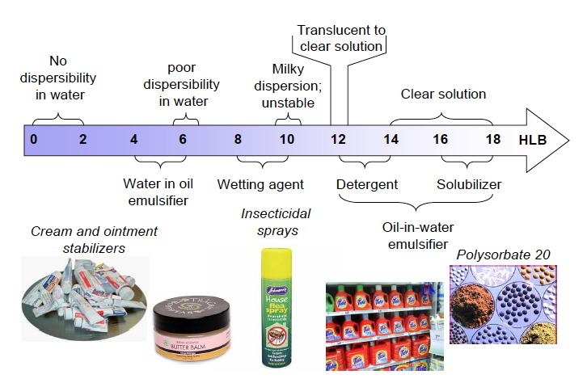
Selecting Nonionic Surfactants
Hydrophilic–lipophilic balance (HLB) reflects surfactant’s partitioning behavior between polar and non-polar medium
Agreed-upon method used to compare surfactants
Useful index for non-ionic surfactants
HLB value = Σ(Hydrophilic groups) + Σ(Lipophilic groups) + 7
Strongly hydrophilic surfactant, HLB → 40
Strongly lipophilic surfactant, HLB → 1
HLB may be used as a predictive parameter to compare surfactant influence on aerogel properties
Notes:
hydrophilic–lipophilic balance (HLB) value, which is a measure of the ratio of hydrophilic and lipophilic groups that a surfactant contains; surfactants with an HLB value less than 10 are known to have an affinity for oil and are lipophilic.
HLB is a flawed approach but may be the best predictive parameter

Slide 22
Nonionic Surfactants
Proposed work: Nonionic surfactants
Surface-active portion bears no apparent ionic charge
Chosen surfactant: Pluronic® P-123 (HLB: 7 - 9)
Additional surfactant: Brij® 52 (HLB: 5)
Additional surfactant: Span® 40 (HLB: 6)
Motivation: low Hydrophilic-Lipophilic Balance (HLB) value

