Slide 1
ATM-X Research Portfolio
Kurt Swieringa – ATM-X Deputy Project Manager for Technology
January 18, 2022

Slide 2
Agenda
1. ATM-X Vision
2. Sky for All
3. Digital Information Platform
4. Extensible Traffic Management
5. Pathfinding for Airspace with Autonomous Vehicles
6. Urban Air Mobility Traffic Management

Slide 3
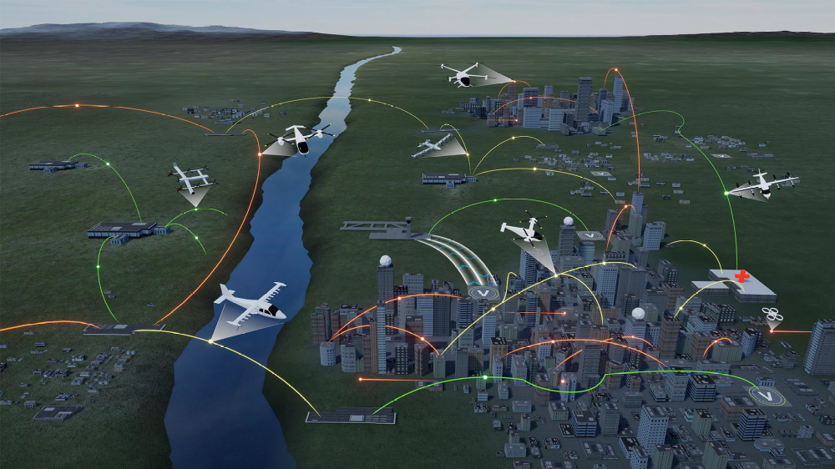
The Rapid Transformation of Aviation
On-Demand Air Taxi
Rural Operations
Cargo Delivery
Airport
Transfer
Distribution Center/
Warehouse
Small Package Delivery

Slide 4
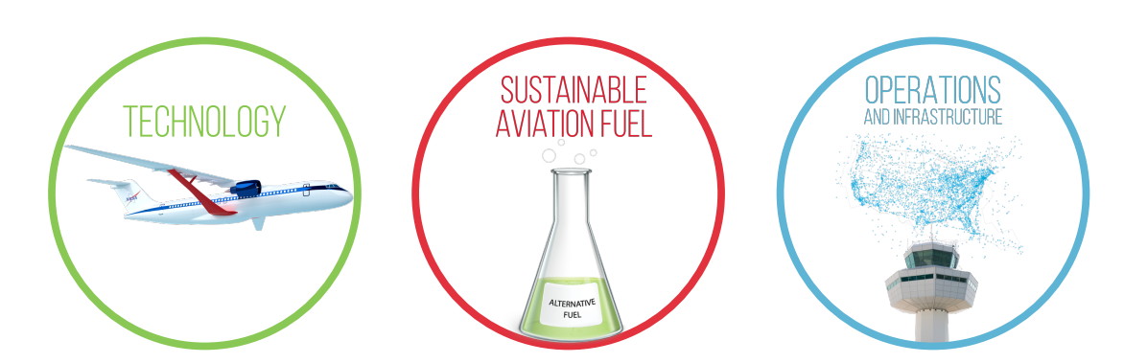
Aviation Industry Pillars for a Sustainable Future

Slide 5
What is the ATM-X project?
The Air Traffic Management-eXploration project, or ATM-X, is transforming air traffic management to accommodate new air vehicles and improve the efficiency of existing aviation operations – from commercial aircraft to autonomous aircraft and urban air taxis.

Slide 6
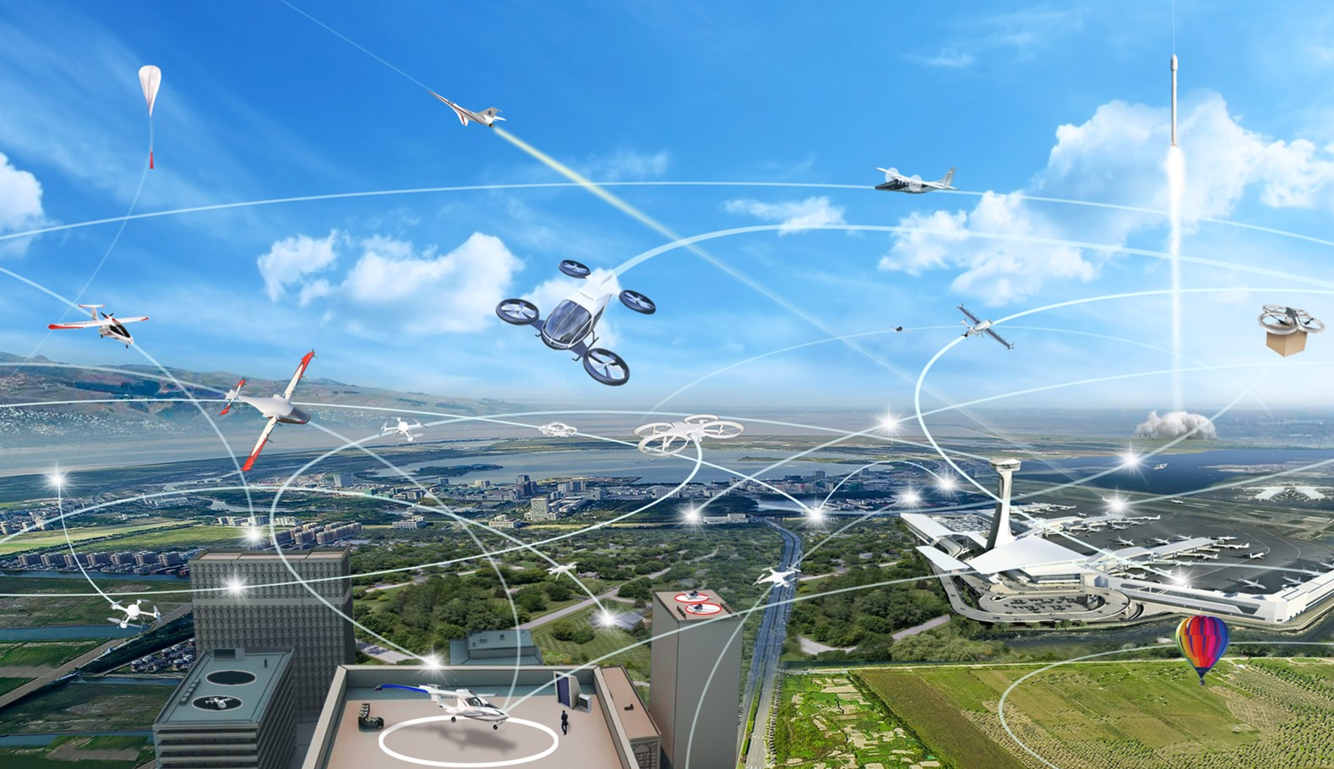
The Future of Air Traffic Management
Scalable to meet future demands
Safe operations for diverse users
Resilient to uncertainty, degradation, and disruptions
Sustainable user-preferred trajectories that minimize impact on the environment
Adaptable to accommodate new types vehicles and operations

Slide 7
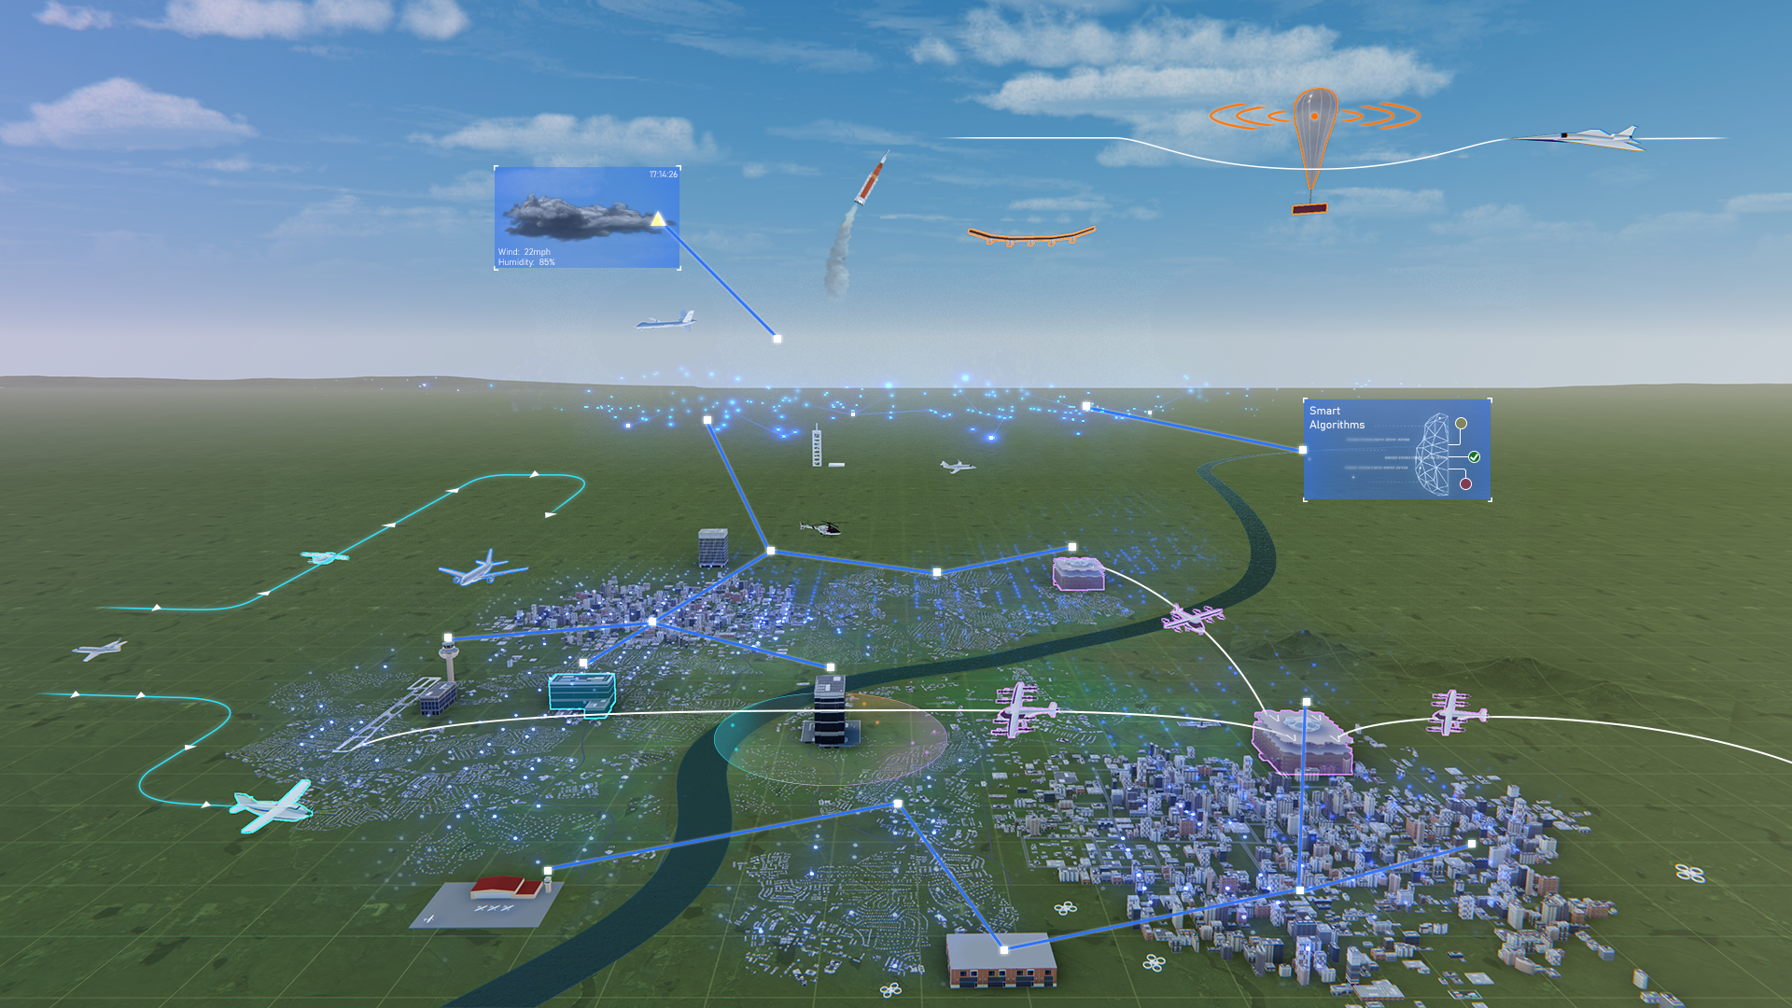

ATM-X Research Areas
Digital Information Platform
Extensible Traffic Management
Open-architecture for advanced data-driven services for traditional operations and new entrants
Cooperative distributed service-based ATM decision-making
Urban Air Mobility
Pathfinding for Airspace with Autonomous Vehicles
Cooperative distributed service-based ATM decision-making for UAM traffic management
Seamless, scalable, and robust airspace integration of increasingly autonomous operations

Slide 8


Slide 9
Sky for All
We envision a mid 21st century airspace system that is more sustainable, safe, resilient, adaptable, and scalable.
Sky for All will be a co-developed vision for the future aviation system with communities across government, industry, and stakeholders around the world.
Notes:
At NASA, we continue to see growing interest in airspace access for novel non-traditional missions that will transform mobility and provide new services that benefit the public. We envision a mid 21st century airspace system that is more sustainable, safe, resilient, adaptable, and scalable.
We want to go further and take a bold, new approach to reimagine and reshape the future aviation system. That’s why we’ve created the Sky for All program, which is aimed at co-developing a vision for the future with communities across government, industry, and stakeholders around the world.

Slide 10
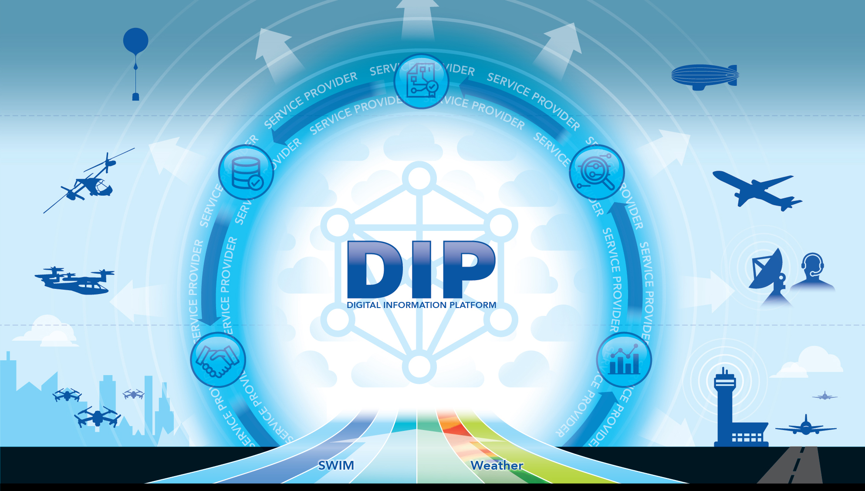
Digital Information Platform
The Digital Information Platform subproject, or DIP, will accelerate the way to a smarter and more integrated airspace.
DIP is designed to be a cloud-based ecosystem that takes data from many sources and turns it into accessible and easy-to-use digital information.
Notes:
The Digital Information Platform, or DIP, subproject will accelerate the way to a smarter and safer airspace. Today, aviation data is often difficult for aircraft operators to access and use, which prevents techniques such as Machine Learning from being used to improve the efficiency of the National Airspace System (NAS).
DIP is designed to be a cloud-based ecosystem that takes data from many sources and turns it into easily accessible, easy-to-use digital information. This capability will provide necessary data for airspace management and users of the airspace system – providing a foundation for new aviation services that will improve the efficiency and sustainability of the future NAS.

Slide 11
Digital Information Platform
Challenge
Solution
Outcomes
Today, aviation data is often difficult for aircraft operators to access and use, which inhibits advanced solutions such as Machine Learning from being used to improve the efficiency of the NAS.
A Digital Information Platform to enable a cloud-based ecosystem that is easily accessible and easy-to-use.
DIP will provide a foundation for new aviation services that will improve the efficiency and sustainability of the future NAS.

Slide 12

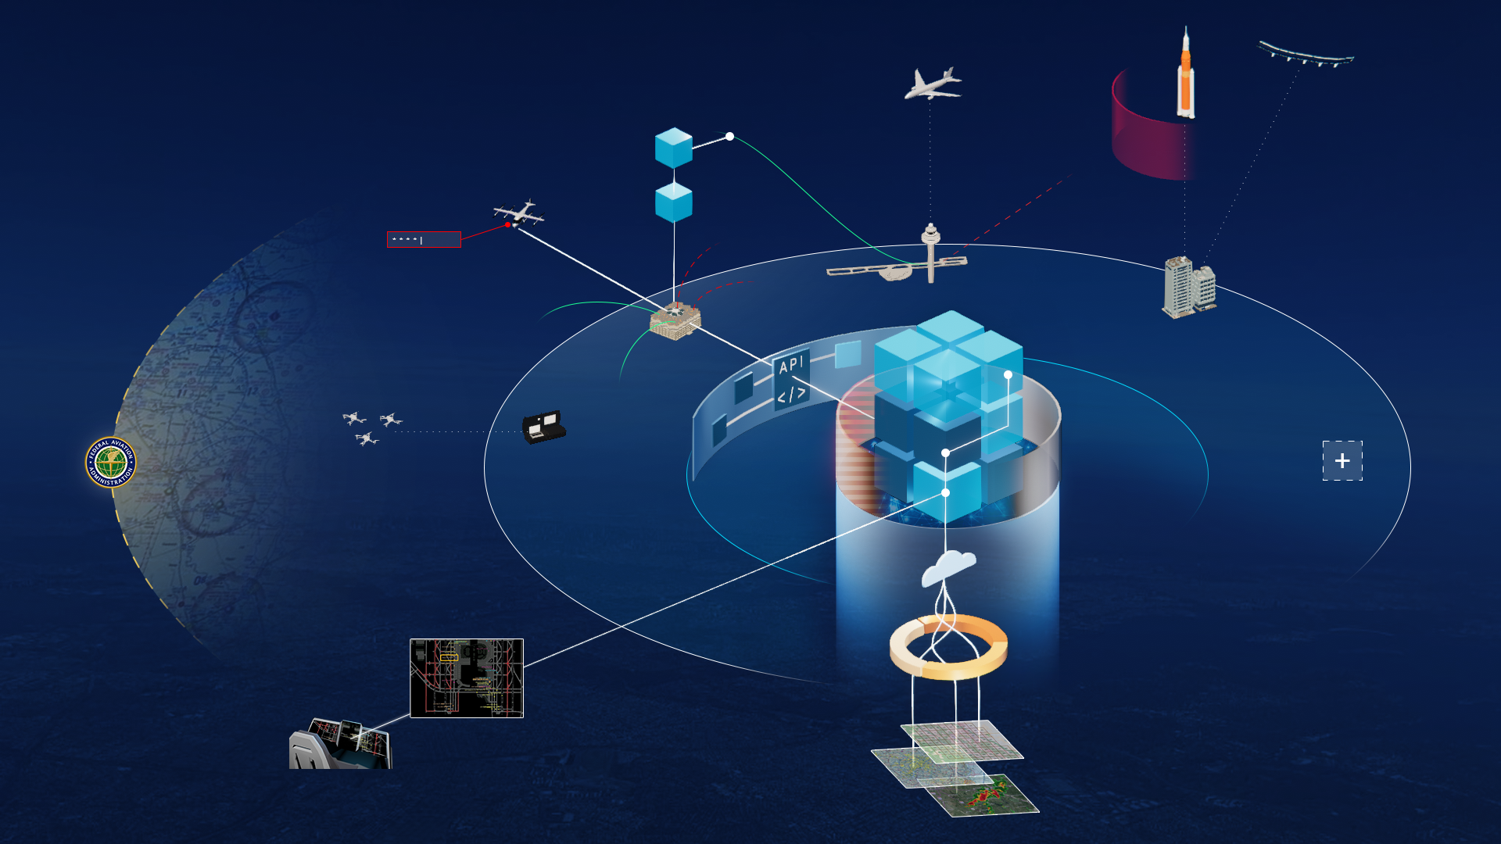


DIP Research Areas
Reference Digital Information Platform (DIP)
DIP-Enabled Services for Sustainability
Development of a platform for advanced, data-driven, digital services for flight operators
Cloud and flightdeck services focused on improving the sustainability of aviation operations
Industry Partner Service Demonstrations
University Challenges
Integration and demonstration of Partner services with DIP for validation of the platform
Development of innovative solutions and advanced algorithms for aviation services

Slide 13
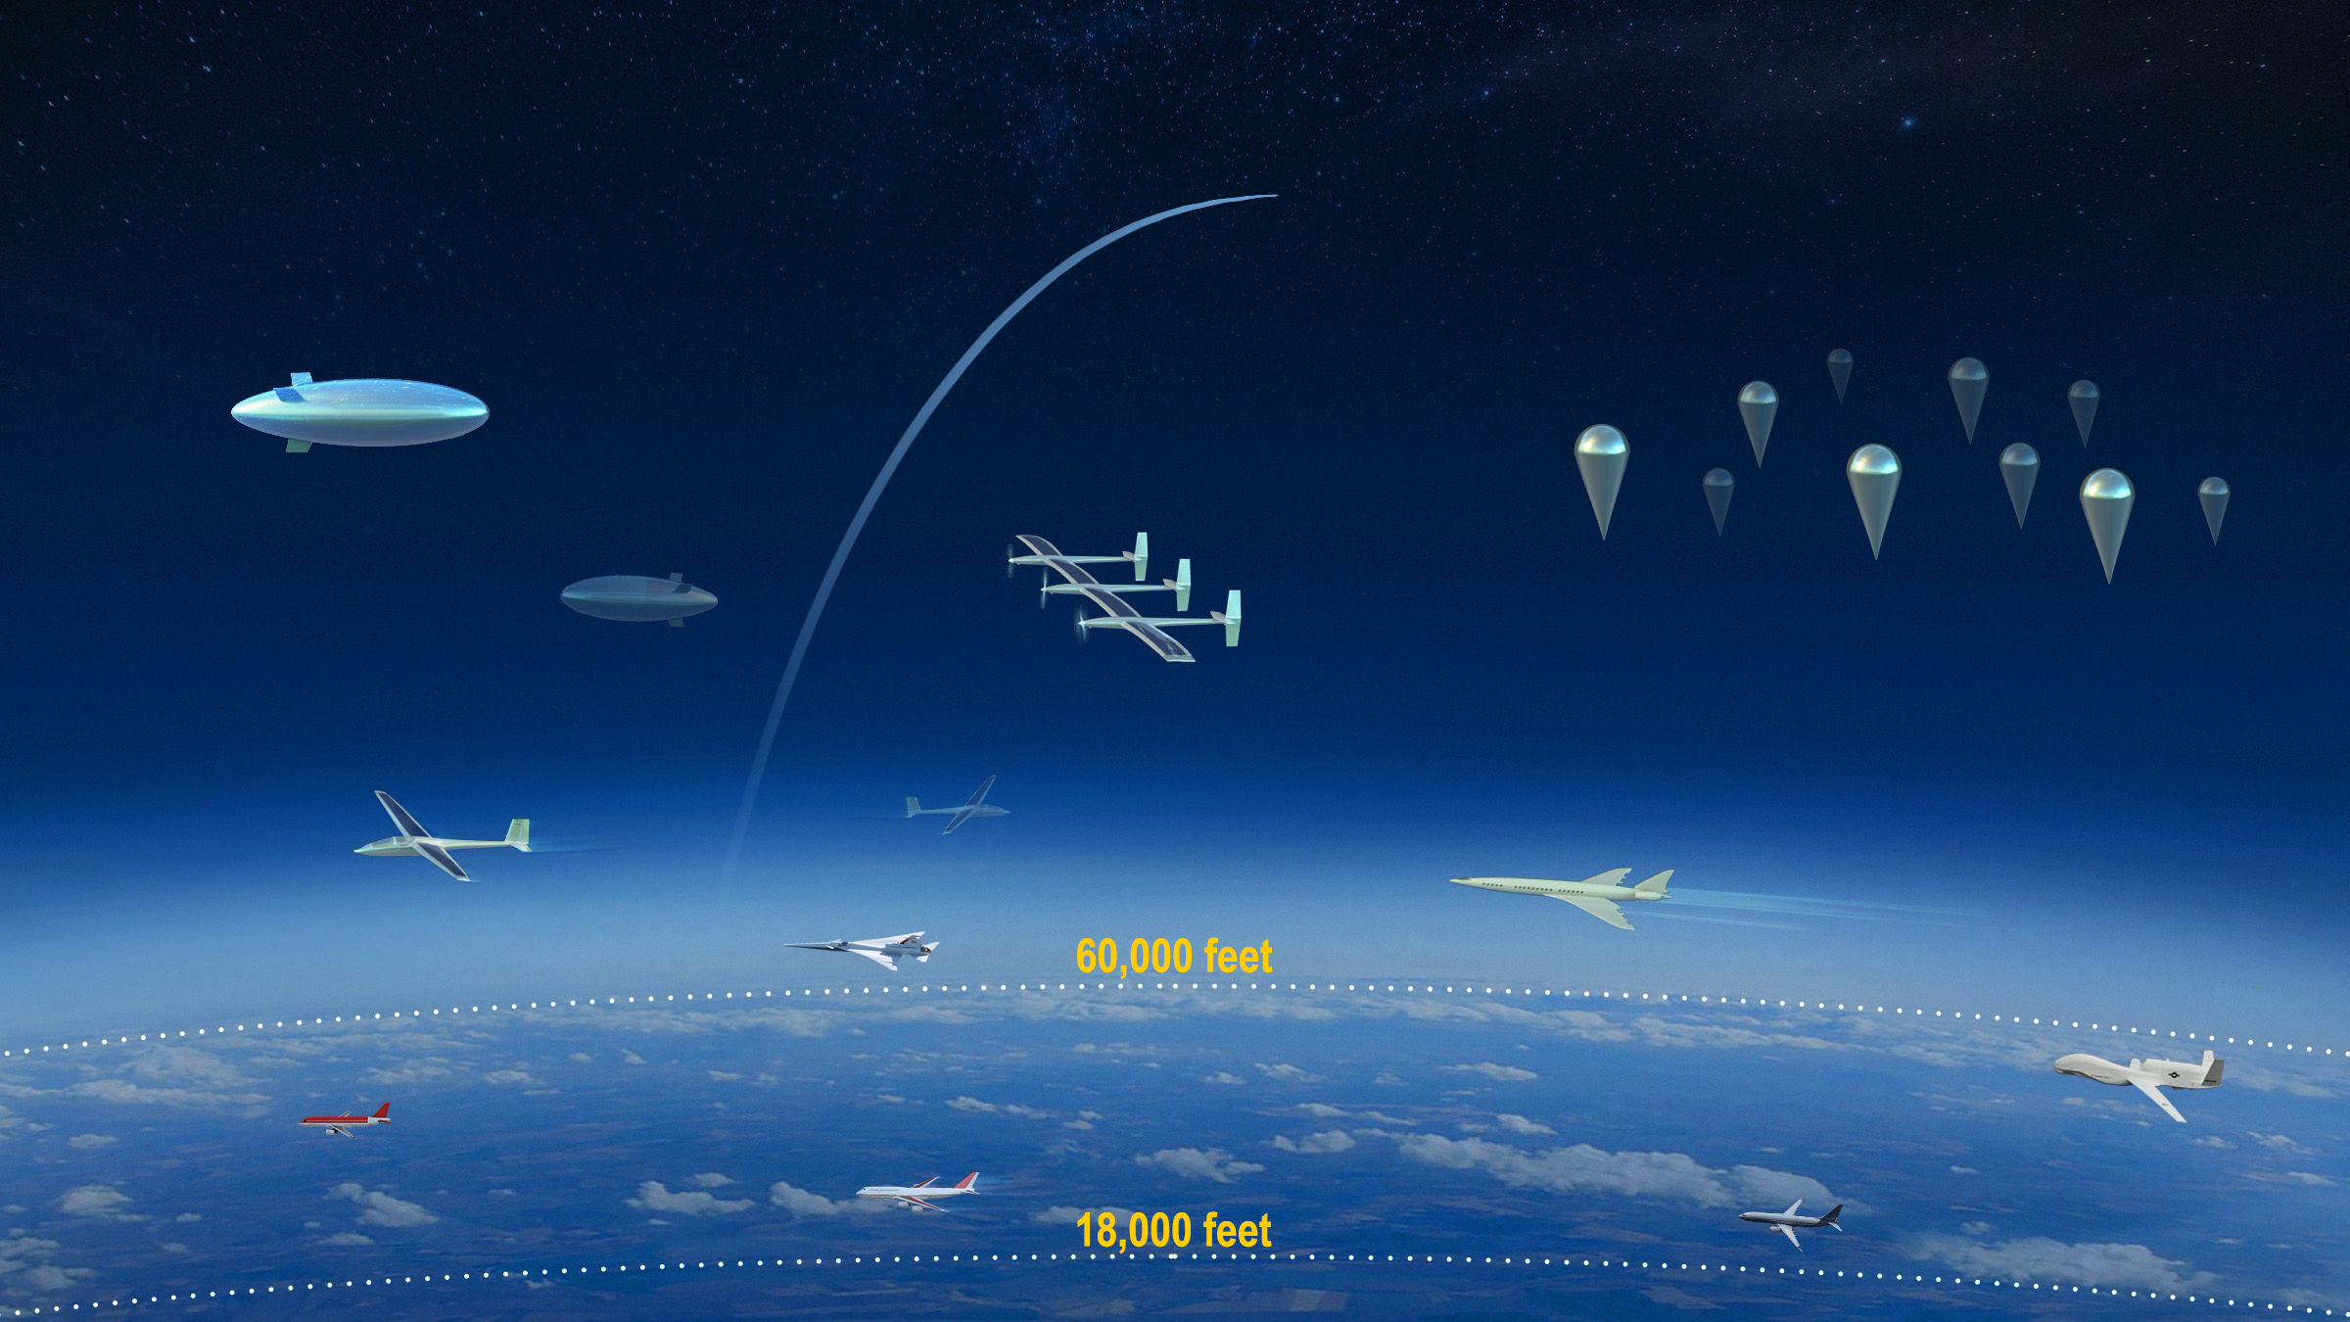
Extensible Traffic Management
There is interest in exploring how the UTM philosophy can be expanded to new domains.
The Extensible Traffic Management subproject, or xTM, framework will catalyze the airspace community to meet their operational needs my maturing existing xTM systems, expanding xTM to new domains, and enhancing integration with ATC.
Notes:
When flying on a commercial airliner, it can feel like you’re on top of the world, riding higher than any airplane out there. But an increasing number of aircraft soon will be flying even higher and NASA is studying ways to manage that anticipated air traffic.
NASA Aeronautics’ newest endeavors, Upper Class E Traffic Management, or ETM, is researching how to create an air traffic management system that addresses the needs of upper Class E airspace.
Flight operations in controlled airspace above 60,000 feet will provide persistent earth observation and communication capabilities. To enable this, aircraft such as high altitude, long endurance (HALE) vehicles, unmanned air balloons, will need seamless access to the National Airspace System (NAS) while minimizing disruptions to other operations.
The Extensible Traffic Management subproject, or xTM, framework will catalyze the airspace community to meet their operational needs for ETM above 60,000 feet. As a collaboration between NASA, the FAA, and industry partners, ETM also will investigate how to modify and implement successfully proven concepts developed for Unmanned Aircraft Systems Traffic Management and Urban Air Mobility to the unique skyscape of upper Class E.

Slide 14
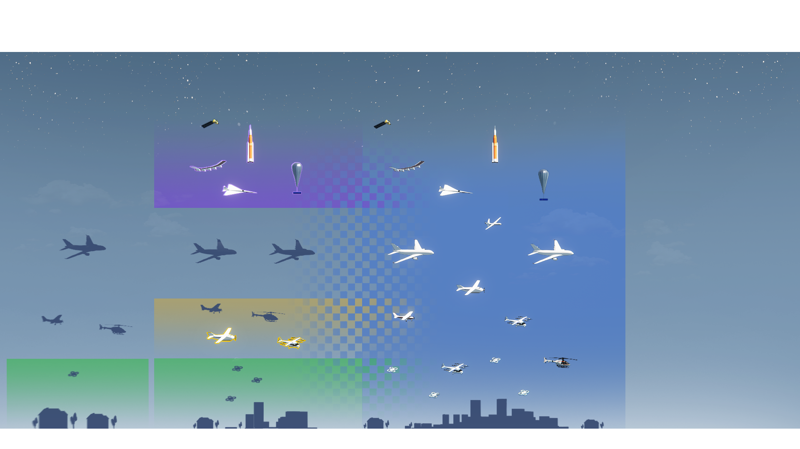
Integration of xTM into the NAS
Integration of xTM and conventional ATM will allow for more efficient use of airspace with harmonized seamless interaction between current and new entrants
TODAY
SEGREGATED
NEAR TERM
HYBRID
FUTURE
INTEGRATED
Upper-E Traffic Management
UAM Traffic Management
UAS Traffic Management

Slide 15
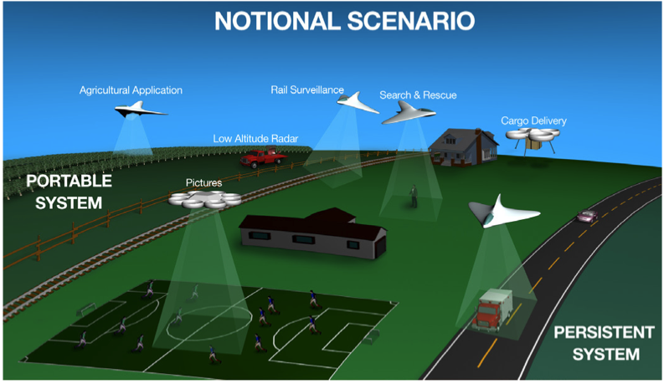
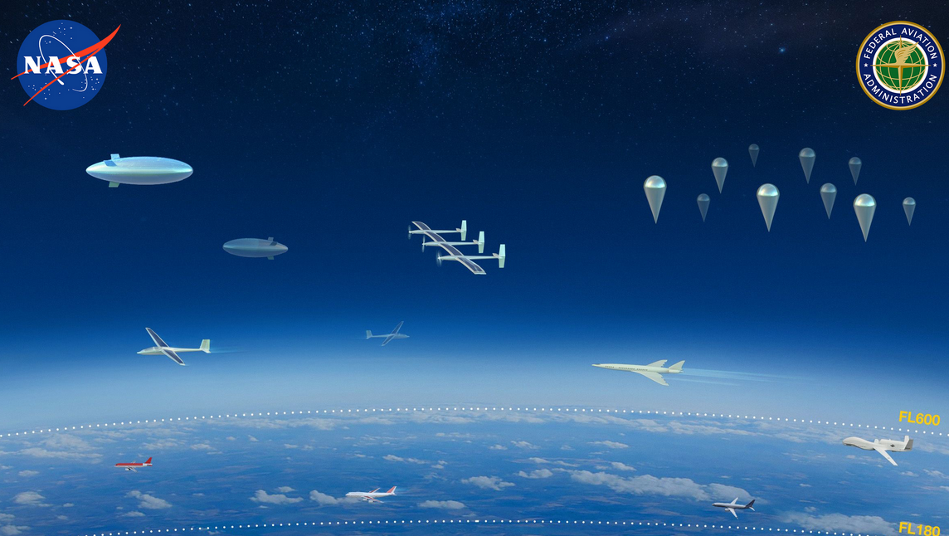
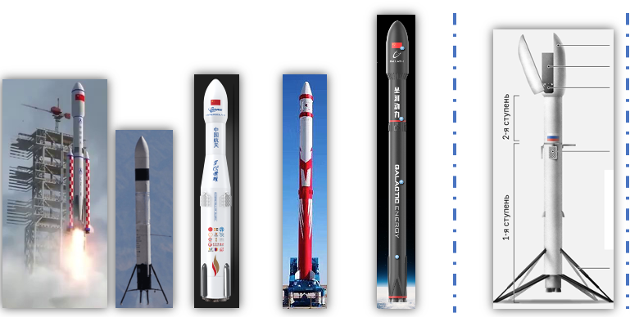
xTM Research Areas
xTM Maturation and Expansion
xTM and ATC Integration
Mature existing xTM systems and expand xTM to new domains
Increase xTM coordination with ATC to improve the flexibility and efficiency of xTM operations
Maturation of UTM toward implementation
Upper Class E Traffic Management (ETM)
Exploration of expanding xTM to new domains, such as commercial space launch

Slide 16
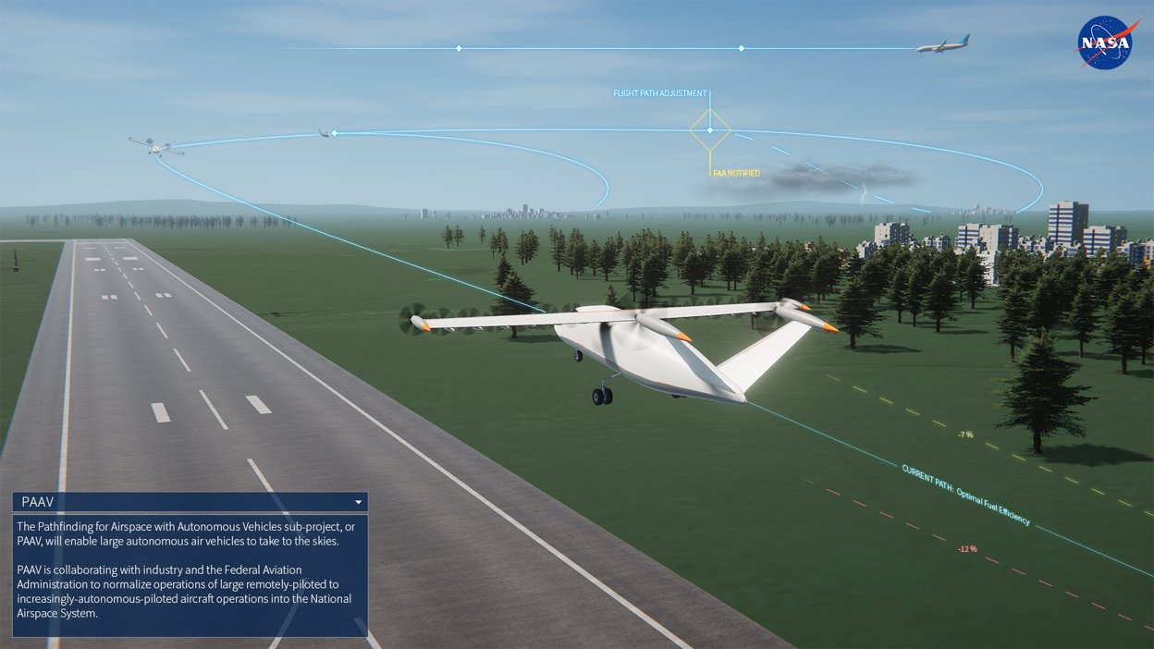
Pathfinding for Airspace
with Autonomous Vehicles
Autonomous air vehicles will revolutionize aviation in the not-too-distant future.
The Pathfinding for Airspace with Autonomous Vehicles subproject, or PAAV, is focused on the seamless and scalable integration of large Unmanned Aerial Vehicles with autonomy that unlocks new opportunities.
Notes:
Autonomous air vehicles will revolutionize aviation in the not-too-distant future – including how goods are moved across the United States. But before autonomous air vehicles can routinely take to the skies, they must seamlessly integrate into the world’s busiest and most complex airspace, the National Airspace System (NAS).
NASA has completed significant research needed to enable Unmanned Aircraft System (UAS) operations which will be leveraged by the Pathfinding for Airspace with Autonomous Vehicles (PAAV) subproject.
PAAV will initially focus on the seamless and scalable integration of large Unmanned Aerial Vehicles (UAV) for cargo transportation. These vehicles will fly in the same airspace as commercial aircraft, with pilots outside of the vehicle and operations outside of the urban area. These efforts will enable large amounts of air cargo to be transported regionally or nationally.

Slide 17
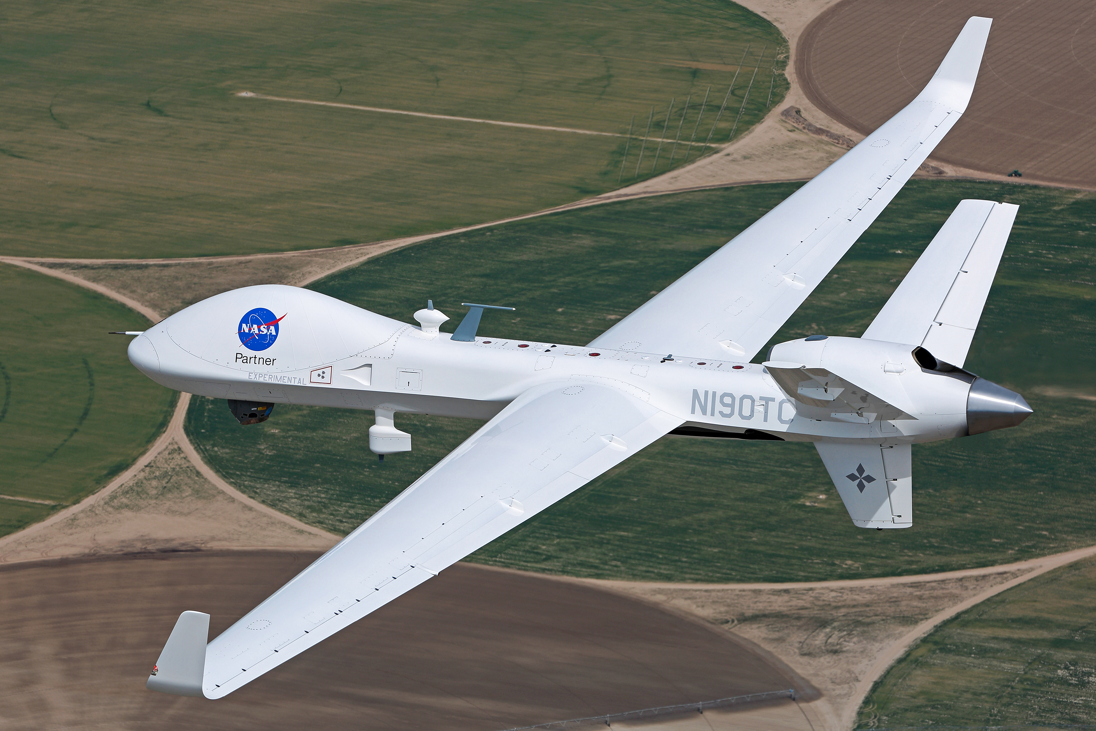
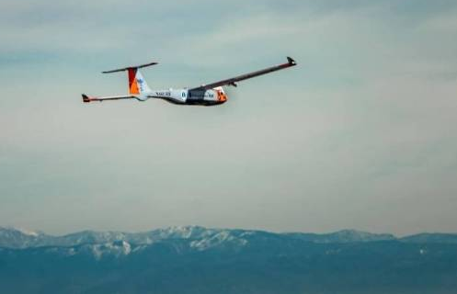
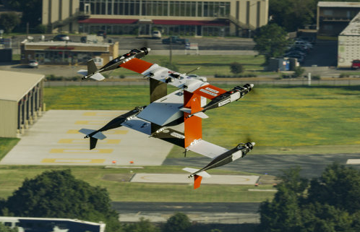
Motivation
State-Of-The-Art
Needs
Problem
The current air traffic management system is not able to support routine “file and fly” of increasingly autonomous aircraft in airspace shared with conventional aircraft
DAA and C2 standards enable industry to build certified systems
Large UAS flights without a chase aircraft with accommodations
Industry is developing vehicle autonomy that will need to be integrated into the airspace
A common stakeholder informed concept for airspace integration of operations scalable to future autonomy
Examination of airspace integration at a systems level
Airspace procedures and technologies that are scalable to future autonomous operations

Slide 18
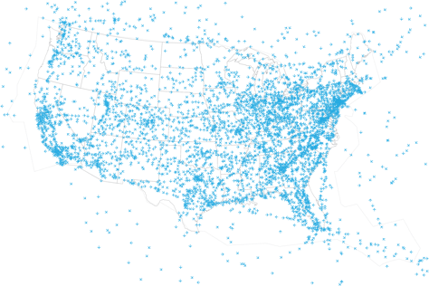
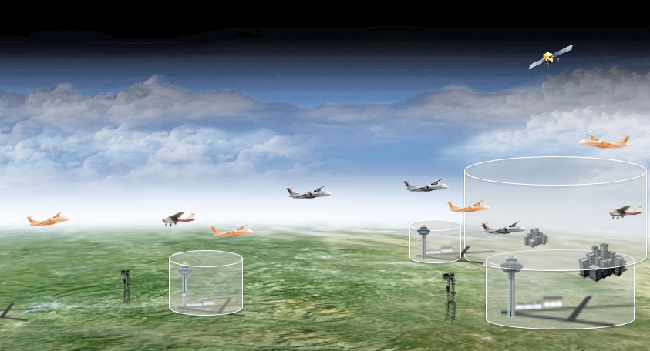
PAAV Research Areas
Systems Assessment of Increasingly Autonomous Operations
Modeling and Simulation of Regional Operations
Collaborative Flight Demonstrations
Identify roles, responsibilities, and allocation of functions needed to enable increasingly autonomous operations in airspace shared with conventional aircraft
Assess airspace integration of increasingly autonomous operations with a focus on flow participation, separation, and contingency management
Demonstrate the airspace integration of industry-developed autonomous technologies and test PAAV ConOps

Slide 19
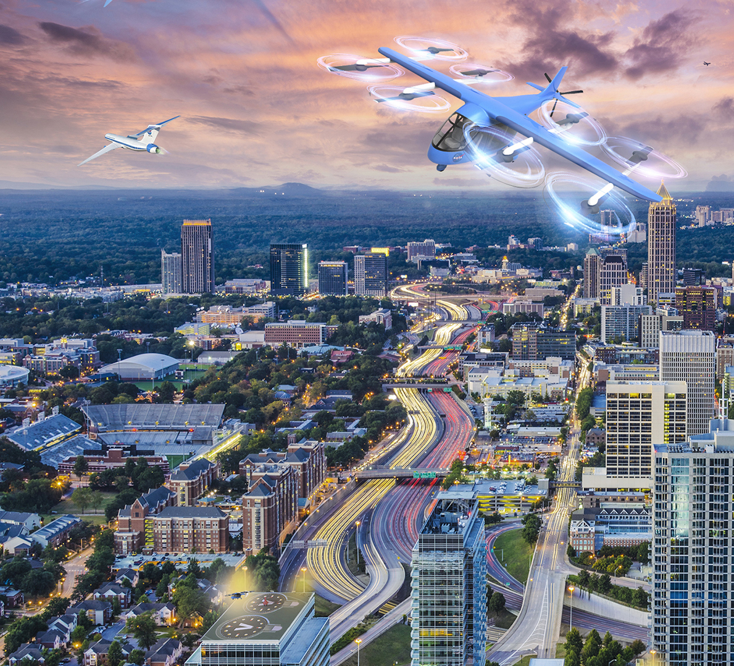
Urban Air Mobility
Airspace Management
Urban Air Mobility aims to revolutionize how people and goods move across urban areas.
The UAM Airspace Management subproject, or UAM, will help enable safe and efficient operations in the National Airspace System above urban areas.
Notes:
From emergency relief to autonomous skyward commutes, Urban Air Mobility (UAM) aims to reshape the future through bold opportunities. However, as electrically powered vertical take-off and landing aircraft are expected to soar above urban areas, that airspace will grow increasingly dense and complex.
To safely achieve the high level of operational density and complexity in the schedule desired by the UAM community, a reimagining of an airspace system that enables UAM operators to readily access and operate safely and efficiently in the National Airspace System (NAS) is needed.
Working with industry and the FAA, the Urban Air Mobility Airspace Management (UAM) subproject, along with the UAM community, is developing a federated service-oriented architecture and paradigm similar to what was developed for small Unmanned Aircraft Systems (sUAS) in NASA’s UAS Traffic Management (UTM) project. These efforts will enable a high level of operational density and complexity to ensure safe, secure, reliable, and predictable UAM operations.

Slide 20
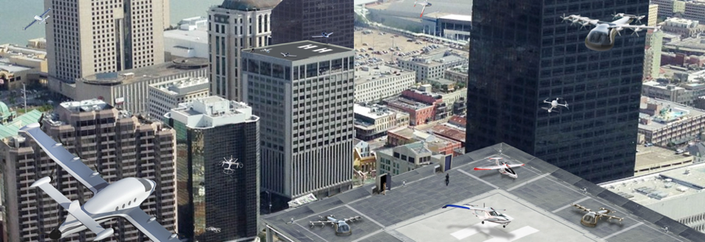
Motivation
The current air traffic management system cannot accommodate the expected scale of UAM operations

Slide 21
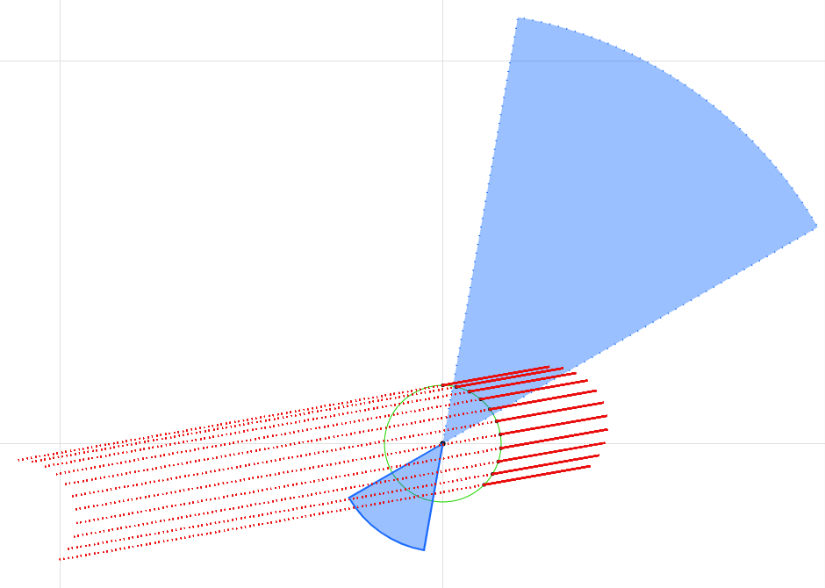
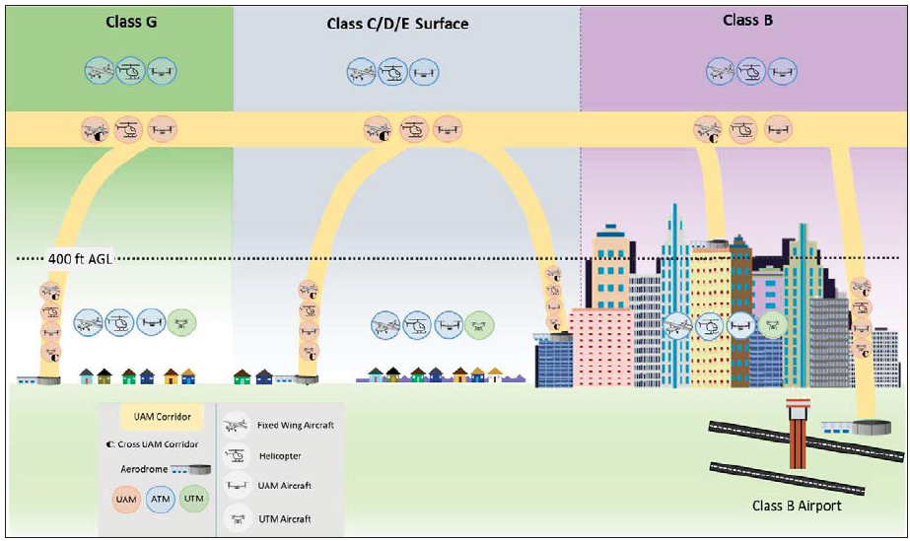
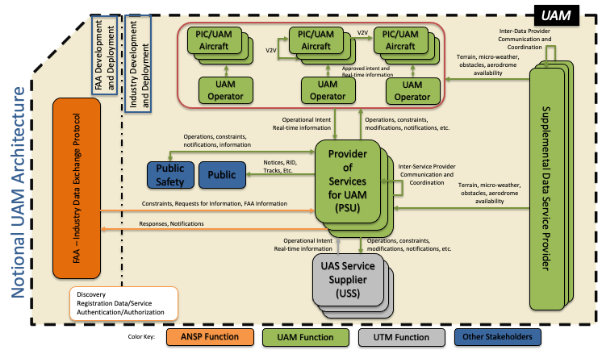
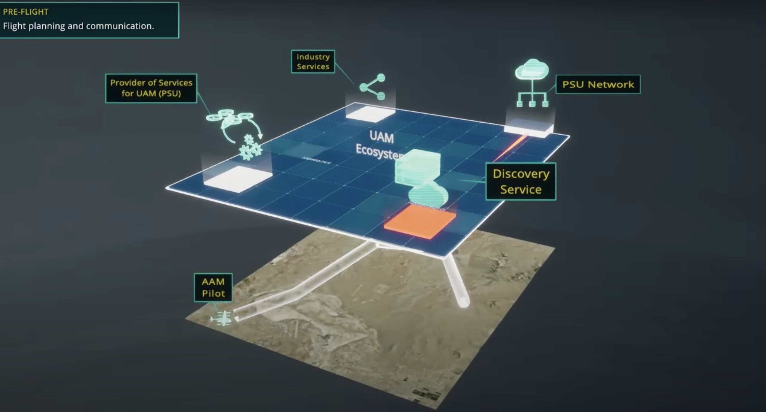

UAM Traffic Management Research Areas
Separation Standards
Airspace Procedures & Design
Airspace Services
Airspace Integration Testing & Demonstration
Communication, Navigation, and Surveillance

Slide 22
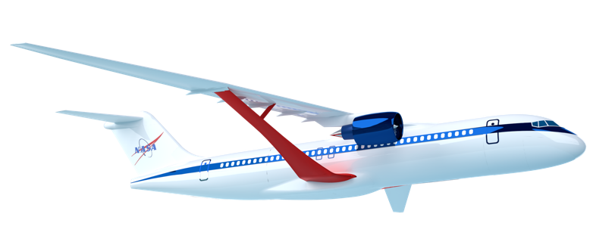
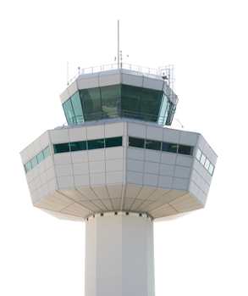
Community Benefits
Accelerating transformation to a digitally-integrated air transportation system
Acceleration of NAS Modernization
Improved Use of
NAS Data
Integration of Diverse Vehicles and Missions
Concepts, requirements, and reference implementations to enable airspace integration of new vehicles and missions
Collaborative service-based architecture to facilitate industry innovation
Data and advanced algorithms to increase efficiency and environmental sustainability

Slide 23





Q&A
@NASAaero
Contact Us: Kurt Swieringa, kurt.a.Swieringa@nasa.gov
Follow Us: www.nasa.gov/aeroresearch/programs/aosp/atm-x

