Slide 1

QUANTIFYING CHROMOSOME ABERRATIONS INDUCED BY DIRECT ION TRAVERSAL VS. DELTA-ELECTRONS
February 9, 2022
Floriane Poignant¹, Ianik Plante², Tony C. Slaba³
¹National Institute of Aerospace, Hampton, VA 23666
²KBR, 2400 NASA Parkway, Houston 77058
³NASA Langley Research Center, Hampton, VA 23681
2022 NASA Human Research Program Investigators’ Workshop
Notes:
Hello everyone, I am Floriane Poignant and in this presentation I will talk about quantifying chromosome aberrations induced by direct ion nuclear traversal versus delta-electrons.

Slide 2

Context Method Results
Galactic Cosmic Rays comprise high energy and charge (HZE) ions, characterized by a high linear energy transfer (LET) [1]. HZE ions induce DNA damages leading to chromosome aberrations (CAs), positively correlated with carcinogenesis [2].
Ion energy deposition pattern (track structure) responsible for DNA breaks depends on the ion LET and is described as a dense ionization core along the ion path, and a penumbra made of δ-electrons with sufficient energy to travel across many cells.
We study CA formation by separating those created by direct ion traversal of the cell nucleus (direct contribution), and those created by δ-electrons coming from distant ion tracks (indirect contribution).
Direct
Track
Indirect
Track
Nucleus
Chromosome
Irradiation volume
[1] Durante, M.; Cucinotta, F.A. Nature Reviews Cancer 2008, 8.6, 465-472. [2] Sridharan, D.M. et al. Life sciences in space research 2016, 9, 19-47.
Notes:
Space radiation is one of the major risk of space travel. Galactic cosmic rays in particular comprise high energy and charge ions, which have a high linear energy transfer. They can induce DNA damages and thus chromosome aberrations which correlates with cancer risks.
At the sub-cellular scale, high-LET ions have a distinct energy deposition patterns, known as the track structure, that depend on the ion LET. The track structure, illustrated in red and blue on the figure, is usually described as a dense ionization core located along the ion path, and a penumbra made of delta electrons, which have enough energy to travel across many cells.
In this work we study the formation of chromosome aberrations and separate the contribution from tracks directly crossing the nucleus, called direct contribution and illustrated in red, and the contribution of delta-electrons generated by distant tracks, called indirect contribution, as illustrated in blue.

Slide 3
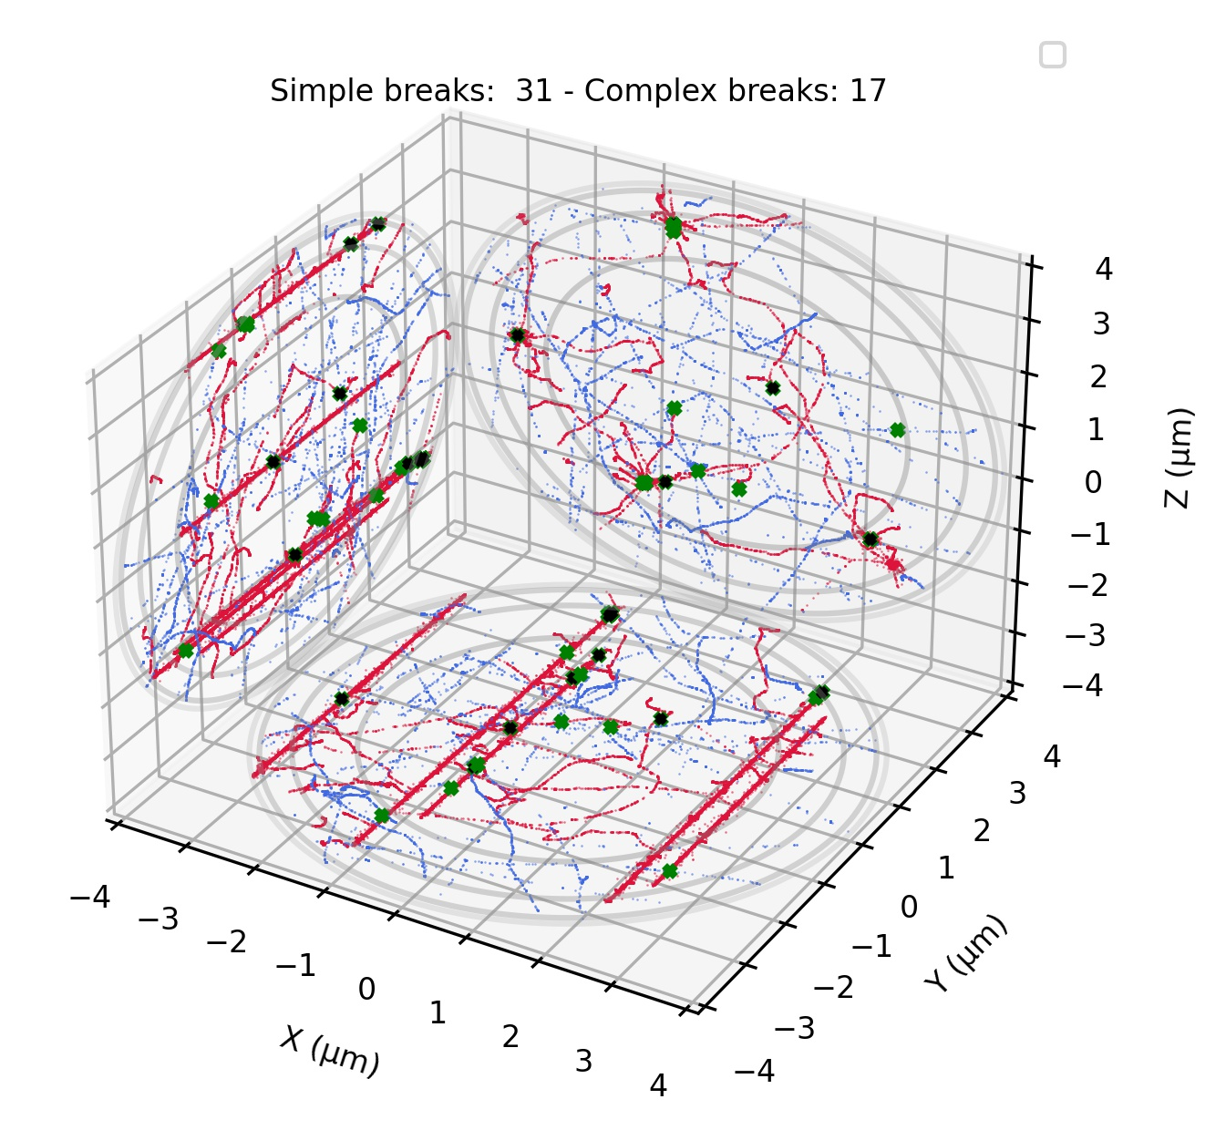
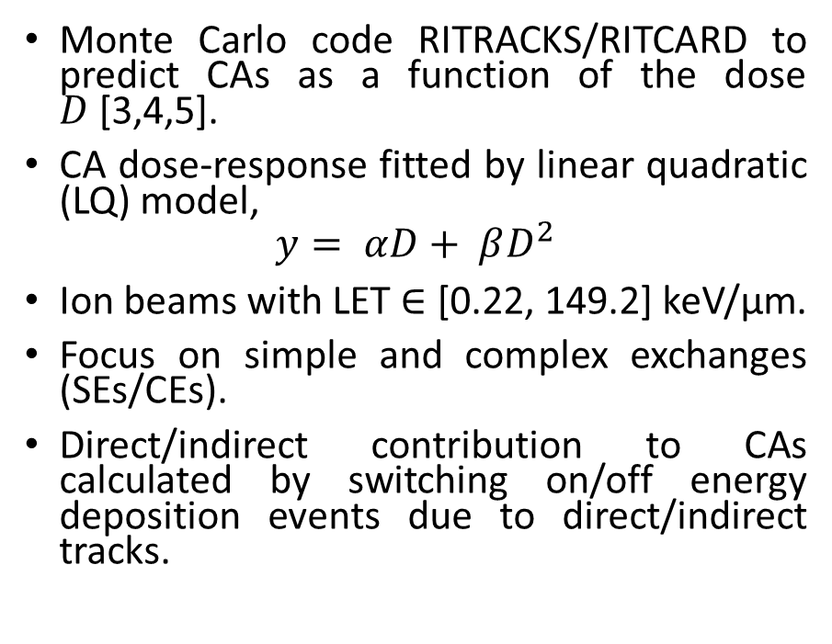
Context Method Results
Track structure
Monte Carlo code RITRACKS/RITCARD to predict CAs as a function of the dose $D$[3,4,5].
CA dose-response fitted by linear quadratic (LQ) model,
$$y= αD+ βD^{2}$$
Ion beams with LET $∈$ [0.22, 149.2] keV/µm.
Focus on simple and complex exchanges (SEs/CEs).
Direct/indirect contribution to CAs calculated by switching on/off energy deposition events due to direct/indirect tracks.
Si 300 MeV/n (68.9 keV/µm)
Nucleus
Energy deposition events from direct contribution
Energy deposition events from indirect contribution
DNA Double-strand breaks
[3] Plante, I. et al. InTech, Rijeka, Croatia 2011, 315-356. [4] Plante, I. et al. Radiation research 2019, 192(3), 282-298. [5] Plante, I. et al. Life 2021, 11(11), 1112
Notes:
To that end, we used the set of monte carlo codes RITRACKS and RITCARD to predict chromosome aberrations as a function of the dose, which was then fitted by a linear quadratic model. The ion beams had LET spanning from .22 to 150 keV/um. We focused on simple and complex exchanges. The direct and indirect contributions were obtained by switching on or off the associated energy deposition events.
This figure illustrates an example of a simulated track structure projected onto the different axes, for a beam of LET equal to 70 keV/um and a dose of 1 Gy. The nucleus is represented in Grey. In red, we have energy deposition events coming from the direct contribution, and in blue coming from the indirect contributions. The green dots represent DNA double-strand breaks, mostly located along the ionization core of the ions.

Slide 4
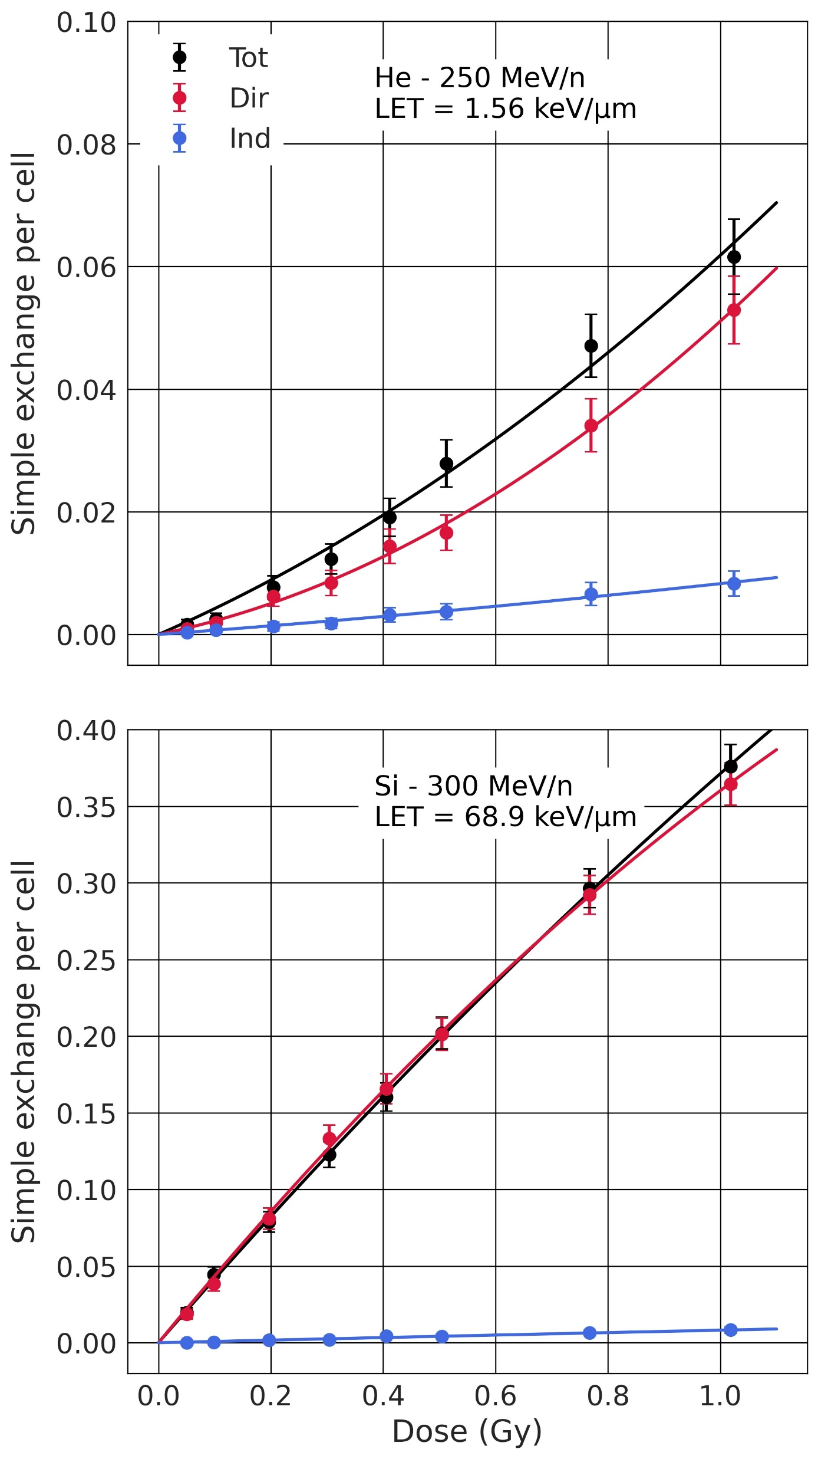
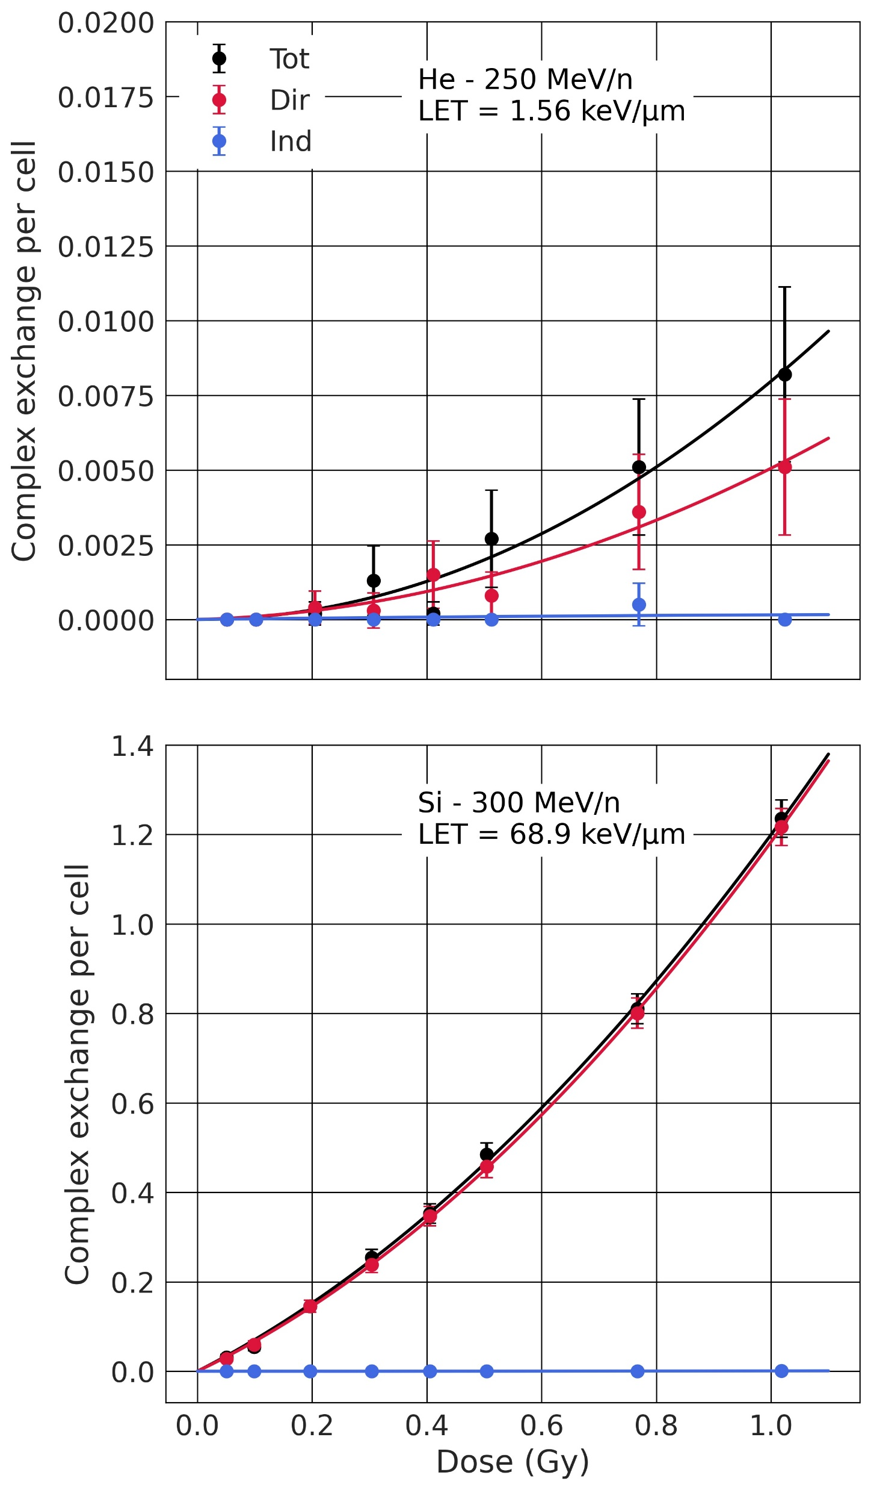
Context Method Results
Dose-response
Direct contribution
  ~ 80% of total dose
  ~ 80% of DNA DSBs.
Indirect contribution
  ~ 20% of total dose
  ~ 20% of DNA DSBs
Ratio not preserved for CAs. At 1 Gy, the direct contribution induces 84 to 98% of SEs and 96 to 100% of CEs, depending on ion LET.
Notes:
These two graphs show the results of the dose response, in black, red and blue for the total, direct and indirect contributions, for simple exchanges on the left and complex exchanges on the right. On the top results are for a low LET ion beam, and on the bottom for high LET ion beam. The direct contribution is responsible of approximately 80% of the total dose and thus DNA double strand breaks, while the indirect contribution is responsible for the other 20%. Those ratios are not preserved when looking at chromosome aberrations. At 1 Gy, the direct contribution induces 84 to 98% of the simple exchanges depending on the LET, and close to 100% of complex exchanges.

Slide 5
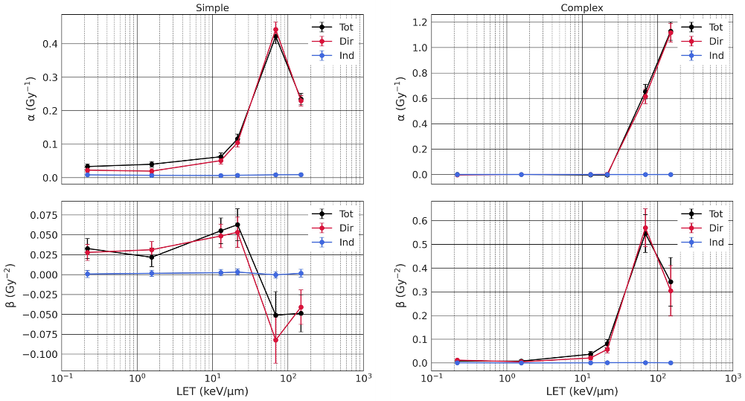
Context Method Results
LQ coefficients
Direct contribution
  Majority of CAs (SEs and CEs)
  LET dependent
  Clustered DNA DSBs
Indirect contribution
  Negligible for CEs
  LET independent for SEs
  Sparsely distributed DSBs
Clustered DSBs necessary for CA formation
Notes:
These graphs show the linear quadradic coefficients alpha and beta as a function of the LET. This confirms that the direct contribution induces the majority of the chromosome aberrations in a way that is LET dependent. This is because it induces the majority of DNA DSBs, and they are clustered along the track. The indirect contribution is negligible for complex exchanges, and small and LET independent for simple exchanges. It is because the number of induced DSBs is low, and they are sparsely distributed. This study shows that clustered DSBs are necessary for the formation of chromosome aberrations. Thank you for your attention.

