Slide 1

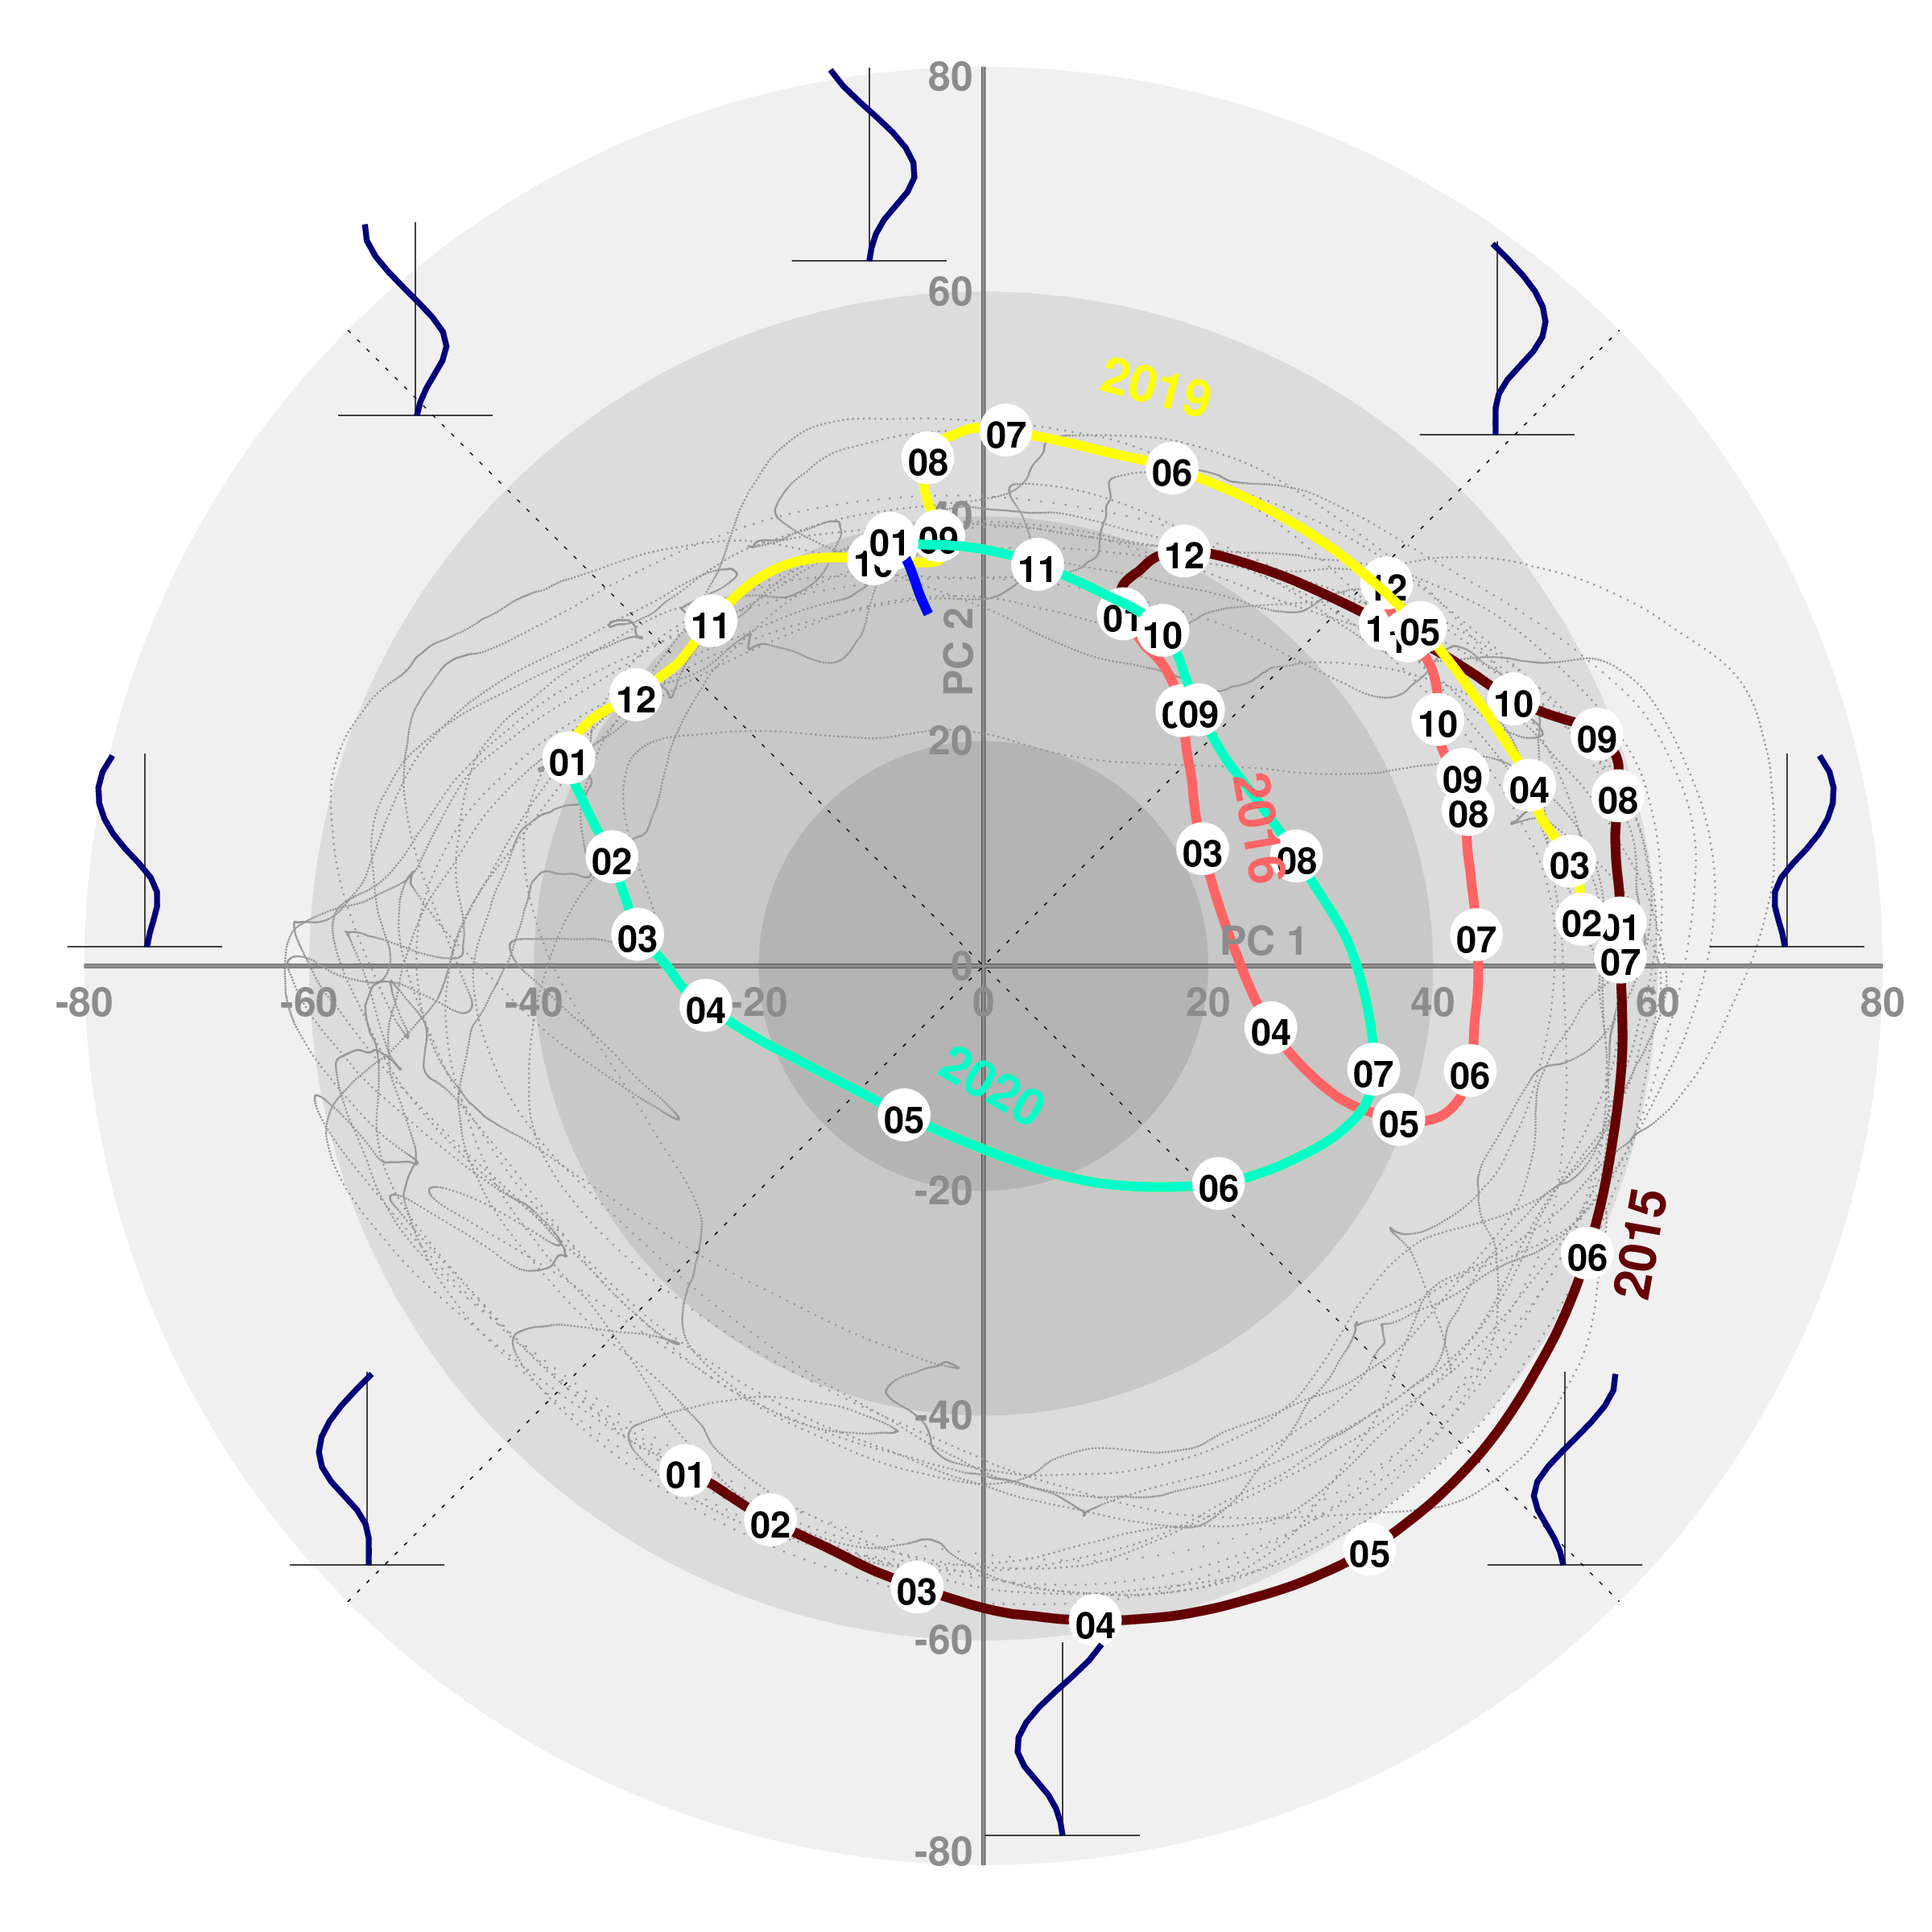
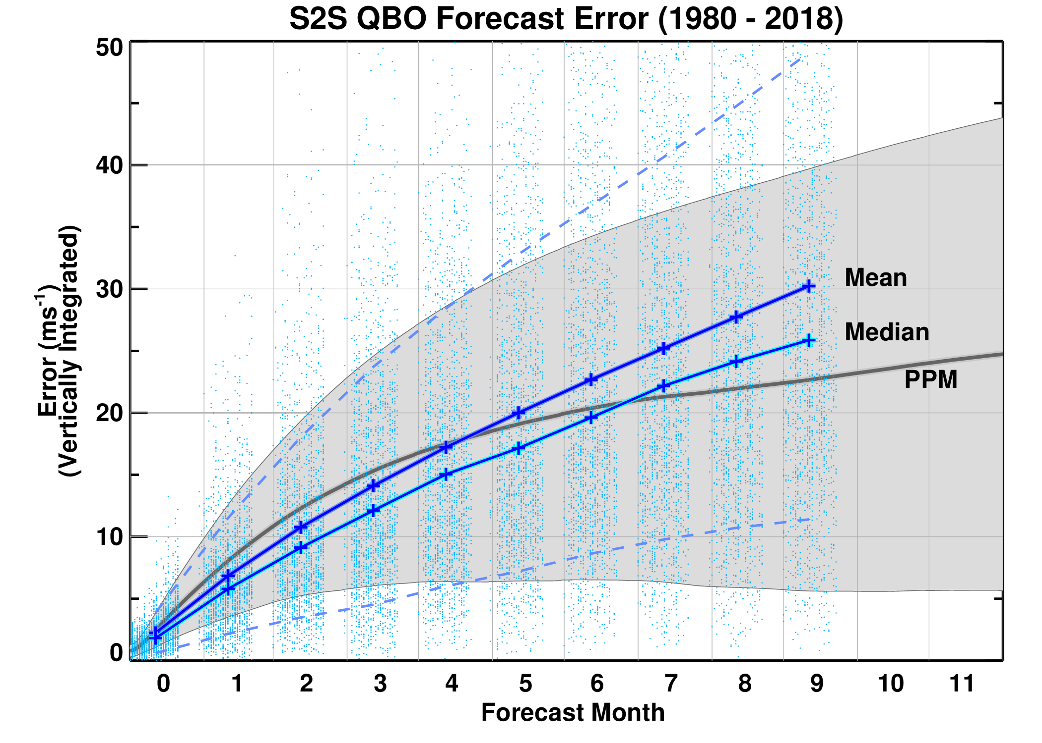
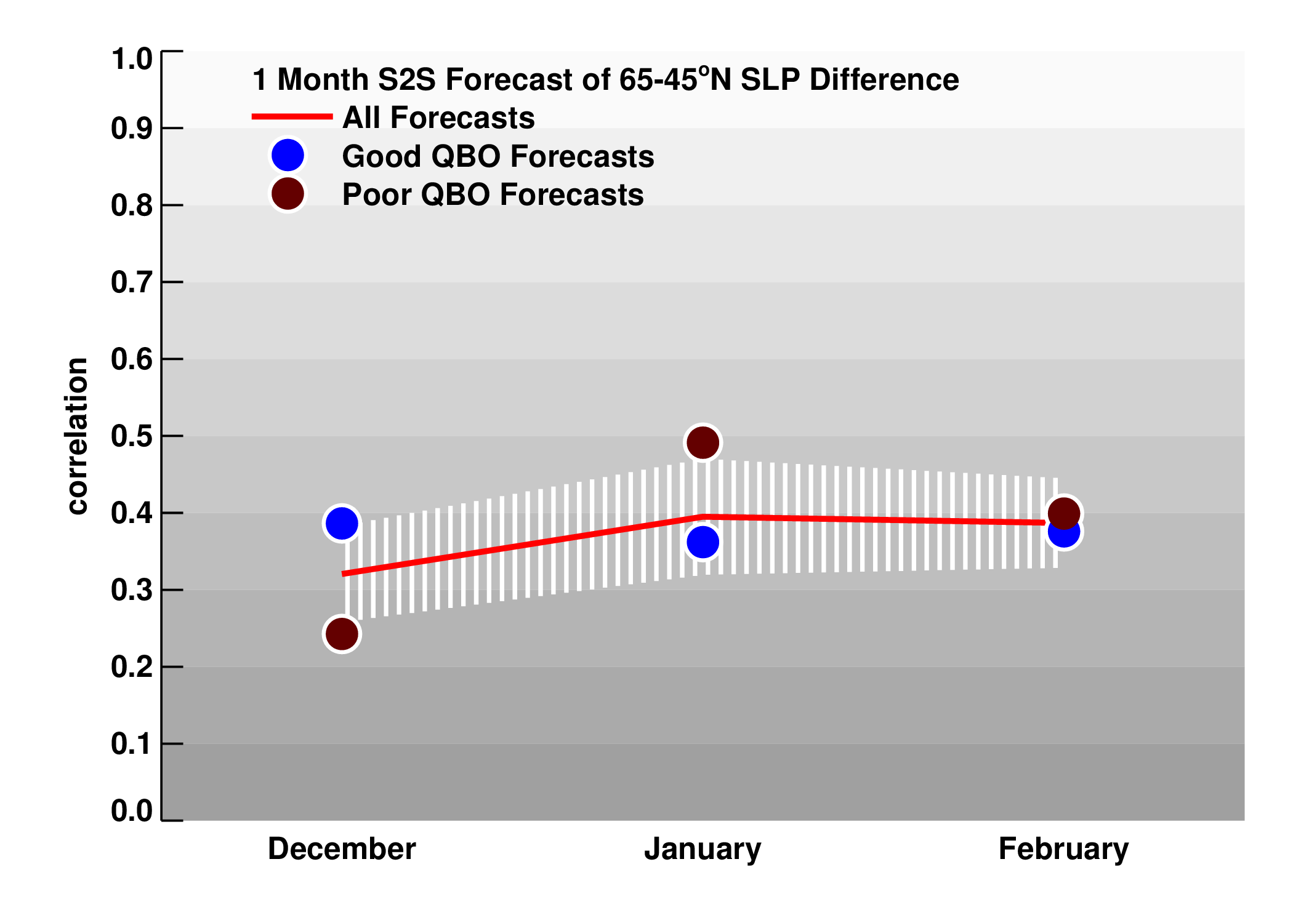
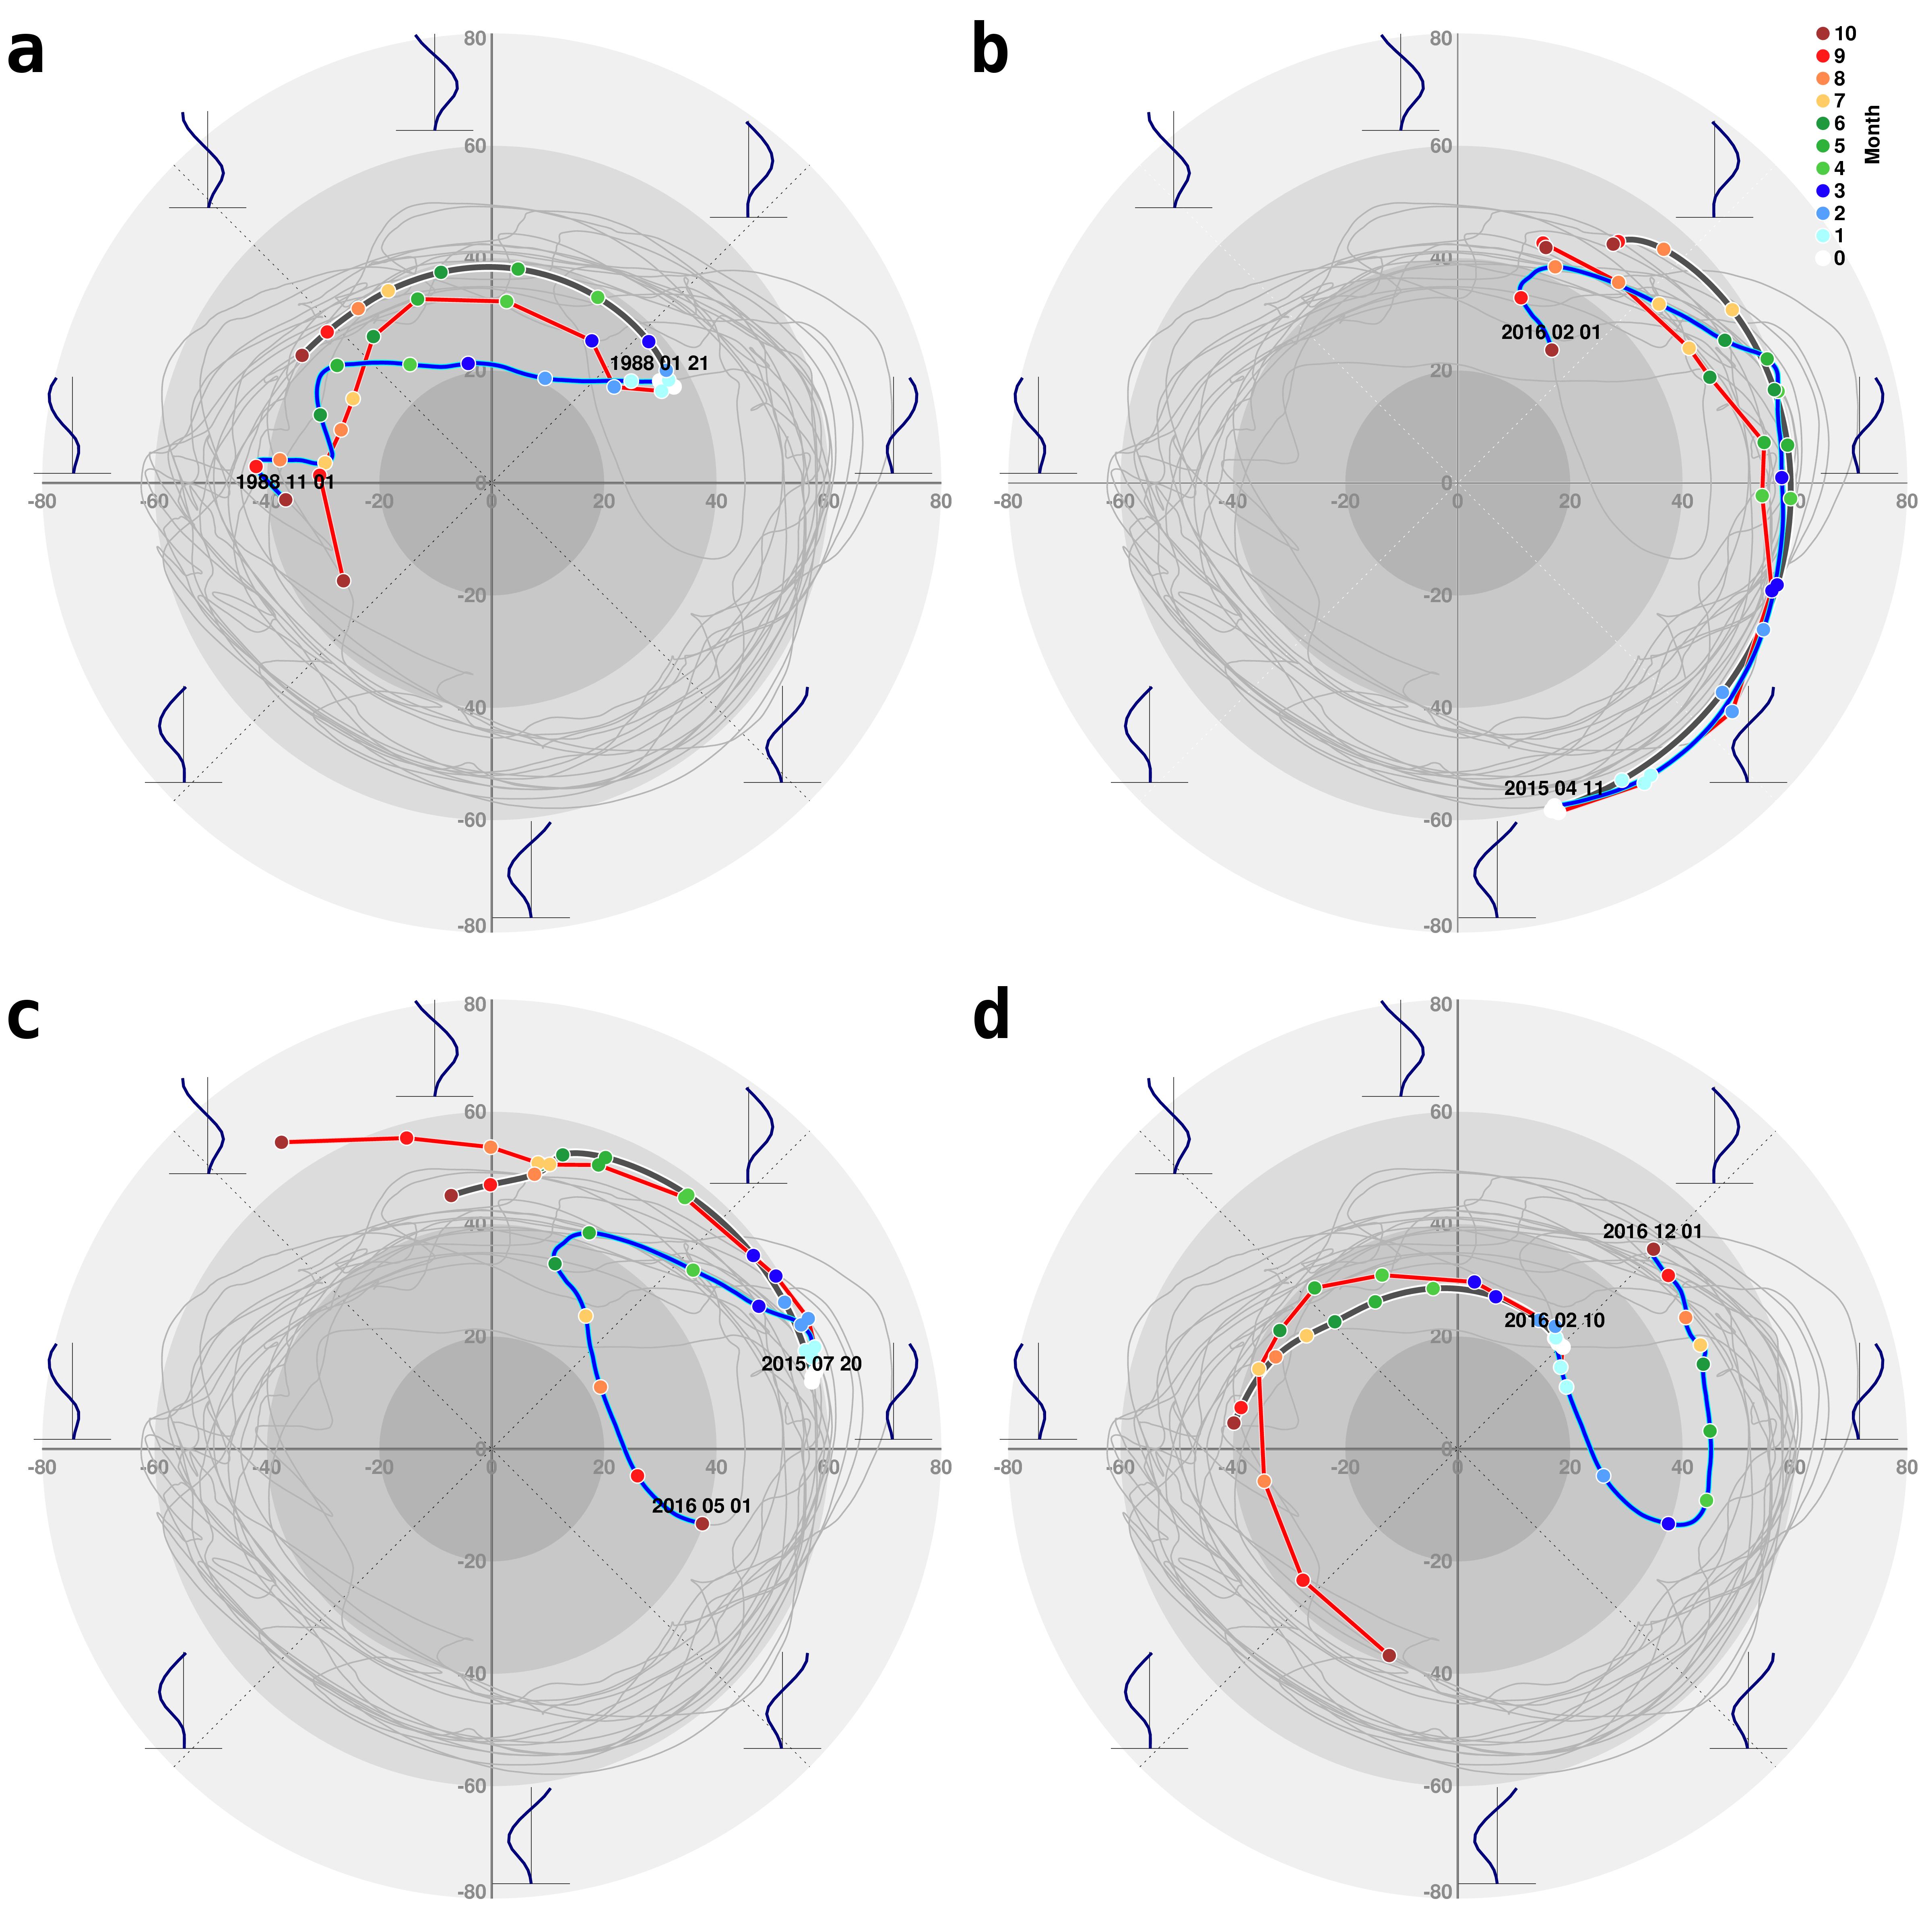
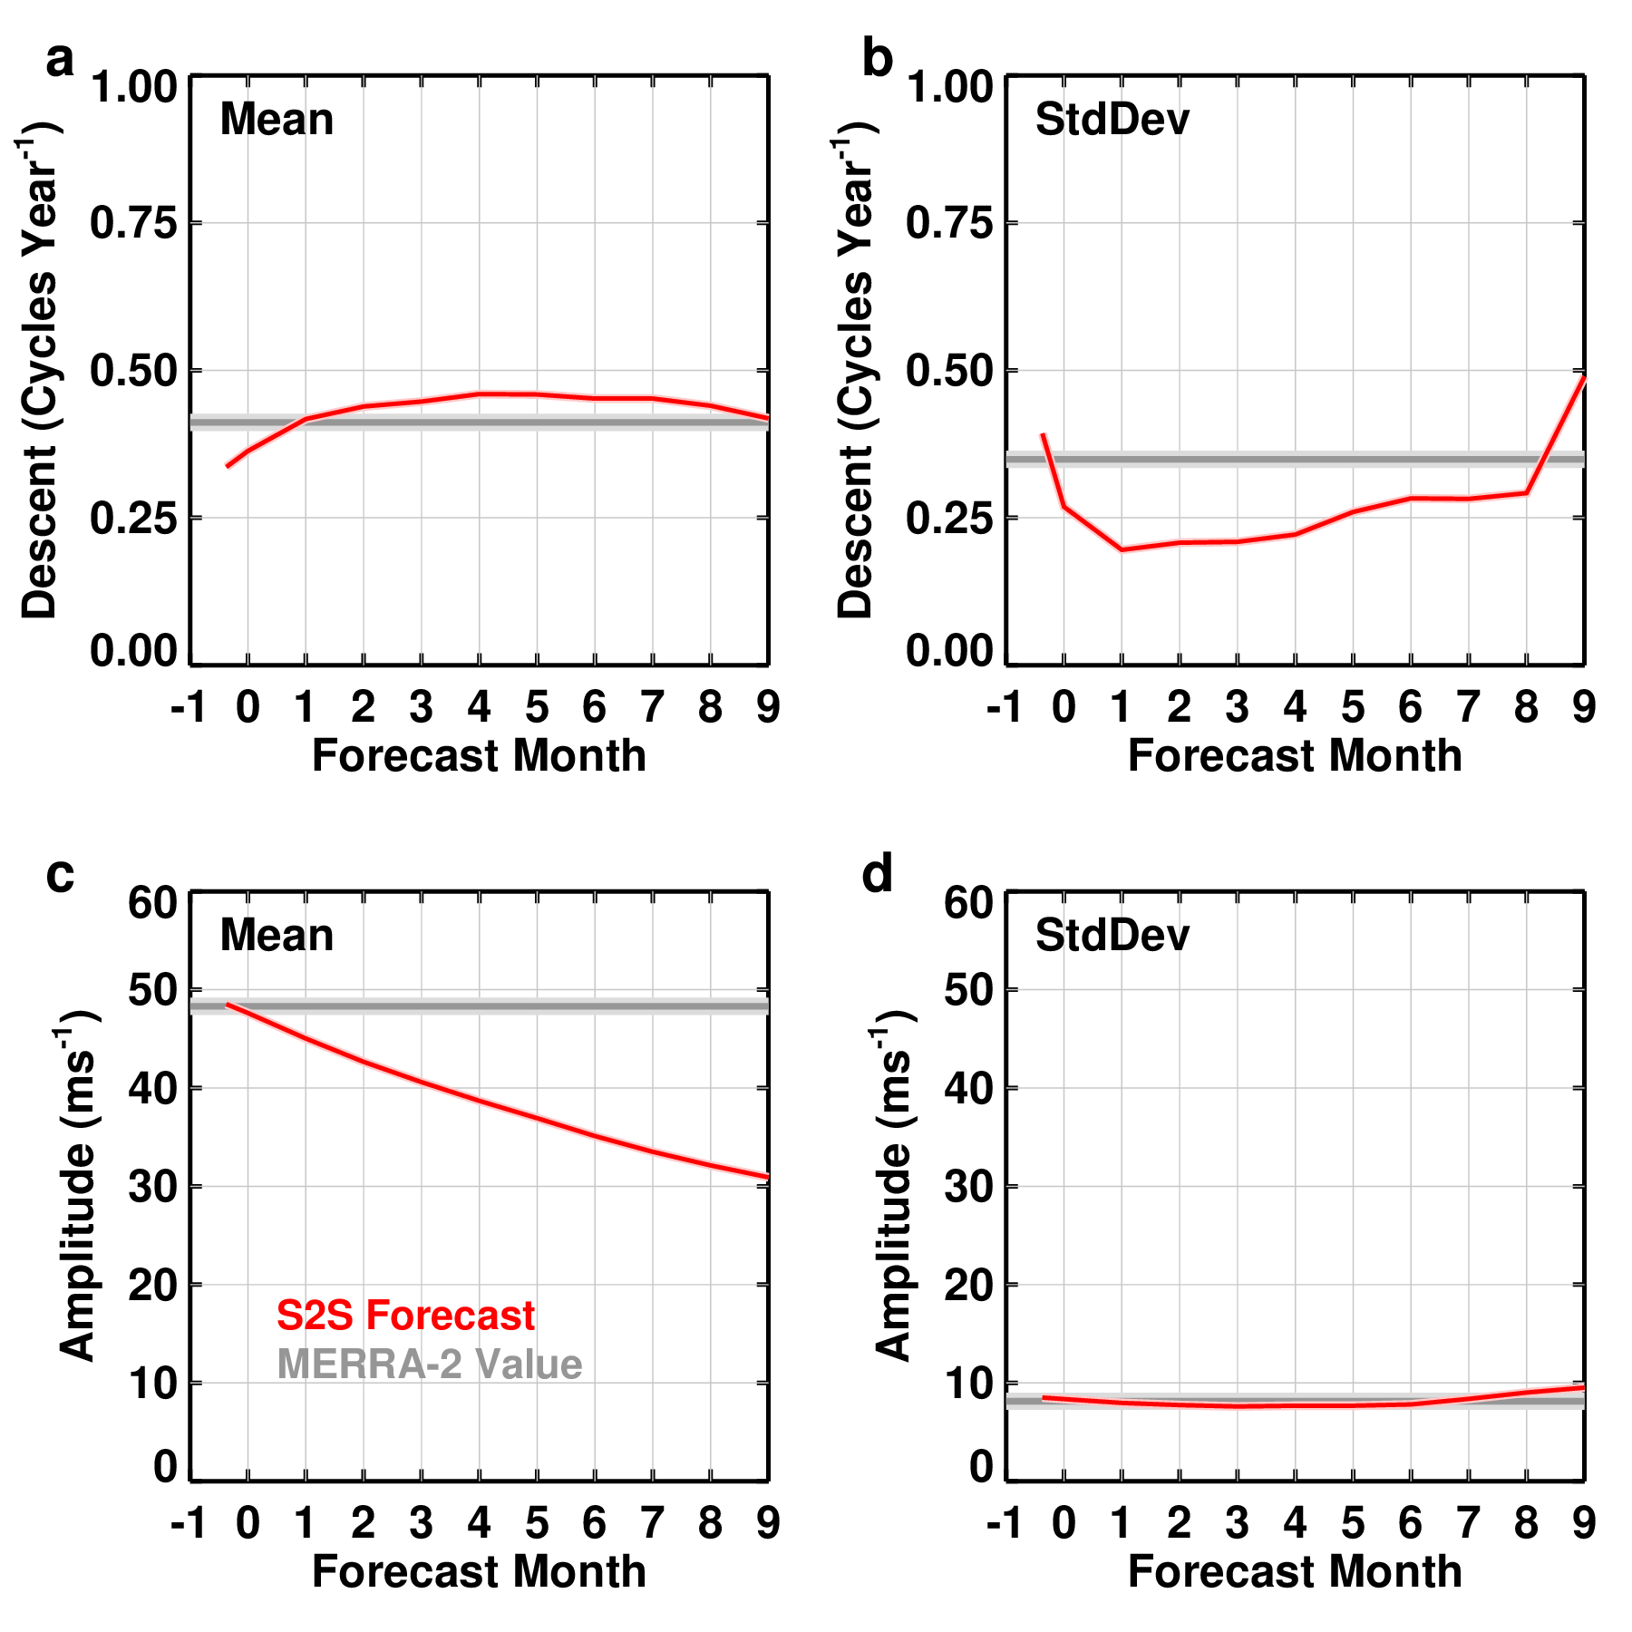
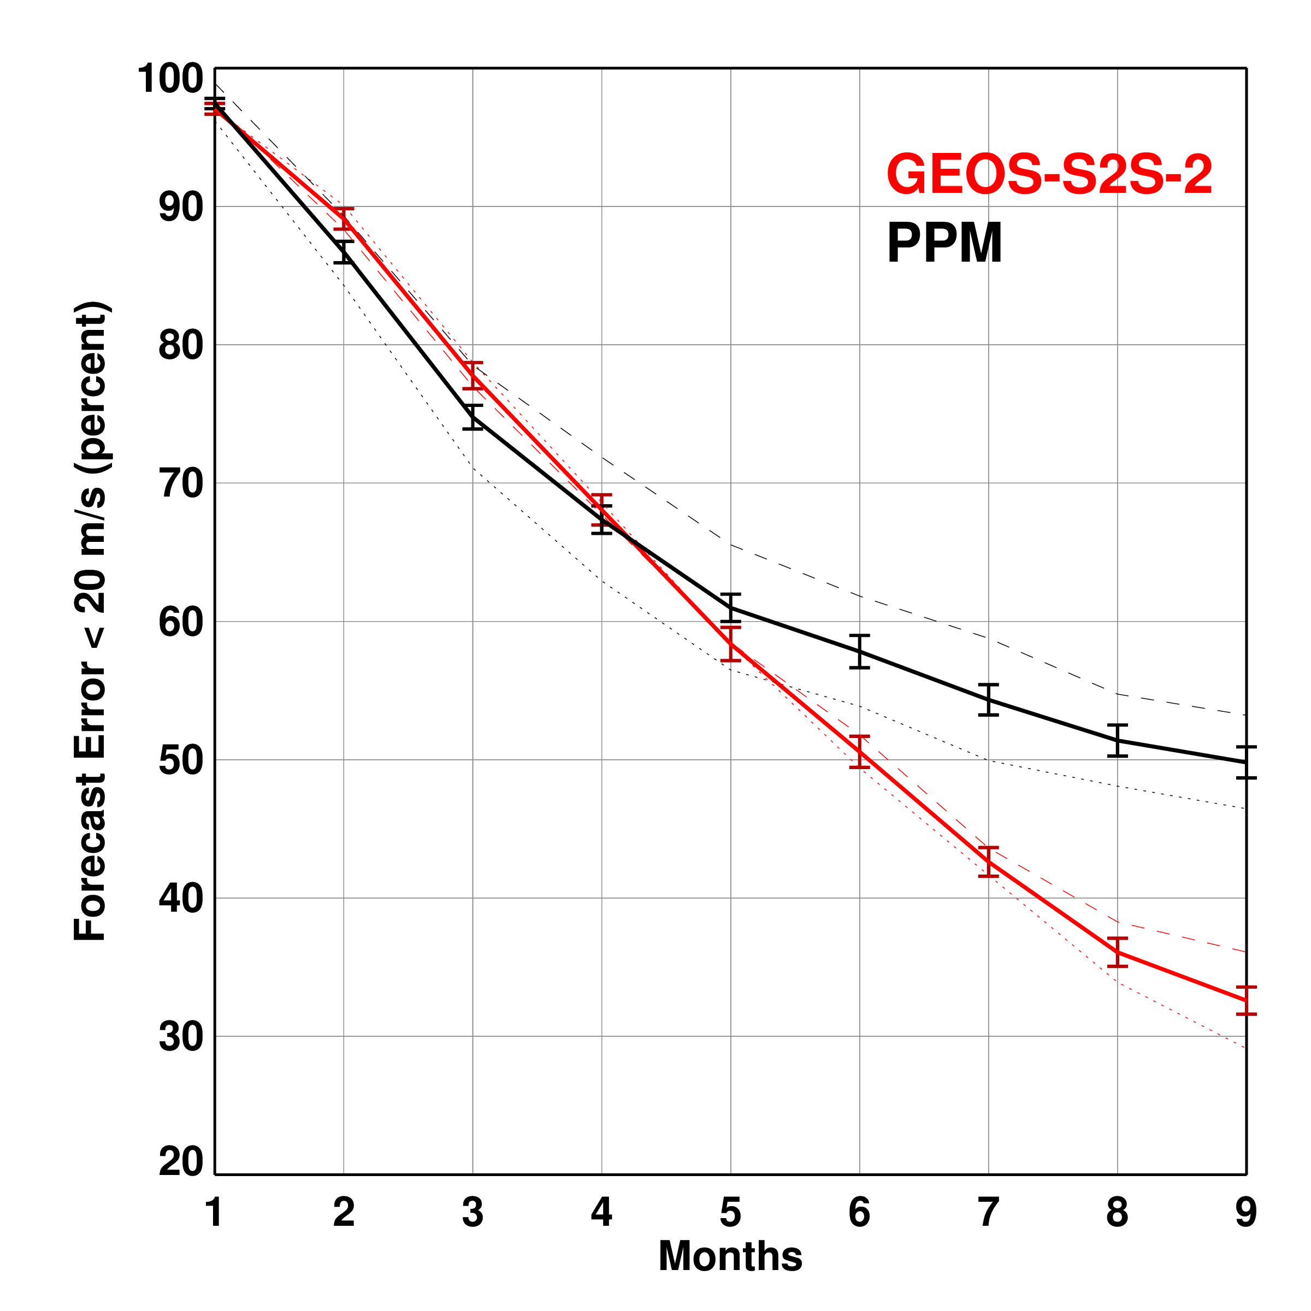
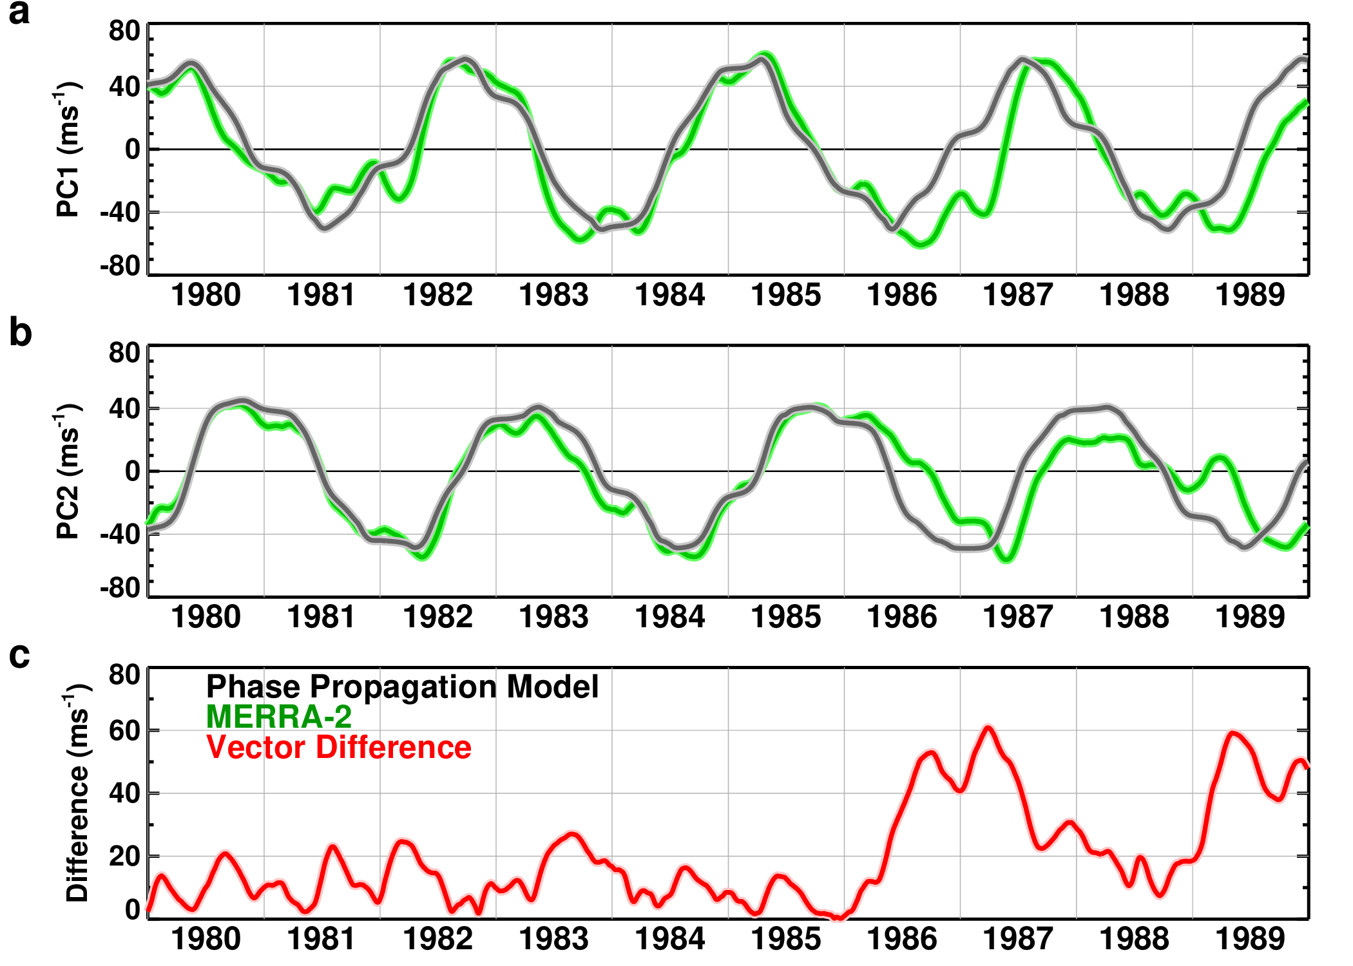
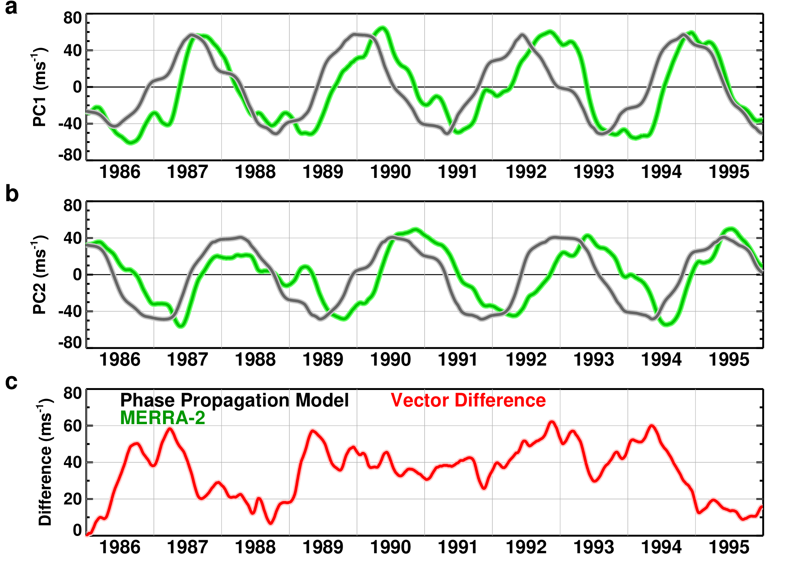
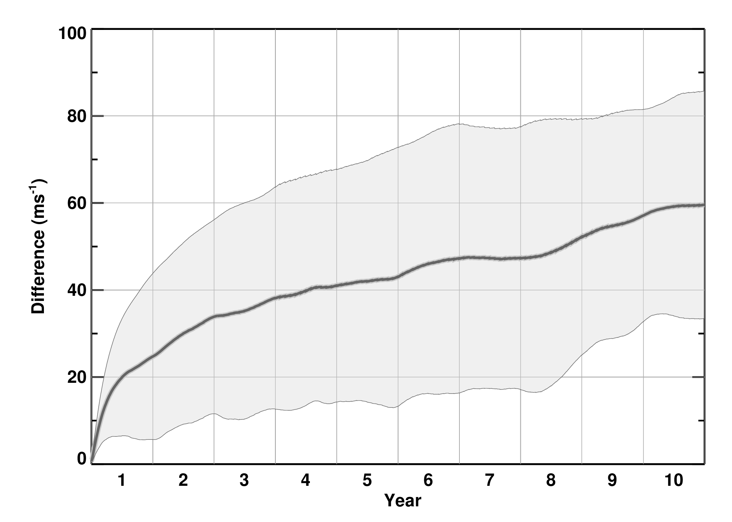
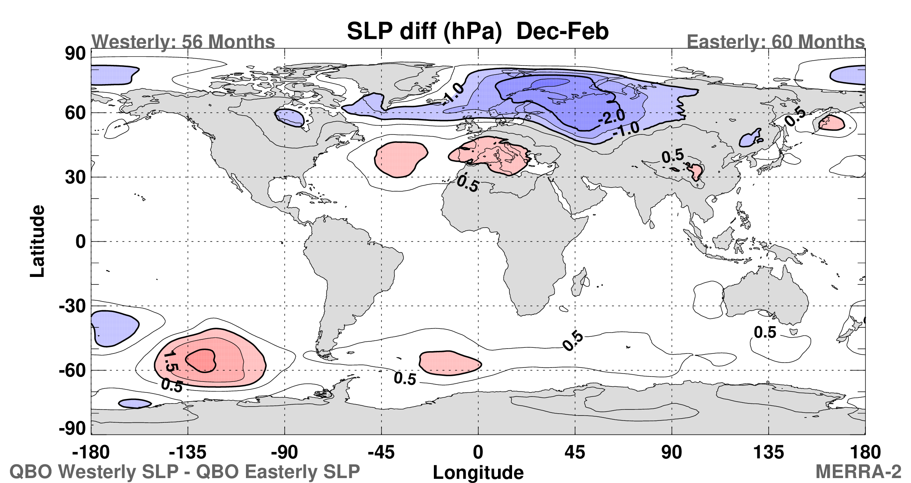
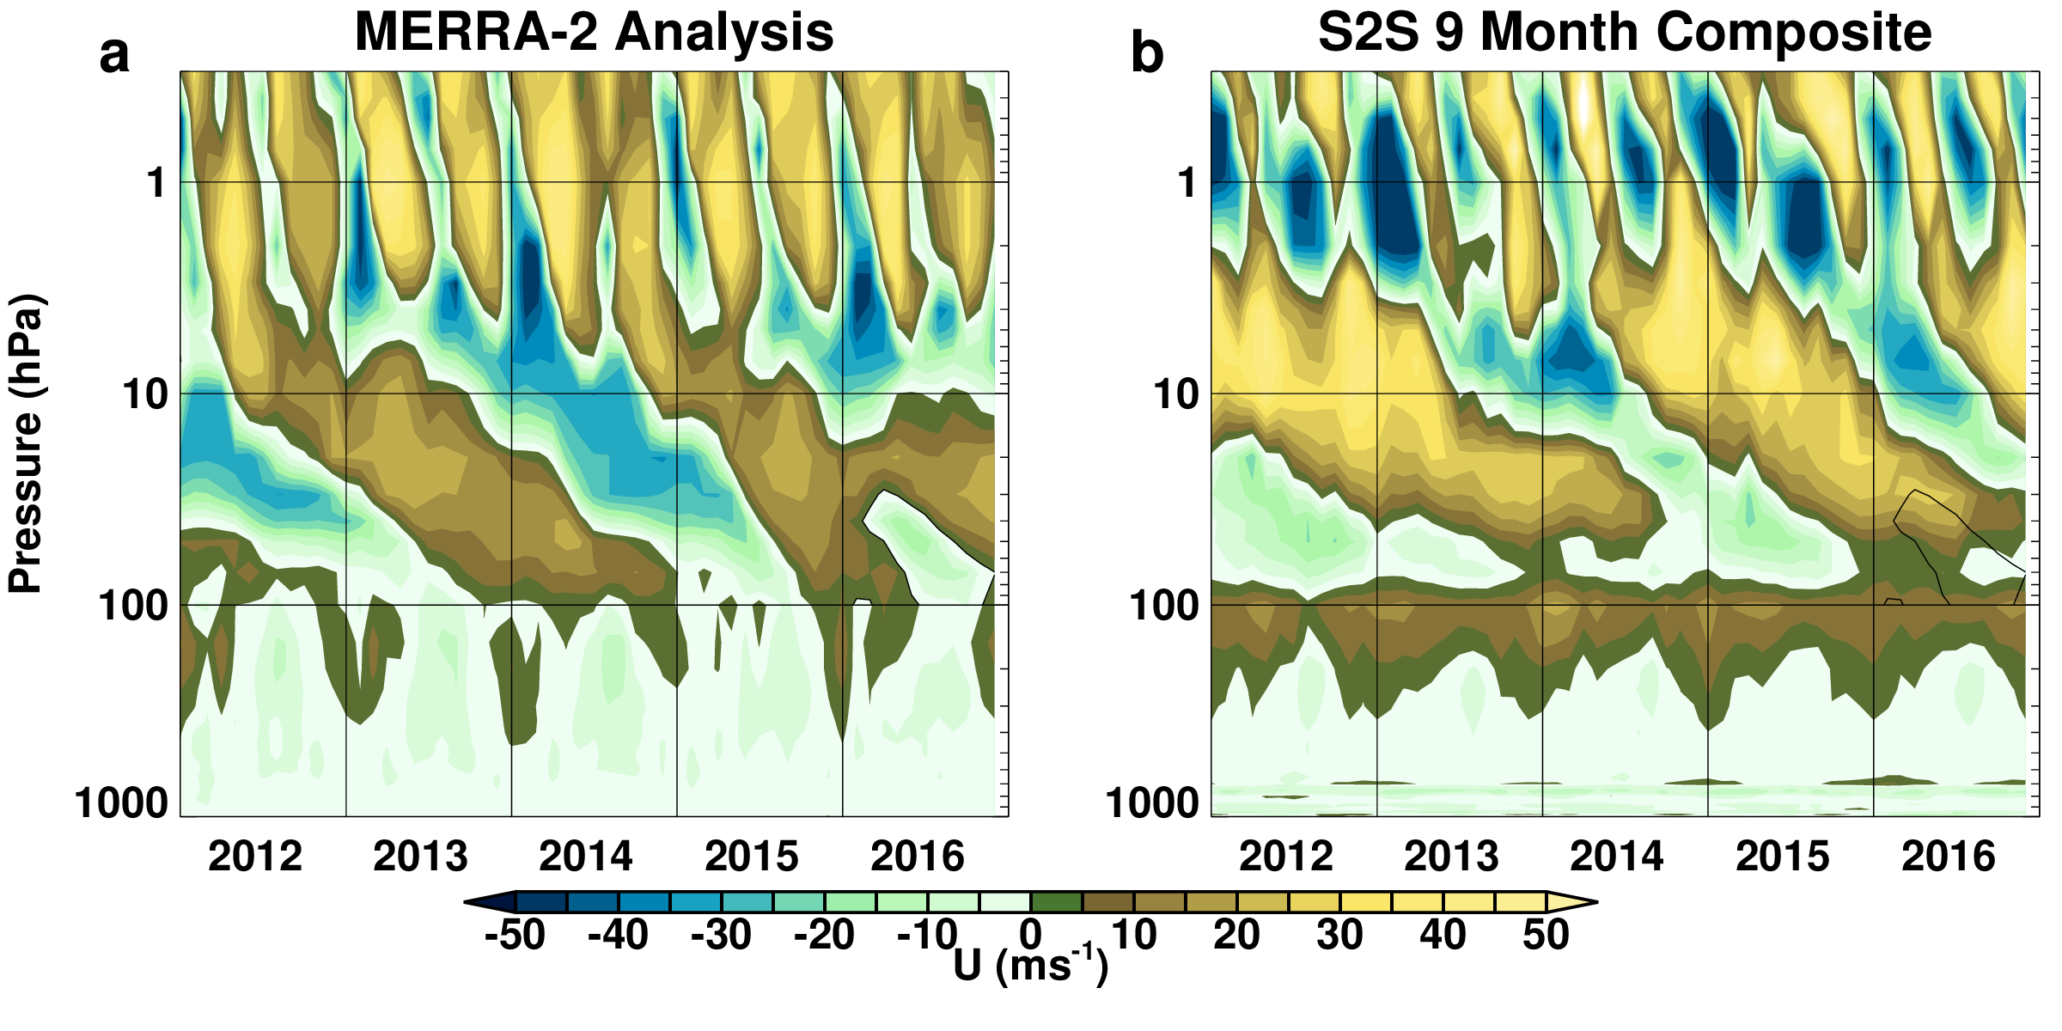
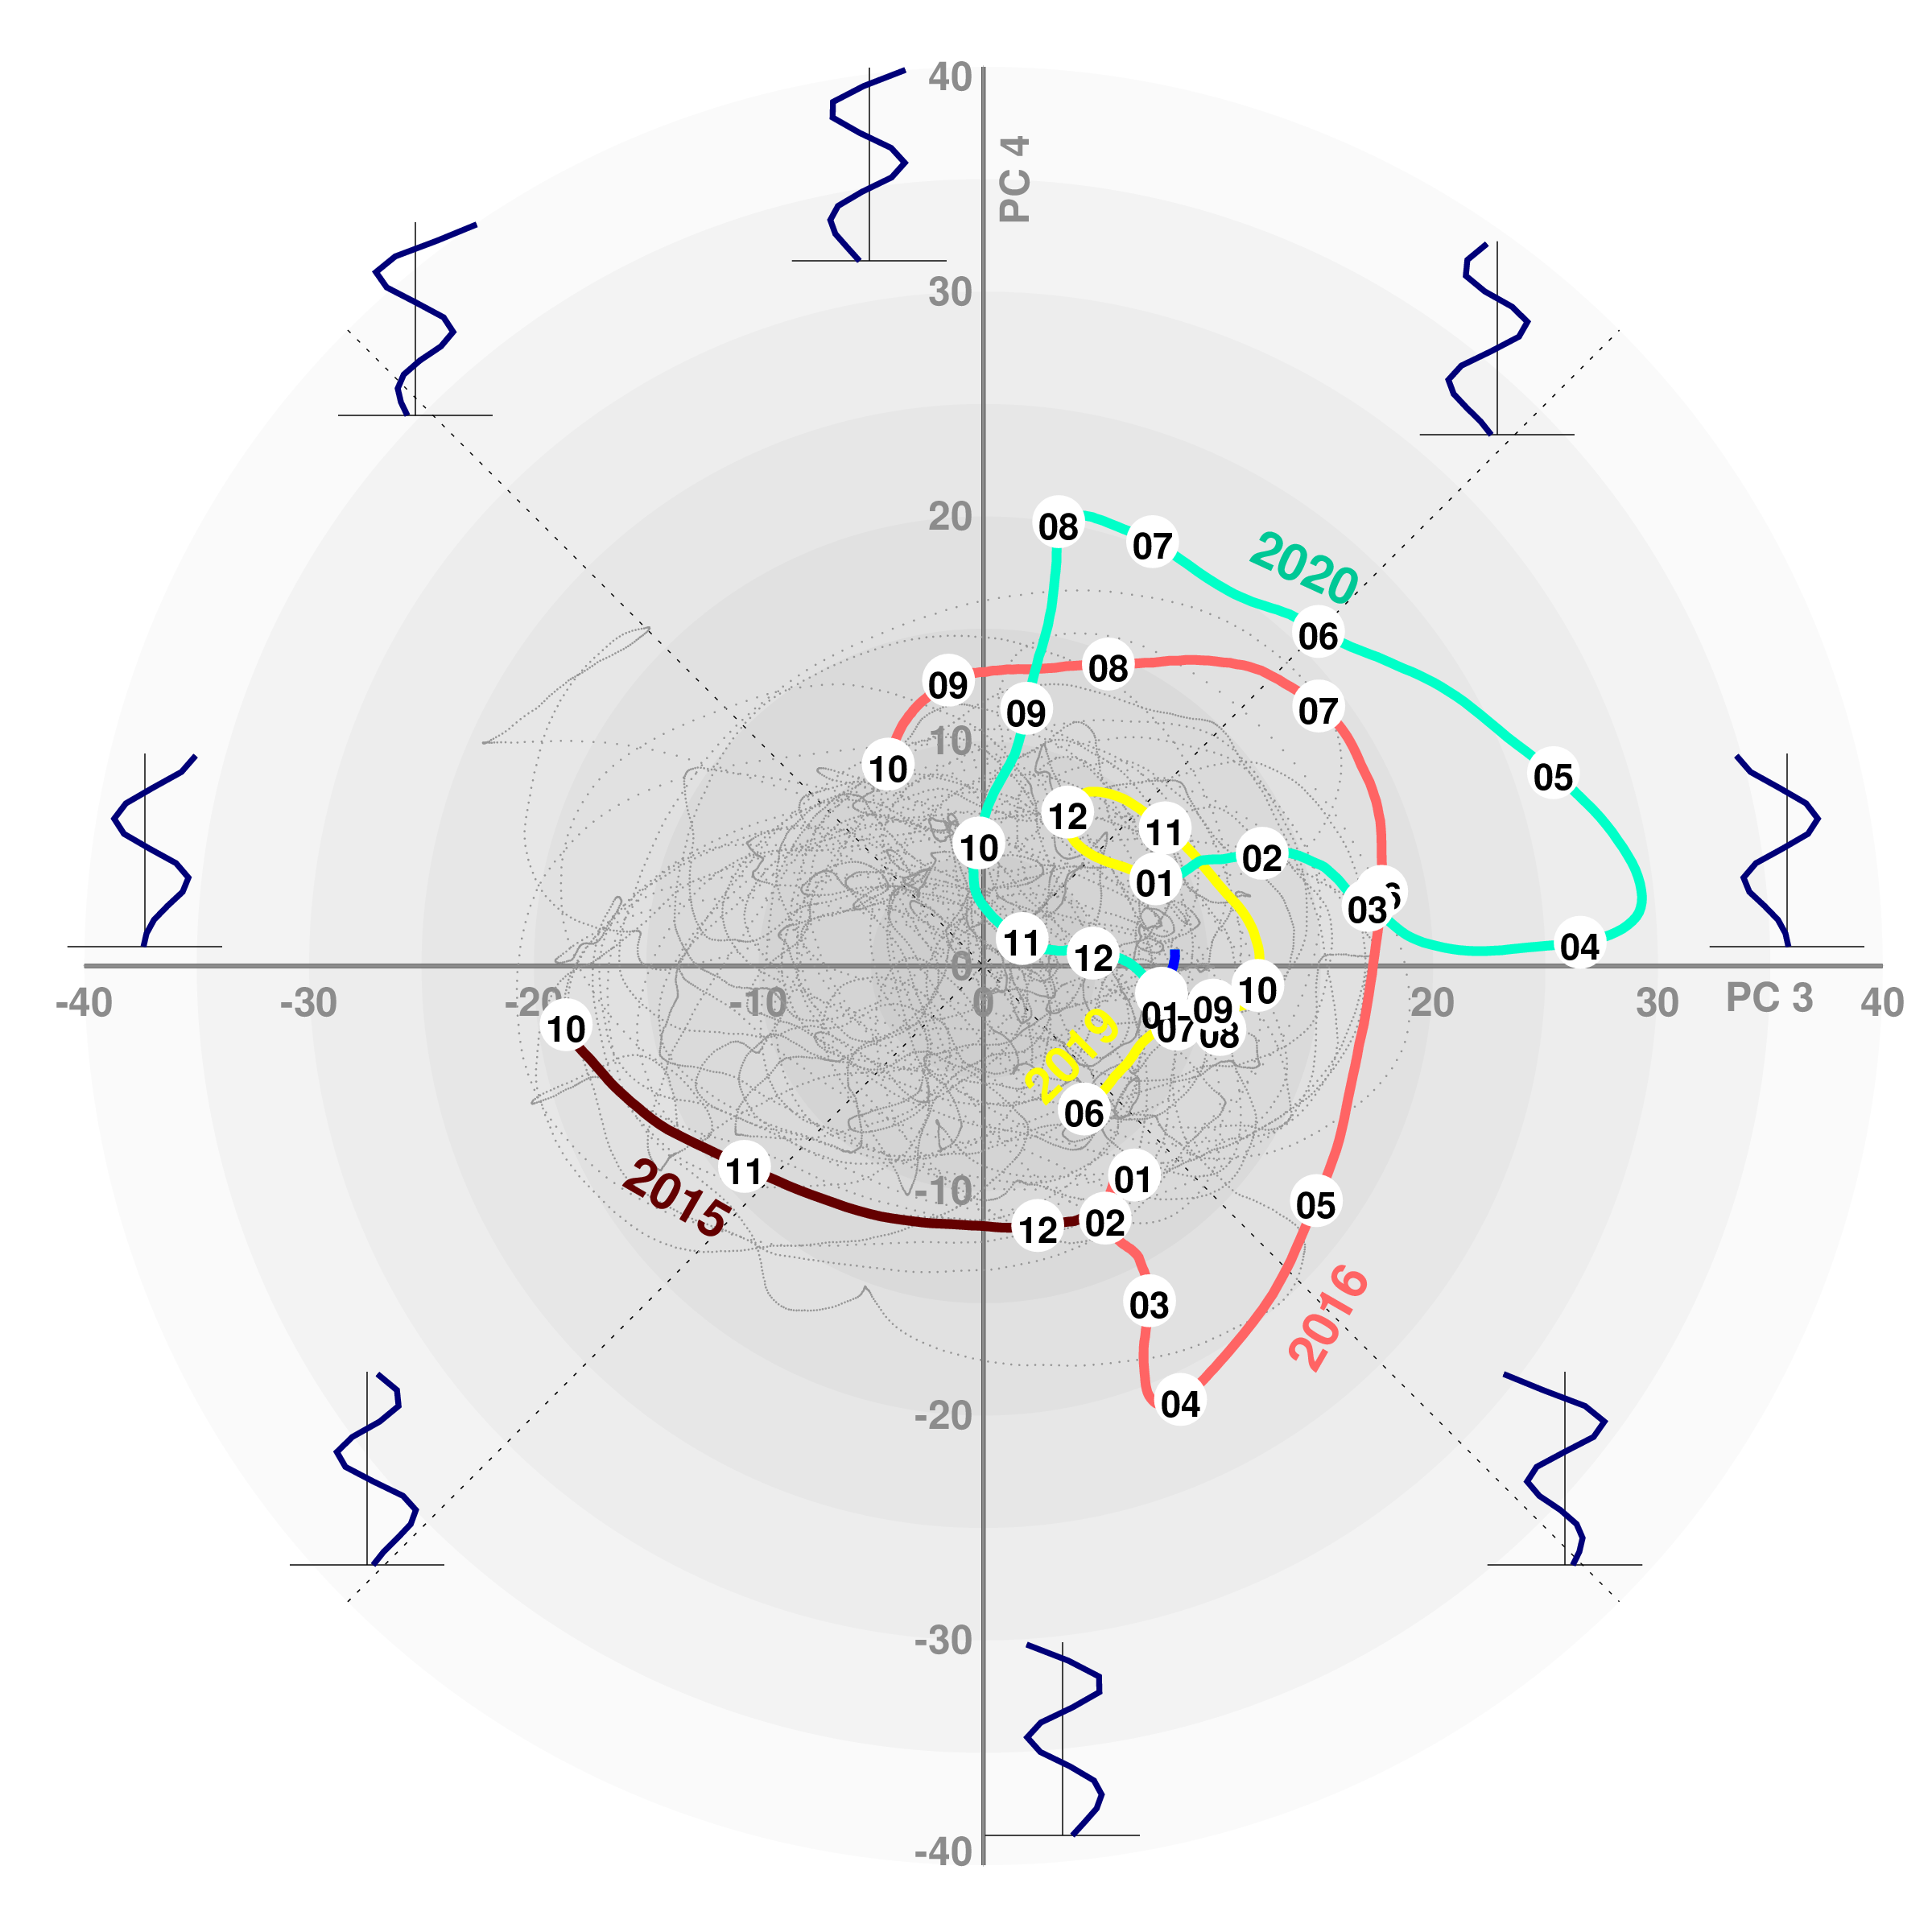

Forecasting the Quasi-Biennial Oscillation
Lawrence Coy (GSFC and SSAI)
Paul A. Newman, Andrea Molod, Steven Pawson (GSFC)
M. Joan Alexander, L. Holt (NWRA)
AMS 102nd Annual Meeting, Houston TX R235
Overview
The ability to seasonally forecast the Quasi-Biennial Oscillation (QBO) is examined using NASA GEOS-S2S-2 (Goddard Earth Observing System Sub-seasonal to Seasonal), 9-month, retrospective forecasts.
EOFs Characterize the QBO Vertical Structure
Forecast Error Growth
QBO and NH Sea Level Pressure Forecasts
Sample Forecasts
S2S forecast vector amplitude error (m/s) based on 1,835 9-month forecasts from 1980-2018: monthly mean (dark blue), standard deviation (dashed), monthly median (light blue) values, and individual monthly forecast values (light blue points). Also shown are the mean (dark gray) and standard deviation region (light gray) of the PPM.
Correlation between MERRA-2 analyses and one month S2S forecasts. The vertical white lines denote the standard deviation when half of the S2S forecasts are randomly selected.
PC1 vs PC2 for MERRA-2. The gray dots are daily values from January 1980 through January 2021. The EOF structures are illustrated at the appropriate phases with the EOF 1 on the right and EOF 2 on the top.
Identifying Model Biases
MERRA-2 analyses, S2S retrospective forecasts, and PPM forecasts (blue, red, and black curves respectively) for initial times: a) 21 January 1988, b) 11 April 2015, c) 20 July 2015, and d) 10 February 2016. The color filled circles denote the start of corresponding months in the MERRA-2 analyses and S2S retrospective forecasts
Percent of Useful Forecasts
Phase Propagation Model (PPM) provides Baseline Forecast
Conclusions
Validation of these forecasts shows that the S2S retrospective QBO forecasts can improve skill in predicting the QBO amplitude and phase over a simple QBO phase propagation model at forecast lead times of 1-3 months.
Results from an initial assessment of whether more accurate QBO forecasts can improve Northern Hemisphere winter sea level pressure forecasts show no significant forecast improvement at a 1 month lead time.
These results suggest that future improvements in representing the QBO in global models can increase the number of valid 1-3 month QBO forecasts and potentially extend useful QBO forecasts beyond 3 months.
Ten year phase propagation forecast initialized on 1~January~1980 compared to MERRA-2 (green curves) for a) PC1 and b) PC2, along with c) the vector amplitude difference between the phase propagation model and MERRA-2 as a function of year
Percent of forecasts with the error less than 20 m/s as a function of forecast length (months) for GEOS-S2S (red) and the PPM (black) based on 1,835 forecasts initialized over the years 1981--2018.
The error bars denote the standard deviation calculated when half the forecasts are randomly selected. The dashed and dotted curves show results for the years 1981--1999 and 2000--2018 respectively.
S2S forecast QBO descent rate (cycles/year): a) mean and b) standard deviation and QBO amplitude (m/s): c) mean and d) standard deviation. The gray horizontal lines denote the corresponding MERRA-2 average values.
E-mail: Lawrence.coy@nasa.gov | Web: gmao.gsfc.nasa.gov

