Slide 1
Shock tube radiation measurement in expanding air flows
Augustin Tibère-Inglesse¹
Khalil Benssassi², Aaron Brandis², Brett Cruden²
¹ NASA Postdoctoral Program Fellow at NASA Ames Research Center
²AMA Inc at NASA Ames Research Center, Mountain View
AIAA SciTech meeting, 3-7 January 2021

Slide 2
Outline
1) Introduction
2) CFD simulations of EAST expansion cone
3) Experimental data
4) Conclusions

Slide 3
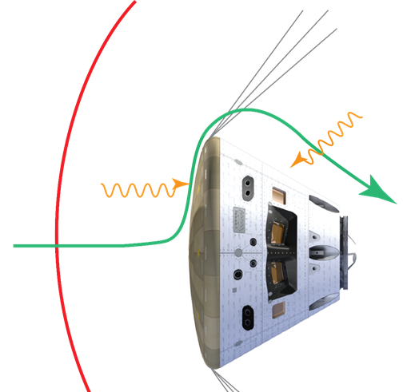
Atmospheric entry phase: radiative heating
Shock
Equilibrium
Nonequilibrium
V ~ 11 km/s
T ~ 200 K
P ~ 10⁻⁵ atm
V ~ 100 m/s
T ~ 11000 K
P ~ 0.5 atm
Radiative heat fluxes
200% uncertainties
N₂
e⁻
C. O. Johnston and A. M. Brandis, JSR 2015
N₂
O₂
N₂
O
Afterbody
= 2/3 of the surface
N₂
e⁻
N⁺
q ~ 100 W/cm²
q ~ 20 W/cm²
High uncertainties on afterbody radiation because of nonequilibrium and lack of validation data

Slide 4
Experimental setup of EAST
Cone
Driven
Buffer (opt)
Driver
4 spectrometers
(VUV, Blue, Red, IR)
Pitot rake
PCB
Last PCB before
cone entrance
Velocity estimated using PCB measurements in the tube and extrapolating to the cone
Test conditions
Test gas is Air at 0.2 Torr (60 km equivalent altitude)
Target velocities at cone entrance are 10 and 11 km/s
Optional Configuration – He or He/Ar Buffer at 50 Torr
Diaphragm Configurations
Thin Aluminum – Breaks randomly, burst at 130 psi
Scored Stainless Steel – Breaks on petals, burst is estimated at 6000-12000 psi
Driver options - 30’’ Cylindrical or 11” Conical
Notes:
Drop configurations

Slide 5
2D-axisymmetric simulations
Time step not constant
Notes:
Primary shock -> flow establishment behind -> flow expanding in the nozzle
Impact of the window: oblique shock

Slide 6
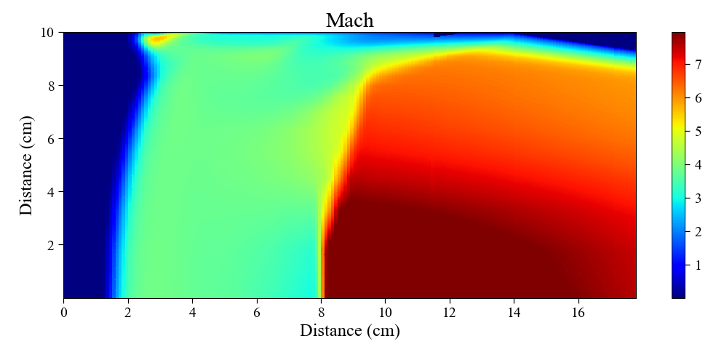
Goal: studying expanding flows
Flow
Camera range covers compressing and expanding flows
Expanding region starts ~6.5 cm from shock front
Compressing flow
Expanding flow
Shock front
Camera range
Line of sight: compressing + expanding flow
After 6.5 cm, the measured radiation is a combination of radiation coming from both expanding and compressing flows
Can we validate aerothermal mission design tools for wake flows with EAST cone measurements?

Slide 7
Radiation from recombining region?
0
Accumulated radiance from 200 to 500 nm
Volumetric radiance
Expanding region
Line of sight
“double” peak observed because of shock curvature
Total radiance (measured by optical setup)
45 %
85 %
of total radiation
10 %
0 %
70 %
25 %
Compression/expanding interface at ~6.5cm from shock front → 9 us minimum test time (v_{CFD}=7 km/s)
Radiation from recombining region dominant ~10.5 cm from shock front → test time of ~15 us needed

Slide 8
Test 63 summary
37 shots, >50% with useable spectra
5 without Velocity/Time of Arrival data
Test times from 3.5 to 10.5 us
“Good” (complete dataset + high test times) data for at least 4 shots, from 9.64 to 11.11 km/s
Data presented | Velocity (cone entrance) | Velocity (camera location)
CFD | 10.2 | 6.5 (with window)
 |  | 7.0 (w/o window)
Shot 8 | 10.2 | 8.85
Shot 21 | 9.64 | 8.54
Notes:
Replace table with plots shot # vs test times or test time vs velocity
Shot 21

Slide 9
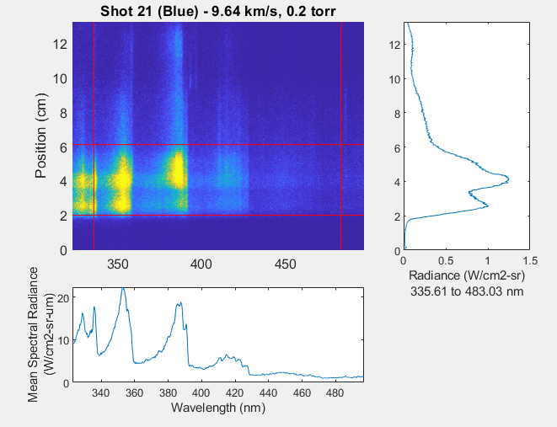
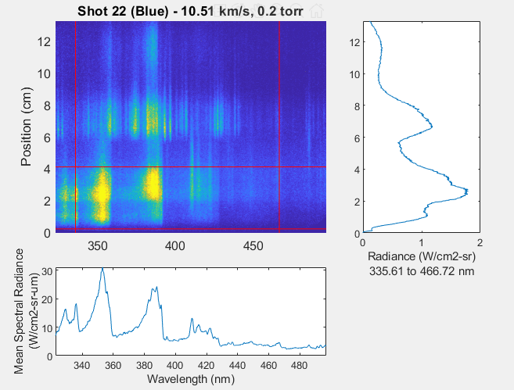
Spectra
Typical shots:
Faint atomic line from impurities
Strongly contaminated
Ca⁺
Fe → steel diaphragm
Test time:
3 to 10 us

Slide 10
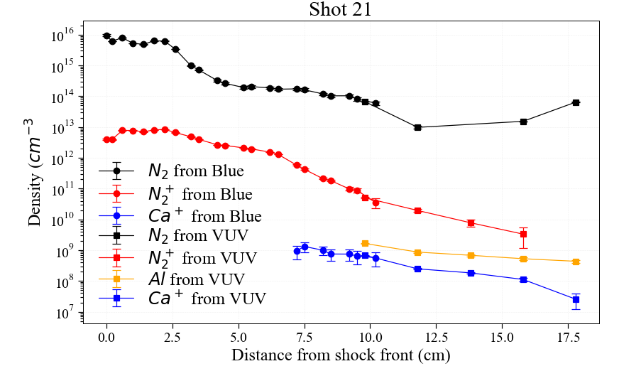
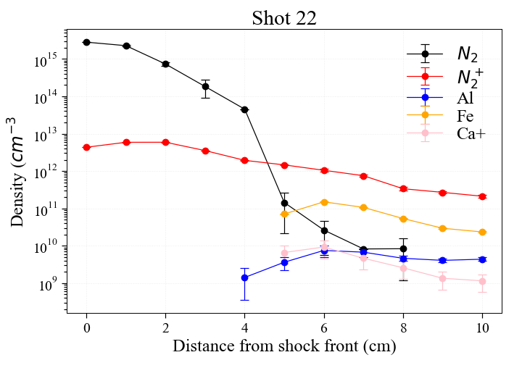
Number densities
Shot 22 test time easily determined by the arrival of Fe lines and decrease of N₂
No Fe lines on Shot 22, and no strong decrease of N₂, larger test time?
Weakly contaminated
Strongly contaminated
Notes:
Use same colors for species

Slide 11
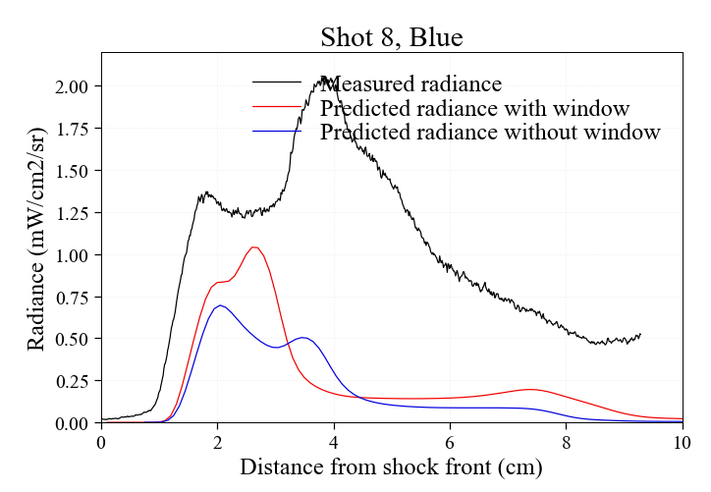
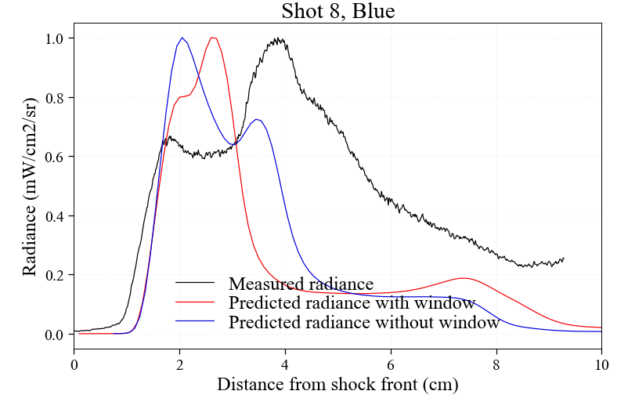
Comparison radiance CFD/experiments
Data presented | Velocity (cone entrance) | Velocity (camera location)
CFD | 10.2 | 6.5 (with window)
 |  | 7.0 (w/o window)
Shot 8 | 10.2 | 8.85
Shot 21 | 9.64 | 8.54
Radiance underpredicted in the UV
Ratio of peaks intensity relatively well predicted with window
Distance between peaks not well predicted with the window, better agreement without the window
Radiance (normalized)

Slide 12
Conclusions
Test 63 campaign is done: good data measured for 10 and 11 km/s shock speeds
Test times need to be higher than 15 us. May have been achieved for 3 or 4 shots
30’’ driver and buffer tends to increase test times → use of both should be investigated in the future
Regions of shock identified
Compressive flow in the cone: freestream gas in the cone is compressed by the shock
Expansion region about 6.5 cm behind: Shocked gas from the tube expands in the cone
Double peak in intensity attributed to nonequilibrium regions on centerline and near wall
Ratio of intensities relatively well predicted by CFD with window
Peaks separation relatively well predicted by CFD without window
Simulations testing different kinetic model for N₂ will be performed in the future

Slide 13
Backup
Backup pitot pressures test time

Slide 14
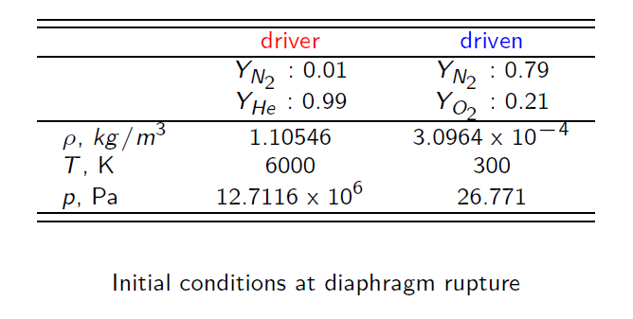
Unsteady 1D simulation & 2D-axisymmetric (COOLFluid)
One-dimensional, Δx = 10⁻⁴ m
Wall condition is used at the end of the driver tube.
Test gas: Air -11 species-, driver gas: 99% He, 1% N₂.
Thermal and chemical non-equilibrium : Park’s two-temperatures model
Notes:
Drop? Talk in next one

Slide 15
Improving test times
30’’ driver and buffer seems to improve test times
Test times on shots 16, 21 and 25 may be underestimated
30’’ driver with buffer worth investigating
11’’ conical driver
30’’ driver
Test driver diaphragm with
lower/higher burst pressure
High pressure driver
Lighter buffer diaphragm
11’’ conical driver
Buffer
(He or He/Ar)
Higher Ar concentration

Slide 16
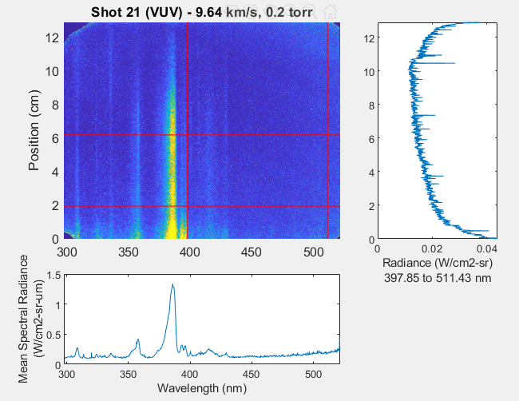
Spectra
Shot 21:
Image taken 12 us after Blue
Ca⁺
No Fe contamination
Cu
Driver gas may arrive much later increasing the test time (from 15 to 22 us)
Notes:
Drop for video

Slide 17
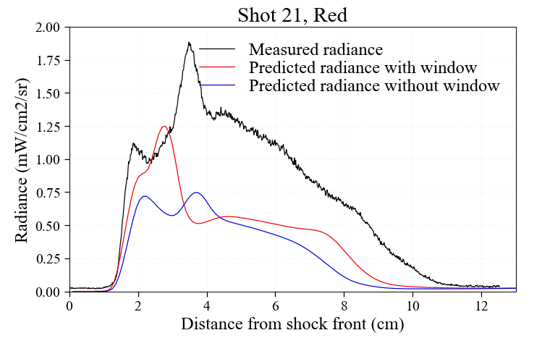
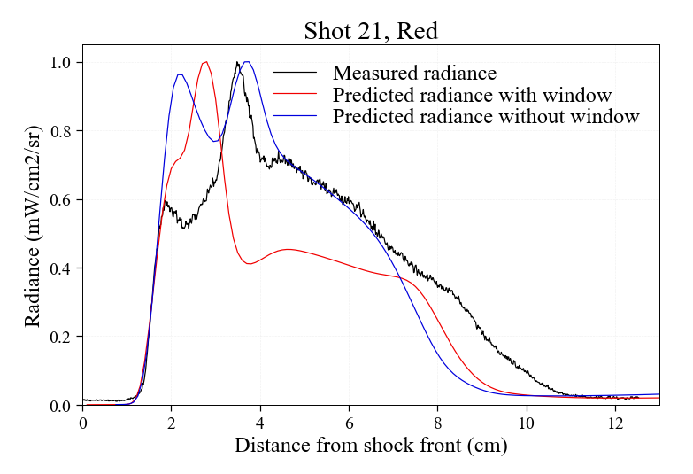
Comparison with Shot 21
Ratio of peaks better predicted with window, and distance without
Intensity still underpredicted by a factor ~2
Radiance (normalized)

Slide 18
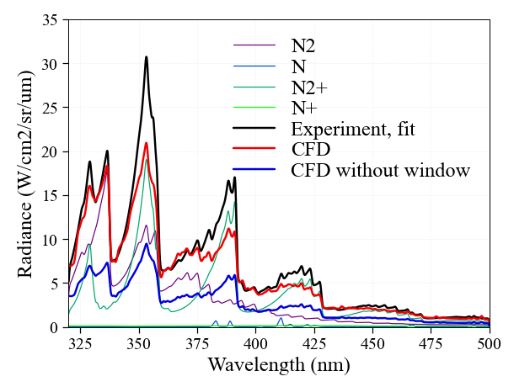
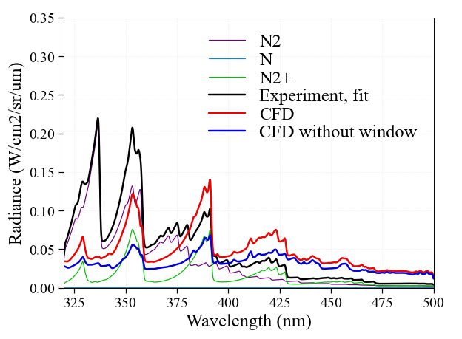
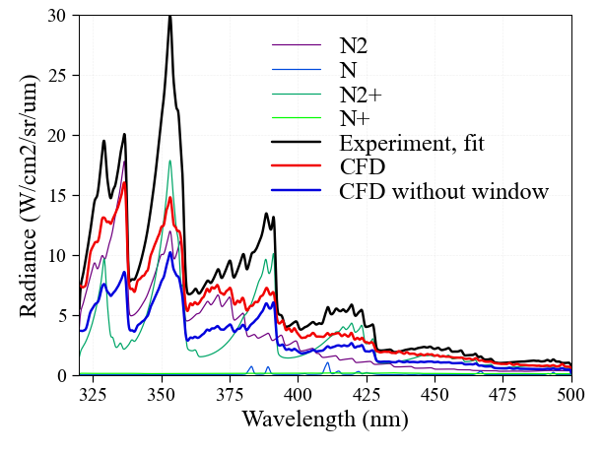
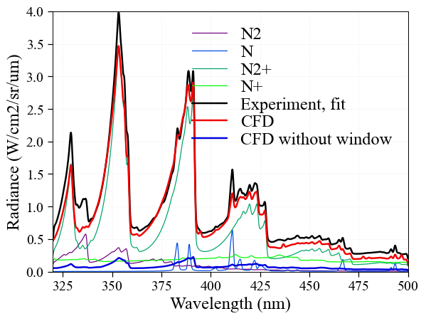
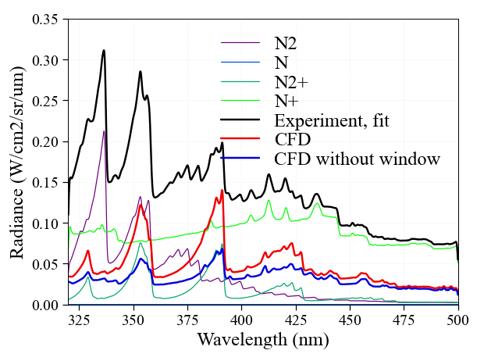
Radiation from recombining region?
Accumulated radiance from 200 to 500 nm
Volumetric radiance
~50% from expanding region
Shock front (wall)
Compression/expansion interface
Expansion region
Shock front (centerline)
N₂⁺ radiation well predicted
N₂ underestimated, maybe because of recombination
N⁺ continuum overestimated in fit
Relativelly good agreement
Total radiation slightly underpredicted
N₂ radiation relatively well predicted but N₂⁺B underpredicted
Good agreement overall

Slide 19
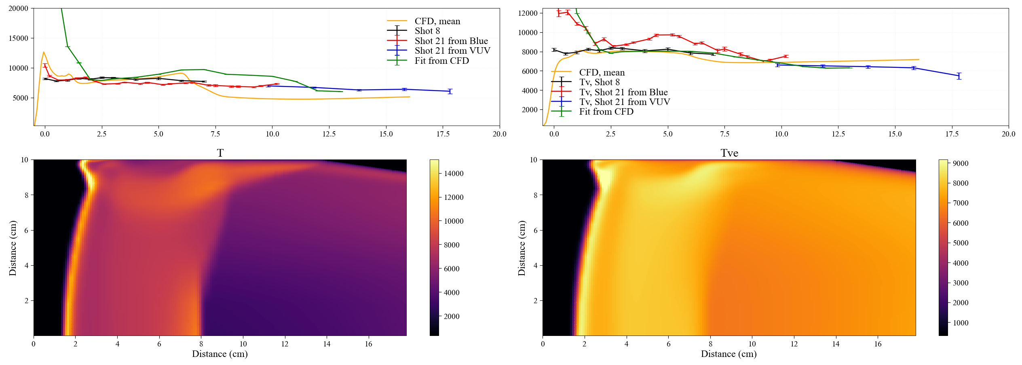
Temperatures
Compression region:
Shock front overpredicted with the fit but good agreement with the mean
Good agreement after the shock front
Expansion region:
Tv: good agreement
T: ~20% disagreement but strongly impacted by multi-dimensions effects

Slide 20
Temperatures: CFD vs experiments
Measurements are line of sight integrated : shock is not 1D
Compare fit temperatures to predicted (max and mean):
Tr relatively well predicted after ~2cm

Slide 21
Outline
1) Introduction
2) Radiance
3) Spectra
4) Temperature and densities
5) Conclusions

Slide 22
Radiative species
Densities relatively well predicted near shock front
Higher discrepancies after the peak intensity
N₂ underpredicted later on (recombination?)

Slide 23
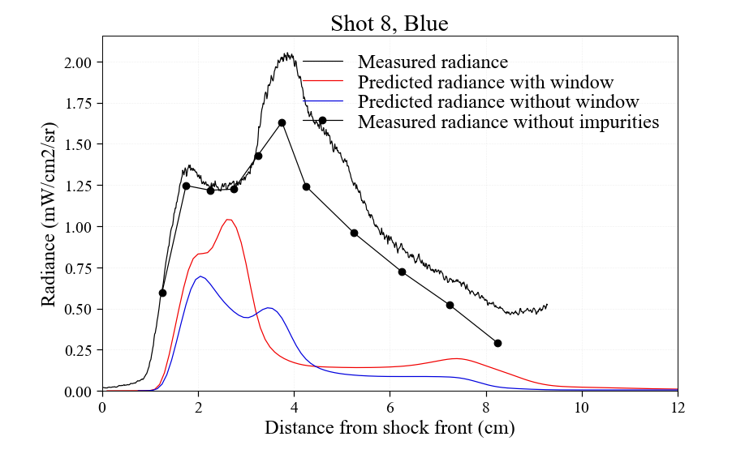
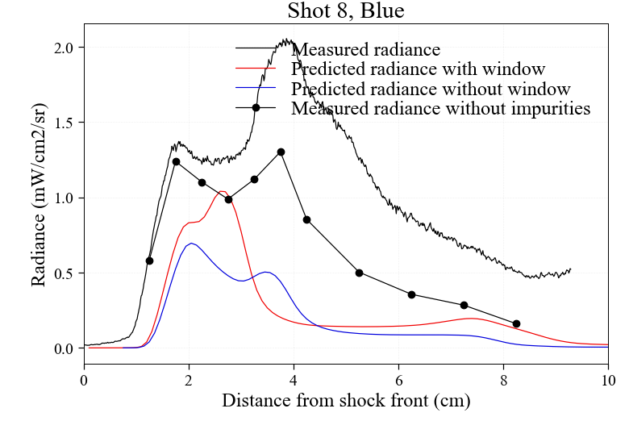
Radiance comparison with/without impurities
CN radiation alone does not explain the discrepancies
Without impurities
Without impurities and N⁺ continuum

Slide 24
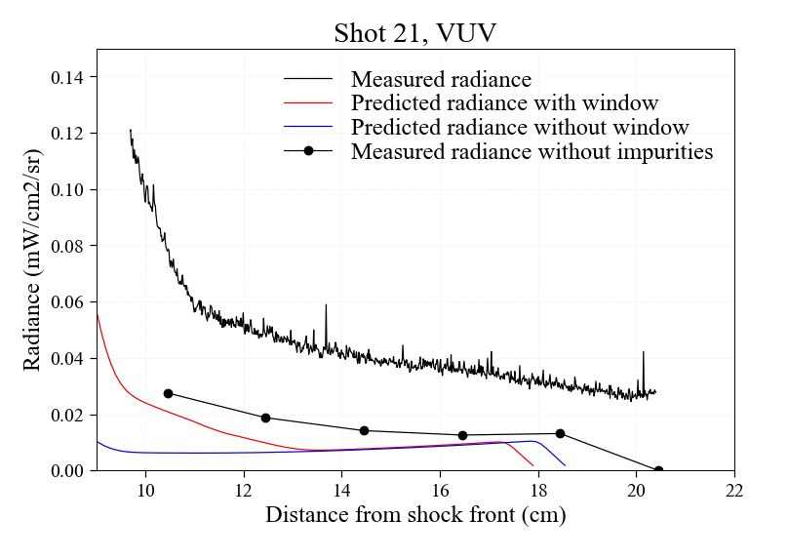
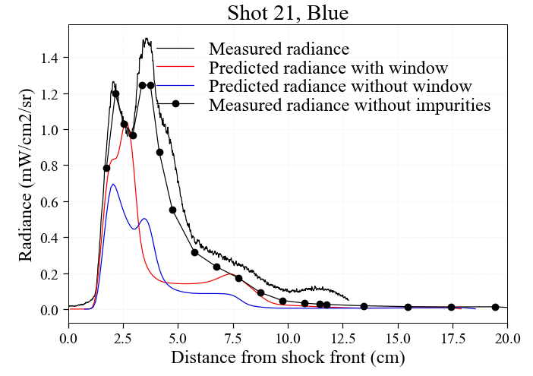
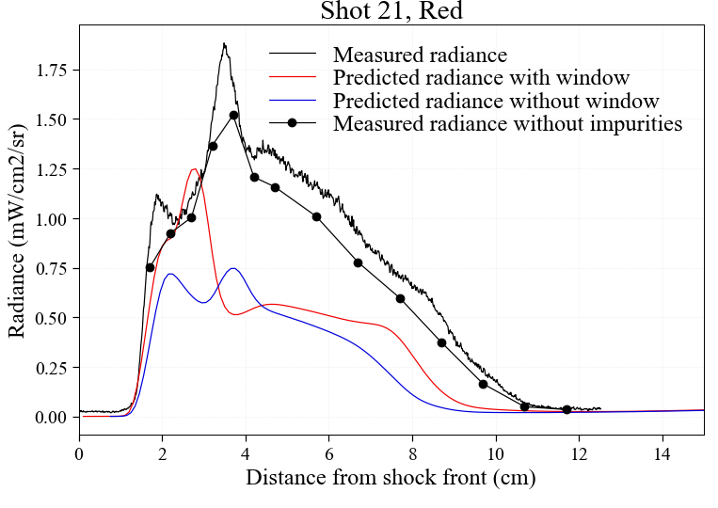
Radiance comparison without impurities (Shot 21)
Differences are less, maybe due to lower velocity
Relatively good agreement after ~8cm

Slide 25
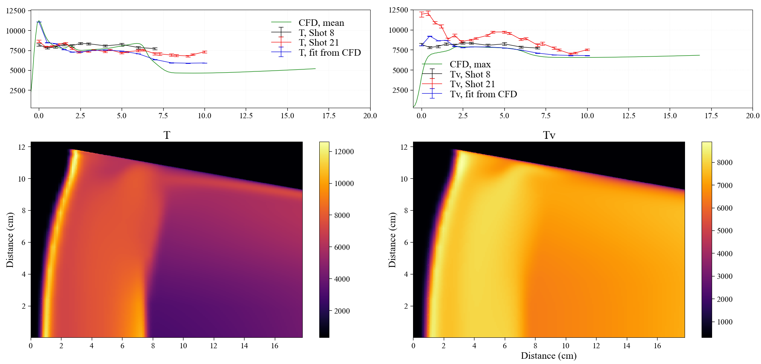

Slide 26
