Slide 1
The Potential Outcome Model
Explaining Low-Dose Radiobiology through an Epidemiologic Lens
CM Milder, MSPH
LS Peetluk, PhD, MPH
2022 NASA Human Research Program Investigators’ Workshop
Notes:
I’m going to start this lightning talk off by saying something very triggering to all of us….
(next slide, say “linear no-threshold model”)

Slide 2
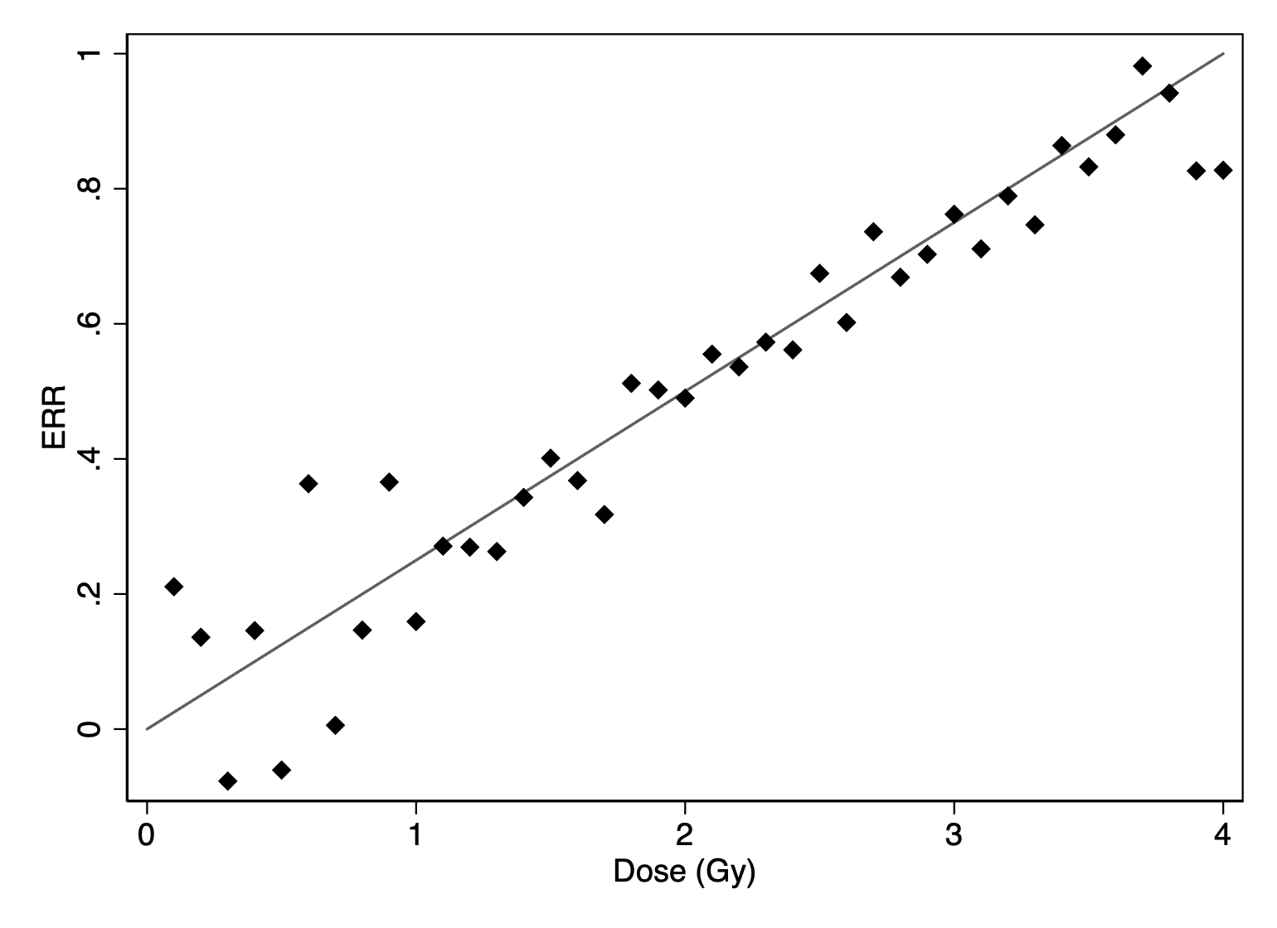
Linear no-threshold model
?
Image credit
https://www.sciencenews.org/blog/scicurious/all-mice-are-same-until-theyre-not
http://www.clker.com/clipart-cho-cell-petri-dish.html
Notes:
Explain that this isn’t a graph of anything in particular

Slide 3

Potential Outcomes at the Individual Level
Doomed: will get breast cancer no matter what
Exposure causal: Will get breast cancer if exposed to radiation but not otherwise
Exposure preventive: Will get breast cancer UNLESS exposed to radiation
Immune: will NOT get breast cancer no matter what
Images from <a href="https://www.freepik.com/photos/business">Business photo created by d3images - www.freepik.com</a>
Notes:
We are going to use the potential outcomes model to explain those different outcomes in radiobiology.
Let’s simplify radiation exposure here and say it’s a dichotomous exposure—either you’re exposed to radiation or you aren’t. And let’s simplify our outcome here—say you can either get breast cancer or you don’t get breast cancer. So, for any individual, there are four possible outcomes.
Potential outcome = outcome we would see for an individual if they have exposure level set to X=x – every individual has two potential outcomes
When we have a single dichotomous exposure and outcome, there are four possible response types
Fundamental problem in population causal inference is that we can only observe one outcome for each individual

Slide 4
Potential Outcomes at the Individual Level
Outcome when:
Susceptibility Type | Exposed | Unexposed
Doomed | 1 | 1
Exposure causal | 1 | 0
Exposure preventive | 0 | 1
Immune | 0 | 0
1 = experiences the outcome
0 = does not experience the outcome
Notes:
So for both exposure scenarios, there are 2 outcomes: breast cancer or not breast cancer.
Potential outcome = outcome we would see for an individual if they have exposure level set to X=x – every individual has two potential outcomes
Fundamental problem in population causal inference is that we can only observe one outcome for each individual

Slide 5
Potential Outcomes at the Individual Level
Potential Outcomes: Observed Outcomes:
Outcome when:
 | Exposed | Unexposed | Exposure received | Observed outcome
Person A | 1 | 1 | 1 | 1
Person B | 1 | 0 | 1 | 1
Person C | 0 | 1 | 1 | 0
Person D | 0 | 0 | 1 | 0
Person E | 1 | 1 | 0 | 1
Person F | 1 | 0 | 0 | 0
Person G | 0 | 1 | 0 | 1
Person H | 0 | 0 | 0 | 0
Susceptibility Type | Exposed | Unexposed
Doomed | 1 | 1
Exposure causal | 1 | 0
Exposure preventive | 0 | 1
Immune | 0 | 0
1 = experiences the outcome
0 = does not experience the outcome
Notes:
Consider now a sample of 8 people – 2 of each response type (we wouldn’t really know this), so you can see what would happen if they were exposed or unexposed.
Let’s see what exposure they actually received—this is all we would know in the real world (click)
You don’t know the susceptibility type because you can only see one exposure scenario per person.
At the population level, the effect is null, even though at the individual level, exposure is both causal and preventative in different people.
At the population level, we would conclude that there is no association between exposure and outcome because 2 people who were exposed had the outcome and 2 people who were unexposed had the outcome – thus, the population average effect is null

Slide 6
16 Potential Outcome Types
Table adapted from Rothman, Greenland, and Lash. Chapter 5: Concepts of Interaction. Modern Epidemiology (3rd Ed.). 2008, Lippincott Williams & Williams. Page 76.
Color images from <a href="https://www.freepik.com/photos/business">Business photo created by d3images - www.freepik.com</a>
Notes:
Now consider a scenario where we have 2 dichotomous exposures (say, radiation and BRCA2) – in this scenario, we have 16 potential outcome types
We still have the people who are doomed (will experience the outcome regardless of either exposure) and people who are immune (who will not experience the outcome regardless of exposure), but there are now 14 additional individual causal response types, which cannot be determined when looking at population averages
The idea is that some of these if some of these response types are more common at the population level, you will notice a population effect and can infer that the individual causal types that lead to those effects being noticed at the population level
This is a terrifying table! Basically, it illustrates that for any given individual, you can only see one potential exposure combination. You’re missing the information about what would happen if any other combination occurred. Let’s break it down….

Slide 7
LNT is the average of individual effects
Potential interaction at the cellular, system, and person level
All 16 individual effect types may exist
Some are more prevalent
Population-level effects reflect the average of all response types in a population
We see varying effects at the individual level
AND we see LNT at the population level
Notes:
Using this framework, the linear no threshold model is the average of these 16 individual effects.
Because you only see one exposure combination per person and some exposures will be more common than others, you get an averaging out of effects in a population.
And that results in the linear no-threshold model

Slide 8
Thank you very much!
Please reach out with questions or ideas!
cato.m.milder@nasa.gov

