Slide 1
Interplanetary Trajectory Optimization ISP
Lecture 1
Orbital and Spacecraft Mechanics

Slide 2
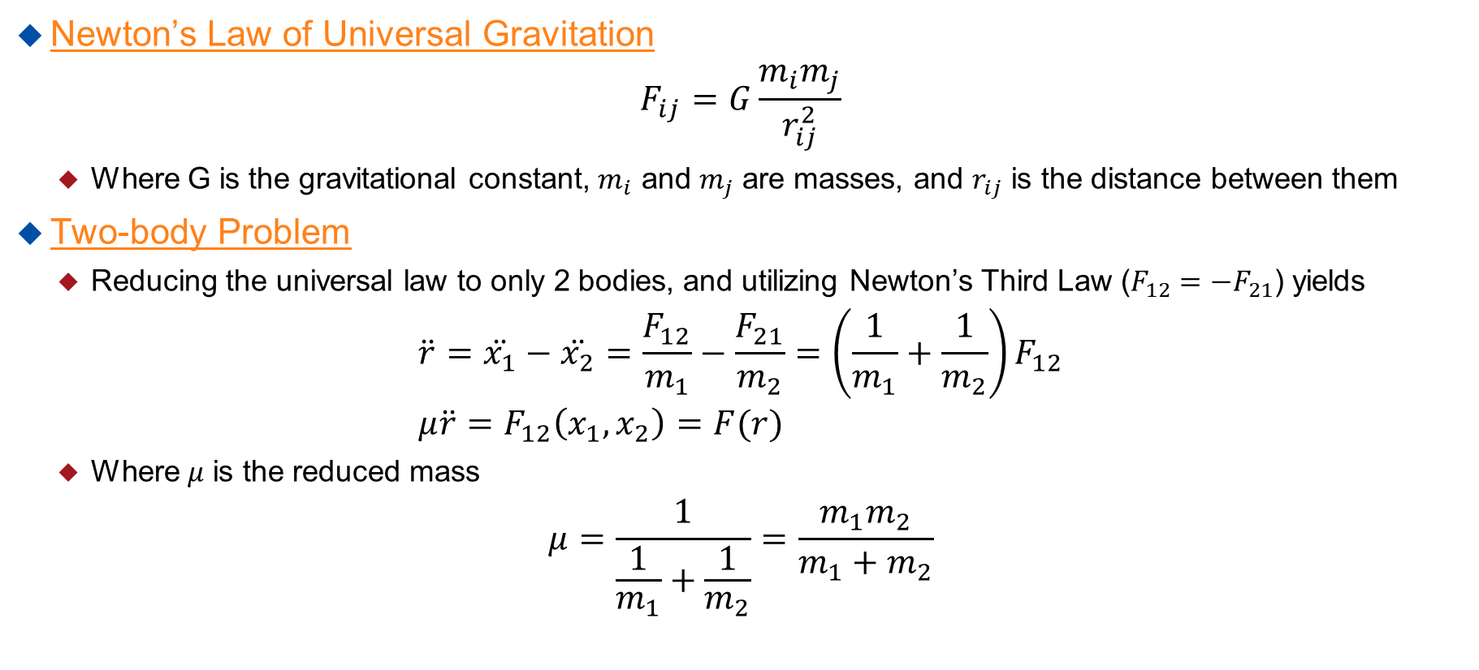
Orbital Mechanics
Newton’s Law of Universal Gravitation
$$F_{ij}=G\frac{m_{i}m_{j}}{r_{ij}^{2}}$$
  Where G is the gravitational constant, $m_{i}$ and $m_{j}$ are masses, and $r_{ij}$ is the distance between them
Two-body Problem
  Reducing the universal law to only 2 bodies, and utilizing Newton’s Third Law ($F_{12}=−F_{21}$) yields
$$\ddot{r}=\ddot{x_{1}}−\ddot{x_{2}}=\frac{F_{12}}{m_{1}}−\frac{F_{21}}{m_{2}}=\left(\frac{1}{m_{1}}+\frac{1}{m_{2}}\right)F_{12} \\ μ\ddot{r}=F_{12}\left(x_{1},x_{2}\right)=F(r)$$
  Where $μ$ is the reduced mass
$$μ=\frac{1}{\frac{1}{m_{1}}+\frac{1}{m_{2}}}=\frac{m_{1}m_{2}}{m_{1}+m_{2}}$$

Slide 3
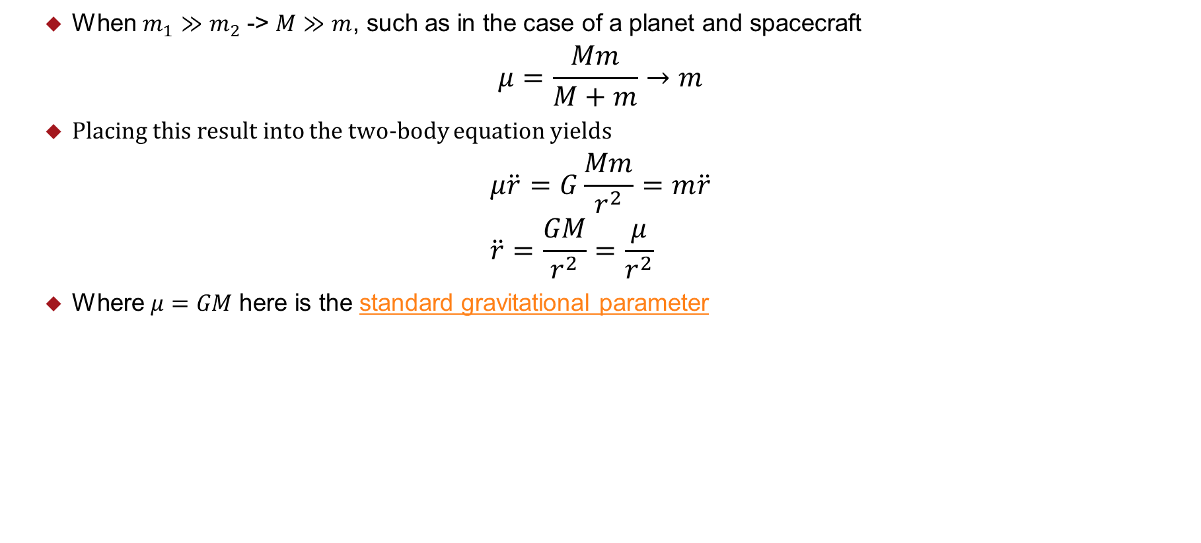
Orbital Mechanics
  When $m_{1}≫m_{2}$ -> $M≫m$, such as in the case of a planet and spacecraft
$$μ=\frac{Mm}{M+m}→m$$
  Placing this result into the two-body equation yields
$$μ\ddot{r}=G\frac{Mm}{r^{2}}=m\ddot{r} \\ \ddot{r}=\frac{GM}{r^{2}}=\frac{μ}{r^{2}}$$
  Where $μ=GM$ here is the standard gravitational parameter

Slide 4
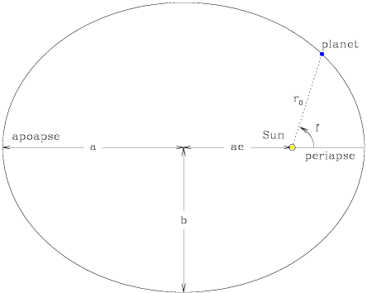
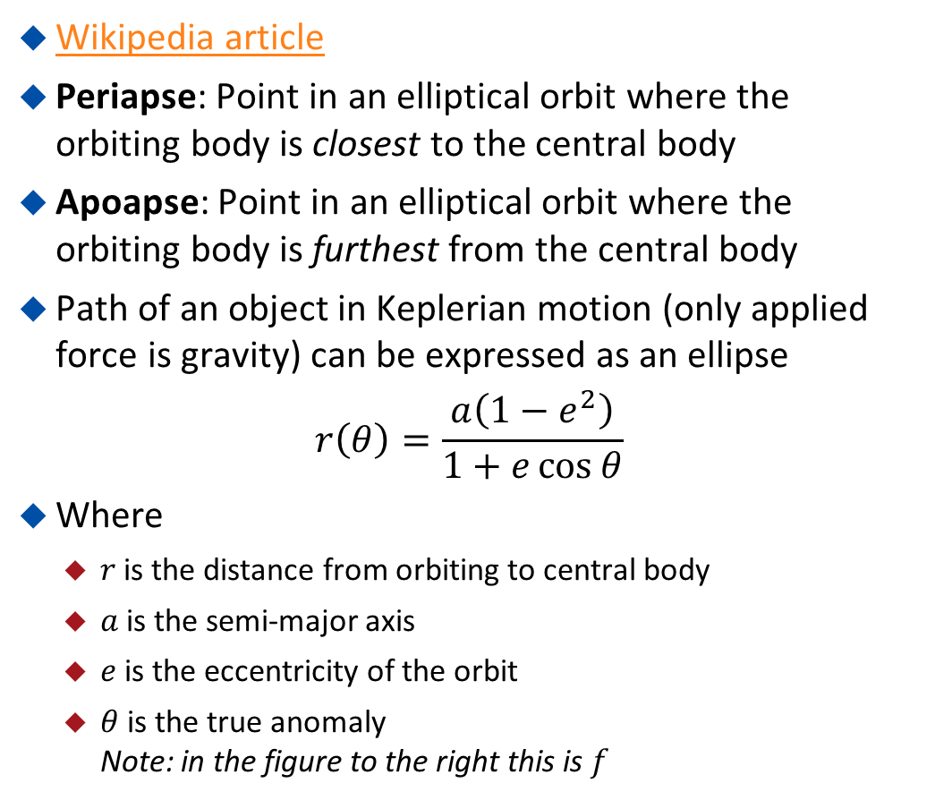
Keplerian Orbits
Wikipedia article
Periapse: Point in an elliptical orbit where the orbiting body is closest to the central body
Apoapse: Point in an elliptical orbit where the orbiting body is furthest from the central body
Path of an object in Keplerian motion (only applied force is gravity) can be expressed as an ellipse
$$r\left(θ\right)=\frac{a\left(1−e^{2}\right)}{1+e\cos{θ}}$$
Where
  $r$ is the distance from orbiting to central body
  $a$ is the semi-major axis
  $e$ is the eccentricity of the orbit
  $θ$ is the true anomaly
  Note: in the figure to the right this is $f$

Slide 5
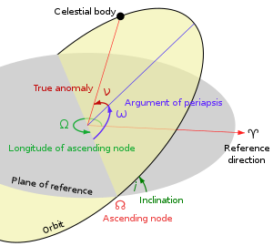
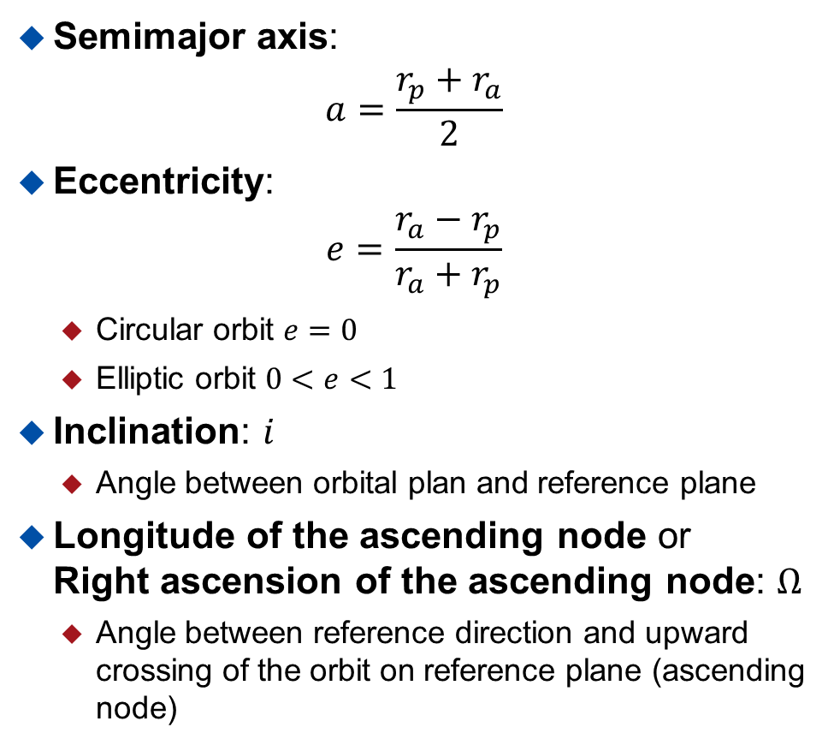
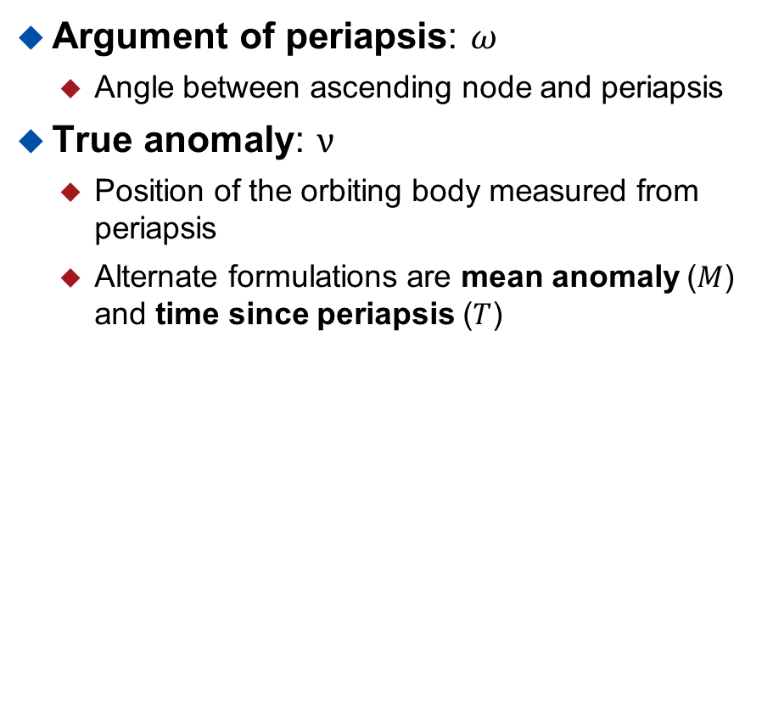
Orbital Elements
Semimajor axis:
$$a=\frac{r_{p}+r_{a}}{2}$$
Eccentricity:
$$e=\frac{r_{a}−r_{p}}{r_{a}+r_{p}}$$
  Circular orbit $e=0$
  Elliptic orbit $0<e<1$
Inclination: $i$
  Angle between orbital plan and reference plane
Longitude of the ascending node or
Right ascension of the ascending node: $Ω$
  Angle between reference direction and upward crossing of the orbit on reference plane (ascending node)
Argument of periapsis: $ω$
  Angle between ascending node and periapsis
True anomaly: $ν$
  Position of the orbiting body measured from periapsis
  Alternate formulations are mean anomaly ($M$) and time since periapsis ($T$)

Slide 6
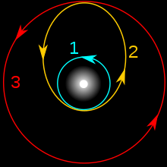
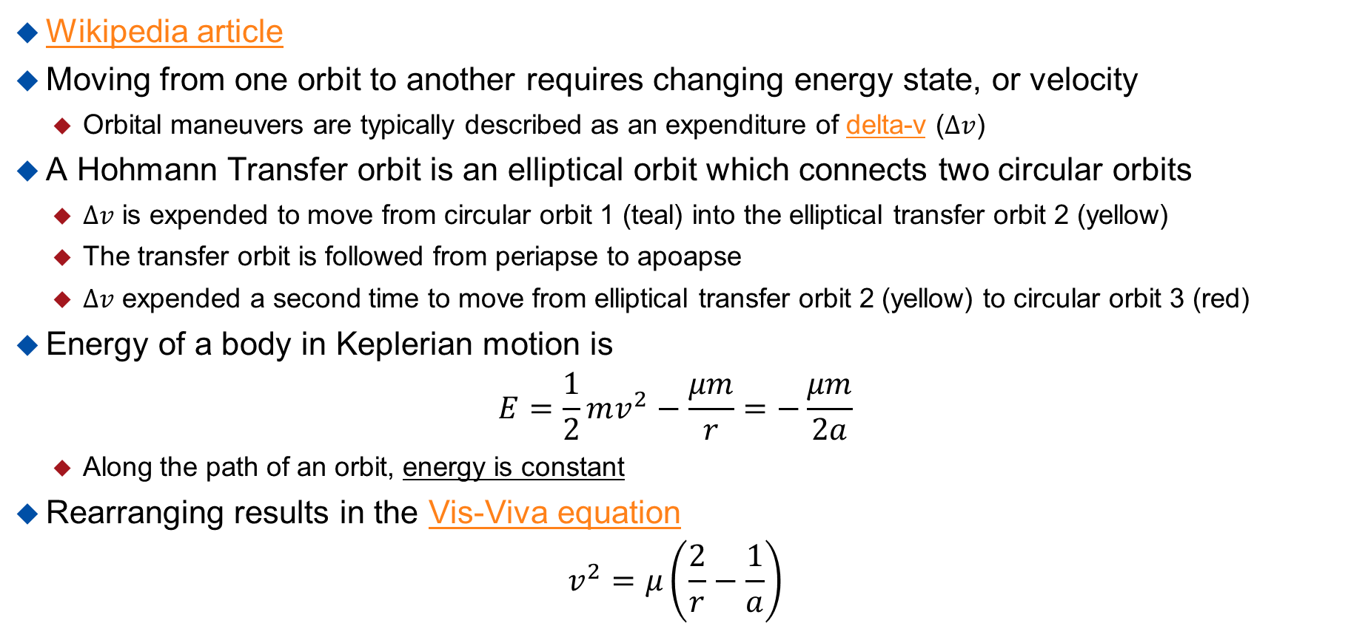
Hohmann Transfer
Wikipedia article
Moving from one orbit to another requires changing energy state, or velocity
  Orbital maneuvers are typically described as an expenditure of delta-v ($∆v$)
A Hohmann Transfer orbit is an elliptical orbit which connects two circular orbits
  $∆v$ is expended to move from circular orbit 1 (teal) into the elliptical transfer orbit 2 (yellow)
  The transfer orbit is followed from periapse to apoapse
  $∆v$ expended a second time to move from elliptical transfer orbit 2 (yellow) to circular orbit 3 (red)
Energy of a body in Keplerian motion is
$$E=\frac{1}{2}mv^{2}−\frac{μm}{r}=−\frac{μm}{2a}$$
  Along the path of an orbit, energy is constant
Rearranging results in the Vis-Viva equation
$$v^{2}=μ\left(\frac{2}{r}−\frac{1}{a}\right)$$
  This equation can tell us how much $∆v$ is required for each maneuver

Slide 7
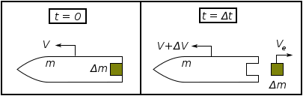
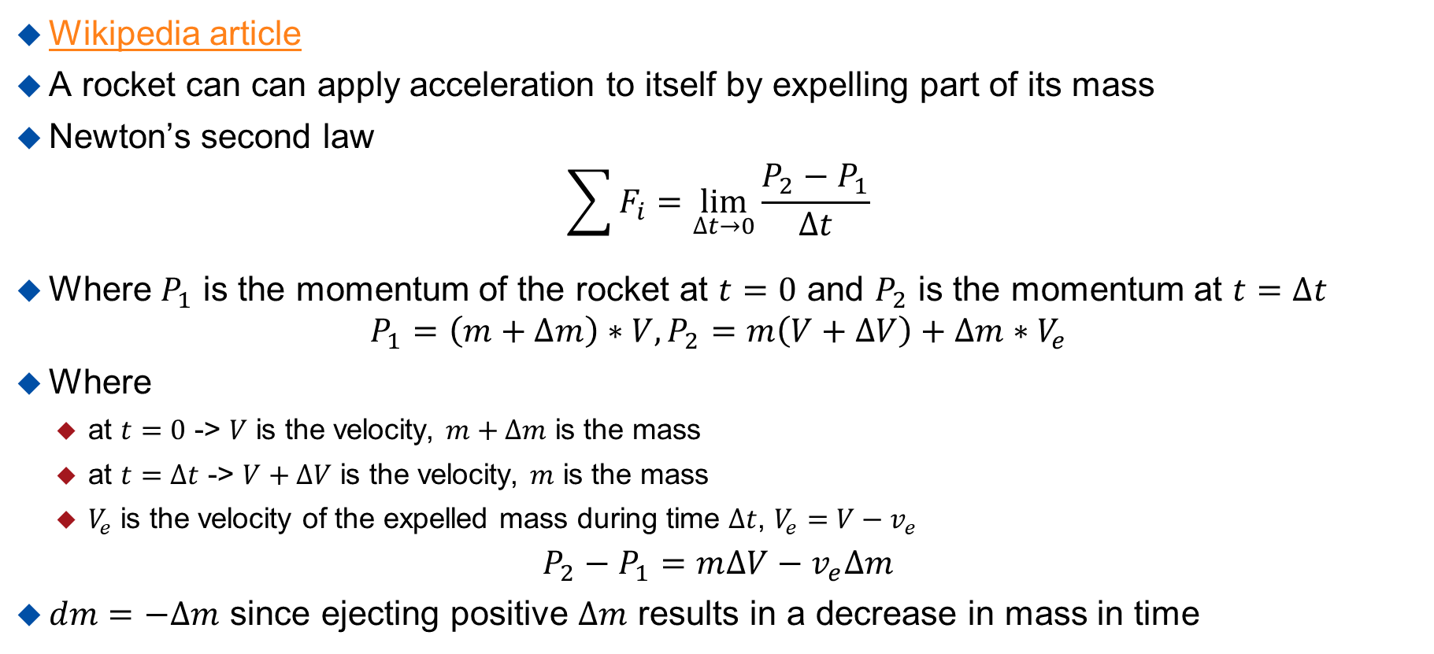
Tsiolkovsky Rocket Equation
Wikipedia article
A rocket can can apply acceleration to itself by expelling part of its mass
Newton’s second law
$\sum{F_{i}=\lim_{∆t→0}{\frac{P_{2}−P_{1}}{∆t}}}$
Where $P_{1}$ is the momentum of the rocket at $t=0$ and $P_{2}$ is the momentum at $t=∆t$
$P_{1}=\left(m+∆m\right)∗V, P_{2}=m\left(V+∆V\right)+∆m{∗V}_{e}$
Where
  at $t=0$ -> $V$ is the velocity, $m+∆m$ is the mass
  at $t=∆t$ -> $V+∆V$ is the velocity, $m$ is the mass
  $V_{e}$ is the velocity of the expelled mass during time $∆t$, $V_{e}=V−v_{e}$
$$P_{2}−P_{1}=m∆V−v_{e}∆m$$
$dm=−∆m$ since ejecting positive $∆m$ results in a decrease in mass in time

Slide 8
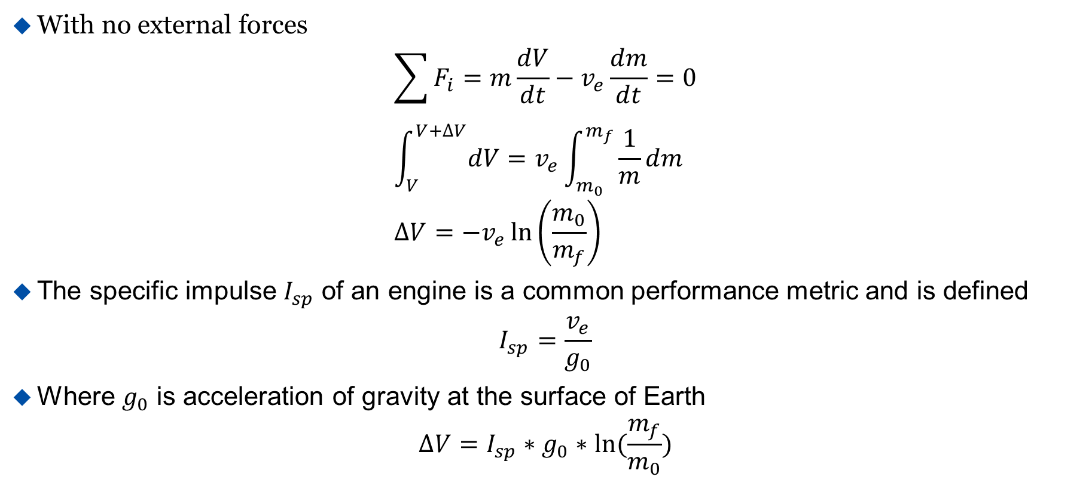
Tsiolkovsky Rocket Equation
With no external forces
$$\sum{F_{i}}=m\frac{dV}{dt}−v_{e}\frac{dm}{dt}=0 \\ \int_{V}^{V+∆V}{dV}=v_{e}\int_{m_{0}}^{m_{f}}{\frac{1}{m}dm} \\ ∆V=−v_{e}\ln\left(\frac{m_{0}}{m_{f}}\right)$$
The specific impulse $I_{sp}$ of an engine is a common performance metric and is defined
$$I_{sp}=\frac{v_{e}}{g_{0}}$$
Where $g_{0}$ is acceleration of gravity at the surface of Earth
$$∆V=I_{sp}∗g_{0}∗ln⁡(\frac{m_{f}}{m_{0}})$$

Slide 9
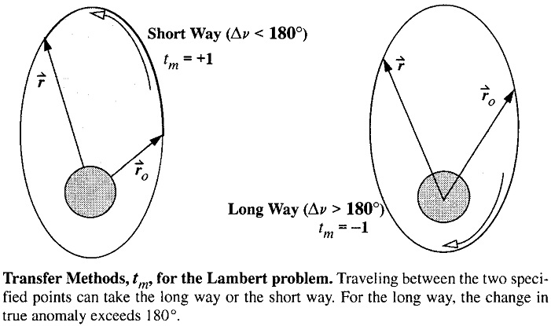
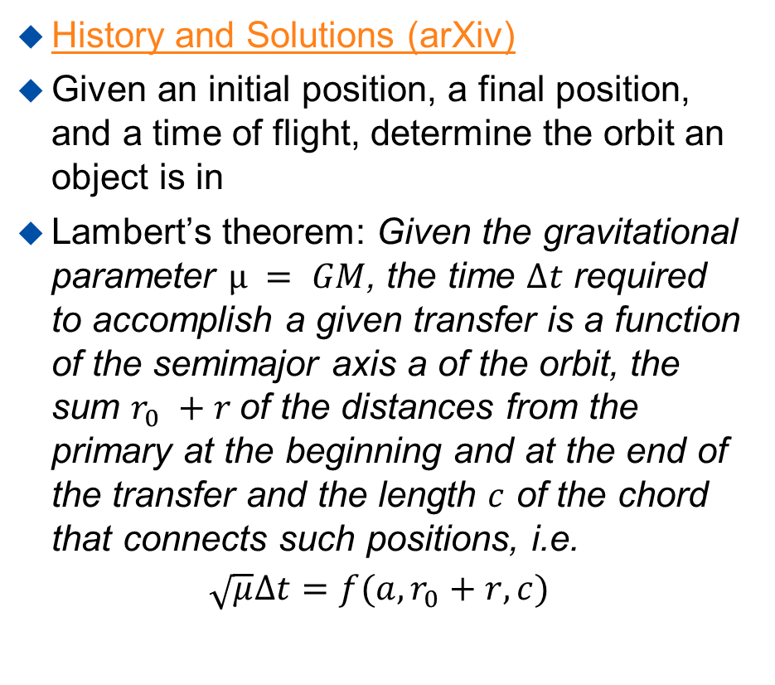
Lambert’s Problem
History and Solutions (arXiv)
Given an initial position, a final position, and a time of flight, determine the orbit an object is in
Lambert’s theorem: Given the gravitational parameter $µ = GM$, the time $∆t$ required to accomplish a given transfer is a function of the semimajor axis a of the orbit, the sum $r_{0} +r$of the distances from the primary at the beginning and at the end of the transfer and the length $c$ of the chord that connects such positions, i.e.
$$\sqrt{μ}∆t=f(a, r_{0}+r,c)$$
Mathworks

Slide 10
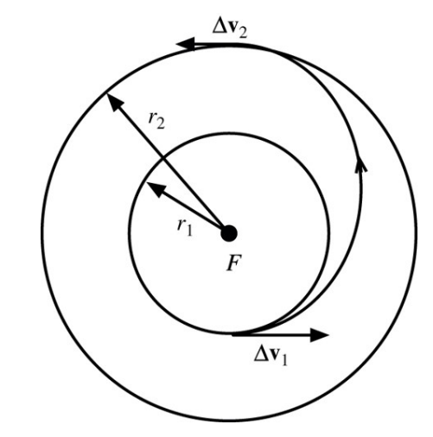
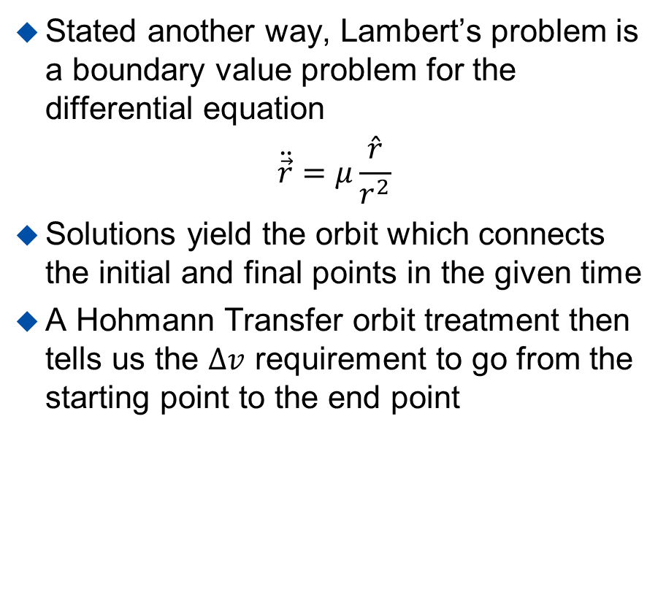
Lambert’s Problem
Stated another way, Lambert’s problem is a boundary value problem for the differential equation
$$\ddot{\vec{r}}=μ\frac{\hat{r}}{r^{2}}$$
Solutions yield the orbit which connects the initial and final points in the given time
A Hohmann Transfer orbit treatment then tells us the $∆v$ requirement to go from the starting point to the end point
Mathworks
Source

Slide 11
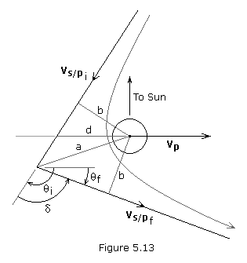
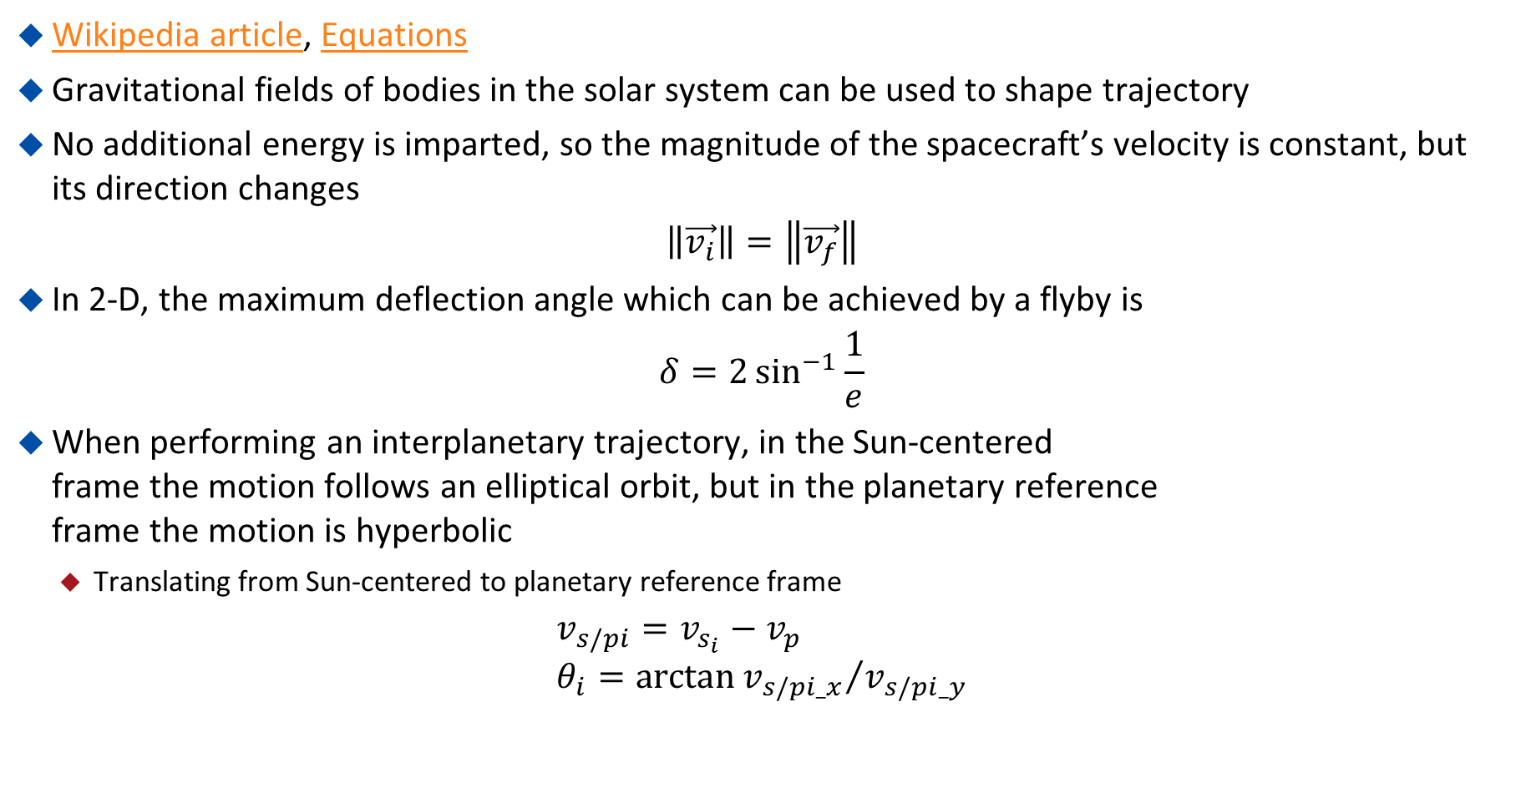
Gravity Assist
Wikipedia article, Equations
Gravitational fields of bodies in the solar system can be used to shape trajectory
No additional energy is imparted, so the magnitude of the spacecraft’s velocity is constant, but its direction changes
$$\left\|\vec{v_{i}}\right\|=\left\|\vec{v_{f}}\right\|$$
In 2-D, the maximum deflection angle which can be achieved by a flyby is
$$δ=2\sin^{−1}{\frac{1}{e}}$$
When performing an interplanetary trajectory, in the Sun-centered
frame the motion follows an elliptical orbit, but in the planetary reference
frame the motion is hyperbolic
  Translating from Sun-centered to planetary reference frame
$$v_{s/pi}=v_{s_{i}}−v_{p} \\ θ_{i}=\arctan{{v_{s/pi_x}}/{v_{s/pi_y}}}$$
Source

Slide 12
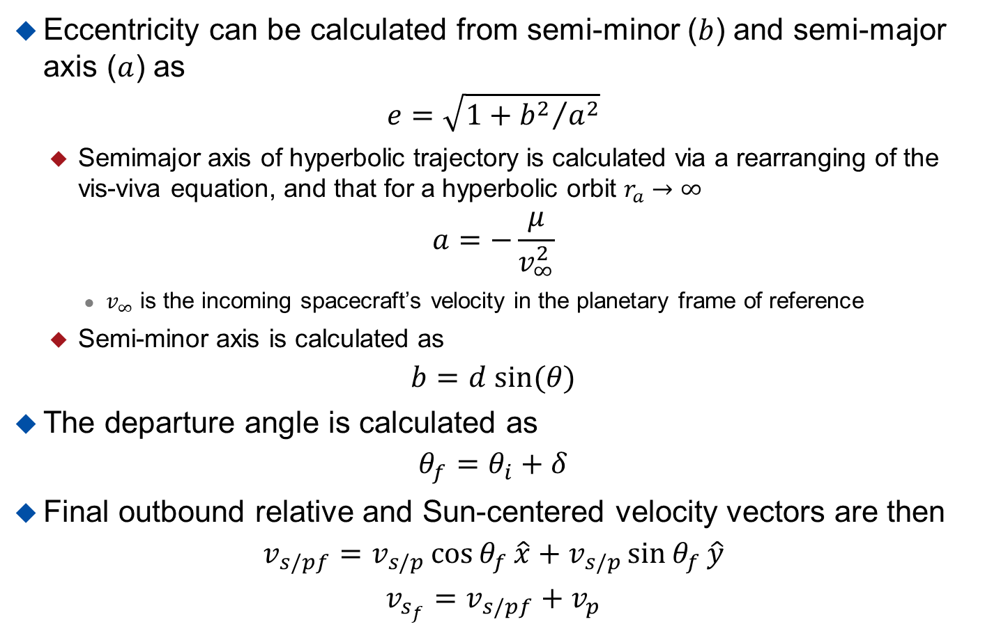
Gravity Assist
Eccentricity can be calculated from semi-minor ($b$) and semi-major axis ($a$) as
$$e=\sqrt{1+{b^{2}}/{a^{2}}}$$
  Semimajor axis of hyperbolic trajectory is calculated via a rearranging of the vis-viva equation, and that for a hyperbolic orbit $r_{a}→∞$
$$a=−\frac{μ}{v_{∞}^{2}}$$
    $v_{∞}$ is the incoming spacecraft’s velocity in the planetary frame of reference
  Semi-minor axis is calculated as
$$b=d sin⁡(θ)$$
The departure angle is calculated as
$$θ_{f}=θ_{i}+δ$$
Final outbound relative and Sun-centered velocity vectors are then
$$v_{s/pf}=v_{s/p}\cos{θ_{f}}\hat{x}+v_{s/p}\sin{θ_{f}}\hat{y}$$
$$v_{s_{f}}=v_{s/pf}+v_{p}$$
Source

