Slide 1

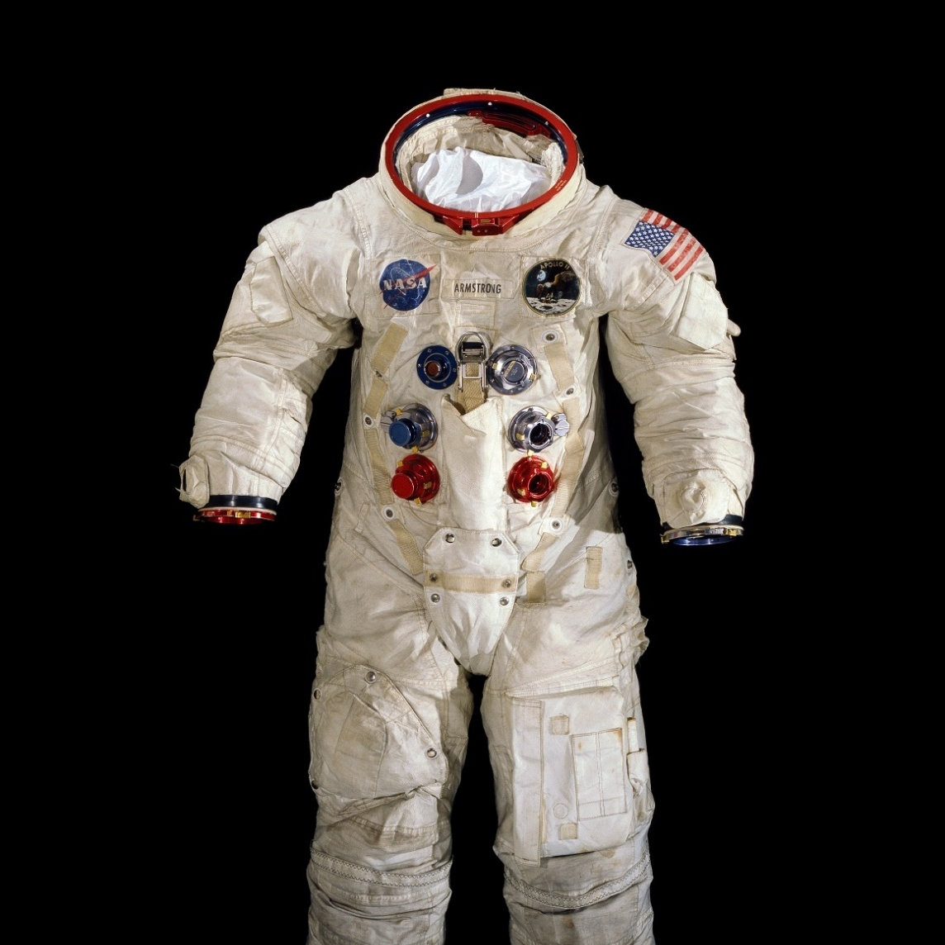
Astronaut Healthcare at the JSC Clinic
Ronak V. Shah, DO, MBA, MPH
Medical Director of Clinical Services
NASA Johnson Space Center
January 2022

Slide 2
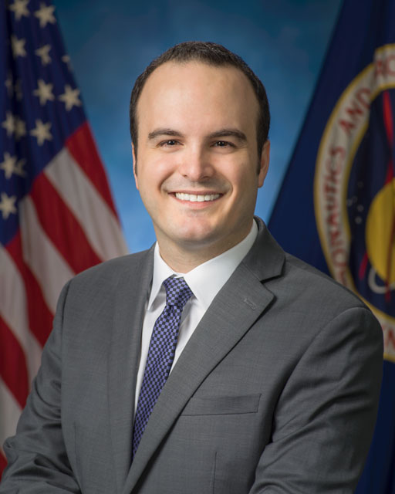
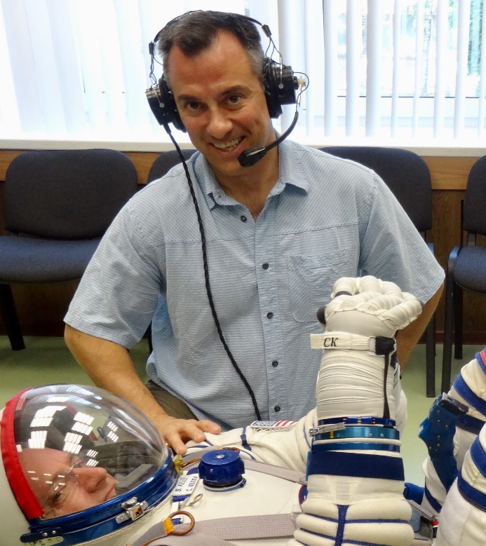
Introduction
Dr. Robert Mulcahy
Lead, Flight Medicine Clinic
Dr. David Reyes
COVID Response Coordinator for SD

Slide 3
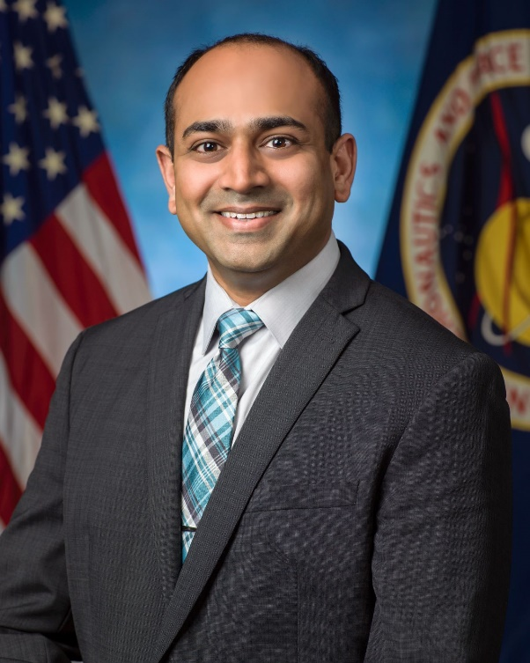
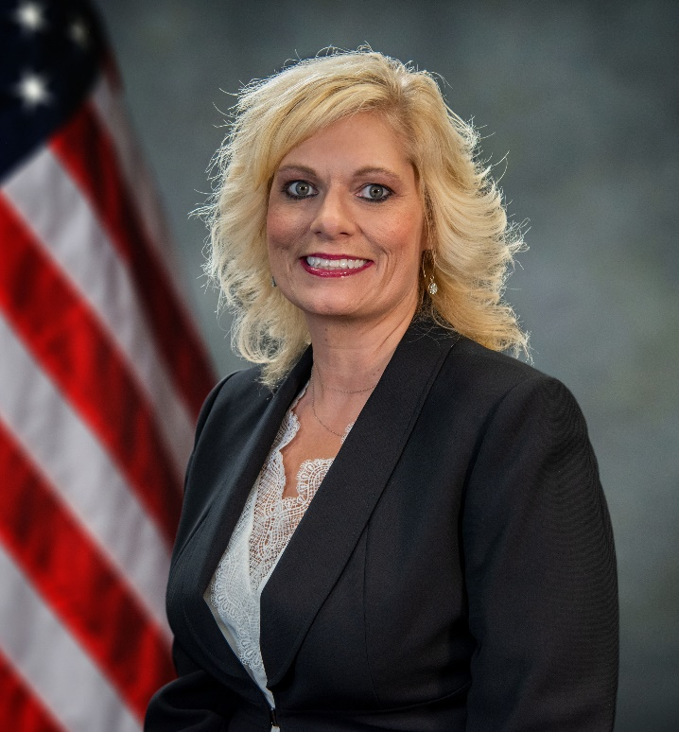
Introduction
Ronak Shah
Medical Director of Clinical Services
LaRona Smith
Chief Nurse & Clinic Operations Manager

Slide 4
General Information
281-483-7999
7:30-4:30 Mon-Fri (except quiet Friday)
On-call 24/7/365
Ambulance on-site
CB Liaison

Slide 5
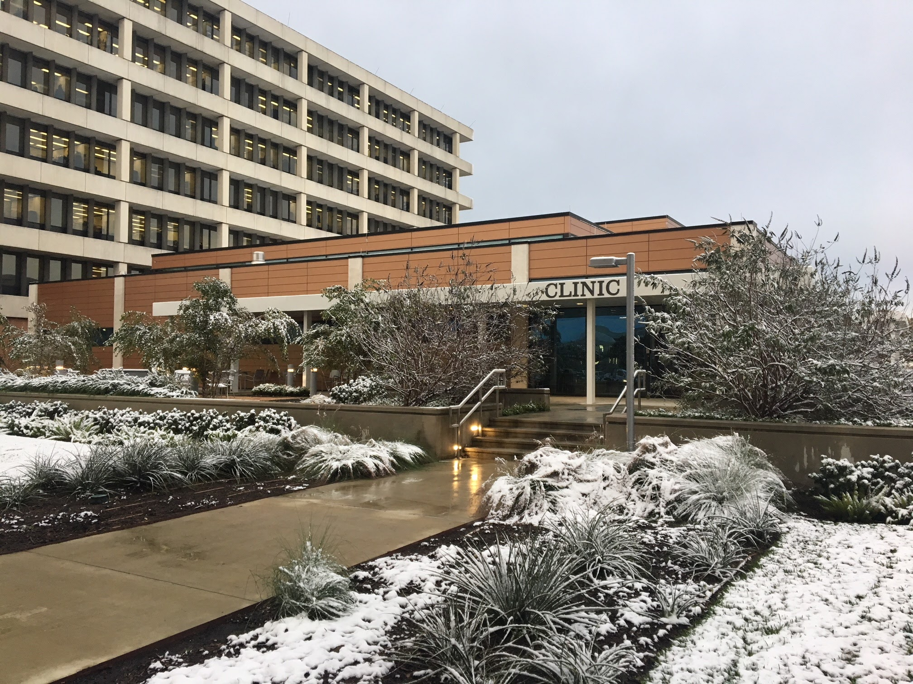

Slide 6
NASA-JSC Clinical Services
Flight Medicine
Neutral Buoyancy Lab
Astronaut Gym
Pharmacy
Moscow & Star City, Russia
Clinical Laboratory
White Sands Test Facility
Occupational Medicine
Test Subject Screening

Slide 7

Services
  Primary care
  Specialty care as required for flight
  Immunizations
  Pharmacy
  Radiology (ultrasound, X-ray, DEXA)
  Optometry (contact lenses, flight glasses)
  Audiology
  Lab

Slide 8
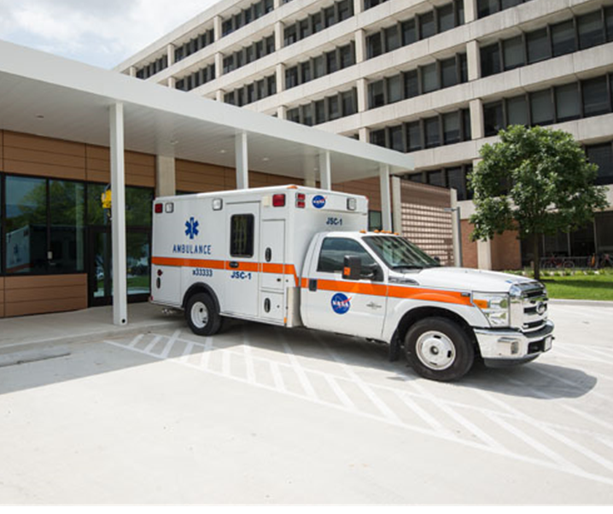
  Dental (off-site)
  Musculoskeletal program
  Assisted Reproductive Technology
  Billing/referral specialist (role of insurance)
  Behavioral health

Slide 9
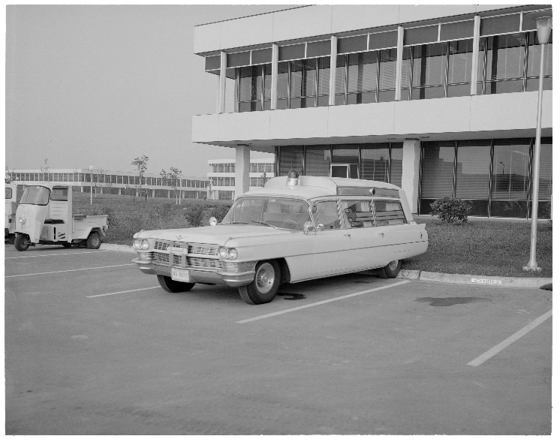
  LSAH program
  Worker’s Compensation
  TREAT Act

Slide 10
Certification
Annual exam on your birth month (Part 1 & 2)
Presentation to the Aerospace Medicine Board (AMB)
Presentation to the Multilateral Space Medicine Board (MSMB)
Once flight assigned…

Slide 11
Dependent Spouse and Children
Annual physical
Physicals are provided for dependent spouses and children up to the age of 23.
FMC does not provide specialty pediatric care (e.g. well child exams)
Routine medical care and immunizations
Behavioral health services

Slide 12
Thank You and
Congratulations! we look forward to taking care of you…

