Slide 1
IMPACT 2021: MEDICAL DATABASE ACCOMPLISHMENTS AND LESSONS LEARNED
Human Research Program
Exploration Medical Capability Element
February 7, 2022
P. Augustine¹,
A. Al², S. Ozbek², M. Kaetzer²,
R. Daiker³, R. Lake³, A. Harrivel³
S. Maddock⁴, K. Klein⁴
1 NASA Johnson Space Center, Houston, TX
^{2 KBR, Inc., Houston, TX}
3 NASA Langley Research Center, Hampton, VA
4 Analytical Mechanics Associates, Inc. Hampton, VA
“Expanding the Boundaries of Space Medicine and Technology”

Slide 2
Agenda
Introduction
Systems Engineering
Human Factors
Medical Item Database (MedID)
Evidence Library
IMPACT Medical Database Software
Conclusion
Questions

Slide 3
Introduction
Multidisciplinary collaboration
  Systems engineers validating medical evidence with clinicians
  Clinicians, engineers, and software developers refining resources
  Human factors engineers designing software with clinicians and developers
Innovations to conventional development
  Model-based Systems Engineering for Concept of Operations (ConOps) and Requirements
  Human-centered design of software interfaces
  Agile software development

Slide 4
Systems Engineering
MagicDraw software utilized for MD SE
  Generated MD CONOPS and Requirements
  Produced detailed diagrams of all MD CONOPS Scenarios
    Revealed the need to expand from three to nine scenarios to include all functionality
    Helped identify holes in need of detailed discussion
  Facilitated improved coordination across the project
    Enabled full integration with the HF team, their products, and activities
    Drove consistency across products, resulting in more robust documentation

Slide 5
Systems Engineering
MD Software Verification and Validation (V&V) Approach
  Challenges:
    Compressed schedule, limited timeframe
    Agile software environment requires adaptation of NASA processes
    Highly distributed, multi-functional team with limited bandwidth
  Solution:
    Adapt NASA V&V processes to meet the needs of this unique project
    Utilize detailed HF Action Diagrams and Task Analyses, SE Activity Diagrams and CONOPS Scenarios to validate software
    Leverage recordings of quarterly live demonstrations to customers to verify some functions
    Create new video demonstrations of remaining functionality as needed for verification
    Video demonstrations made available via SharePoint for distributed team to review when convenient
    Potential re-use of demonstration videos for HF training purposes

Slide 6
Systems Engineering
Verification, Validation, and Credibility (VV&C)
  Team collaboration throughout the IMPACT project to understand, define, and construct a Credibility Assessment matrix and Real World System (RWS) Validation plan for the medical evidence.
    IMPACT Credibility matrix, based on Appendix B of the NASA Standard 7009
    (NASA-STD-7009A) document, which describes the credibility assessment scale
    for models and simulations (M&S).
    IMPACT RWS Validation Plan is a cross-validation plan utilizing the RWS Lifetime Surveillance of Astronaut Health (LSAH) data to analyze mission predictions to compare
    to actual data.
  Lessons learned:
    SEs to suggest an approach to assist the clinical team instead of asking how to help.
    Define an Agile approach to review requirement and document changes/updates and product delivery timeframe. Find a balance between Agile and NASA processes.

Slide 7
Human Factors
Applying a human-centered design approach that focuses on the human user’s needs throughout the design and development phases.
Research
Define
Ideate
Prototype
Test
Implement
Notes:
Script:
Hi, my name is Tyler Duke and I am one of the Human Factors Engineers for IMPACT’s Medical Database. One thing we have been able to do is implement a Human-Centered Design process throughout the design and development of Medical Database. By following this process, we have been able to keep users involved by understanding their interactions and thoughts, which have been at the forefront of each design recommendation. This helps ensure an optimal product is being developed, reduces project costs, and increases user satisfaction.
Additional Notes:
Human Factors is a discipline that combines psychology with engineering with the goal of understanding how users interact with products and systems. Human Factors Engineers apply research surrounding human abilities, limitations, behaviors, and thought processes to the design and development of products and systems.
Human-centered design is an iterative process that is commonly used to keep human end-users involved throughout all design and development phases. Keeping the users involved from the beginning to the end of a product’s life cycle and understanding their interactions and thoughts can help ensure the optimal product is being developed, reduce project costs, and increase user satisfaction.
Various tools, techniques, and methodologies are used by Human Factors experts in the testing phase of the human-centered design to document step-by-step interactions between the user and the system, identify common issues, and capture the user’s feedback on the product.
After implementing these methodologies and analyzing the feedback collected, Human Factors experts are able to propose recommendations or alternative designs that will likely improve the usability of and satisfaction towards the final product.

Slide 8
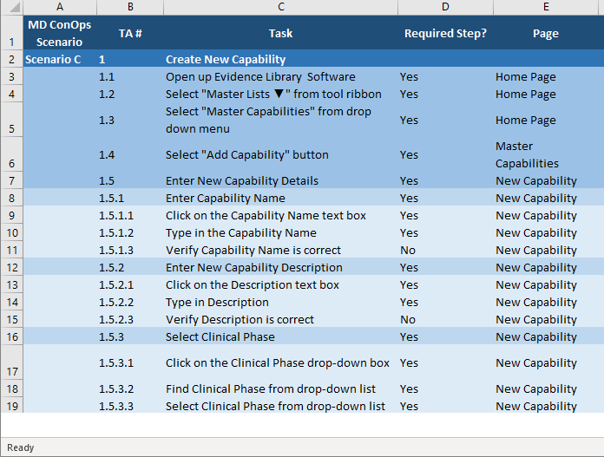
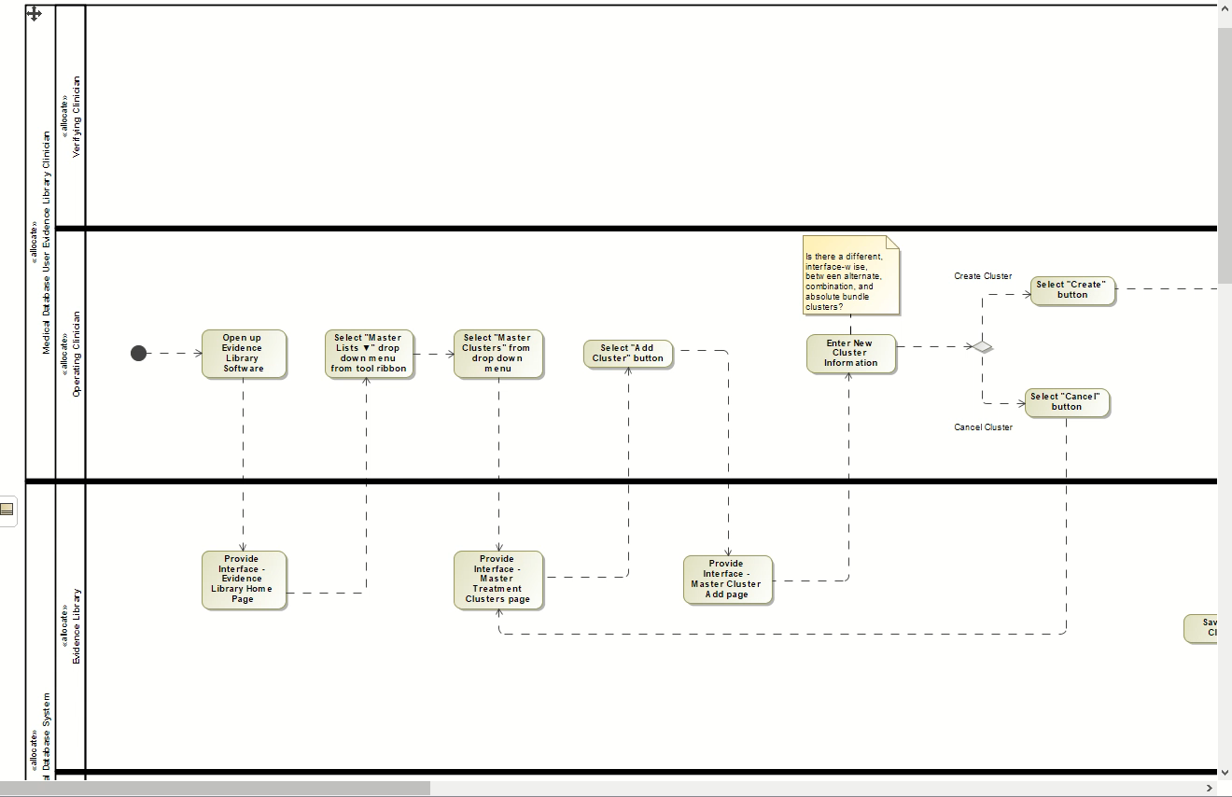
Human Factors - Task Analysis
Using MagicDraw, task analyses have been created for each scenario detailed in the Medical Database ConOps.
Traditional Task Analysis
MagicDraw Task Analysis
Notes:
Script:
One of the methods Human Factors has utilized in the human-centered process is a task analyses. For each Scenario defined in the Medical Database ConOps, a task analysis has been created. This step-by-step analysis helps experts understand how users perform a specific task and identifies any gaps or missing steps that may prevent a user from achieving their intended goal. Traditionally, task analyses were created using Excel. However, we have been able to leverage the Model Based System Engineering tool MagicDraw to create these diagrams. Using this tool allows us to communicate and collaborate with other teams across Medical Database more effectively and efficiently, and it will be useful during verification and validation activities.
Additional Notes:
A task analysis is a Human Factors method that provides a detailed description of how an activity or scenario is performed. The analysis breaks down complex tasks into subtasks performed by both the user and the system.
This step-by-step analysis helps experts understand how users perform a specific task and identifies any gaps or missing steps that may prevent a user from achieving their intended goal.
Initially, Excel was used to perform these analyses, which kept the work Human Factors was doing siloed.
Now, MagicDraw, a Model Based System Engineering tool, is used to create these analyses by diagramming user flows at the functional level (higher level steps) and action level (lower level, more detailed steps).
This tool helps with communication and collaboration across the project with other teams (e.g., developers, system engineers).

Slide 9
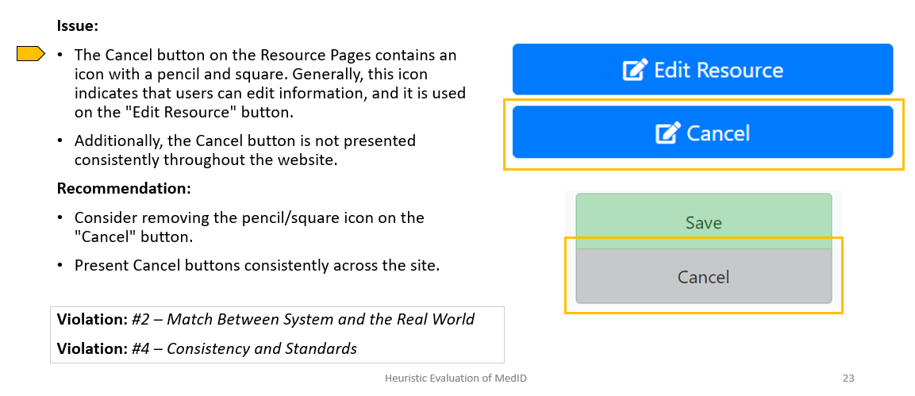
Human Factors - Heuristic Evaluation
A heuristic evaluation is a method that is used to identify usability issues for interfaces. Heuristic evaluations have been performed to help improve the interfaces for Medical Database.
Notes:
Script:
We have also completed heuristic evaluations for Medical Database. A heuristic evaluation is a quick, inexpensive way for Human Factors experts to identify usability issues for interfaces. Typically, Human Factors experts will evaluate an interface against 10 usability principles, or heuristics, and assign a subjective severity rating to each issue identified. After issues and severity ratings are identified, Human Factors experts will generate recommendations to improve the interface usability. These recommendations have helped improve the usability and overall design of IMPACT’s Medical Database.
Additional Notes:
A heuristic evaluation is another Human Factors method that is used to identify usability issues for interfaces.
Human Factors experts will evaluate an interface against 10 usability principles, or heuristics, and assign a subjective severity rating to each issue identified.
Severity ratings indicate whether an issue is: not an issue, cosmetic, minor, major, and critical. It is important to find solutions for all critical ratings, as they may prevent a user from completing a task.
After issues and severity ratings are identified, Human Factors experts will generate recommendations to improve the interface usability.
Heuristic evaluations have been conducted on components to the IMPACT suite, included MedID of Medical Database, and will hopefully enhance the usability of the overall product.

Slide 10
Medical Item Database (MedID) Update
ExMC researchers successfully completed a major project deliverable focused on the population of key engineering data for medical and pharmaceutical resource items (>41K individual items) for the Medical Item Database (MedID) component within the Medical Database (MD) Project.
This update was informed by and in alignment with resource items required to treat medical conditions forecasted for a ‘Level of Care 4’ exploration* environment, as specified by the Clinical Science Team (CST) clinicians and documented via the Evidence Library’s Capability Resource Table (CRT).
* Hailey, M., Urbina, M., Reyes, D., & Antonsen, E. (2017). Interpretation of NASA-STD-3001 Levels of Care for Exploration Medical System Development. NASA/TM-2017-219290

Slide 11

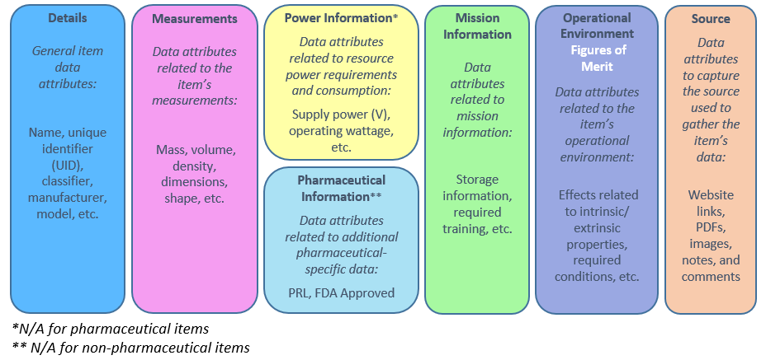








Medical Item Database (MedID) Update
A total of 418 medical items, 268 pharmaceutical items, and 503 associated clinical phase/capability entities (per the CRT list) were populated into MedID in accordance with the following attribute areas:

Slide 12
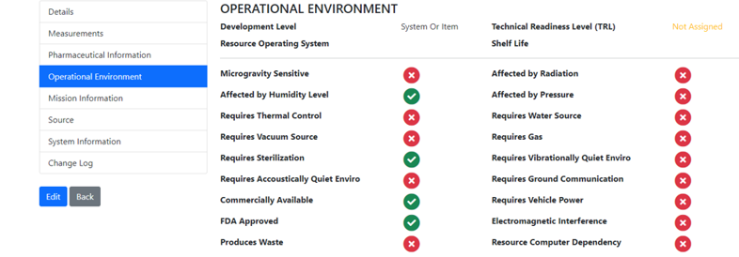
Medical Item Database (MedID) Update
Three new Figures of Merit (FOMs) (depicted by blue asterisks in the image below) were added to MedID :
*
*
*

Slide 13
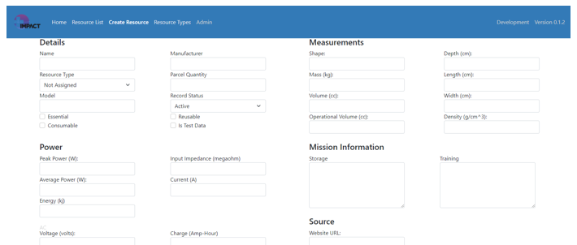
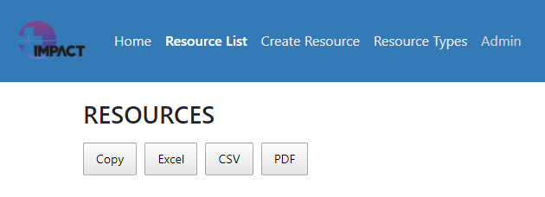
Medical Item Database (MedID) Update
Resource items were populated into MedID via an auto-import script developed by the Lead MedID S/W Developer.
New Graphical User Interface (GUI) features were added to improve visual presentation and efficiency of layout.
  Implemented responsive design and Microsoft best practices
  Updated workflow for creating & editing resource items
  Added data filtering and exporting
  functionalities for the resource list

Slide 14
Medical Item Database (MedID) Update
Resource item data were collected per the process outlined in the MedID Content Development Methods (IMPACT-0027) document.
Data traceability was facilitated via a master resource list spreadsheet, as well as via stored information and source links within the database.
This update was an extensive collaborative effort involving ExMC-based engineers, scientists, software developers, clinicians, and interns.

Slide 15
Evidence Library – A Year of Intense Medical Condition-Building
Condition List and Definitions (both Best and Worst Case) - 122 Medical Conditions
Literature searching
Outsourcing to students at University of Colorado
Meticulous documentation of sourcing and decision rationales
Working with Biostatistician
Consulting with outside SMEs
Two-level peer review
Quality Assurance

Slide 16
Evidence Library – A Year of Intense Medical Condition-Building
Capabilities and Resources Development with Clustering of Resources
Innovative approach to crew task impairment (TI)
Collaborating with MedID to identify resources with figures of merit (FOMs)
Collaborating with software developers - develop new database based on former Integrated Medical Evidence Database (IMED) from the Integrated Medical Model

Slide 17
IMPACT Medical Database Software
Integration of Evidence Library and MedID into one Database
Content branching support
Extensive versioning and change tracking support
Rule-based content validation
Output model generation (Lockdowns)
Web-Based API for model access by other tools

Slide 18
Conclusion
This multidisciplinary team is delivering integrated medical device engineering data and clinical evidence.
  These data will be validated and used as input data for IMPACT-facilitated trade studies for a ‘Level of Care 4’ exploration environment.
  Methods are being established which will inform the collection and curation of validated and credible data for additional exploration environments and future IMPACT customers.
Novel Systems Engineering methods, including Model-Based Systems Engineering, enable this work to be done according to all applicable NASA standards and processes while leveraging the benefits of Agile development.
Rigorous Human Factors methods are being used to incorporate the requirements of human end-users early in the development process for optimal user interfaces in the end product.

Slide 19
Questions?
Philip Augustine <philip.m.augustine@nasa.gov>
Angela Harrivel <angela.r.harrivel@nasa.gov>

