Slide 1
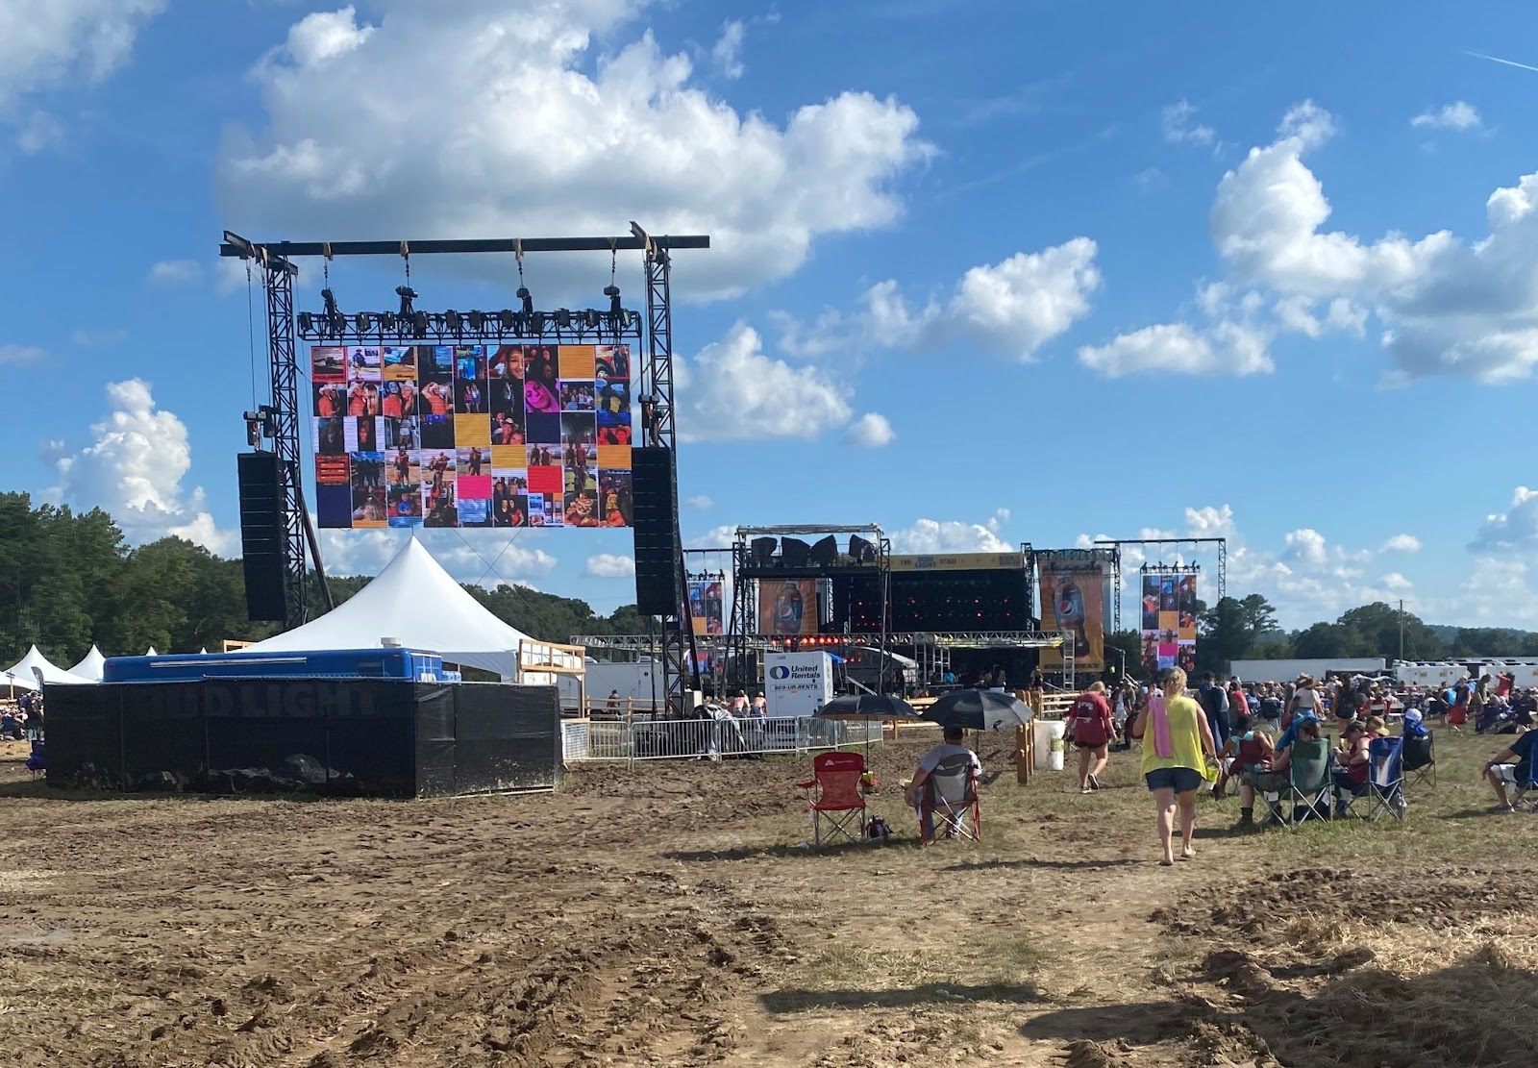
Applications and Performance of a Lightning Risk Assessment using Geostationary Lightning Mapper (GLM) Data
Kelley Murphy¹, Roger E. Allen², Christopher J. Schultz³, Eric C. Bruning⁴,
Kristopher D. White⁵, Ashley Ravenscraft⁵, and Matthew E. Anderson⁵
¹NASA SPoRT/University of Alabama in Huntsville, Huntsville, AL
²NASA SPoRT/Jacobs Engineering, Huntsville, AL
³NASA SPoRT/Marshall Space Flight Center, Huntsville, AL
⁴Department of Geosciences, Texas Tech University, Lubbock, TX
⁵National Weather Service, Huntsville, AL
Photo used with permission by Jessica Chace, NWS Huntsville

Slide 2
Background
Why lightning safety?
  Fatality & injury prevention
  US has made great progress, but lightning is a much larger danger in other countries (especially lesser-developed)

Slide 3
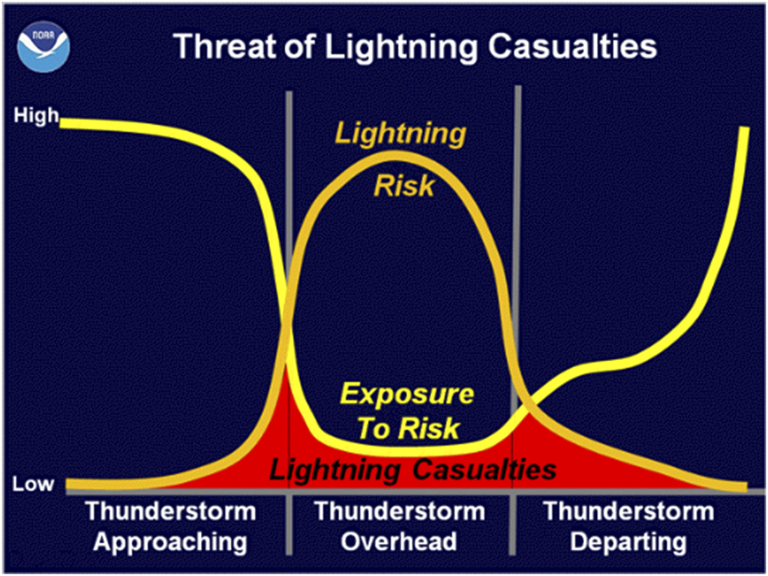
Background
Why lightning safety?
  Fatality & injury prevention
  US has made great progress, but lightning is a much larger danger in other countries (especially lesser-developed)
Why risk?
  Considers both subjective & objective factors
  Risk magnitude based on many variables, room for further expansion/additions in the future

Slide 4
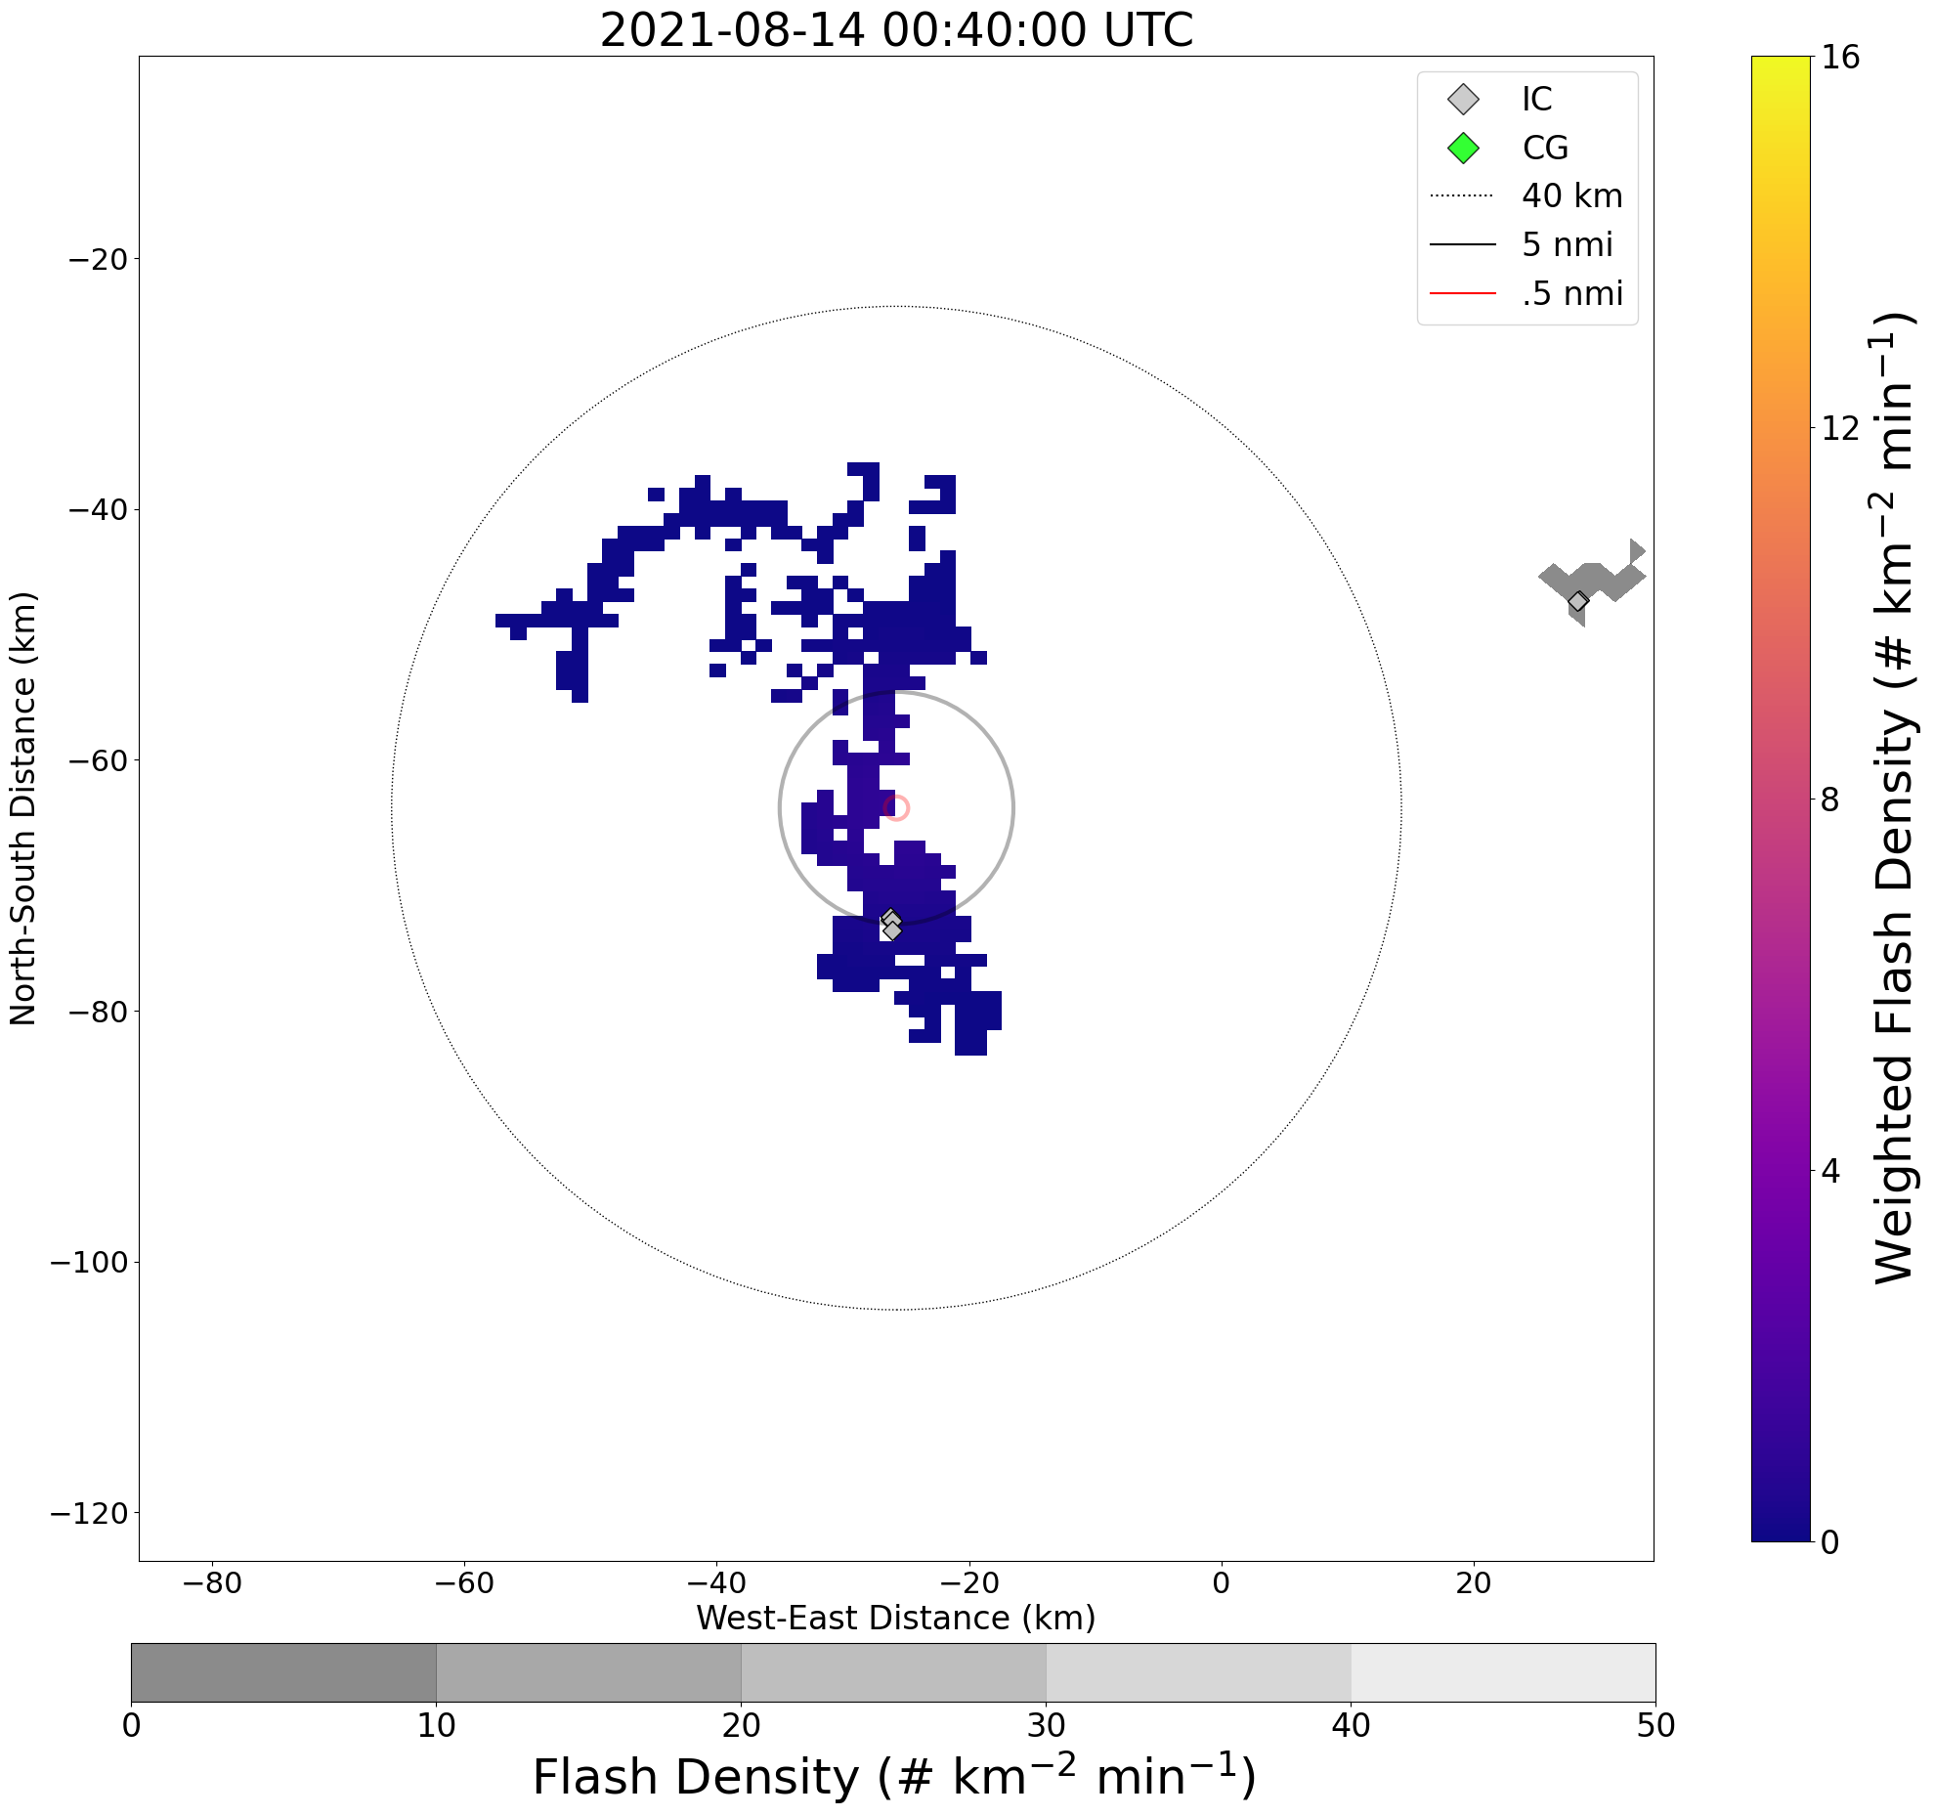
Background
Why lightning safety?
  Fatality & injury prevention
  US has made great progress, but lightning is a much larger danger in other countries (especially lesser-developed)
Why risk?
  Considers both subjective & objective factors
  Risk magnitude based on many variables, room for further expansion/additions in the future
Why GLM?
  Spatially mapped data
  GLM allows for expanded application in areas outside of LMA domains

Slide 5
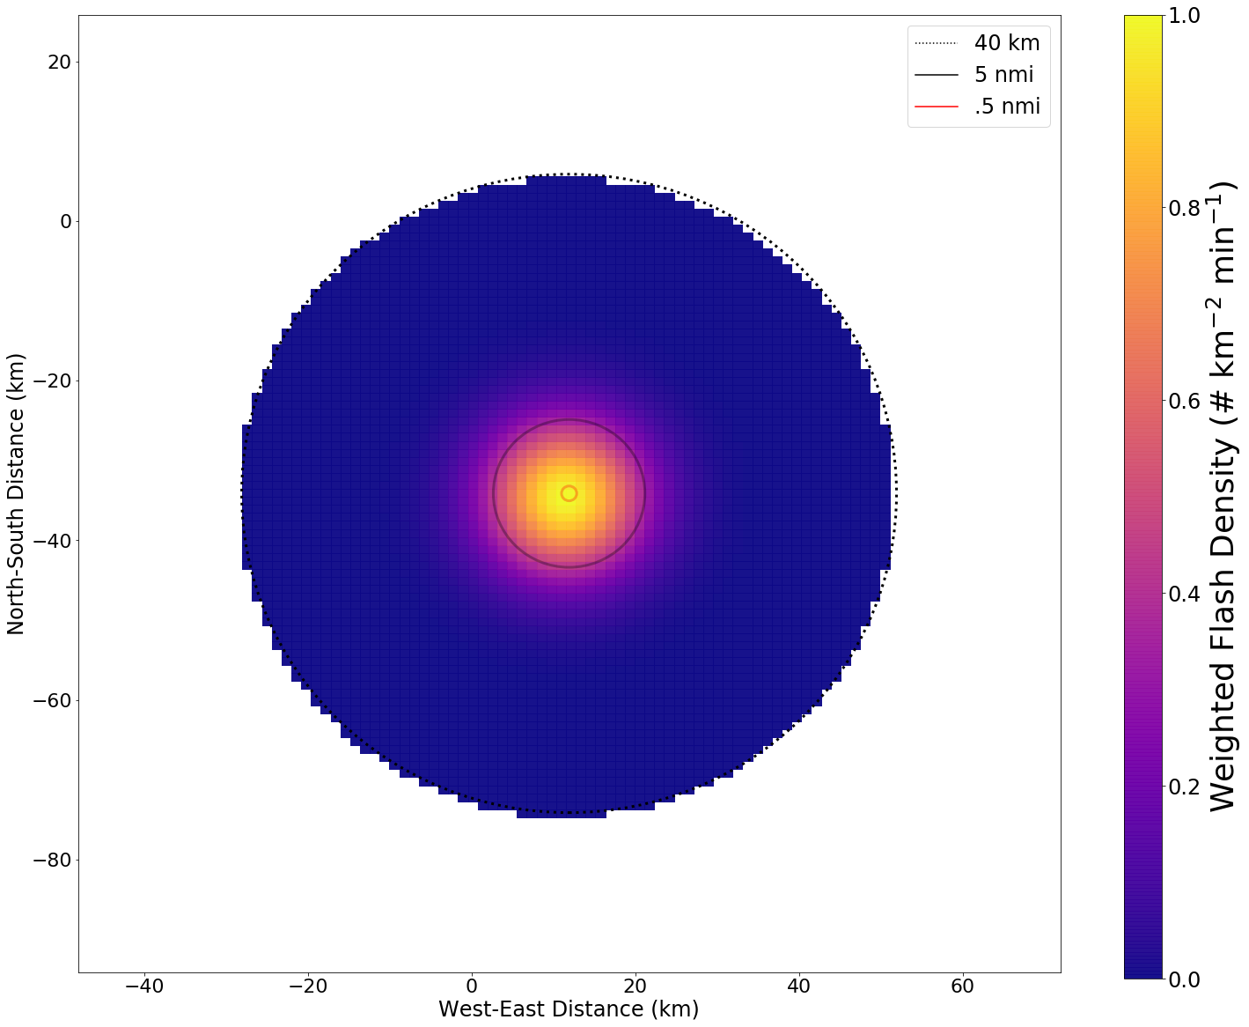
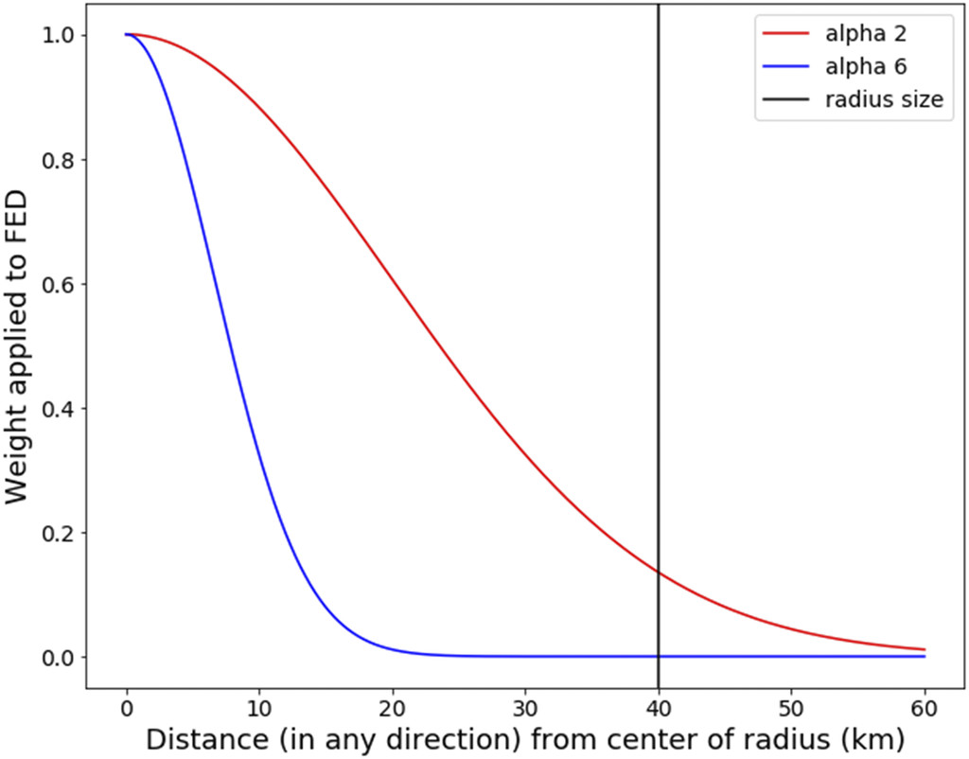
Methods
Calculation is based on International Electrotechnical Commission Standard 62305-2 (IEC 62305-2).
  Adapted for human safety scenarios
  Area used: radius of 100ft surrounding human
Breaks down into three parts: number of dangerous events, probability of damage, and consequent loss.
Resulting risk magnitude compared to tolerability thresholds to evaluate safety
A Spatiotemporal Lightning Risk Assessment Using Lightning Mapping Data
Murphy, K. M., E. C. Bruning, C. J. Schultz, J. K. Vanos
https://journals.ametsoc.org/view/journals/wcas/aop/WCAS-D-20-0021.1/WCAS-D-20-0021.1.xml

Slide 6
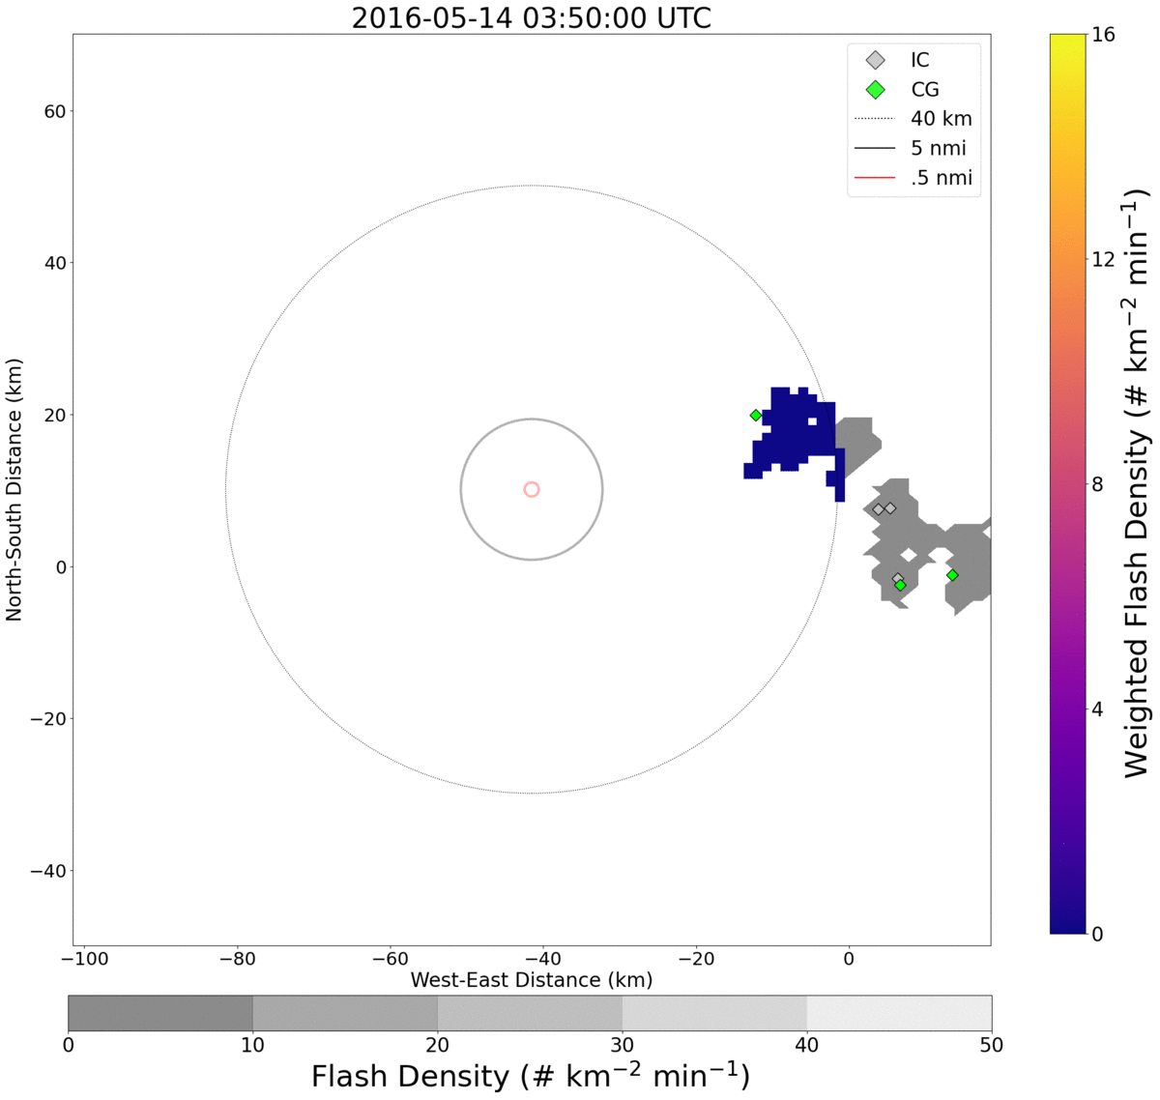
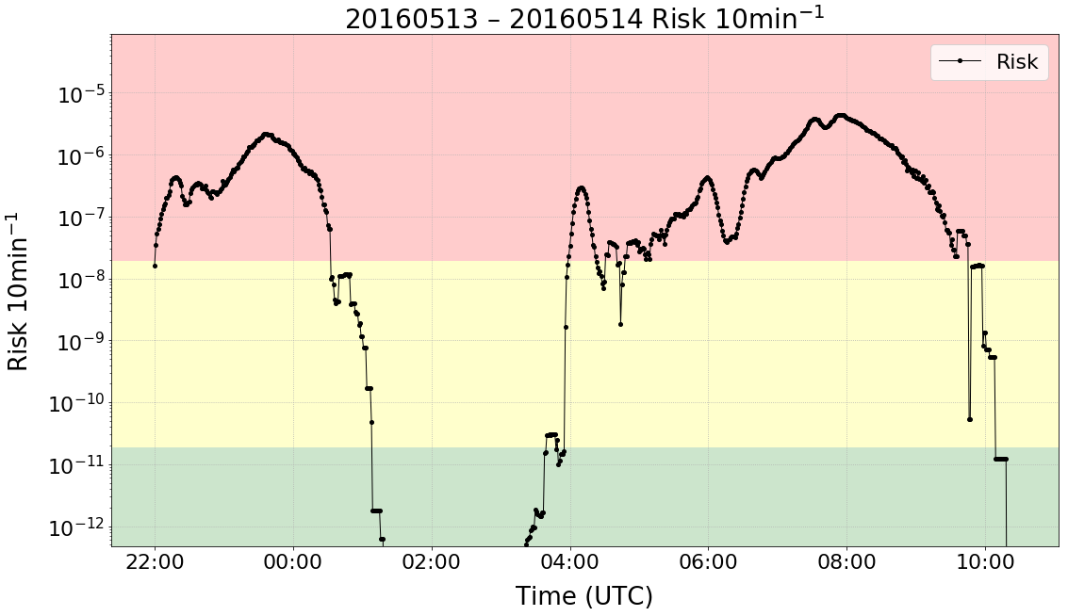
Methods
Calculation is based on International Electrotechnical Commission Standard 62305-2 (IEC 62305-2).
  Adapted for human safety scenarios
  Area used: radius of 100ft surrounding human
Breaks down into three parts: number of dangerous events, probability of damage, and consequent loss.
Resulting risk magnitude compared to tolerability thresholds to evaluate safety
A Spatiotemporal Lightning Risk Assessment Using Lightning Mapping Data
Murphy, K. M., E. C. Bruning, C. J. Schultz, J. K. Vanos
https://journals.ametsoc.org/view/journals/wcas/aop/WCAS-D-20-0021.1/WCAS-D-20-0021.1.xml

Slide 7
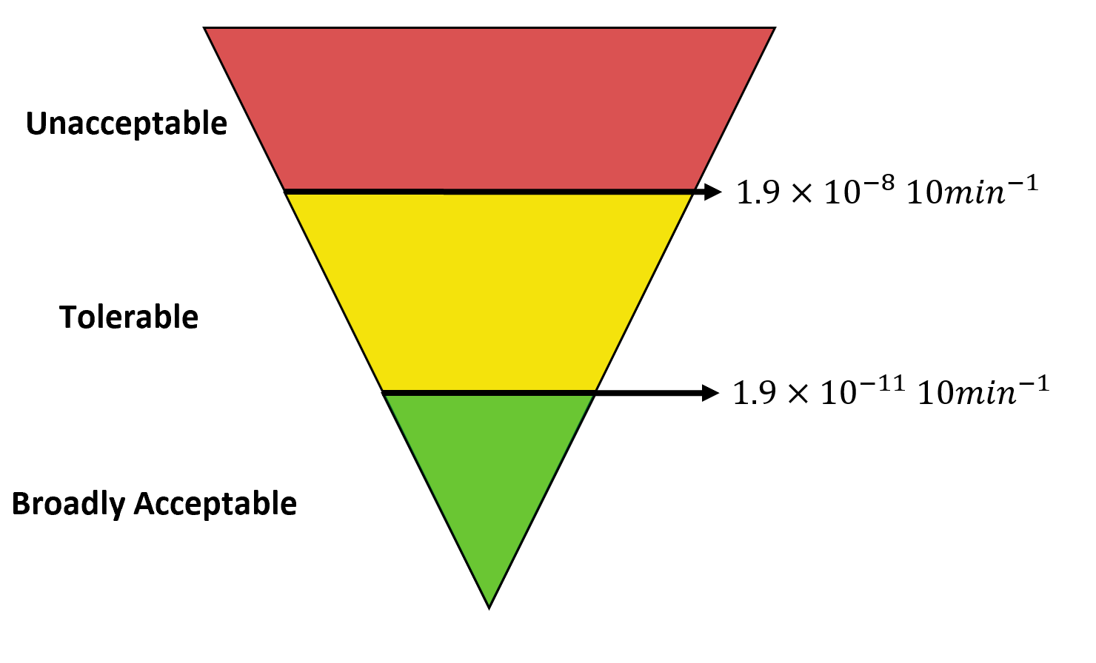
Methods
Calculation is based on International Electrotechnical Commission Standard 62305-2 (IEC 62305-2).
  Adapted for human safety scenarios
  Area used: radius of 100ft surrounding human
Breaks down into three parts: number of dangerous events, probability of damage, and consequent loss.
Resulting risk magnitude compared to tolerability thresholds to evaluate safety
Modified from:
Health and Safety Executive, 2001: Reducing risks, protecting people: HSE’s decision-making process. HSE Doc., 88 pp., https://www.hse.gov.uk/managing/theory/r2p2.htm.
A Spatiotemporal Lightning Risk Assessment Using Lightning Mapping Data
Murphy, K. M., E. C. Bruning, C. J. Schultz, J. K. Vanos
https://journals.ametsoc.org/view/journals/wcas/aop/WCAS-D-20-0021.1/WCAS-D-20-0021.1.xml

Slide 8
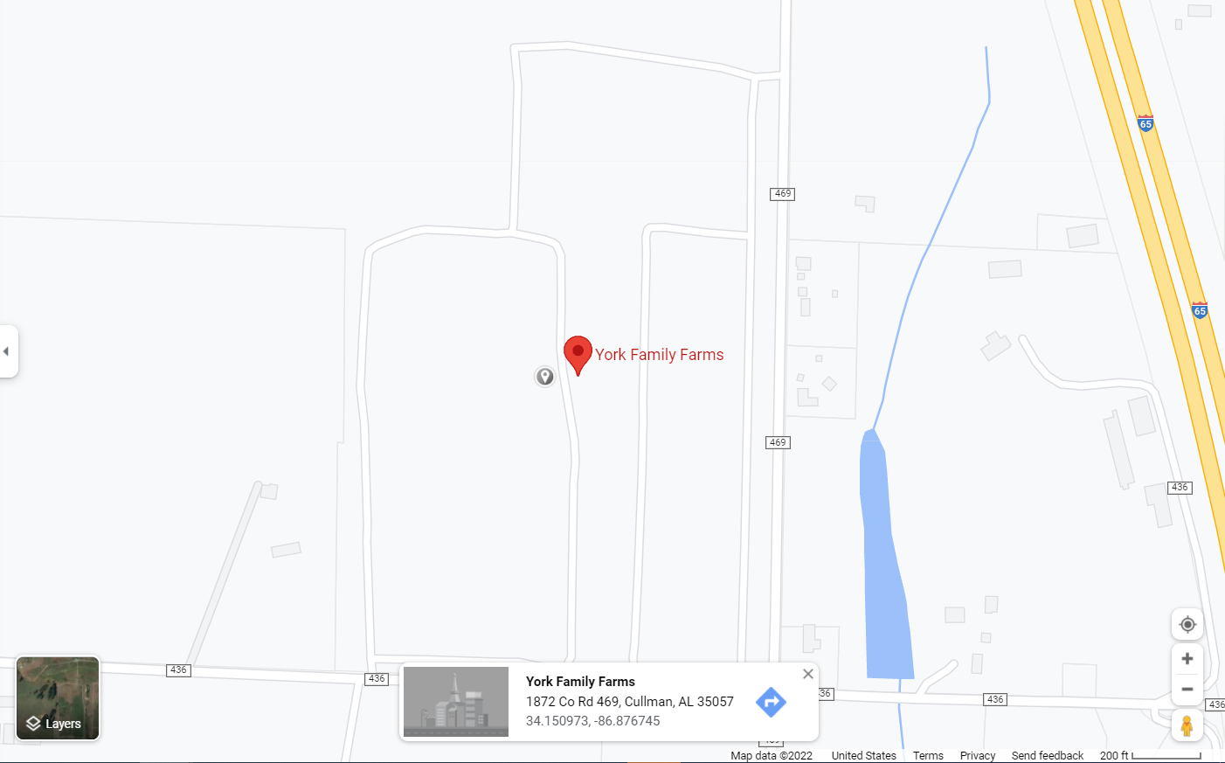
Methods
Assessed lightning threat for the “Rock the South” concert:
  Cullman, AL (used lat, lon of 34.1510, -86.8767)
  Source: address provided on https://www.rockthesouth.com/faq
  08/13/2021 – 08/15/2021
Two main periods of interest:
  Day 1: 22:00 – 02:30 UTC (08/13 – 08/14)
  Day 2: 22:00 – 02:00 UTC (08/14 – 08/15)

Slide 9
Methods
Compare actual event delay periods (based on NWS decision support services (DSS) log) to:
  NLDN 30/30 rule – any flash (IC or CG) within 5 nmi issues a warning, warning period ends 30mins after last flash within 5nmi
  Risk methodology (LMA) – warning period start when risk is unacceptable, ends when risk is tolerable or acceptable
  Risk methodology (GLM) – same as LMA risk
Actual event delay periods (OBSERVED)
NLDN 30/30
(30/30)
Risk Methodology LMA (LMA Risk)
Risk Methodology GLM (GLM Risk)

Slide 10
Day 1 warning periods
LMA Risk
2021-08-13 22:38 – 01:31
Total duration = 2 hr 53 mins
Observed
2021-08-13 22:35 – 02:10
Total duration = 3 hr 35 mins
NLDN 30/30
2021-08-13 22:36 – 01:24
Total duration = 2 hr 48 mins

Slide 11
Day 1 warning periods
LMA Risk
2021-08-13 22:38 – 01:31
Total duration = 2 hr 53 mins
Observed
2021-08-13 22:35 – 02:10
Total duration = 3 hr 35 mins
NLDN 30/30
2021-08-13 22:36 – 01:24
Total duration = 2 hr 48 mins
Day 2 warning periods
LMA Risk
2021-08-14 22:16 – 23:08
Total duration = 52 mins
2021-08-14 23:20 – 23:22
Total duration = 2 mins
2021-08-14 23:39 – 23:49
Total duration = 10 mins
Sum = 1 hr 33 mins
Observed
2021-08-14 22:27 – 00:00
Total duration = 1 hr 33 mins
NLDN 30/30
2021-08-14 22:10 – 00:32
Total duration = 2 hr 22 mins
2021-08-15 01:02 – 01:32
Total duration = 30 mins
Sum = 2 hr 52 mins

Slide 12
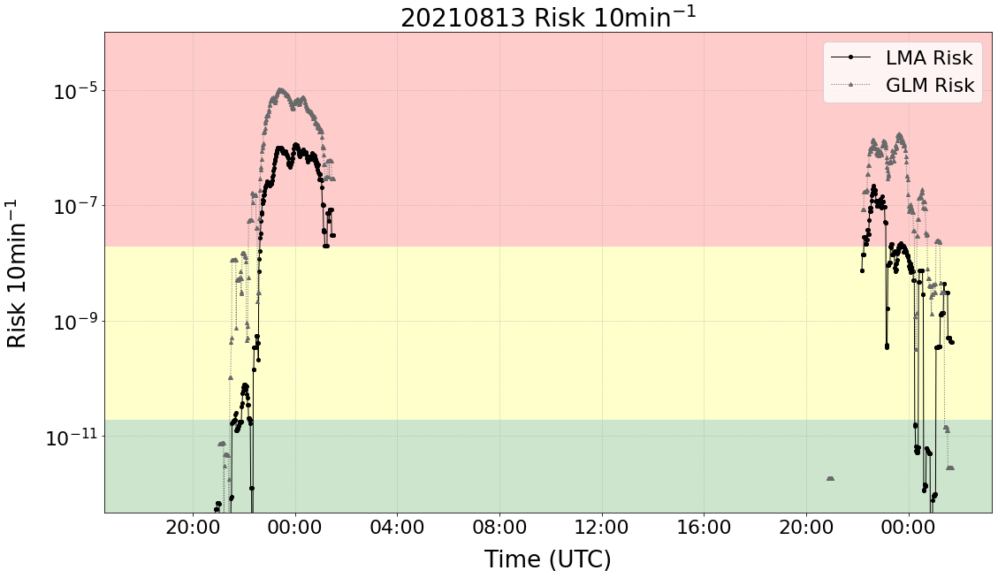
Results

Slide 13
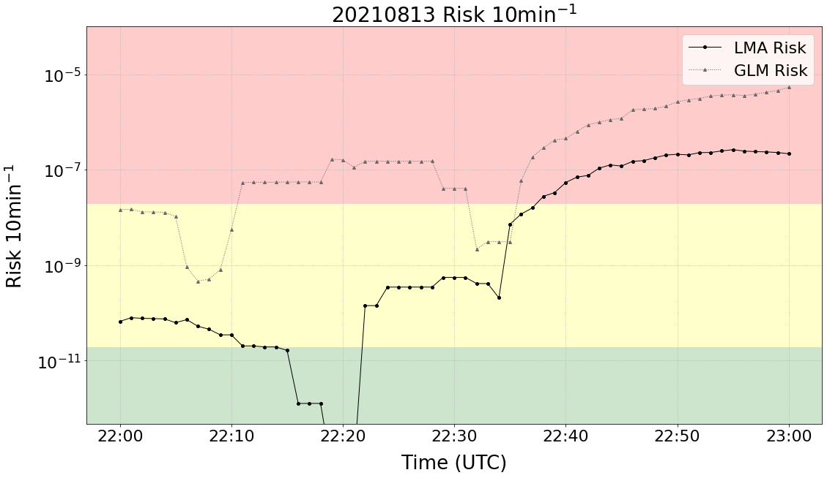
Results
Day 1, start of delay
22:35 UTC
Start of delay (observed)

Slide 14
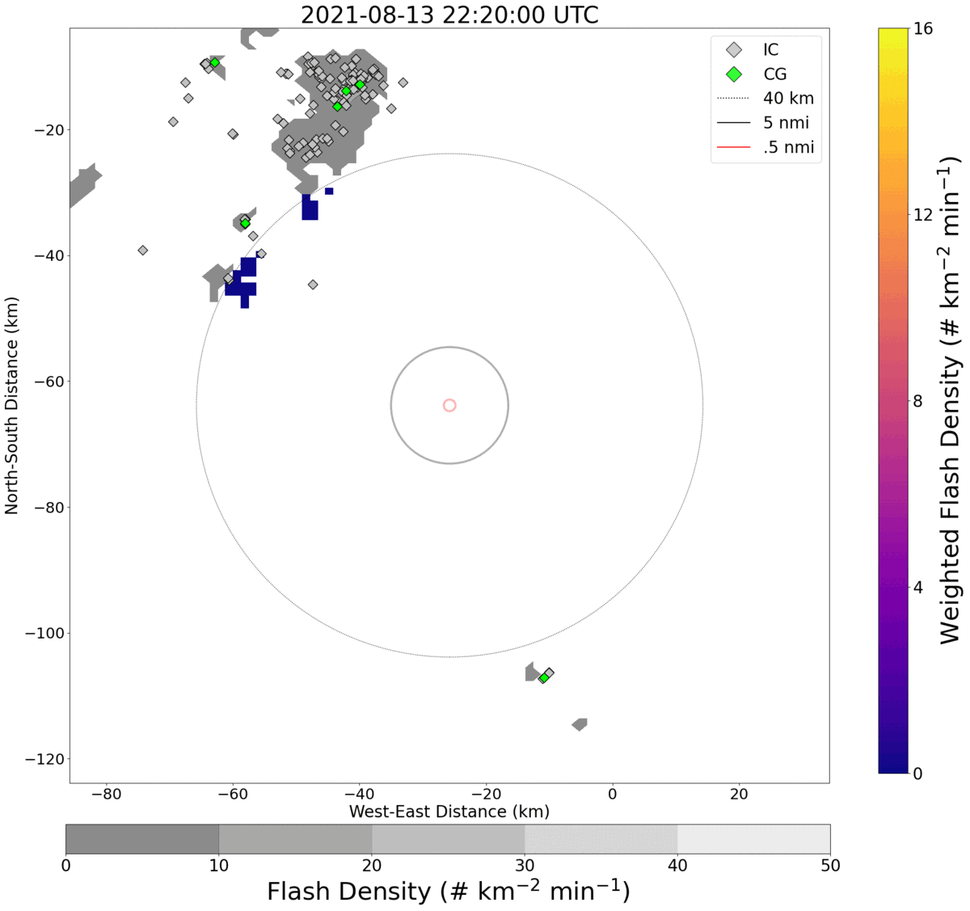
Results
22:35 UTC
Delay start

Slide 15
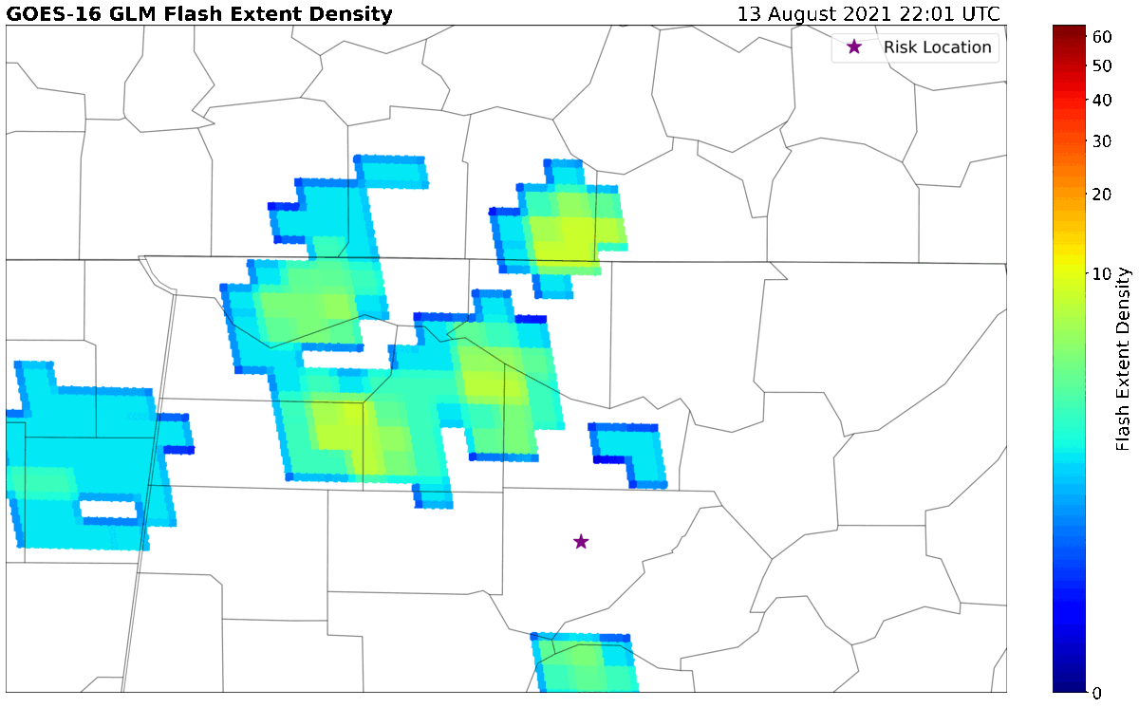
Results
Day 1, start of delay
22:35 UTC
Delay start

Slide 16
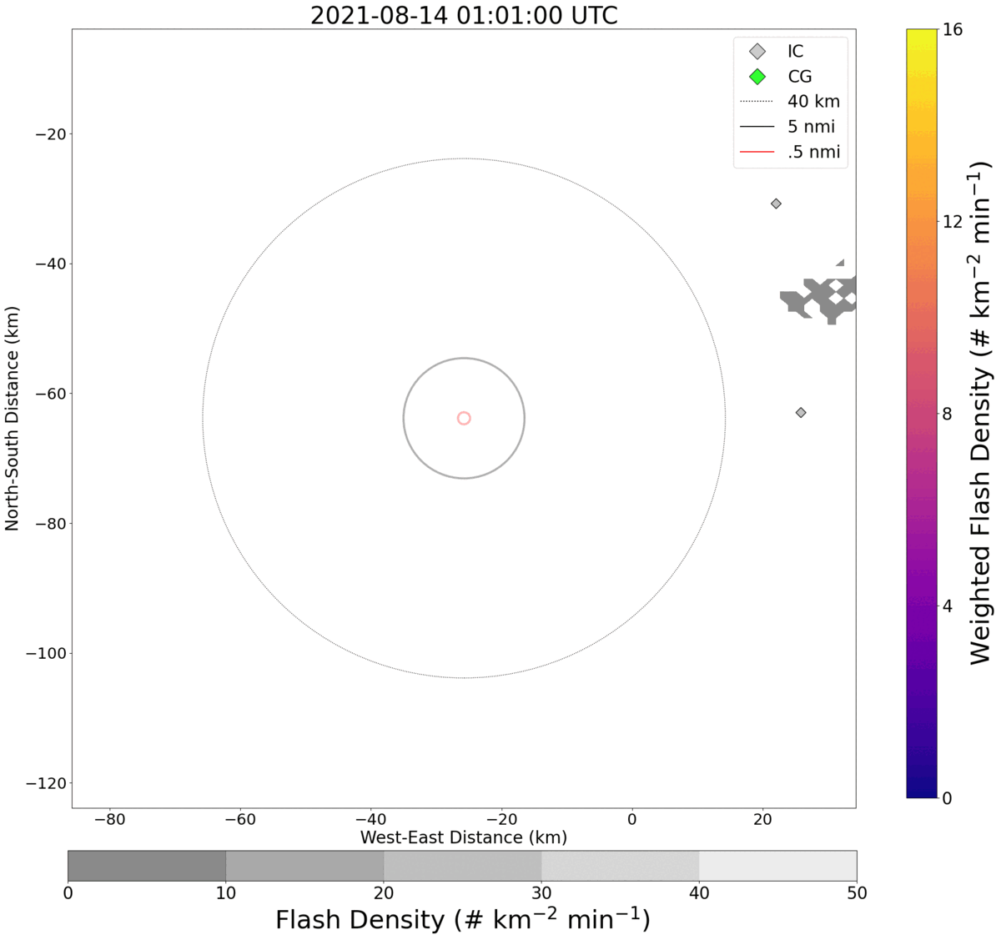
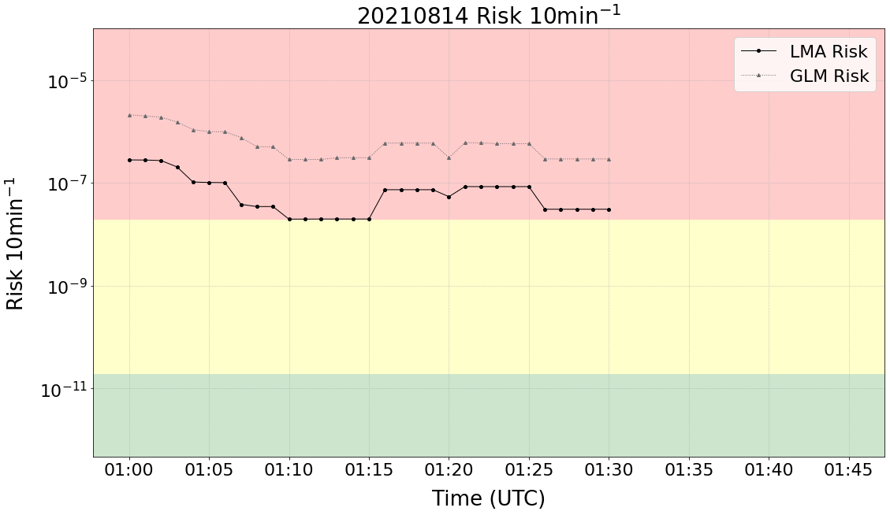
Results
Day 1, end of delay
02:10 UTC – end of delay (observed)

Slide 17
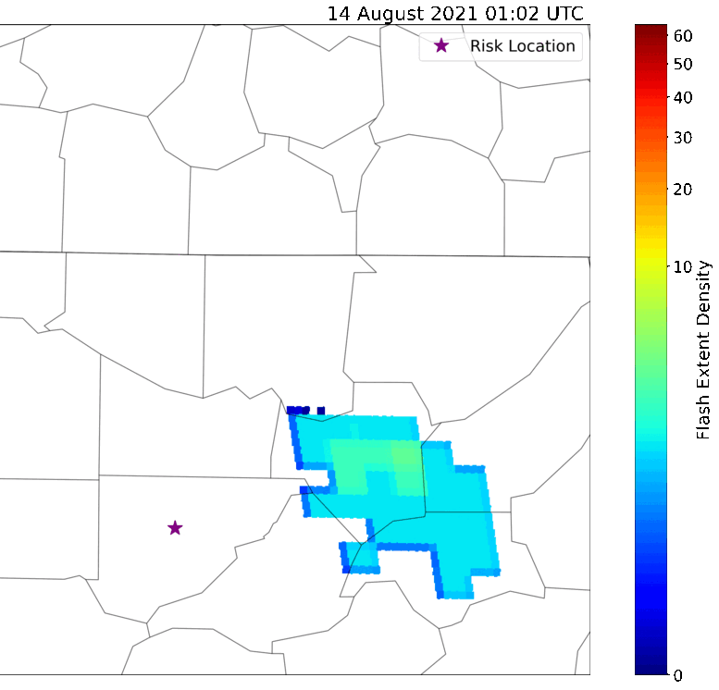
Results
Day 1, end of delay
02:10 UTC – end of delay (observed)
00:45 PM - EMA requested time that the lightning threat will end. We called the office to confirm and said that the cloud-to-ground threat would end around 01:15 UTC, but may still see in-cloud lightning
01:05 UTC - Spoke with event coordinator and said lightning threat should end by 01:15, but may still see in cloud flashes until the rain stops around 02:30-03 UTC
02:10 UTC - Event started again with Nelly

Slide 18
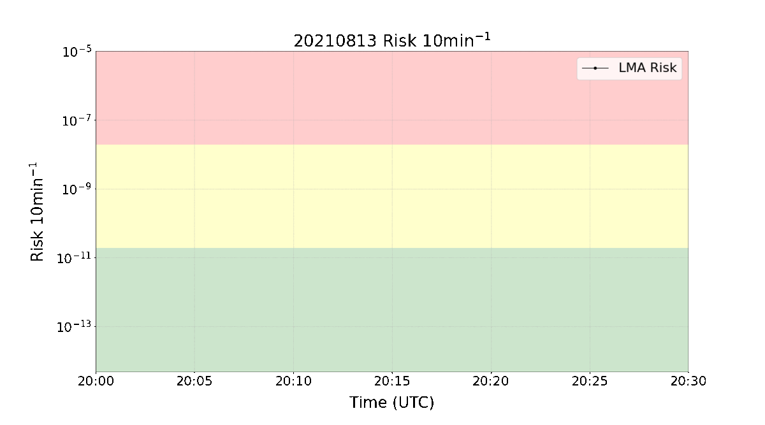
Results

Slide 19
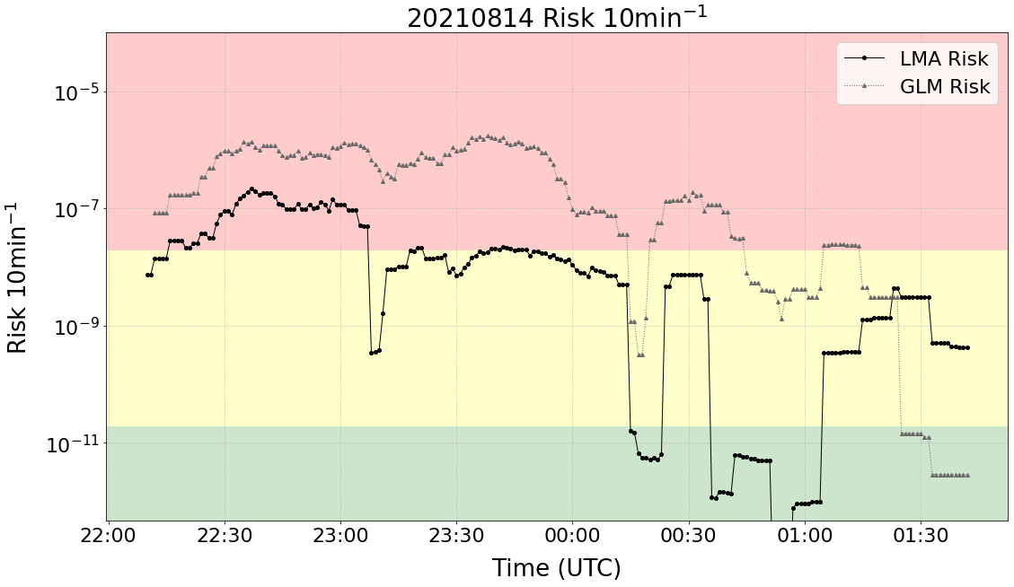
Results
Day 2
22:27 UTC
00:00 UTC
Start of delay (observed)
End of delay (observed)

Slide 20
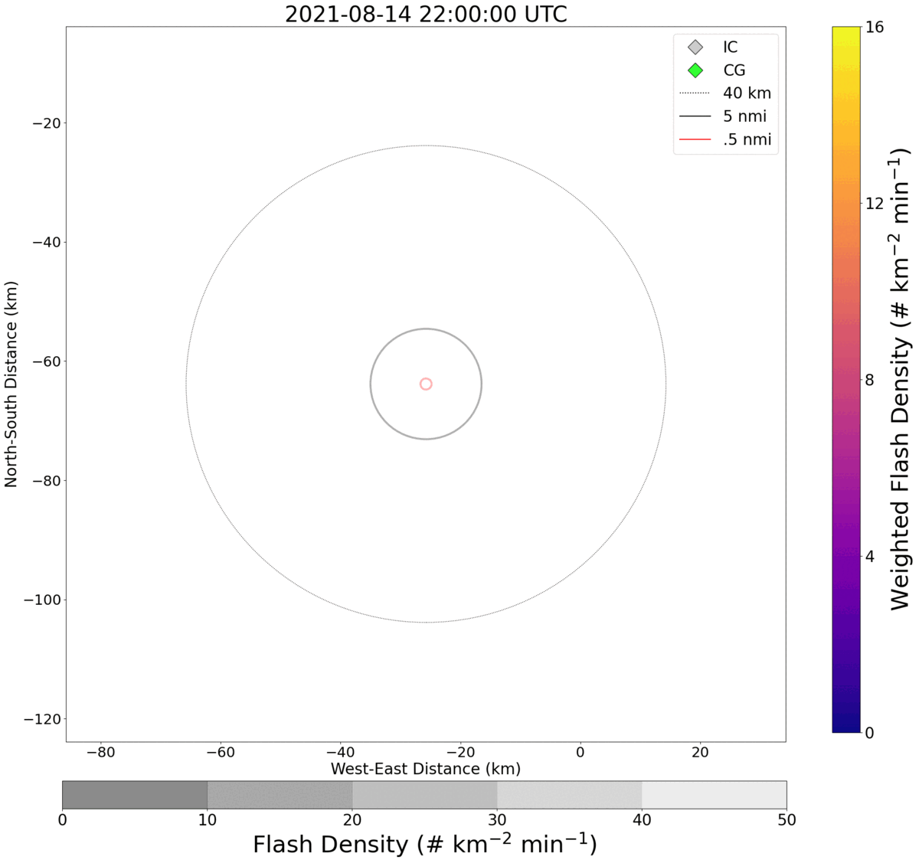
Results
Day 2
22:27 UTC

Slide 21
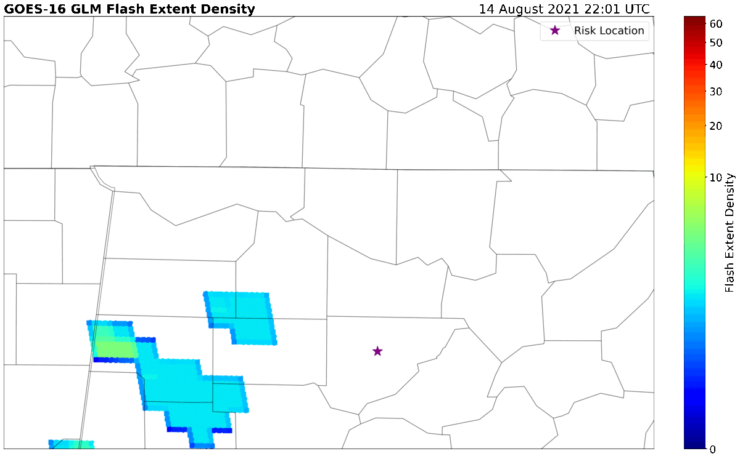
Results
Day 2

Slide 22

Results

Slide 23
Results
Using a combination of units could be explored in the future?
For example – using risk/10min to issue a warning led to a similar warning start time as observed
Start of delay - risk
Start of delay - observed

Slide 24
Results
Using a combination of units could be explored in the future?
But it hovered around the tolerable/acceptable threshold for much of the time there was still an observed delay. This causes multiple risk periods (warning starts and stops).

Slide 25
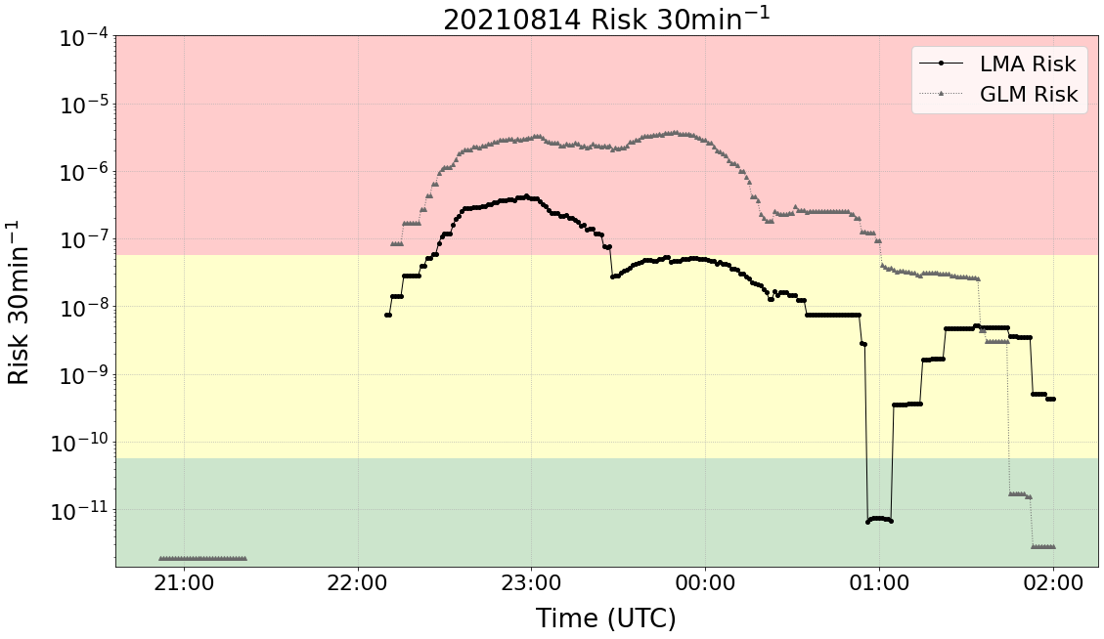
Results
Using a combination of units could be explored in the future?
Instead switch to risk/30 min after warning has been issued to take into account the last 30 minutes, similar to 30/30 rule?
Less “noisy”, though the period after 23:28 now becomes tolerable and wouldn’t be warned. However - individual discretion could be used to continue the warning here based on how close risk magnitude was to the unacceptable range, and risk was not decreasing during this time until near 00:00 UTC.
According to LMA data, after 23:28 there were:
no CG’s within 5 nmi
4 instances an NLDN IC was within 5nmi 0 instances of LMA FED within 5nmi.

Slide 26
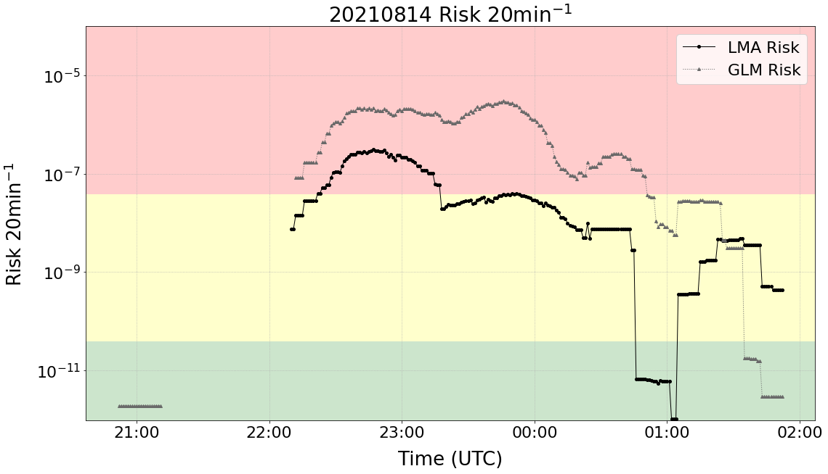
Results
Plots visually show you how frequent/active lightning is in the area
Lots of close flashes – magnitude of risk is high and changes minute by minute
Intermittent flash or flashes appear in radius, causing risk to be stagnant for a period of time relative to risk unit

Slide 27
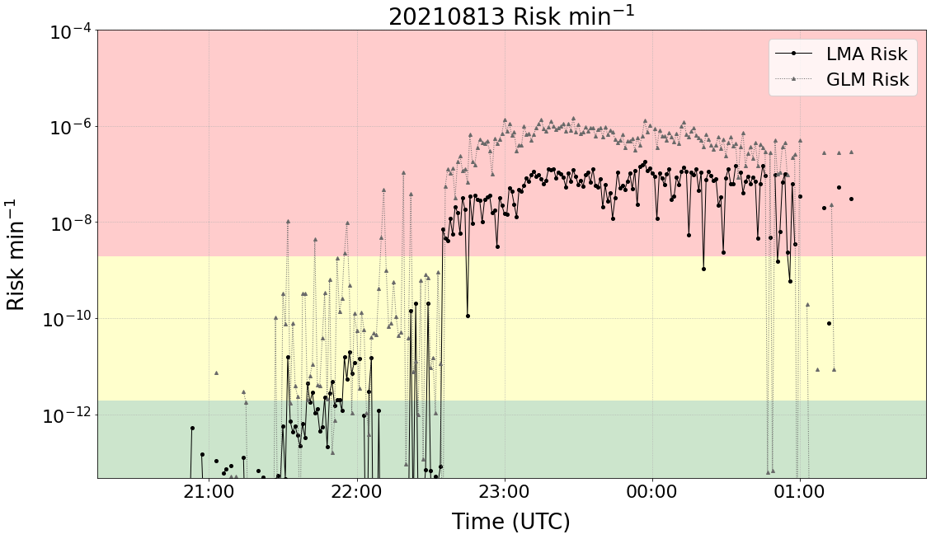
Results
Use different units of risk to get a better idea of how risk is changing over time
Risk per minute, noisy – will be very noisy with further away flashes or inconsistent flashes in radius.
Risk per 30 minutes – incorporates flashes as old as 30 minutes into risk magnitude. Risk falls as older flashes “fall out” of the calculation and not many new flashes are occurring.

Slide 28
Conclusions
GLM risk follows similar trends with respect to increases & decreases in risk but is too high overall
  Resample GLMFED to a smaller grid?
  Consider parallax
Risk time series could be used to aid forecasters in DS scenarios
  Reminder of past lightning activity
Modifications to methodology to tailor to GLM would allow use in areas outside of the US
  Could be helpful in areas where radar data is unavailable
Questions, e-mail: Kelley.m.murphy@nasa.gov

