Slide 1




COMPARING THEORETICALLY SCALED BIOMECHANICAL MODELS
F. N. Matari¹, (in memory of) R. K. Huffman², K. H. Lostroscio³
¹CACI, Inc., 2100 Space Park Dr., Houston, TX 77058
²METECS, Inc., 1030 Hercules Ave., Houston, TX 77058
³NASA Johnson Space Center, 2101 NASA Parkway, Houston, TX 77058
Digital Astronaut Simulation (DAS) Team NASA/ER7/JSC

Slide 2
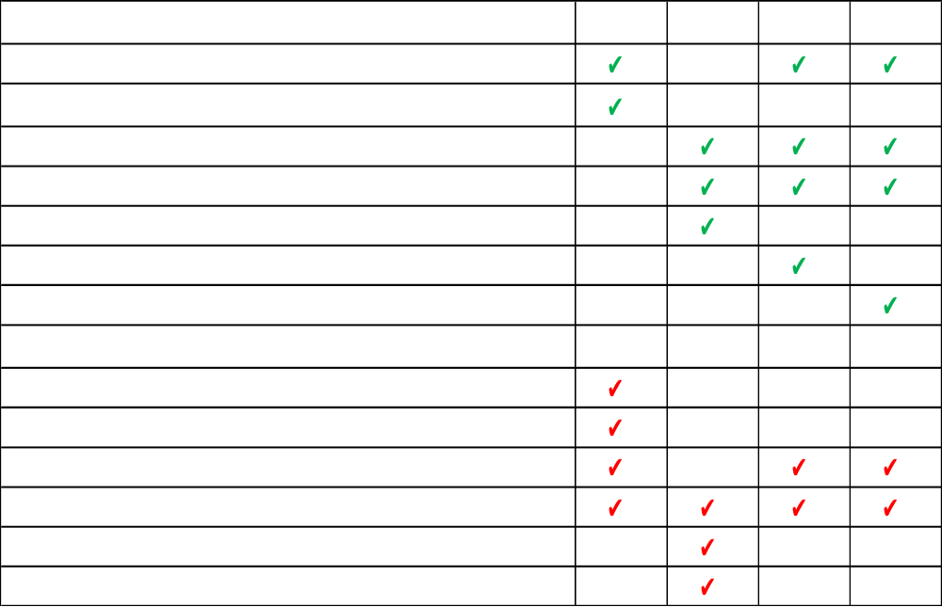
Introduction
The goal of this study is to create an automated process for generating scaled biomechanical models without using real human subjects
The models are generated for use in OpenSim [1]
Comparison with data from NASA STD-3000 (Vol I Sec C) was performed
The Anthropometric Survey of US Army Personnel II (ANSUR) was used as a source for segment lengths, whole body weight, and height [2]
Four approaches were considered
  One method requires a single scaling factor for all segments and does NOT use ANSUR
    IS - Isometric scaling in OpenSim GUI
  Two methods require creating Scaling Factors (SF) for all segments and does use ANSUR
    RS - Modified unscaled OpenSim Full Body Rajagopal Model (FBRM) [3-4]
    SS - Dataset of scaled OpenSim models
  One method utilizes existing scaling factors from literature and does use ANSUR
    DS - Dumas et al. scaling factors [5]

Slide 3



Methods
Start with a subject that is close in height/weight to target
Use OpenSim Scale Tool to scale geometry and mass isometrically
Set manual scale factors to equal value
Scale Factor = Ratio of desired height to subject height
ANSUR Retrieved Data
IS
Set mass to desired mass
Fine tune if necessary
Retrieve segment mass, length, Center of Mass (CoM), and Moment of Inertia (MoI)
*Calculate SF for segment mass, CoM and MoI
Parse ANSUR database for mean segment lengths and whole-body weight
According to desired range of weight, height , and age
**Calculate segment mass, CoM, and MoI
RS
Open FBRM .osim file
Retrieve mean segment mass, length, CoM, and MoI
*Calculate SF for segment mass, CoM and MoI
Parse ANSUR database for mean segment lengths and whole-body weight
According to desired range of weight, height , and age
**Calculate segment mass, CoM, and MoI
SS
Open dataset of .osim files
Calculate ratio for sub-to-full segment mass, length, and SF
Apply ratios to ANSUR lengths and Dumas' segment mass
**Calculate segment mass, CoM, and MoI
DS
Open FBRM .osim file
Some measurements are direct segment lengths and other measurements were used together in order to derive the desired segment length
The reference number correlates to the ANSUR documentation.
*
**
M_{T} = Total body mass
M_{segment} = Mass of segment
L_{segment} = Length of segment

Slide 4
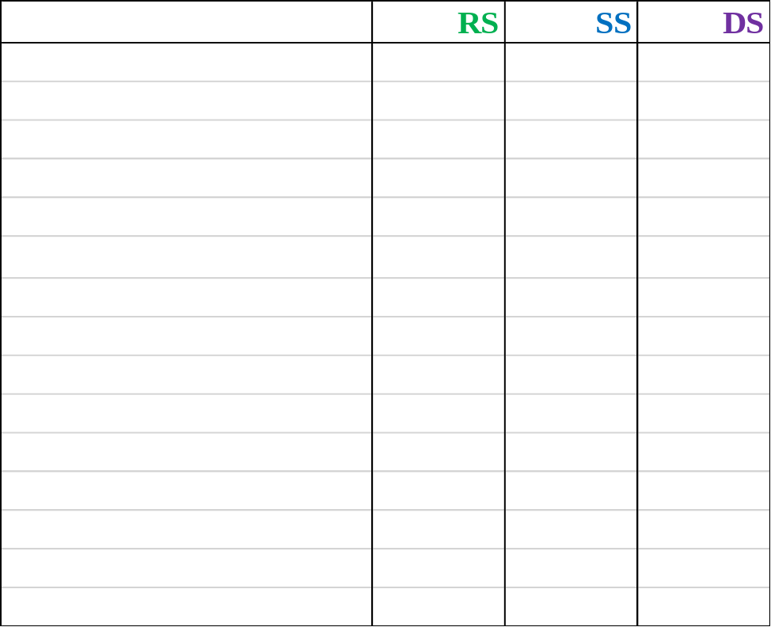
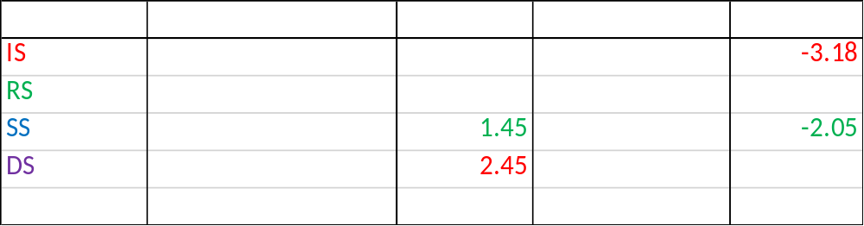
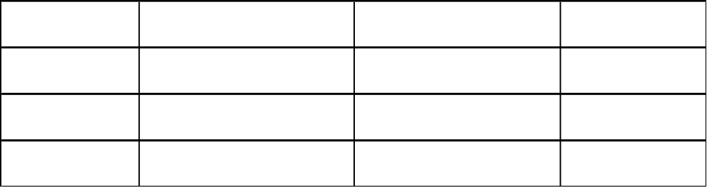
Results
Scaling Factors Comparison
50th Percentile American Male Whole Body CoM Comparison
All measurements are shown in centimeters. The green values represent the smallest error and red represents largest error.
ANSUR Parsing Results for 50th Percentile American Male
Scaling factors are for the segment mass of a male model.
The scaling factors for the Isometrically Scaled (IS) method is dependent upon the height of the initial and desired subject.
258 subjects fall within the requested ANSUR ranges and the mean value for the collected data represents the theoretical model.

Slide 5
Conclusion
Future Work
Whole body CoM for all methods is in good agreement with the standards found in NASA STD-3000
Utilizing the scaled dataset (SS) provided the best results when comparing against the standards
Scaling factors generated from existing OpenSim models mainly differ from Dumas in the torso, pelvis, and feet
Compare results with and use data from future NASA standards (STD-3001 Vol 2 Rev C)
Investigate IK data modifications for use in theoretically scaled models
Create approach for scaling models in data collections that utilize Inertial Measurement Units
Make tools more user friendly
Acknowledgements
References
This work was funded, in part, by JSC’s Center Innovation Fund, and completed in the Simulation and Graphics Branch of the Software, Robotics, and Simulation Division of the NASA JSC Engineering Directorate
[1] Delp, S.L., et al., “OpenSim: Open-source Software to Create and Analyze Dynamic Simulations of Movement”, IEEE Transactions on Biomedical Engineering, (2007).
[2] Gordon C.C., 2012 “Anthropometric Survey of U.S. Army Personnel: Methods and Summary Statistics”, US Army Natick Soldier RD&E Center.
[3] R. K. Huffman, W. K. Thompson, C. A. Gallo, L. J. Quiocho, “Improvement of Scaling and Inverse Kinematic Results with Additional Upper Body Joints Added to Opensim Rajagopal Model”, NASA Human Research Program Investigator’s Workshop, (2019).
[4] Huffman R.K., Thompson W., Gallo C., “Modified OpenSim Rajagopal Full Body Model”, New Technology Report, MSC-26872-1. (August 2020).
[5] Dumas R., Cheze L. and Verriest J., 2007. “Adjustments to McConville et al. and Young et al. body segment inertial parameters”. Journal of Biomechanics 40, pp. 543-553
Contact
For additional information, please contact: fouad.n.matari@nasa.gov or kaitlin.h.lostroscio@nasa.gov

