Slide 1




HUMAN STABILITY WHILE EXERCISING ON A VIS DEVICE IN ZERO GRAVITY
D. Frenkel¹, C.A. Bell¹, (in memory of) R.K. Huffman², L.J. Quiocho³, K.H. Lostroscio³
¹CACI, Inc., 2100 Space Park Dr., Houston, TX 77058
²METECS, Inc., 1030 Hercules Ave., Houston, TX 77058
³NASA Johnson Space Center, 2101 NASA Pkwy, Houston, TX 77058
Digital Astronaut Simulation (DAS) Team/ER7/JSC

Slide 2
Introduction
Background: The European Enhanced Exploration Exercise Device (E4D) [1], which has an exercise bar with cables that extend and retract through openings in the E4D platform, will be mounted on the movable part of a Vibration Isolation and Stabilization (VIS) system. With a crew member exercising on a moving platform, and held to it only by the tension in the cables, the question arises whether exercises successfully performed in 1g on a stationary E4D can be performed without falling in 0g on a moving device.
Stability criterion: While we don’t know how to account for the human ‘control system’, we were able to generalize the approach we have previously used to analyze dynamic feasibility of performing a lunar task [2]. We check for a given exercise trajectory whether the center of pressure (COP) between the E4D platform and the subject’s shoes falls within the base of support (BOS), i.e., within the convex hull of the combined footprints.
Tools: The exercise trajectory in a terrestrial lab is recorded via optical motion capture, with relevant dynamical quantities generated from that trajectory by a custom OpenSim [3] plugin. This dynamical data then drives a multibody simulation of the VIS device, augmented with a cable force model. This simulation can generate the force and moment on the feet allowing the COP to be computed.

Slide 3
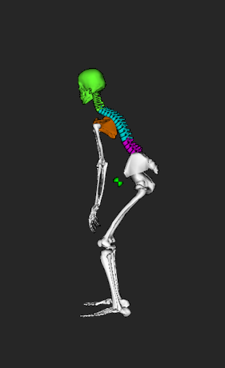

Method
We use a conventional multibody VIS simulation, with the added ‘nonstandard’ capability of allowing one body to have time-varying mass properties due to internal mass motions [4]. This special body models the dynamic effects of the astronaut motion and is driven by the dynamic parameters computed by an OpenSim plugin from a recorded exercise trajectory.
The simulation can compute the total force ${\vec{F}}_{t}$ and moment ${\vec{M}}_{t}$on the human body, made up of the cable and the platform forces and moments on the subject. The cable force ${\vec{F}}_{c}$ is modeled based on the hand positions and the known E4D cable load characteristics. We then obtain the platform force ${\vec{F}}_{p}$ and moment ${\vec{M}}_{p}$ on the subject’s feet via ${\vec{F}}_{p}={\vec{F}}_{t}−$ ${\vec{F}}_{c}$ and ${\vec{M}}_{p}={\vec{M}}_{t}−$ ${\vec{M}}_{c}$.
In the coordinate system shown, the COP location ${\vec{r}}_{cop}$ is given by:
  $r_{cop,x}=\frac{M_{p,z}}{F_{p,y}}$ ; $r_{cop,z}=−\frac{M_{p,x}}{F_{p,y}}$
Dynamic feasibility is indicated by ${\vec{r}}_{cop}$ falling within the BOS
y
F_{p}
F_{c}
x
E4D

Slide 4
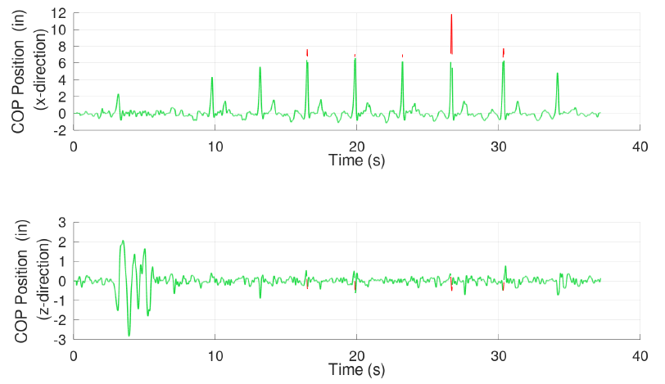
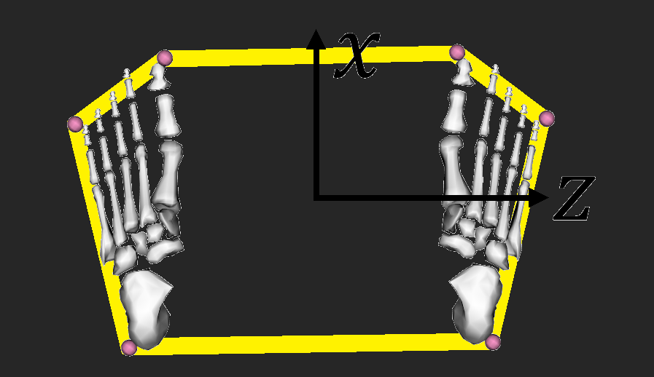
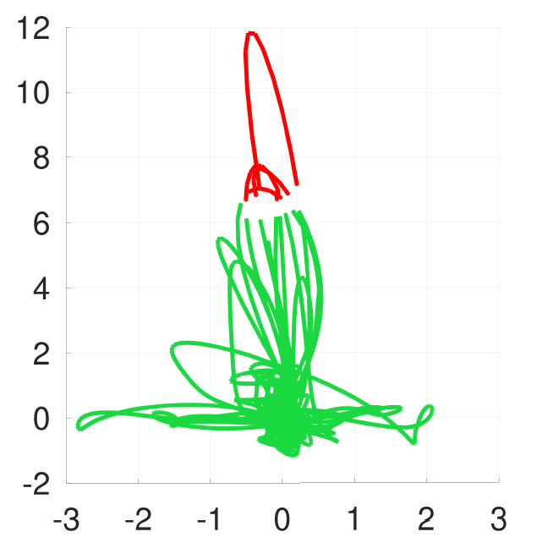





Results
Example COP Time History Plots
$$x$$
$$x$$
$$x$$
Back squat and deadlift exercises found to be dynamically feasible for at least some number of the exercise cycles, this number increasing with nominal cable tension of the idealized inertial load algorithm
At least some realistic trajectories pass the dynamic feasibility criterion
Does not account for the likely alteration of the exercise trajectory from its 1g form in space; subjects will most likely enhance their stability further in 0g
COP Position (in)
(x-direction)
$$z$$
$$z$$
Time (s)
Example Back Squat COP Position Plot
COP Position (in)
(z-direction)
COP Position (in)
(x-direction)
Time (s)
COP Position (in)
(z-direction)
Example Back Squat COP Time History Plots
Dynamically Feasible
Dynamically Infeasible
COP Position (in)
(x-direction)
COP Position (in)
(z-direction)
Time (s)
Time (s)

Slide 5
Conclusions
Quantifying and creating requirements for stability in 0g while exercising on a VIS device is a long-standing problem
While we cannot provide a general solution, we have informed the stability question by looking at the dynamic feasibility in 0g of exercise trajectories recorded in a terrestrial lab, with the feasibility criterion based on using the COP concept in a somewhat novel setting
It would be of significant interest to better understand the stability implications of brief COP excursions outside the BOS
Acknowledgements
References
The work described here was performed entirely within the Simulation and Graphics Branch of the Software, Robotics, and Simulation Division of the NASA JSC Engineering Directorate
[1] New Danish space exercise machine completes testing at NASA. (2019, April 25). https://www.danishaerospace.com/en/news/new-danish-space-exercise-machine-completes-testing-at-nasa
[2] Huffman R.K., Frenkel D., Bell C.A, Lostroscio K.H., and Quiocho L.J. “Feasibility of Earthbound Motion in Lunar Gravity” [#1105-002174] , HRP IWS 2021
[3] Seth et al. OpenSim: Simulating musculoskeletal dynamics and neuromuscular control to study human and animal movement. PLoS Computational Biology, 14(7). (2018)
[4] Frenkel D., Huffman R.K., Quiocho L.J., and Lostroscio K.H. “Dynamics of a Vibration Isolation System Including Inertia of the Human Body” [#19261], HRP IWS 2019, Galveston, TX.
Contacts
For additional information, please contact:
david.frenkel-1@nasa.gov, kaitlin.h.lostroscio@nasa.gov

