Slide 1


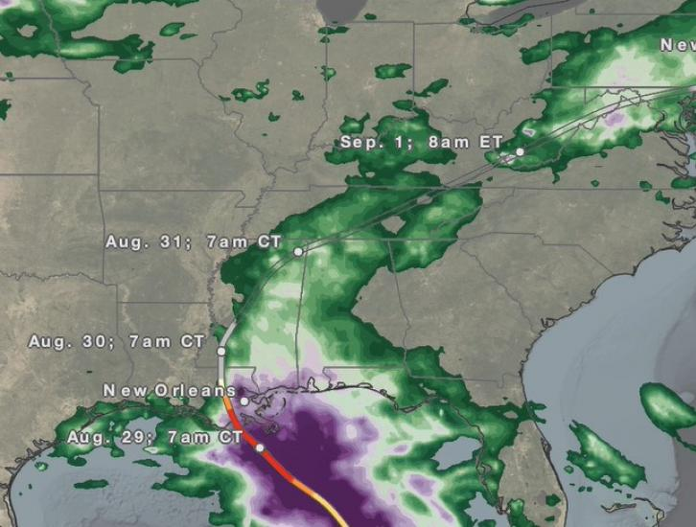
GPM Project Status
Scott Braun
GPM Project Scientist
NASA Goddard Space Flight Center
Precipitation Measurement Missions Meeting
Oct. 18, 2021
www.nasa.gov/gpm
Twitter: NASARain
Facebook: NASARain
Hurricane Ida
August 2020

Slide 2
PMM Meeting At A Glance & Agenda
Early Career/Student poster session earlier today
Sessions (Tuesday–Thursday) designed to give each PI team the opportunity to provide a final report
Final session on Friday on algorithms
Outline
Mission Status
Mission Data Summary—Initial V07 Results
GES-DISC Status
PMM Awards

Slide 3
Status—PMM Project Teams
GPM Program Scientist
(Acting—Tsengdar Lee/Aaron Pina)
GPM Project Scientist
(Scott Braun)
Mission Operations
(Anthony Scaffardi)
Precipitation Processing System (PPS)
(Erich Stocker; Deputy PS for Data)
Application and Communications Team (Dalia Kirschbaum; DPS for Applications)
Ground Validation
(David Wolff ; DPS for GV and WFF GV Manager)
Good luck Joe Munchak!
Algorithm Development (Iguchi, Meneghini, Liao; Grecu, Olson; Kummerow; Huffman; Tao)
Intersatellite Calibration
(Rachel Kroodsma)
Happy retirement Wes Berg!
U. S. Science Team –
40 NASA funded PIs,
7 work packages
International Science Team –
33 no-cost international PIs

Slide 4
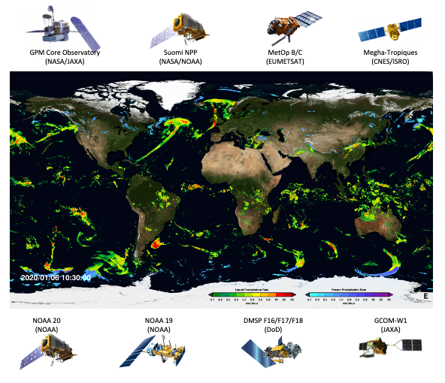
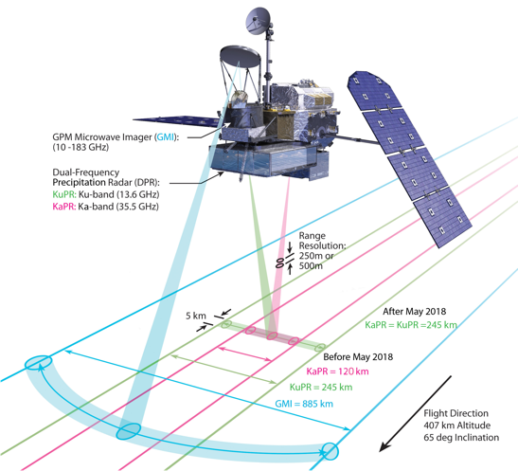
Status—GPM Core Observatory
GPM Core Observatory:
• Launched: Feb. 27, 2014
• 7.5 years of operations, fuel to late 2032
• Instruments working nominally
• Spacecraft system anomalies
– Reaction wheel #2 failed in 2019
– Reaction wheel #5 issues began in 2020
• Mission operations developing plans for operations if more RW failures
The Current GPM Constellation

Slide 5
Mission Data Summary
Details in Erich’s talk coming up
Some initial DPR results follow (courtesy of John Kwiatkowski & PPS Team)

Slide 6
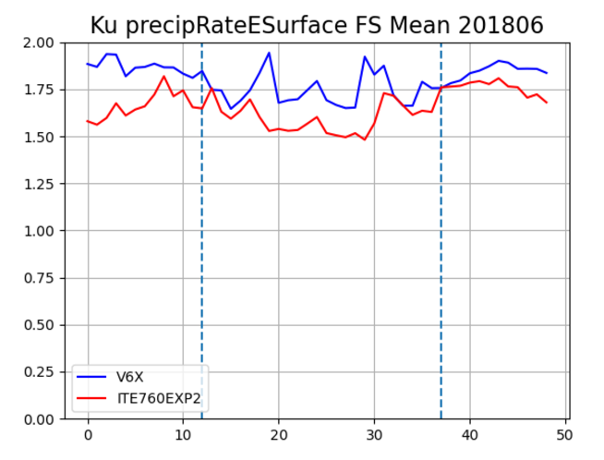
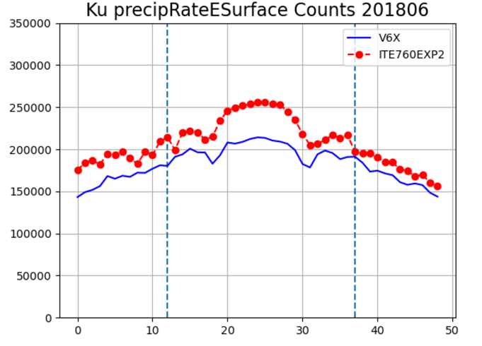
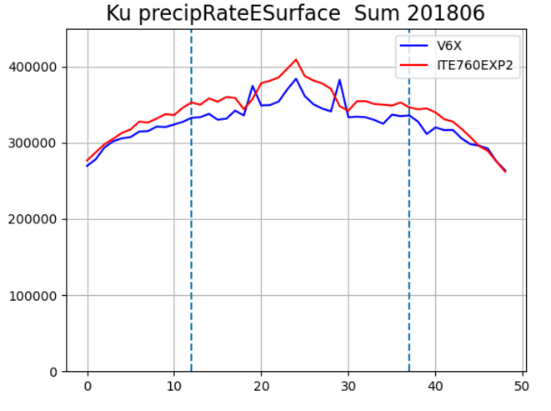
Ku Across scan statistics.
All Surface Types.
Mean Rain Rate
Counts R> 0
Mean Accumulation

Slide 7
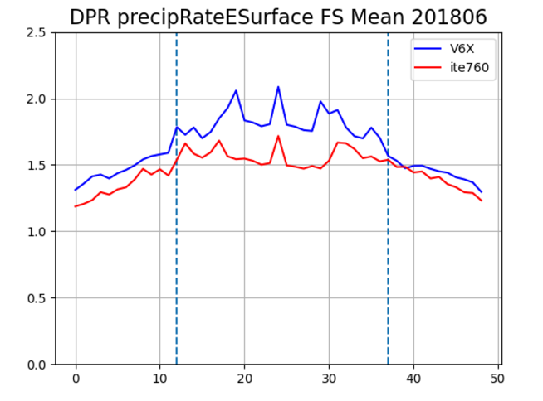
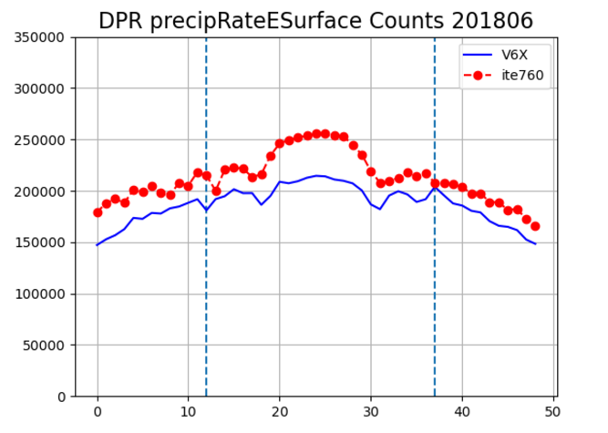
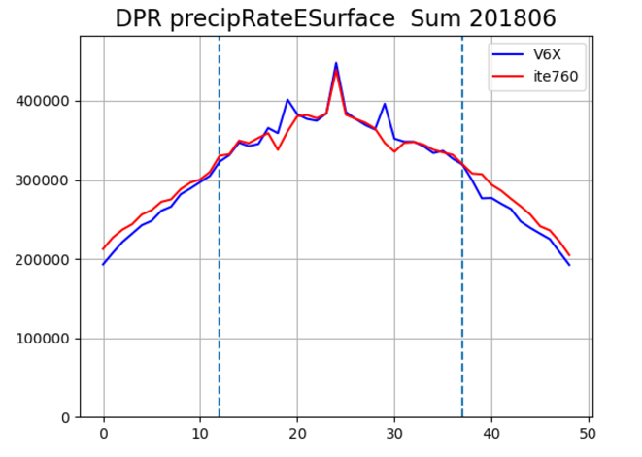
DPR Across scan statistics.
All Surface Types.
Mean Rain Rate
Counts R> 0
Mean Accumulation

Slide 8
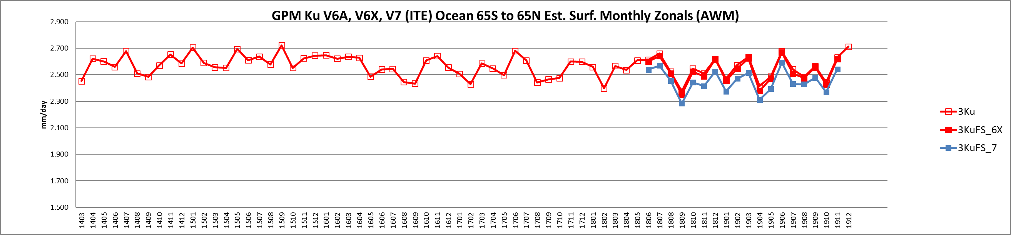
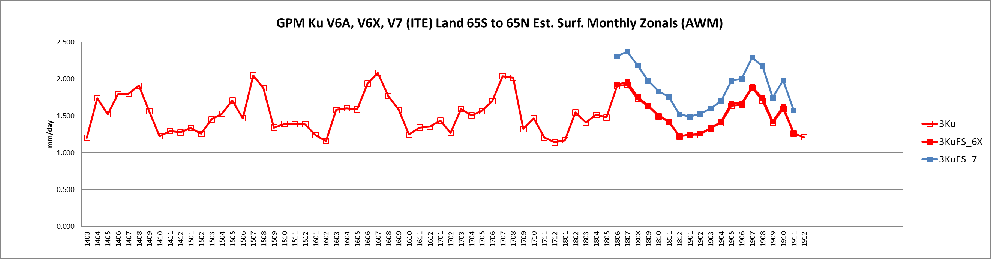
Ku Single Freq. Ocean and Land Zonal Means. ITE760 Latest V7 Test Data
V06, V06X
V07
Over Ocean
V07
V06, V06X
Over Land

Slide 9
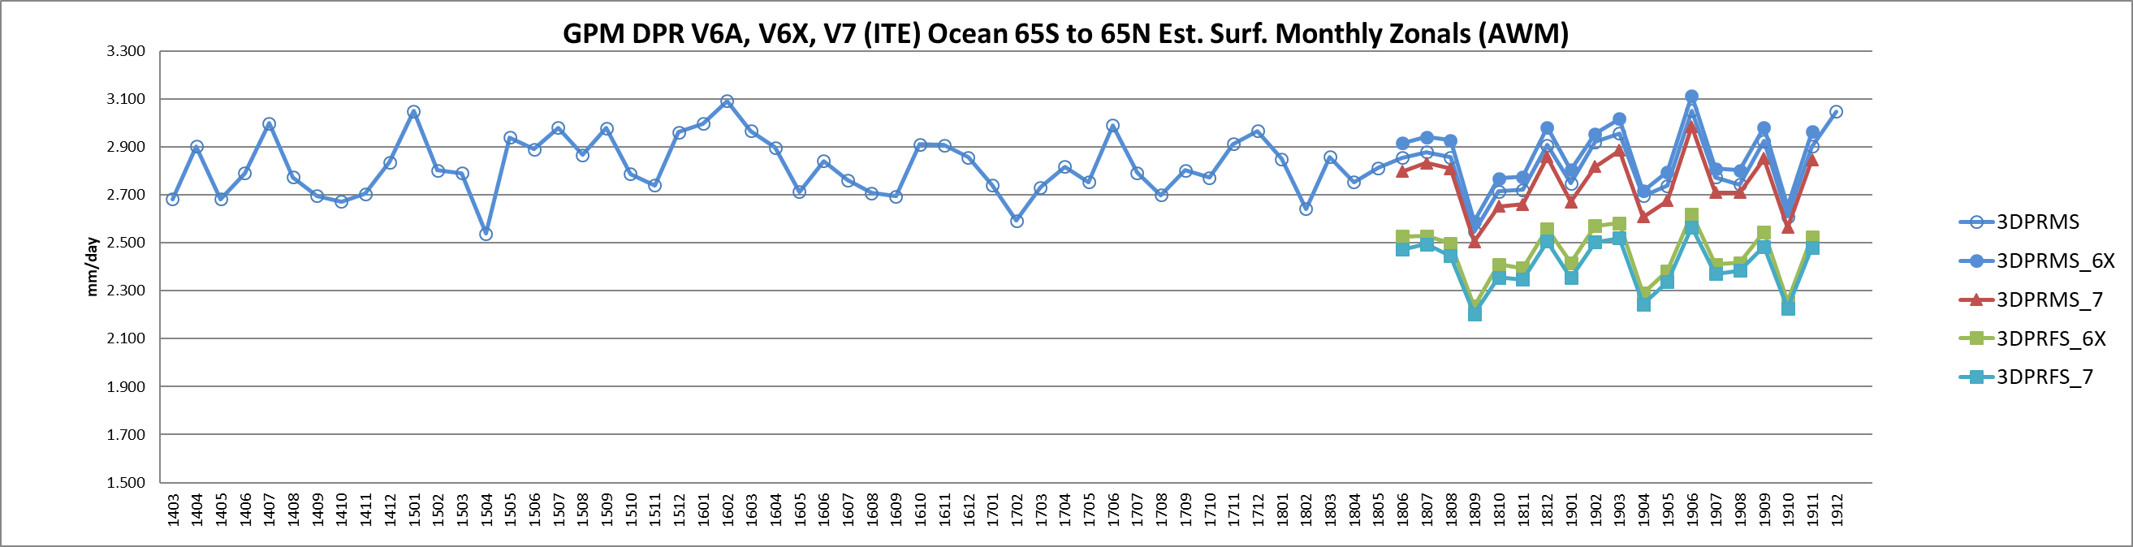
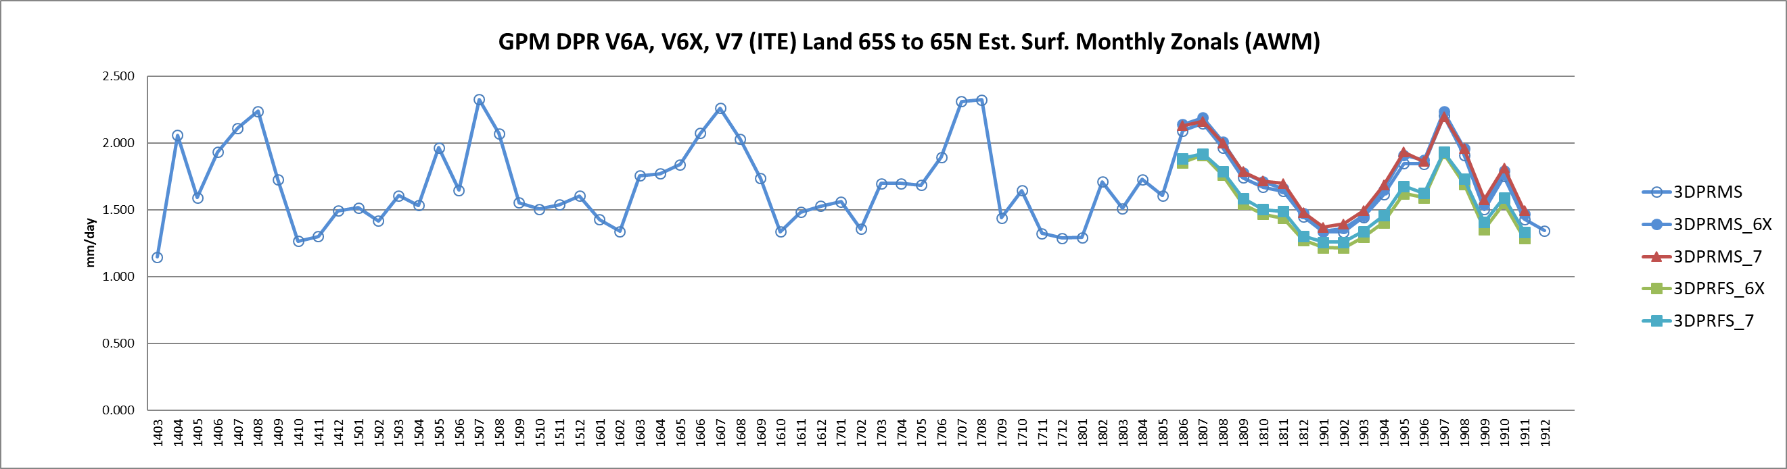
ITE760 Latest V7 test data.
V6A, V6X, V7 -> DPRMS
V6X, V7 -> DPRFS
Over Ocean
Over Land

Slide 10
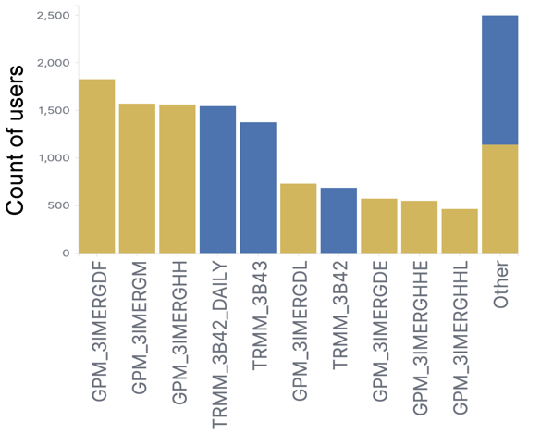
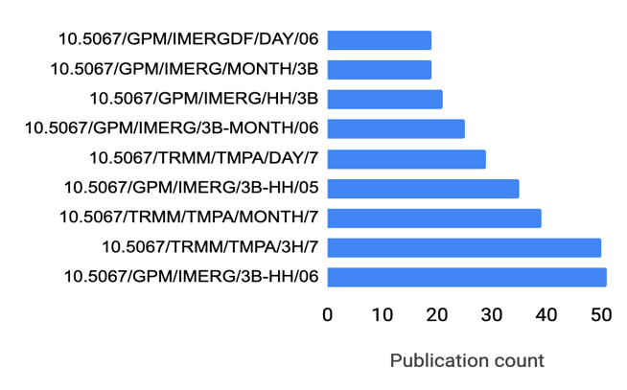
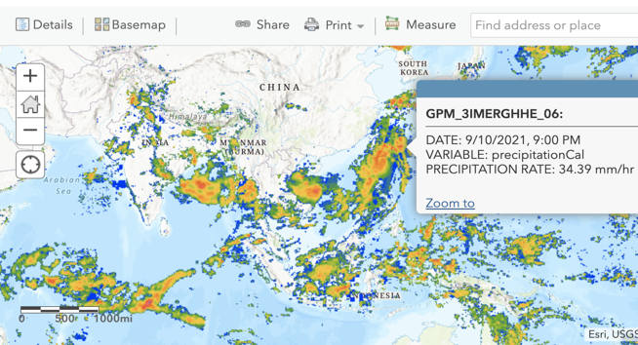
Popular products distributed in the past year:
Support existing services:
OPeNDAP, GDS, OGC, Variable/Spatial subset, Giovanni, Assign DOI, Help Desk
(https://disc.gsfc.nasa.gov/datasets/GPM_3IMERGHH_06/summary)
GPM
TRMM
New: IMERGHH in the Cloud (Cumulus)
1 PB
8000
users
New: “My Dashboard”: save and share favorite search/subset scenarios and histories
https://disc.gsfc.nasa.gov/dashboard (requires Earthdata login)
New: Knowledge database relating datasets and publications
New: ArcGIS Image Service (IMERG Early)
Popular Datasets cited by DOI, to date
https://disc.gsfc.nasa.gov/information/publications

Slide 11
GES DISC cloud migration plans
Strategy: migrate data to cloud with a seamless user experience (no impact on current users) while enabling analysis in-place (analysis co-located with data in the cloud).
Example - direct access to data from Jupyter notebook within cloud (no downloading)
Key priorities for migrating data
Data having value to “early adopters” who would benefit from conducting analysis in cloud environments*
Phasing to maximize the utility of cloud resources while off-loading aging on-premises servers
Migration phasing (not all-inclusive)
Current: IMERG-final 30-min, MERRA-2 single level diagnostics
Early FY22:
  NLDAS hourly (long time series to test)
  Level 2 sounder products (spanning AIRS/SNPP/NOAA-20) to develop Level 2 access and analysis services
  “ozone/composition suite” (OMI/OMPS, Tropomi) to enable cross-platform analysis
Late FY22:
  “carbon suite” (OCO-x ACOS, Carbon Monitoring System products)
  continued GPM/TRMM migration
FY23: Complete GMAO and xLDAS collections, complete GPM/TRMM migration, complete sounder migrations
* - contact Dave Meyer (david.j.meyer@nasa.gov) if interested in being an early adopter. Some AWS experience is highly desirable.

Slide 12
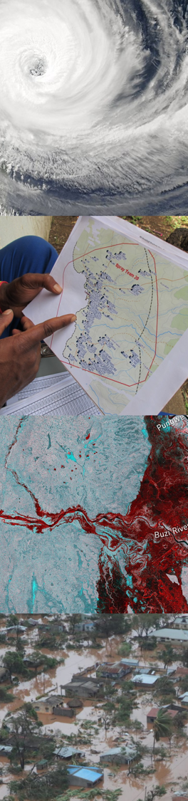

Earth Observation Mentorship Program
What: PMM Mentors (online) needed for new program
Goal of Program:
Develop applications training to discuss ground validation and regional products
Focus on low/lower-middle income countries
Guide new users and consolidate existing ones
Small (and valued) time commitment by mentors: provide case study examples of GPM data for research and applications
Objectives: Combine training with a curated database of use cases, validation results, and training resources.
*Interest to be a mentor? Online discussion (informal) in November
*Please register here: https://tinyurl.com/mentorshipPMM
Points of contact: vasco.mantas@dct.uc.pt / andrea.m.portier@nasa.gov

Slide 13


Today’s Science Team Award
Award Person(s) or Team(s) that significantly enhance PMM science
2020 Winner…
Global Precipitation Measurement
Patty McCaughy, PPS
Science Team Award 2021

Slide 14


Today’s Science Team Award
Award Person(s) or Team(s) that significantly enhance PMM science
2020 Winner…
Chris Williams,
U. Colorado
Thanks to Joe Turk and coauthors for donation of books for award.

