Slide 1
From IMM to IMPACT: Enhanced Functionality for Exploration Missions
Human Research Program
Exploration Medical Capability Element
February 7, 2022
E. Kerstman¹, L. Boley², D. Goodenow³, and W. Thompson³
¹Department of Preventive Medicine and Population Health, University of Texas Medical Branch, Galveston, Texas, ²KBR, Houston, Texas, ³NASA Glenn Research Center, Cleveland, OH
“Expanding the Boundaries of Space Medicine and Technology”

Slide 2
Outline
IMM Overview
IMPACT Overview
IMM Deficiencies and Lessons Learned
Enhanced Functionalities of IMPACT
Conclusions

Slide 3
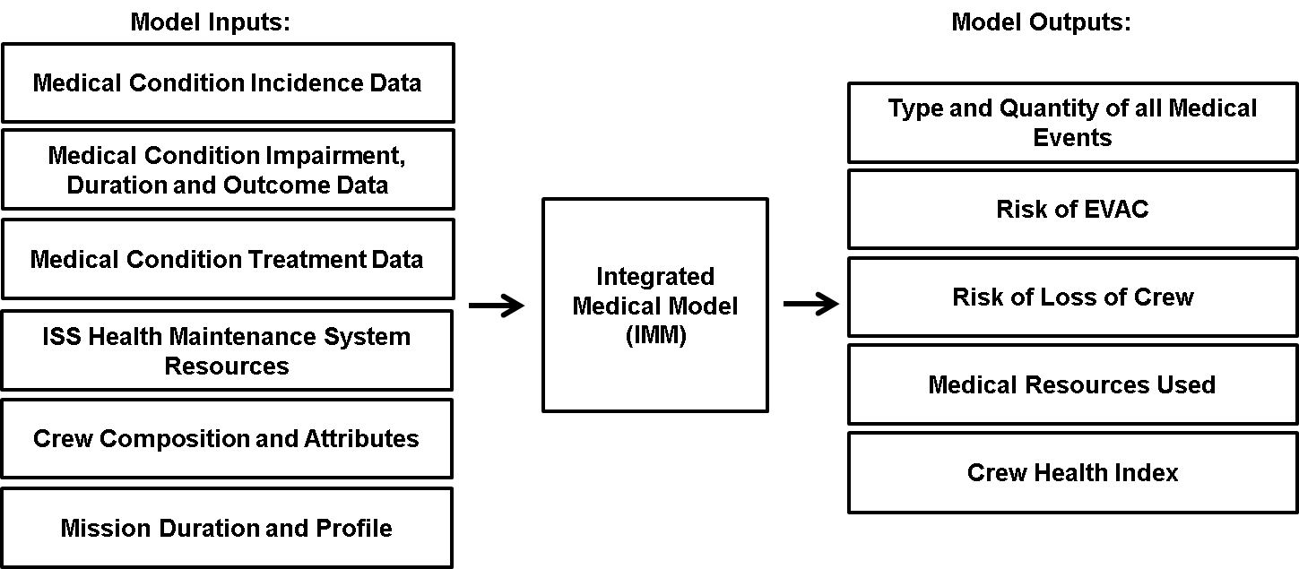
IMM: Integrated Medical Model
An evidence-based simulation model used to predict in-flight medical events, the resources required to diagnose and treat, and impacts to the spaceflight mission*
*Baselined to ISS
Typically ~100,000 trial simulations

Slide 4
IMM Event Simulation
Best-case resources available?
Yes
Treated Case: Decrement medical resources
Calculate End States:
Evacuation
Loss of Crew Life
Quality Time Lost
Resource Utilization
Type and Number of Medical Events
No
Untreated Case Decrement medical resources
Best-case Scenario
Medical Event
Untreated Worst-Case Decrement medical resources
No
Worst-case Scenario
Worst-case resources available?
Yes
Treated case: Decrement medical resources
Range of partial treatment

Slide 5
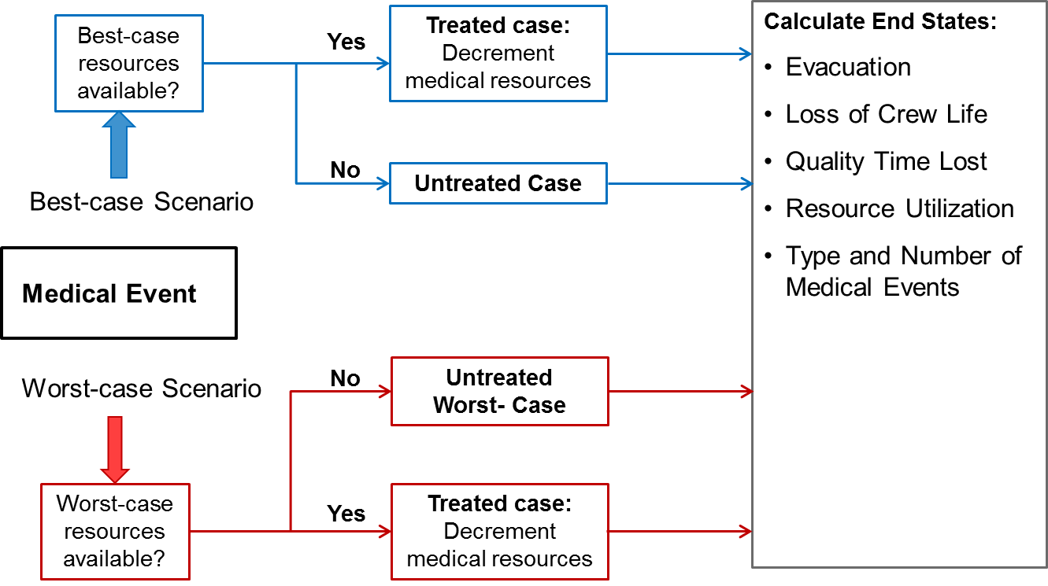
IMM Framework
DRM / Scenario Definition
Methodology
Crew Medical Attributes
Crew Composition
Mission Profile
Clinical outcome uncertainty: Implementation of best-case, worst-case, and untreated-case event tree scenarios
16 Assumptions and limitations
Examples -
No medical mistakes
All treatments 100% reliable
Only SAS and EVA event dependence
No crew carry on items
5
Data Sources
iMED Database
ISS Expeditions
Shuttle missions
US Crew - Apollo, Skylab, Mir
Analog data, terrestrial data,
Bayesian Analyses
Independent Predictive Models
Medical conditions including SAS and EVA specific
Medical condition incidence data
Treatment information for medical conditions
Medical system resources
IMM
IMM Output
Resource
Optimization
Probabilistic Risk Analysis Monte Carlo Simulation
Probability of LOCL and Evac Consideration
Optimized Medical Resources
mass, volume, or risk level
Estimate of Quality time lost
Type and # of medical events
Medical resources used

Slide 6
IMPACT: Informing Mission Planning via Analysis of Complex Tradespaces
  Provides a data-driven means to inform human health and performance risk mitigation
  Accounts for the resource-constrained environment of exploration missions
  Enables systematic trade studies to evaluate medical system options
Clinician/ SME
Provides Consultation/Vetting
Clinician/SME
Provides Consultation/Interpretation
Provides Query
Requestor
Operator
Provides Inputs
IMPACT
Provides Outputs
Operator
Provides Reports
SME = Subject Matter Expert

Slide 7
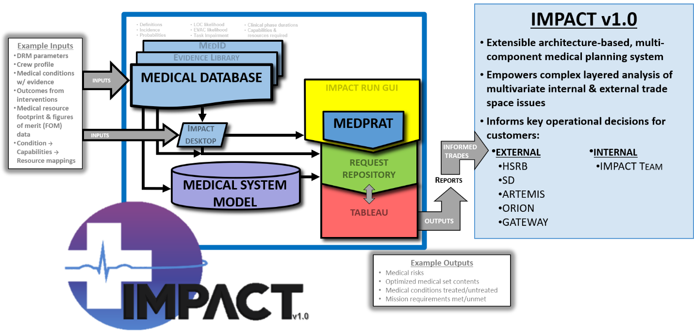
IMPACT: A suite of tools working together
(IMPACT-MD)
LONG DUR.
MEDPRAT = Medical Extensible Dynamic Probabilistic Risk Assessment Tool
7

Slide 8
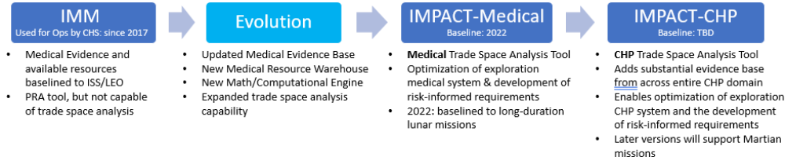
IMPACT: The Evolution of Probabilistic Risk Analysis (PRA) for Crew Health and Performance (CHP)
HRP/ExMC is developing IMPACT to understand the impacts of mission design and vehicle resource allocation on medical risk and ultimately Crew Health and Performance (CHP)
IMPACT supports data-driven and evidence-based decision-making throughout the entire mission life cycle
IMPACT quantifies the effects of specific design decisions on medical and CHP risks and allows for analysis of complex trade spaces

Slide 9
IMM Deficiencies and Lessons Learned
No definition of roles and responsibilities
No hard deadlines
Funding fluctuations in the operation domain
No clearly defined customer requirements
No detailed project-level schedule
Limited attention to systems engineering
Failure to initially recognize IMM as a software development project
Delayed application of configuration management
Insufficient documentation of sources and rationale for database evidence
Notes:
Will talk about how IMPACT addresses each of these lessons learned during this slide.

Slide 10
Enhanced Functionalities of IMPACT
Agile development approach
Improved execution speeds for simulations and optimizations
Expanded condition list (>120 vs 100) with improved database documentation
Task Impairment vs Functional Impairment
Addition of capabilities and expanded resources (CRTs)
Enhanced optimization algorithm
Partial gravity environments
Beyond LEO environment
Segmented missions and partial gravity environments
Knowledge, skills, and abilities (KSA)
Conditional occurrence probabilities using susceptibility inference network (SIN)
Partial treatment weighting of resources
Inclusion of systems engineering requirements
Treatment clusters
Expanded resources and figures of merit (FOM)

Slide 11
Conclusions
IMPACT is leveraging lessons learned from IMM
IMPACT will have a more robust database and more functionalities than IMM
IMPACT will provide more realistic and accurate modeling of exploration missions than IMM

