Slide 1

Apollo Crew Loads
Data Mining
Tessa Reiber¹, Nate Newby¹, Jeff Somers²
¹KBR, Houston, TX
²NASA Johnson Space Center, Houston TX
The Human Physiology, Performance, Protection & Operations Laboratory

Slide 2


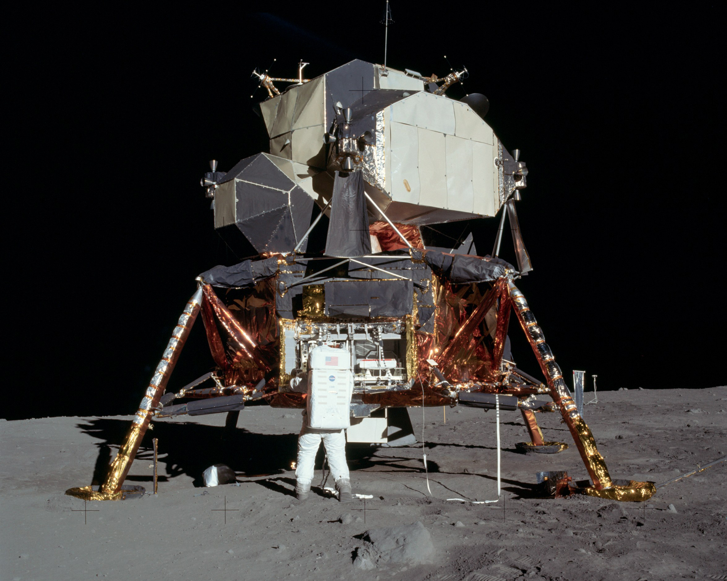
Introduction
The Applied Injury Biomechanics Team assesses crew vehicle dynamics to ensure crew safety
  This includes defining requirements for dynamic phases of flight (launch, landing, aborts, etc.)
Recently, new requirements were written for dynamic events during lunar missions, including lunar landings
Generally, human exposure data to dynamic loads in spaceflight are sparse
  We have not been able to find data on the dynamics experienced in lunar landings
The Apollo program crewed missions are unique and valuable for understanding human tolerance in:
  water landing conditions for both short-duration and long-duration crewmembers
  standing postures during planetary landings
  The goal of this task was to find relevant Apollo data to better understand human tolerance in these scenarios, in order to apply this knowledge to future missions.

Slide 3
Objectives and Planned Work
The intent of this task was to recover time history data from dynamic phases of flight from crewed Apollo missions
The first phase of this task was to search available records at JSC and other centers to locate the appropriate records at the National Archives in Fort Worth, TX
Once the possible data locations were located, it was planned that one researcher would travel to the National Archives in Fort Worth, TX to collect the relevant Apollo data
These data would be used to assess the feasibility and acceptability of current standards and vehicle design requirements for lunar and Mars missions

Slide 4
Completed Work
Due to COVID-19, NASA has only allowed mission essential travel until recently
The National Archives was also closed to the public for most of 2021
Because of this, travel to the National Archives was not possible
Many online resources were used to search records held at NASA centers and the National Archives
Potentially relevant records were identified (examples below)
National Archives – Ft. Worth | Apollo Lunar Surface Experiment Package (ALSEP) Technical Memos, 1965-1971 | This series contains copies of documents prepared by Bendix Aerospace under contract NAS9-5829. The documents relate to manufacturing procedures, mechanical interface, qualification status, calibration curves, dynamics analysis, failure mode analysis, weight reports, command lists, surface operating procedures, testing, and engineering support.
National Archives – Ft. Worth | Apollo Spacecraft Program Office, E.209B. Manned Spacecraft Center Internal Technical Notes 1964-69 | Copies of technical reports prepared by various units on highly technical topics such as guidance and trajectory, tracking, data acquisition, hardware design and operation, mission parameters, and abort procedures
National Archives – College Park | Data Files, 1958-1980 | Unprocessed records. Access is restricted.
National Archives – College Park | Planning, Evaluation, and Review Files Relating to Apollo Missions, 1969-1972 | Unprocessed. Possible restricted.

Slide 5
Conclusion
Relevant records were identified at the National Archives in Ft. Worth, TX and College Park, MD
Unfortunately, the descriptions of each collection are very broad. Though we are hopeful that relevant data is stored in one of these collections, we cannot be sure that we will find what we are looking for
In May 2021, it was decided to close this task because it was not clear when the Archives would reopen to the public or when NASA would allow travel
A trip to the National Archives will be reassessed in the future when the travel situation improves

Slide 6
Thank you!
Email:
teresa.m.reiber@nasa.gov

